Slide 1

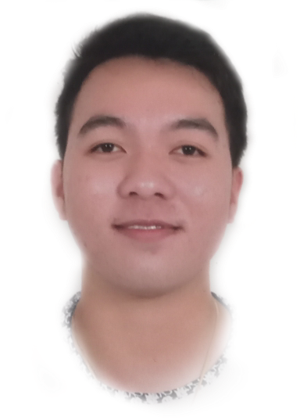
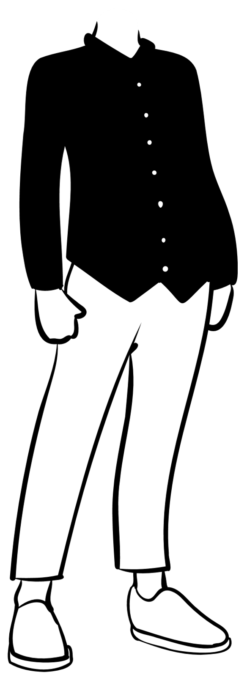

FAMILY TREE
I am honored today to speak about my family tree , I am reminded of the importance of family and the uniqueness connection that we share with our loved ones. Our family tree is a living testament to the generations that have come before us and the legacy that they have left behind . Through the stories and memories that have been passed down from our ancestors.
Hi, I'm Hassanor G. Saanoding

Slide 2

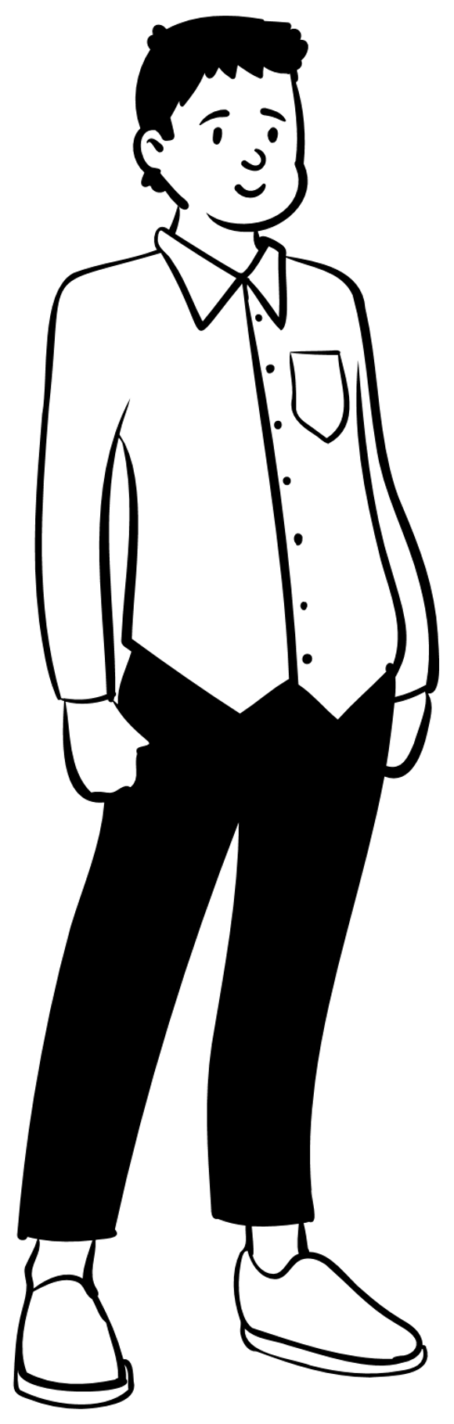
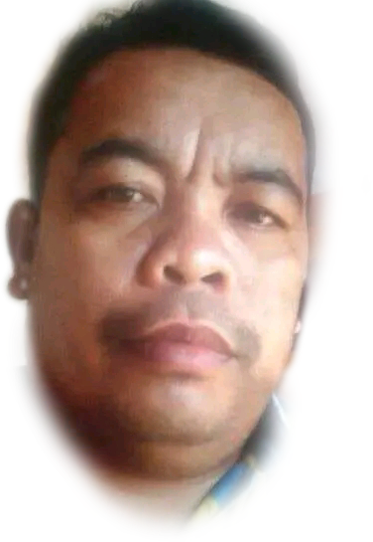
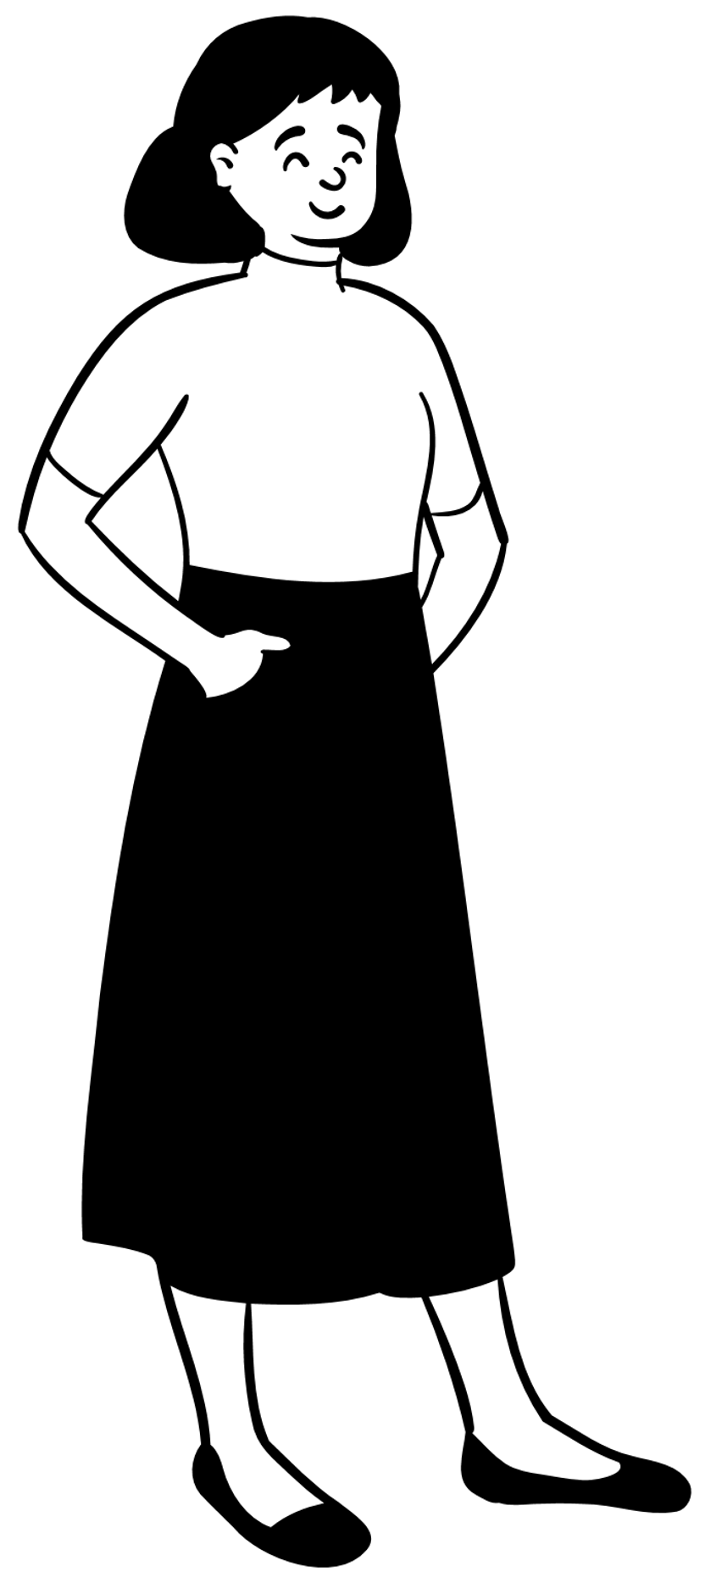
They are my parents. She is Sittie Noor S. Gaguil and he is Saanoding Raula Gunting . My mother is the eldest daughter of my grandparents and it was different to my father because my father is the youngest among them. My parents had a 6 children and I'm the eldest one.
And also I am his dad.
Hi, I'm his mom.

Slide 3
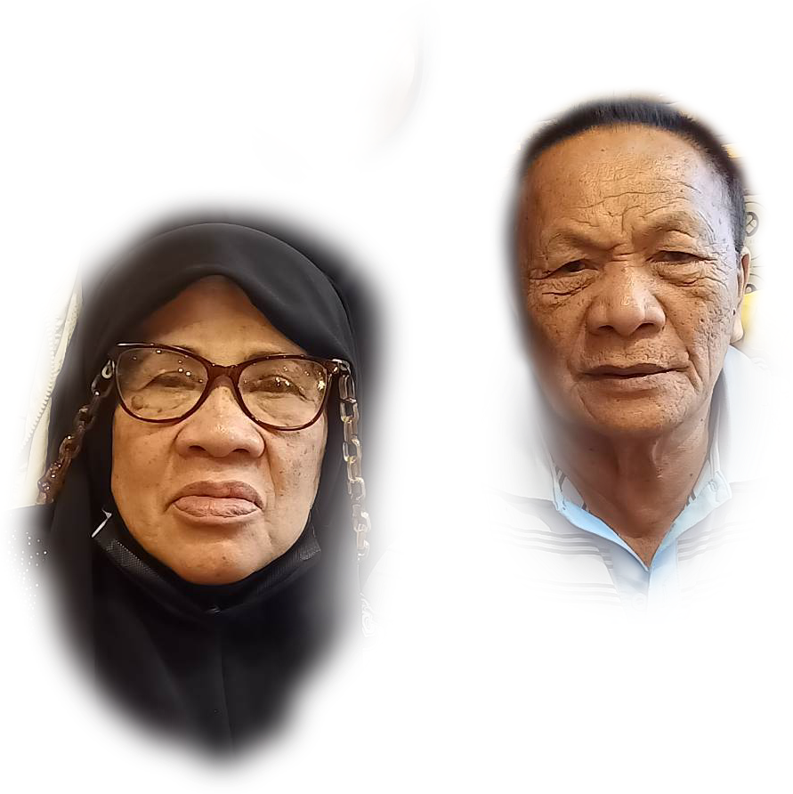
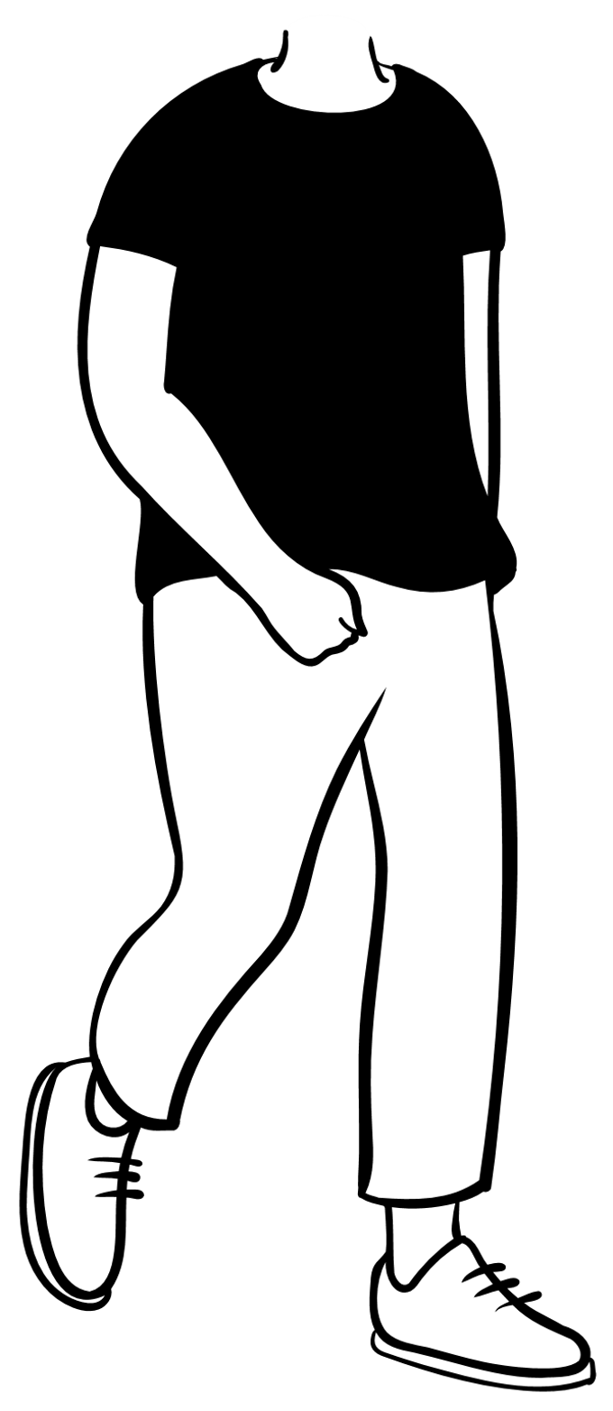
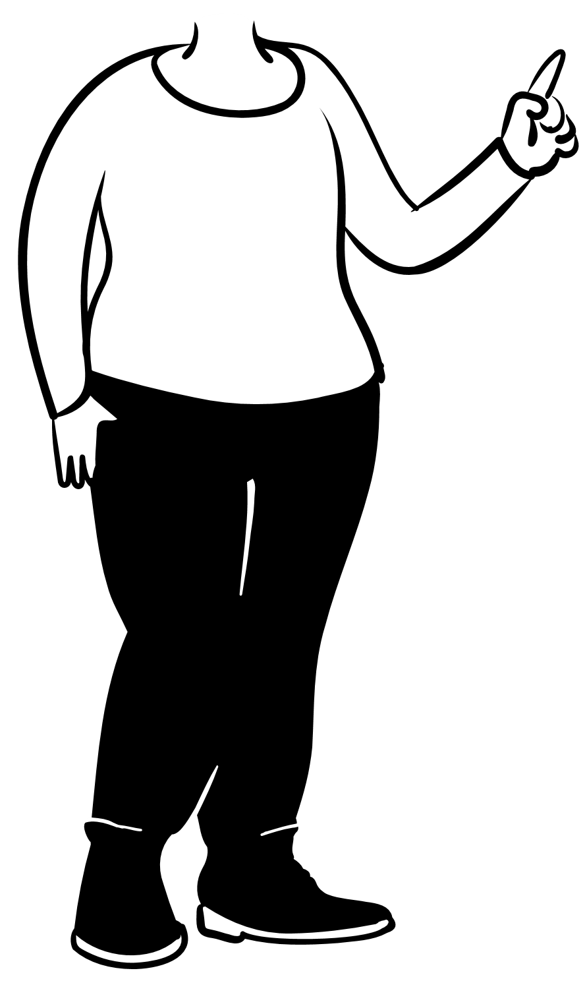


My Grandparents in Mother Side
They are my grandparents. She is Rohanisah D. Saripada and he is Fahad S. Gaguil . My grandmother is the eldest among them 10 and it was different to my grandfather because my grandfather is the youngest among their family. My Grandparents had a 12 childrens and one of them is my mother who is also the eldest.

Slide 4

My Great Grandparents in Mother Side
Hi, I'm Raga Saripada
Hi, I'm Kayog Dirag
Hi, I'm Jabbar Gaguil
Hi, I'm Saphia Sarip
My Great Grandparents in mother side in my grandmother parents they are Mrs. Raga Saripada and Mr. Kayog Dirag and on my grandfather side they are Mrs. Saphia Sarip and Mr. Jabbar Gaguil actually I don’t have photos to show because it was part of our belief that if someone is passed or died their photos should not be seen by other to avoid sin.

Slide 5
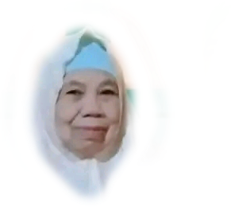


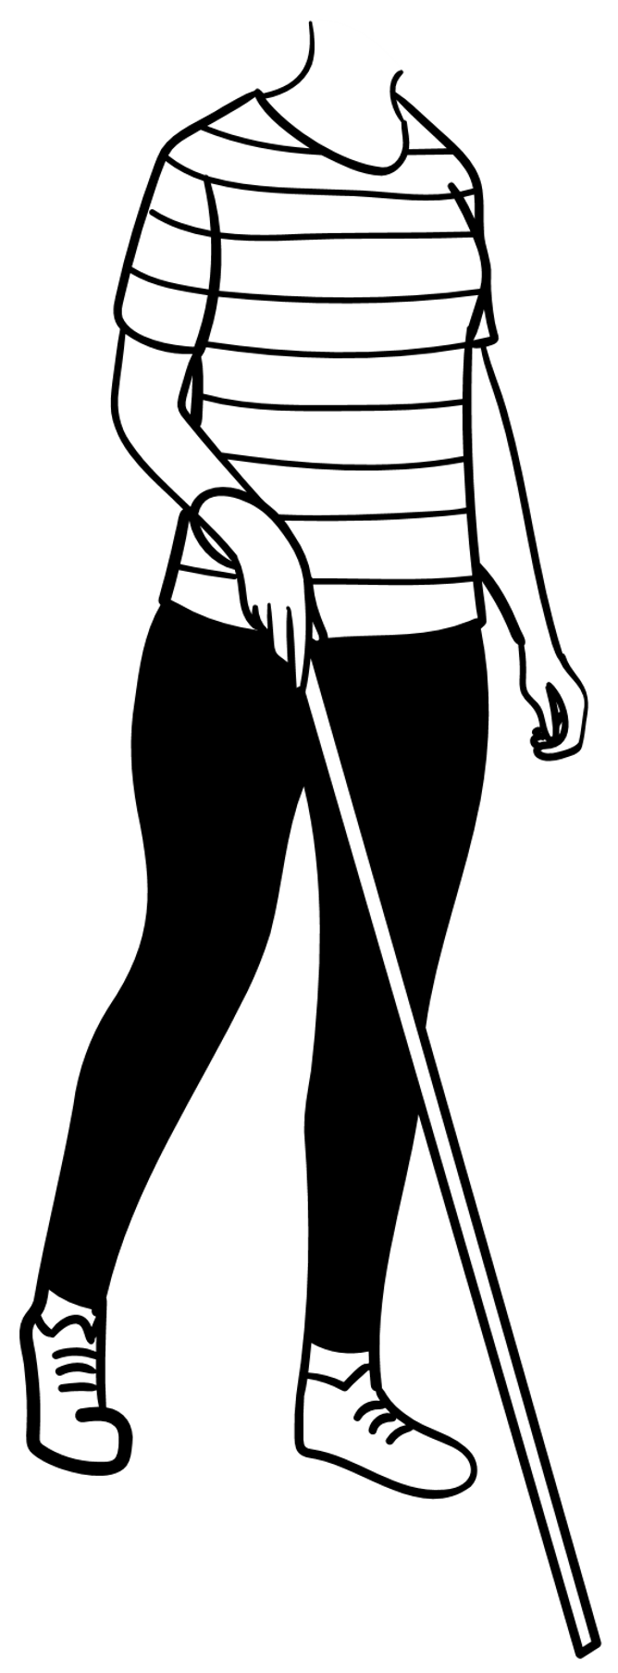
My Grandparents in Father Side
Hi, I'm Abdullah Buntal Gunting
They are my grandparents in father side. She is Raola Diamla Gunting and he is Abdullah Buntal Gunting . My grandmother is the youngest among them 12 and it was different to my grandfather because my grandfather is the eldest among their family. My Grandparents had a 10 childrens , 6 are passed away and 4 was alive and one of them is my father who is also the youngest among them.
Hi, I'm Raola Diamla Macarimbang

Slide 6
My Great Grandparents in Father Side
Hi, I'm Maniri Diamla
Hi, I'm Moner Macarimbang
Hi, I'm Faharodin Gunting
Hi, I'm Asya Buntal
My Great Grandparents in father side, in my grandmother parents they are Mrs. Maniri Diamla and Mr. Moner Macarimbang and on my grandfather side they are Mrs. Asya Buntal and Faharodin Gunting. Actually I don’t have photos to show because it was part of our belief that if someone is passed or died their photos should not be seen by other to avoid sin.

