Slide 1
Go Programming Language
Code-In

Slide 2


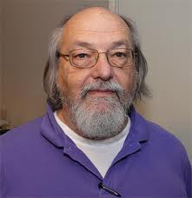
Go
Developed ~2007 at Google by
Robert Griesemer, Rob Pike, Ken Thompson

Slide 3
outline
Program Structure
Why Go?
Keywords, Constants and Data types
Composite Types
Functions
Methods
Interfaces

Slide 4
Program structure
package main //creating a package main.
import "fmt” //importing ”fmt” package. This is similar like including a header file using #include in C/C++
func main() { //main is the Execution entry point
fmt.Println("Hello, World!")
}
$ go run hello.go # to compile and run
$ go build hello.go # to create a binary
$ go help # for more

Slide 5
Why Go?
Open Source
Very fast compilation
Ex:- Unlike C++, Go has no templates and no inline functions. This means that Go doesn't need to perform any template or function instantiation.
Cross Compilation
The compiler defaults to the current architecture used for development, but we can also tell it to compile to a different architecture. This is known as cross-compilation.
Default Arch | Windows
package main import ”fmt” func main(){ fmt.Println(“Hello”) } $ go build program.go Generates executable file “program” | package main import ”fmt” func main(){ fmt.Println(“Hello”) } $ GOOS=windows GOARCH=amd64 go build program.go Generates executable file “program.exe”

Slide 6
Go infers the type from the type of the initializer (Shorthand declaration and initialization of variable)
Normal variable:
var a int = 10
Shorthand:
a:=10 //int
b:=“string” //string
In Go increment and decrement operations can’t be used as expressions, only as statements. Also, only the postfix notation is allowed.
Error Code i := 0 fmt.Println(++i) fmt.Println(i++) | Correct Code i := 0 i++ fmt.Println(i) fmt.Println(i) i++

Slide 7
No implicit conversions : Keep things explicit
C/C++ | GO
#include <stdio.h> int main() { int i=10; float j=i; printf("%f\n",j); return 0; } Output: 10.000000 | package main import "fmt" func main() { var i int = 10 var j float32 = i fmt.Println(j) } Output: Error: cannot use i (type int) as type float32 in assignment

Slide 8
Keywords
Go has 25 keywords . They cannot be used as variable names.
break | default | func | interface | select
case | defer | go | map | struct
chan | else | goto | package | switch
const | fallthrough | if | range | type
continue | for | import | return | var

Slide 9
Lets Understand Continue, Break and fallthrough
Continue | Break | fallthrough
func main() { var sum int = 0 for i := 0; i < 5; i++ { if i == 3 { continue } sum = sum + i } fmt.Println(sum) } Output: 7 | func main() { var sum int = 0 for i := 0; i < 5; i++ { if i == 3 { break } sum = sum + i } fmt.Println(sum) } Output: 3 | func main() { x := 1 switch x { case 1: fmt.Println("One") fallthrough case 2: fmt.Println("Two") fallthrough case 3: fmt.Println("Three") } } Output: One Two Three

Slide 10
Constants and datatypes
Constants:
true false iota nil
Data types:
int int8 int16 int32 int64
uint uint8 uint16 uint32 uint64 uintptr
bool byte rune string error
float32 float64
complex64 complex128
Examples of variable declaration:
Var a int
Var b int =10
a,b int =10,20

Slide 11
Composite Types
Composite Datatypes are created by combining the basic types in various ways. We will talk about four such types.
Arrays
Slices
Maps
Structs

Slide 12
Arrays
An Array is a fixed length.
Individual array elements are accessed with the conventional subscript notation, where subscript runs from zero to one position less than array length. The function to find the length of the array is “len”.
We can only have one type per array
Consist of contiguous memory locations (so the in-memory representation of [4]int is just four integer values laid out sequentially)
Array variable is not a pointer to the first array element, array variable stands for the whole array
when we assign or pass around an array in Go — we make a copy of it (not a pointer or reference to it)
Size must be an integer constant
Default value of the array elements are set to ZERO
var arr [3]int //array of 3 integers
fmt.Println(arr[0]) //prints the first element of an array
In an array literal, if an ellipsis ‘‘...’’ appears in place of the lengt h, the array length is determined by the number of initializers. The definition of q can be simplified to
q := [...]int{1, 2, 3}
fmt.Println(q) // [1,2,3]

Slide 13
Array - Example
package main
import "fmt"
func main() {
var a [2]string //array of two strings
a[0] = "Hello”
a[1] = "World"
fmt.Println(a[0], a[1]) // printing strings at 1st and 2nd indexes of the array
fmt.Println(a). //prints the whole array
primes := [6]int{2, 3, 5, 7, 11, 13}
fmt.Println(primes)
}
Output:
Hello World
[Hello World]
[2 3 5 7 11 13]

Slide 14
Slice
A Slice is a segment of an array. Slices build on arrays and provide more power, flexibility, and convenience compared to arrays.
Just like arrays, Slices are indexable and have a length. But unlike arrays, they can be resized.
Slice is not always a segment of an array.
Example:-
func main() {
// Creating a slice using a slice literal
var s = []int{3, 5, 7, 9, 11, 13, 17}
// Short hand declaration
t := []int{2, 4, 8, 16, 32, 64}
fmt.Println("s = ", s)
fmt.Println("t = ", t)
}
Output:
s= [3,5,7,9,11,13,17]
t=[2,4,8,16,32,64]

Slide 15
Slice implicitly has a pointer to an array
Slice capacity (maximum length it can store)
To create a slice from an array a, we specify two indices low (lower bound) and high (upper bound) separated by a colon.
Example:-
func main() {
var a = [5]string{"Alpha", "Beta", "Gamma", "Delta", "Epsilon"}
// Creating a slice from the array
var s []string = a[1:4]
fmt.Println("Array a = ", a)
fmt.Println("Slice s = ", s)
}
Output:
Array a = [Alpha Beta Gamma Delta Epsilon]
Slice s = [Beta Gamma Delta]

Slide 16
Array vs slice
When to use which?
Arrays are useful when planning the detailed layout of memory and sometimes can help avoid allocation, but primarily they are a building block for slices.
Most array programming in Go is done with slices rather than simple arrays
Slices hold references to an underlying array(=it doesn’t store any data),and if you assign one slice to another, both refer to the same array
Changing the elements of a slice modifies the corresponding elements of its underlying array
The length of a slice may be changed as long as it still fits within the limits of the underlying array
the capacity of a slice, accessible by the built-in function cap, reports the maximum length the slice may assume. If the data exceeds the capacity, the slice is reallocated. Built-in append will do it for us;

Slide 17
maps
A map is an unordered collection of key-value pairs. It maps keys to values. The keys are unique within a map while the values may not be.
The map data structure is used for fast lookups, retrieval, and deletion of data based on keys.
Declaring a map
A map is declared using the following syntax -
var m map[KeyType]ValueType
For example, Here is how you can declare a map of string keys to int values -
var m map[string]int

Slide 18
The zero value of a map is nil. A nil map has no keys. Moreover, any attempt to add keys to a nilmap will result in a runtime error.
Example:-
package main
import "fmt"
func main() {
var m map[string]int
fmt.Println(m)
if m == nil {
fmt.Println("m is nil")
}
// Attempting to add keys to a nil map will result in a runtime error
// m["one hundred"] = 100
}
Output:
map[]
m is nil

Slide 19
Initializing a map using the built-in make() function
You can initialize a map using the built-in make() function. You just need to pass the type of the map to the make() function as in the example below. The function will return an initialized and ready to use map.
Example:-
func main() {
var m = make(map[string]int)
fmt.Println(m)
if m == nil {
fmt.Println("m is nil")
} else {
fmt.Println("m is not nil")
}
// make() function returns an initialized and ready to use map.
// Since it is initialized, you can add new keys to it.
m["one hundred"] = 100
fmt.Println(m)
}
Output:
map[]
m is not nil
map[one hundred:100]

Slide 20
Initializing a map using a map literal
A map literal is a very convenient way to initialize a map with some data. You just need to pass the key-value pairs separated by colon inside curly braces
Example:-
package main
import "fmt"
func main() {
var m = map[string]int{
"one": 1,
"two": 2,
"three": 3,
"four": 4,
"five": 5, // Comma is necessary
}
fmt.Println(m)
}
Output:
map[one:1 two:2 three:3 four:4 five:5]

Slide 21
Retrieving the value associated with a given key in a map
You can retrieve the value assigned to a key in a map using the syntax m[key]. If the key exists in the map, you’ll get the assigned value. Otherwise, you’ll get the zero value of the map’s value type.
Example:-
package main
import "fmt"
func main() {
var personMobileNo = map[string]string{
"John": "+33-8273658526",
"Steve": "+1-8579822345",
"David": "+44-9462834443",
}
var mobileNo = personMobileNo["Steve"]
fmt.Println("Steve's Mobile No : ", mobileNo)
// If a key doesn't exist in the map, we get the zero value of the value type
mobileNo = personMobileNo["Jack"]
fmt.Println("Jack's Mobile No : ", mobileNo)
}
Output:
Steve's Mobile No : +1-8579822345
Jack's Mobile No :

Slide 22
structs
A struct is a user-defined type that contains a collection of named fields/properties. It is used to group related data together to form a single unit. Any real-world entity that has a set of properties can be represented using a struct.
Defining a struct type
You can define a new struct type like this -
type Person struct { FirstName string LastName string Age int }
The type keyword introduces a new type. It is followed by the name of the type (Person) and the key.
word struct to indicate that we’re defining a struct.
Declaring a variable of a struct type
Just like other data types, you can declare a variable of a struct type like this -
// Declares a variable of type 'Person’
var p Person // All the struct fields are initialized with their zero value
The above code creates a variable of type Person that is by default set to zero. For a struct, zero means all the fields are set to their corresponding zero value.
Initializing a struct
You can initialize a variable of a struct type using a struct literal like so -
// Initialize a struct by supplying the value of all the struct fields.
var p = Person{"Rajeev", "Singh", 26}

Slide 23
Pointer to a struct
You can get a pointer to a struct using the & operator.
type Student struct {
RollNumber int
Name string
}
func main() {
// instance of student struct type
s := Student{11, "Jack"}
ps := &s // Pointer to the student struct
fmt.Println(ps)
fmt.Println((*ps).Name) // // Accessing struct fields via pointer
fmt.Println(ps.Name) //same as bove
ps.RollNumber = 31
fmt.Println(s) //should be very conscious while using pointer
}
Output:
&{11 Jack}
Jack Jack
&{31 Jack}

Slide 24
You can get a pointer to a struct using the new operator
Package main
import "fmt"
type Employee struct {
Id int
Name string
}
func main() {
// You can also get a pointer to a struct using the built-in new() function
// It allocates enough memory to fit a value of the given struct type, and returns a pointer to it
pEmp := new(Employee)
pEmp.Id = 1000
pEmp.Name = "Sachin"
fmt.Println(pEmp)
}
Output:
&{1000 Sachin}

Slide 25
Functions
Functions and methods are both used extensively in Go to provide abstractions and make our programs easier to read and reason about. On the surface, functions and methods both look similar, but there are some important semantic differences which can make a big difference to the readability of your code.
In Golang, we declare a function using the func keyword. A function has a name, a list of comma-separated input parameters along with their types, the result type(s), and a body. Function Arguments and return type is optional.
Following is an example of a simple function called avg that takes two input parameters of type float64 and returns the average of the inputs. The result is also of type float64 -
func avg(x float64, y float64) float64 {
return (x + y) / 2
}
Now, calling a function is very simple. You just need to pass the required number of parameters to the function like this -
avg(6.56, 13.44)

Slide 26
Example:-
package main
import "fmt"
func avg(x float64, y float64) float64
{
return (x + y) / 2
}
func main() {
x := 5.75
y := 6.25
result := avg(x, y)
fmt.Printf("Average of %.2f and %.2f = %.2f\n", x, y, result)
}
Output:
Average of 5.75 and 6.25 = 6.00

Slide 27
Functions with multiple return values
Go functions are capable of returning multiple values. This is something that most programming languages don’t support natively.
package main
import "fmt"
func fun(x, y int) (int, int) {
return x, y
}
func main() {
a, b := fun(10, 20)
fmt.Println(a, b)
}
Output:
10 20

Slide 28
Method
A method is nothing but a function with a special receiver argument.
The receiver argument has a name and a type. It appears between the func keyword and the method name -
func (receiver Type) MethodName(parameterList) (returnTypes) { }
Methods help you write object-oriented style code in Go.
Moreover, Methods help you avoid naming conflicts. Since a method is tied to receiver, you can have the same method names on different receiver types.

Slide 29
type A struct {
a string
}
func (obj A) display() string {. //method with receiver A
return obj.a
}
type B struct {
b string
}
func (obj1 B) display() string { // method with receiver B
return obj1.b
}
func main() {
obj := A{"I am A struct"}
obj1 := B{"I am B struct"}
fmt.Println(obj.display())
fmt.Println(obj1.display())
}
Output:
I am A struct
I am B struct

Slide 30
interface
An interface in Go is a type defined using a set of method signatures. The interface defines the behaviour for similar type of objects
Typically, if you see a function or a method that expects an empty interface, then you can typically pass anything into this function/method.
Example:
package main
import ( "fmt" )
func myFunc(a interface{}) {
fmt.Println(a)
}
func main() {
var my_age int
my_age = 25
myFunc(my_age)
}
Output:
25

Slide 31
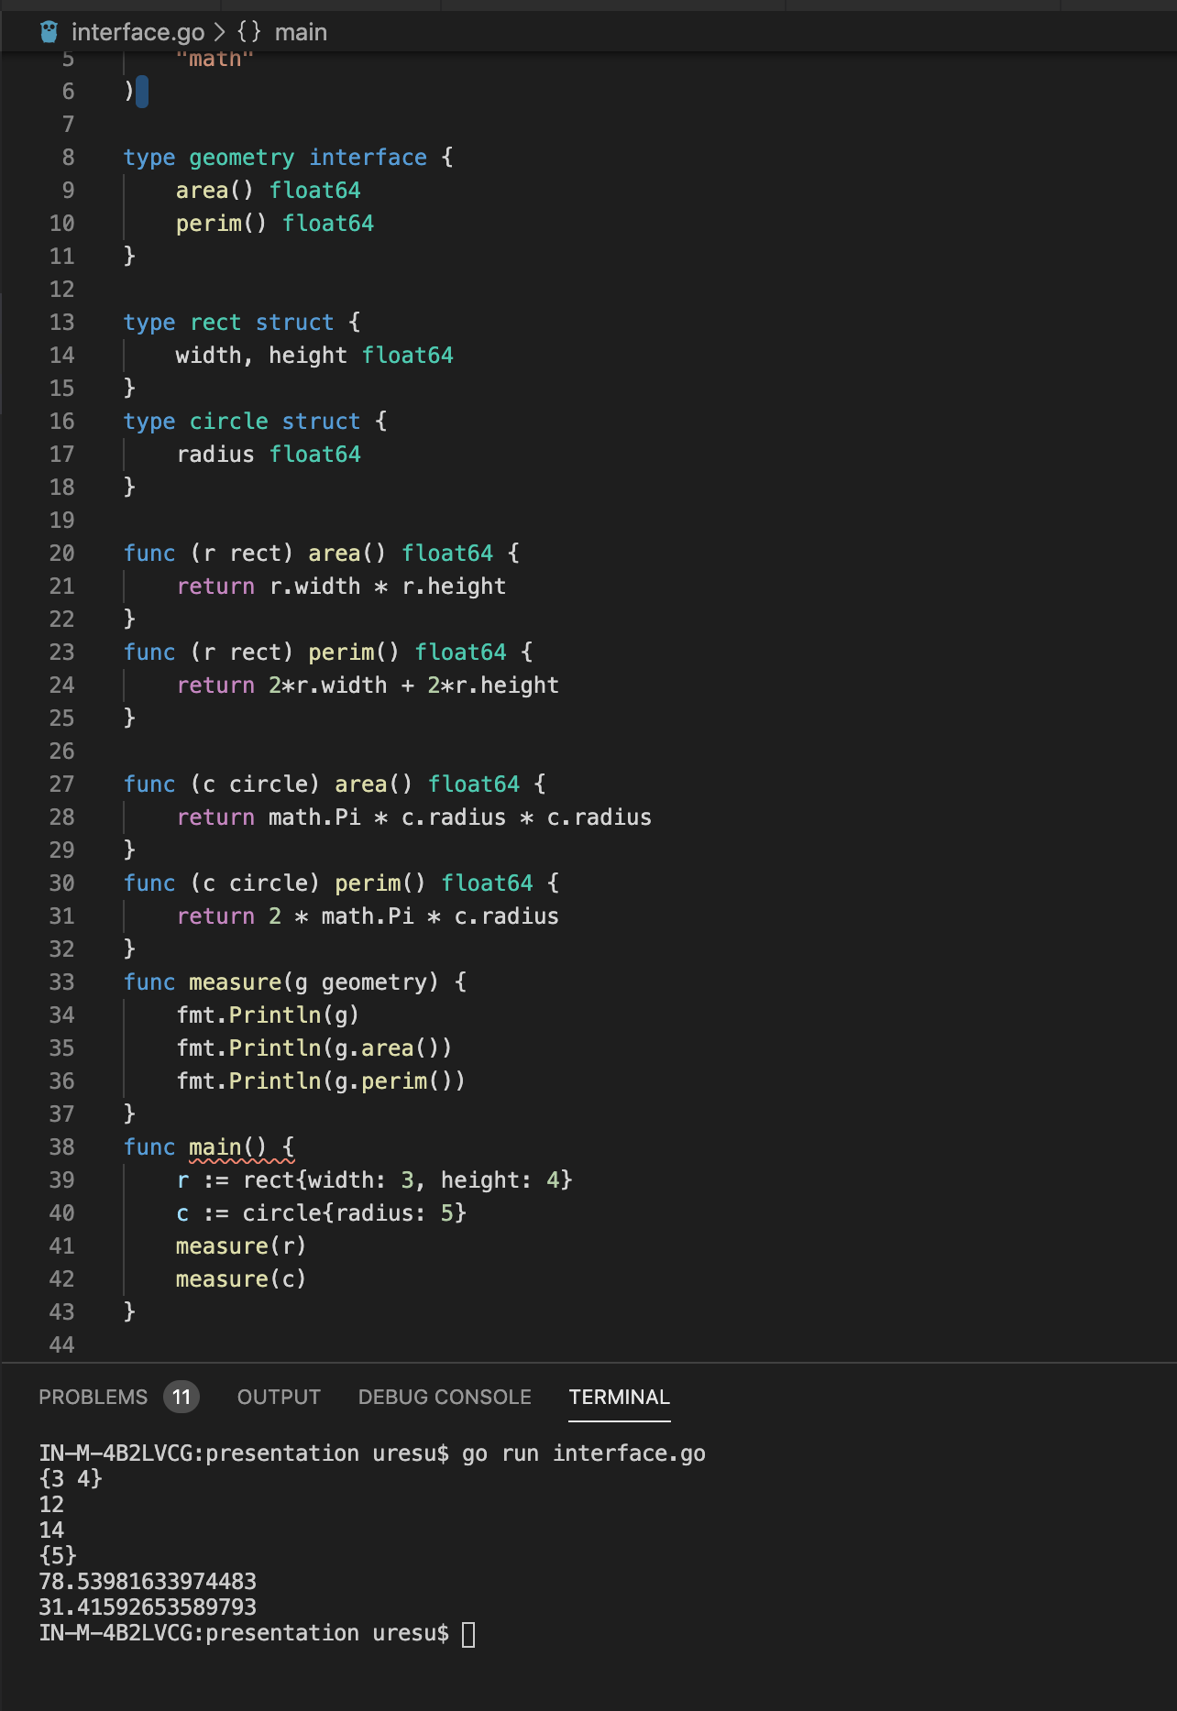

Slide 32
Method Receiver types on Interface
Interface and value Receiver
type User struct {
Name string
Period int
}
type Worker interface {
Work()
}
func (u User) Work() {
fmt.Println(u.Name, "has worked for", u.Period, "hrs.")
}
func DoWork(w Worker) {
w.Work()
}
func main() {
uval := User{"UserVal", 5}
DoWork(uval)
pval := &User{"UserPtr", 6}
DoWork(pval)
}
Output:
UserVal has worked for 5 hrs.
UserPtr has worked for 6 hrs.

Slide 33
Interface and pointer Receiver
type User struct {
Name string
Period int
}
type Worker interface {
Work()
}
func (u *User) Work() {
fmt.Println(u.Name, "has worked for", u.Period, "hrs.")
}
func DoWork(w Worker) {
w.Work()
}
func main() {
uval := User{"UserVal", 5}
DoWork(uval)
pval := &User{"UserPtr", 6}
DoWork(pval)
}
Error//
cannot use uval (type User) as type Worker in argument to DoWork:
User does not implement Worker (Work method has pointer receiver)

Slide 34
Thank you

