Slide 1

Illustrated by
LEA JEAN RIZALDA
Notes:
the lion and the mouse

Slide 2
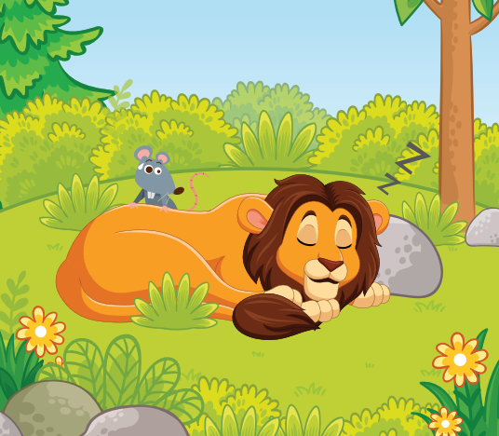
A Lion lay asleep in the forest, his great head resting on his paws. A timid little Mouse came upon him unexpectedly, and in her fright and haste to get away, ran across the Lion's nose.
Notes:
A Lion lay asleep in the forest, his great head resting on his paws. A timid little Mouse came upon him unexpectedly, and in her fright and haste to get away, ran across the Lion's nose.

Slide 3
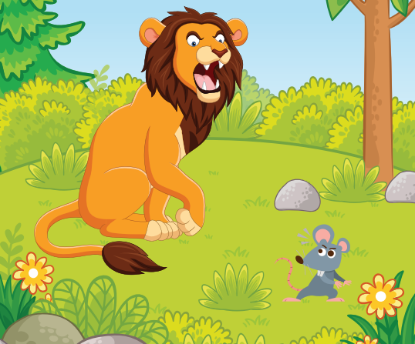
Roused from his nap, the Lion laid his huge paw angrily on the tiny creature to kill her.
Notes:
Roused from his nap, the Lion laid his huge paw angrily on the tiny creature to kill her.

Slide 4
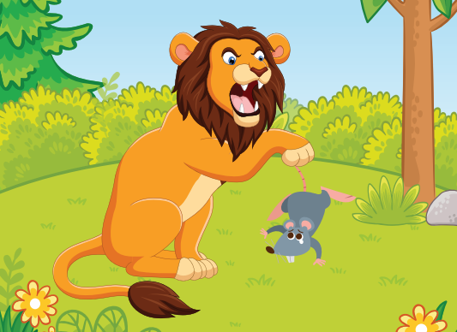
"Spare me!" begged the poor Mouse. "Please let me go and someday I will surely repay you."
Notes:
"Spare me!" begged the poor Mouse. "Please let me go and someday I will surely repay you."

Slide 5
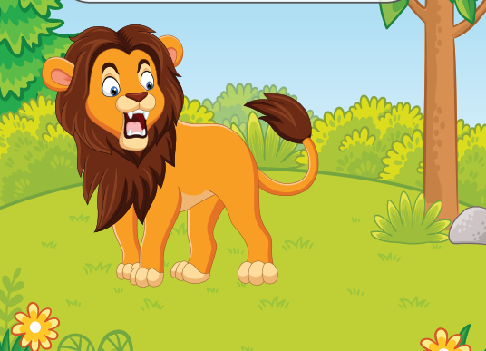
The Lion was much amused to think that a Mouse could ever help him. But he was generous and finally let the Mouse go.
Notes:
The Lion was much amused to think that a Mouse could ever help him. But he was generous and finally let the Mouse go.

Slide 6
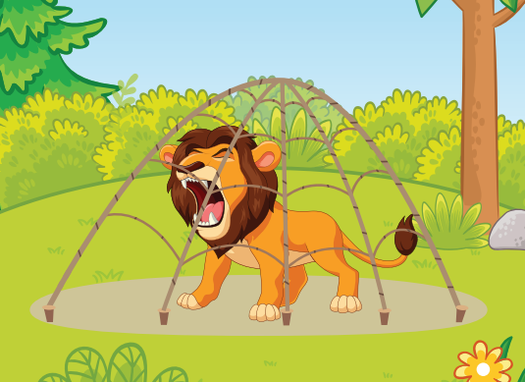
Some days later, while stalking his prey in the forest, the Lion was caught in the toils of a hunter's net. Unable to free himself, he filled the forest with his angry roaring.
Notes:
Some days later, while stalking his prey in the forest, the Lion was caught in the toils of a hunter's net. Unable to free himself, he filled the forest with his angry roaring.

Slide 7
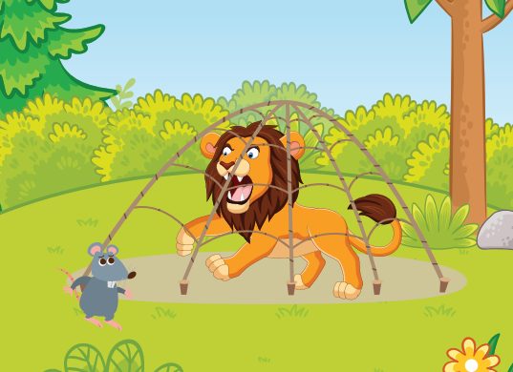
The Mouse knew the voice and quickly found the Lion struggling in the net.
Notes:
The Mouse knew the voice and quickly found the Lion struggling in the net.

Slide 8
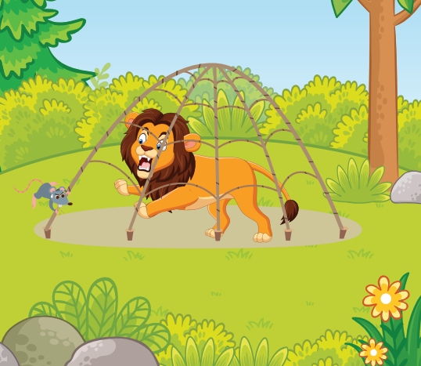
Running to one of the great ropes that bound him, she gnawed it until it parted, and soon the Lion was free.
Notes:
Running to one of the great ropes that bound him, she gnawed it until it parted, and soon the Lion was free.

Slide 9
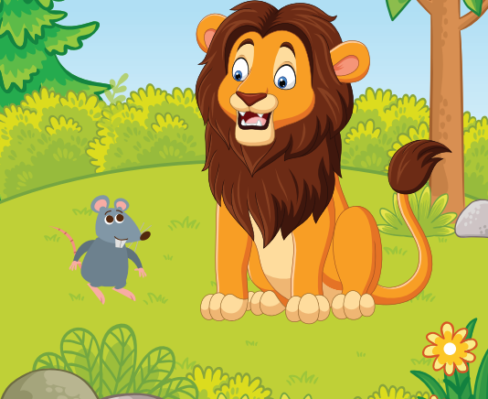
"You laughed when I said I would repay you," said the Mouse. "Now you see that even a Mouse can help a Lion."
Notes:
"You laughed when I said I would repay you," said the Mouse. "Now you see that even a Mouse can help a Lion."

Slide 10
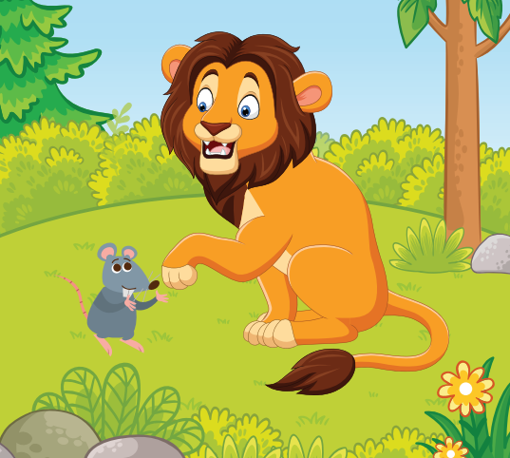
A kindness is never wasted.
Notes:
MORAL: Small acts of kindness will be rewarded greatly.

