Slide 2
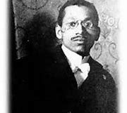

William Hunter Dammond
Notes:
William Hunter Dammond

Slide 3
Introduction
William Hunter Dammond was born on October 26, 1873. He was born in Pittsburgh Pennsylvania to a middle-class family by the name of Lucy and Edward Dammond. He was the fifth child out of eight children. He invented the railroad switching mechanism that enables trains to change direction. His birthday is October 26, 1873, and he was born at Pittsburgh, Pennsylvania.
Notes:
Introduction.
William Hunter Dammond was born on October 26, 1873. He was born in Pittsburgh Pennsylvania to a middle-class family by the name of Lucy and Edward Dammond. He was the fifth child out of eight children. He invented the railroad switching mechanism that enables trains to change direction. His birthday is October 26, 1873, and he was born at Pittsburgh, Pennsylvania.

Slide 4

Accomplishment
William Hunter Dammonnd accomplish being a railroad engineer.
Notes:
Accomplishment
William Hunter Dammonnd accomplish being a railroad engineer.

Slide 5

Why the person is notable?
William Hunter Dammond is notable because, he is a Famous Inventor (1873-1956) invented the railroad switching mechanism which enabled trains to change direction. He is also the First African American Graduate from the University of Pittsburgh with a Degree in Civil Engineering.
Notes:
Why the person is notable?
William Hunter Dammond is notable because, he is a Famous Inventor (1873-1956) invented the railroad switching mechanism which enabled trains to change direction. He is also the First African American Graduate from the University of Pittsburgh with a Degree in Civil Engineering.

Slide 6

Why you chose the person?
I choose William Hunter Dammond, because he also taught math and I like math, and he also an engineer for railroads and developed he railroad switching mechanism we uses today.
Notes:
Why you chose the person?
I choose William Hunter Dammond, because he also taught math and I like math, and he also an engineer for railroads and developed he railroad switching mechanism we uses today.

Slide 7
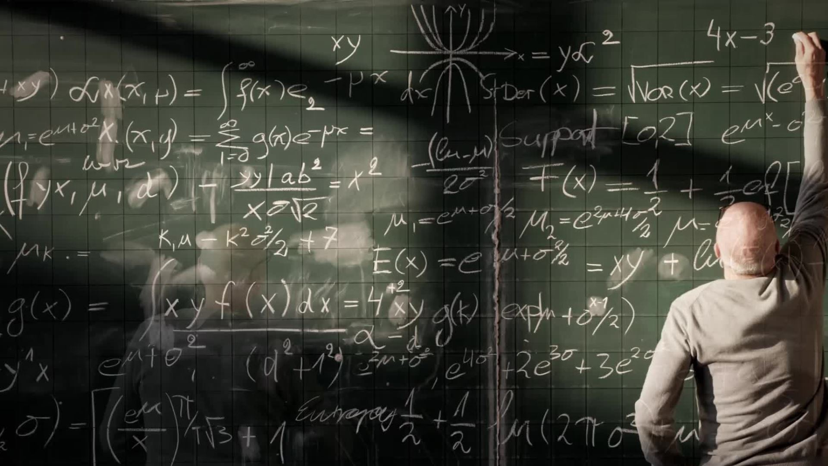
Facts about William Hunter Dammond
He was a math professor
He has 1 child
He developed a traffic light-like system
He developed the Dammond circuit
Notes:
Facts about William Hunter Dammond
He was a math professor
He has 1 child
He developed a traffic light-like system
He developed the Dammond circuit

