Slide 1
Welcome To Karupannya.org

Slide 2

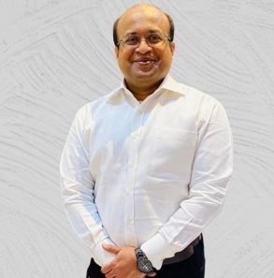
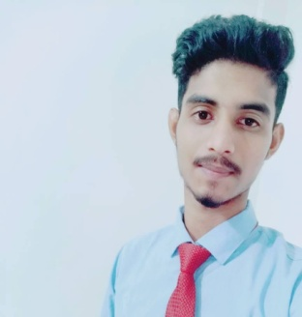
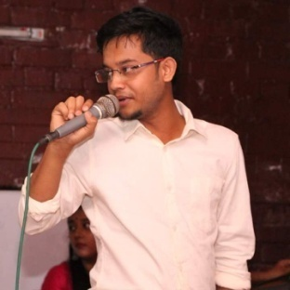

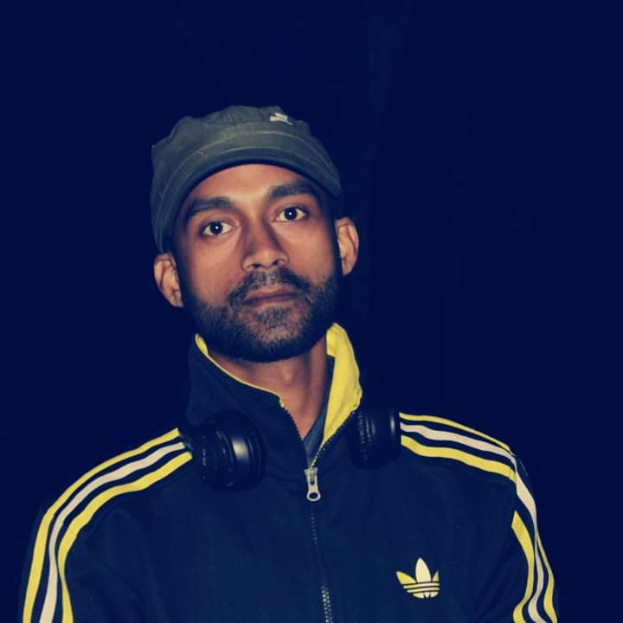
Karupannya Team
Mohammad Ariful Haque
Managing Director & CEO
+8801711677388
ariful@karupannya.org
Asaduzzaman Sarker Hridoy
Co-Founder
+8801971-545505
asaduzzaman@karupannya.org
Rimel Ahmed
Co-Founder
+8801940921293
rimel@karupannya.org
Nupur
Graphic Designer
+880 1886-943211
Nupur@karupannya.org
MD Maud Rana
Purchase Officer
+8801660199985 masud@karupannya.org

Slide 3

Mohammad Ariful Haque
Managing Director & CEO
+8801711677388
ariful@karupannya.org

Slide 4

Asaduzzaman Sarker Hridoy
Co-Founder
+8801971-545505
asaduzzaman@karupannya.org

Slide 5
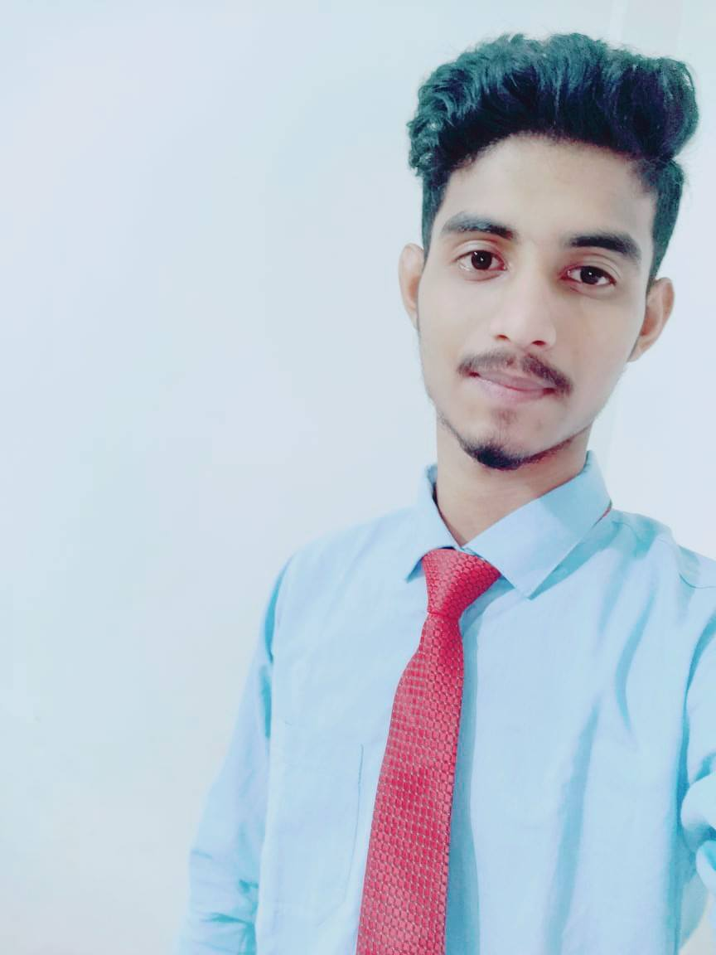
Rimel Ahmed
Co-Founder
+8801940921293
rimel@karupannya.org

Slide 6

Kanij Rabeya Nupur
Graphic Designer
+88 01789943211
Nupur@karupannya.org

Slide 7
MD Maud Rana
Purchase Officer
+8801660199985 masud@karupannya.org

Slide 8

Thanks

