Slide 1


Slide 2
Acquire More Customers with Bajaj Pay Brand EMI and Grow Your Business with us.
Notes:
Acquire More Customers with Bajaj Pay Brand EMI and Grow Your Business with us.

Slide 3
Let’s start step by step on your Brand EMI journey with the Bajaj Pay EDC device to offer your customers.
Notes:
Let’s start step by step on your Brand EMI journey with the Bajaj Pay EDC device to offer your customers.

Slide 4
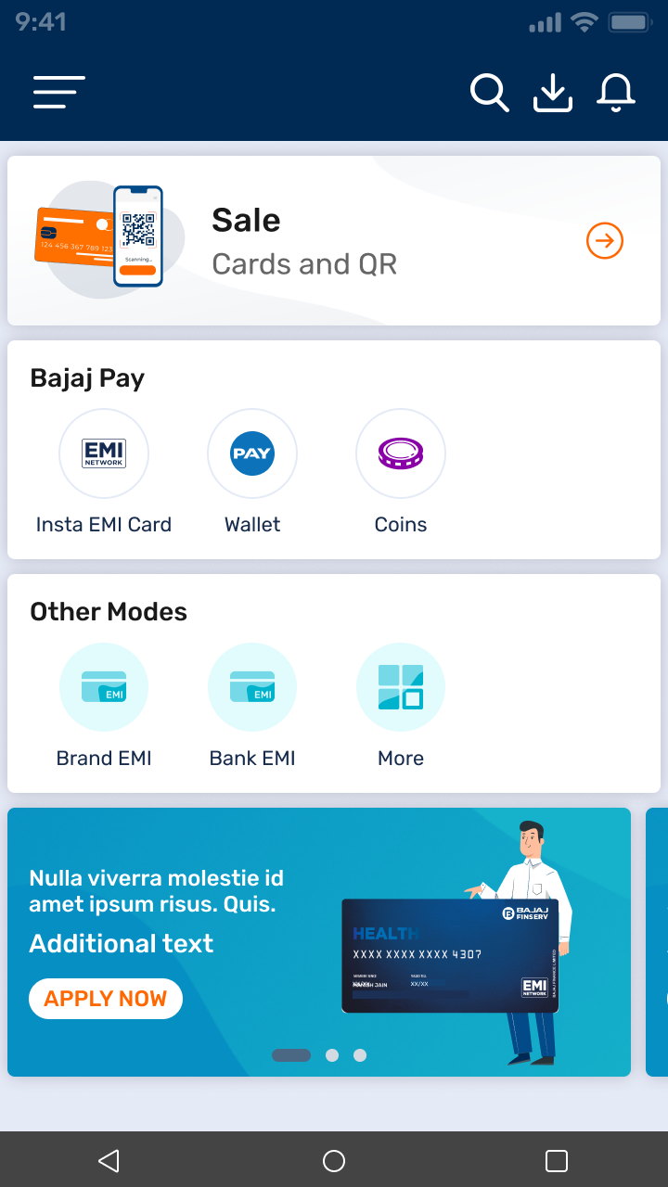
Tap on Brand EMI
Notes:
Tap on Brand EMI

Slide 5
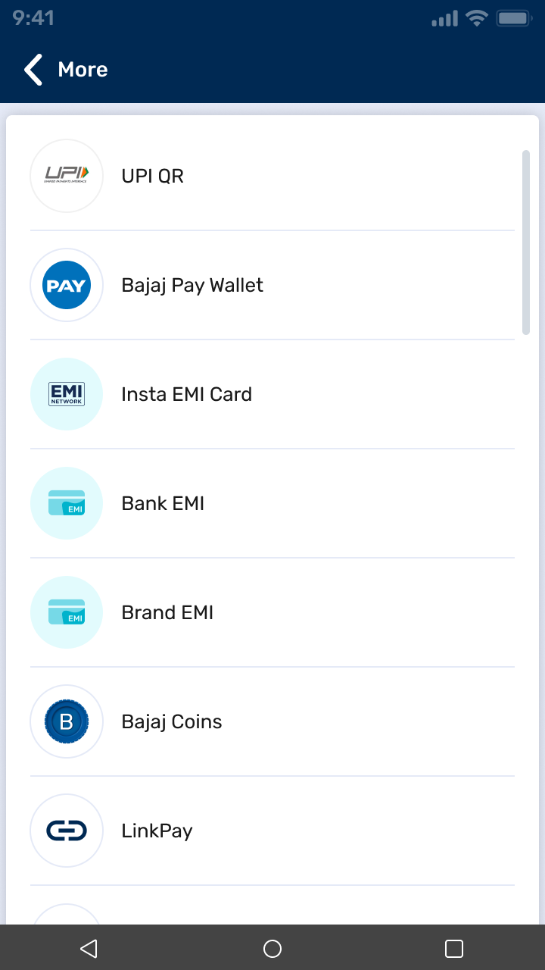
Select on Brand EMI option
Notes:
Select on Brand EMI option

Slide 6
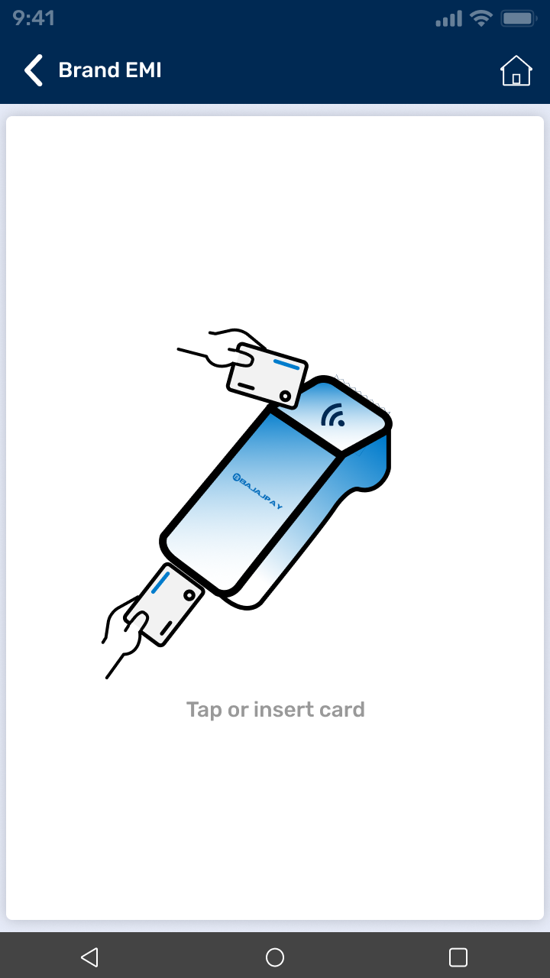
Insert your Customer Credit Card
Notes:
Insert your Customer Credit Card

Slide 7
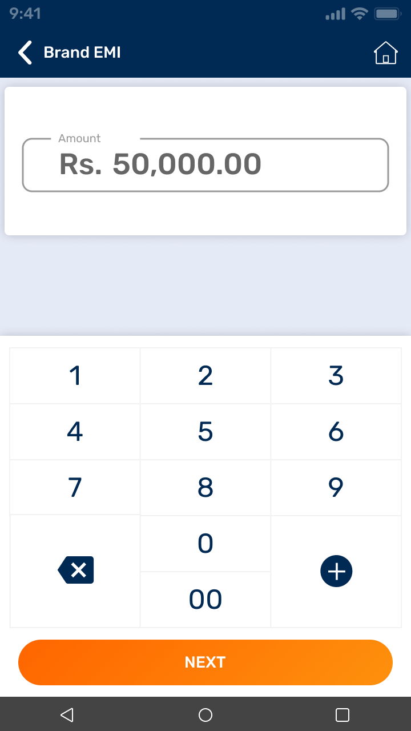
Enter Amount
Notes:
Enter Amount

Slide 8
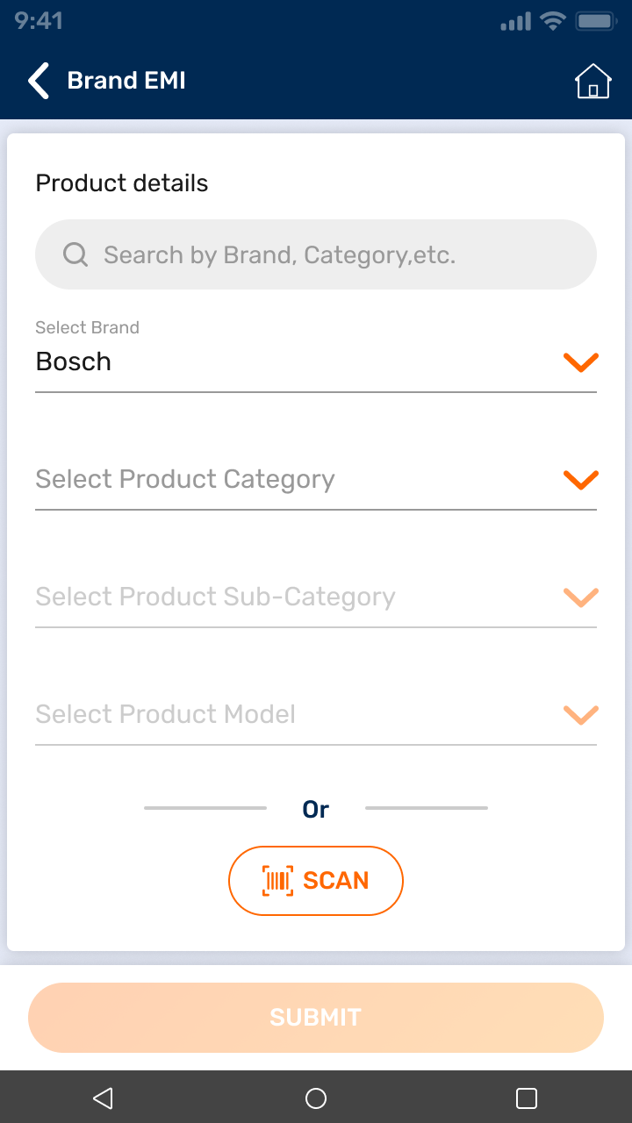
Select Brand
Notes:
Select Brand

Slide 9
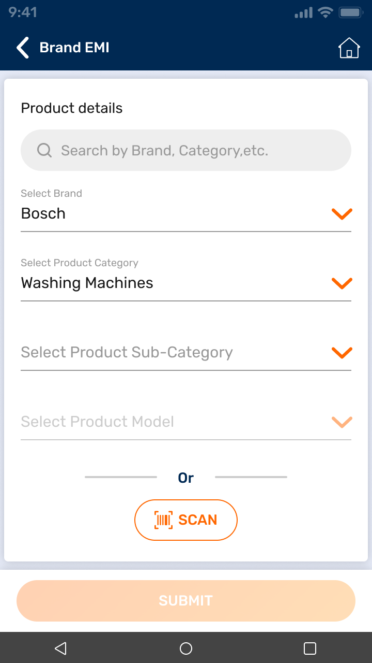
Select Product Category
Notes:
Select Product Category

Slide 10
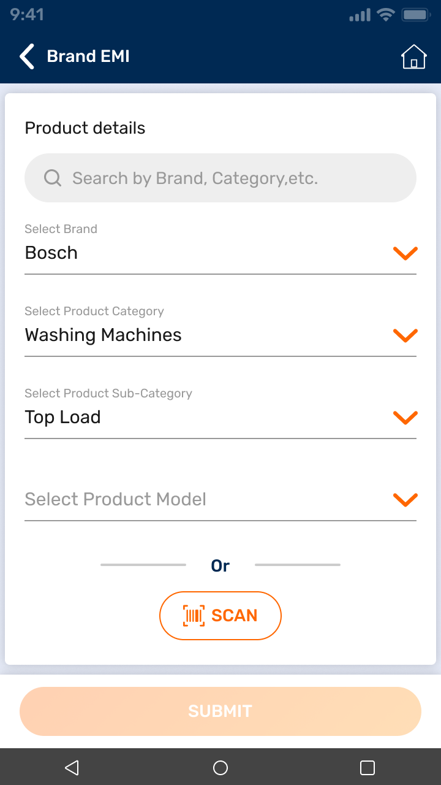
Select Product Sub-Category
Notes:
Select Product Sub-Category

Slide 11
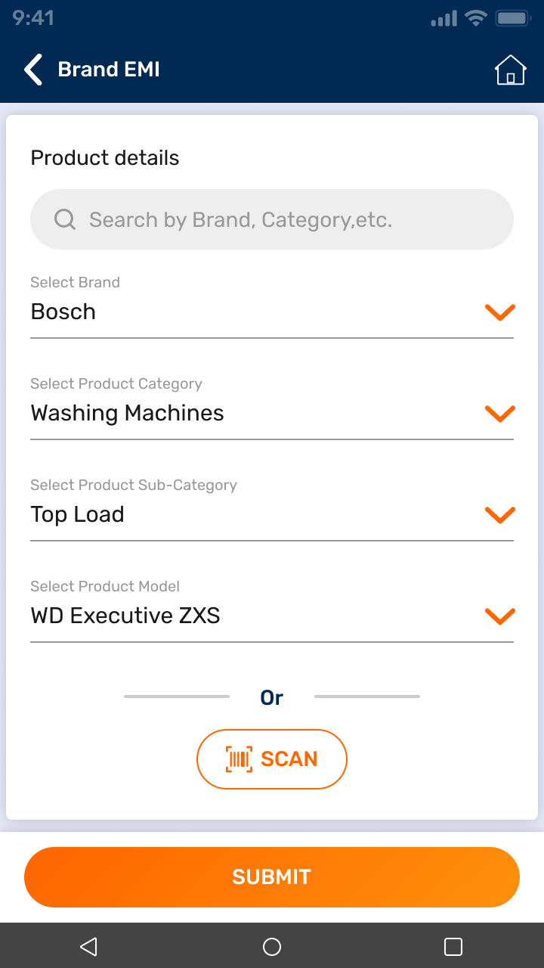
Select Product Model Number
Now click on Submit
Notes:
Select Product Model Number
Now click on Submit

Slide 12
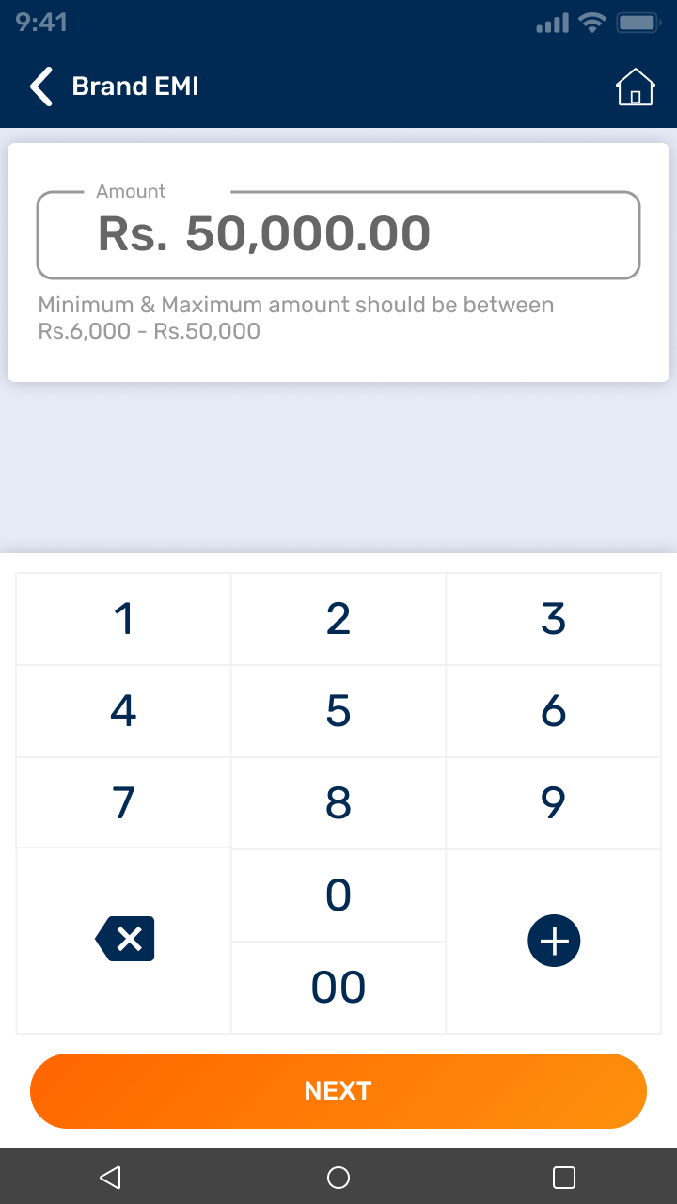
Now you can change your amount between Minimum and Maximum amount of your selected product
Now Click on Next
Notes:
Now you can change your amount between Minimum and Maximum amount of your selected product
Now Click on Next

Slide 13
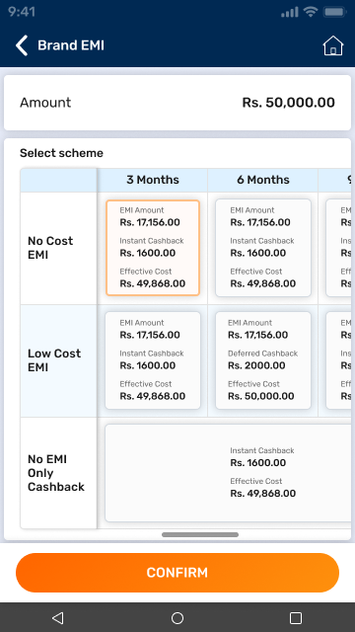
Now select the EMI offer and tenure according to the customer’s preference
Now Click on Confirm
Notes:
Now select the EMI offer and tenure according to the customer’s preference
Now Click on Confirm

Slide 14
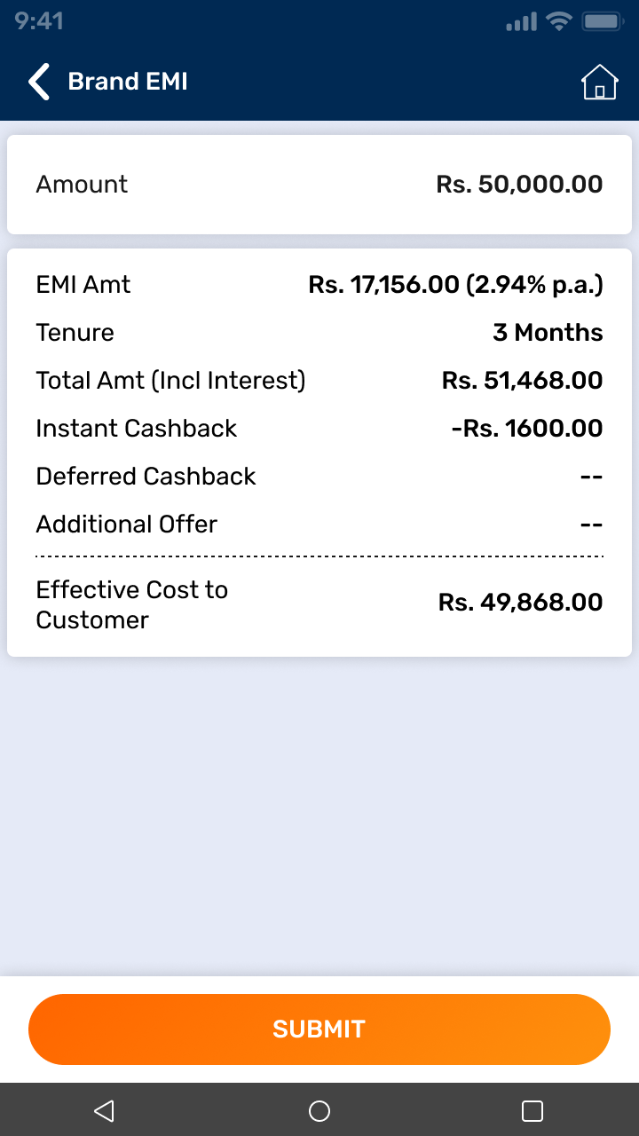
Now Payment Summary screen will display details such as the EMI amount tenure total amount with interest, cashback amount and Additional Offer
Notes:
Now Payment Summary screen will display details such as the EMI amount tenure total amount with interest, cashback amount and Additional Offer

Slide 15
Show all details to the customer and click on Submit to complete the Brand EMI payment
Notes:
Now Payment Summary screen will display details such as the EMI amount tenure total amount with interest, cashback amount and Additional Offer

Slide 16
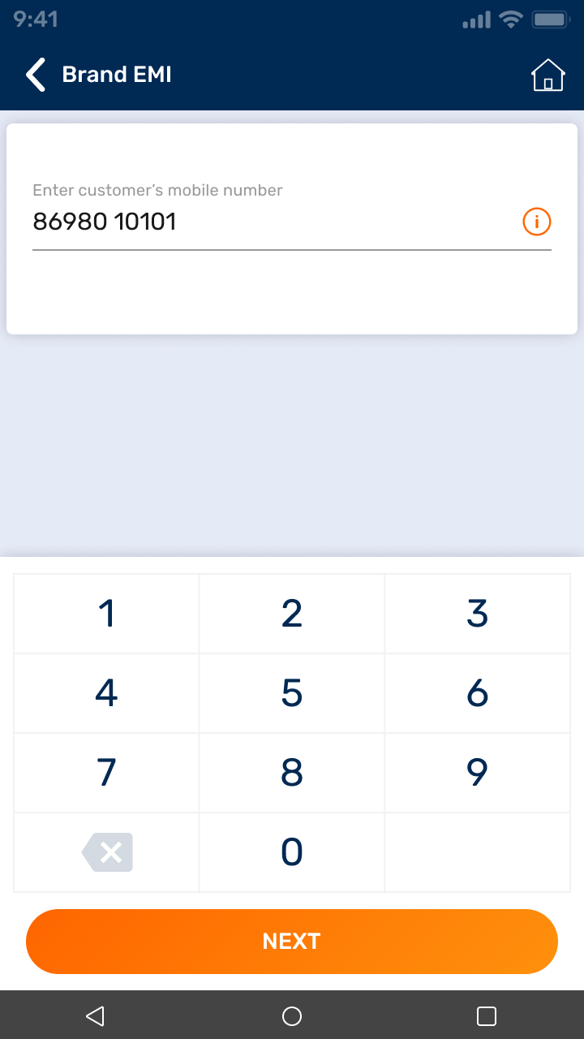
Now enter the customer mobile number
Now Click on Next
Notes:
Now enter the customer mobile number
Now Click on Next

Slide 17
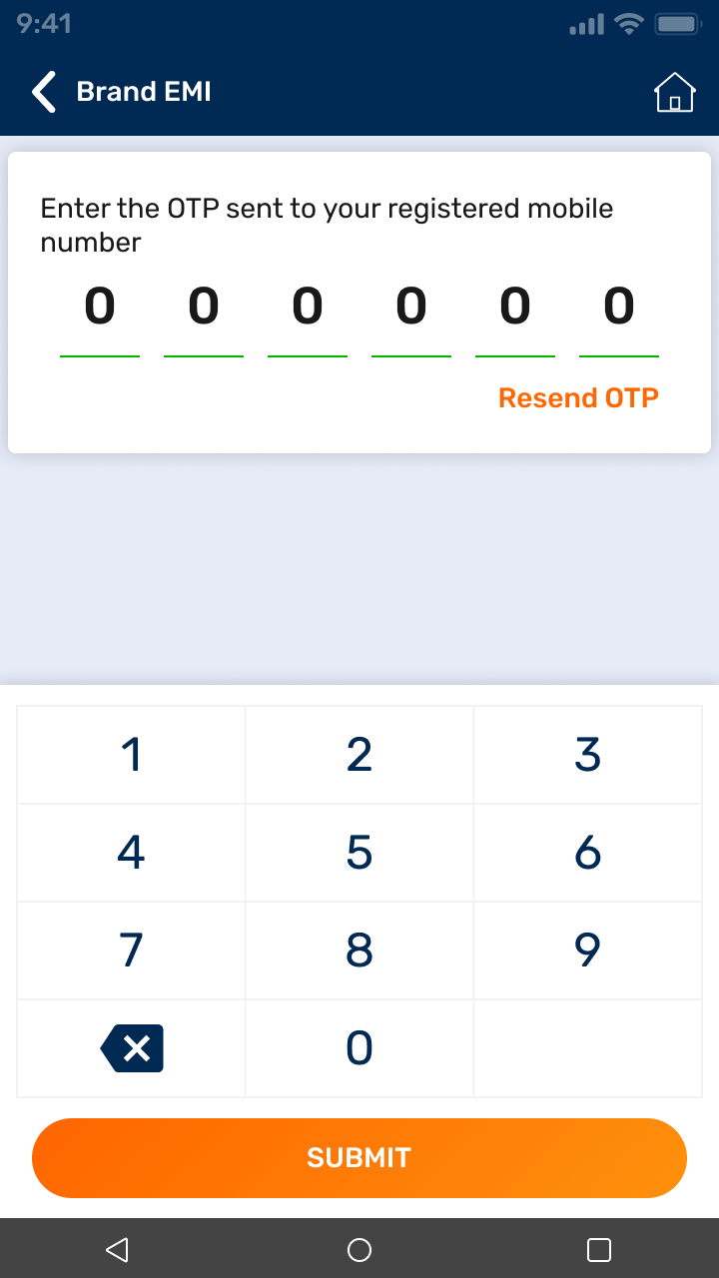
Enter the 6digit OTP sent to the customer's previously given mobile number
Now click on Submit
Notes:
Enter the 6digit OTP sent to the customer's previously given mobile number
Now click on Submit

Slide 18
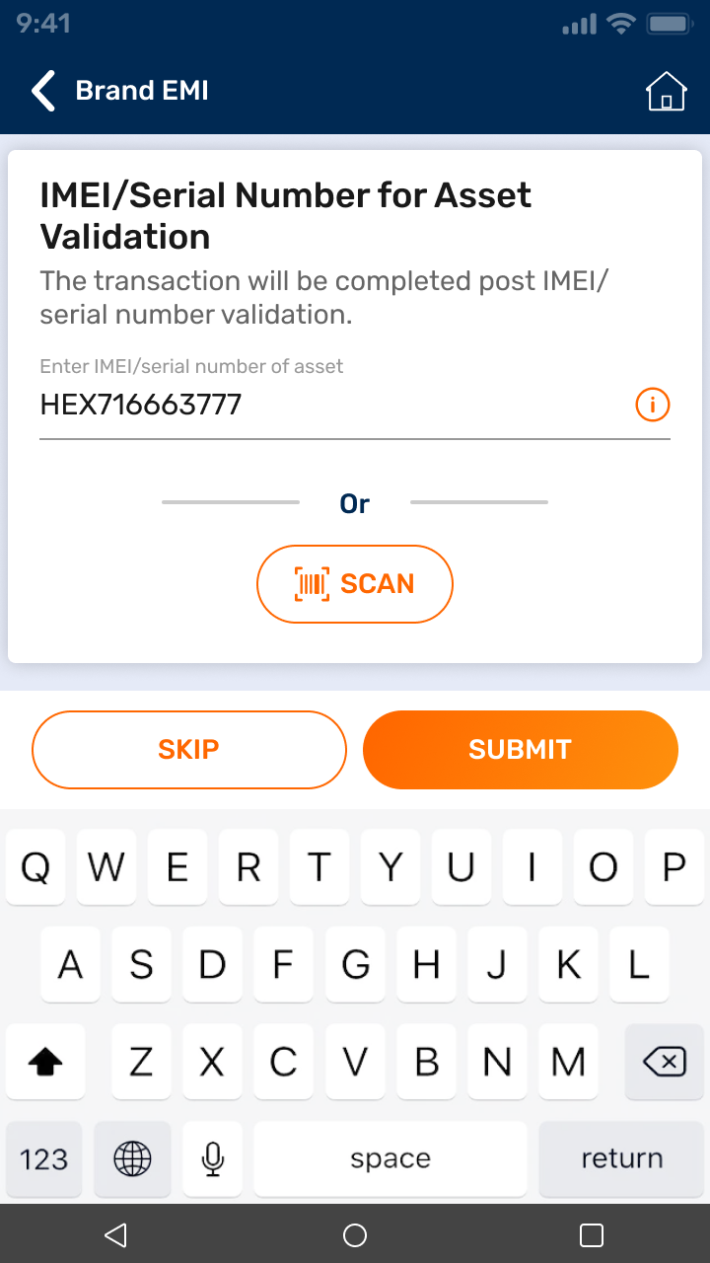
Now enter the product IMEI or serial number
Now click on Submit
Notes:
Now enter the product IMEI or serial number
Now click on Submit

Slide 19
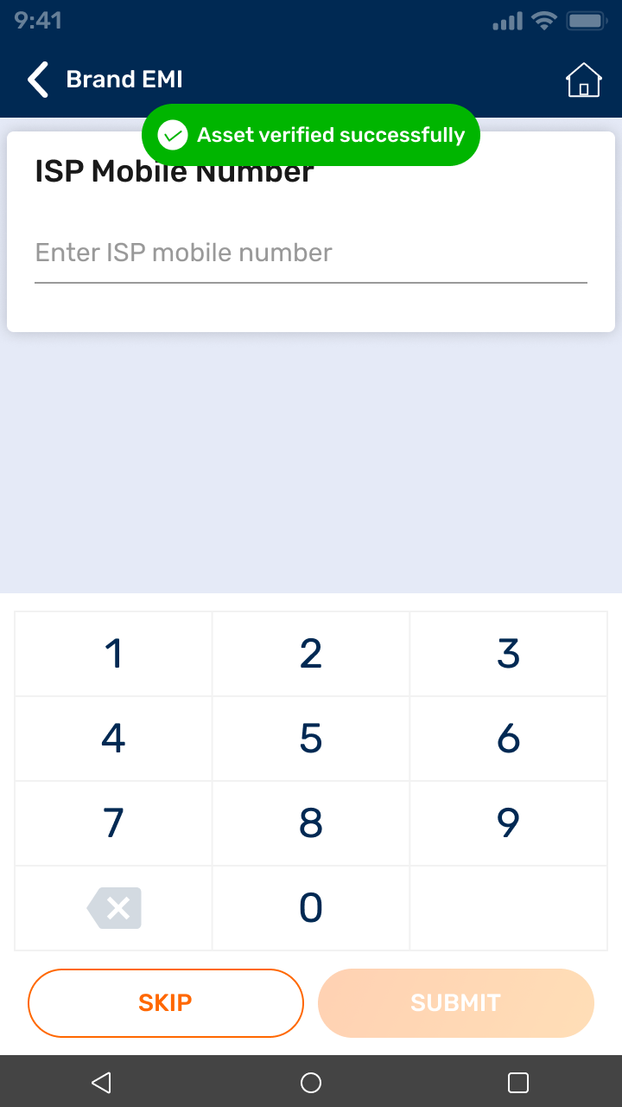
IMEI or serial number will be verified by the OEM backend
Notes:
IMEI or serial number will be verified by the OEM backend

Slide 20
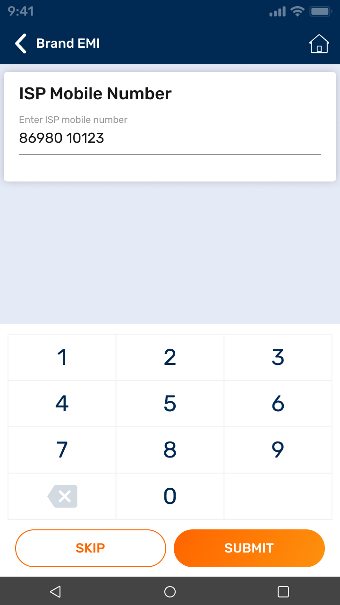
Now enter the Cashier or FOS mobile number
Now click on Submit
Notes:
Now enter the Cashier or FOS mobile number
Now click on Submit

Slide 21
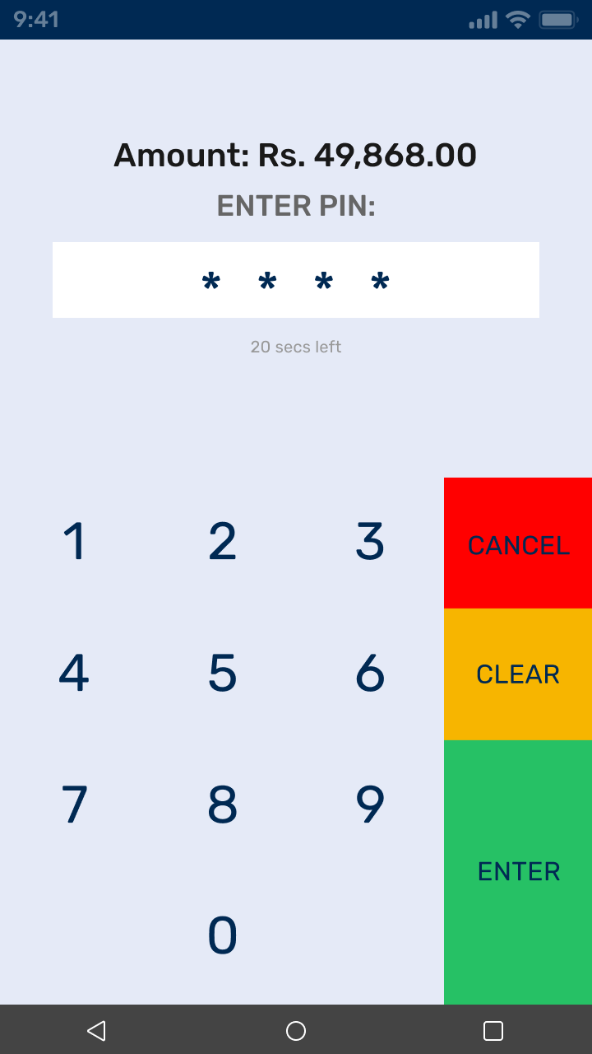
Please ask the customer to enter their card PIN number
Now click on Enter
Notes:
Please ask the customer to enter their card PIN number
Now click on Enter

Slide 22
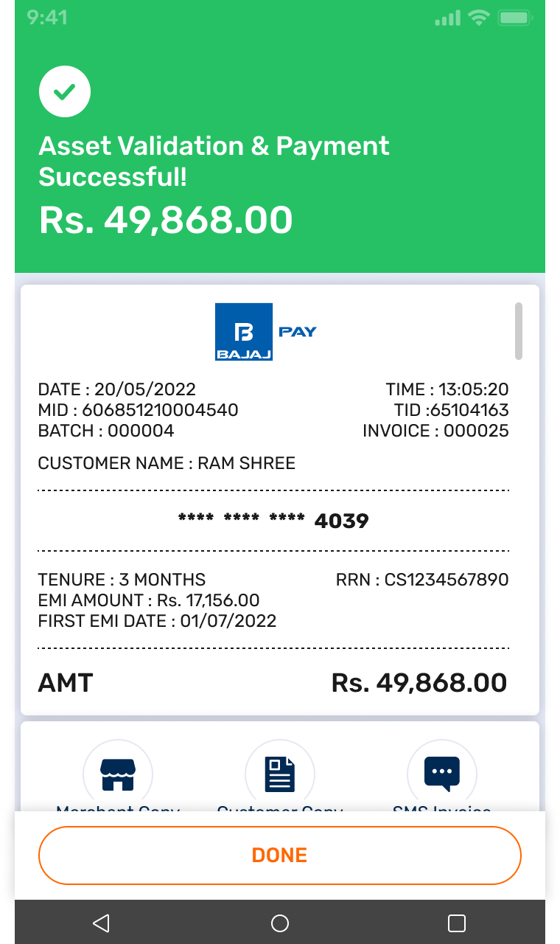
Your Brand EMI payment is now complete.
Now click to print the merchant charge slip and the customer charge slip
Notes:
Your Brand EMI payment is now complete.
Now click to print the merchant charge slip and the customer charge slip

Slide 23
If an SMS is Required click on SMS Invoice and the charge slip will be sent to the customer's mobile number
Notes:
If an SMS is Required click on SMS Invoice and the charge slip will be sent to the customer's mobile number

Slide 24
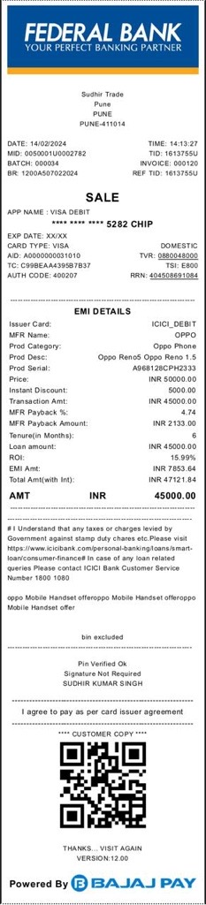
Here is the sample charge slip for your reference
Notes:
Here is the sample charge slip for your reference

