Slide 1

MEET THE TEAM
Ndzalama Mashale
Project Manager
CREATIVE DIVISION
Nthabiseng Mashile
Product Manager
Lungisa Mahlokomane
UX Researcher
Precious Matlou
UI/UX Designer
Data Analyst
Zamanguni Khuzwayo
Notes:
IMAGE
https://www.google.com/search?q=tech%20innovation&udm=2&tbs=rimg:CbcGRpI3hATgYcY5EKS7TDNCsgIAwAIA2AIA4AIA&rlz=1C1PRFI_enZA923ZA923&hl=en&sa=X&ved=0CBoQuIIBahcKEwiAy8Dx1PiMAxUAAAAAHQAAAAAQBw&biw=1536&bih=730&dpr=1.25#vhid=i2Hv7564jl51aM&vssid=mosaic

Slide 2

YOUTH UNEMPLOYMENT IN SOUTH AFRICA AS OF 2024
Problem: High unemployment rates are limiting economic growth and individual well-being.
GCGO Related: Unemployment
Why It Matters:
Unemployment leads to poverty, social instability, and lost potential, harming both individuals and the broader economy. Addressing unemployment is crucial for building inclusive, resilient communities and ensuring sustainable development.
Notes:
https://mybroadband.co.za/news/business/471859-south-africas-unemployment-improves-to-third-highest-in-the-world.html

Slide 3

IMPACTED PERSON
Personal Story:
Thabo has been unemployed for two years, applying for jobs using his phone when he can afford data. He often visits local community centers for free Wi-Fi but finds it difficult to access structured career guidance. He dreams of becoming a graphic designer but lacks the resources to develop his skills.
Challenges:
- Limited access to reliable internet for job applications and skill development
- No formal career mentorship or guidance
- Struggles to create a professional CV and portfolio
Feels discouraged due to repeated job rejections
Thabo represents a realistic subset of the affected population—youth aged 18 to 35 in townships and rural areas who face barriers to employment due to lack of resources and guidance.
Thabo Mokoena
Occupation/Role : Unemployed young adult seeking career opportunities
Demographics
- Age: 24
- Gender: Male
- Location: Mamelodi, Pretoria, South Africa
- Income: No stable income, relies on occasional freelance work
Background & Context
Thabo is a 24-year-old living in a township outside Pretoria.
He completed high school but was unable to afford tertiary education. He has been searching for job opportunities but struggles due to limited internet access and lack of professional guidance.
3
Notes:
https://www.google.com/search?q=high+school+uniform+fo+boys+african&sca_esv=e834d918a624f451&rlz=1C1PRFI_enZA923ZA923&udm=2&biw=1536&bih=730&sxsrf=AHTn8zr9iKxoaMWNTck7sbH8Kb8umqfQNg%3A1745757955236&ei=AycOaOGZDpLi7_UPye708QU&ved=0ahUKEwihp6SWn_iMAxUS8bsIHUk3PV4Q4dUDCBQ&uact=5&oq=high+school+uniform+fo+boys+african&gs_lp=EgNpbWciI2hpZ2ggc2Nob29sIHVuaWZvcm0gZm8gYm95cyBhZnJpY2FuSJk0ULoIWPAwcAJ4AJABAJgBogKgAZAdqgEEMi0xNLgBA8gBAPgBAZgCAaACiQLCAgcQIxgnGMkCmAMA4gMFEgExIECIBgGSBwMyLTGgB-QIsgcDMi0xuAeJAg&sclient=img#vhid=0OQGLGGcILSW4M&vssid=mosaic

Slide 4


YOUTH UNEMPLOYMENT IN SOUTH AFRICA AS OF 2024
The youth unemployment rate (ages 15–24) stood at 59.6% in the fourth quarter of 2024, reflecting a slight decrease from 60.2% in the third quarter
Notes:
SOURCE:
Trading Economics. (2024). South Africa Youth Unemployment Rate. Retrieved from https://tradingeconomics.com/south-africa/youth-unemployment-rate
SOURCES
Trading Economics. (2024). South Africa Youth Unemployment Rate. Retrieved from https://tradingeconomics.com/south-africa/youth-unemployment-rate
https://www.google.com/search?q=unemployment+images&rlz=1C1PRFI_enZA923ZA923&oq=unemployment+images&gs_lcrp=EgZjaHJvbWUyCQgAEEUYORiABDIHCAEQABiABDIHCAIQABiABDIHCAMQABiABDIHCAQQABiABDIHCAUQABiABDIICAYQABgWGB4yCAgHEAAYFhgeMggICBAAGBYYHjIICAkQABgWGB7SAQg2OTkxajBqN6gCALACAA&sourceid=chrome&ie=UTF-8#vhid=TDqauDU8_ygdlM&vssid=_cicOaKzEM4GChbIPnc-gIQ_38
https://www.educba.com/essay-on-unemployment/

Slide 5
THE UNEMPLOYMENT RATE IN SOUTH AFRICA
2023 VS 2024
Notes:
SOURCE
Statistics South Africa. (2023). Quarterly Labour Force Survey Q4 2023. Retrieved from
https://www.statssa.gov.za/publications/P0211/QLFS_Q4_2023.pdf
Statistics South Africa. (2024). Quarterly Labour Force Survey Q4 2024. Retrieved from
https://www.statssa.gov.za/publications/P0211/Media%20Release%20QLFS%20Q4%202024.pdf

Slide 6
UNEMPLOYMENT RATES ACROSS DIFFERENT EDUCATION LEVELS
Notes:
Sources
Statistics South Africa. (2024). Quarterly Labour Force Survey Q4 2024. Retrieved from
https://www.statssa.gov.za/publications/P0211/Media%20Release%20QLFS%20Q4%202024.pdf
Human Sciences Research Council (HSRC). (2021). Education and Employment in South Africa: An Analysis of Unemployment by Education Level. Retrieved from
https://www.hsrc.ac.za/en/research-data/ktree-doc/2491
OECD. (2020). Education at a Glance: South Africa. Retrieved from
https://www.oecd.org/education/south-africa-education-at-a-glance-2020.pdf

Slide 7
POSSIBLE SOLUTION TO THE GCGO PROBLEM
Portable Career Pods – Compact, solar-powered booths that pop up in rural or township areas and offer free Wi-Fi, virtual job training, CV creation tools, and live chats with real career advisors via hologram.
Real-Time Support: Live chats with career advisors (even via hologram) offer personalized guidance, which can significantly improve job-seeking strategies, application quality, and interview readiness.
Accessibility: The Pods are mobile and solar-powered, meaning they can be deployed anywhere without needing existing infrastructure.
Skill Development: Free virtual job training provides critical upskilling opportunities, enabling individuals to become more employable in current and future job markets.
Practical Tools: CV creation tools and Wi-Fi access empower users to apply for jobs immediately, increasing their chances of finding employment faster.

Slide 8
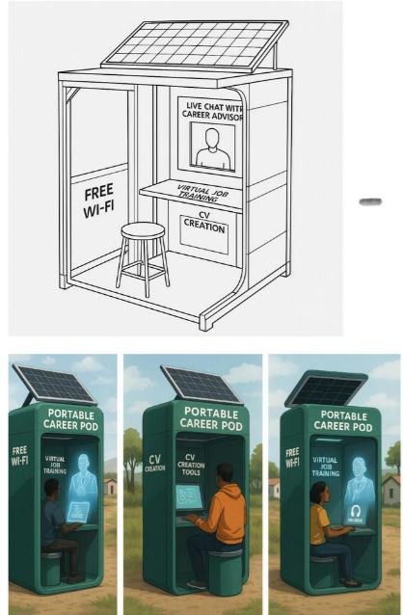
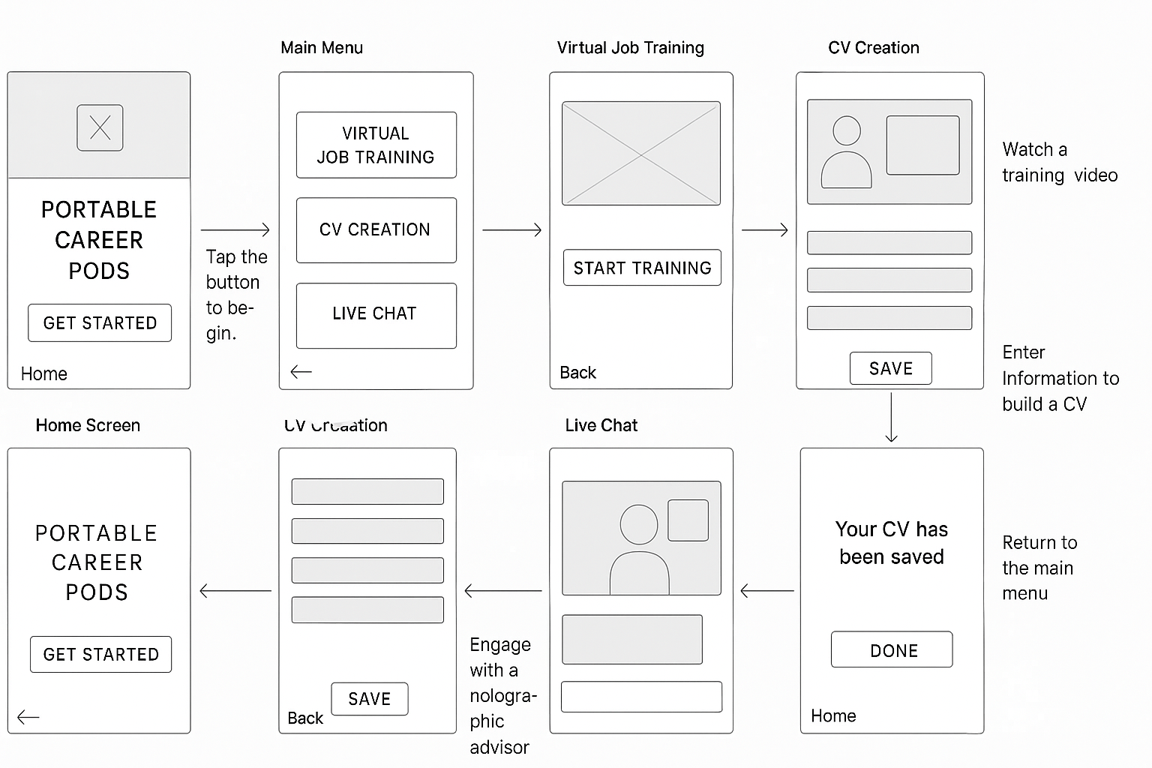
POSSIBLE SOLUTION FOR UNEMPLOYMENT RATE
User interface of the Portable Career POD
Prototype 3D structure of Portable Career POD

Slide 9

CHALLENGES OF THE USER INTERFACE FOR THE PORTABLE CAREER POD
1. No Offline Options:
The Pod’s internet went down, users were left without any way to continue learning or preparing their CVs.
2. Intimidation by Technology
First-time users found the high-tech hologram environment intimidating
Notes:
Image:
https://medium.com/@rasheedamir/what-are-challenges-of-microservices-architecture-136689781fde

Slide 10

POSSIBLE SOLUTIONS
1.Downloadable offline training modules and basic CV templates that don’t require internet.
2. A "basic mode" with simple voice and touch guidance to ease them into using the system without feeling overwhelmed.
Notes:
Image:
https://www.gpestratagem.com/blog/2016/1/29/sometimes-solutions-can-be-just-as-problematic

Slide 11

ACTION ITEMS
✅ Deploy 10,000+ Portable Career Pods
✅ Train and place 1 million+ people into jobs or self-employment within 5 years
✅ Help communities move from unemployment to empowerment.
Notes:
Image:
https://westsidenewsny.com/news/2023-01-15/veteran-organizations-invited-toapply-for-capital-program-funding/

Slide 12

WHY THE PORTABLE CAREER POD AS A CHOSEN SOLUTION?
In many rural and township communities, talented individuals are trapped by barriers like poor internet access, lack of skills training, and little connection to real job markets.
The Portable Career Pods are designed to break those barriers by delivering free Wi-Fi, virtual job training, CV creation tools, and live career coaching directly to the people who need them most — powered by solar energy and smart technology.
This solution matters because it transforms career access from a distant dream into a reachable, tangible reality. By connecting people with the tools, skills, and support they need to succeed, the Pods empower individuals to build better futures for themselves and their communities.
Ultimately, the Portable Career Pods are more than just technology — they are gateways to dignity, hope, and economic transformation.
Notes:
IMAGE: https://nairametrics.com/2015/08/26/find-out-why-ecobank-was-ordered-to-pay-skye-bank-n629m/

Slide 13


Notes:
Image:https://www.freepik.com/free-photos-vectors/thank-you
https://www.freepik.com/free-photos-vectors/thank-you

