Slide 1


Ethnic Groups
Mercy Linder

Slide 2
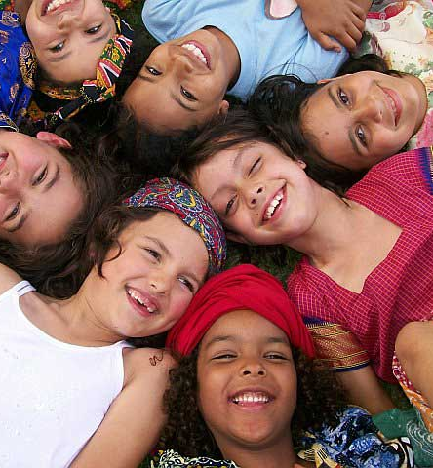
Everyday Ethnic Groups
Christianity
Hispanics
Caucasians
African Americans
This Photo by Unknown author is licensed under CC BY-NC-ND.

Slide 3
Concepts/Theories
Multiethnic- A society composed of numerous cultural, racial, and religious groups.
Ethnocentrism- The belief by members of a group that their culture is superior to others.
Ideology- A set of beliefs and values that explain, rationalize, and justify inequalities in wealth, power, and privilege.

Slide 4

Why These Concepts?
This Photo by Unknown author is licensed under CC BY-SA-NC.

