Slide 1
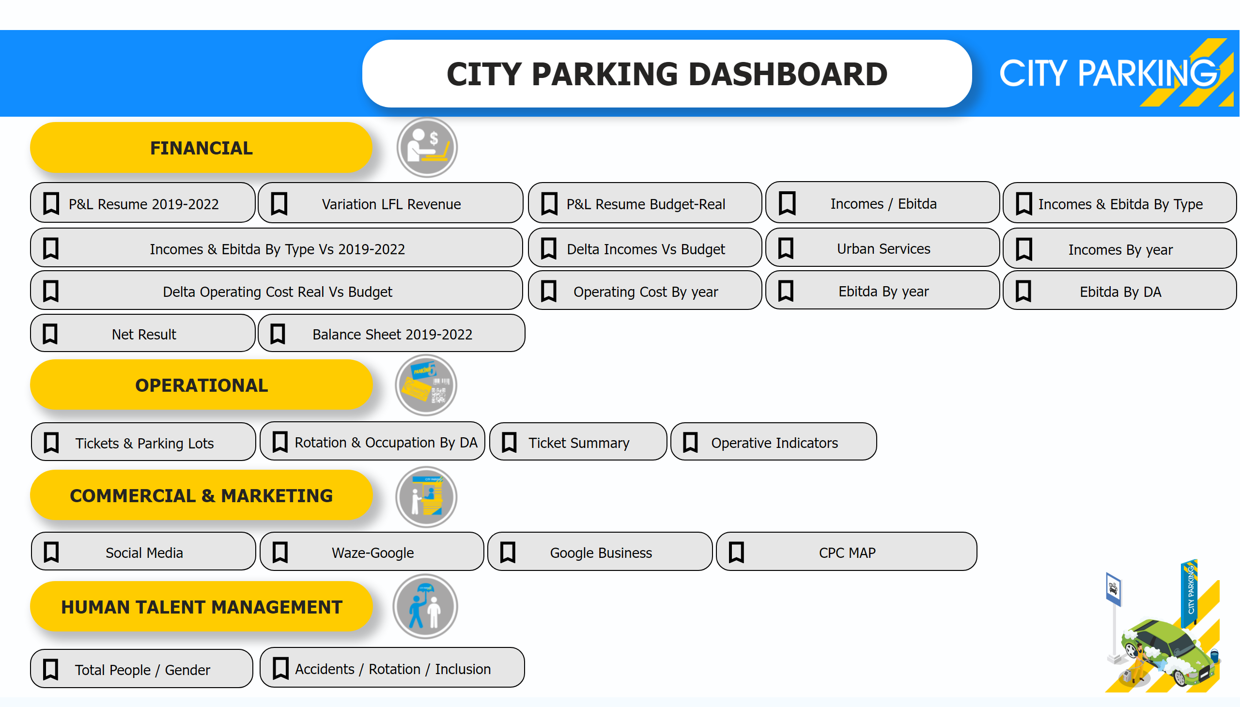
Main Page
Notes:
textbox
No alt text provided
actionButton
No alt text provided
textbox
No alt text provided
textbox
No alt text provided
textbox
No alt text provided
textbox
No alt text provided
actionButton
No alt text provided
actionButton
No alt text provided
GHGH
No alt text provided
actionButton
No alt text provided
actionButton
No alt text provided
actionButton
No alt text provided
actionButton
No alt text provided
actionButton
No alt text provided
actionButton
No alt text provided
actionButton
No alt text provided
actionButton
No alt text provided
actionButton
No alt text provided
actionButton
No alt text provided
actionButton
No alt text provided
actionButton
No alt text provided
actionButton
No alt text provided
actionButton
No alt text provided
actionButton
No alt text provided
actionButton
No alt text provided
actionButton
No alt text provided
shape
No alt text provided
image
No alt text provided
image
No alt text provided
image
No alt text provided
image
No alt text provided
image
No alt text provided
image
No alt text provided
actionButton
No alt text provided
slicer
No alt text provided
actionButton
No alt text provided
actionButton
No alt text provided
actionButton
No alt text provided
image
No alt text provided

Slide 2
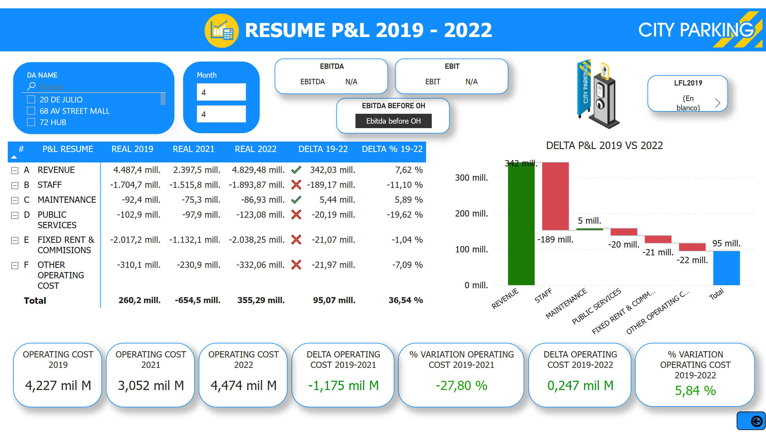
P&L Resume 2019-2022
Notes:
image
No alt text provided
% VARIATION OPERATING COST 2019-2022
No alt text provided
DELTA OPERATING COST 2019-2022
No alt text provided
OPERATING COST 2022
No alt text provided
LFL2019
No alt text provided
slicer
No alt text provided
DELTA OPERATING COST 2019-2021
No alt text provided
image
No alt text provided
shape
No alt text provided
image
No alt text provided
actionButton
No alt text provided
EBITDA
No alt text provided
OPERATING COST 2021
No alt text provided
% VARIATION OPERATING COST 2019-2021
No alt text provided
OPERATING COST 2019
No alt text provided
EBIT
No alt text provided
DELTA P&L 2019 VS 2022
No alt text provided
pivotTable
No alt text provided
EBITDA BEFORE OH
No alt text provided
textbox
No alt text provided
slicer
No alt text provided
slicer
No alt text provided

Slide 3
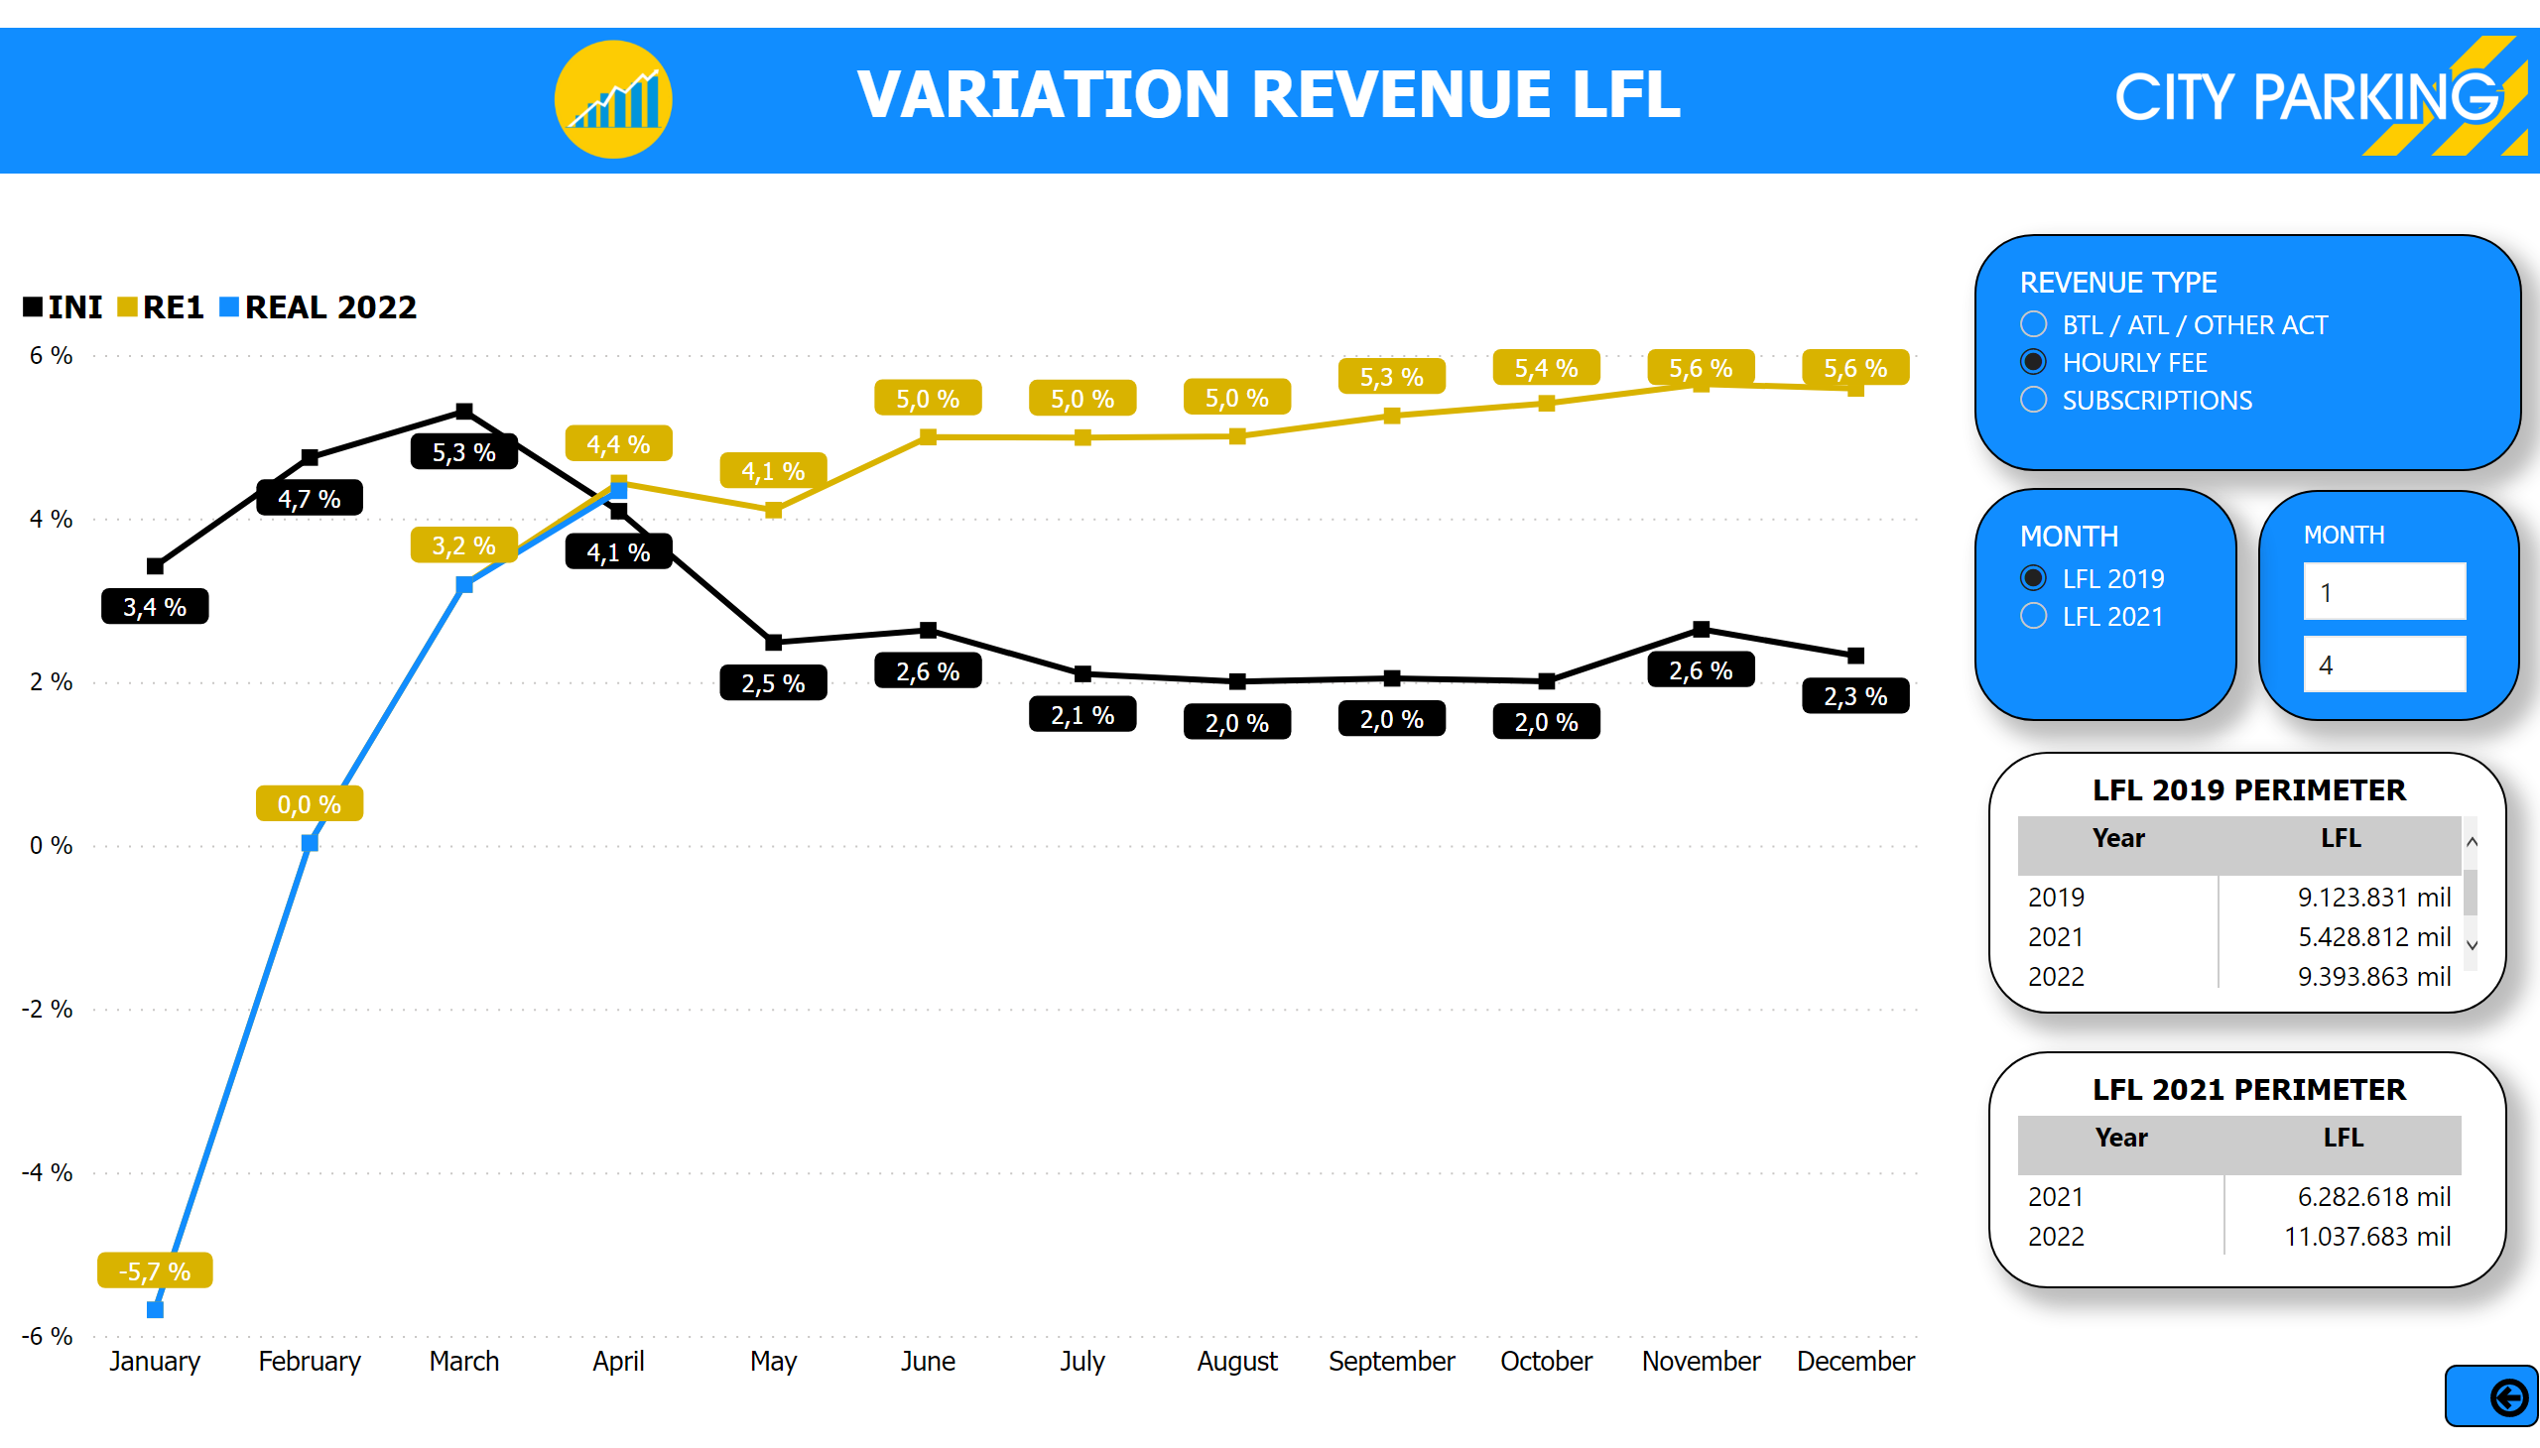
Variation Revenue LFL
Notes:
textbox
No alt text provided
shape
No alt text provided
image
No alt text provided
actionButton
No alt text provided
slicer
No alt text provided
VARIATION LFL REVENUE Vs 2019
No alt text provided
Month
No alt text provided
Month
No alt text provided
image
No alt text provided
Month
No alt text provided
LFL 2019 PERIMETER
No alt text provided
LFL 2021 PERIMETER
No alt text provided

Slide 4
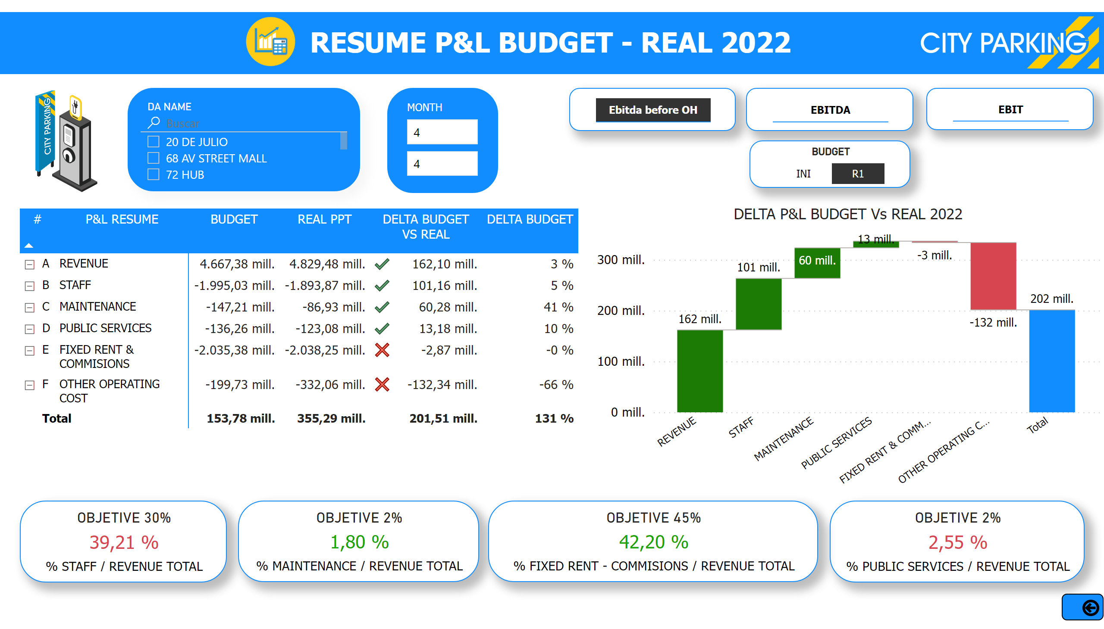
P&L Resume Budget -REAL
Notes:
slicer
No alt text provided
slicer
No alt text provided
textbox
No alt text provided
slicer
No alt text provided
pivotTable
No alt text provided
DELTA P&L BUDGET Vs REAL 2022
No alt text provided
OBJETIVE 30%
No alt text provided
slicer
No alt text provided
OBJETIVE 2%
No alt text provided
OBJETIVE 2%
No alt text provided
OBJETIVE 45%
No alt text provided
slicer
No alt text provided
actionButton
No alt text provided
image
No alt text provided
shape
No alt text provided
image
No alt text provided
slicer
No alt text provided
BUDGET
No alt text provided
image
No alt text provided

Slide 5
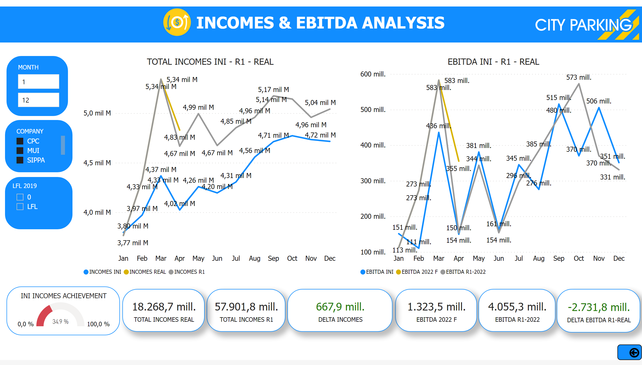
Incomes / Ebitda
Notes:
TOTAL INCOMES INI - R1 - REAL
No alt text provided
EBITDA INI - R1 - REAL
No alt text provided
card
No alt text provided
card
No alt text provided
slicer
No alt text provided
textbox
No alt text provided
card
No alt text provided
card
No alt text provided
INI INCOMES ACHIEVEMENT
No alt text provided
card
No alt text provided
actionButton
No alt text provided
image
No alt text provided
shape
No alt text provided
image
No alt text provided
slicer
No alt text provided
slicer
No alt text provided
slicer
No alt text provided
LFL 2019
No alt text provided
card
No alt text provided

Slide 6
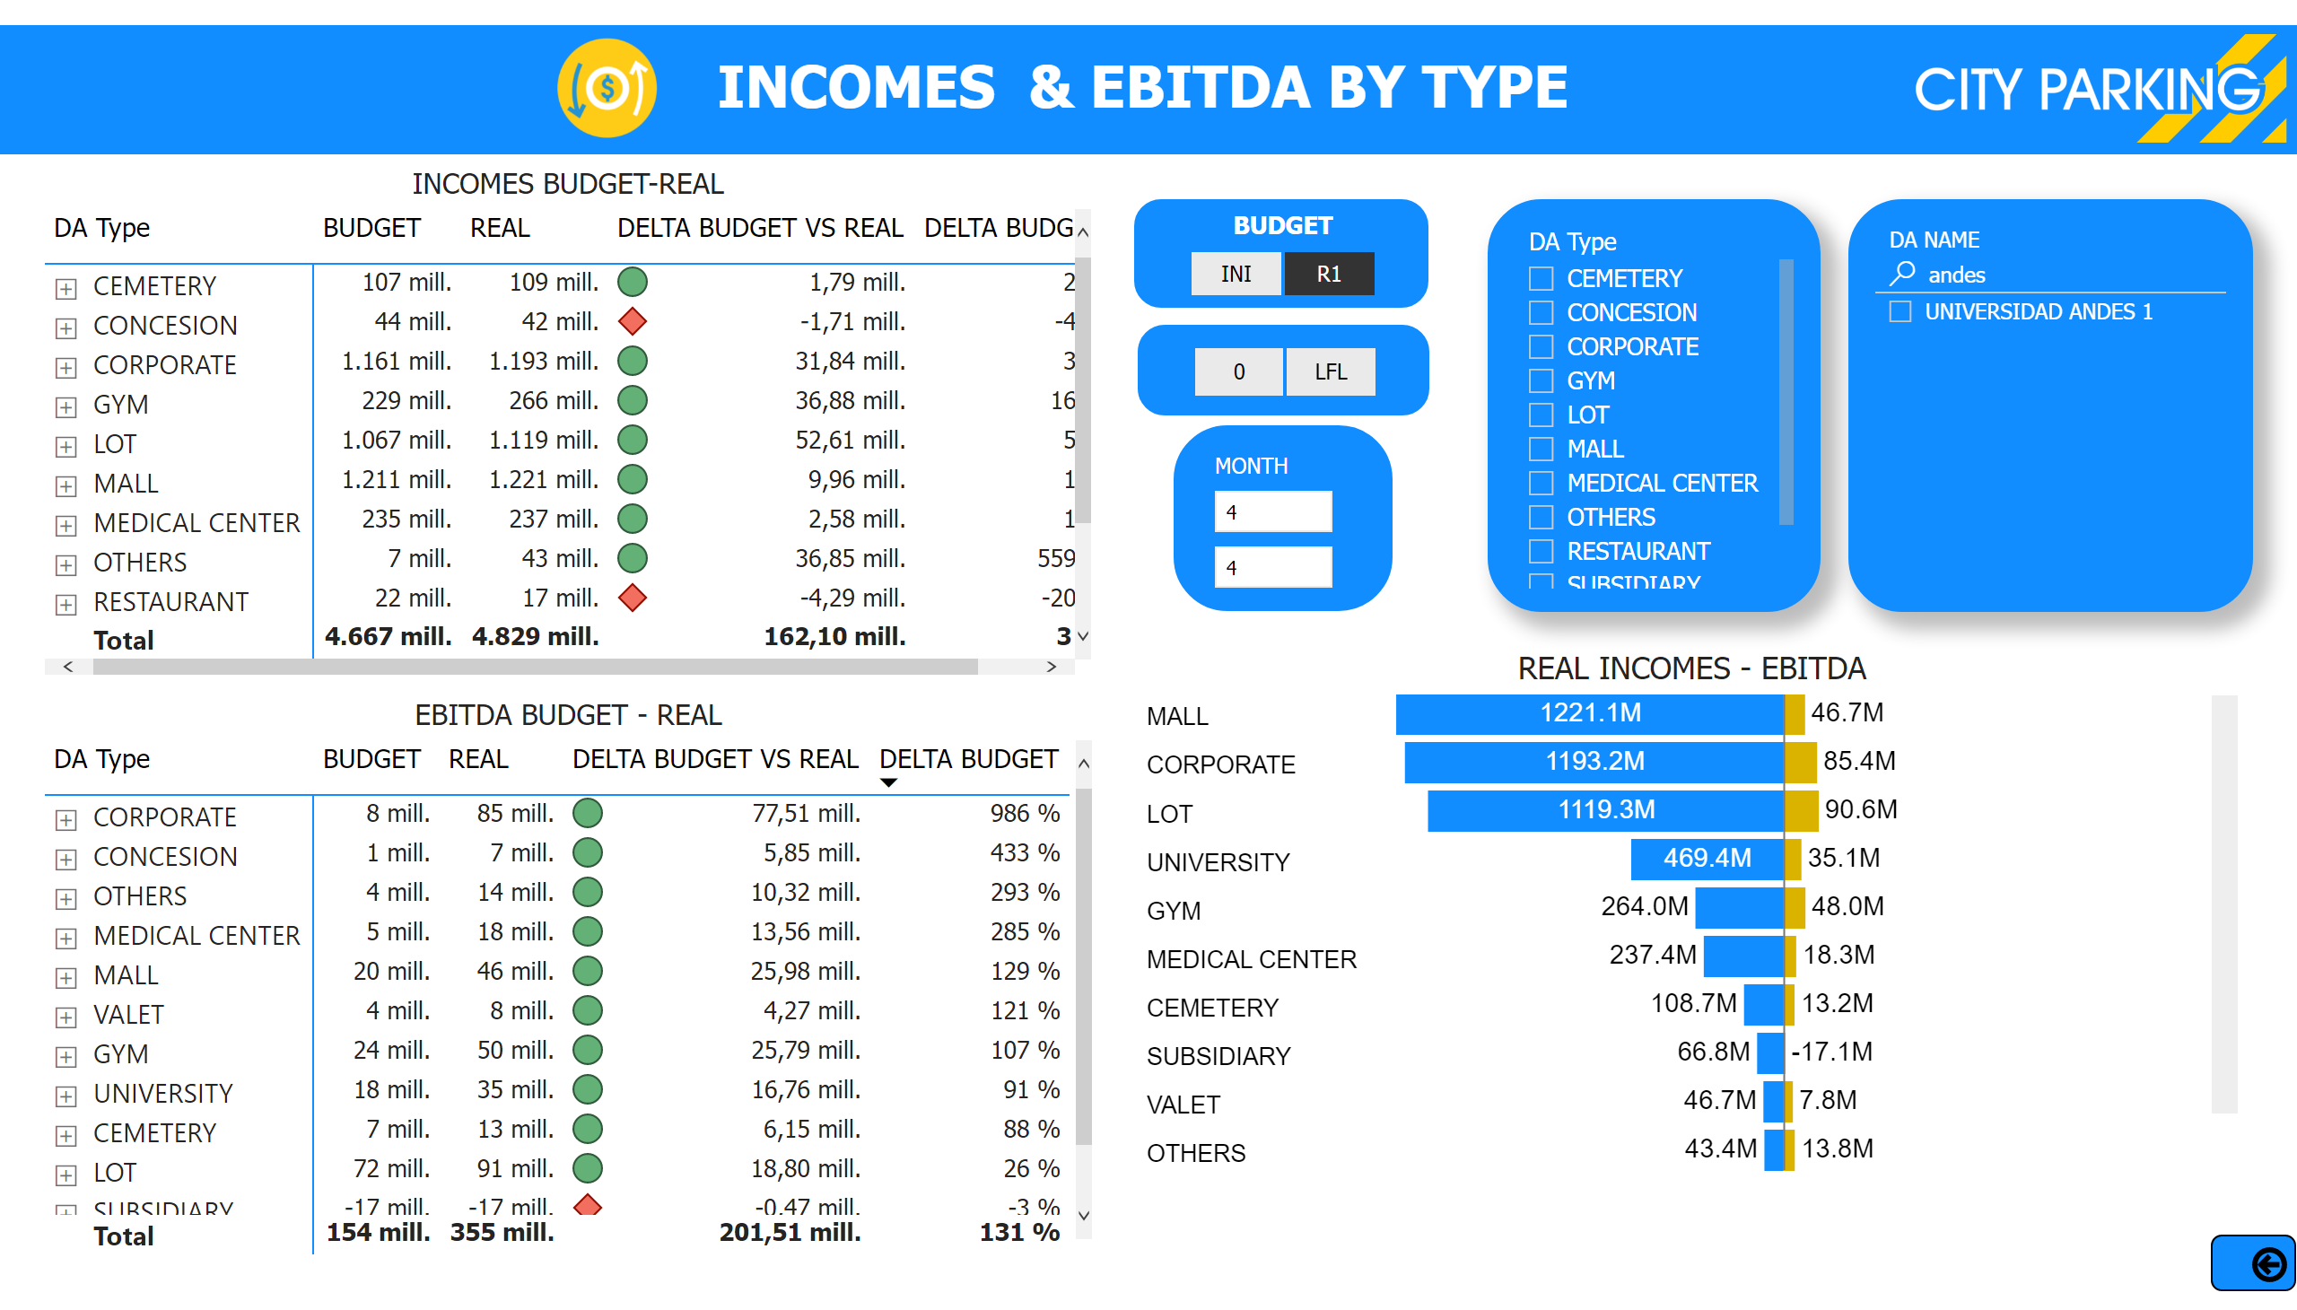
Incomes & Ebitda By Type vs Budget
Notes:
INCOMES BUDGET-REAL
No alt text provided
EBITDA BUDGET - REAL
No alt text provided
slicer
No alt text provided
REAL INCOMES - EBITDA
No alt text provided
slicer
No alt text provided
slicer
No alt text provided
actionButton
No alt text provided
textbox
No alt text provided
image
No alt text provided
shape
No alt text provided
image
No alt text provided
BUDGET
No alt text provided
LFL 2019
No alt text provided

Slide 7
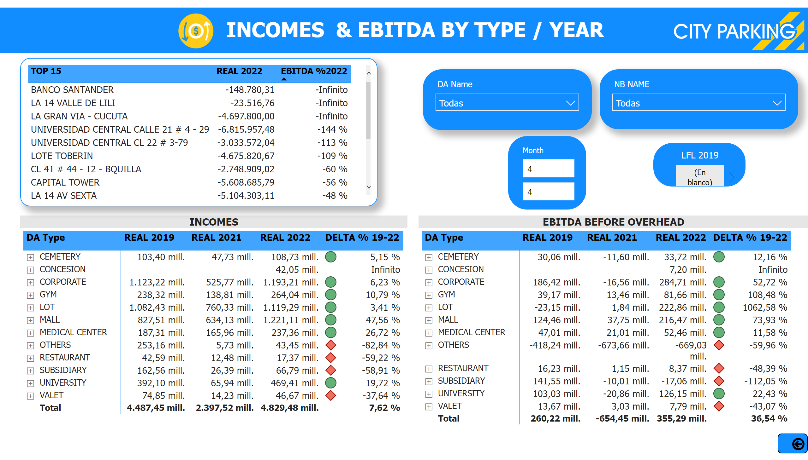
Incomes & Ebitda By Type Vs 2019-2022
Notes:
INCOMES
No alt text provided
slicer
No alt text provided
slicer
No alt text provided
actionButton
No alt text provided
textbox
No alt text provided
image
No alt text provided
shape
No alt text provided
image
No alt text provided
LFL 2019
No alt text provided
EBITDA BEFORE OVERHEAD
No alt text provided
slicer
No alt text provided
tableEx
No alt text provided

Slide 8
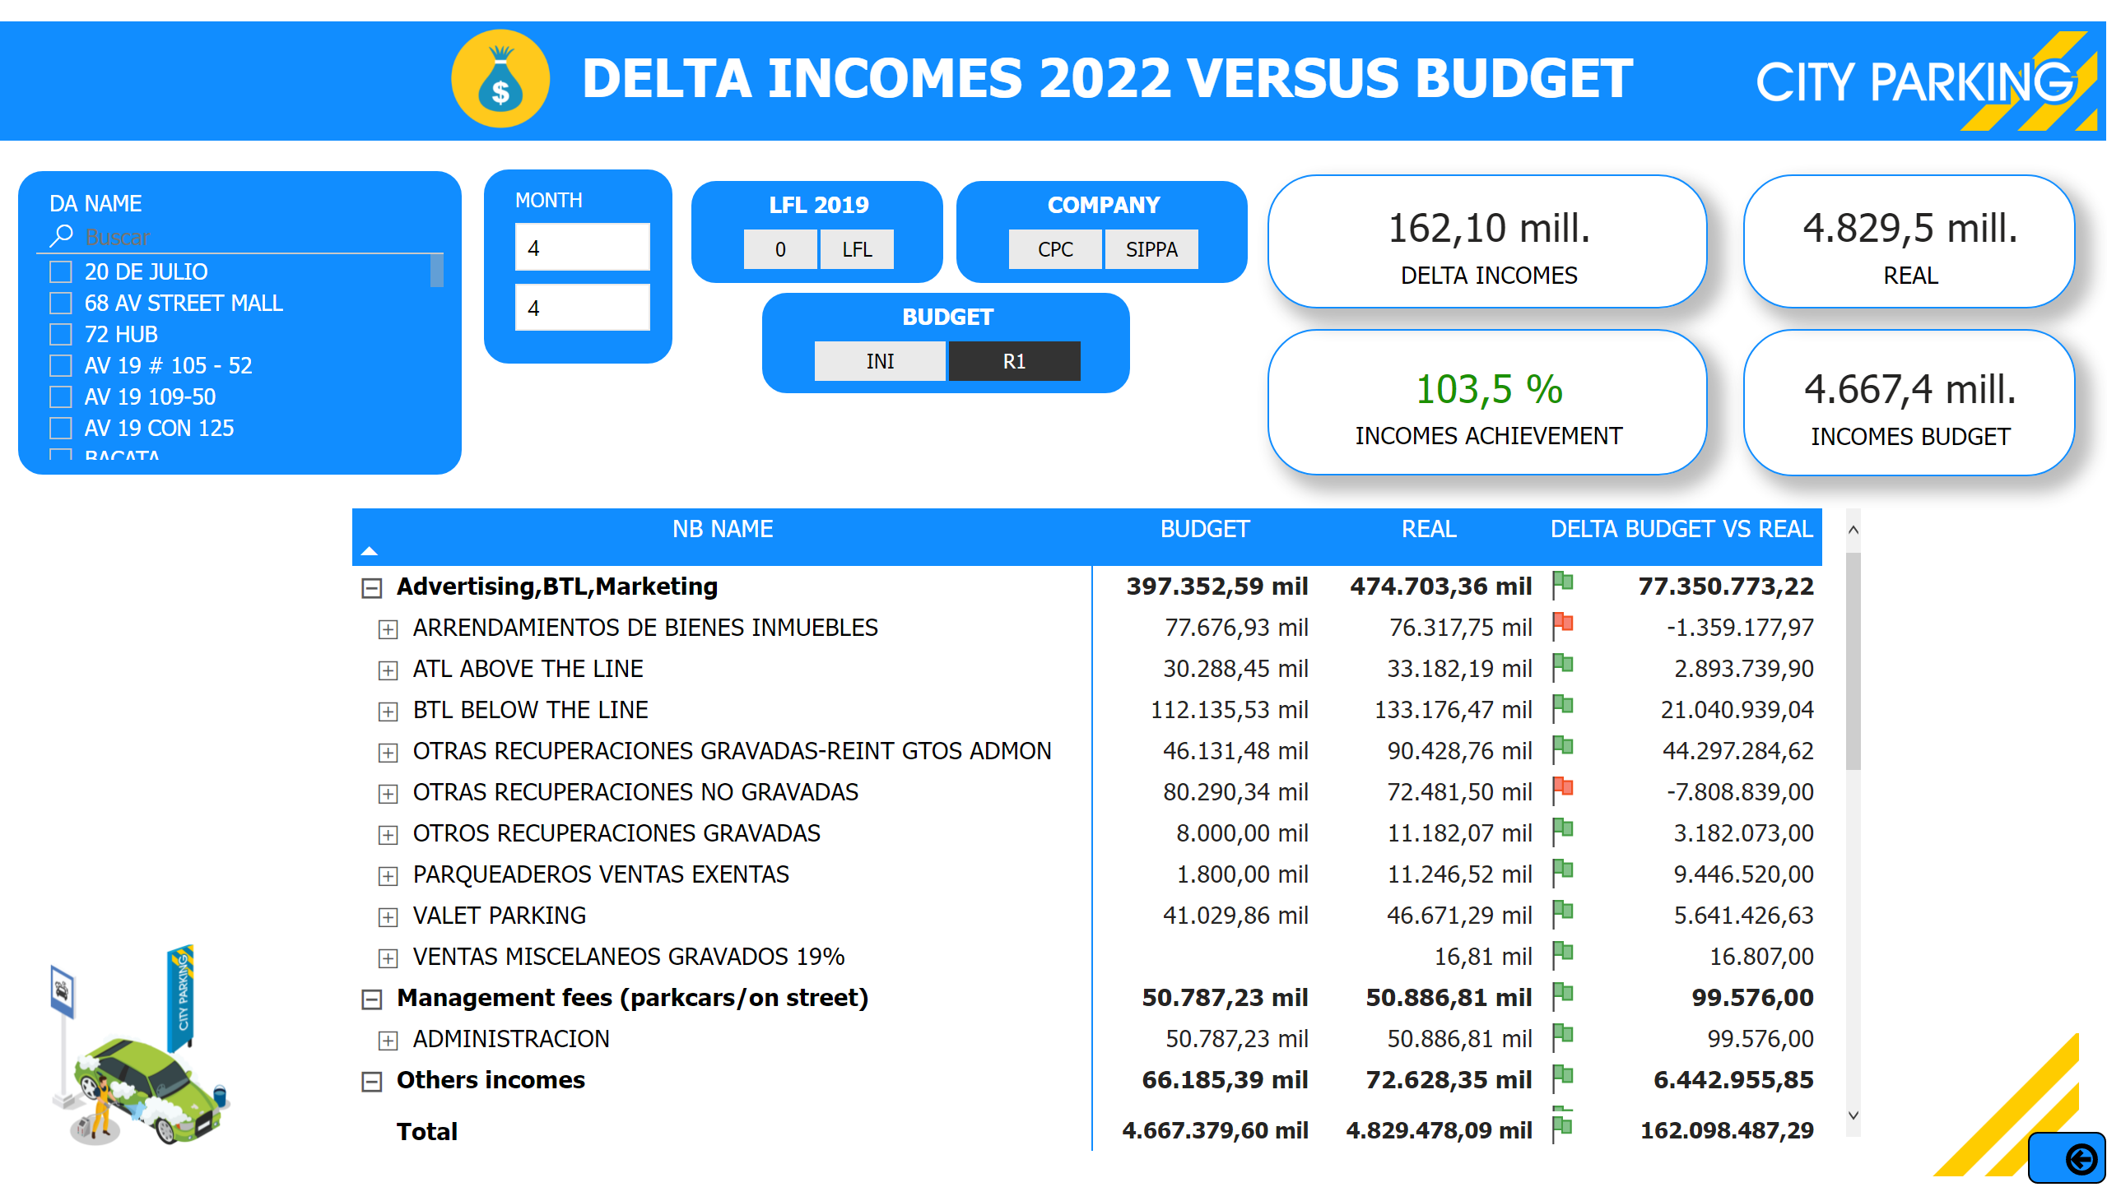
Delta Incomes Vs Budget
Notes:
card
No alt text provided
card
No alt text provided
card
No alt text provided
TOTAL INCOMES ACHIEVEMENT
No alt text provided
slicer
No alt text provided
textbox
No alt text provided
image
No alt text provided
shape
No alt text provided
image
No alt text provided
slicer
No alt text provided
actionButton
No alt text provided
LFL 2019
No alt text provided
COMPANY
No alt text provided
pivotTable
No alt text provided
BUDGET
No alt text provided
image
No alt text provided
image
No alt text provided

Slide 9
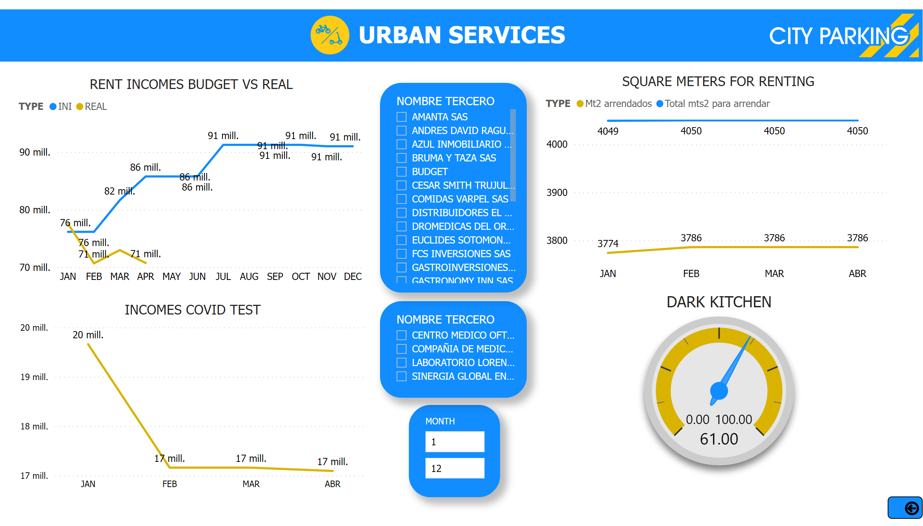
Urban Services
Notes:
slicer
No alt text provided
RENT INCOMES BUDGET VS REAL
No alt text provided
textbox
No alt text provided
INCOMES COVID TEST
No alt text provided
slicer
No alt text provided
slicer
No alt text provided
SQUARE METERS FOR RENTING
No alt text provided
DARK KITCHEN
No alt text provided
image
No alt text provided
shape
No alt text provided
image
No alt text provided
actionButton
No alt text provided
slicer
No alt text provided

Slide 10
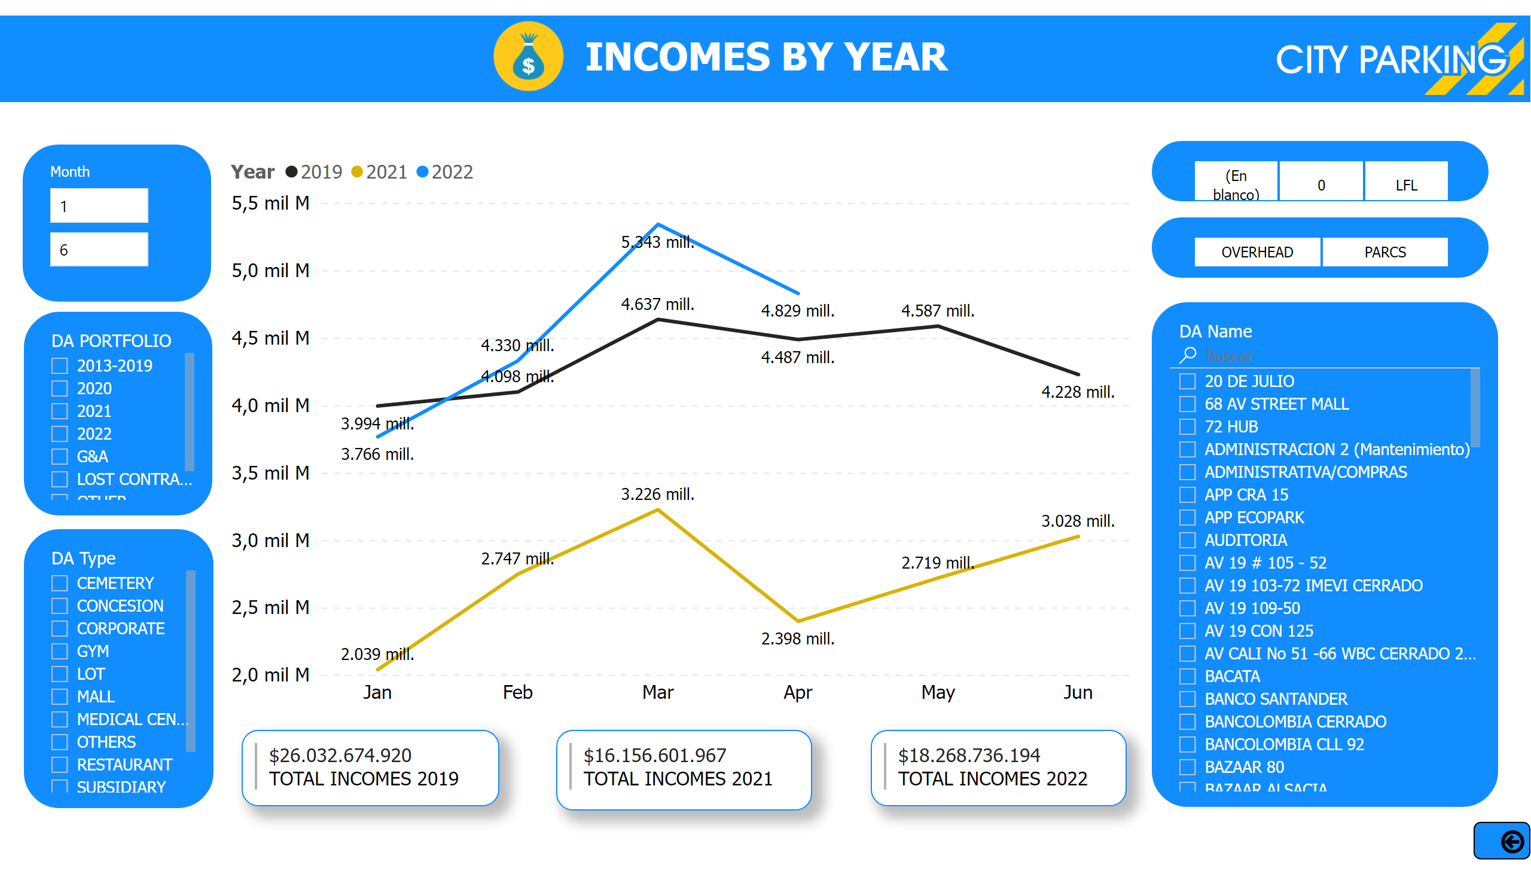
Incomes By year
Notes:
lineChart
No alt text provided
slicer
No alt text provided
slicer
No alt text provided
slicer
No alt text provided
multiRowCard
No alt text provided
multiRowCard
No alt text provided
multiRowCard
No alt text provided
textbox
No alt text provided
slicer
No alt text provided
slicer
No alt text provided
image
No alt text provided
image
No alt text provided
shape
No alt text provided
actionButton
No alt text provided
LFL 2019
No alt text provided
slicer
No alt text provided

Slide 11
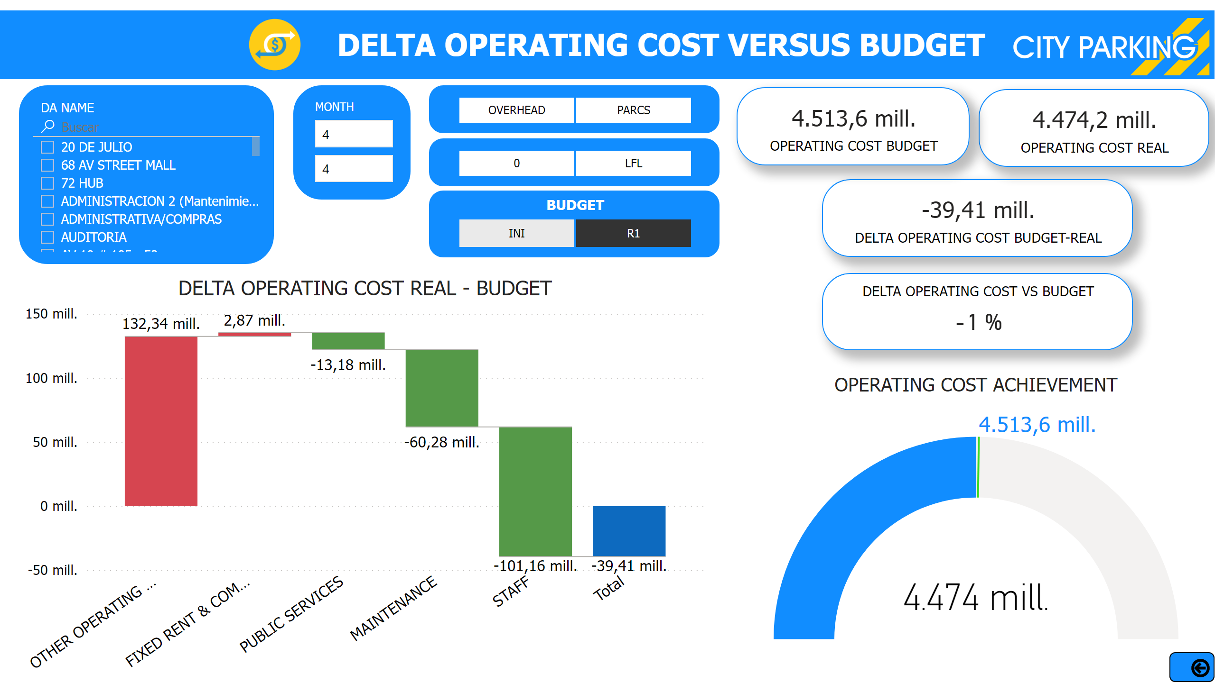
Delta Operating Cost Real Vs Budget
Notes:
card
No alt text provided
card
No alt text provided
DELTA OPERATING COST REAL - BUDGET
No alt text provided
card
No alt text provided
OPERATING COST ACHIEVEMENT
No alt text provided
DELTA OPERATING COST VS BUDGET
No alt text provided
slicer
No alt text provided
LFL 2019
No alt text provided
textbox
No alt text provided
slicer
No alt text provided
image
No alt text provided
shape
No alt text provided
image
No alt text provided
actionButton
No alt text provided
slicer
No alt text provided
BUDGET
No alt text provided

Slide 12
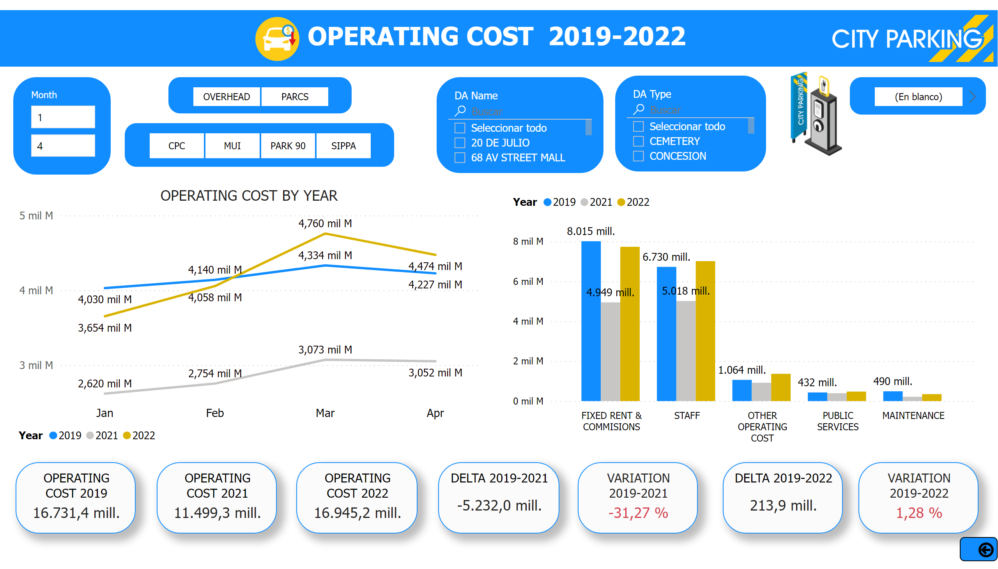
Operating Cost By Year
Notes:
OPERATING COST 2022
No alt text provided
DELTA 2019-2022
No alt text provided
slicer
No alt text provided
OPERATING COST BY YEAR
No alt text provided
OPERATING COST 2019
No alt text provided
VARIATION 2019-2022
No alt text provided
textbox
No alt text provided
OPERATING COST Year
No alt text provided
slicer
No alt text provided
OPERATING COST 2021
No alt text provided
slicer
No alt text provided
DELTA 2019-2021
No alt text provided
VARIATION 2019-2021
No alt text provided
slicer
No alt text provided
slicer
No alt text provided
LFL 2019
No alt text provided
image
No alt text provided
shape
No alt text provided
image
No alt text provided
actionButton
No alt text provided
slicer
No alt text provided
image
No alt text provided

Slide 13
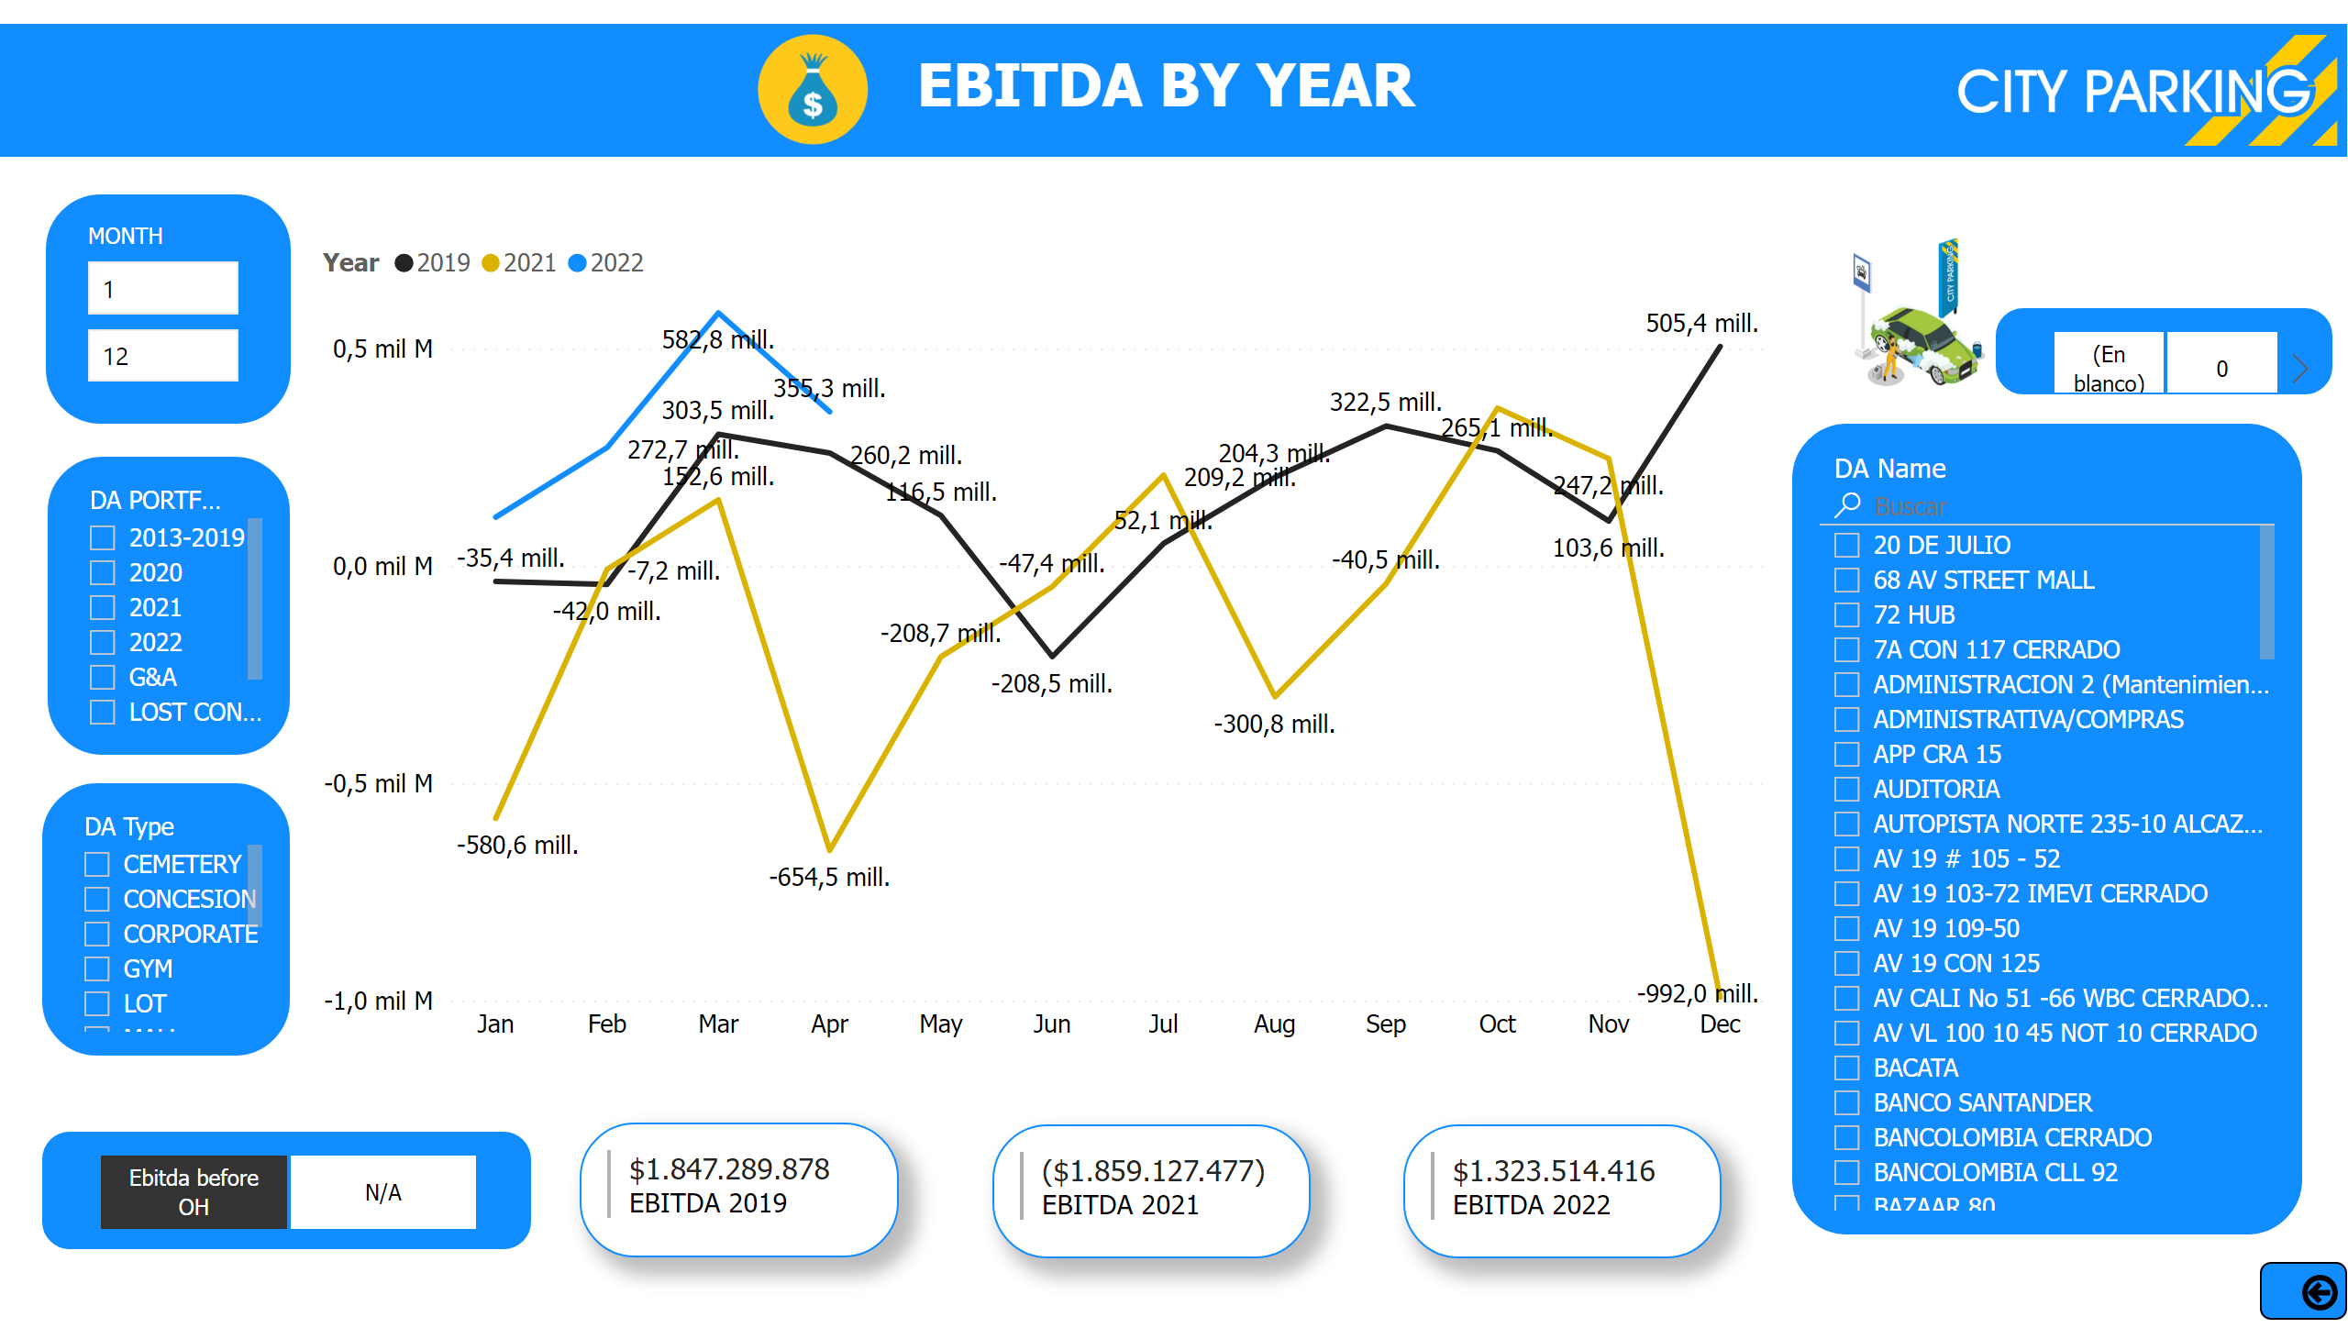
Ebitda By year
Notes:
lineChart
No alt text provided
slicer
No alt text provided
slicer
No alt text provided
multiRowCard
No alt text provided
multiRowCard
No alt text provided
multiRowCard
No alt text provided
slicer
No alt text provided
slicer
No alt text provided
slicer
No alt text provided
textbox
No alt text provided
image
No alt text provided
shape
No alt text provided
actionButton
No alt text provided
image
No alt text provided
slicer
No alt text provided
LFL 2019
No alt text provided
image
No alt text provided

Slide 14
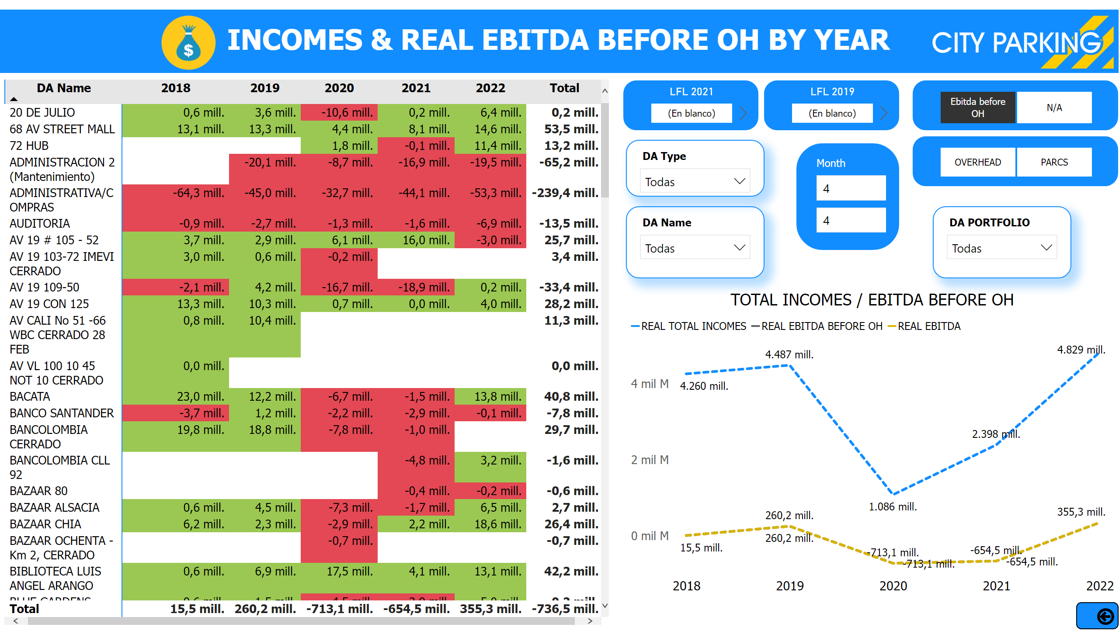
Ebitda By DA
Notes:
slicer
No alt text provided
pivotTable
No alt text provided
slicer
No alt text provided
TOTAL INCOMES / EBITDA BEFORE OH
No alt text provided
slicer
No alt text provided
textbox
No alt text provided
slicer
No alt text provided
slicer
No alt text provided
slicer
No alt text provided
image
No alt text provided
shape
No alt text provided
image
No alt text provided
actionButton
No alt text provided
MONTH
No alt text provided
LFL 2019
No alt text provided
LFL 2021
No alt text provided

Slide 15
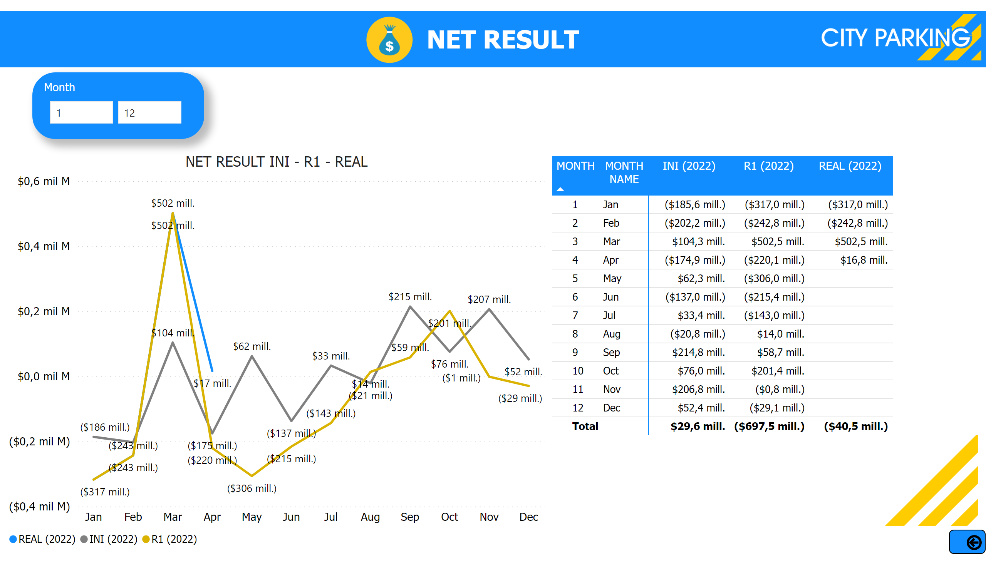
Net Result
Notes:
NET RESULT INI - R1 - REAL
No alt text provided
Month
No alt text provided
pivotTable
No alt text provided
textbox
No alt text provided
image
No alt text provided
shape
No alt text provided
image
No alt text provided
image
No alt text provided
actionButton
No alt text provided
slicer
No alt text provided

Slide 16
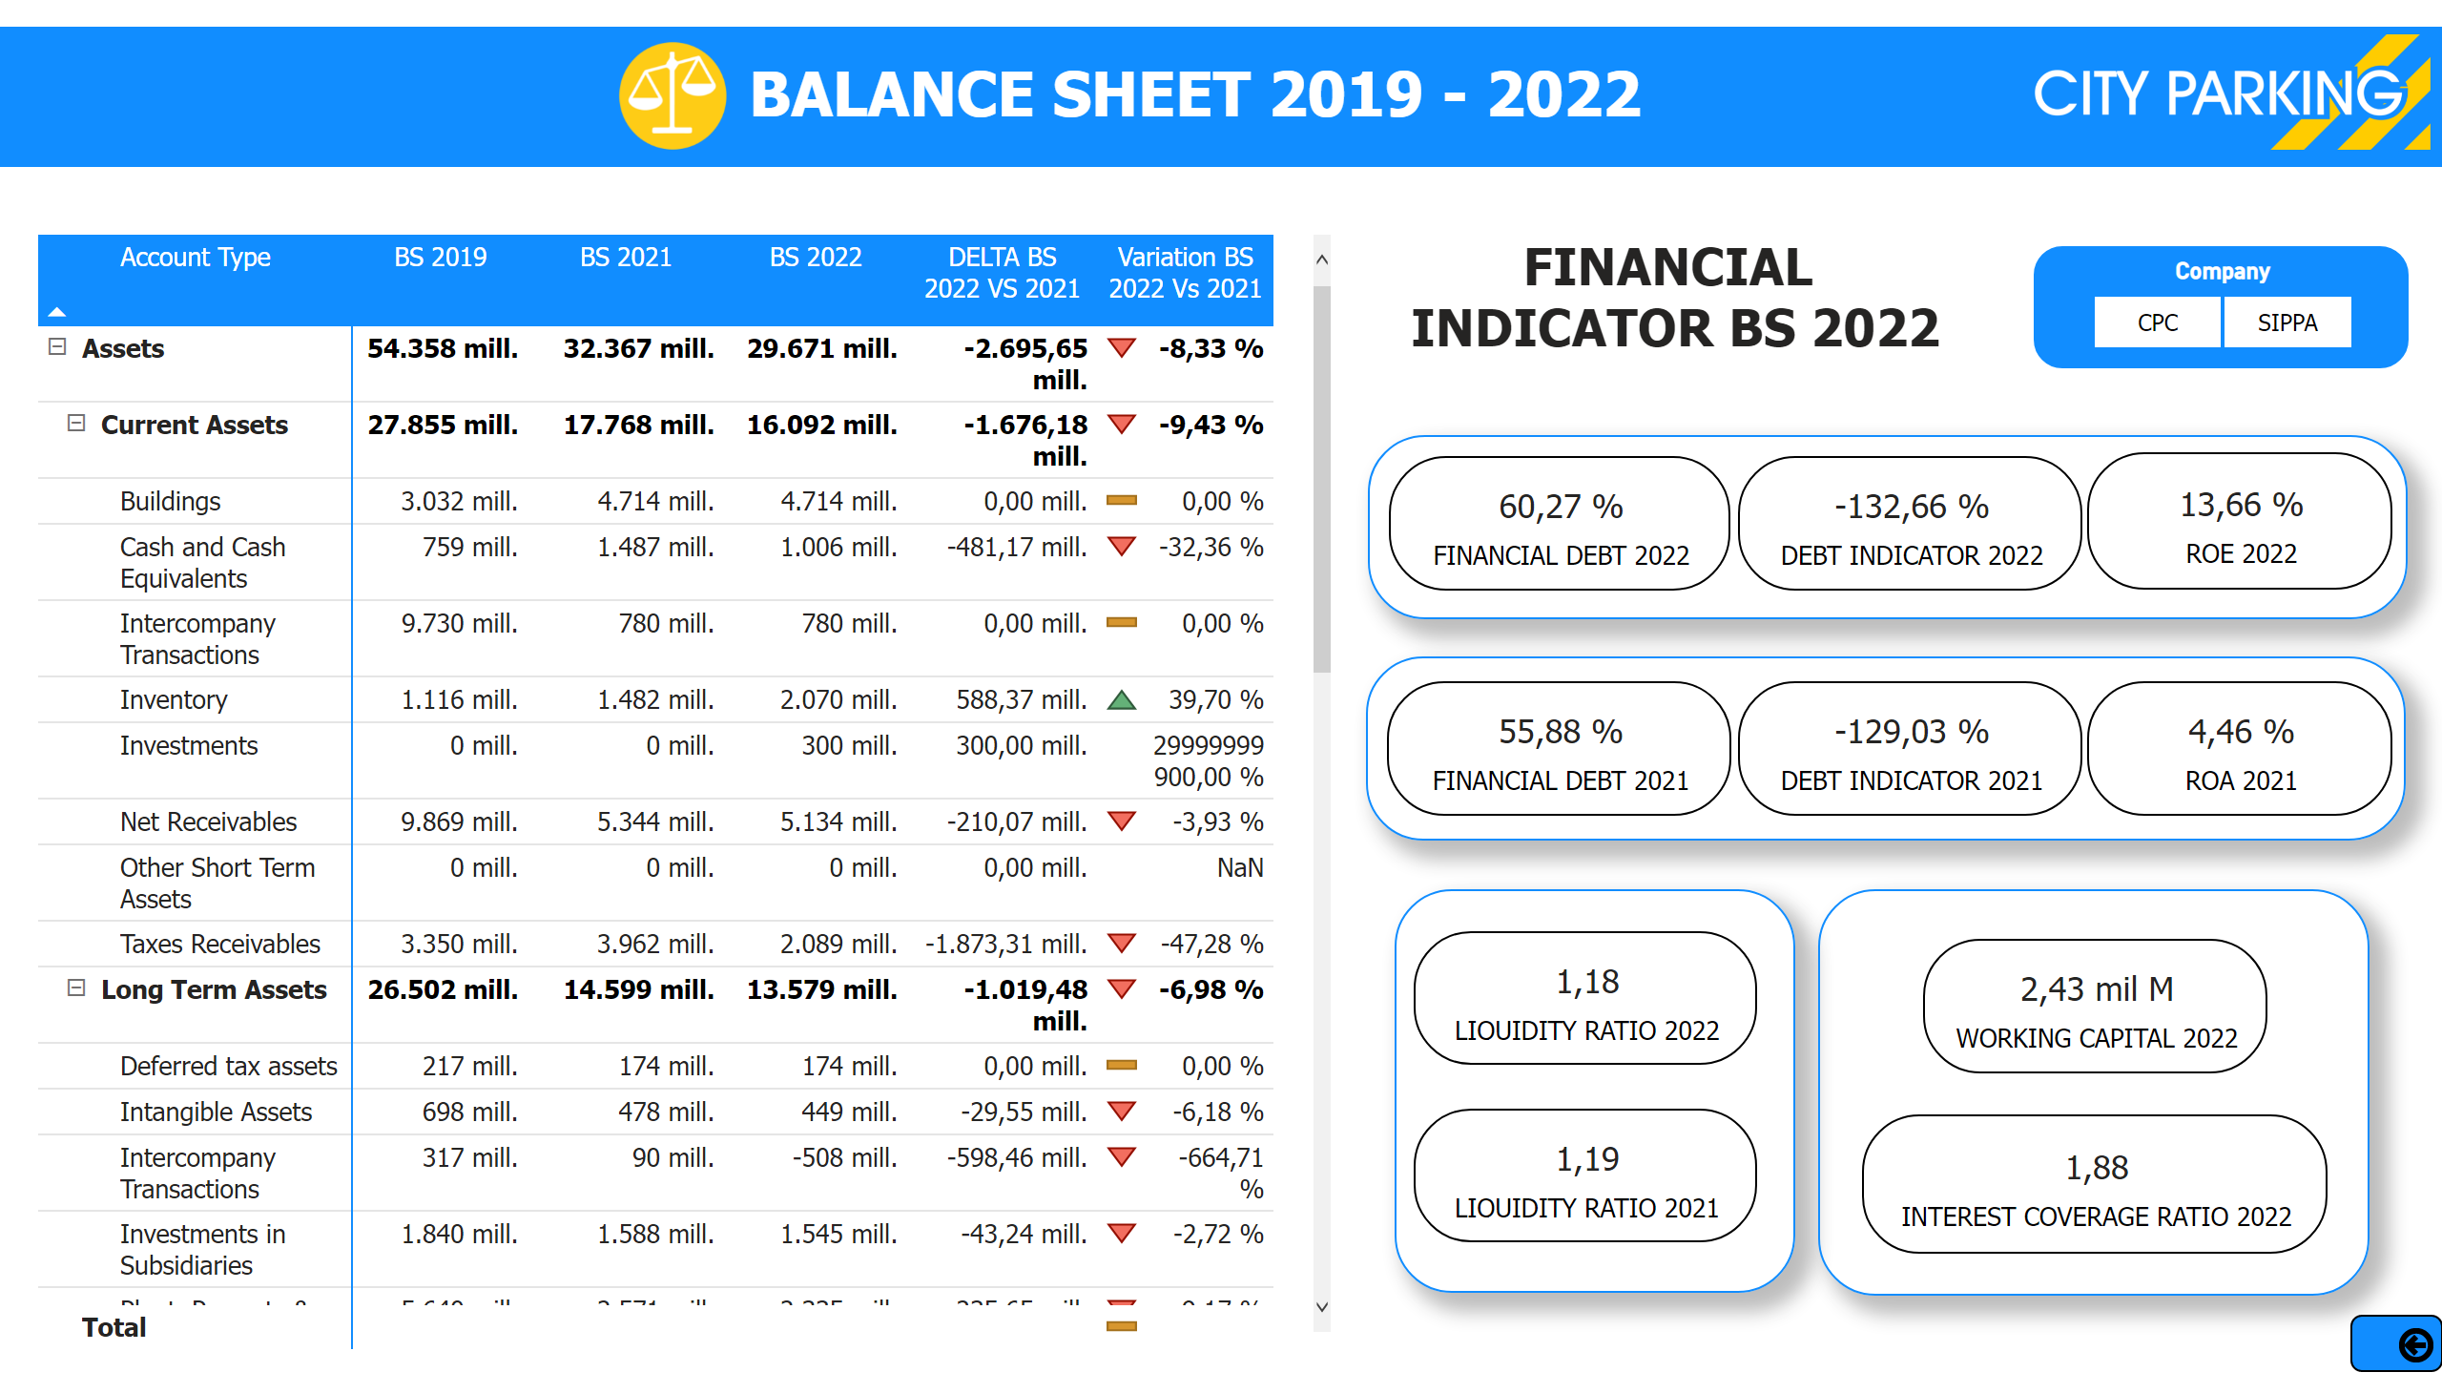
BS 2019-2022
Notes:
pivotTable
No alt text provided
card
No alt text provided
card
No alt text provided
textbox
No alt text provided
textbox
No alt text provided
card
No alt text provided
card
No alt text provided
card
No alt text provided
card
No alt text provided
basicShape
No alt text provided
card
No alt text provided
basicShape
No alt text provided
card
No alt text provided
card
No alt text provided
card
No alt text provided
Company
No alt text provided
shape
No alt text provided
image
No alt text provided
image
No alt text provided
actionButton
No alt text provided
slicer
No alt text provided
basicShape
No alt text provided
basicShape
No alt text provided

Slide 17
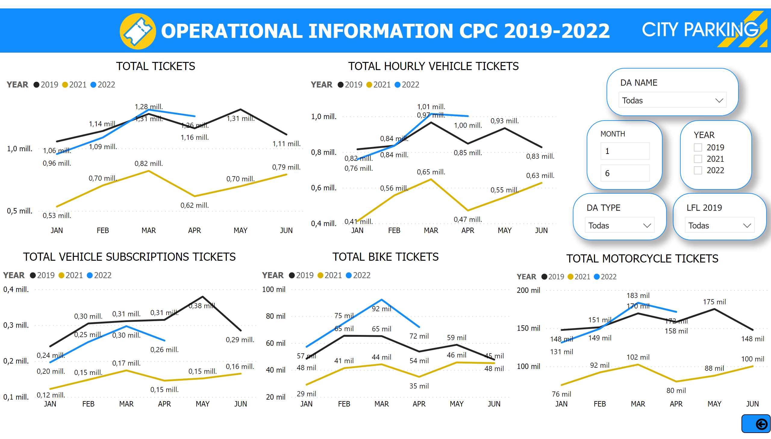
Tickets & Parking Lots
Notes:
TOTAL TICKETS
No alt text provided
TOTAL VEHICLE SUBSCRIPTIONS TICKETS
No alt text provided
TOTAL BIKE TICKETS
No alt text provided
TOTAL HOURLY VEHICLE TICKETS
No alt text provided
TOTAL MOTORCYCLE TICKETS
No alt text provided
textbox
No alt text provided
shape
No alt text provided
image
No alt text provided
image
No alt text provided
actionButton
No alt text provided
slicer
No alt text provided
sss
No alt text provided
sss
No alt text provided
sss
No alt text provided
sss
No alt text provided
sss
No alt text provided

Slide 18
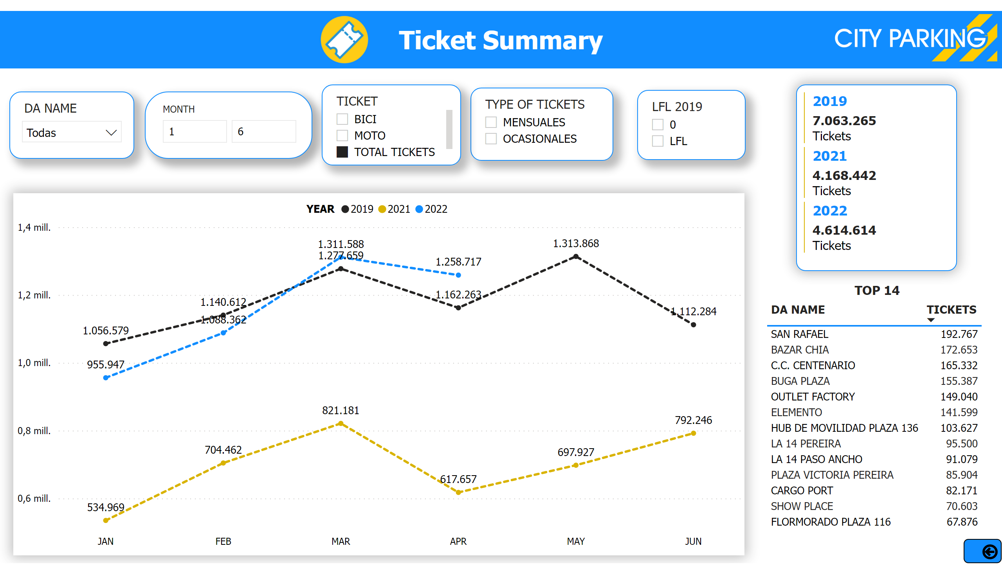
Ticket Summary
Notes:
Tickets CPC
No alt text provided
slicer
No alt text provided
slicer
No alt text provided
slicer
No alt text provided
slicer
No alt text provided
textbox
No alt text provided
shape
No alt text provided
image
No alt text provided
image
No alt text provided
TOP 14
No alt text provided
multiRowCard
No alt text provided
slicer
No alt text provided
actionButton
No alt text provided

Slide 19
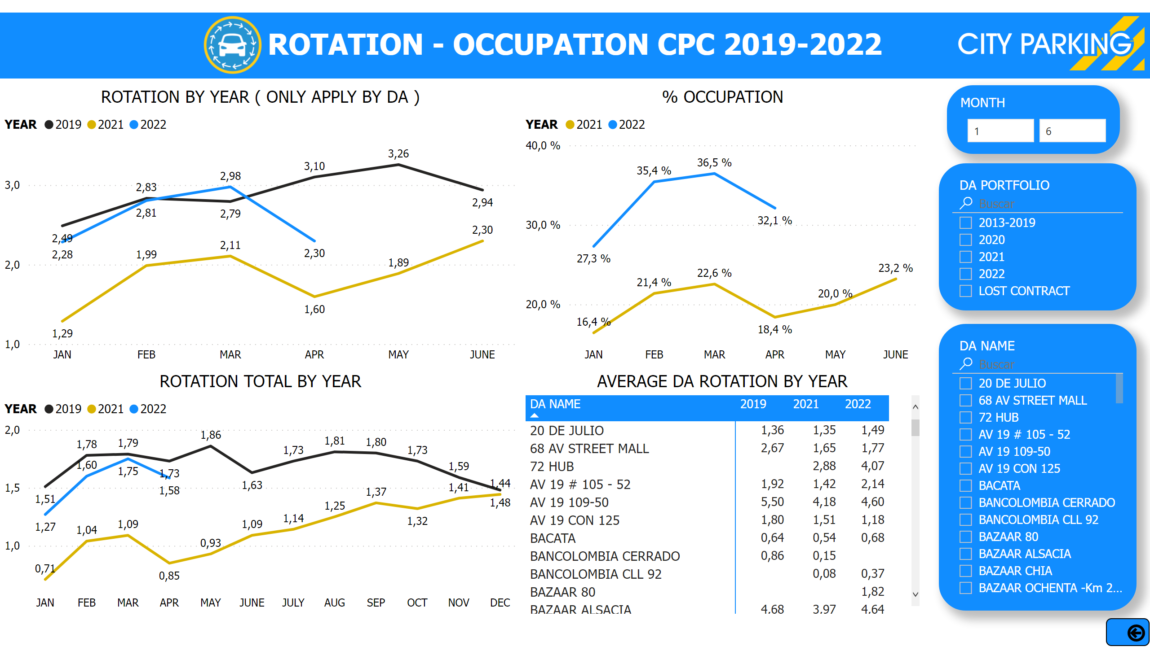
Rotation & Occupation By DA
Notes:
ROTATION TOTAL BY YEAR
No alt text provided
slicer
No alt text provided
textbox
No alt text provided
% OCCUPATION
No alt text provided
MONTH
No alt text provided
ROTATION BY YEAR ( ONLY APPLY BY DA )
No alt text provided
AVERAGE DA ROTATION BY YEAR
No alt text provided
shape
No alt text provided
image
No alt text provided
image
No alt text provided
actionButton
No alt text provided
slicer
No alt text provided
slicer
No alt text provided

Slide 20
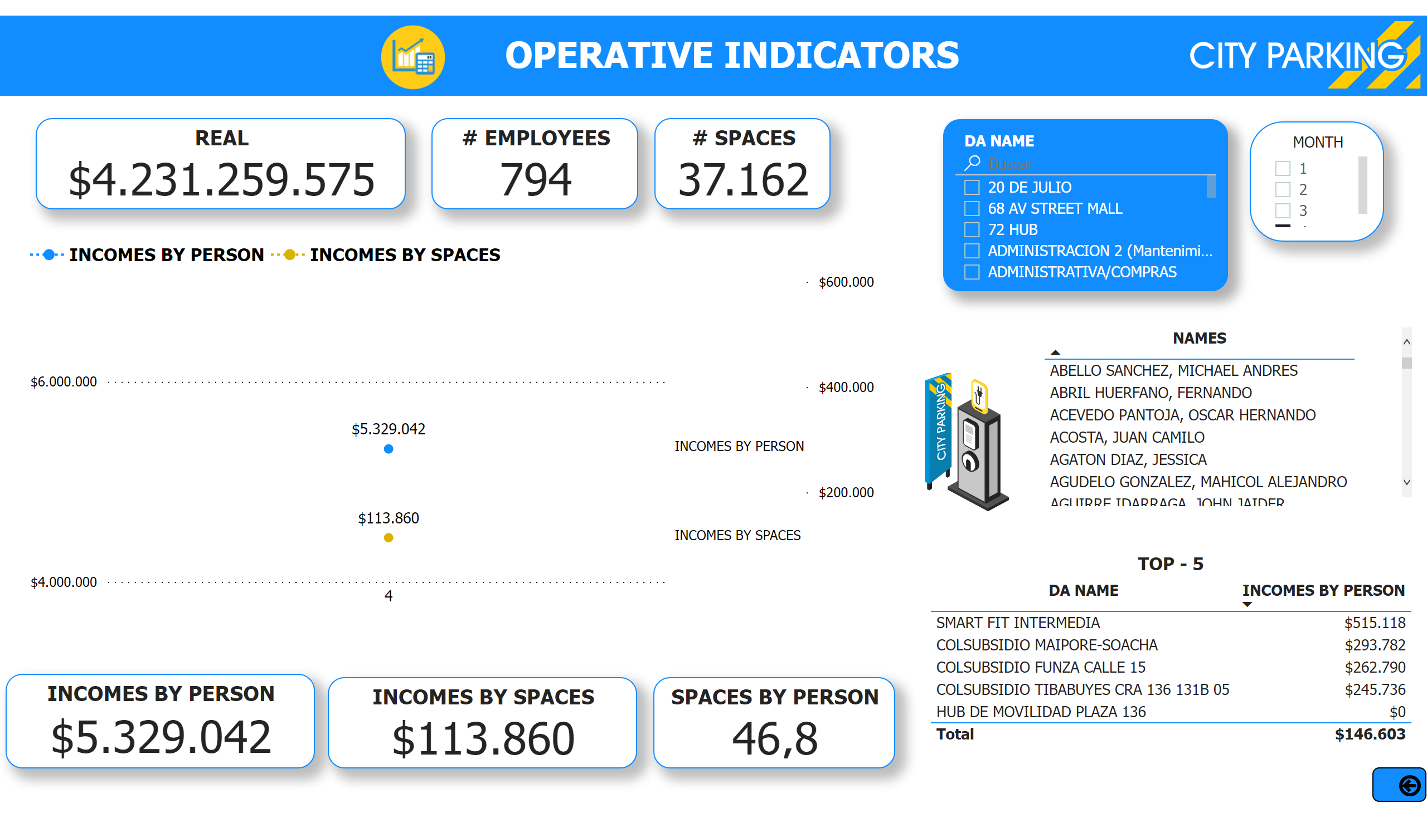
Operative indicators
Notes:
REAL
No alt text provided
# EMPLOYEES
No alt text provided
# SPACES
No alt text provided
slicer
No alt text provided
MONTH
No alt text provided
INCOMES BY PERSON
No alt text provided
INCOMES BY SPACES
No alt text provided
tableEx
No alt text provided
lineChart
No alt text provided
textbox
No alt text provided
image
No alt text provided
shape
No alt text provided
image
No alt text provided
actionButton
No alt text provided
image
No alt text provided
SPACES BY PERSON
No alt text provided
TOP - 5
No alt text provided

Slide 21
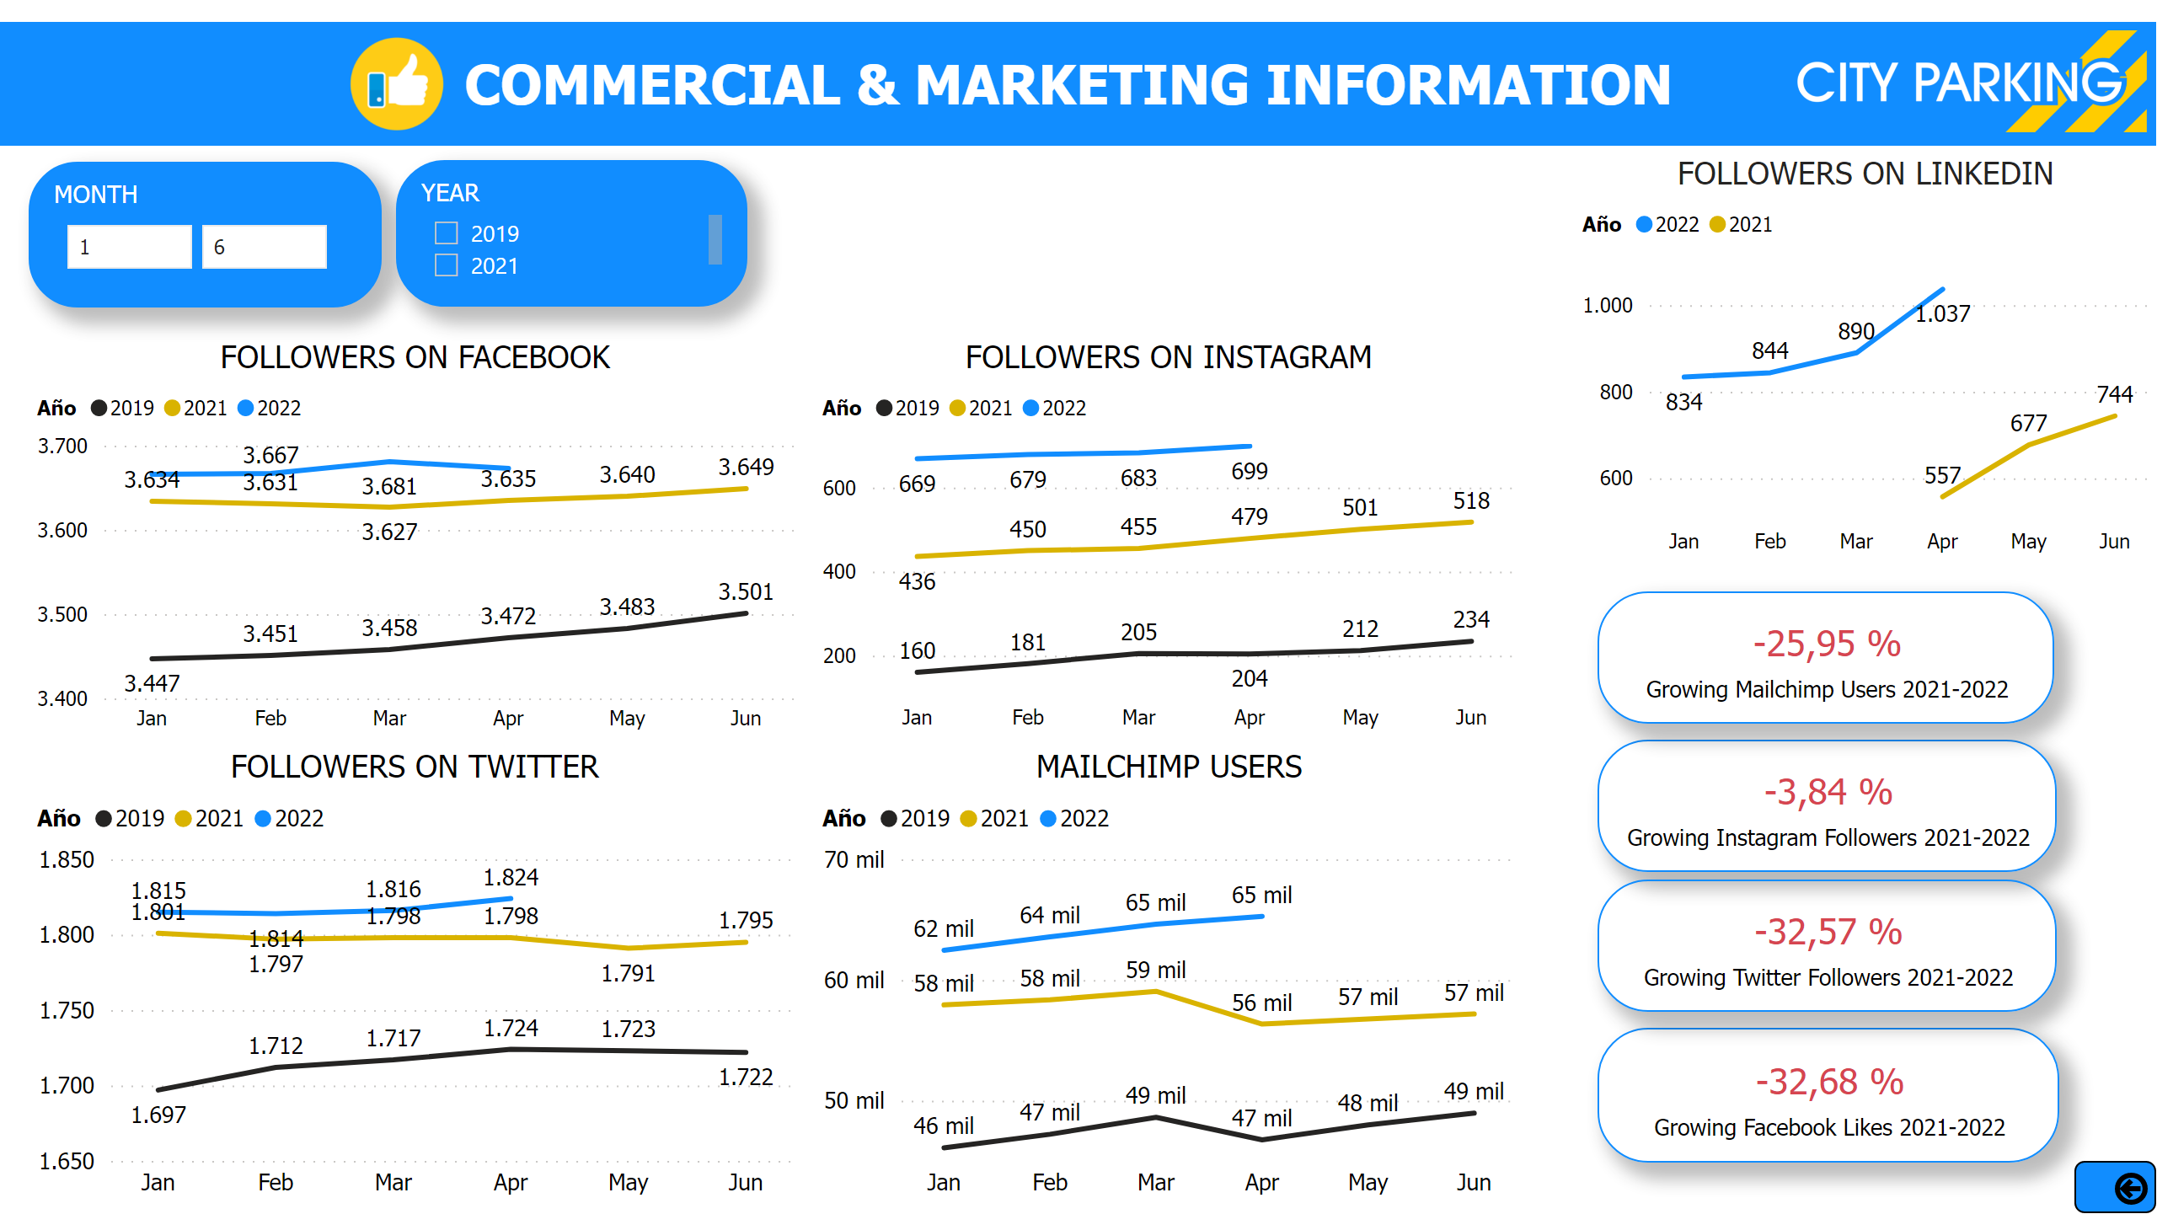
Comercial & Marketing Social Media
Notes:
textbox
No alt text provided
FOLLOWERS ON INSTAGRAM
No alt text provided
MAILCHIMP USERS
No alt text provided
FOLLOWERS ON TWITTER
No alt text provided
card
No alt text provided
MONTH
No alt text provided
card
No alt text provided
card
No alt text provided
card
No alt text provided
FOLLOWERS ON LINKEDIN
No alt text provided
shape
No alt text provided
image
No alt text provided
image
No alt text provided
actionButton
No alt text provided
slicer
No alt text provided
FOLLOWERS ON FACEBOOK
No alt text provided
YEAR
No alt text provided

Slide 22
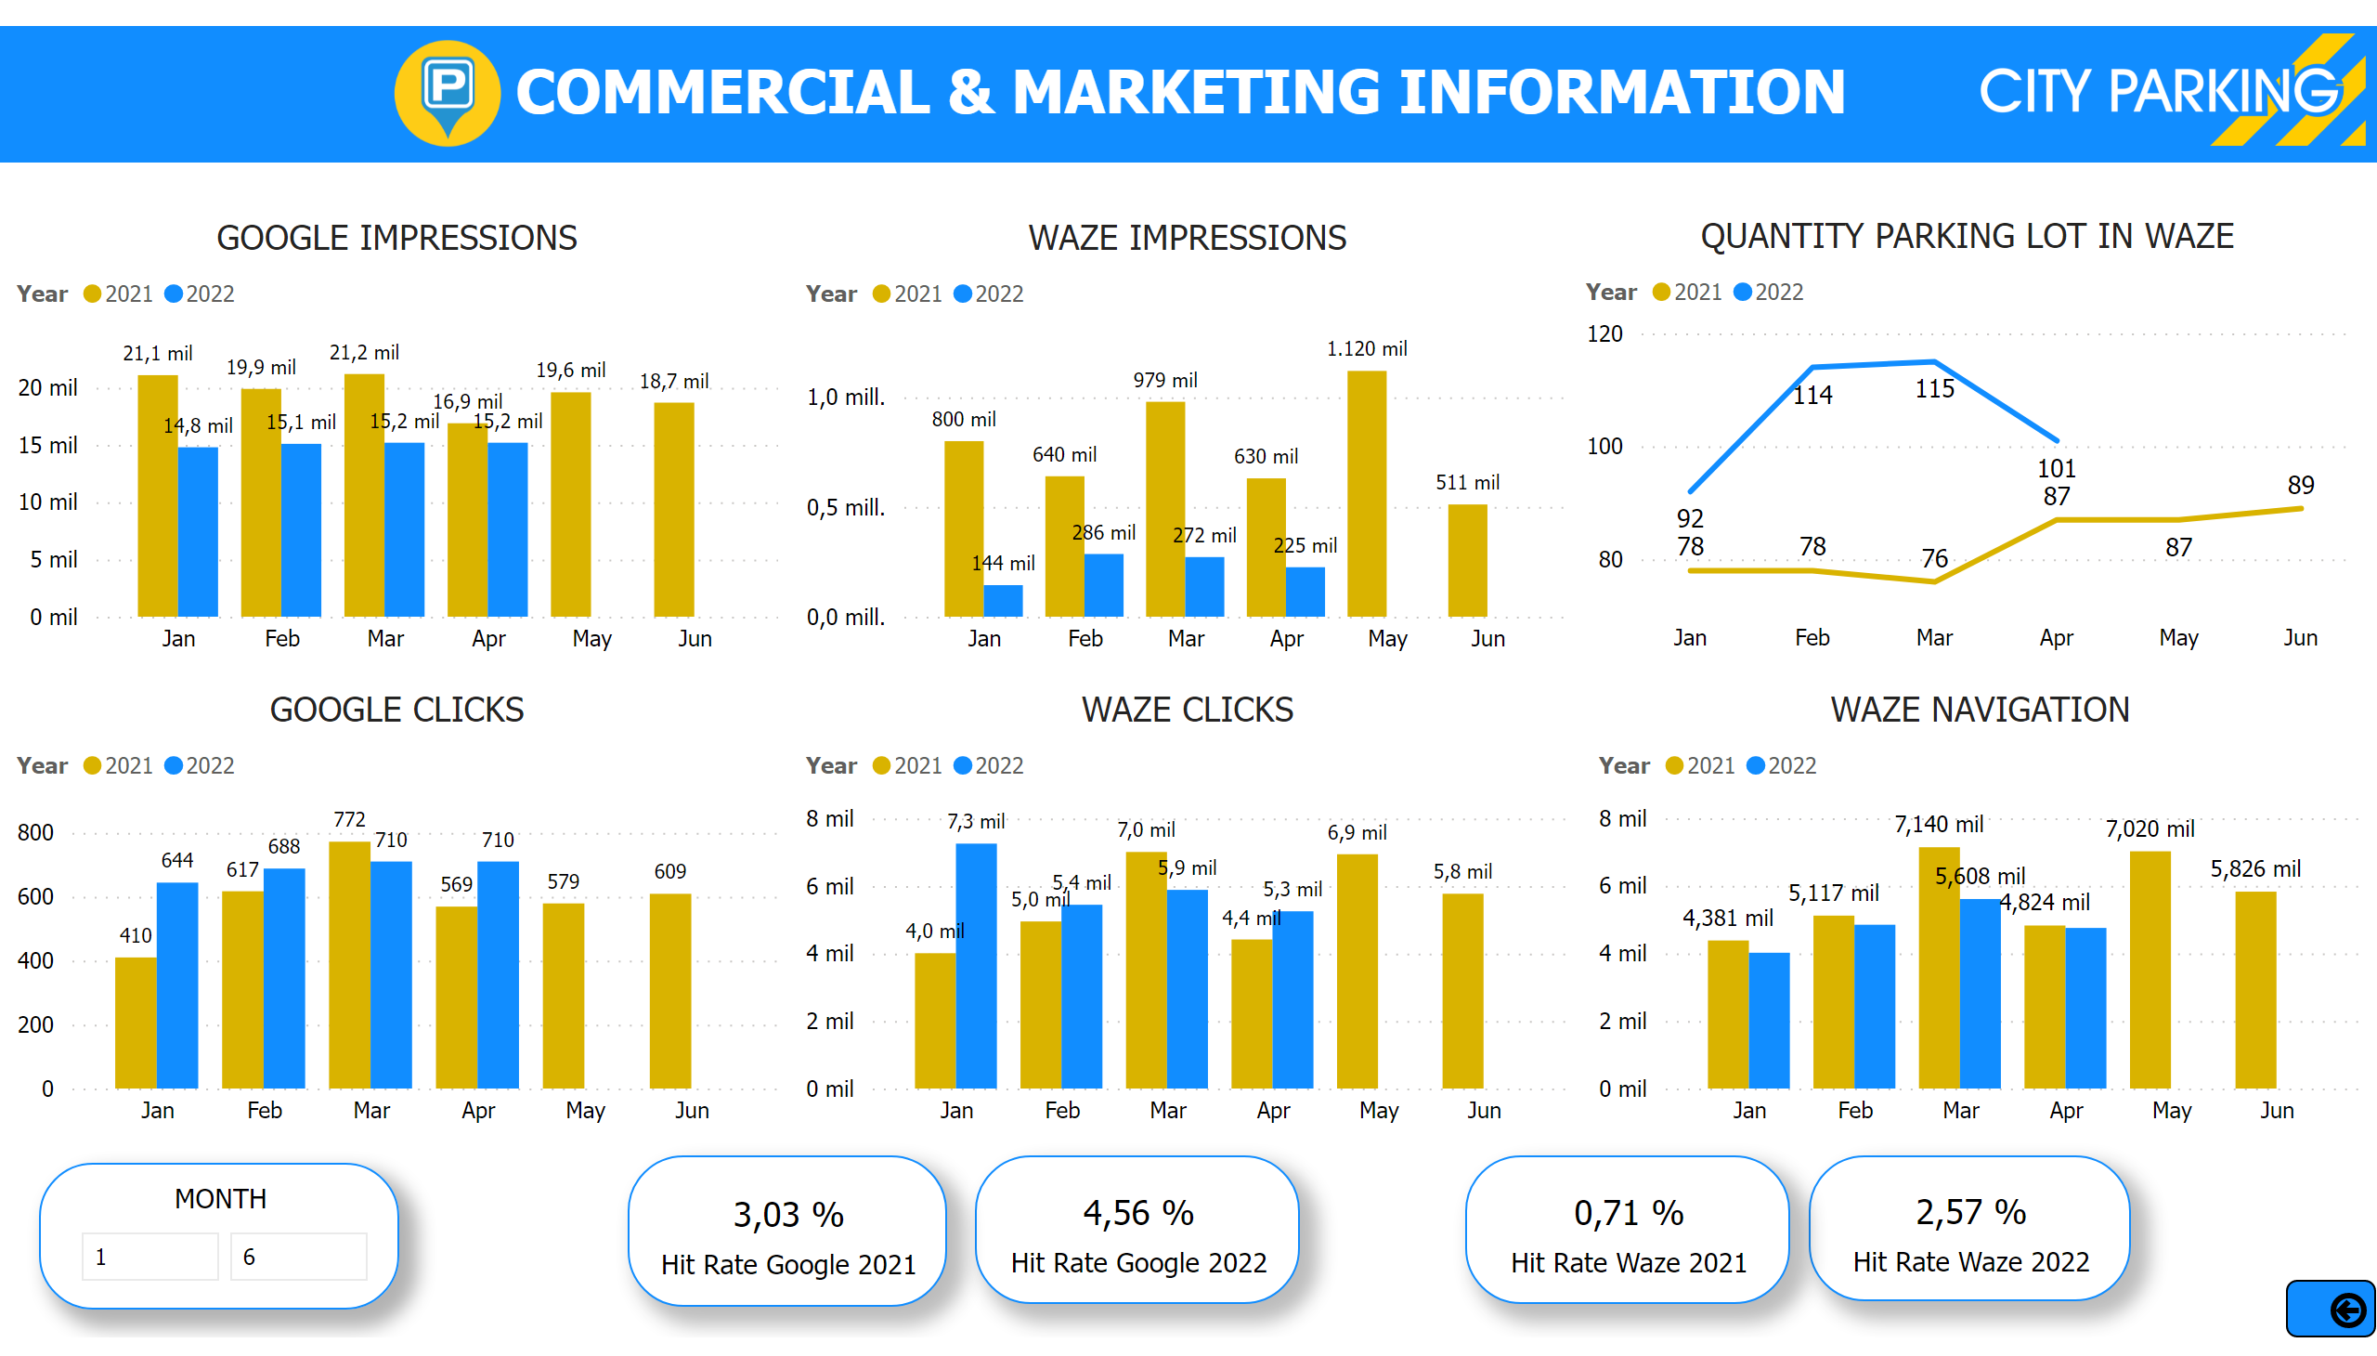
Comercial & Marketing Waze-Google
Notes:
GOOGLE CLICKS
No alt text provided
textbox
No alt text provided
MONTH
No alt text provided
WAZE CLICKS
No alt text provided
WAZE IMPRESSIONS
No alt text provided
QUANTITY PARKING LOT IN WAZE
No alt text provided
WAZE NAVIGATION
No alt text provided
GOOGLE IMPRESSIONS
No alt text provided
card
No alt text provided
card
No alt text provided
card
No alt text provided
card
No alt text provided
shape
No alt text provided
image
No alt text provided
image
No alt text provided
actionButton
No alt text provided
slicer
No alt text provided

Slide 23
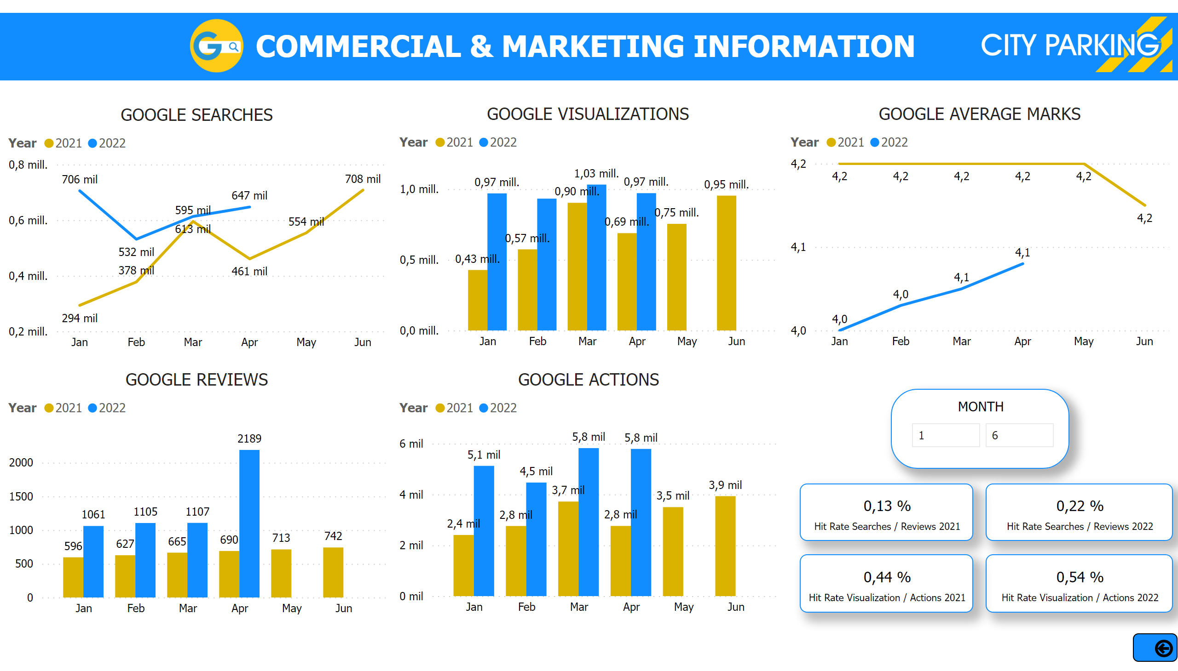
Comercial & Marketing Google Business
Notes:
GOOGLE REVIEWS
No alt text provided
textbox
No alt text provided
MONTH
No alt text provided
GOOGLE AVERAGE MARKS
No alt text provided
GOOGLE SEARCHES
No alt text provided
GOOGLE VISUALIZATIONS
No alt text provided
GOOGLE ACTIONS
No alt text provided
card
No alt text provided
card
No alt text provided
card
No alt text provided
card
No alt text provided
shape
No alt text provided
image
No alt text provided
image
No alt text provided
actionButton
No alt text provided
slicer
No alt text provided

Slide 24
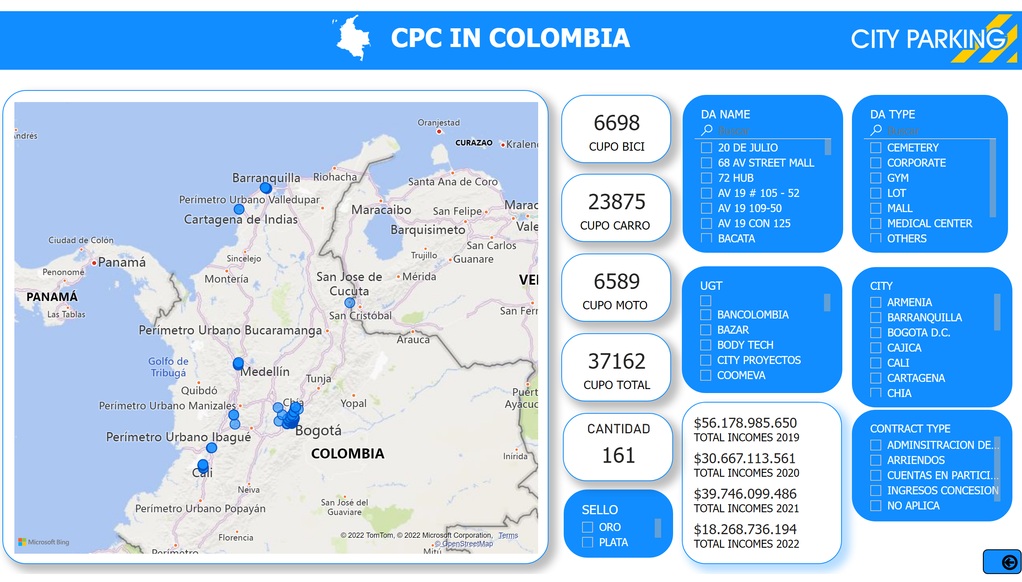
Map
Notes:
map
No alt text provided
card
No alt text provided
card
No alt text provided
card
No alt text provided
card
No alt text provided
slicer
No alt text provided
multiRowCard
No alt text provided
slicer
No alt text provided
CIUDAD
No alt text provided
slicer
No alt text provided
slicer
No alt text provided
slicer
No alt text provided
textbox
No alt text provided
CANTIDAD
No alt text provided
shape
No alt text provided
image
No alt text provided
image
No alt text provided
actionButton
No alt text provided
slicer
No alt text provided

Slide 25
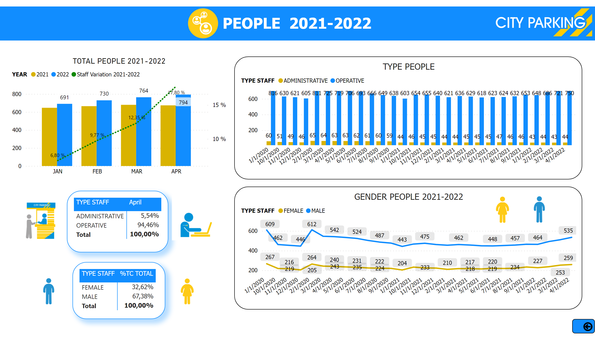
People
Notes:
textbox
No alt text provided
TOTAL PEOPLE 2021-2022
No alt text provided
TYPE PEOPLE
No alt text provided
GENDER PEOPLE 2021-2022
No alt text provided
shape
No alt text provided
image
No alt text provided
image
No alt text provided
actionButton
No alt text provided
image
No alt text provided
image
No alt text provided
slicer
No alt text provided
pivotTable
No alt text provided
pivotTable
No alt text provided
image
No alt text provided
image
No alt text provided
image
No alt text provided
image
No alt text provided

Slide 26
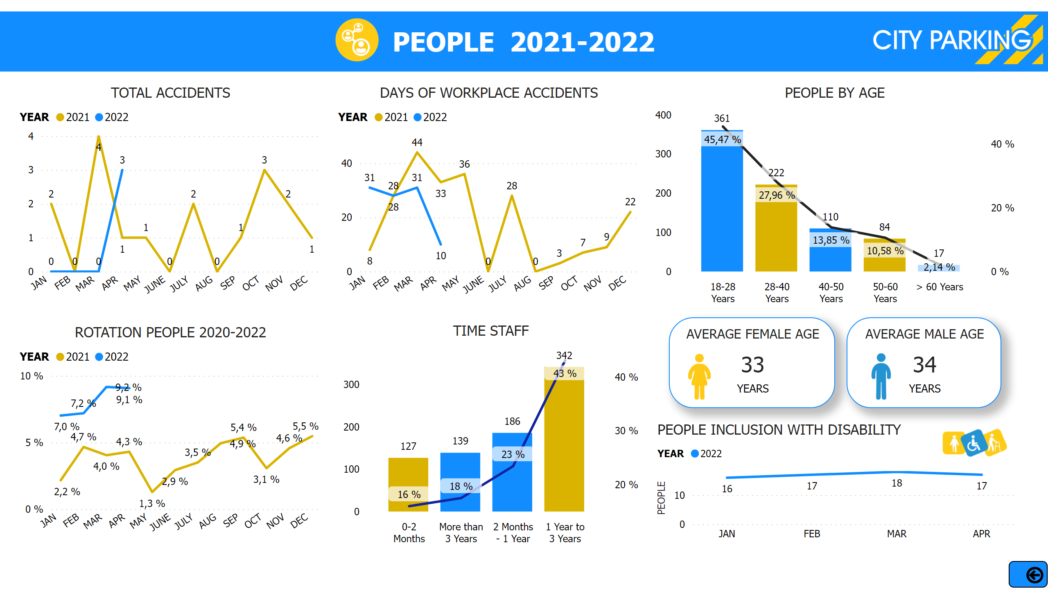
People 1
Notes:
textbox
No alt text provided
actionButton
No alt text provided
ROTATION PEOPLE 2020-2022
No alt text provided
DAYS OF WORKPLACE ACCIDENTS
No alt text provided
TOTAL ACCIDENTS
No alt text provided
PEOPLE BY AGE
No alt text provided
AVERAGE FEMALE AGE
No alt text provided
PEOPLE INCLUSION WITH DISABILITY
No alt text provided
AVERAGE MALE AGE
No alt text provided
shape
No alt text provided
image
No alt text provided
image
No alt text provided
image
No alt text provided
image
No alt text provided
image
No alt text provided
slicer
No alt text provided
TIME STAFF
No alt text provided

