Slide 1
Taguig City
Pre-Owned House
3-sty corner lot

Slide 2
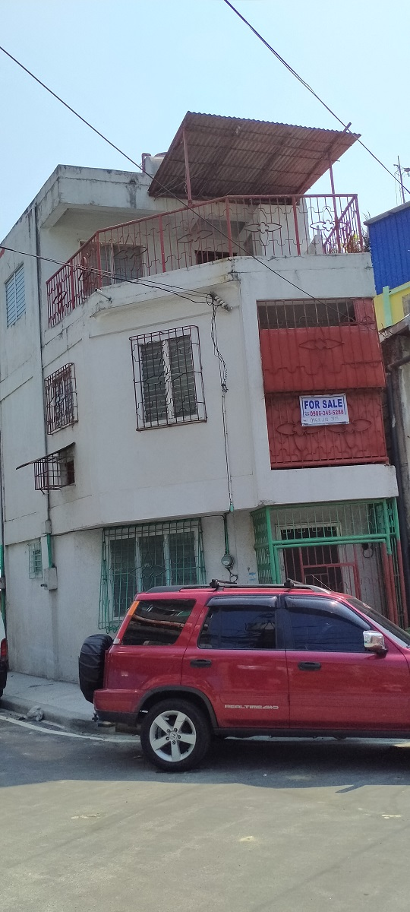
Pre-owned, concrete, three-storey house in a corner lot
The structure is of CWB, durable enough with strong foundation too.
Ground floor – living / living areas, kitchen with shelves, bathroom, ceramic tiled flooring.
Second floor – bedroom with cabinet, bathroom, extra space for sofa bed and storage.
Third floor – bedroom with cabinet, bathroom, extra space for sofa bed and storage, balcony for potted garden, drying / washing area, viewing deck
The location is in Upper Bicutan, a high-elevated area of Taguig City. Lots here are not big cut, economy size and maximized vertically, thus this property is a three storey house. No association dues, with street lights, gutters, barangay CCTV, and utilities. Near market, schools and with public transportation.

Slide 3
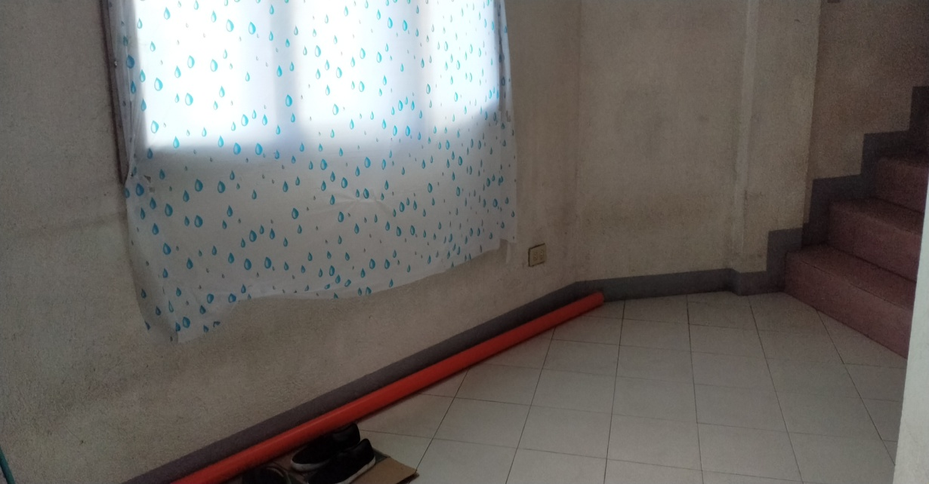
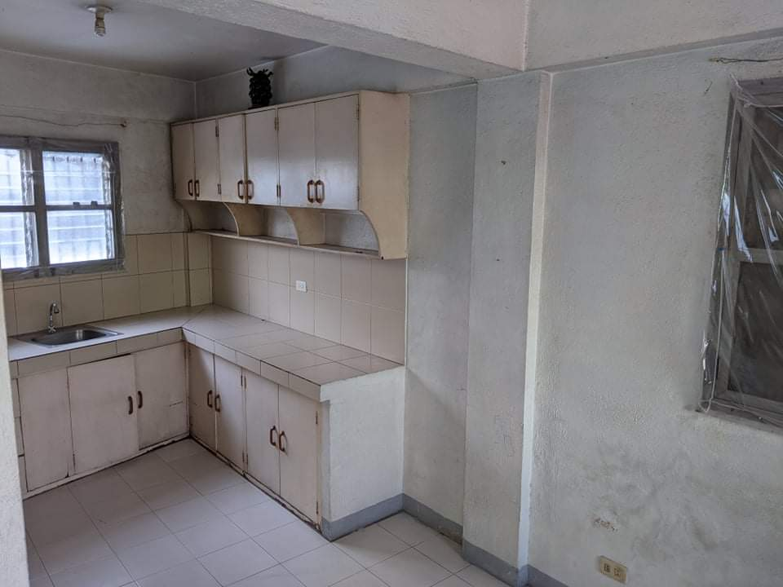
Ground floor
Spacious living area with bathroom, dining and kitchen.
The ground floor is simply ventilated with windows in front and kitchen side. .

Slide 4
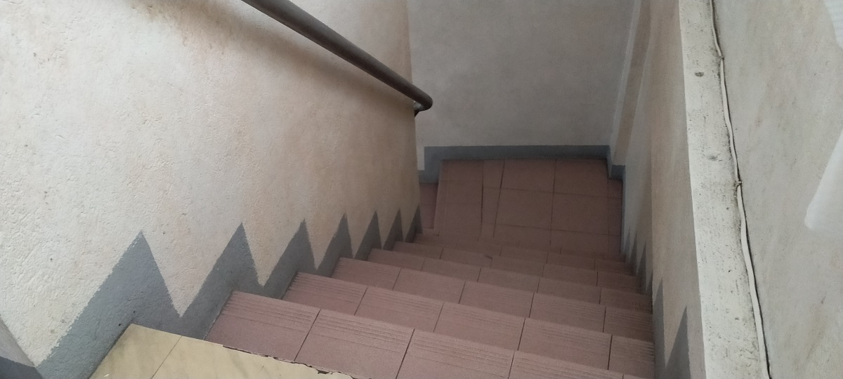
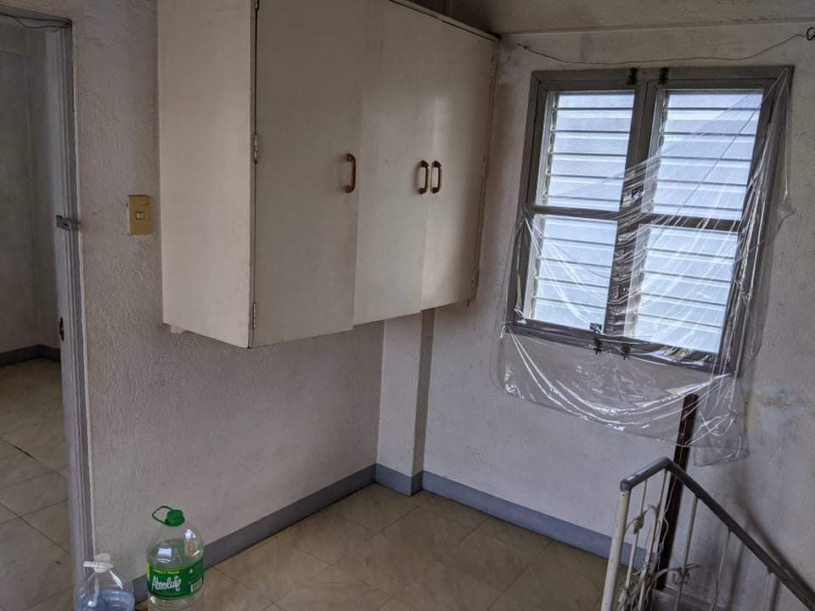
Cemented stairways to the second floor
Second floor is provided with big cabinet outside the bedrooms.

Slide 5
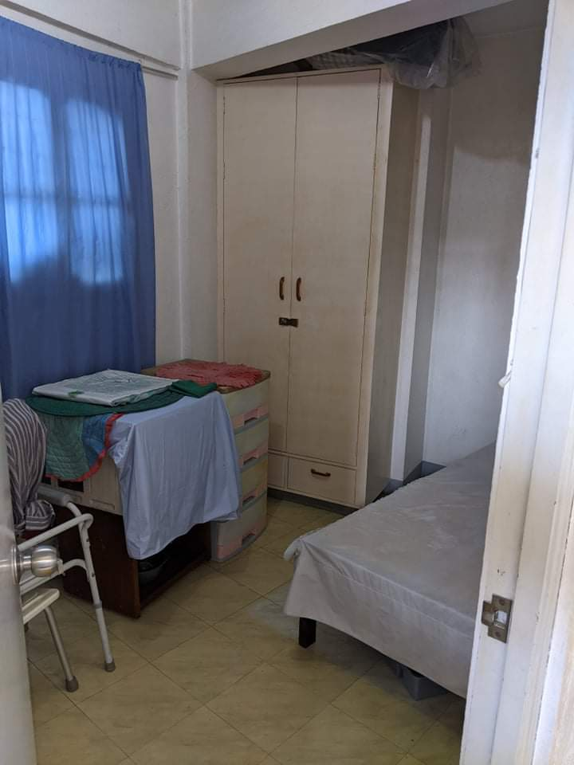
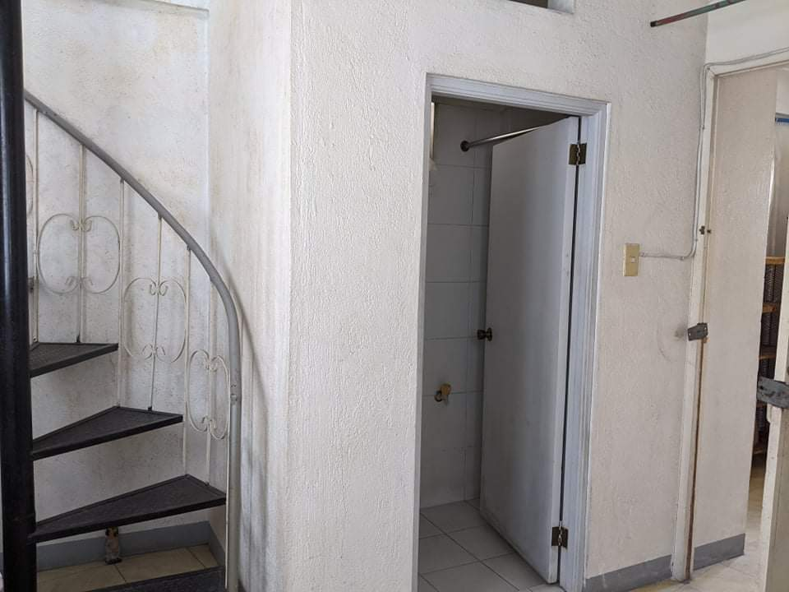
The bedroom on the second floor has a wardrobe cabinet. It is furnished in the picture ubt will be sold unfurnished.
A bathroom is available just very close across the bedroom.
The stairs on the left leads to the third floor,

Slide 6
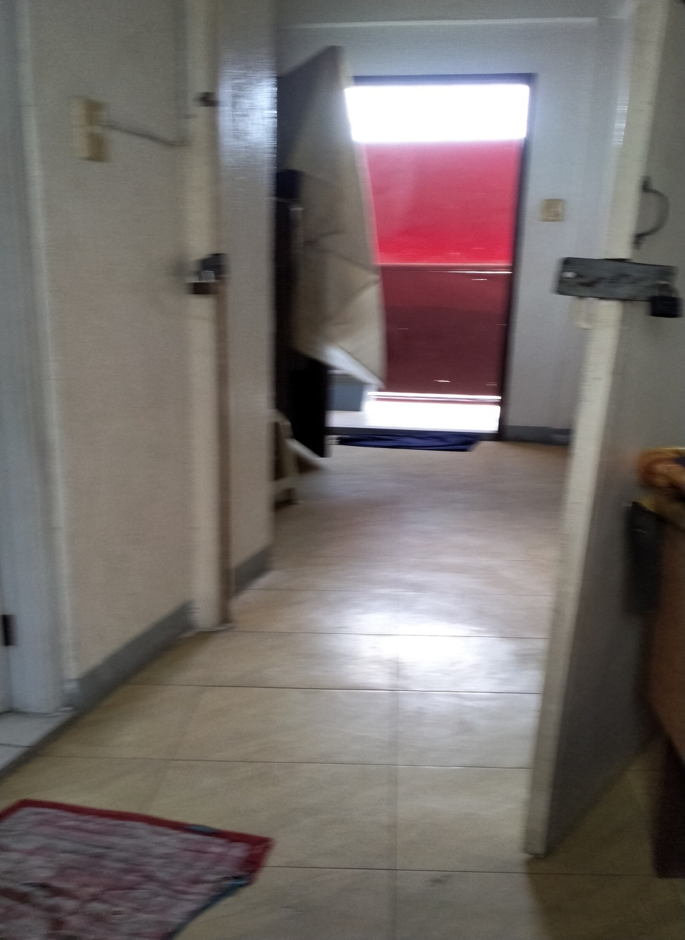
The Aisle on the Second Floor
On the left side is the door to the bathroom, on the right side is the bedroom. Just across the bedroom is a space where a sofa bed, a double deck or a storage deck can be put for additional use.
Moving farther is a vacant area (with red cover) for possible washing or drying area. A small table may also be placed with a stove for cooking if the second floor will be rented out separately.
Removing the red cover gives extra ventilation and light to the second floor.

Slide 7
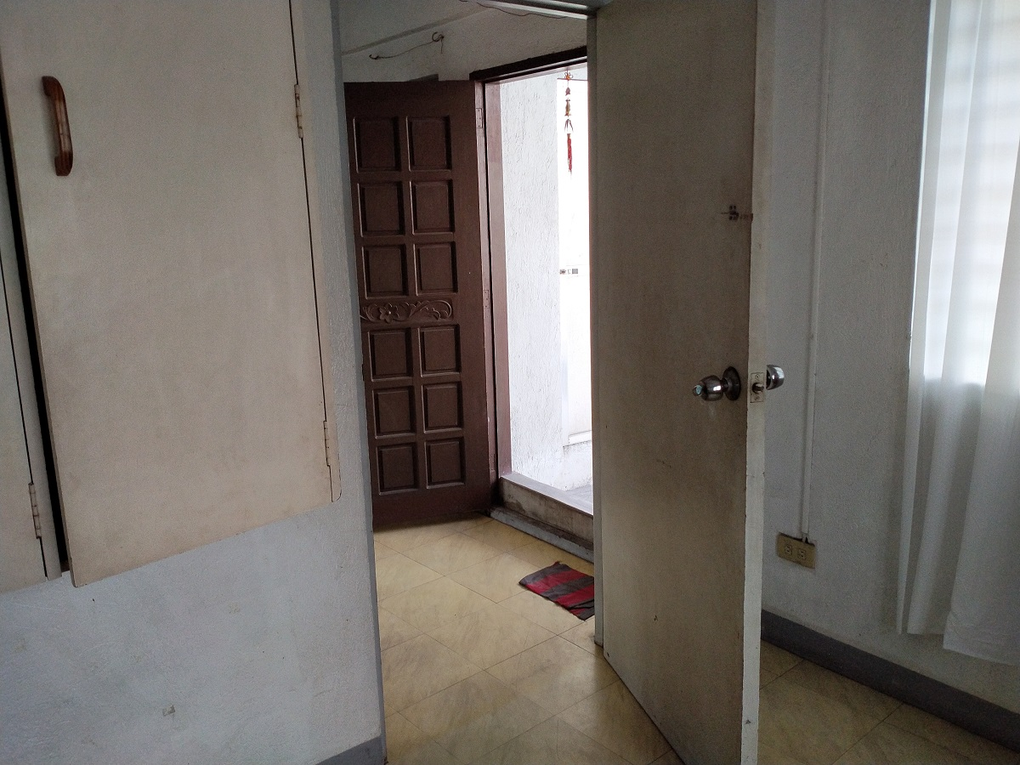
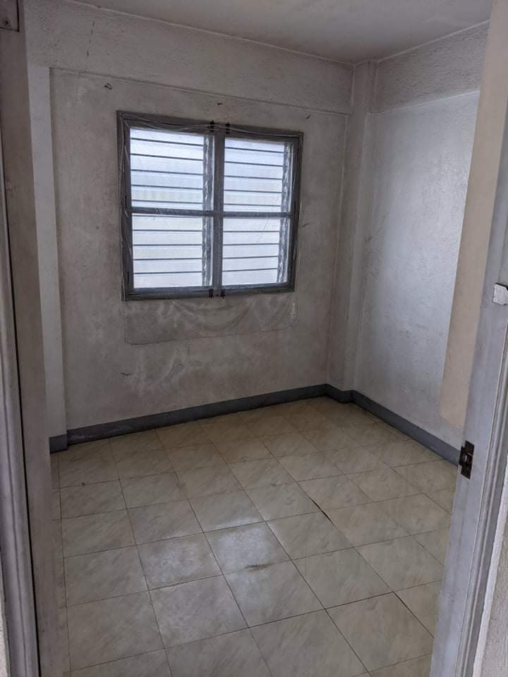
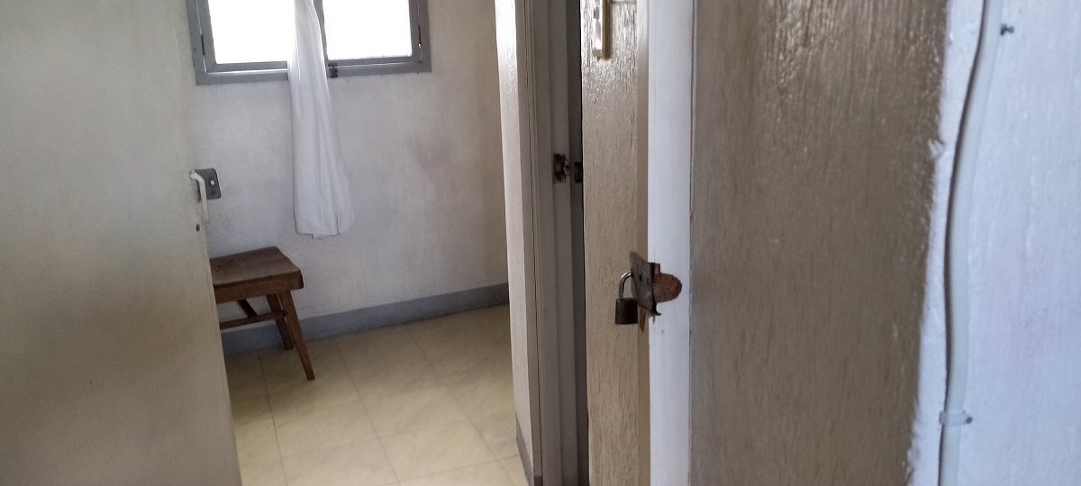
Third floor
One room close to the balcony . All floors have a bathroom.

Slide 8
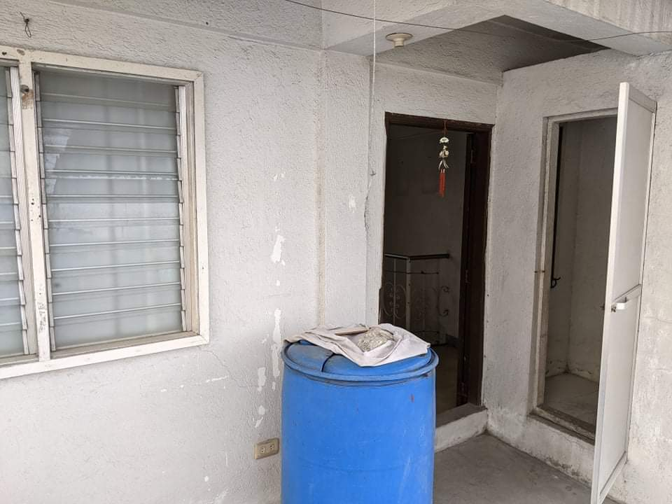
The Balcony on the Third Floor
This is part of the balcony.

Slide 9
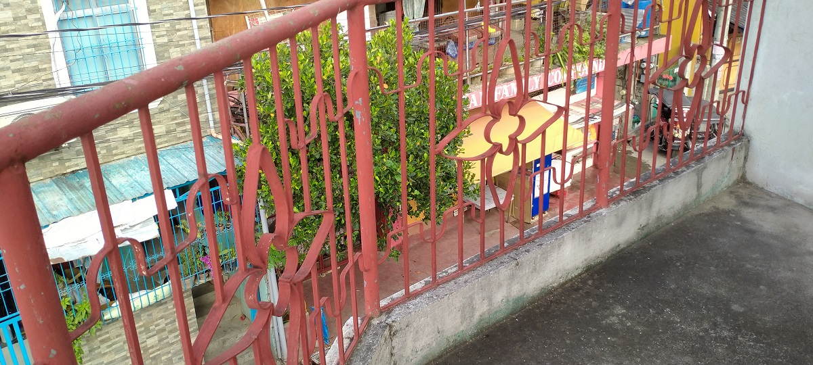
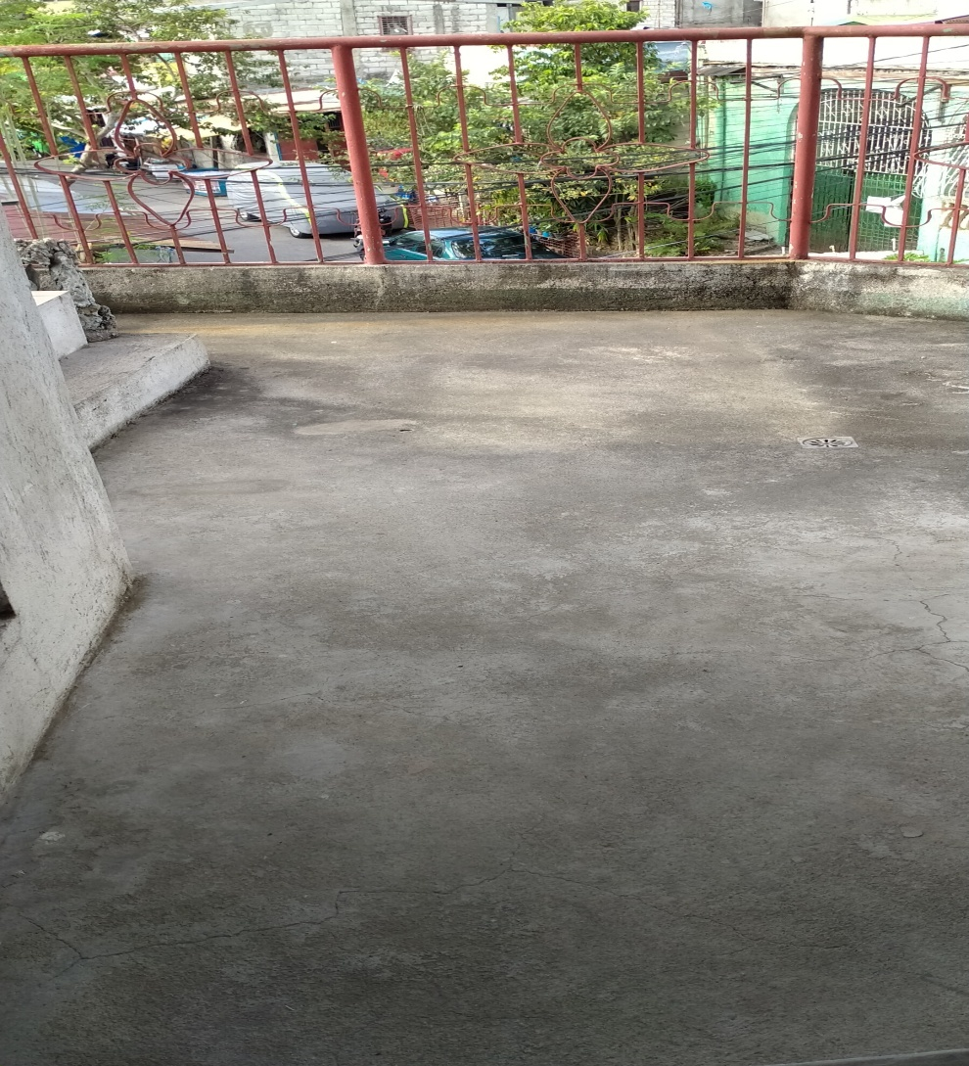
The Balcony

Slide 10
The Property is now unoccupied and ready for move-in. It is clean inside, repainted and with existing light and water connection.
Total usable area is about 100 square meters, two bedrooms , three bathrooms and a balcony. The front and side of the house is customarily being used to park car. Being a corner lot, there is enough view of two streets and with the balcony, there is more than enough air and light adding to the ventilation to the unit.
There are not enough land where horizontal developments are constructed since more condominiums are being built specially in the Metro Manila. Take the opportunity to get investments like this property in the city, otherwise you need to move to areas outside of the city, in this case.. Taguig City.
Upper Bicutan is very accessible to BGC, and one ride to reach other places where business, education, entertainment and commercial establishments are reached. This place is also noted for being a flood-free area.
At Php 3.2M (cash) , get this soonest. It is with clean title, updated tax payments and title ready for transfer to the next owner. There is NO ISSUE to think of.
Call - 09171305288 for inquiry. Property is closed so please request so we can schedule your viewing.

