Slide 1
Command Control center
plot options study

Slide 2
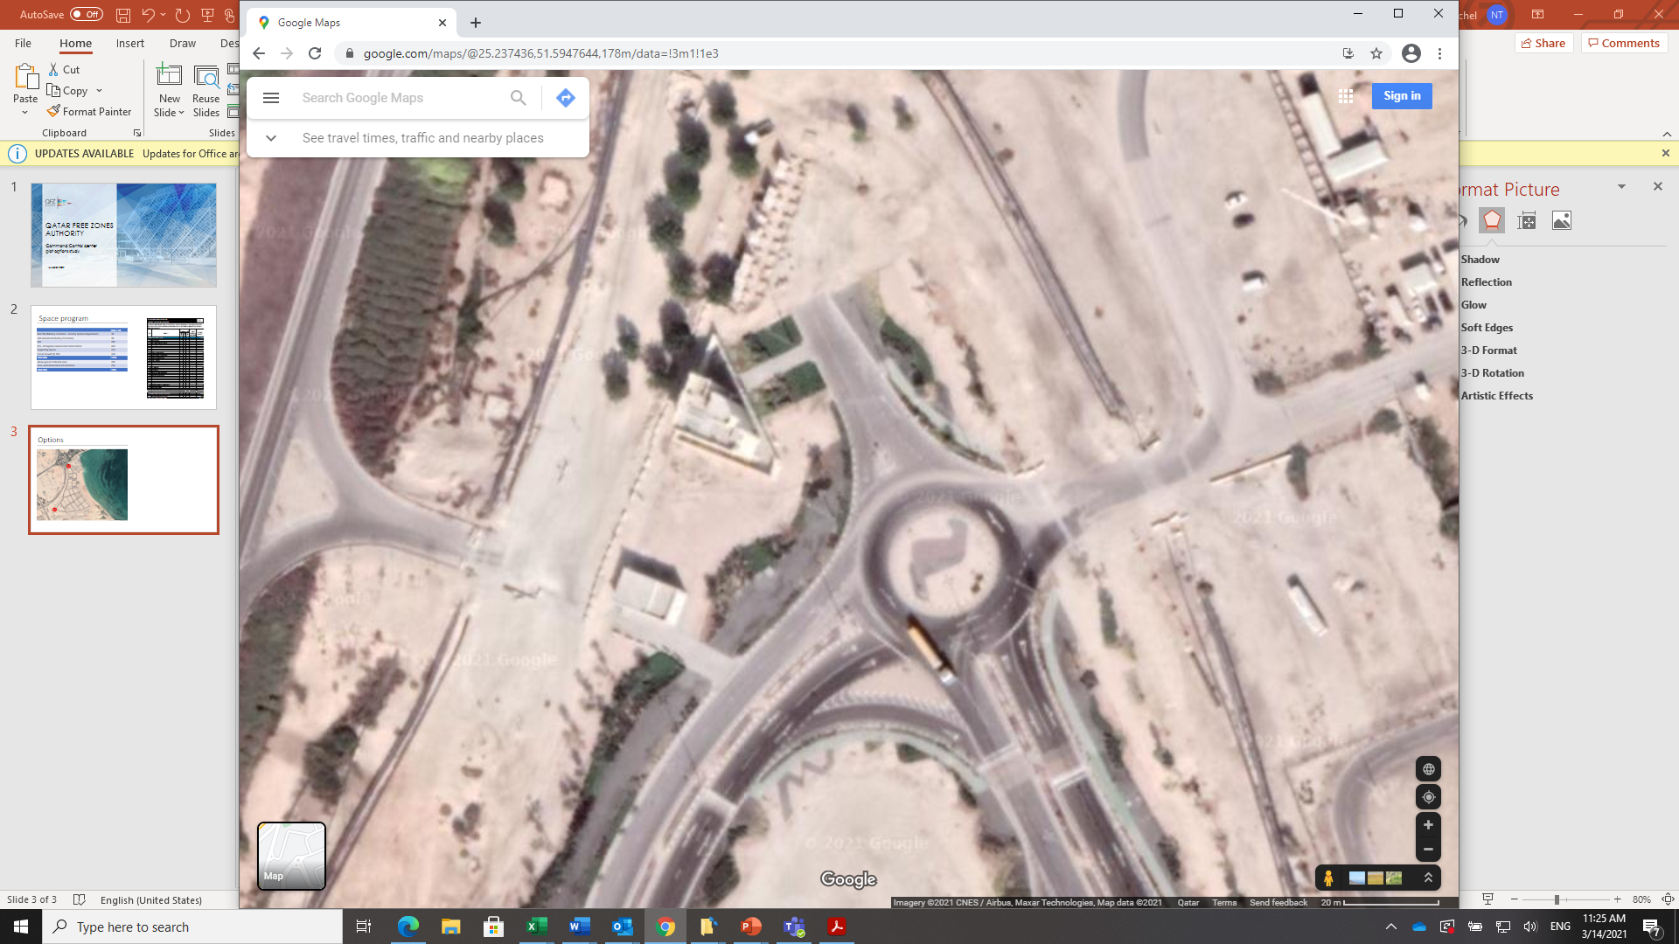
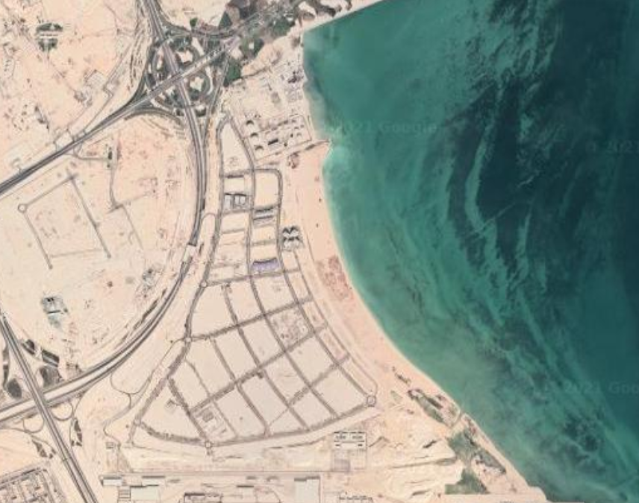
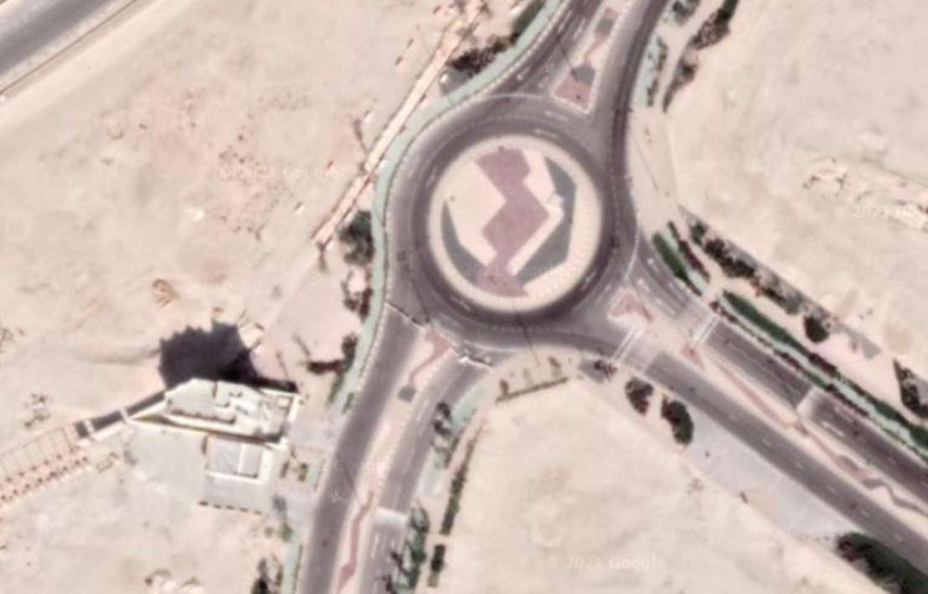
Pop Buildings
1
1. North pop building: 150m2 NFA excluding circulation
2
2. South pop building: 154m2 NFA excluding circulation

Slide 3
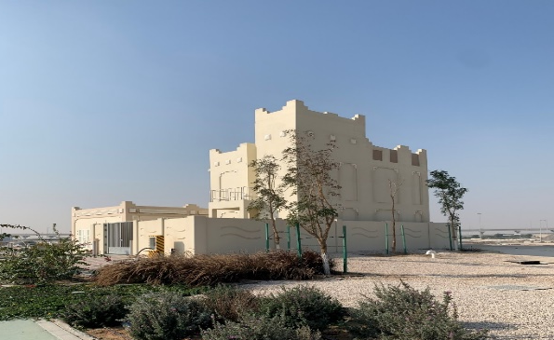
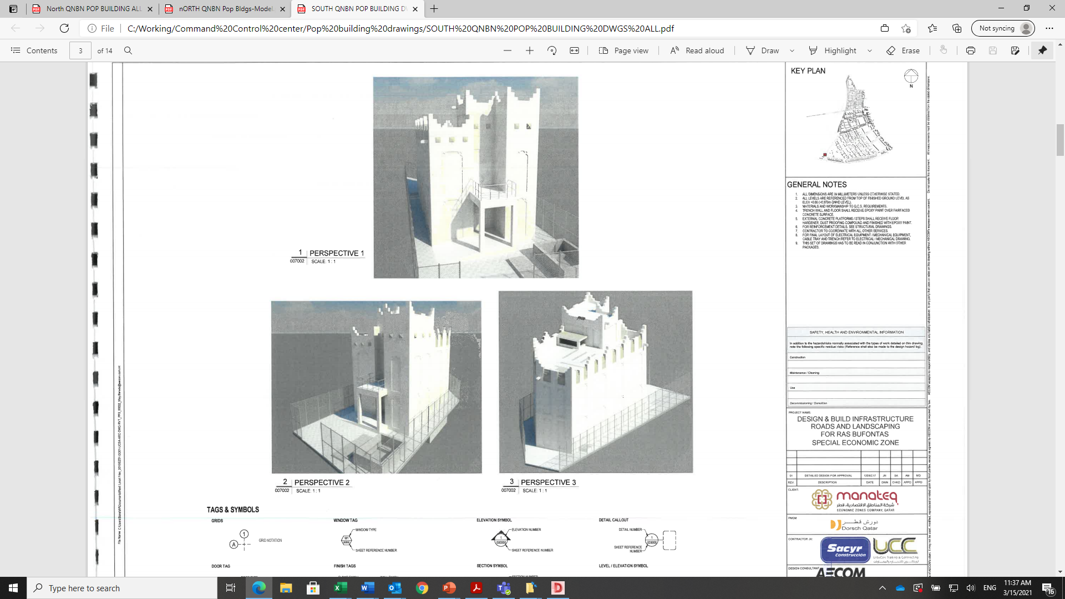
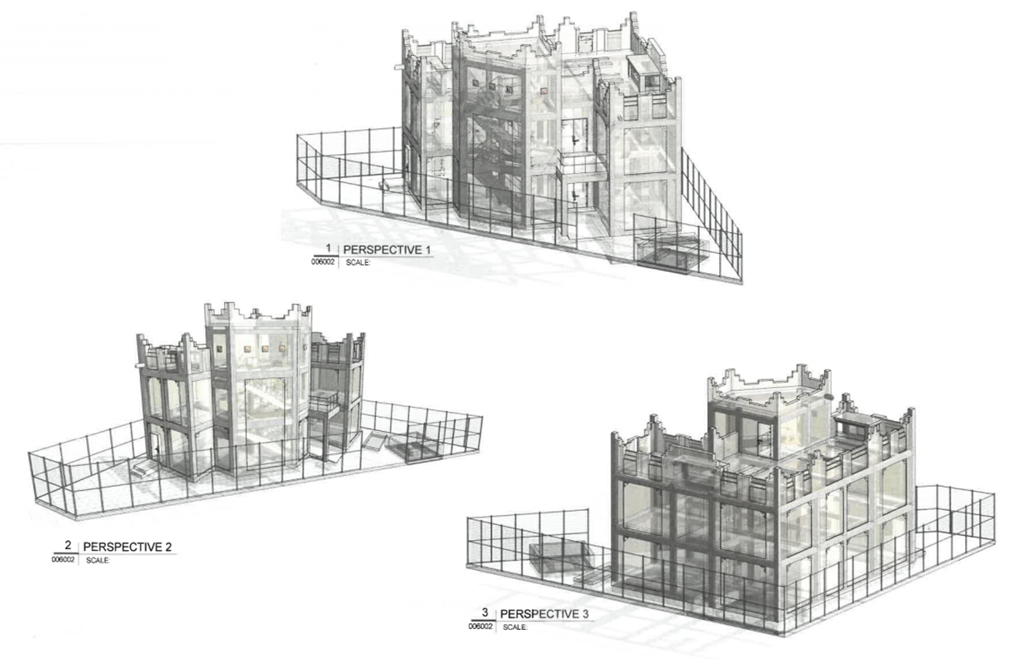
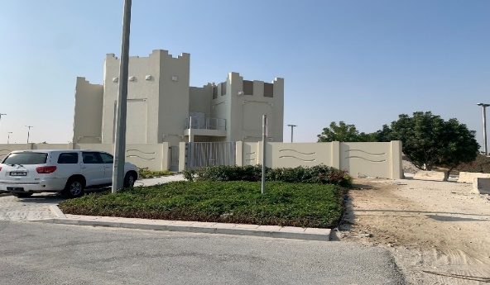
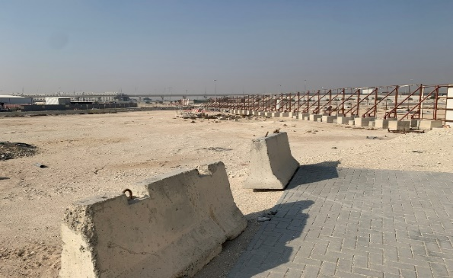
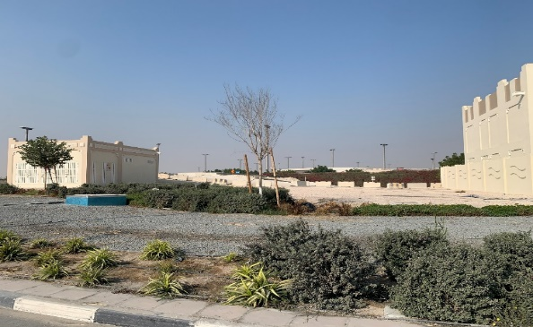
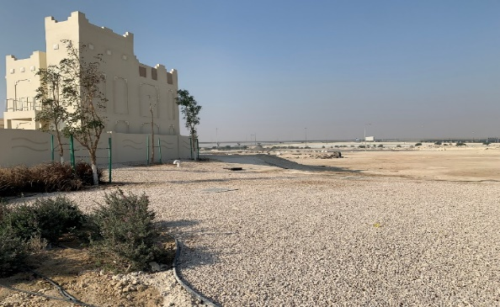
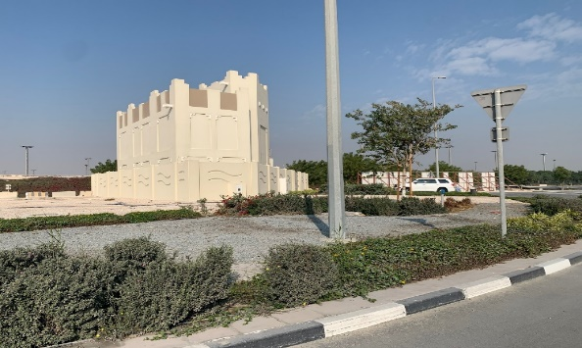
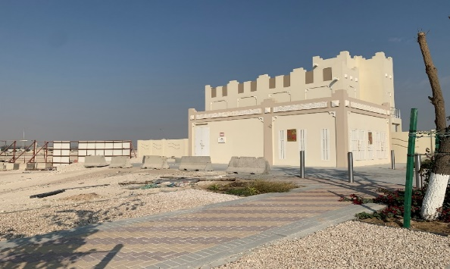
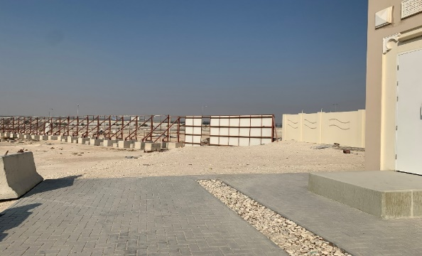
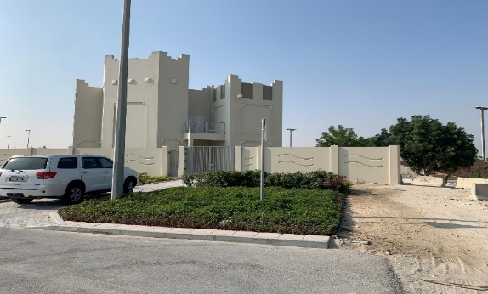
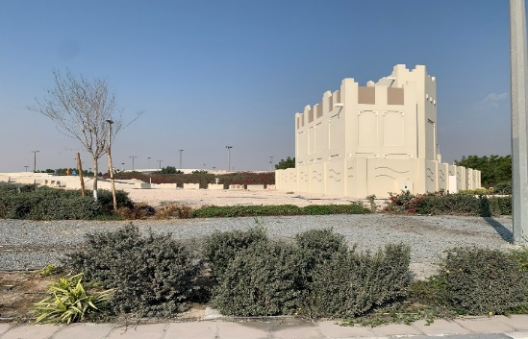
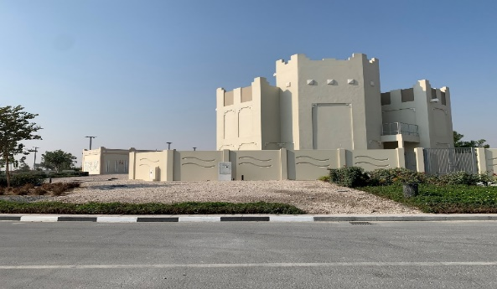
SOUTH POP BUILDING
PROPOSED POP BUILDING LOCATION COMPARISON
NORTH POP BUILDING

Slide 4
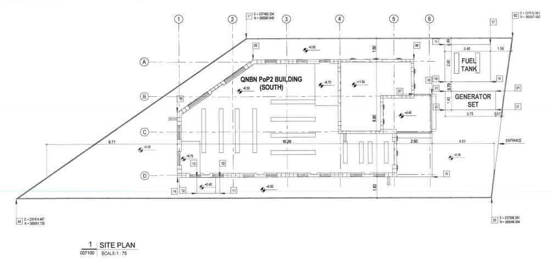
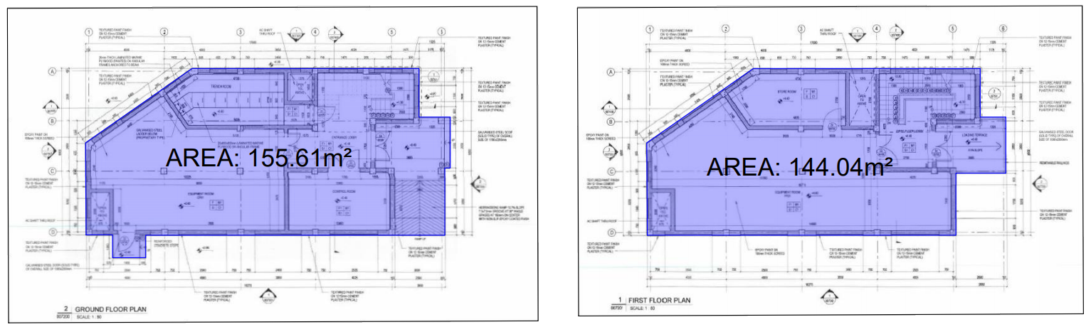
SOUTH POP BUILDING
Total GFA: 299.65 m2

Slide 5

C³ Required space program
 | NFA / m2
MoI SSD (Ministry of Interior - Security Systems Department) | 33
GAC (General Authority of Customs) | 33
QFZ | 261
EC3 - Enterprise Command & Control Center | 465
Supporting Spaces | 195
Future Growth @ 10% | 100
Total NFA | 1087
Above ground technical areas | 108
Core, vertical & horizontal circulation | 217
Total GFA | 1413

Slide 6
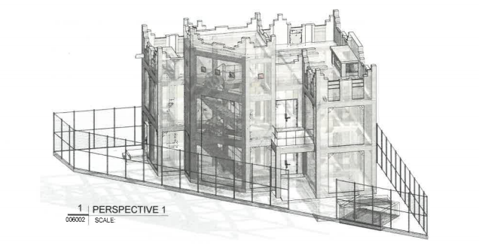
OPTION 1
Use of North pop-up and south pop-up buildings

Slide 7
Split space program
North PoP building
South PoP building
 | NFA / m2
MoI SSD (Ministry of Interior - Security Systems Department) | 33
GAC (General Authority of Customs) | 33
QFZ | 84
EC3 - Enterprise Command & Control Center | 290
Supporting Spaces | 200
Future Growth @ 10% | 70
Total NFA | 710
Above ground technical areas | 71
Core, vertical & horizontal circulation | 107
Total GFA | 888
 | NFA / m2
MoI SSD (Ministry of Interior - Security Systems Department)
GAC (General Authority of Customs)
QFZ | 177
EC3 - Enterprise Command & Control Center | 215
Supporting Spaces | 150
Future Growth @ 10% | 30
Total NFA | 572
Above ground technical areas | 57
Core, vertical & horizontal circulation | 86
Total GFA | 715

Slide 8
USE EXISTING POP BUILDINGS
 | Existing | Height | Required | Proposed
 | GFA | Height | GFA | GFA | Height
North PoP | 300 m2 | 11.9 m G+2 | 888m 2 | 900m2 | 25 m G+5
South PoP | 300 m2 | 12.8 m G+2 | 715 m2 | 750 m2 | 21 m G+4
Conclusion
North building 3 stories would need to be added and height would exceed the 15 meters limit by 10 meters
South building 2 stories would need to be added and height would exceed the 15 meters limit by 6 meters
The geometry of the building would be very slender and tall which is not very efficient in terms of ratio of circulation to floor plate and internal communication.
The Estimated costs for this option are QAR 12.8M with an overall duration of 12 months

Slide 9
OPTION 2
Use of North PoP and adjacent open area

Slide 10
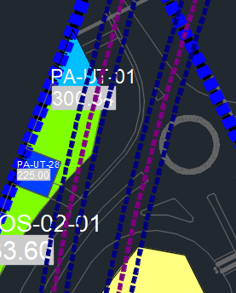
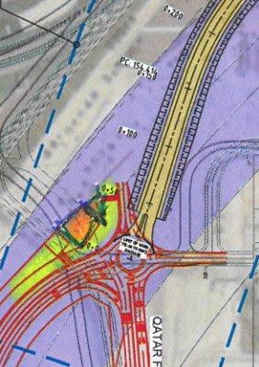
POP Buildings
Future HIA road connection
North PoP building: 300m2 GFA excluding circulation
Proposed expansion area

Slide 11
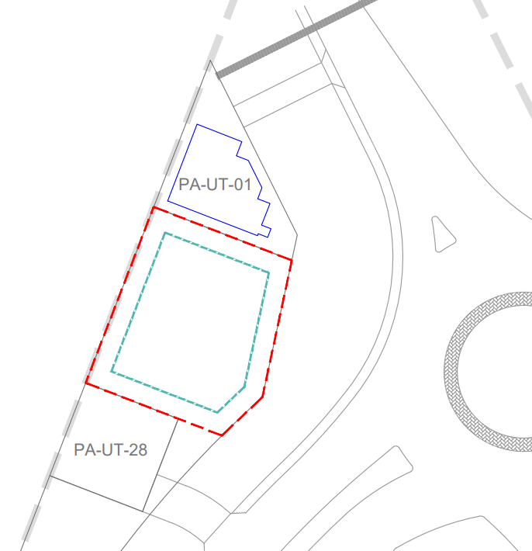
Pop Buildings
 | GFA | Height
Required area | 1413 m2
North PoP | 300 m2 | 11.9m G+1
Open area expansion | 1200 m2 | 12.5m G+2
Total GFA | 1500 m2 | Varies
400m2 footprint open area
Temp Parking
Parking is provided on public realm in front of buildings but would need to be moved in case HIA connection road will require this land.
The Estimated costs for this option are QAR 13.5M with an overall duration of 14 months

Slide 12
OPTION 3
Use of south PoP and part of adjacent utility plot.

Slide 13
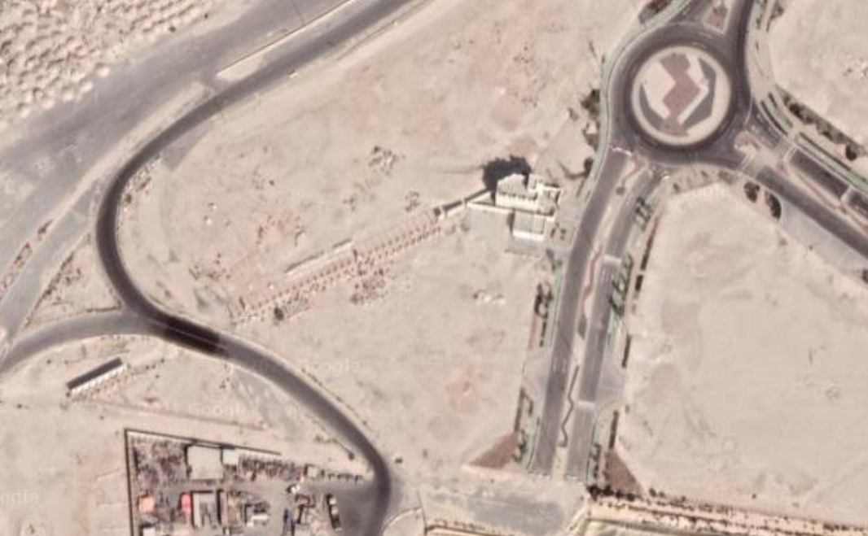
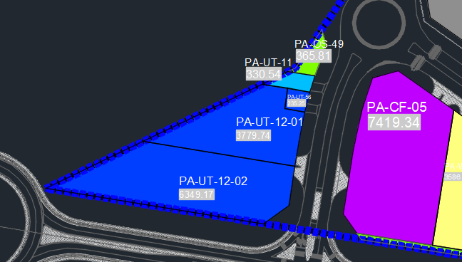
PoP Buildings
As per section 5.0 of the Final Potable Water report (EZ01-CW02-UCSA-UTL-RPT-00005 REV.8 )(Nov 2017 ) “The Potable Water reservoir has been removed following requirement of direct connection with the Kahramaa (Water).” therefore the Utility Plots PA-UT-12-01 & PA-UT-12-01 are no longer required and expansion onto these plots can be considered.
South PoP building: 300m2 GFA excluding circulation
Proposed expansion area on lot PA-UT12-01

Slide 14
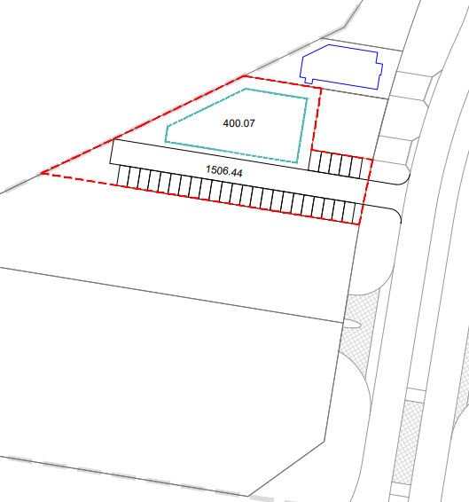
Pop Buildings
400m2 footprint open area
 | GFA | Height
Required area | 1413 m2
South PoP | 300 m2 | 11.9m G+1
Open area expansion | 1200 m2 | 12.5m G+2
Total GFA | 1500 m2 | Varies
1500 m2
plot area
400m2 footprint open area
Plot PA-UT-56
Plot PA-UT-12-01
25 parking
spaces
The Estimated costs for this option are QAR 13.2M with an overall duration of 14 months
Plot PA-UT-12-02

Slide 15
OPTION 4
Custom design on new plot

Slide 16
New Plot assumptions
GFA optimized space program: 1500m2
Height : G+2 (12-14m)
Parking : 25 parking's
Footprint: 500 m2
Parking area: 750 m2
Ancillary uses, circulation and landscape: 250 m2
Total plot area required approximately: 1500 m2

Slide 17
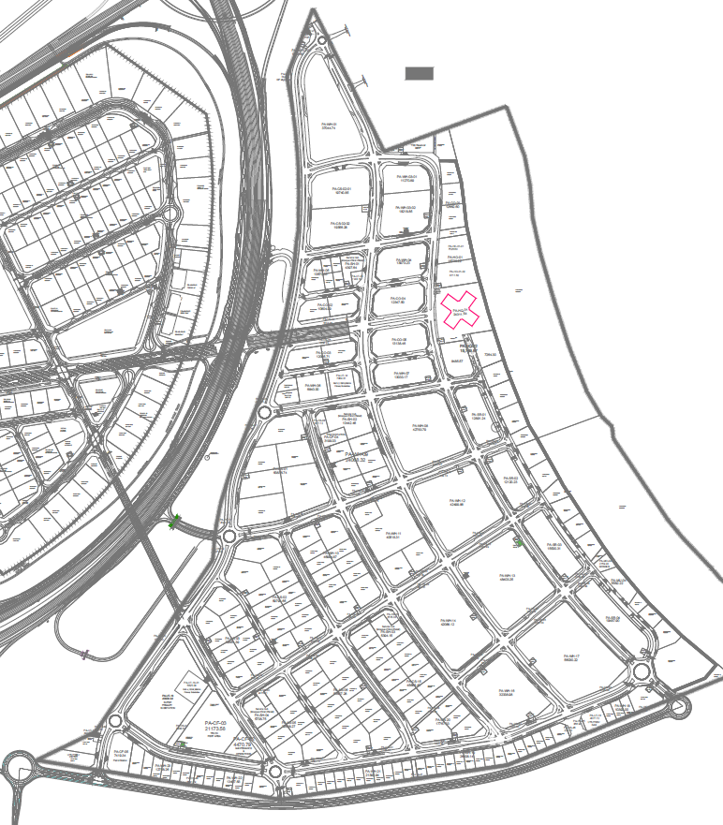

Proposed plot location plan
Pending Land allocation
approval
Option 1
(Total Area = 2993 m² )
Option 2
(Total Area = 2609.76 m² )

Slide 18
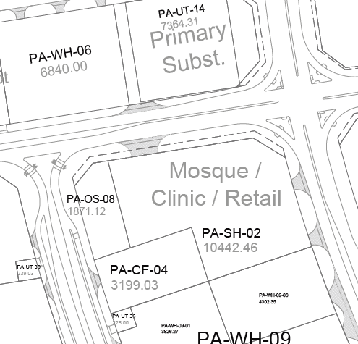

Option A
Pending Land allocation
approval
Ras Bufontas Location Option 1 – Plot PA-SH-02-01
(now Service Hub subdivided plot, former plot PO-MO- 02)
Key Planning Regulations
Plot Area | m² | 2993m²
Max. Plot Coverage | 60% | 1,795.8m²
Min. Permeable Area | 15% | 448.95m²
Min. Planting Area | 6% | 179.58m²
Max. FAR / Total GFA | 0.60 | 1,795.8m²
Min. Car Parking Spaces | .377/100 | 7
Basement | - | n/a
Max. Building Frontage | 70% | -
Max. Building Height | G+1 | 15 m
Utility Demand Allocation
 | Avg. Demand
Electrical Demand Load (KVA) | 101.6
Foul / Sewage (m³/day) | 20.63
Potable Water (m³/day) | 0.31
Fire Water (gpm) @min 8bar pressure | 550
Irrigation | -
Storm Water Storage (m³) | -
PA-SH-02-01
PA-SH-02-02
18

Slide 19
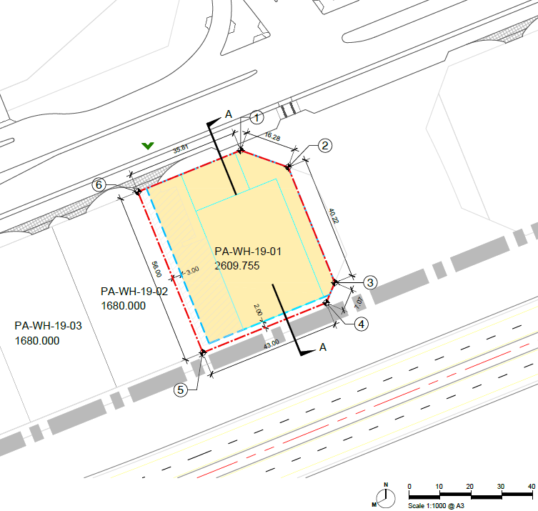
Option B
Pending Land allocation
approval
Ras Bufontas Location Option 2 - Plot PA-WH-19-01
Key Planning Regulations
Plot Area | m² | 2609.76m²
Max. Plot Coverage | 60% | 1565.86m²
Min. Permeable Area | 15% | 391.46m²
Min. Planting Area | 6% | 156.59m²
Max. FAR / Total GFA | 0.60 | 1565.86m²
Min. Car Parking Spaces | .377/100 | 6
Basement | - | n/a
Max. Building Frontage | 70% | -
Max. Building Height | G+M | 15 m
Utility Demand Allocation
 | Avg. Demand
Electrical Demand Load (KVA) | 257.09
Foul / Sewage (m³/day) | 0.72
Potable Water (m³/day) | 1.03
Fire Water (gpm) @min 8bar pressure | 2000
Irrigation | -
Storm Water Storage (m³) | -
19
19

Slide 20
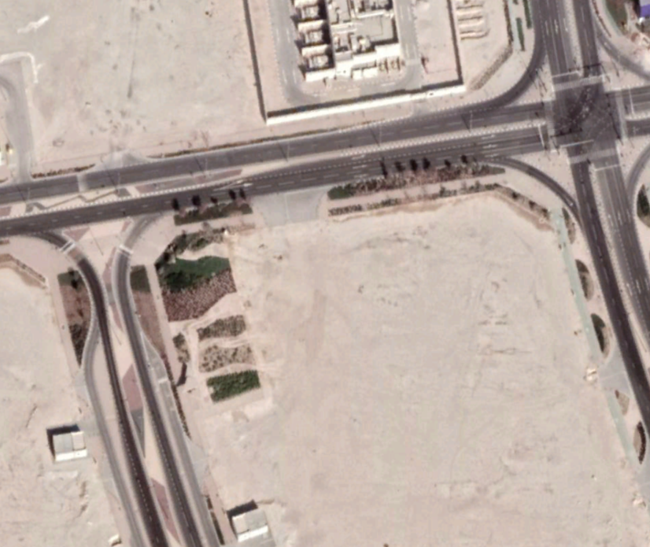
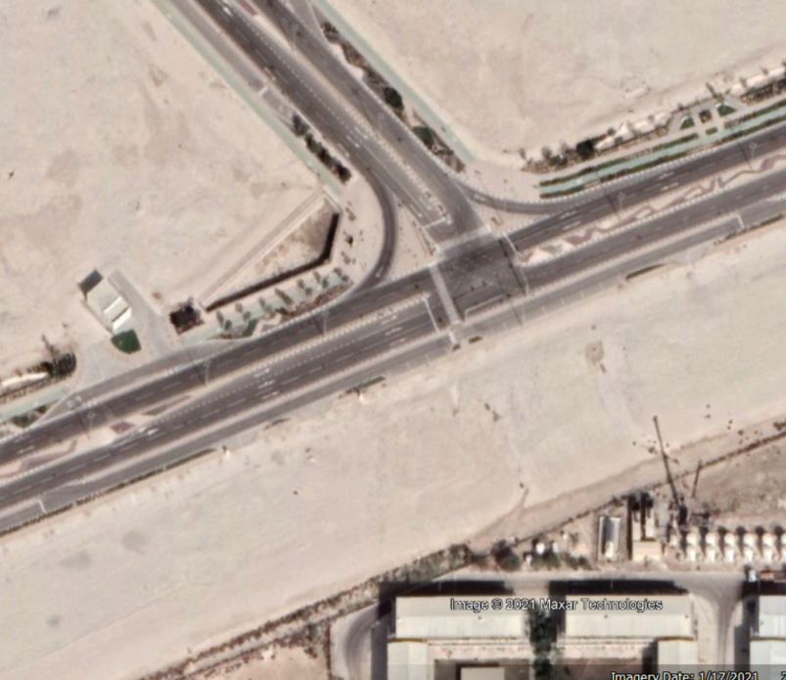
SWOT Analysis
Pending Land allocation
approval
 | STRENGTHS | WEAKNESSES | OPPORTUNITIES | THREATS
Option A (Total Area = 2993m²) | 1. Parcel A central location, part of Service Hub / community services zoned lands. | - | 1. Given the location within the Service Hub plot, there is opportunity for the customs building to be converted into a community facility building once the customs facility is no longer required at this location. | -
 | 2. Relatively level site with small level differences across the site. | - | 2. Opportunity to extend development on the adjacent open space area in order to accommodate any potential building extension / additional parking requirements. | -
 | 3.Larger overall plot size which can amply accommodate space for all required activities within the site and even potential expansion should it be required. . | - |  | -
Option B (Total Area = 2609.76m²) | 1. Relatively level site with small level differences across the site. | 1. Remote location at Southern end of Parcel A. | 1. Opportunity to extend development on the adjacent open space area in order to accommodate any potential building extension / additional parking requirements. | 1. A customs building developed on this site may not be suitable for conversion to accommodate future use / needs of potential investors once the customs facility will no longer be required at this location.
 | 2. Site located within IT / Technology cluster, therefore proposed facility use is compatible with the land use zoning. | - | - | -
Option 1 site conditions
Recommendation is to utilize the Option 1 location due to the points mentioned above.
Option 2 site conditions
20

Slide 21
High Level Indicative Program for the Proposed Command & Control Center (C³) in Ras Bufontas Free Zone

Slide 22
C³ PoP Buildings SWOT
 | Space | Cost | Time | Risk
Option 1 Using PoP buildings only | North building + 3 floors South building + 2 floors Height of the north building at 24 meters approximately would exceed the 15-meter limit by 9 meters. | Complicated structure, limited size and geometry for uses. Total Estimated Cost QAR 12.8M | Extension of two to three floors on existing structure will require more complex design, planning and construction procedures Estimated development program 12 months | Complex construction process. Limited space and layout options. Unfavorable vertical circulation.
 | + | +++ | + | +
Option 2 Using north PoP building with adjacent public plot | Adjacent plot together with existing PoP building would allow for a GFA of approximately 1500m2 which would suit the required optimized space program of 1413m2. | Reduced works due to use of existing structure Total Estimated Cost QAR 13.5M | New built section can be designed to match schedule. Existing Pop-up structure should be designed for minor adjustments only. Overall reduced construction scope. Estimated development program 14 months | Scope creep could put strain on limited available BUA
 | +++ | ++ | +++ | ++
Option 3 Using south PoP building with part of adjacent utilities plot | Adjacent plot together with existing PoP building would allow for a GFA of approximately 1500m2 which would suit the required optimized space program of 1413m2. Also, parking could be accommodated on the adjacent plot. | Reduced works due to use of existing structure Cost of land. Utility plot could equally be converted to investor plot instead of use for CCC. Total Estimated Cost QAR 13.2M | New built section can be designed to match schedule. Existing Pop-up structure should be designed for minor adjustments only. Overall reduced construction scope. Estimated development program 14 months
 | +++ | ++ | +++ | +++
Option 4 Custom design on new plot | A plot of 1500 m2 would be required. | Cost of land, loss of revenue, possible demolition costs once CCC moves to UAH Total Estimated Cost QAR 14M | Design and construction methodology can be chosen to reduce time. Estimated development program 18 months | Use of building once command control center moves to UAH.
 | ++ | + | ++ | ++
Option 5 Qatar national broadband network (QNBN) (Maintain 50% use and expansion on public open space | Not considered since use of Pop-ups by themselves without QNBN is already a challenge in terms of areas and height restrictions.

Slide 23
SWOT Conclusion
The recommended option is number 3; the South PoP building and the adjacent utility plots. Option 3 provides a better compromise making use of the existing Pop building and the previously allocated plots for utilities next to it. In addition, it removes any uncertainty around land limitations with the potential HIA Bridge or Ashghal Utility access associated with the North PoP Building. Moreover, it is neighboring the proposed General Authority of Customs (GAC) permanent offices/inspection sites and will have a more accessible network of roads based on proposed masterplan.
Lastly, while the growth potential is protected by choosing the South PoP building, this land could equally be freed up and allocated to investors if utility use is no longer required. (Confirm with Mr. Abdulla)
Existing South PoP building: 300m2 GFA ex. circulation
Proposed expansion area on lot PA-UT12-01

