Slide 1


AIRCRAFT - Traditional vs. Modern Solutions
This presentation explores the evolution of air travel, comparing traditional and modern solutions, discussing the advantages and disadvantages of each, and highlighting the future of aviation.
By Dharamveer &Roshan kartick
Notes:
Morning to one and all watching this video
Today I am going to present about the planes
This presentation explores the evolution of air travel, comparing traditional and modern solutions, discussing the advantages and disadvantages of each, and highlighting the future of aviation.

Slide 2
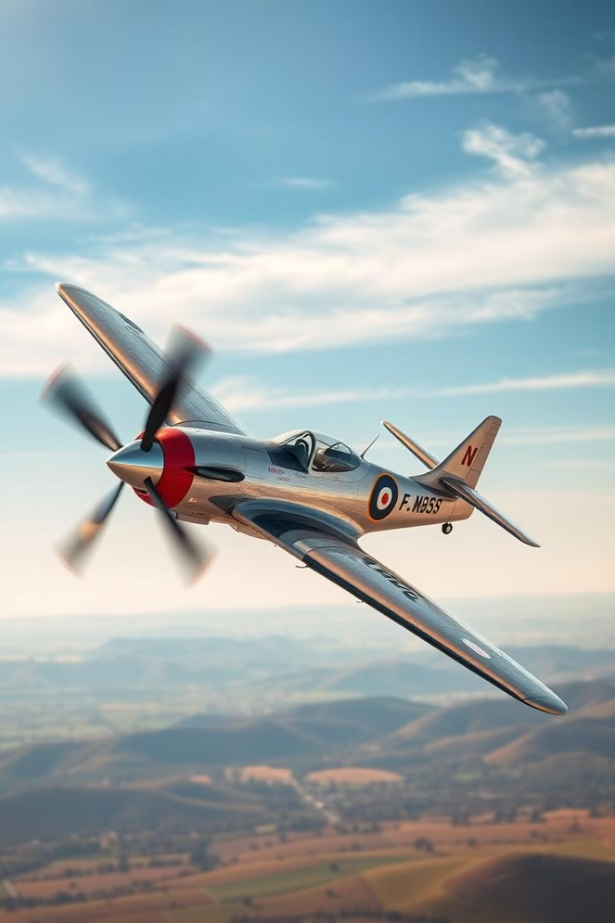
Traditional Planes: Advantages
1
Established Infrastructure
2
Proven Technology
Years of research and development have resulted in reliable and efficient engines and airframes.
Extensive network of airports and maintenance facilities, providing a well-established framework for operation.
3
Cost-Effectiveness
Traditional planes are often more affordable to operate and maintain compared to newer technologies.
Notes:
Advantages of traditional planes
Established Infrastructure
Extensive network of airports and maintenance facilities, providing a well-established framework for operation.
Proven Technology
Years of research and development have resulted in reliable and efficient engines and airframes.
Cost-Effectiveness
Traditional planes are often more affordable to operate and maintain compared to newer technologies.

Slide 3
Traditional Planes: Disadvantages
Fuel Consumption
Noise Pollution
Limited Efficiency
Traditional planes rely on fossil fuels, leading to high carbon emissions and contributing to climate change.
The engines of traditional planes generate significant noise, impacting communities near airports.
Traditional planes are less fuel-efficient than newer technologies, resulting in higher operating costs.
Notes:
Traditional Planes: Disadvantages
Fuel Consumption
Traditional planes rely on fossil fuels, leading to high carbon emissions and contributing to climate change.
Noise Pollution
The engines of traditional planes generate significant noise, impacting communities near airports.
Limited Efficiency
Traditional planes are less fuel-efficient than newer technologies, resulting in higher operating costs.

Slide 4
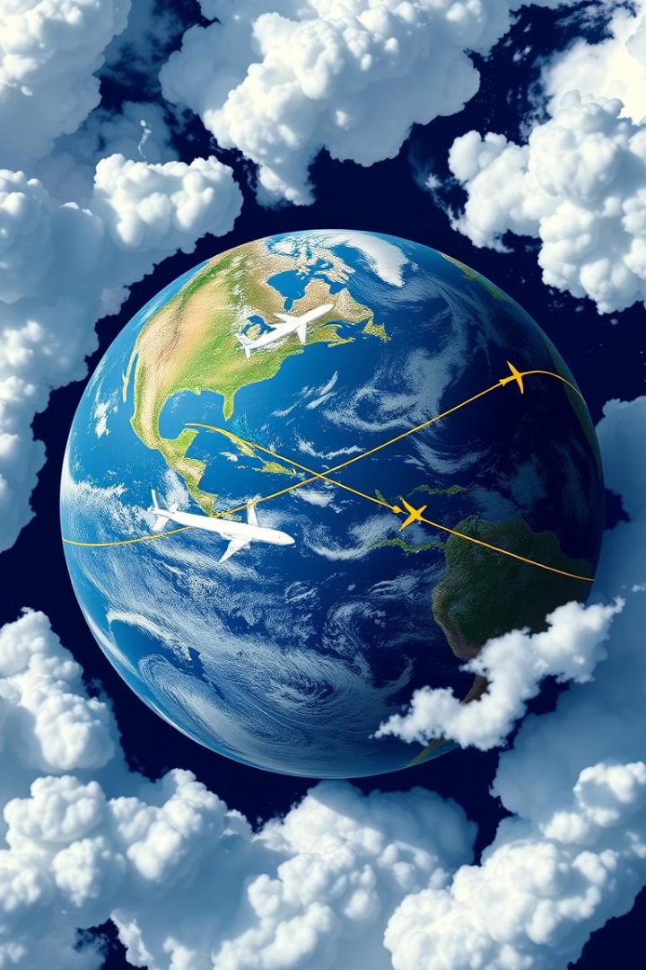
Environmental Impact of Traditional Planes
1
Carbon Emissions
Aviation contributes significantly to greenhouse gas emissions, accelerating climate change.
2
Noise Pollution
Aircraft noise impacts wildlife and human communities near airports, disrupting ecosystems and affecting well-being.
3
Air Quality
Emissions from aircraft engines contribute to air pollution, harming human health and the environment.
Notes:
Environmental Impact of Traditional Planes
Carbon Emissions
Aviation contributes significantly to greenhouse gas emissions, accelerating climate change.
Noise Pollution
Aircraft noise impacts wildlife and human communities near airports, disrupting ecosystems and affecting well-being.
Air Quality
Emissions from aircraft engines contribute to air pollution, harming human health and the environment.

Slide 5
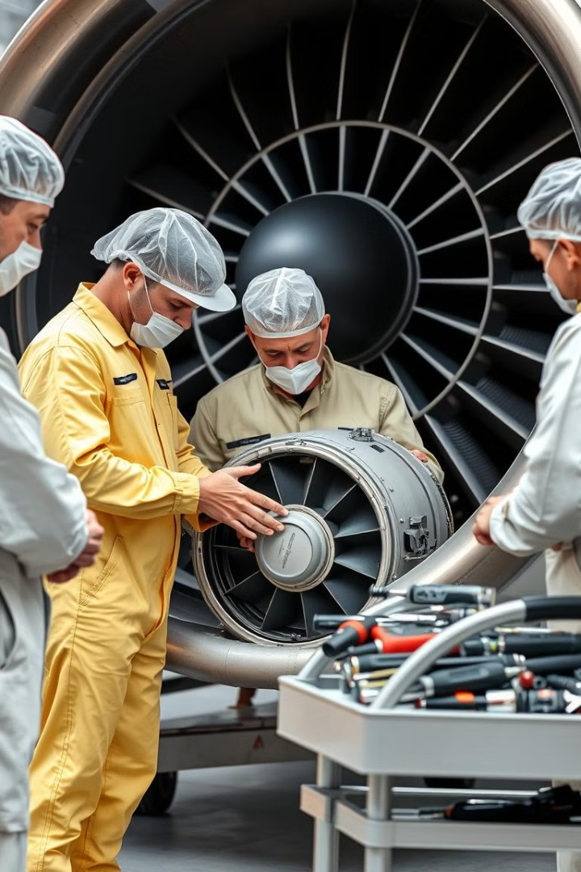



Reliability and Safety Concerns
Mechanical Failures
Traditional planes are complex machines with numerous components that can malfunction.
Human Error
Pilot fatigue, miscommunication, and decision-making errors can lead to accidents.
Weather Conditions
Turbulence, storms, and other weather events can pose significant risks to air travel.
Notes:
Reliability and Safety Concerns
Mechanical Failures
Traditional planes are complex machines with numerous components that can malfunction.
Human Error
Pilot fatigue, miscommunication, and decision-making errors can lead to accidents.
Weather Conditions
Turbulence, storms, and other weather events can pose significant risks to air travel.

Slide 6
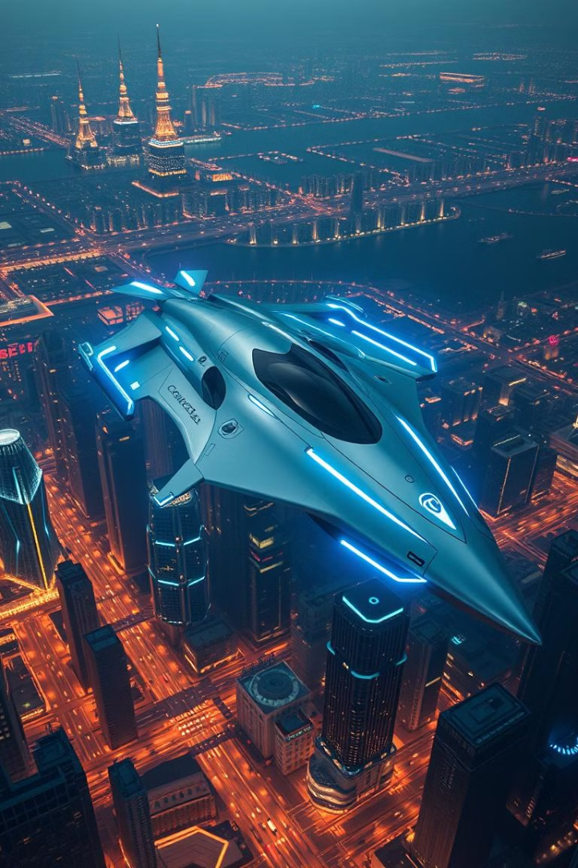
Emerging Technologies in Aviation
Hybrid Propulsion
Electric Aircraft
Combining traditional jet engines with electric motors for increased fuel efficiency and reduced emissions.
Fully electric aircraft powered by batteries, offering zero-emission flight and quiet operation.
Autonomous Flight
Developing AI-powered systems for autonomous aircraft navigation, enhancing safety and efficiency.
Notes:
Emerging Technologies in Aviation
Hybrid Propulsion
Combining traditional jet engines with electric motors for increased fuel efficiency and reduced emissions.
Electric Aircraft
Fully electric aircraft powered by batteries, offering zero-emission flight and quiet operation.
Autonomous Flight
Developing AI-powered systems for autonomous aircraft navigation, enhancing safety and efficiency.

Slide 7
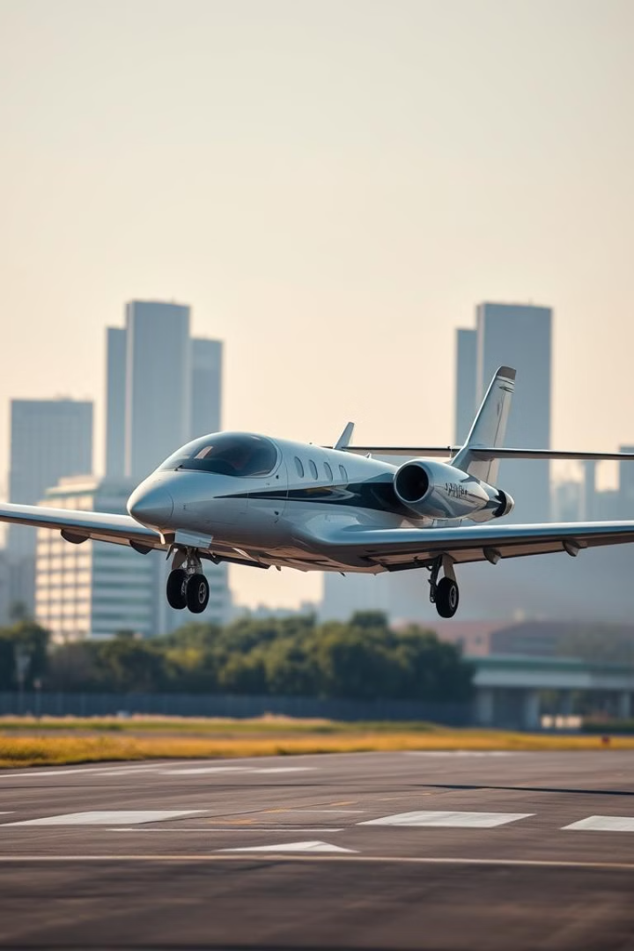
Hybrid and Electric Plane Solutions
Technology
Advantages
Disadvantages
Hybrid Planes
Reduced fuel consumption and emissions, improved efficiency
Higher initial cost, limited range, complexity of integration
Electric Planes
Zero-emission flight, quieter operation, lower maintenance costs
Limited battery range, high charging infrastructure requirements, weight limitations
Notes:
Hybrid and Electric Plane Solutions
Advantages & disadvantage

Slide 8
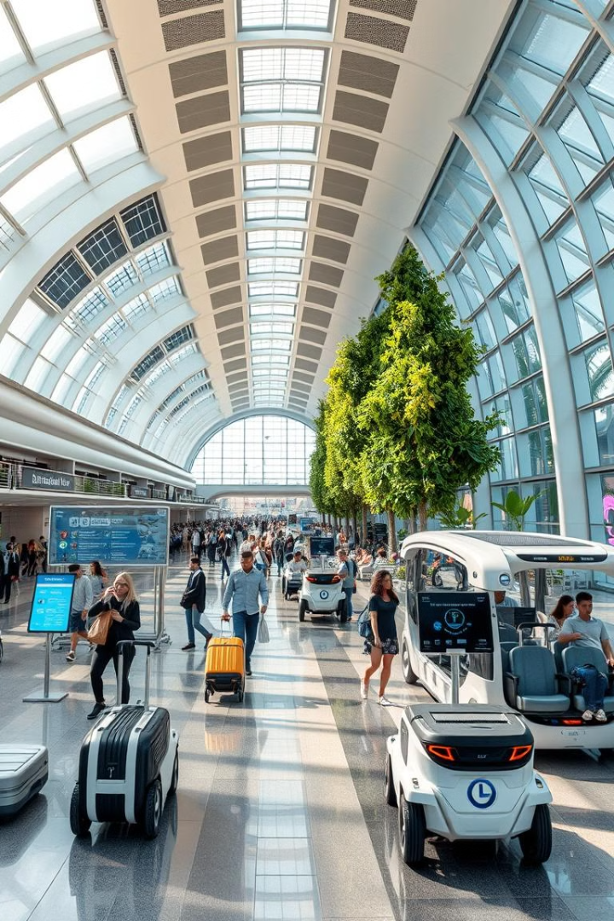




The Future of Air Travel
Sustainable Aviation
Faster Travel Times
Focus on reducing environmental impact through fuel-efficient aircraft and alternative propulsion systems.
Advances in technology and infrastructure enable quicker journeys and more efficient routes.
Enhanced Passenger Experience
Increased Accessibility
Expanding air travel to underserved regions through innovative aircraft designs and infrastructure.
More comfortable and personalized experiences with advanced cabin amenities and personalized services.
Notes:
The Future of Air Travel
Sustainable Aviation
Focus on reducing environmental impact through fuel-efficient aircraft and alternative propulsion systems.
Faster Travel Times
Advances in technology and infrastructure enable quicker journeys and more efficient routes.
Enhanced Passenger Experience
More comfortable and personalized experiences with advanced cabin amenities and personalized services.
Increased Accessibility
Expanding air travel to underserved regions through innovative aircraft designs and infrastructure.

Slide 9

Conclusion and Key Takeaways
The future of air travel is marked by innovation and sustainability. While traditional planes offer proven technology and infrastructure, emerging technologies like hybrid and electric planes offer a more sustainable and efficient approach. The industry is evolving towards a future of clean and accessible air travel, shaping the way we connect and explore the world.
Notes:
Conclusion and Key Takeaways
The future of air travel is marked by innovation and sustainability. While traditional planes offer proven technology and infrastructure, emerging technologies like hybrid and electric planes offer a more sustainable and efficient approach. The industry is evolving towards a future of clean and accessible air travel, shaping the way we connect and explore the world.

Slide 10
Thank
You
Notes:
Thank you

