Slide 1

खेल शिक्षा
(physical education)

Slide 2
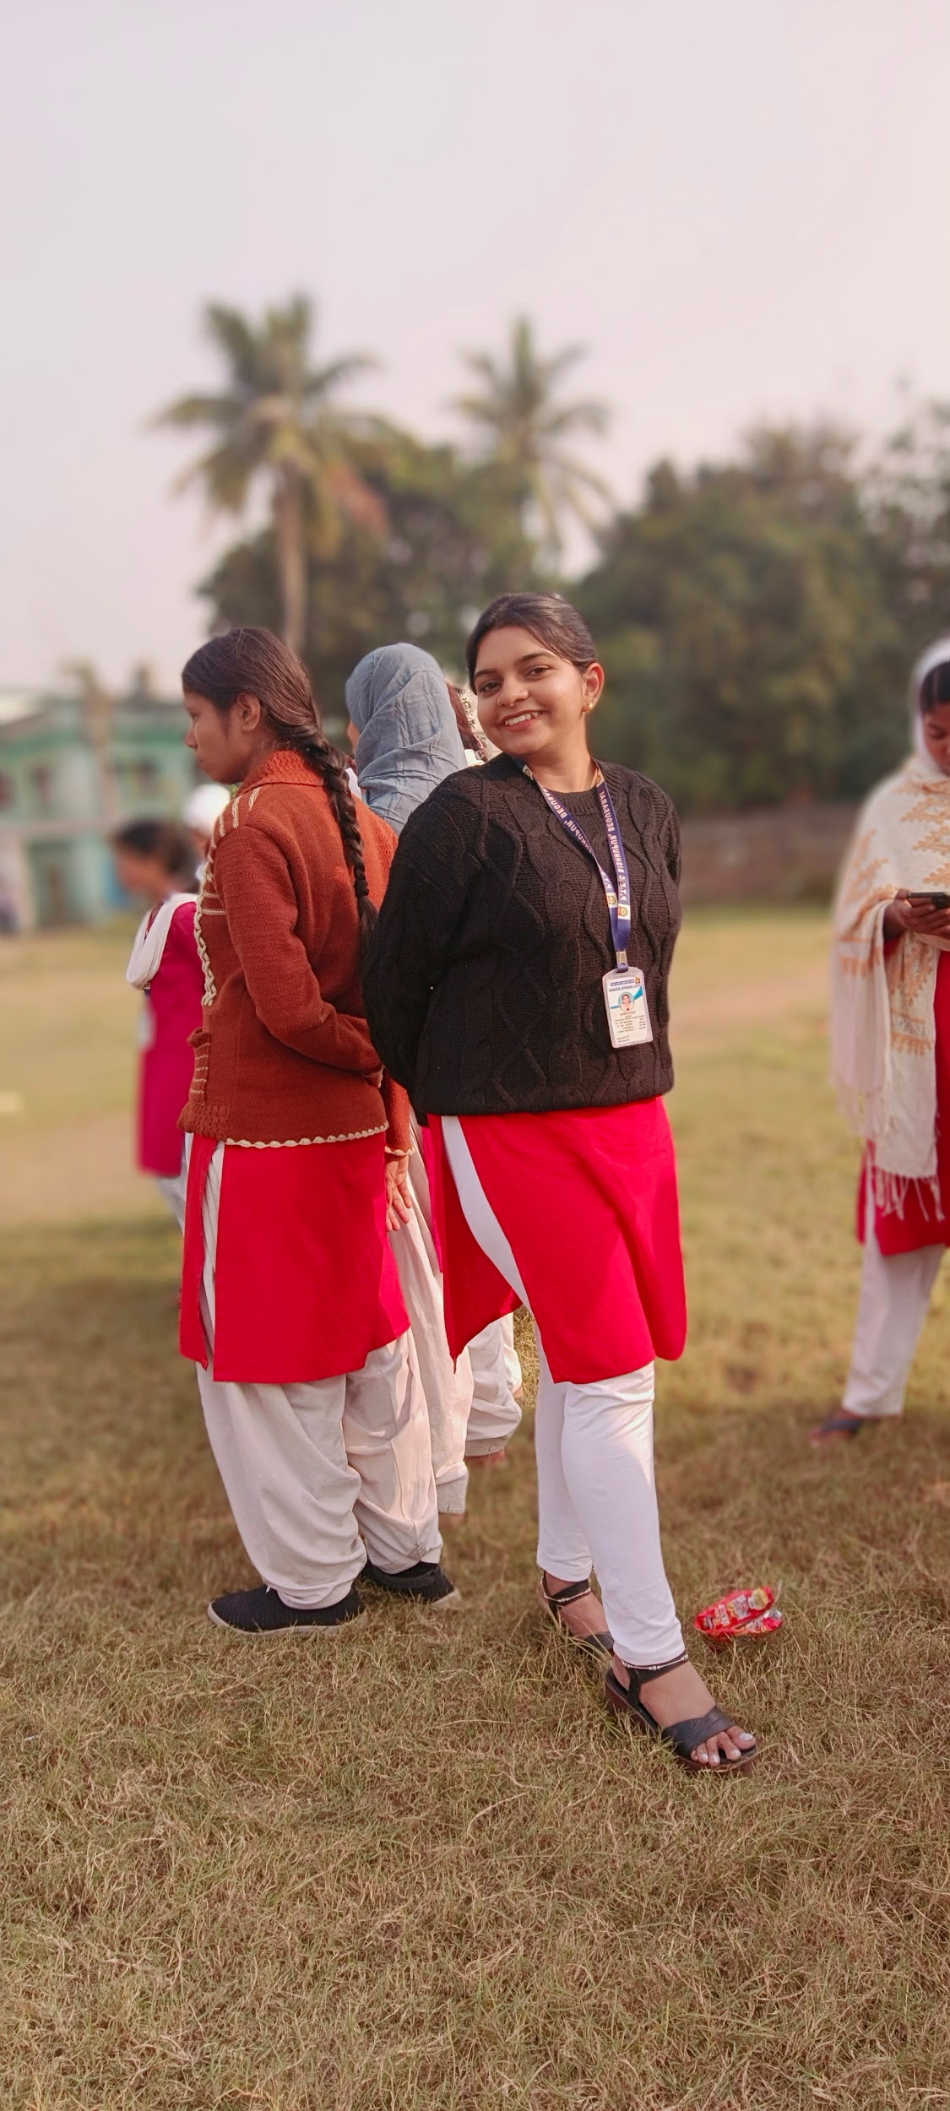
Hosting by Tanya

Slide 3

Poster made by
Presenting by Shivam Sima Salma

Slide 4
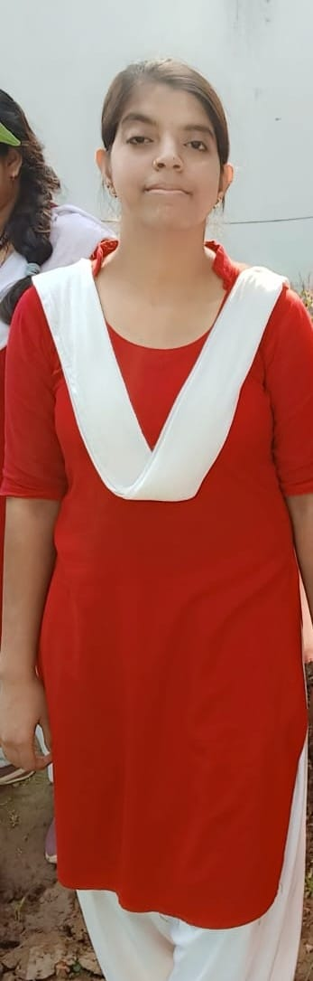
खेल क्या है ?खेलकूद की अवधारणा
Presenting by sakshi

Slide 5
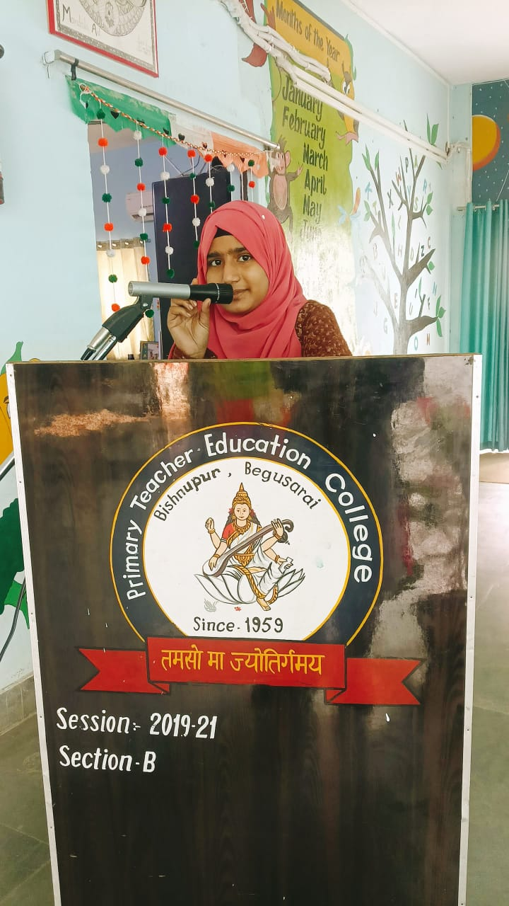
खेल एवं खेलकूद का महत्व तथा बुनियादी आधार
Presenting by rukshar

Slide 6
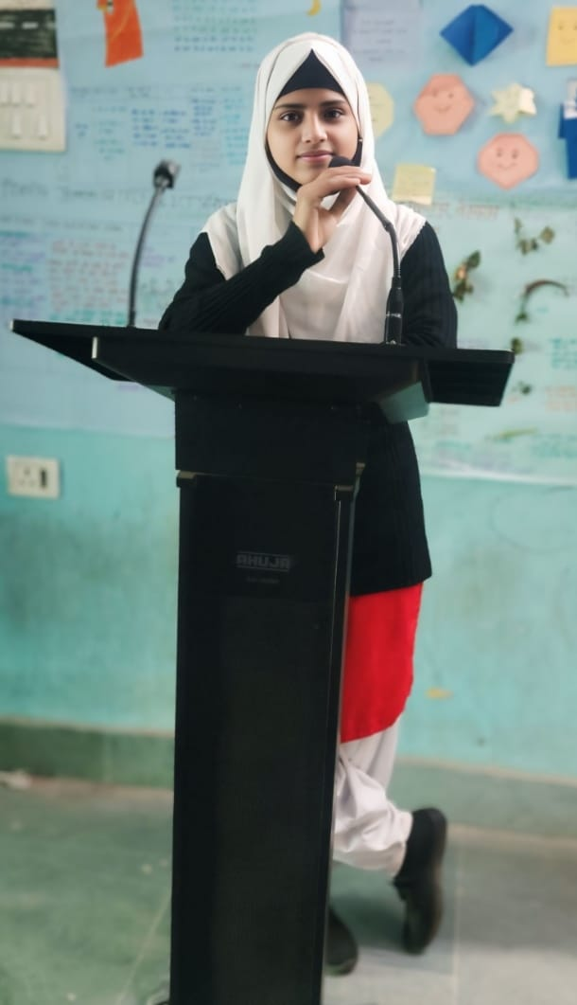
खेल को विद्यालय पाठ्यक्रम का हिस्सा बनने के सबसे महत्वपूर्ण लाभ
Zainab Khatun

Slide 7
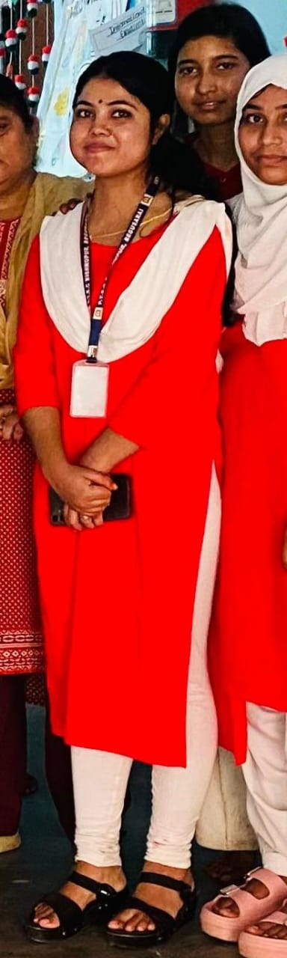
Case study
Presenting Shivani

Slide 8
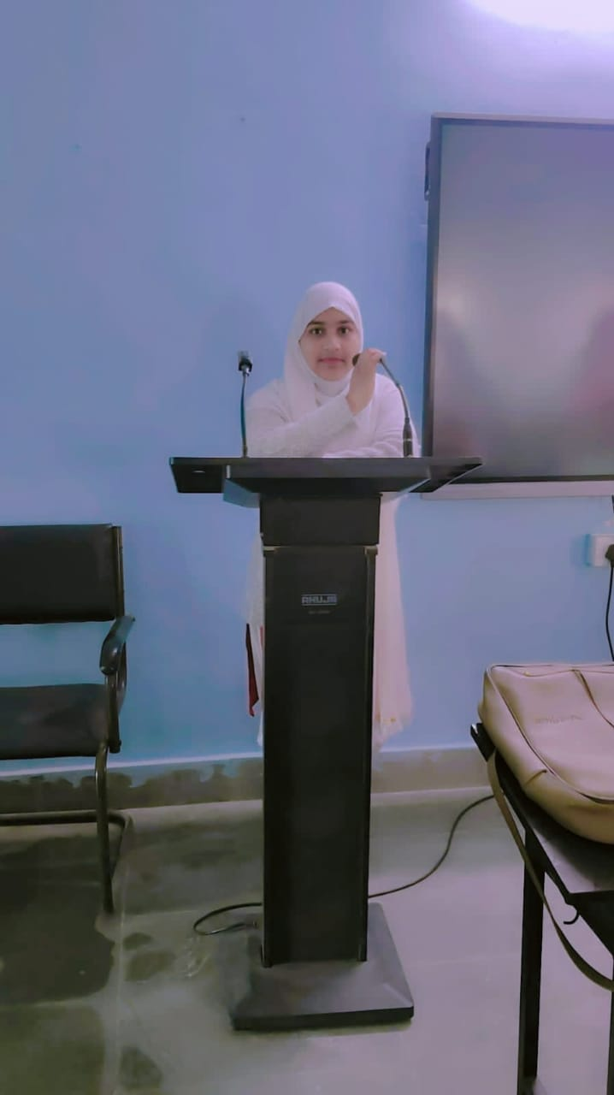
खेल में अनुभव करके सीखना
Saishta

Slide 9

मनोरंजनआत्मक शैक्षिक खेल का महत्व
Shagufa

Slide 10


Slide 11

Atheletics
Presenting by शत्रुध्न

Slide 12
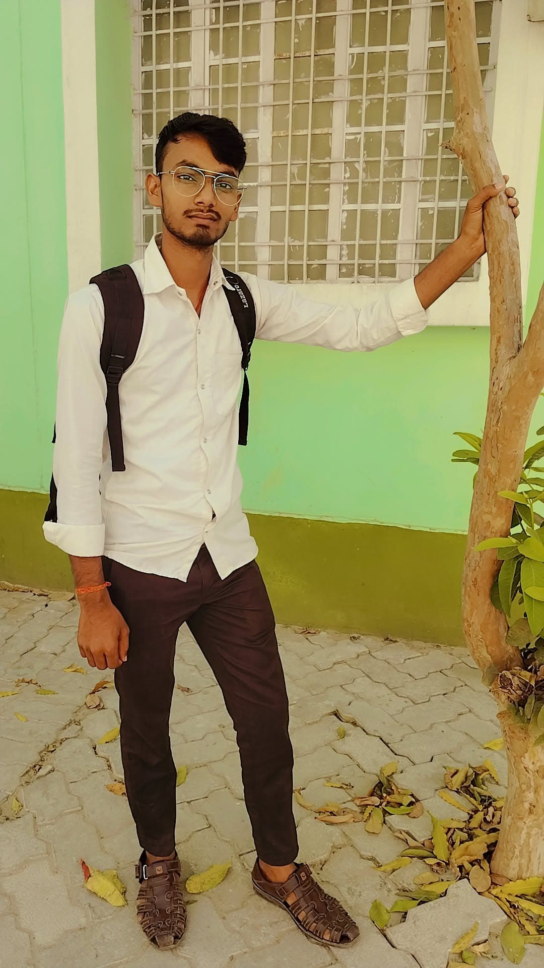
कबड्डी
Presenting by Umesh Kumar

Slide 13
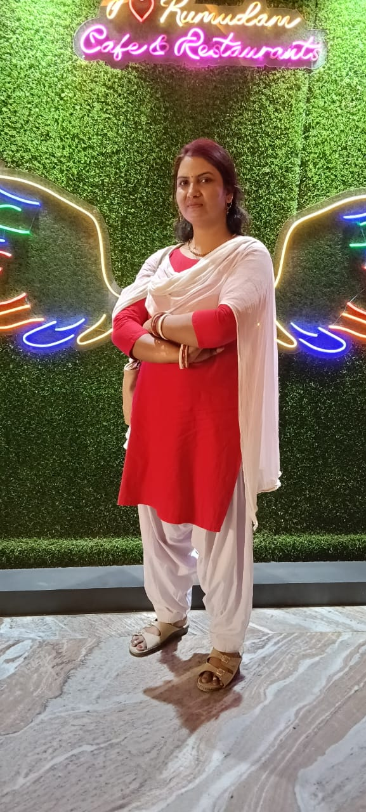
खो खो
Presenting by Rinku ji

Slide 14
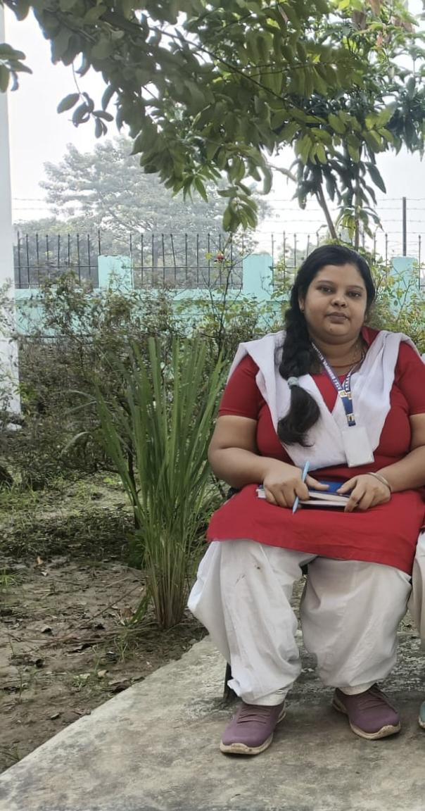
फुटबॉल
Presenting
by sakshi Saurav

Slide 15

Cricket
Presenting by sushil kumar

Slide 16
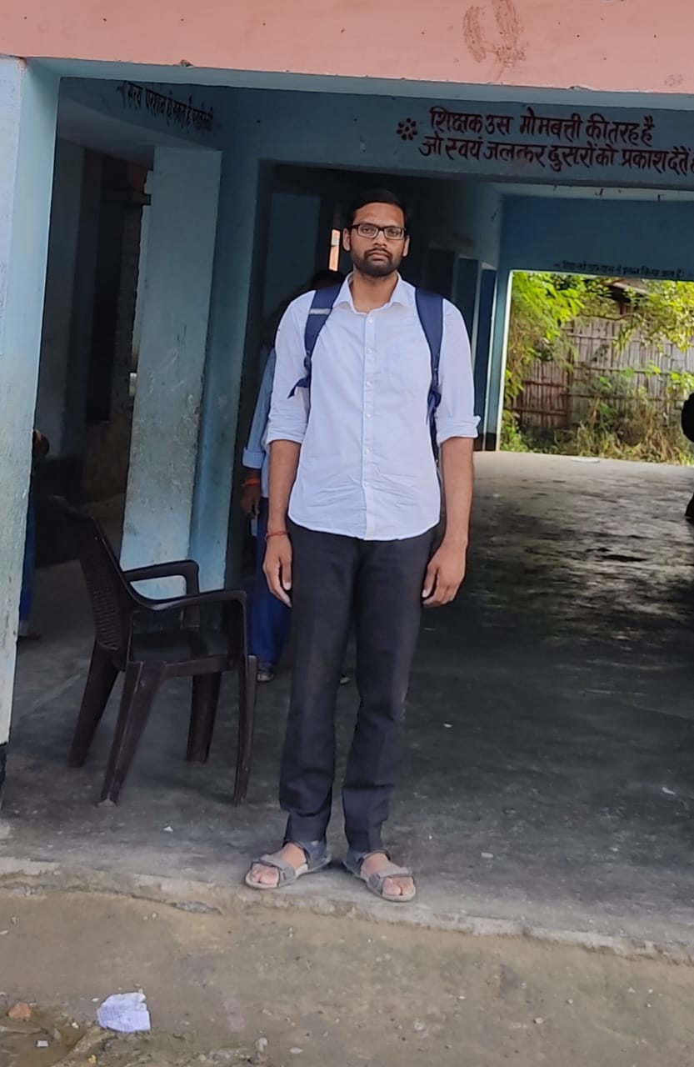
Volleyball
Presenting by shivam

Slide 17
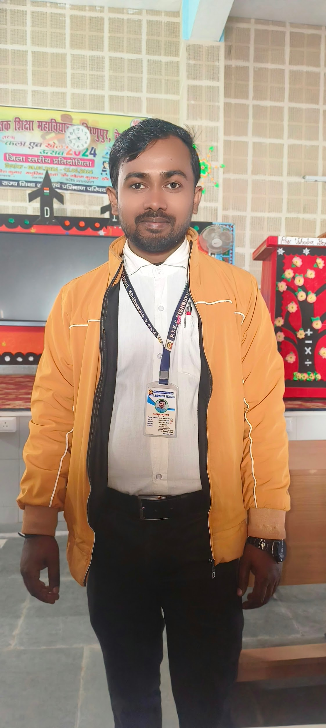
Badminton
Presenting by Rajesh

Slide 18
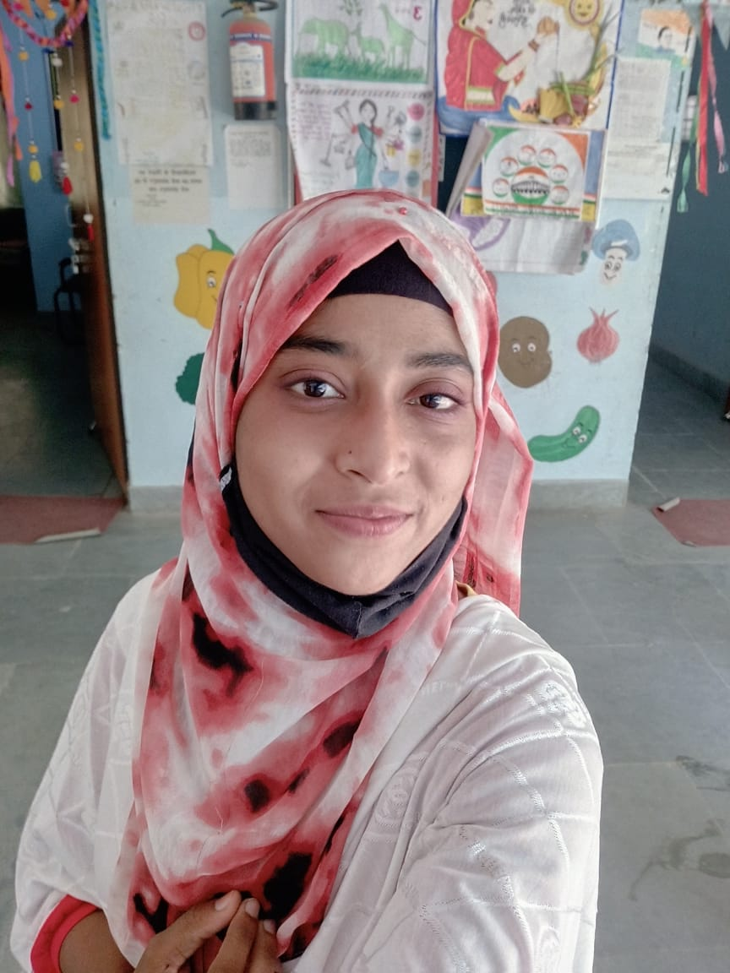
Basketball
Presenting by Saeshta Khatun

Slide 19
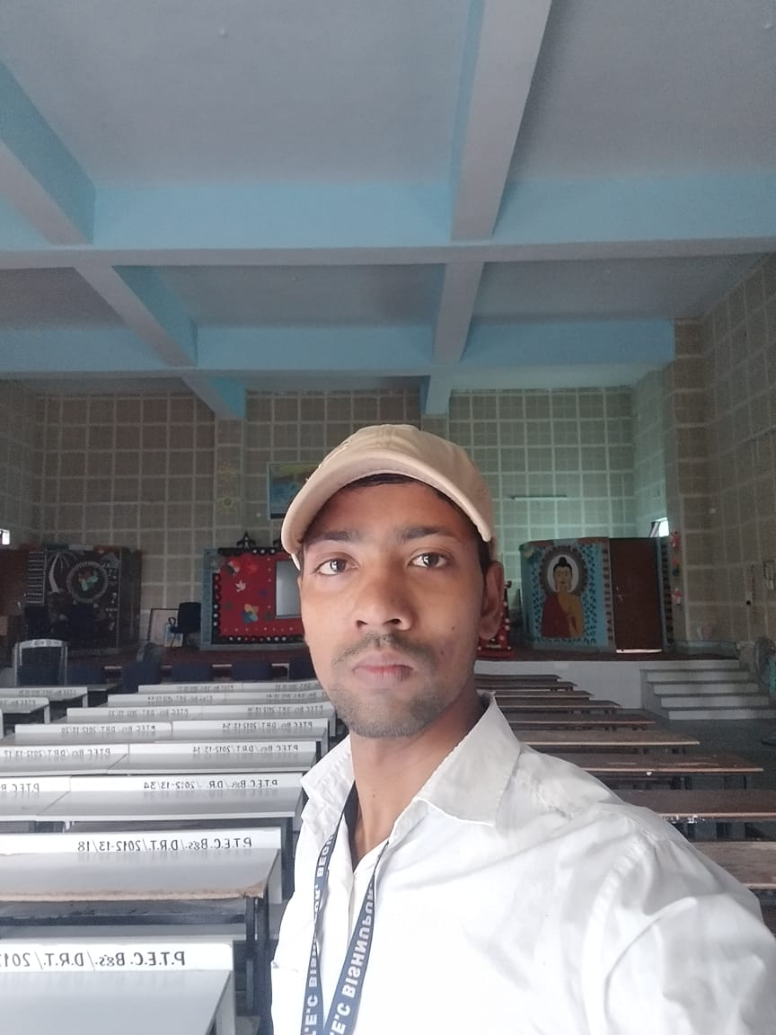
प्रारंभिक विद्यालय को समय सारणी में खेलकूद का स्थान तथा इसका प्रभावी उपयोग
Presenting by Sikander Kumar

Slide 20

खिलाड़ी को चोट से बचाव उपचार ( Prevent and treat player injuries)
Presenting by Shatrughan

Slide 21
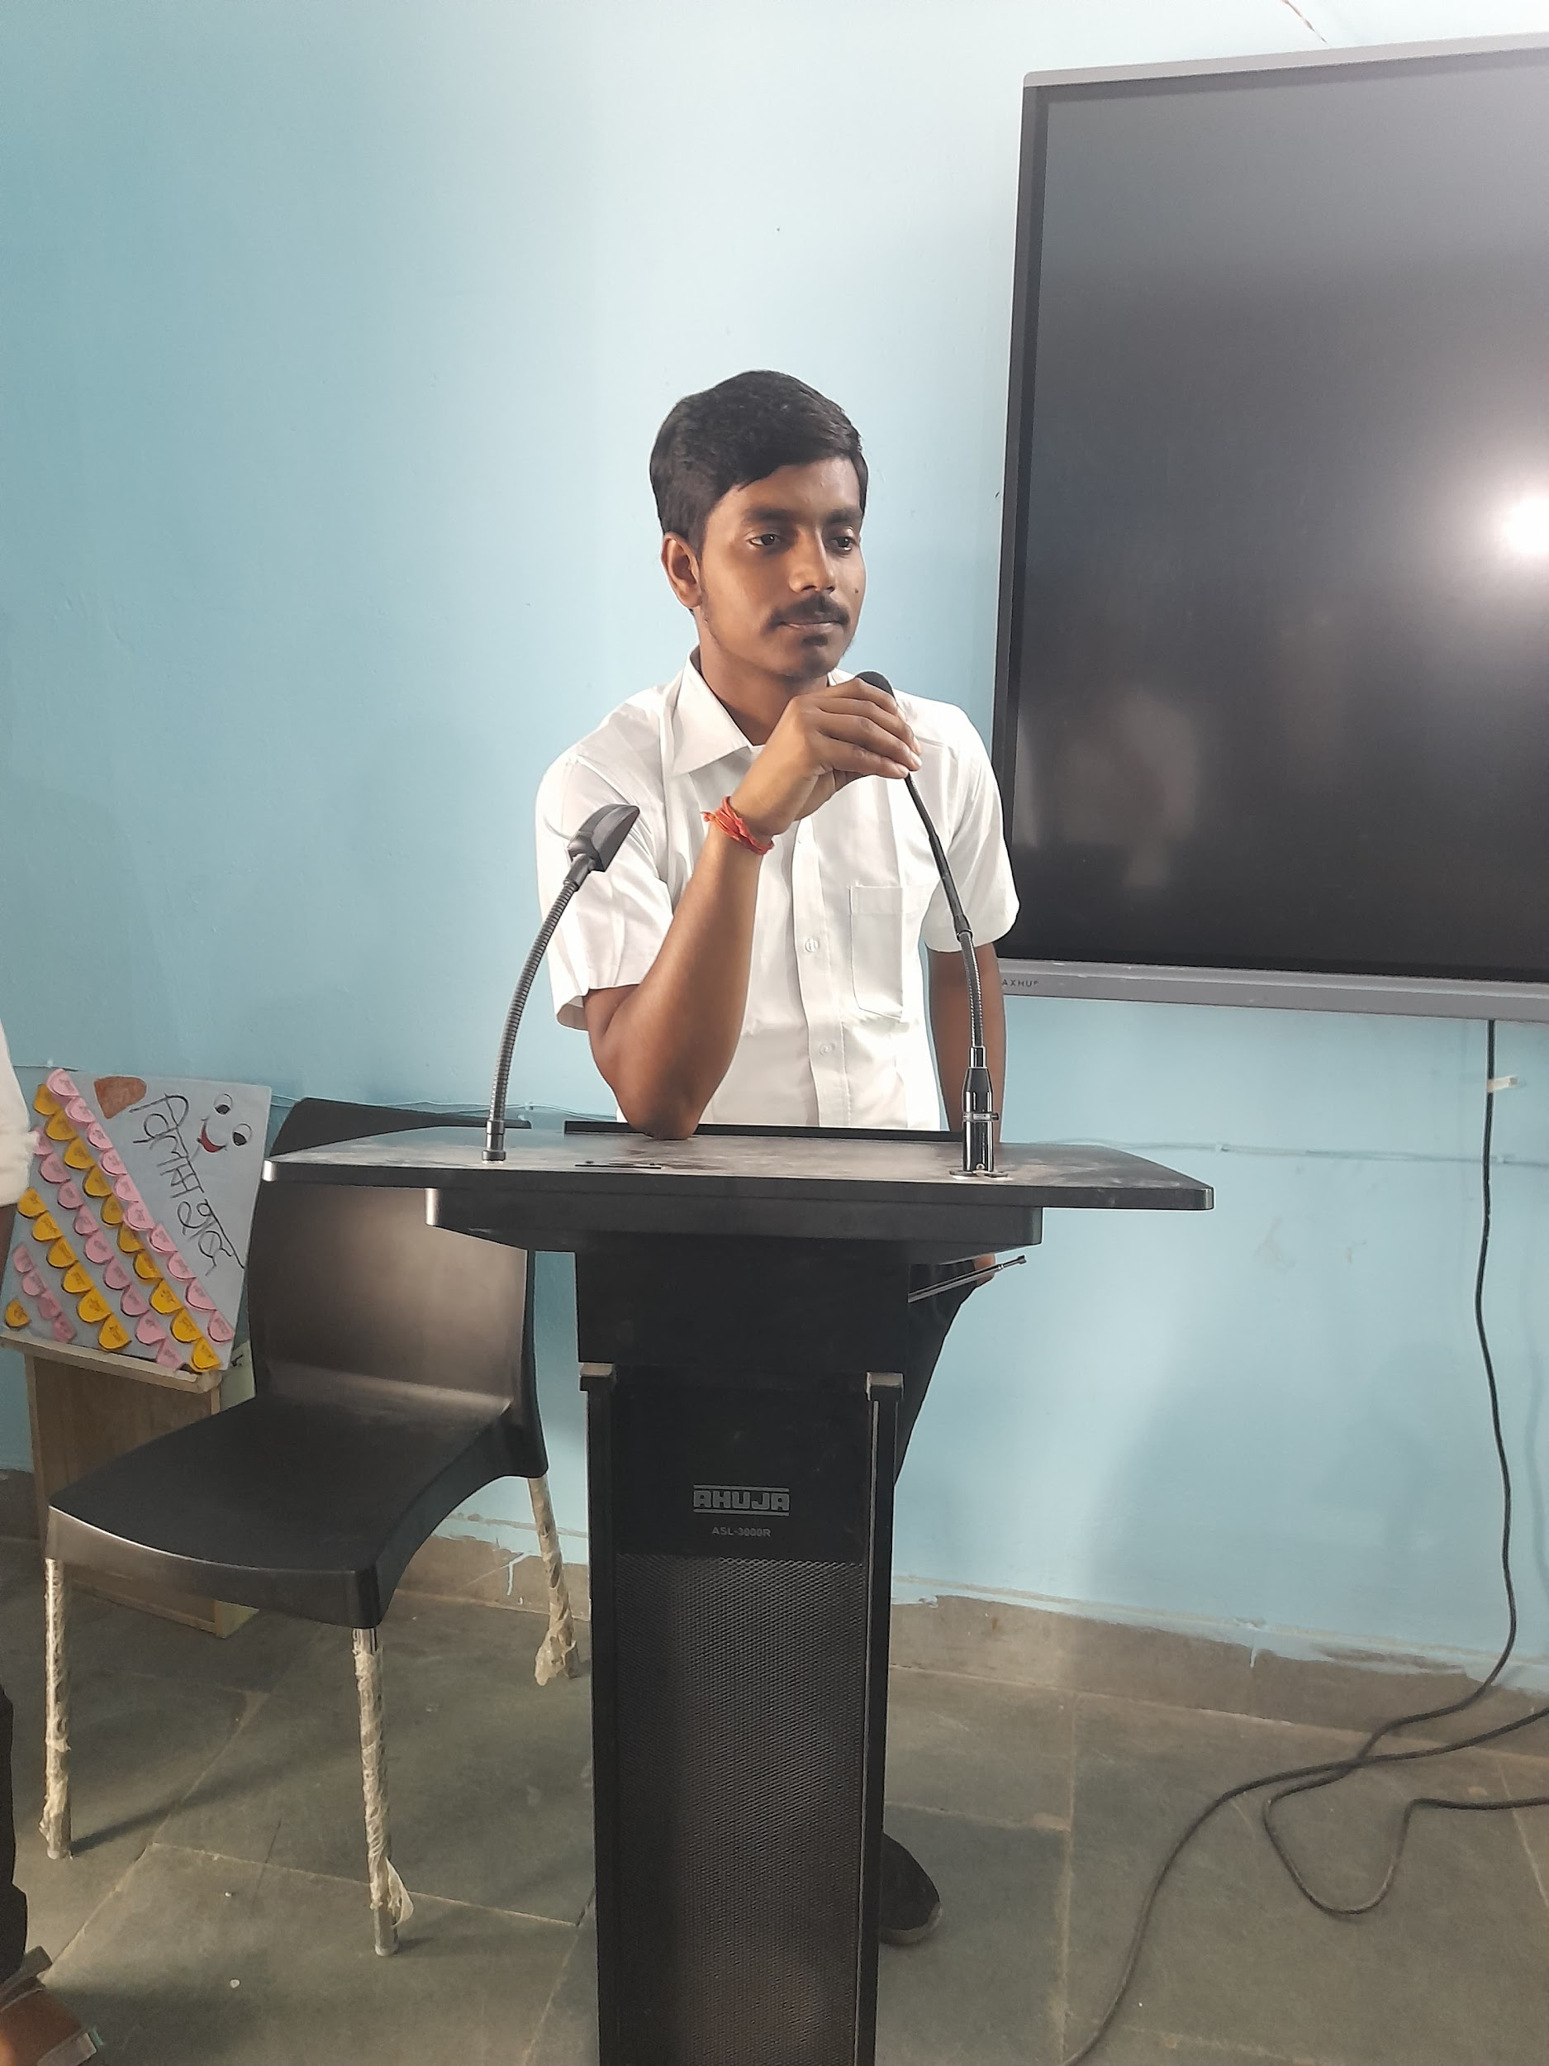
National and international tournament
Presenting by Ritik

Slide 22
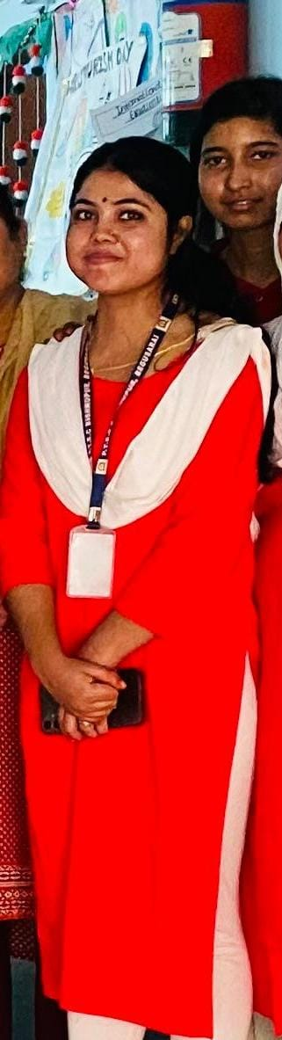
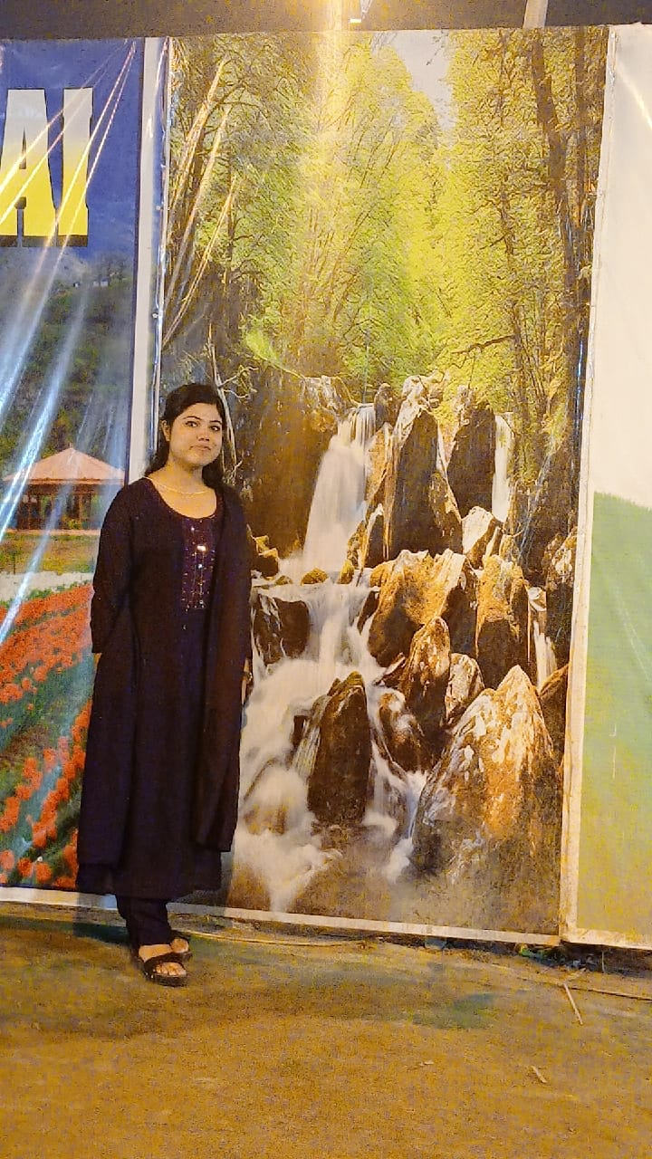
Conclusion
Presenting by shivani

