Slide 1

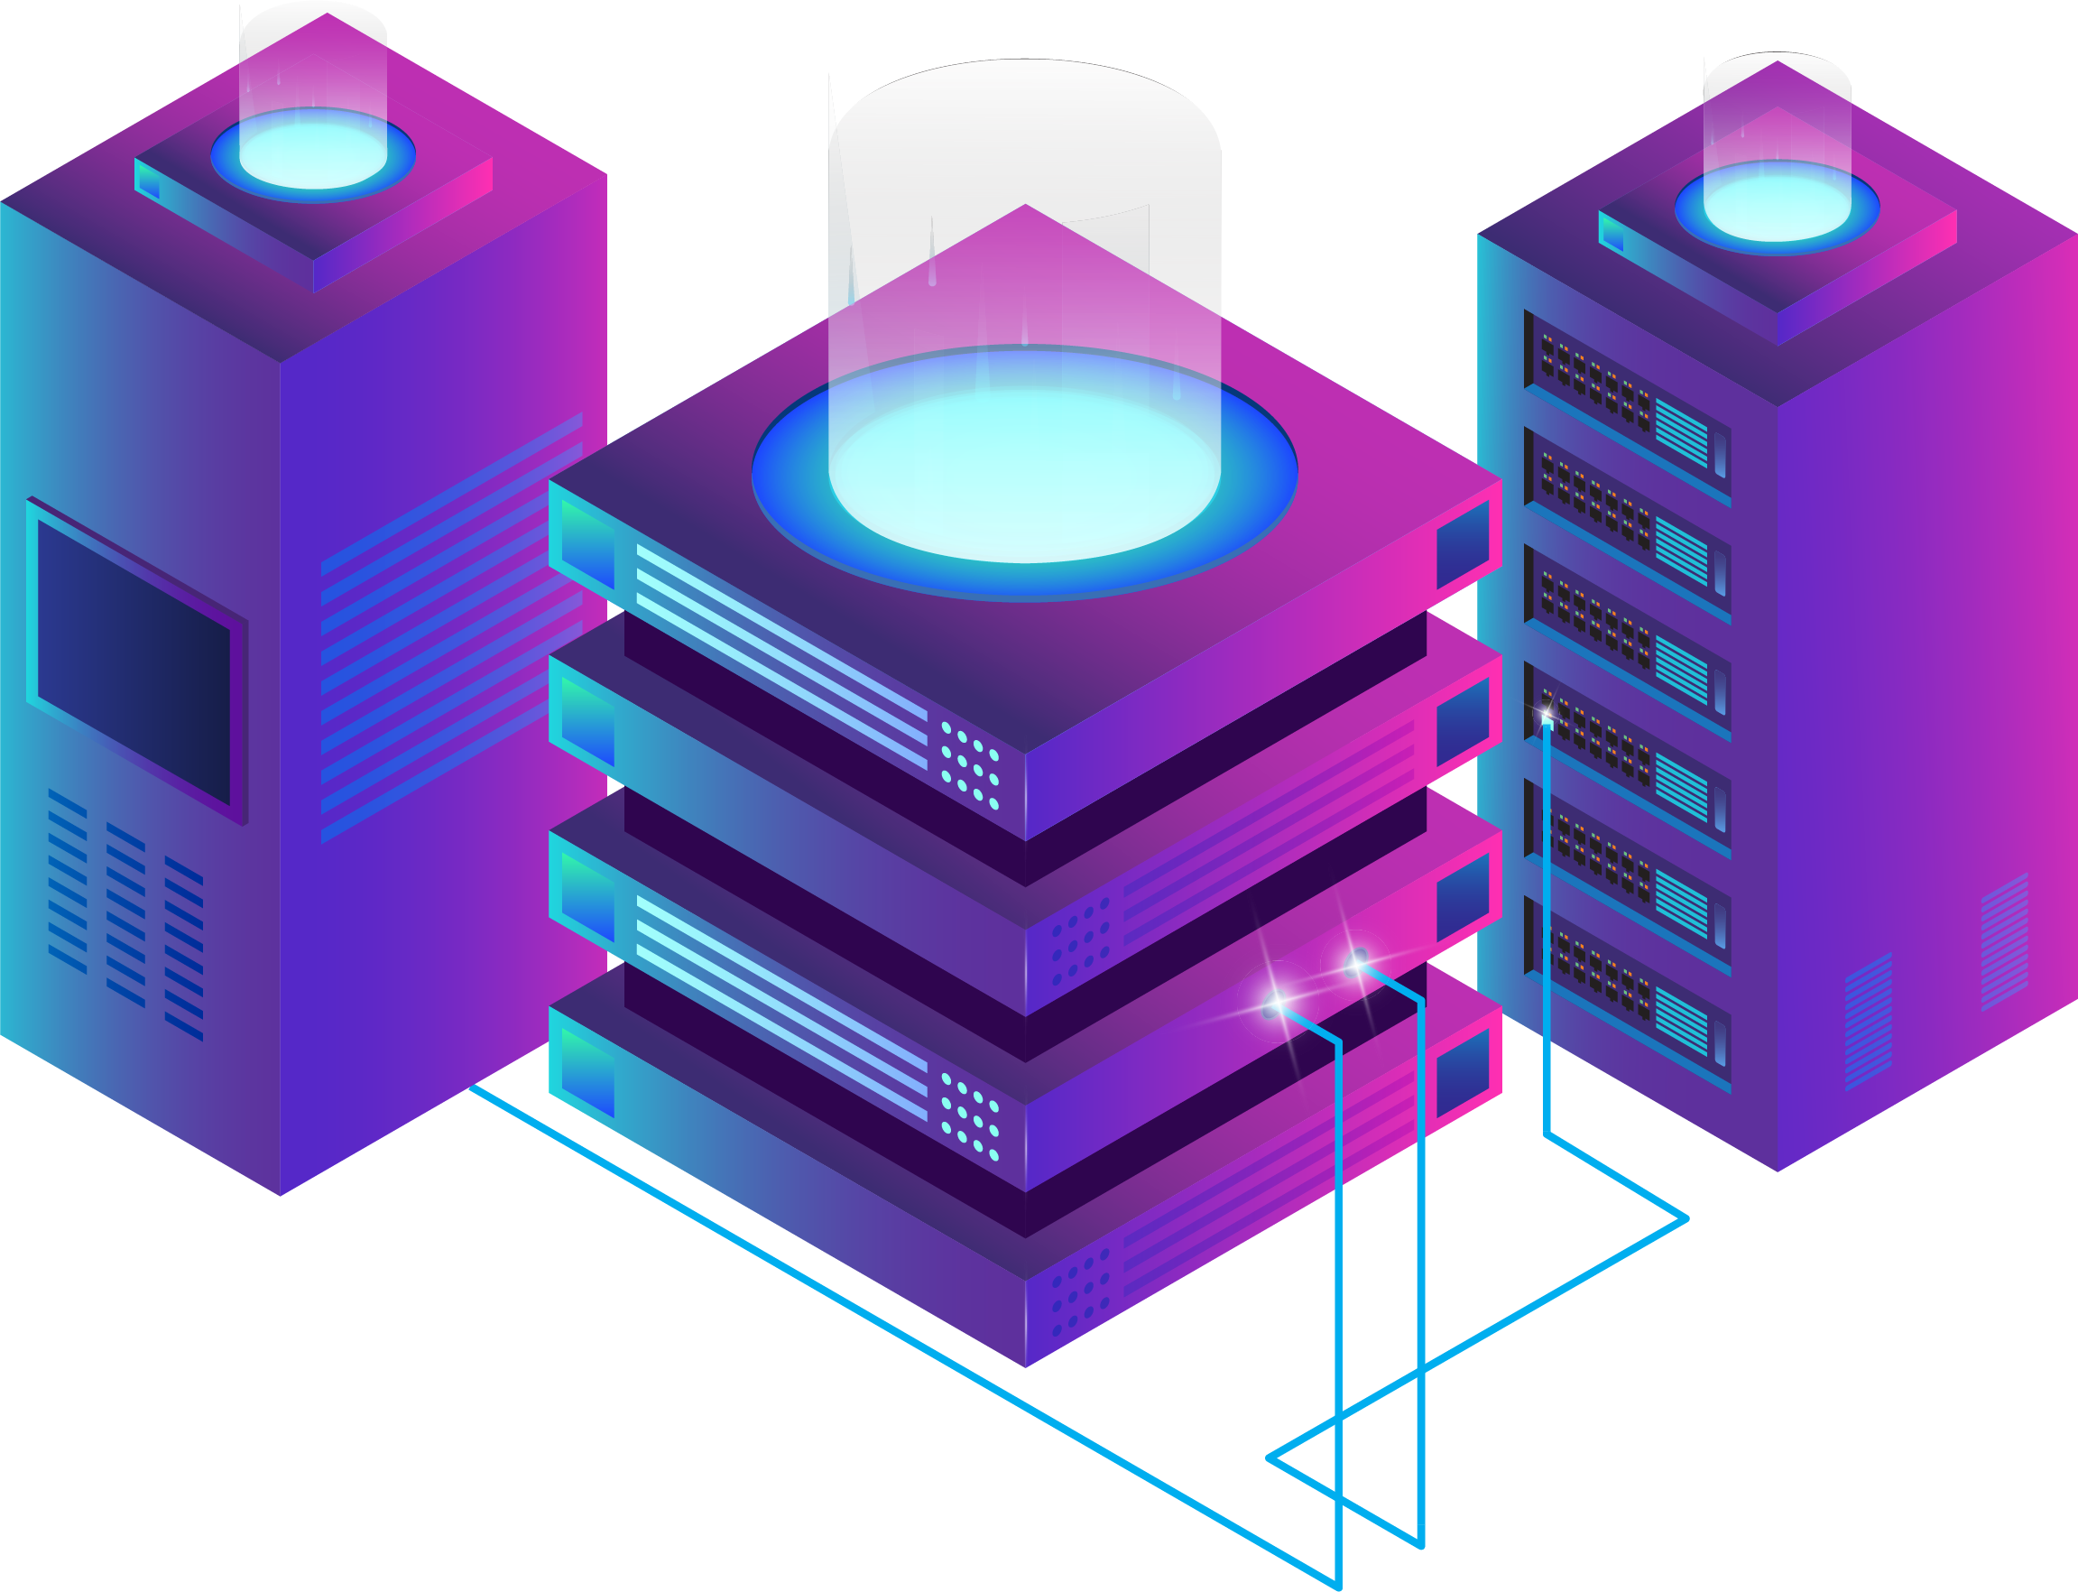
UBIKA WAAP GATEWAY
EXPERT TRAINING
PERFORMANCE

Slide 2
Overview
Performance
  There are several ways to optimize performance of your web application:
    Timeout
    Compression
    Caching
    Reverse Proxy Profile
  First three parameters can be implemented separately on each tunnel, but you can edit and modify the configuration of your Reverse Proxy to adjust his Apache configuration and timeout.

Slide 3
Reverse Proxy Profile

Slide 4
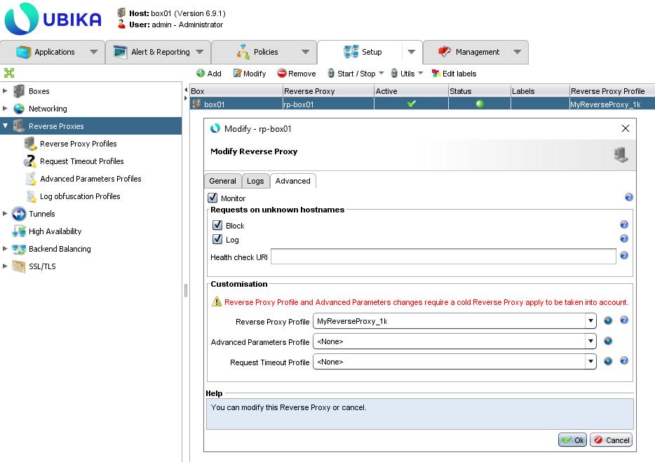
Overview
Reverse Proxy Profile
  Ubika WAAP Gateway is based on Apache 2.4 for handling web traffic. Before creating a tunnel for a web application, you need to create a reverse proxy on every appliance which will handle traffic.
  A reverse proxy is Apache instance (and a tunnel is a vhost).
  When you add a reverse proxy, you need to select a “Reverse Proxy Profile”. This profile contains all configuration regarding Apache and Network. This profile have to be selected in the “Advanced” tab.

Slide 5
How Apache works?
Reverse Proxy Profile
  On Ubika WAAP Gateway, Apache is configured with Worker MPM (Multi-Processing Modules).
  In that module, an Apache root process is responsible for launching child processes. Each child process creates a fixed number of server threads as well as a listener thread which listens for connections and passes them to a server thread for processing when they arrive.
  The number of child launched is defined by the administrator, two parameters exists:
    Number of child at Apache Instance (reverse proxy) start
    Number maximum of child
  For each child, you will have to handle a number of threads. Each thread will handles one connection per time.

Slide 6
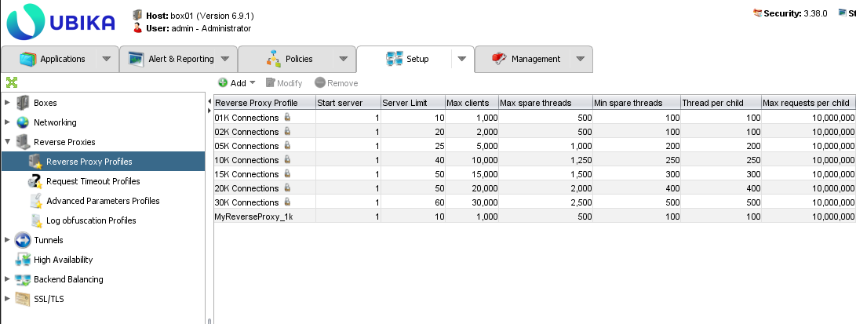
Reverse Proxy Profile
Reverse Proxy Profile
  Reverse Proxy Profiles are profiles for adjusting a Reverse Proxy with regard to capacity and performance. The default values (including when no profile is assigned to the Reverse Proxy) are appropriate in most cases.
  A Reverse Proxy is configured with the default values of a '01K Connections' profile.

Slide 7
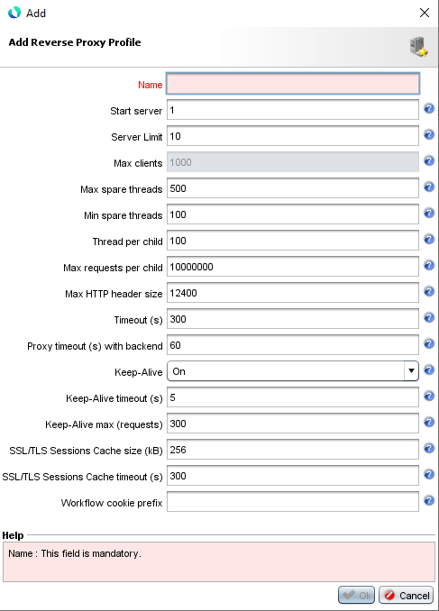
New Reverse Proxy Profile
Reverse Proxy Profile
  When adding a new reverse proxy profile, you need to configure some options. Default values are specified to handle 1000 maximum clients.
  Parameters to be configured:
    Server Limit represents the upper limit of children Apache is allowed. The practical usage for ServerLimit is creating a hard ceiling in Apache to protect against input errors with MaxRequestWorkers. The cap prevents spawning vastly more children than a system can handle, resulting in downtime, revenue loss, reputation loss or even data loss.
    "Min spare threads" / "Max spare threads" governs the minimum & total number of idle threads allowed on the server across all children. Any threads below this limit direct their parent to start new child. Any threads above this limit direct their parent to shut down to reduce memory consumption during off-peak hours. Having a limit to the number of idle open threads is excellent for smaller servers with hardware constraints.
    Thread par child define the limit of threads that each Apache child can manage. Every thread running can handle a single request.
    Max requests per child: The number of requests a single Apache child process can handle equals a cumulative total on the child server across all threads it controls. Each request handled by a thread counts toward this limit to its parent. Once the child server has reached its limit, the child is then recycled.

Slide 8
Explication
Reverse Proxy Profile
  Let’s take a look at the reverse proxy profile “01K Connections”:
  First of all, whenever an apache is started, it will start 1 child process determined by the “Start server” parameter. Then each process will start with 100 threads determined by the “Thread Per Child” parameter, so this means 1 child process can service only 100 concurrent connections/clients (i.e., 100×1=100).
  If more concurrent users come, then another child process will start to serve another 100 users. But how many child processes can be started is controlled by the “Server Limit” parameter. This means that in the configuration above, I can have 10 child processes in total, with each child process can handle 100 thread, in total handling 10×100=1000 concurrent users.
  The reverse proxy will also provide initially 100 threads which will be in the idle state up to 500. If more than 500 threads are idle, they will be killed.

Slide 9
Max client
Reverse Proxy Profile
  The value of "Max Clients" is not configurable. But this value will determine the number of concurrent clients connection with the Reverse Proxy.
  This value is determined with this calcul : "Server Limit" x "Thread per Child".
  If you want to increase the number of maximum client connection, you need to increase one of these two parameters or both.
  There are already different reverse proxy profile existing by default on the system. If you need to increase the performance of your reverse proxy, you can swap the reverse proxy profile or modifying your custom profile. Don't forget to apply the configuration with cold restart when modifying a reverse proxy.

Slide 10
Optimization
Reverse Proxy Profile
  To handle web traffic, Apache will create child and thread per child. So what is the best combination for handling concurrent connection ? Should we have a lots of children and few threads per child ? Or should we have few children but a lots of thread per child ?
  The best combination depend on the web traffic you have to handle. Our by default profile are created to optimize the use of your reverse proxy.
  But some application will need to change this configuration: for example: webmail, websocket, web application with persistent connection...
  In that case, you will have to create a custom reverse proxy profile and adapt the value of "Server Limit" and "Thread per child" depending on your application.

Slide 11
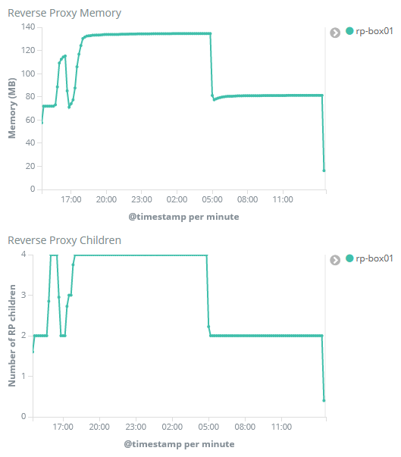
Apache Stats
Reverse Proxy Profile
  In “UBIKA - Appliance Monitoring” dashboard you will find some graphs providing you some interesting informations about each reverse proxy:
    Reverse Proxy Memory
    Reverse Proxy Children

Slide 12
Mod_status
Reverse Proxy Profile
  The Status module allows a server administrator to find out how well their server is performing. A HTML page is presented that gives the current server statistics in an easily readable form. If required this page can be made to automatically refresh (given a compatible browser). Another page gives a simple machine-readable list of the current server state.
  The details given are:
    The number of workers serving requests
    The number of idle workers
    The status of each worker, the number of requests that worker has performed and the total number of bytes served by the worker (*)
    A total number of accesses and byte count served (*)
    The time the server was started/restarted and the time it has been running for
    Averages giving the number of requests per second, the number of bytes served per second and the average number of bytes per request (*)
    The current percentage CPU used by each worker and in total by all workers combined (*)
    The current hosts and requests being processed (*)

Slide 13
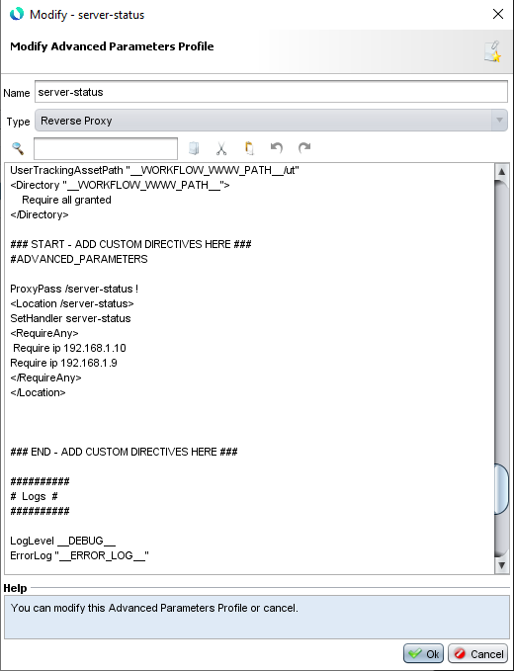
Mod_status Access
Reverse Proxy Profile
  If you want to access to the Reverse Proxy statistics, you need to create an advanced parameter profile for reverse proxy and add these data:
  Attach this profile to your Reverse Proxy (advanced tab).
  Access using your web browser: http://server-name/server-status, use one hostname of your web application, the reverse proxy will intercept this request.
ProxyPass /server-status !
<Location /server-status>
SetHandler server-status
<RequireAny>
Require ip 192.
Require ip 172.
</RequireAny>
</Location>

Slide 14
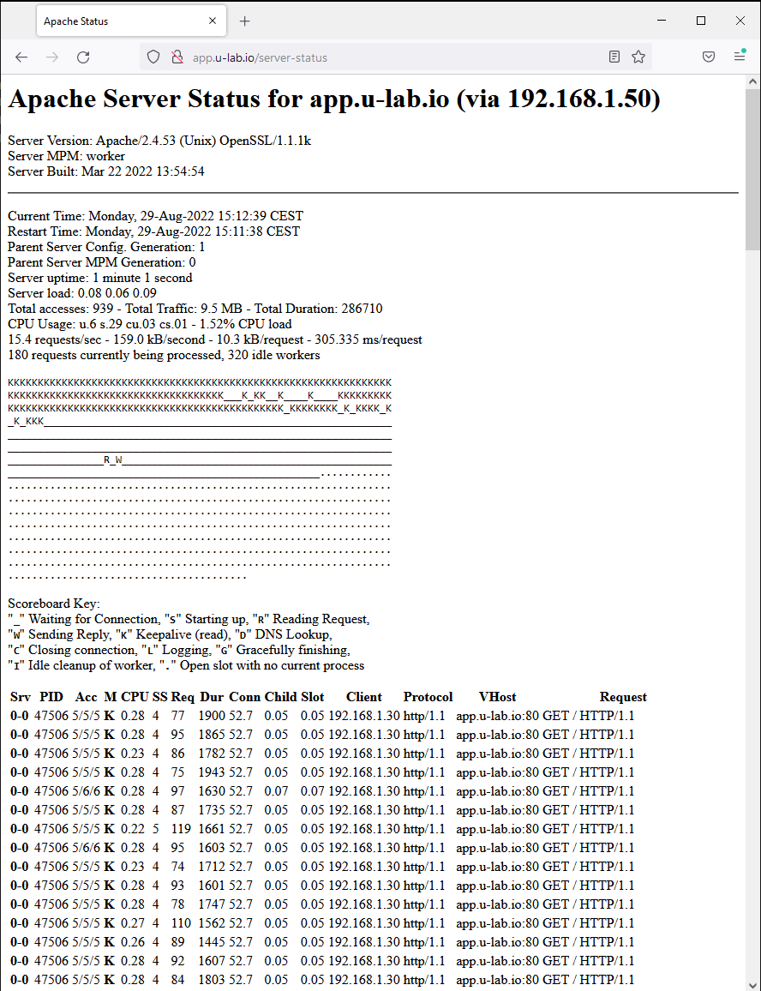
Mod_status Result
Reverse Proxy Profile
  When you connect to the path for mod_status, the web browser will show you all statistics for the reverse proxy.
  You will have stats on uptime, load, cpu & memory use. You will also see all thread available for this reverse proxy (and for each thread what is happening).
  You also will have information on last requests that have been processed.

Slide 15
Lab

Slide 16
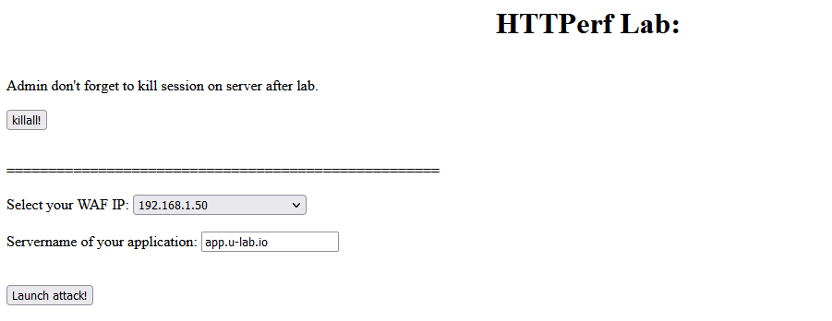
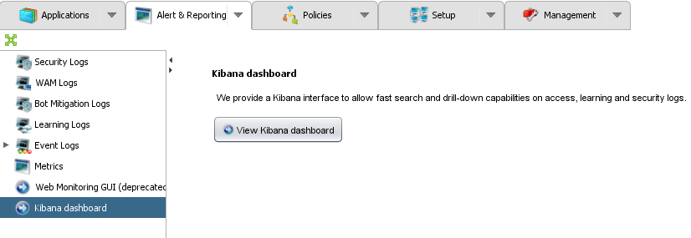
Lab1
Reverse Proxy Profile
  Check the local time of your appliance;
  Generate traffic with HTTPerf lab.
  Analyze Kibana to see Reverse Proxy statistics.

Slide 17
Lab2
Reverse Proxy Profile
  Create an advanced parameter profile and add server-status configuration. Edit your reverse proxy to use it.
  Generate web traffic with HTTPerf lab
  Access /server-status to see the statistics.

Slide 18
Timeout

Slide 19


Overview
Timeout
  HTTP protocol is based on TCP protocol (for HTTP version 1.x and 2.0). When a client want to send a request to a web server, first he need to create a TCP connection.
  To create a new TCP connection, the client send a TCP Syn packet, receive a TCP Syn-Ack packets and reply then with a TCP Ack packet followed by TCP packets containing the HTTP requests.
TCP SYN
TCP SYN-ACK
TCP ACK
TCP DATA (HTTP REQUEST)

Slide 20
Overview (2)
Timeout
  When you have a reverse proxy, two TCP connection will be generated:
    First TCP connection will be between the client and the reverse proxy
    The second one will be between the reverse proxy and the web server
  The second TCP connection will only be initiated if the first TCP is created (TCP 3-handshake succeeded).
TCP connection
TCP connection

Slide 21
Overview (3)
Timeout
  When a TCP is established, it remains active until one of the side ask to close it.
  Between the client and the reverse proxy, the initiator of the closing connection can be the client or the reverse proxy. Between the reverse proxy and the backend server, the initiator of the closing connection can be the backend server or the reverse proxy.
  TCP connection can be close because one equipment decide that there is no more data to be send or the timeout of the TCP connection arrive to expires.
  Sometimes, the closing can be different with TCP FIN / TCP ACK / TCP RST / TCP ACK.
TCP FIN
TCP ACK
TCP FIN
TCP ACK

Slide 22
Timeout Managing
Timeout
  Some protections exist to avoid the increase of the number of TCP connection and its generation:
    Timeout between client and reverse proxy
    Timeout between reverse proxy and web server
    Request timeout
  These protections are already implemented with standard value but can be adjusted in:
    Reverse proxy profile
    Tunnel configuration
  By default, tunnel will inherit the value from reverse proxy, but you can adjust the configuration in each tunnel separately if wanted.

Slide 23
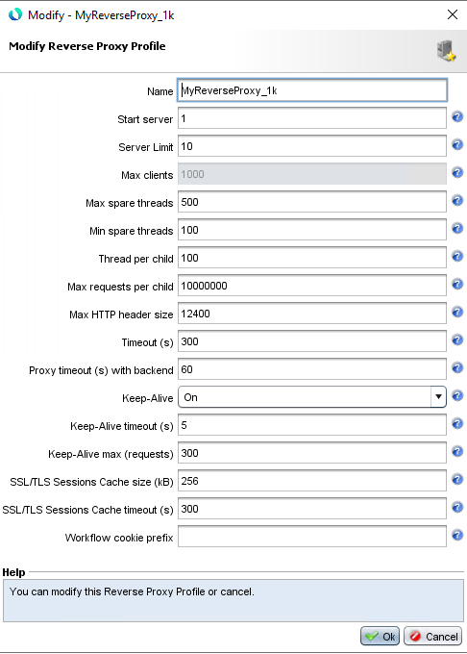
Timeout
Timeout
  The option “Timeout” allows you to define the time that a TCP connection between the client and the Ubika WAAP Gateway device remains active before asking to close it. This is the amount of second Apache waits for all common request or response events for this TCP connection.
  By default, his value is defined in the reverse proxy profile and is 300 seconds. You can change this value and adjust it in the reverse proxy profile if you use a custom profile or adjust it in the tunnel configuration.
  Determining the best “Timeout” depends on both traffic habits and web application. Ideally, the “Timeout” value should be as low as possible while still allowing most of the regular traffic to operate without issue. This value should be bigger than “Proxy Timeout” (it’s better to not close the connection on the client side if the connection on the server is still active).

Slide 24
Proxy Timeout
Timeout
  The option “Proxy Timeout” allows you to define the time that a TCP connection between the Ubika WAAP Gateway device and the web server remains active before asking to close it. This is the amount of second Apache waits for all common request or response events for this TCP connection.
  By default, his value is defined in the reverse proxy profile and is 60 seconds. You can change this value and adjust it in the reverse proxy profile if you use a custom profile or adjust it in the tunnel configuration.
  Determining the best “Proxy Timeout” depends on both traffic habits and web application. Ideally, the “Timeout” value should be as low as possible while still allowing most of the regular traffic to operate without issue. This value should match the web application server configuration.

Slide 25
Keep-Alive
Timeout
  The parameter “Keep-Alive” is an option which can be active or not, defined in the Reverse Proxy profile. When activated, you will have access to two more option: “Keep-Alive timeout” and “Keep-Alive max (requests)”.
  Enabling KeepAlive parameter allows to reuse the same connection a browser creates when connecting to the Ubika WAAP Gateway for all follow-up requests which occur within a short period. The KeepAlive feature can provide as much as a 50% reductions in latency, significantly boosting the performance of the appliance.
  KeepAlive is a powerful feature and in general, should be enabled in most situations. It works great for reducing some of the CPU and Network overhead with modern element heavy websites. For example, an easy way to visualize KeepAlive is with the “hold the door” phrase. Imagine a queue of people entering a building through a single doorway. Each person is required to open the door, walk through it, then close the door before the next person does the same process. Mostly, that's how Apache works without KeepAlive. When enabled, the door stays open until all the people in line are through the door before it closes again.

Slide 26
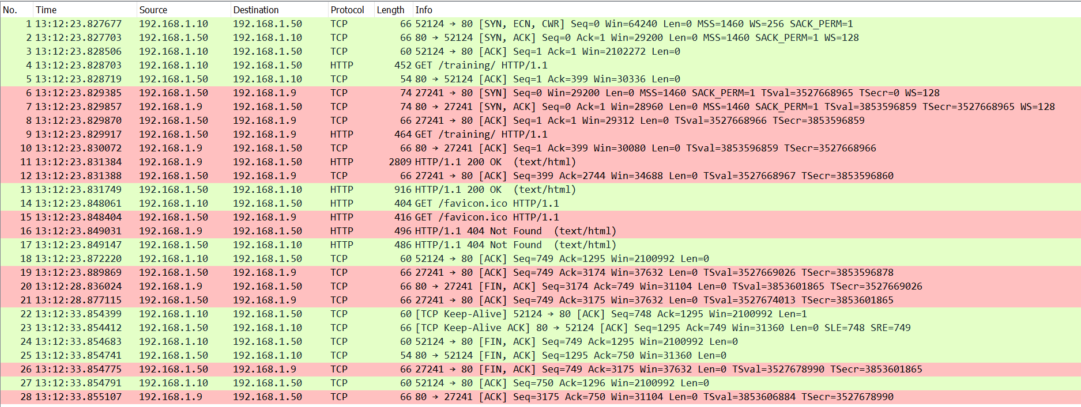
TCP Exchange
Timeout
  Full TCP exchange for a simple request from a client:

Slide 27
Disablereuse
Timeout
  As we saw, the TCP connection between the reverse proxy and the backend server is closed after the timeout delay when all requests from the client were served.
  But it’s possible to configure the reverse proxy to close immediately the TCP connection with the backend when all requests were served. This option is: “disablereuse”. By default, his value is set to Off.
  To do that, you need to create an advanced parameters profile and add the follow line:
    A.B.C.D is the IP address of your backend server
    Status=+i: Worker is in ignore-errors mode and will always be considered available.
    Retry=0: Connection pool worker retry timeout in seconds.
    Smax=0: Retained connection pool entries above this limit are freed during certain operations if they have been unused for longer than the time to live.
ProxyPass "/" "http://A.B.C.D" status=+i retry=0 smax=0 ttl=4 upgrade=websocket disablereuse=On

Slide 28
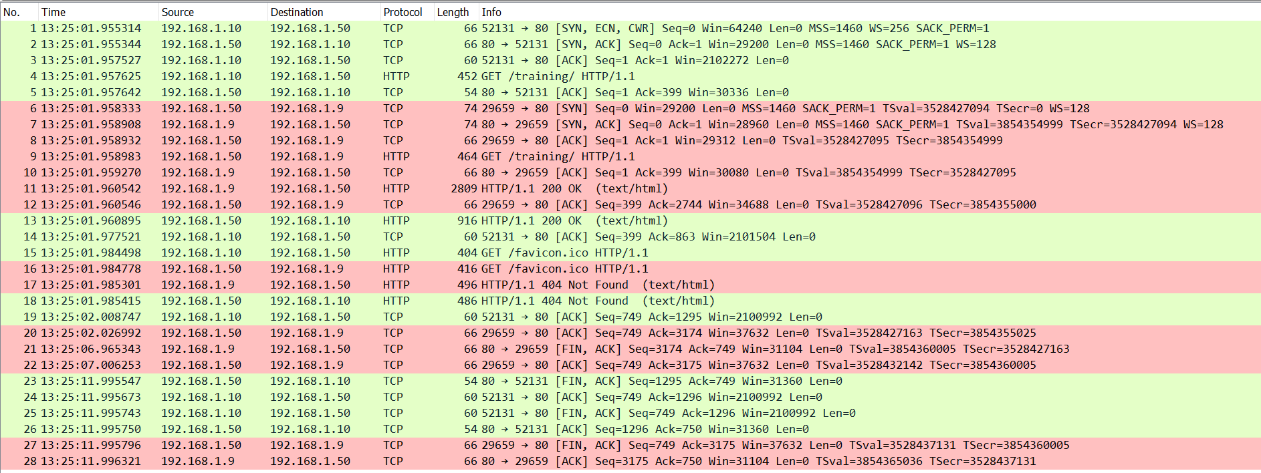
Disablereuse
Timeout
  Full TCP exchange for a simple request from a client with disablereuse=On:

Slide 29
Request Timeout
Timeout
  Request Timeout are parameters to specify various timeouts for receiving headers and bodies of requests coming from the client. If the client fails to conform to the timeouts, a 408 REQUEST TIME OUT error code is sent.
  By default, some values are configured in Apache to avoid some attacks on the device.
    TLS handshake: 10s
    Header timeout: 20s
    Header max timeout: 40s
    Header minimum rate: 500bytes
    Body: 20s
    Body minimum rate: 500bytes
  If you want to customize these values, you can create a request timeout profile which can be configured on each tunnel or on a reverse proxy (so all tunnel will inherit it).

Slide 30
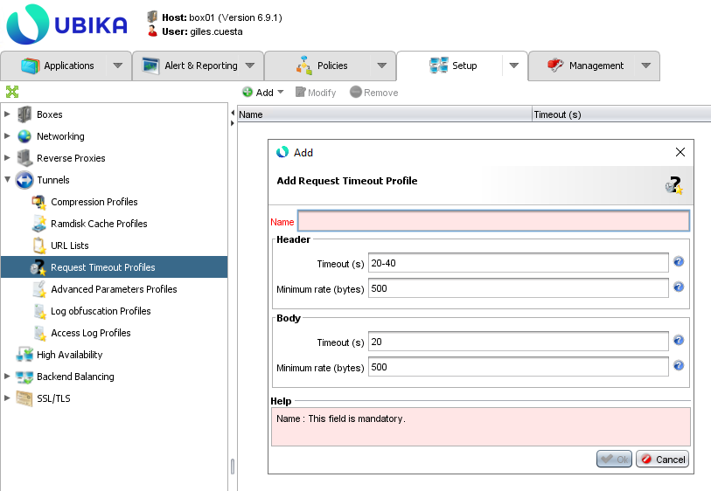
Request Timeout Profile
Timeout
  You can create a “Request Timeout Profile” in the menu located in Setup > Tunnels > Request Timeout Profiles or in Setup > Reverse Proxies > Request Timeout Profiles. These two menu allows to create the same profile.
  You can manage profile from one of these two menu. You can add, delete or modify a profile.
  If you want to create a new profile, you need to click on “Add” button and then customize the parameters with your needs:
    Header Timeout (s): the time, in seconds, initially allowed before starting to read the request headers. A value of 0 means there is no limit.
    As soon as data are received, the timeout allocated is increased at the rate specified by the Rate parameter. A maximum timeout can be defined with the syntax: <initial timeout>-<maximum timeout>.
    Header Rate (bytes): Increases the timeout allowed for reception of data at the rate of one second per number of bytes specified.
    Body Timeout (s): The time, in seconds, allocated before starting to read the request body. A value of 0 means there is no limit.
    As soon as data are received, the timeout allocated is increased at the rate specified by the Rate parameter. A maximum timeout can be defined with the syntax: <initial timeout>-<maximum timeout>.
    Body Rate (bytes): Increases the timeout allowed for reception of data at the rate of one second per number of bytes specified.

Slide 31
Recommendation
Timeout
  You need to adjust the timeout for each application. Some application require small timeout, others bigger timeout.
  For client timeout, you increase the timeout of your backend with 1s.
  If you think that your backend has a too big timeout, you can reduce it on client side. The point is you need to specify a timeout that will allow all requests to be process by the backend.
  For request timeout, you can use the default value. If your web application is available for device that have bad network performance, you can increase the timeout. In otherwise, if your web application are available only from devices with fast internet access, you can decrease the value.
  Don't forget that if your web traffic cross some network equipment, you need to adjust the timeout on it too.

Slide 32
Lab

Slide 33
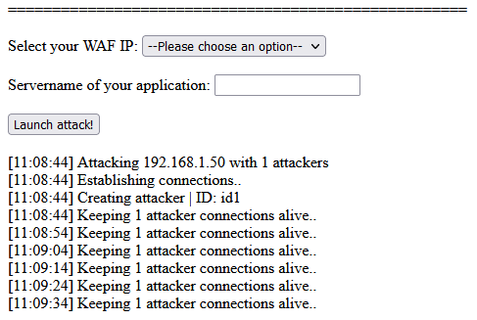
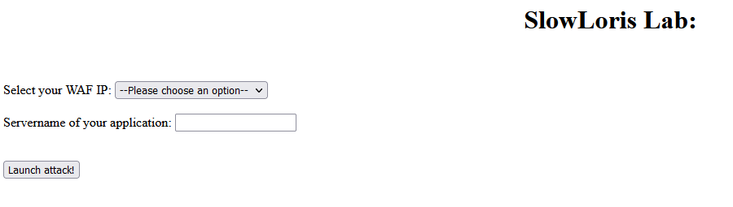
Lab1
Timeout
  Launch slow loris lab on your web application protected by WAF.
  This attack will start to send a request that will be not finished. One request is sent that is refresh every 10s.

Slide 34
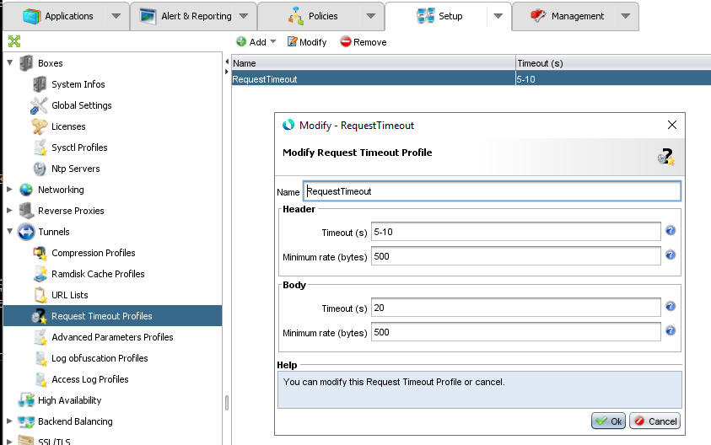
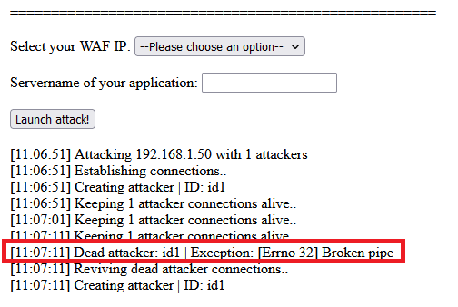
Lab2
Timeout
  Create a new Request Timeout Profile with these parameter:
    Header timeout: 5-10
  Launch again the SlowLoris attack! Now you can see the difference!

Slide 35
Compression

Slide 36
Overview
Compression
  Compression of data allow to minimize the size of data that are transferred from web server to the client.
  By default, web browser specify that they can handle data compressed with header: Accept-Encoding. Different values can be found for this header: gzip, compress, deflate, br, identity or *.
  In that case, the web server will compress the data with one compression protocol and specify this in the header: Content-Encoding.
  If your web server is not able to compress the data, you can do it on the WAAP Gateway.

Slide 37

Little Reminder
Compression
  Uncompressed case:
  Compressed case:
HTTP REQUEST (1ko)
GET /index.php HTTP/1.1
Host: server.example.com
HTTP RESPONSE (100ko)
HTTP/1.1 200 OK
<html> … </html>
HTTP REQUEST (1ko)
GET /index.php HTTP/1.1
Host: server.example.com
Accept-Encoding, gzip, deflate
HTTP RESPONSE (100ko)
HTTP/1.1 200 OK
Content-Encoding: gzip
<compressed file>

Slide 38
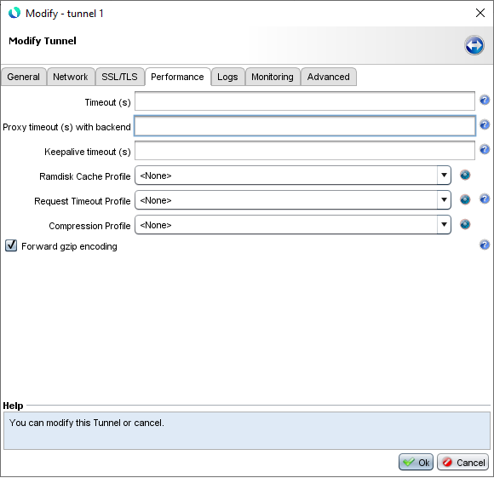
Tunnel configuration
Compression
  The compression parameter can be found in the tunnel configuration window in the tab “Performance”. The parameter name is “Compression Profile”
  If you want to activate it, you need to choose a profile in the list.
  The parameter “Forward gzip encoding”, if checked, will keep the response send by the backend compressed if no modification is done by the workflow.

Slide 39
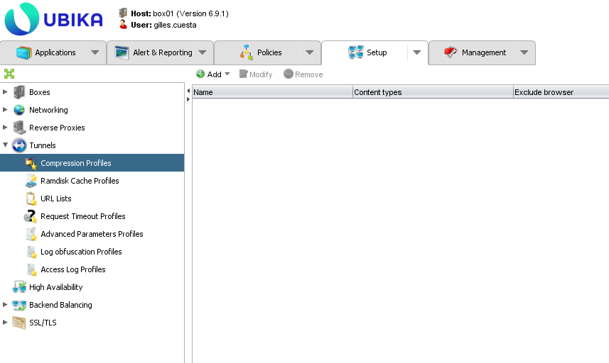
Compression profile
Compression
  If you want to manage “Compression Profile”, go to Setup > Tunnels > Compression Profiles. From this menu, you can add, delete, modify a profile.
  Click on “Add” button to create a new profile, a popup window will appear on your screen.

Slide 40
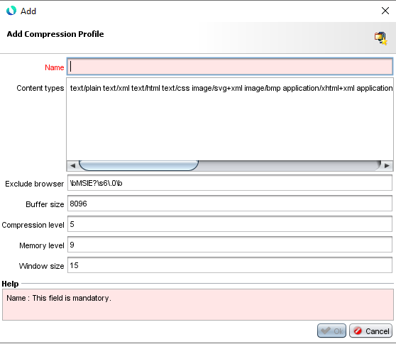
New Compression Profile
Compression
  When creating your new compression profile, you need to configure it. Only the name parameter is empty, other parameters are already configured. You can keep these parameters or modify them with your need.
  Parameter to configure:
    Content-type: Enter the types of content you want to compress.
    Exclude browser: Enter the signatures of browsers for which you don’t want to enable compression.
    Buffer size: Enter the size of the compression buffer.
    Compression level: Enter the compression ratio. The higher the ratio, the smaller the size of the data will be, but the use of hardware resources will be higher.
    Memory level: Enter the level of memory used for the compression. The higher the level, the more hardware resources will be used.
    Window size: Enter the size of the window used for compression (value between 1 and 15). Larger the window size is, greater the compression rate can be expected.

Slide 41
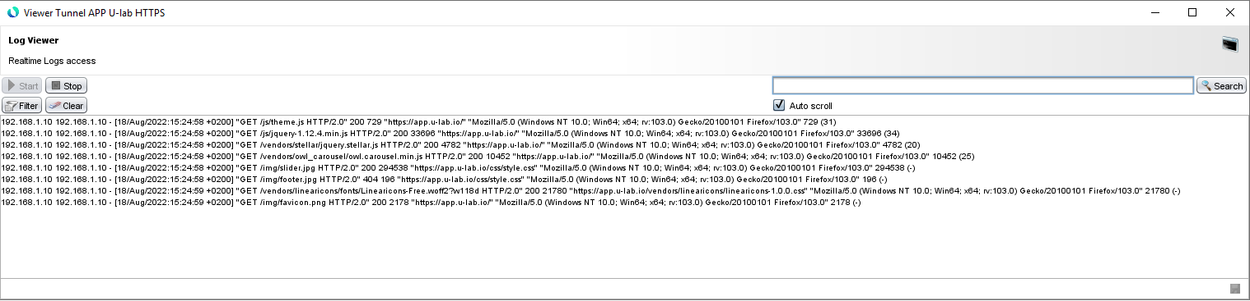
Tips
Compression
  If you want to have statistics on the ratio of your compression, you can change the profile of access logs of your traffic to have additional information regarding compression.
  Create a new access logs profile and add this:
    %h %a %u %t "%r" %>s %b "%{Referer}i" "%{User-agent}i" %b (%{ratio}n)
    %b: size of the file
    %{ratio}n: rate of compression

Slide 42
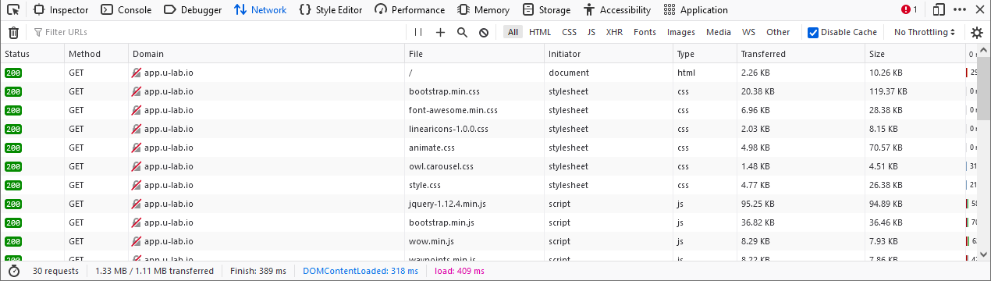
Tips (2)
Compression
  You can see the compression stats on your web browser when surfing.
  Here, in Firefox, we have two columns:
    “transferred”: size of the file compressed
    “Size”: real size of the file

Slide 43
Lab

Slide 44
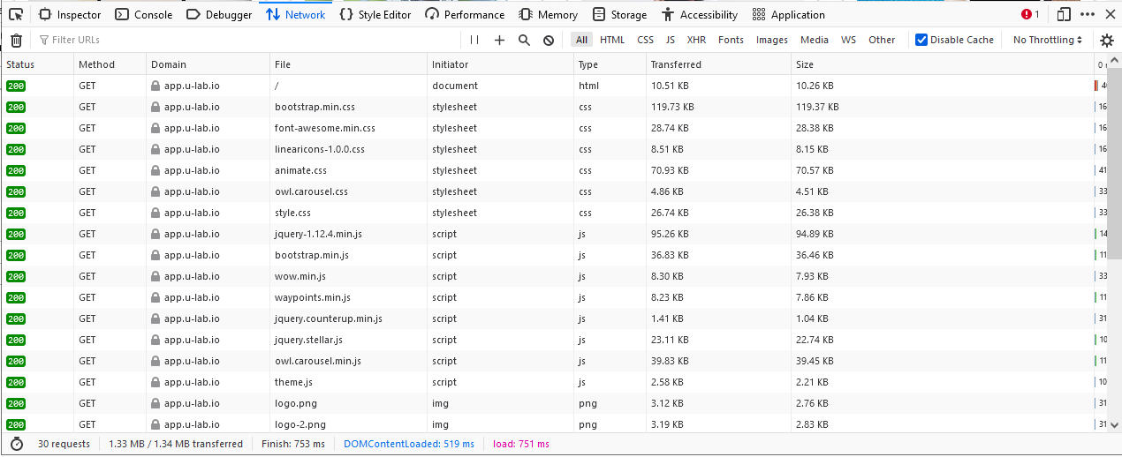
Lab1
Compression
  Generate some traffic on your application and analyze the compression performance. You will see that your traffic is not compressed.

Slide 45
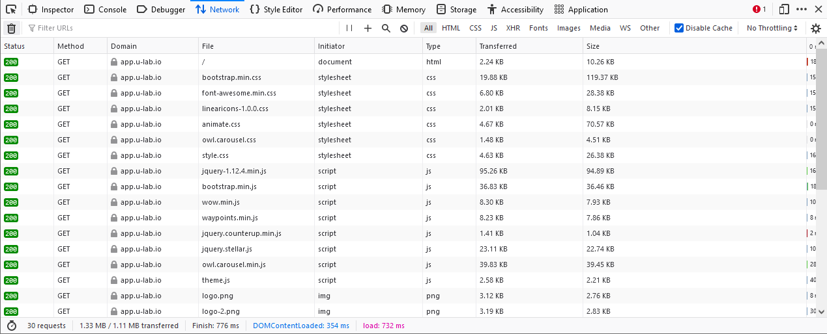
Lab2
Compression
  Create a new compression profile with standard parameters but put compression level to “9” and apply it to your tunnel. Generate some traffic and analyze it:
Data compressed
Data uncompressed

Slide 46
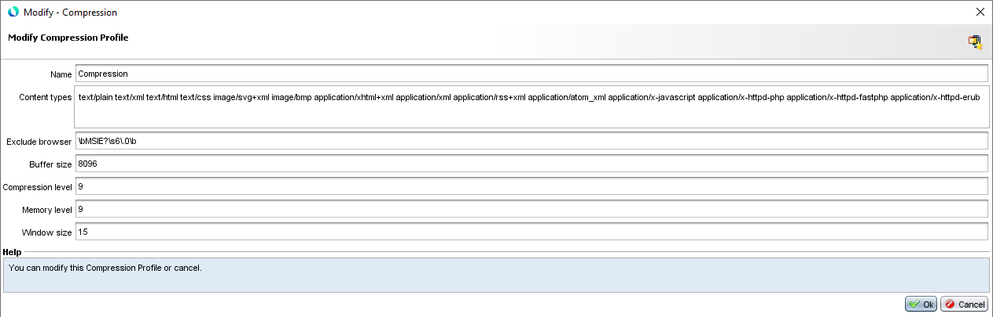
Lab2 Tips
Compression
  Configuration to do:

Slide 47
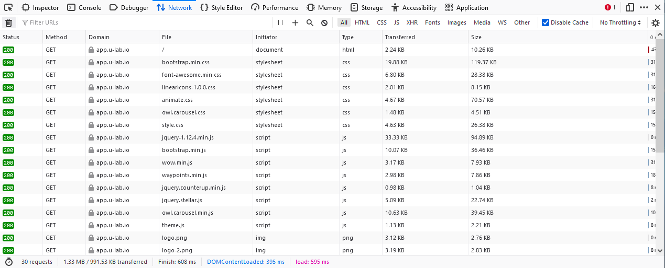
Lab3
Compression
  From previous lab, you have seen that all traffic is not compressed. You can edit your compression profile and add the content type of any text data to be compress.
  Modify your compression profile to handle file .js (application/javascript). Generate some traffic and verify that javascript are now compressed:
Data compressed

Slide 48
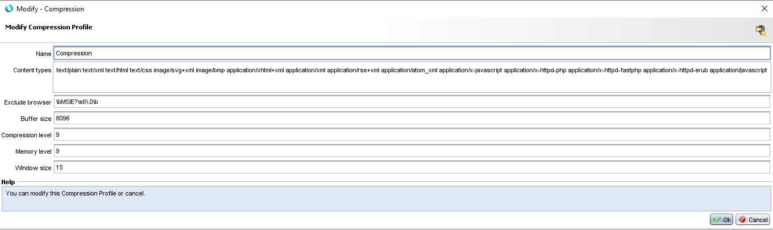
Lab3 Tips
Compression
  Configuration to do:

Slide 49
Lab4
Compression
  Create a new custom access logs profile and add these parameters:
    %h %a %u %t "%r" %>s %b "%{Referer}i" "%{User-agent}i" %b (%{ratio}n)
  Generate some traffic to your web application and verify that you have additional information on compression in your access logs.

Slide 50
Caching

Slide 51
Overview
Caching
  Since your reverse proxy will be in front of backend web server, duplicate requests can be done by several clients. In order to improve performance, it’s better if the reverse proxy can cache some static data and thus avoid making unnecessary requests to the backend server.
  Ubika WAAP Gateway can act as a cache server. Data will be store in the RAM disk.
  Configuration have to be done on each tunnel separately.

Slide 52
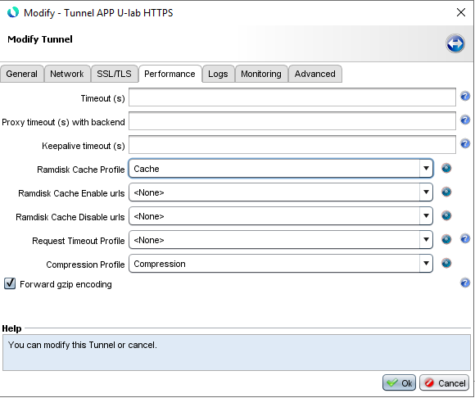
Tunnel Configuration
Caching
  To activate caching on a tunnel, modify the tunnel and go to “Performance” tab, then you will find the “Ramdisk Cache Profile”.
  You must choose a profile and apply the configuration. By default, no profile exist on the system. You must configure at least one profile.
  When you activate a Ramdisk cache profile, you can configure two additional parameters:
    Enable urls: URLs that should be cached on a RAM disk
    Disable urls: URLs that should be not cached on a RAM disk

Slide 53
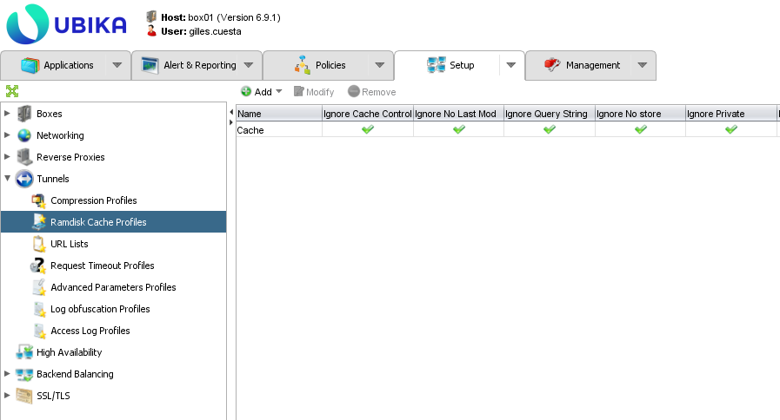
Ramdisk Cache Profile
Caching
  Ramdisk cache profile can be managed in Setup tab, under tunnels menu. You can modify, add or delete a profile from this view.
  If you want to add a new profile, click on “Add” button, a popup window will appear on your screen.

Slide 54
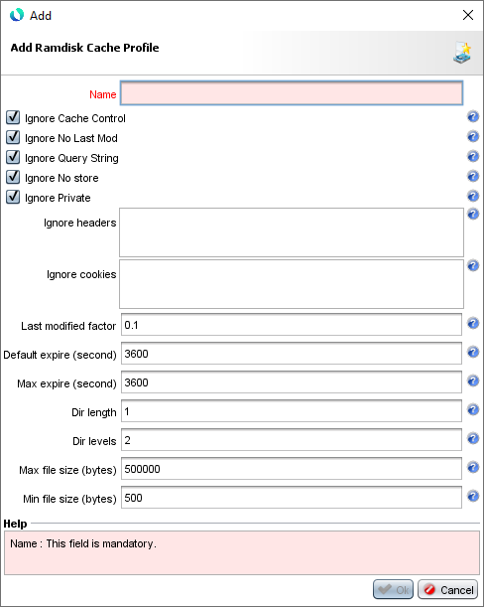
New Ramdisk Cache Profile
Caching
  When creating your new ramdisk cache profile, you need to configure it. Only the name parameter is empty, other parameters are already configured. You can keep these parameters or modify them with your need.
  Parameters to configure:
    Ignore Cache Control: when checked, the proxy will attempt to serve the resource from the cache, even if the request contains one of the headers mentioned above. Resources that require authorization will never be cached.
    Ignore No Last Mod: lets you specify whether documents having no date of last modification should be cached, even without the date of last modification.
    Ignore Query String: enables requests to be cached even if no expiration date is specified, and a response to be sent from the cache even if the parameter strings differ. From the point of view of the cache, the request is handled as if it had no parameter string when this directive is enabled.
    Ignore No Store: the proxy attempts to cache the resource even if it contains headers having the “no-store” value.
    Ignore Private: the proxy attempts to cache the resource even if it contains headers having the private value. Resources requiring authorization are never cached.

Slide 55
New Ramdisk Cache Profile (2)
Caching
  Parameters to configure:
    Ignore Header: specify header to not be cached. For example, cookies header is not appropriate to be cached.
    Ignore Cookies: enables a list of identifiers to be dfeind that will be eliminated from the key used to identify an entity in the cache, so that the resources will not be stored separately for each session
    Last modified factor: Lets you shift the Last-modified information returned by the server. For example, if the last modification of the document dates from 10 hours, and if factor has a value of 0.1, the expiration time will be 10*0.1 = 1 hour.
    Default expire: Lets you specify the default expiration time of a cached object.
    Max expire: Lets you specify the default expiration time of a cached object.
    Dir Length: Defines the number of characters in each subdirectory name in the cache hierarchy.
    Dir Level: Defines the number of levels of subdirectories the cache will have.
    Max file size: Determines the maximum size of a cached object in bytes.
    Min file size: Determines the minimum size of a cached object in bytes.

Slide 56
Uncached Case
Caching
  Elements will not be cached in the following cases:
    On a status code: 200 or 203 or 206 or 300 or 301 or 410 and if there is no Expire or Cache-Control header
    On status code: 304
    If the Expire header is invalid or has expired
    On a query-string without an expiration date (via Expire or Cache-Control: [s-]max-age header)
    On a request using the HEAD method
    When the following headers are present: Cache-Control: no-store|private (without the CacheStoreNostore or Private directives)
    When the Authorization request header is present and no Cache-Control: s-maxage|must-revalidate|public response header
    When the “Vary: *” response header is present.
    On a status code 200 but no ETag nor Expire nor Last-Modified nor Cache-Control: max-age|s-maxage header

Slide 57
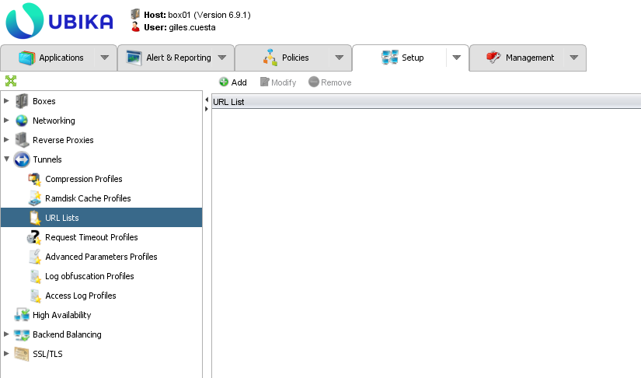
URL List
Caching
  The URL List lets you save lists of URLs that can be cached or not.
  The menu can be found in Setup > Tunnels > URL Lists.
  From this menu, you can manage an URL Lists profile. You can modify, add or delete a profile. You can also add new URL pattern in a profile.
  One URL Lists profile can be used as ramdisk cache enable urls or as ramdisk cache disable urls. And also, can be used as many times as possible you need.

Slide 58
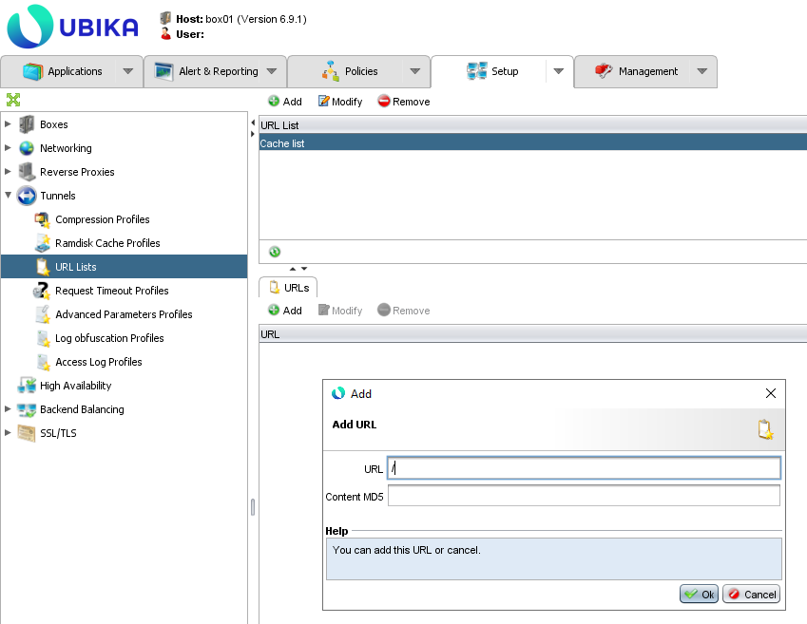
New URL List
Caching
  To create a new URL Lists profile, click on the “Add” button.
  Then select your profile, and in the bottom side of the window, you have the view of URL already added to the profile.
  You can add a new url by clicking on “Add” button. A popup window will appear on your screen, fill the URL and then click on “OK”.

Slide 59
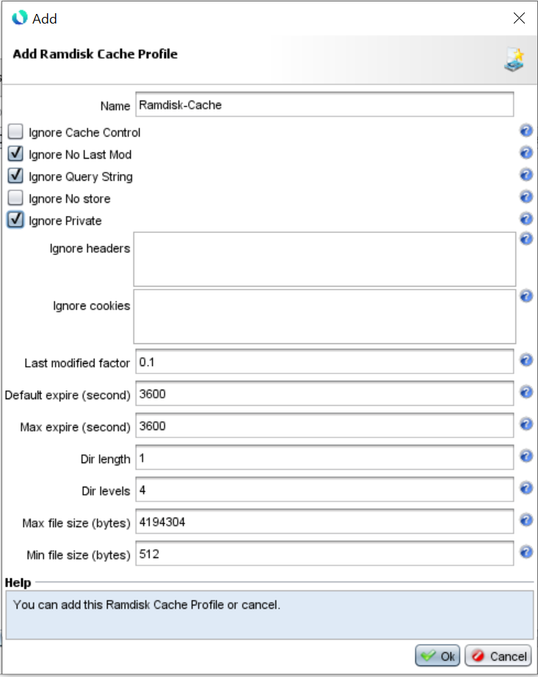
Recommandation
Caching
  The default caching profile is too aggressive, and you will cache some data that should not be cache like personal data.
  We recommand you this profile:
    Ignore Cache Control is disabled cause this header is very important, so if this header say to not cache, the system will not cache.
    Ignore No store is disabled so the system will not try to cache response which contains data with no store value.
    Dir level is set to 4: this allows up to 16777216 directory.

Slide 60
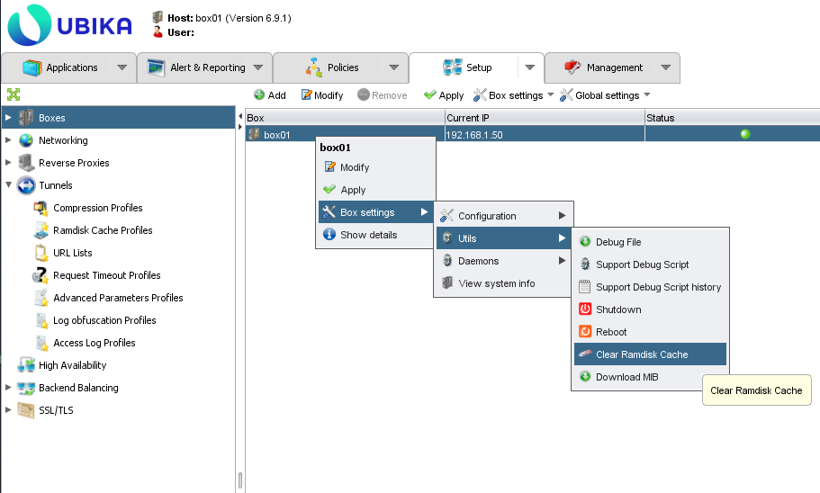
Clear Ramdisk Cache
Caching
  The cache will automatically clear his content after the expiration time for each file.
  You can delete manually the cache if you need for each appliance.
  In order to do that, in Setup tab, click on Boxes menu. Then right click on your appliance and go to Box settings > Utils > Clear Ramdisk Cache.

Slide 61
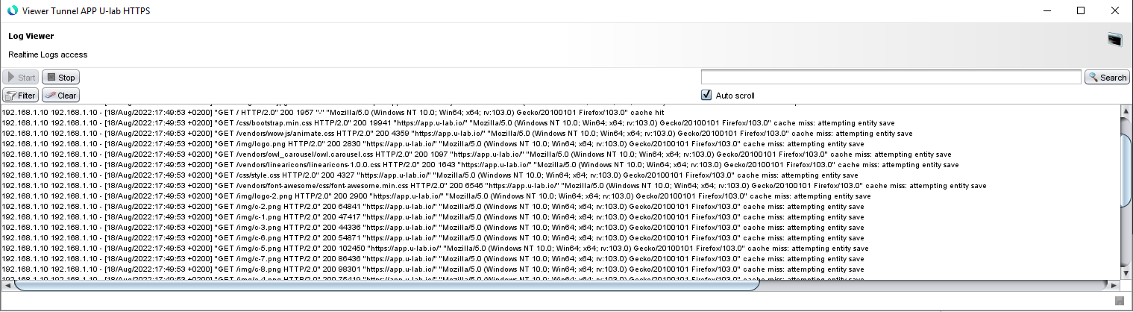
Tips
Caching
  If you want to have statistics on the use of cache for a tunnel, you can change the profile of your traffic to have additional information regarding compression.
  Create a new access logs profile and add this:
    %h %a %u %t "%r" %>s %b "%{Referer}i" "%{User-agent}i" %{cache-status}e
    %{cache-status}e will give the information of the file regarding with the cache

Slide 62
Lab

Slide 63
Lab1
Caching
  Create a new access logs profile with cache information:
    %h %a %u %t "%r" %>s %b "%{Referer}i" "%{User-agent}i" %{cache-status}e
  Modify the tunnel configuration of your web application to use it.
  Create a new ramdisk cache profile with default parameters and apply it to your tunnel. Apply the configuration.
  Open the Access logs viewer in real time and connect to your web web browser. You should see in the log that items are missing from the cache.
  Refresh your web browser, items should hit the cache.
  Check the access log of your application on your appliance.

Slide 64
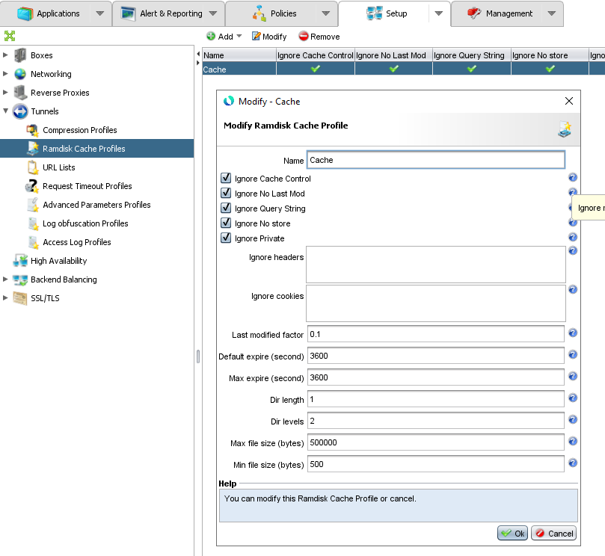
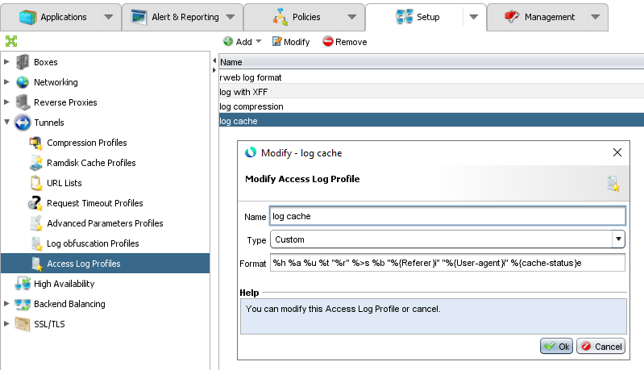
Lab1 Tips
Caching
  Configuration to do:

Slide 65
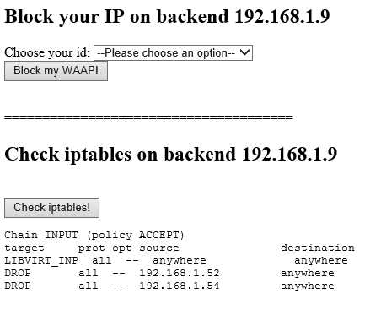
Lab2
Caching
  Use the web training application with Cache lab to block the IP address of your WAAP Gateway on the backend 192.168.1.9. We will simulate a network issue to validate than new request are trully handled by the cache.
  Close your web browser and launch it again to access your web application. It should work!
  Verify in the access logs than all requests are handled with the cache.

Slide 66
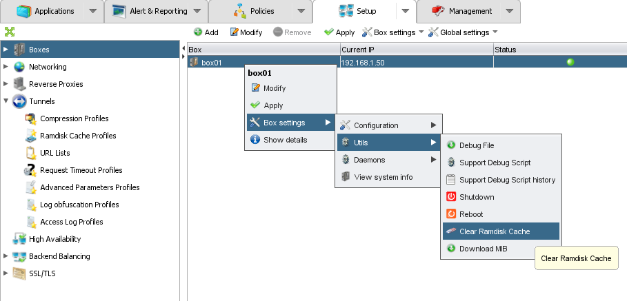
Lab3
Caching
  In the GUI console, clear the ramdisk cache of your appliance.
  Close your web browser and launch it again to access your web application. It should not work.

Slide 67
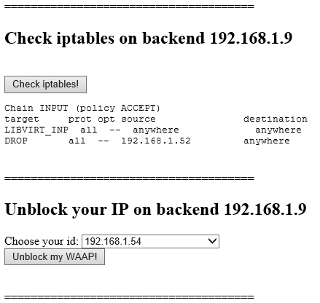
Lab4
Caching
  Use the web training application with Cache lab to unblock the IP address of your WAAP Gateway on the backend 192.168.1.9.
  Refresh your web browser to access your web application. It should work.

Slide 68


www.ubikasec.com

