Slide 1


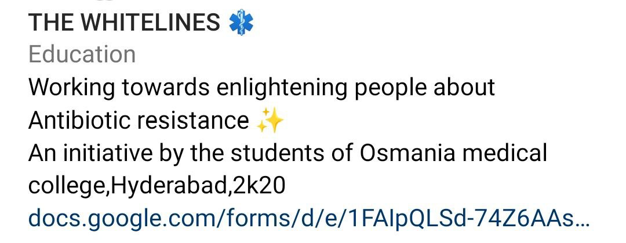

_lookfurther_

