Slide 1
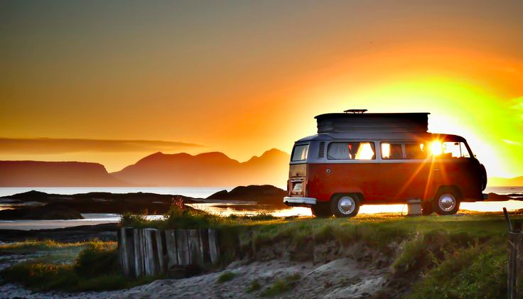
Connecting camper owners with vacationers
“HappyCamper will provide camper owners with smarter marketing solutions for holiday rental leading to better results and high levels of subscription renewal
Connecting camper owners with vacationers
“HappyCamper will provide camper owners with smarter marketing solutions for holiday rental leading to better results and high levels of subscription renewal”
Notes:
%%SPEECH%

