Slide 1
3rd Quarter Examination in Science 7
Notes:
3rd Quarter Examination in Science 7
%%TTS_FEMALE%

Slide 2
1. Speed plus direction is called ______________.
A. Velocity
B. Acceleration
Notes:
Speed plus direction is called ________________________.
A. Velocity
B. Acceleration

Slide 3
2. It measures the length of the total path travelled by the object.
A. Displacement
B. Distance
Notes:
2. It measures the length of the total path travelled by the object.
A. Displacement
B. Distance

Slide 4
3. It is the change in velocity over a time interval.
A. Speed
B. Acceleration
Notes:
3. It is the change in velocity over a time interval.
A. Speed
B. Acceleration

Slide 5
4. Distance plus direction is called __________.
A. Velocity
B. Displacement
Notes:
4. Distance plus direction is called __________.
A. Velocity
B. Displacement

Slide 6
5. The distance over time is called ___________.
A. Velocity
B. Speed
Notes:
5. The distance over time is called ___________.
A. Velocity
B. Speed

Slide 7
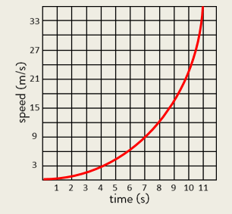
6. What does the
graph showing?
A. Gradually speeding up
B. Gradually slowing down
Notes:
6. What does the graph showing?
A. Gradually speeding up
B. Gradually slowing down

Slide 8
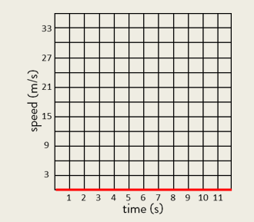
7. What does the
graph showing?
A. Fast constant speed
B. At rest
Notes:
7. What does the graph showing?
A. Fast constant speed
B. At rest

Slide 9
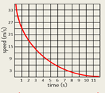
8. What does the
graph showing?
A. gradually speeding up
B. Gradually slowing down
Notes:
8. What does the graph showing?
A. gradually speeding up
B. Gradually slowing down

Slide 10
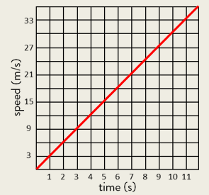
9. What does the
graph showing?
A. Constantly speed up
B. At rest
Notes:
9. What does the graph showing?
A. Constantly speed up
B. At rest

Slide 11
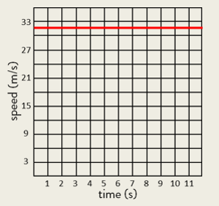
10. What does the
graph showing?
A. Fast Constant Speed
B. At rest
Notes:
10. What does the graph showing?
A. Fast Constant Speed
B. At rest

Slide 12
11. It is a vibration or disturbance in space that moves away from the source and carries energy.
A. Wave
B. Medium
Notes:
11. It is a vibration or disturbance in space that moves away from the source and carries energy.
A. Wave
B. Medium

Slide 13
12. The movement of this wave is up and down or perpendicular to the source.
A. Longitudinal
B. Transverse
Notes:
12. The movement of this wave is up and down or perpendicular to the source.
A. Longitudinal
B. Transverse

Slide 14
13. The movement of this wave is side by side or parallel to the source.
A. Longitudinal
B. Transverse
Notes:
13. The movement of this wave is side by side or parallel to the source.
A. Longitudinal
B. Transverse

Slide 15
14. A type of wave that requires a medium in order to propagate.
A. Mechanical wave
B. Electromagnetic wave
Notes:
14. A type of wave that requires a medium in order to propagate.
A. Mechanical wave
B. Electromagnetic wave

Slide 16
15. A type of wave that can travel into a vacuum and can propagate with or without medium.
A. Mechanical wave
B. Electromagnetic wave
Notes:
15. A type of wave that can travel into a vacuum and can propagate with or without medium.
A. Mechanical wave
B. Electromagnetic wave

Slide 17
15. A type of wave that can travel into a vacuum and can propagate with or without medium.
A. Mechanical wave
B. Electromagnetic wave
Notes:
15. A type of wave that can travel into a vacuum and can propagate with or without medium.
A. Mechanical wave
B. Electromagnetic wave

Slide 18
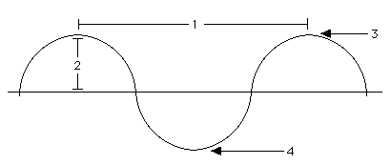
16. Which part of the wave below is the crest?
A. 1
B. 3
Notes:
16. Which part of the wave below is the crest?
A. 1
B. 3

Slide 19
17. Which part of the wave shows the wavelength?
A. 1
B. 3
Notes:
17. Which part of the wave shows the wavelength?
A. 1
B. 3

Slide 20
18. Which part of the wave is the trough?
A. 2
B. 4
Notes:
18. Which part of the wave is the trough?
A. 2
B. 4

Slide 21
19. Which part of the wave is the amplitude?
A. 2
B. 4
Notes:
18. Which part of the wave is the trough?
A. 2
B. 4

Slide 22
20. Which of the following scenarios would result in sound being produced?
A. sharpening your pencil
B. looking at a window
Notes:
20. Which of the following scenarios would result in sound being produced?
A. sharpening your pencil
B. looking at a window

Slide 23
20. Which of the following scenarios would result in sound being produced?
A. sharpening your pencil
B. looking at a window
Notes:
20. Which of the following scenarios would result in sound being produced?
A. sharpening your pencil
B. looking at a window

Slide 24
21. Human can hear from 20-20, 000 Hz which is called _______.
A. Audible
B. Ultrasonic
Notes:
21. Human can hear from 20-20, 000 Hz which is called _______.
A. Audible
B. Ultrasonic

Slide 25
22. It refers to how high or low a sound is. It is related to the frequency of the sound wave.
A. loudness
B. pitch
Notes:
22. It refers to how high or low a sound is. It is related to the frequency of the sound wave.
A. loudness
B. pitch

Slide 26
23. How loud or soft the sound is produced is called _______.
A. loudness
B. pitch
Notes:
23. How loud or soft the sound is produced is called _______.
A. loudness
B. pitch

Slide 27
24. A sound wave is a __________.
a. longitudinal wave
b. transverse wave
Notes:
24. A sound wave is a __________.
a. longitudinal wave
b. transverse wave

Slide 28
25. What happens to the sound an object makes when the speed of vibrations decreases (slow down)?
A. its pitch rises
B. its pitch becomes lower
Notes:
25. What happens to the sound an object makes when the speed of vibrations decreases (slow down)?
A. its pitch rises
B. its pitch becomes lower

