Slide 1

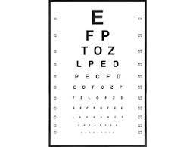



Customers undergo eye tests for several reasons, primarily to assess and evaluate their visual health and to determine the quality of their vision.
Here are some key reasons why customers undergo eye test
Vision assessment Monitoring eye health Prescription for corrective lenses Occupational requirements
Notes:
Customers undergo eye tests for several reasons, primarily to assess and evaluate their visual health and to determine the quality of their vision.
Here are some key reasons why customers undergo eye test
Vision assessment
Monitoring eye health
Prescription for corrective lenses
Occupational requirements

