Slide 1

PBL
Notes:
PBL

Slide 2
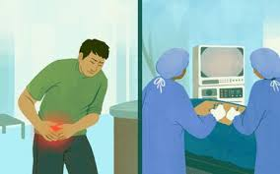
Mr. Ali, a 45-year-old farmer, experienced sudden onset symptoms of abdominal pain, vomiting and diarrhea. The pain started at 6 a.m. this morning and by noon, the pain was intolerable.
Notes:
Mr. Ali, a 45-year-old farmer, experienced sudden onset symptoms of abdominal pain, vomiting and diarrhea. The pain started at 6 a.m. this morning and by noon, the pain was intolerable

Slide 3
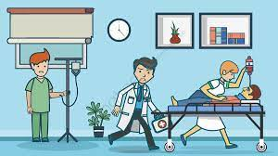
So, he decided to seek medical care at a nearby hospital. He was seen in the Emergency Department by a General Surgery specialist who diagnosed him as acute appendicitis and admitted him for emergency appendicectomy.
Notes:
So, he decided to seek medical care at a nearby hospital. He was seen in the Emergency Department by a General Surgery specialist who diagnosed him as acute appendicitis and admitted him for emergency appendicectomy

Slide 4

He underwent the surgical procedure at 4 p.m. in the afternoon and the surgery was uneventful. He was sent to the postoperative recovery room to receive his postoperative medications and care.
Notes:
He underwent the surgical procedure at 4 p.m. in the afternoon and the surgery was uneventful. He was sent to the postoperative recovery room to receive his postoperative medications and care.

Slide 5

The attending nurse prepared the postoperative medications which included intravenous antibiotic combination containing ampicillin and sulbactam and injected the required dose via the IV cannula.
Notes:
The attending nurse prepared the postoperative medications which included intravenous antibiotic combination containing ampicillin and sulbactam and injected the required dose via the IV cannula.

Slide 6
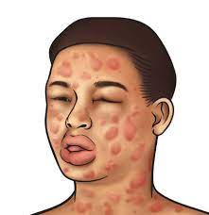
Rapidly after injection, he developed marked sweating, urticaria, erythema and edema in his upper and lower limbs. A few minutes later, he suddenly collapsed with severe hypotension, shortness of breath and stridor with laryngeal obstruction and cyanosis.
Notes:
Rapidly after injection, he developed marked sweating, urticaria, erythema and edema in his upper and lower limbs. A few minutes later, he suddenly collapsed with severe hypotension, shortness of breath and stridor with laryngeal obstruction and cyanosis.

Slide 7
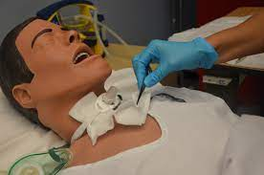
Emergency Response team was called where they tried to stabilize the patient. Intramuscular adrenalin was administered, and emergency tracheotomy was carried out to overcome upper airway obstruction. Unfortunately, despite their best efforts, the condition rapidly deteriorated and the patient became unresponsive.
Notes:
Emergency Response team was called where they tried to stabilize the patient. Intramuscular adrenalin was administered, and emergency tracheotomy was carried out to overcome upper airway obstruction. Unfortunately, despite their best efforts, the condition rapidly deteriorated and the patient became unresponsive.

Slide 8
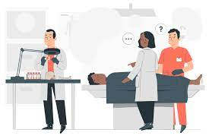
The chief of staff conducted an incident report about that unfortunate incident and review all the medical records including physician’s order to determine the medicolegal responsibility.
Family members agreed on autopsy report and forensic medicine pathologist was involved to determine the cause of death.
Notes:
The chief of staff conducted an incident report about that unfortunate incident and review all the medical records including physician’s order to determine the medicolegal responsibility.
Family members agreed on autopsy report and forensic medicine pathologist was involved to determine the cause of death.

Slide 9


