Slide 1
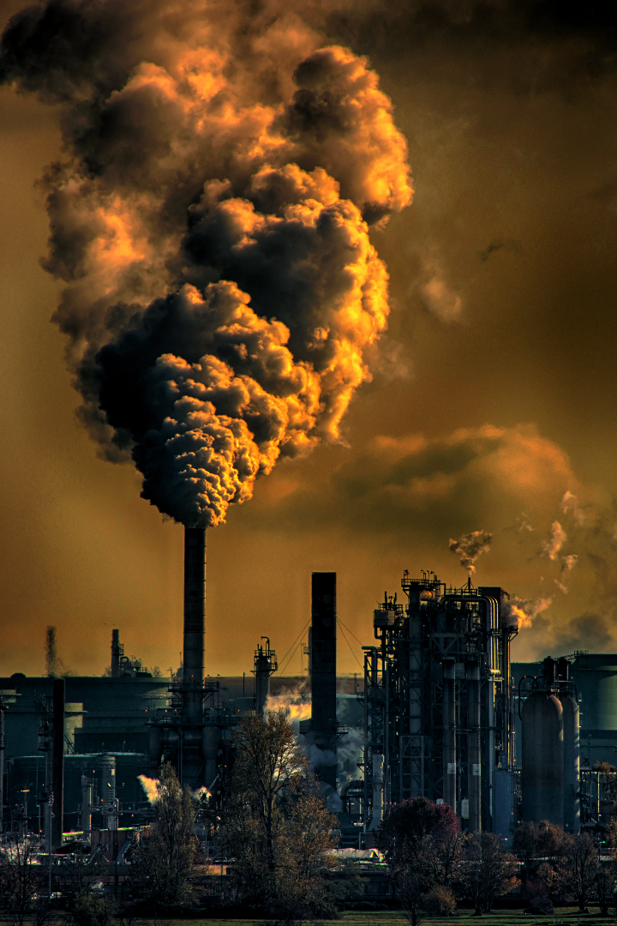


Introduction to Environmental Pollution
Environmental pollution poses a significant threat to the planet's well-being, impacting ecosystems and human health. It includes air, water, and soil pollution, each with diverse causes and effects.
by Asmaa Altunaiji

Slide 2
Types of Environmental Pollution
Air Pollution
Water Pollution
Soil Pollution
Caused by emissions from vehicles, industrial activities, and wildfires.
Resulting from industrial discharge, agricultural runoff, and oil spills.
Caused by pesticides, improper disposal of waste, and industrial activities.

Slide 3
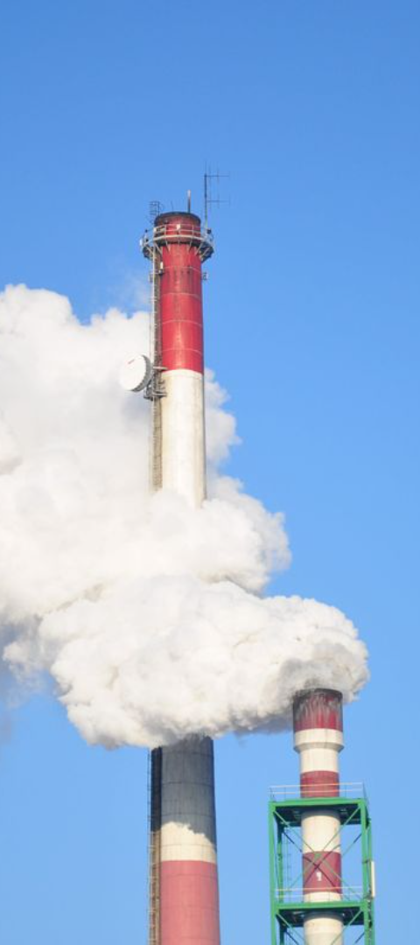
Air Pollution and Its Causes
1
Industrial Emissions
2
Vehicular Exhaust
Factories and power plants release harmful gases and particulate matter.
Transportation emissions contribute to the buildup of pollutants in the atmosphere.
3
Natural Disasters
Wildfires and volcanic eruptions release pollutants into the air.

Slide 4
Water Pollution and Its Sources
Industrial Discharge
Agricultural Runoff
Oil Spills

Slide 5
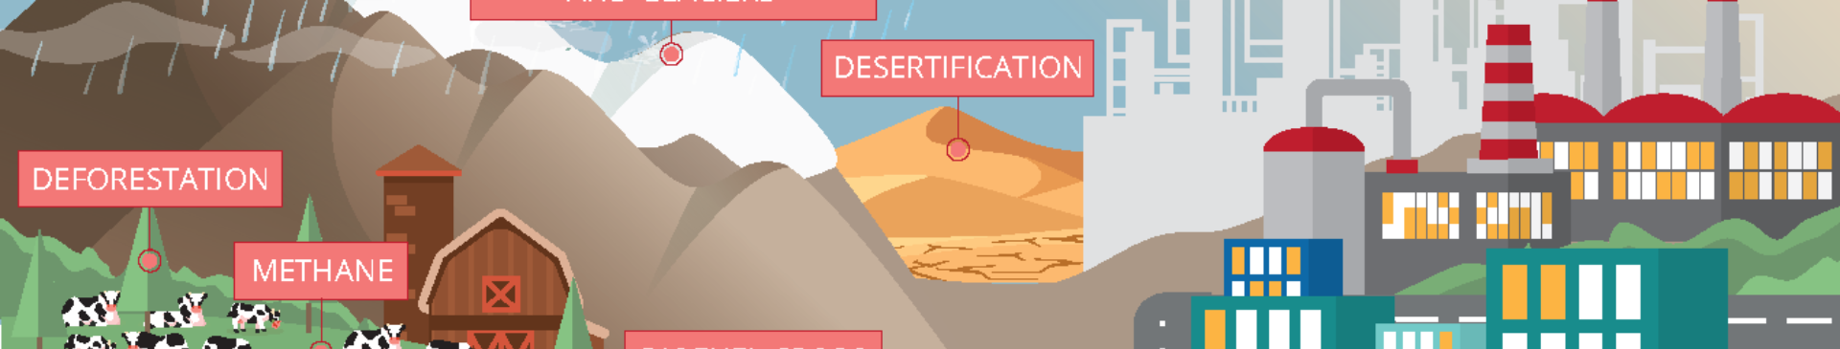
Soil Pollution and Its Impacts
Reduced Fertility
Groundwater Contamination
Ecosystem Disruption
Contaminated soils hinder plant growth and affect agricultural productivity.
Pollutants leach into the groundwater, posing a risk to drinking water.
Adverse effects on soil-dwelling organisms and the ecological balance.

Slide 6
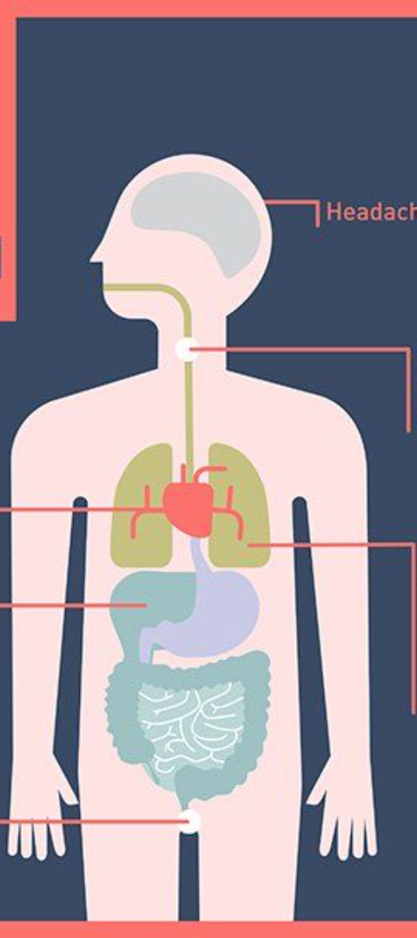



Effects of Environmental Pollution on Human Health
Respiratory Diseases
Higher risk of asthma, lung cancer, and other respiratory ailments.
Waterborne Illnesses
Exposure to contaminated water leads to gastrointestinal diseases.
Chronic Health Conditions
Prolonged exposure can result in cardiovascular issues and neurological damage.

Slide 7
Solutions to Reduce Environmental Pollution
Recycling
Renewable Energy
Environmental Policies
Recycling Initiatives
Adoption of Renewable Energy
Implementation of Stringent Environmental Policies

Slide 8
Conclusion and Call to Action
Raise Awareness
1
Educating communities about pollution's impact and steps for mitigation.
2
Promote Sustainable Practices
Encouraging sustainable consumer habits and eco-friendly technologies.
Advocate for Policy Changes
3
Pushing for stronger environmental regulations and enforcement.

