Slide 1
FLOODS AND MANAGEMENT OF FLOODS IN ASSAM
By trideep bhattacharyya of class 9

Slide 2
INTRODUCTION TO THE TOPIC :-
IN THIS POWERPOINT PRESENTATION I AM GOING TO TELL SOME INFORMATION ABOUT FLOODS IN ASSAM AND THE ACT OF MANAGEMENT FROM THE GOVERNMENT.

Slide 3
WHY IS ASSAM SO PRONE TO FLOODS?
ASSAM IS PRESENT IN THE NORTH EASTERN PART OF INDIAN UNION. NORTH-EASTERN PART OF INDIAN MAINLAND IS VERY PRONE TO FLOODS AS IT IS MOSTLY COVERED BY THE BAY OF BENGAL AND MIGHTY RIVERS LIKE BRAHMAPUTRA. ALSO THE GEOGRAPHIC PLACEMENT OF ASSAM IS PRESENT SURROUNDED BY MOUNTAINS AND SMALL TRIBUTARIES OF VARIOUS RIVERS.

Slide 4
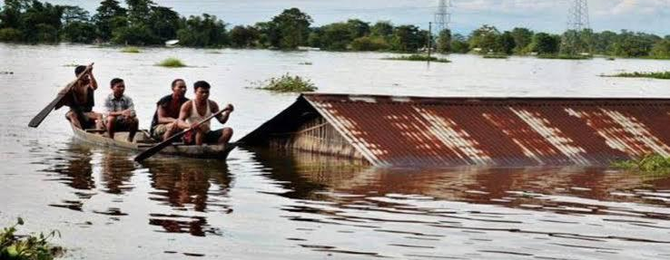
IMAGE OF FLOOD IN ASSAM
SOURCE : THE TIMES OF INDIA

Slide 5
EFFECTS OF FLOOD IN ASSAM
EVEN THOUGH THE FLOODS ARE A GREAT DISADVANTAGE TO A PLACE BUT WE SHOULD ALSO CONSIDER THE ADVANTAGES THAT IT BRINGS TO US ..
ASSAM IS KNOWN FOR ITS VARIOUS AGRICULTURAL HERITAGE AND TEA FARMING. FLOODS ARE VERY VITAL IN AGRICULTURE. THEY ARE VERY USEFUL IN RE - GRADING THE SOIL NUTRIENTS.
FLOODS HELP IN DEPOSITING ALLUVIAL SOIL WHICH IS VERY PERFECT FOR AGRICULTURE.
FLOODS HELP IN REFILLING GROUND WATER LEVELS

Slide 6
EFFECT OF FLOOD IN ASSAM .2
WE KNEW IN LAST SLIDE THAT FLOODS ARE KIND OF IMPORTANT FOR US BUT THEIR ARE MORE DISADVANTAGES OF FLOODS THAN ADVANTAGES...
FLOODS MAKES LAND SLIDES MORE EASILY AND DRIVES AWAY VEGETATION.
FLOODS LEAD TO SEVERAL OTHER NATURAL DISASTERS LIKE LANDSLIDES AND SOIL EROSION.
FLOODS ARE RESPONSIBLE FOR DESTROYING HABITATS OF ANIMALS AND HOUSES OF PEOPLES.
FLOODS MAKE AGRICULTURE FIELDS BE UNABLE TO WORK ON.

Slide 7
HOW FLOODS OCCUR SO FREQUENTLY IN ASSAM?
ASSAM IS SITUATED AT A PLACE OF NORTHEASTERN INDIA THAT IT IS SOLELY COVERED WITH WATER BODIES.
ASSAM IS ALSO COVERED WITH MOUNTAINS THAT ATTRACT DENSE CLOUDS IN RAINY SEASON. BECAUSE OF CLIMATIC CHARACTERISTICS OF ASSAM, RAIN IS AVAILABLE FOR AT LEAST 3 MONTHS OF SUMMER SEASON,WHICH MAKES THE WATER BODIES TOTALLY FULL WHICH RESULTS IN OVERFLOW AND LASTLY FLOODS

Slide 8
WHAT PEOPLE DO TO STOP THESE FLOODS ?
PEOPLE OF ASSAM CAN’T DO MUCH TO STOP THESE FLOODS ALONE.
PEOPLE FROM VARIOUS STATES, EVEN COUNTRIES DONATE IN CHARITY FOR THE PEOPLE THAT ARE EFFECTED DURING FLOODS.
IF FLOODS ARE TOO DRASTIC THEN, THE AREA OF FLOOD IS EVACUATED.

Slide 9
WHAT SHOULD WE DO DURING FLOOD?
SAFETY PRECAUTIONS SHOULD BE TAKEN DURING A FLOOD
GO TO HIGHER GROUNDS OF SHELTER TO AVOID FLOODS
CLOSE THE WINDOWS AND DOORS TO AVOID DISEASE CAUSING INSECTS ENTER YOUR HOME
BOIL THE WATER THOROUGHLY BEFORE DRINKING TO AVOID CONTAMINATION
DON’T LET WATER BE STRORED IN YOUR HOMES TO AVOID BREEDING OF MOSQUITOS

Slide 10
WHAT ROLE DOES GOVERNMENT PLAY TO AVOID FLOODS ?
GOVERNMENT PLAYS A VITAL ROLE TO AVOID FLOODS AND ENSURE SAFETY OF AFFECTED PEOPLE
GOVERNMENT INVESTS IN MAKING OF BORDERS AROUND RIVERS THAT ARE PRONE TO FLOODING
GOVERNMENT ENSURES SAFETY BY SENDING HELICOPTER RESCUERS DURING FLOOD.
GOVERNMENT MAINTAINS A PART OF ANNUAL BUDGET TO SUPPORT DURING NATURAL DISASTERS LIKE FLOODS

Slide 11
CAN FLOODS BE STOPPED FOREVER?
EVEN IF GOVERNMENT PUTS MONEY TO MAKE BORDERS NEAR RIVERS FLOODS HAVE ENOUGH ENERGY TO DESTROY THE BORDERS AND COME AGAIN STRONGER.
AT LAST WE SHOULD ADAPT TO THESE CLIMATIC CONDITIONS BECAUSE ITS NOT SO BAD FOR US.
ONE THING WE SHOULD DO TO CONTROL THE IMPACT OF FLOODS IS TO GROW LARGE DENSE TREES NEAR THE SHORE .

Slide 12

THANKS FOR CHECKING OUT THIS POWERPOINT PRESENTATION!
I HOPE YOU LIKED THIS POWERPOINT PRESENTATION ABOUT FLOODS IN ASSAM AND THEIR MANAGEMENTS.!

