Slide 1

PHYSICS QUIZZ

Slide 2
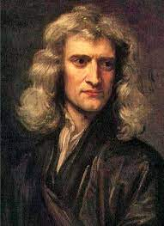
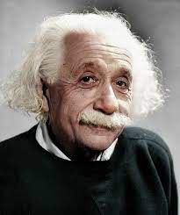
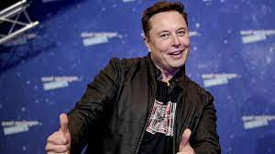
Who defined the law of universal gravitation?
Isaac Newton
Albert Einstein
Elon Musk
Notes:
%%PAUSE_AFTER%

Slide 3
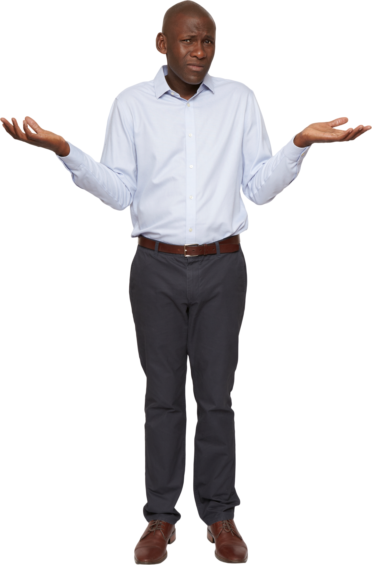
WRONG !!
TRY AGAIN
Notes:
%%GOTO%2%%GOTO-END%

Slide 4
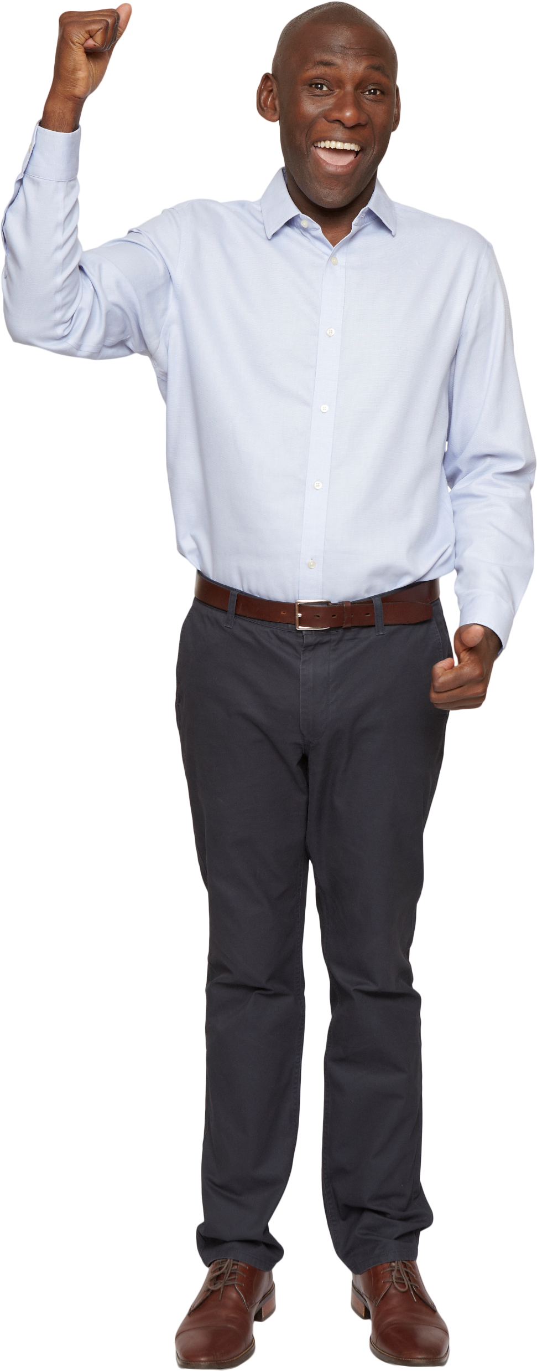
CORRECT!!
NEXT

Slide 5
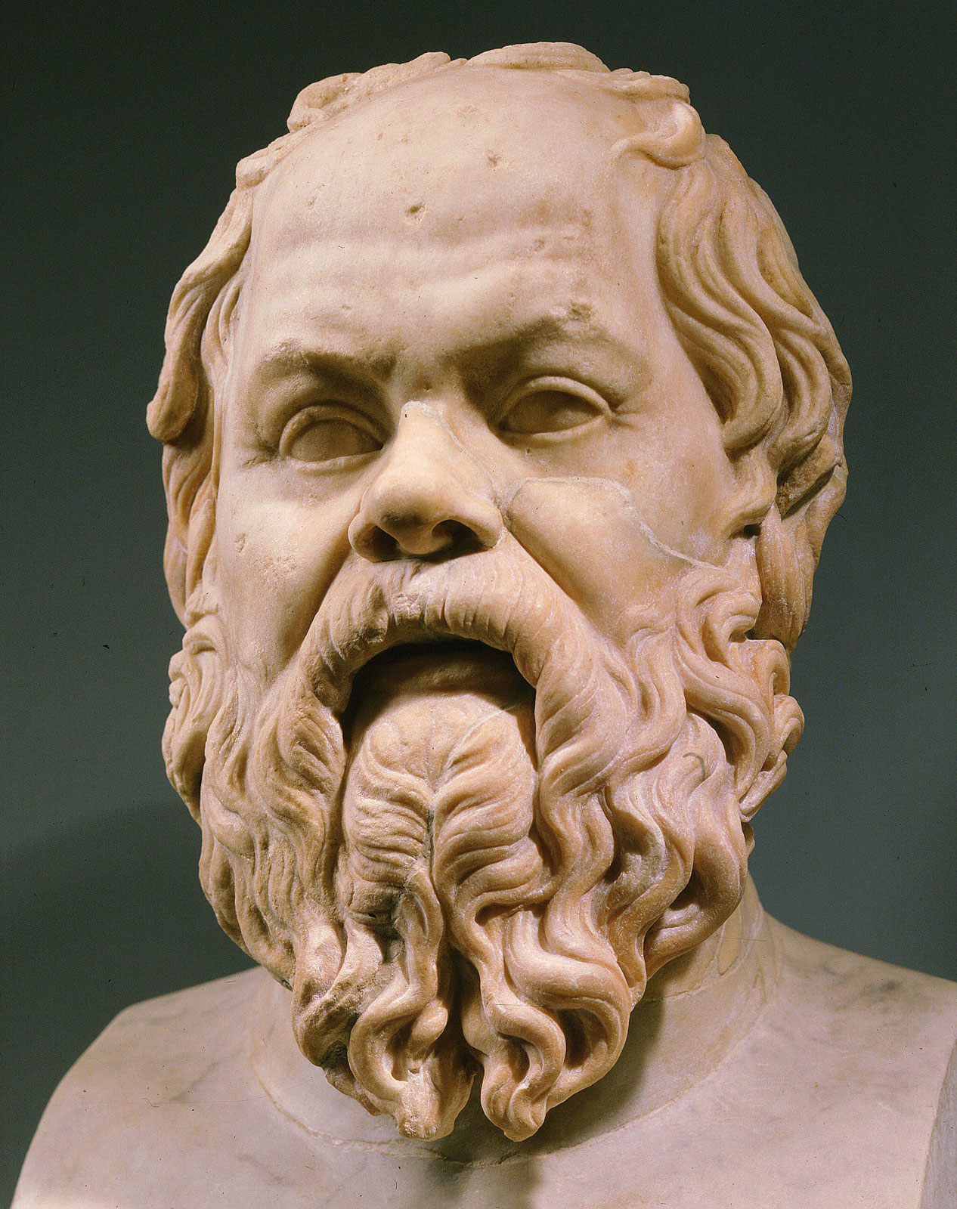
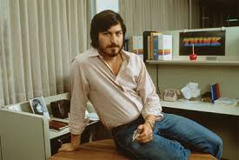
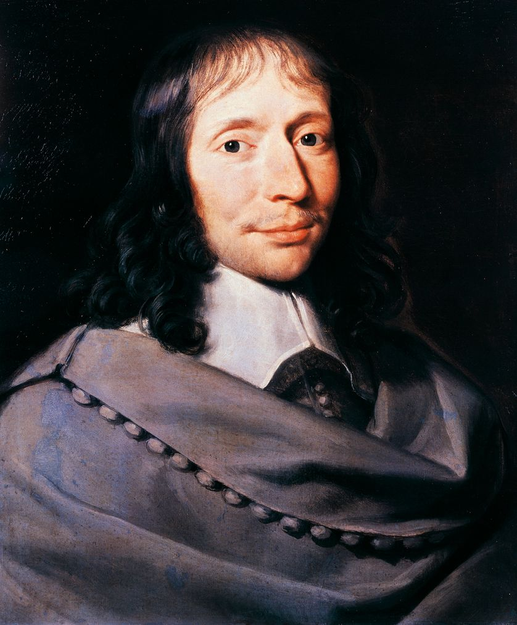
Who invented the first calculator?
Socrates
Steve Jobs
Blaise Pascal
Notes:
%%PAUSE_AFTER%

Slide 6
WRONG !!
TRY AGAIN
Notes:
%%GOTO%5%%GOTO-END%

Slide 7
Congratulations !
You finished this quizz !

