Slide 1


The Role of the Individual in Addressing Societal Challenges
Name
Institution
Course
Date

Slide 2
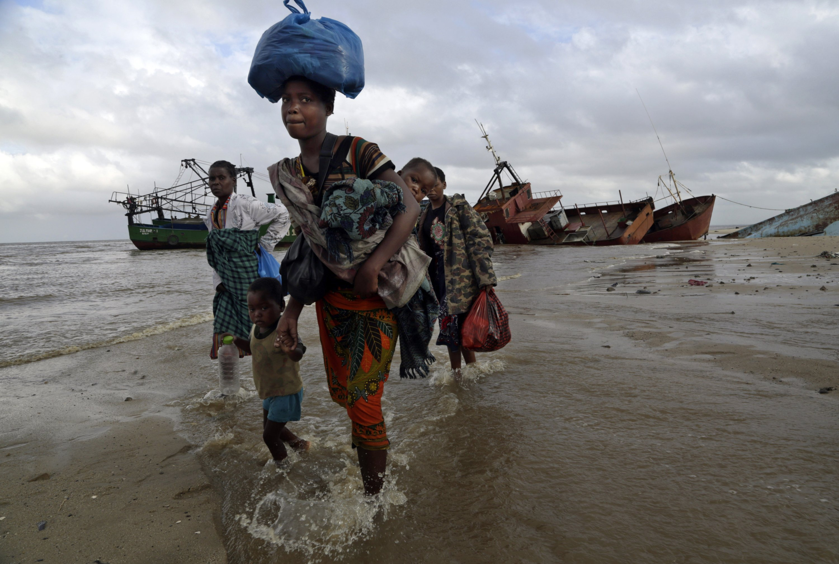


Introduction:
Individuals are essential in addressing social issues.
Understanding one's place in larger cultural context
social media, technology, and automation influence
Notes:
To address societal issues, individuals play a significant role. Individuals are free to autonomously find their own fulfillment in a free society. Nevertheless , it's vital to understand that individual are not autonomous beings but rather are a part of a larger society framework. This context consists of their own family, neighbors, and the larger global community. Additionally, the impact of social media, new media technologies, and automation further mold and transform our society while posing fresh problems for people to solve.

Slide 3
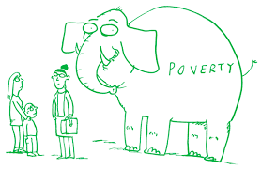
The Role of the Individual
Personal and public lives are affected by decisions and actions.
Encourage social justice and sustainable behaviors
Engage in community projects and volunteer work
Raising awareness and inspiring others
Notes:
On a personal level, people may make a big contribution to alleviating societal problems. Although systemic and structural changes are crucial, it is through the decisions and deeds of the person that meaningful change may be brought about. People may affect not just themselves but also others around them by taking ownership of their own behavior and actively engaging in positive change. People may address concerns like property rights, unemployment, and environmental disasters by supporting sustainable practices, fighting for social justice, and taking part in relevant projects. People may influence public opinion and inspire others to support their efforts by being knowledgeable about these topics and raising awareness about them. Participating in community projects, volunteering, and aiding organizations that deal with these issues are all practical acts that may have a big impact. Recognizing that personal development begins with the individual and that people may influence others to improve the future is vital.

Slide 4
Embracing a Sense of Common Purpose
Shared purpose and civic spirit for the collective good
Cooperation and unity are essential
Pooling resources for innovative solutions
Forge connections, engage in dialogue, and create an inclusive society
Notes:
Individuals must embrace a shared purpose and a civic spirit centered on the collective good in order to address societal challenges. Individual pursuits are important, but it's also important to realize that everyone's wellbeing is interconnected. Individuals may utilize their collective power and experience to foster innovative solutions by prioritizing shared objectives above self-interest. His feeling of a shared goal fosters empathy, unanimity, and a willingness to work together. Individuals may deal with the underlying causes of social problems more successfully by pooling resources and working together. Adopting a collective mindset also acknoledges that Individual's decisions and actions have an influence on the greater community. It encourages people to connect despite their differences, seek common ground, and engage in constructive dialogue. Individuals may create an inclusive society and foster a culture of cooperation and sustainability for everyone by banding together.

Slide 5
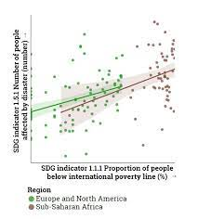
Private Pursuits and a Market Mentality
balance between individual goals and group efforts
Recognize the effects of your consuming choices.
Utilize sustainable consumption habits.
Encourage ethical individual behavior
Notes:
While individual pursuits and market competitiveness have value in a free society, it is crucial to establish a balance. Simply emphasizing private consumption as a solution to societal problems ignores the systemic nature of such problems and the need for collective action. People should be aware that the effects of their consumption decisions have an impact beyond their own life. Individuals may contribute to the collective well-being as well as their individual satisfaction by adopting sustainable consumption patterns, supporting local businesses, and advocating for sustainable energy systems. Consider opposing points of view, acknowledge the need for structural changes, and encourage responsible individual actions that contribute to a more sustainable and equitable society are all crucial.

Slide 6
Balance between Individual Responsibility and the Public Sphere
Personal responsibility and civic engagement
Support community initiatives and political involvement
Consider socioeconomic position and resource availability
Create an inclusive atmosphere for equal participation
Notes:
It's vital to strike a balance between participation in public and personal responsibility life. As human beings, it is our obligation to influence involvement in politics and society constructively by our work. Giving back to the society, political organizations and supporting social and taking part in local initiatives that share our values are all examples of how to do this. In any case, it is vital to acknowledge that idividuals have a range of abilities and circumstances that may affect how much they participate. Social economic position and resource accessibility may have an impact on each person's degree of engagement. Structured barriers must be removed by society working to create an inclusive environment where everyone has an equal chance to participate and contribute to addressing social challenges.

Slide 7
Conclusion
Individuals make a big contribution to tackling social issues.
Personal accountability and active engagement are crucial.
embrace group effort and a common goal
Align personal objectives with the larger good.
Notes:
In conclusion, people have a big part to play in solving society problems. Individual decisions and actions have a real influence on the world, even while structural adjustments and group efforts are required. Individuals may affect change by taking personal responsibility, actively engaging in constructive change, and supporting projects that are consistent with their values. People may cooperate to create a more just and sustainable society by embracing a sense of shared purpose and understanding the interconnection of social issues. To achieve both personal fulfillment and society growth, it is crucial to strike a balance between one's own objectives and the larger good. Both individual satisfaction and society advancement are possible when people work to bring about constructive change.

