Slide 1


Onboarding Training
Day 1
Deal Life Cycle
Notes:
Welcome, everyone!
I'm thrilled to be here today to give you an inside look at our prospecting process within the Business Development team. We'll explore how our teamwork is driving success in generating new leads and enhancing our CRM database.
Have you ever wondered how we identify and connect with potential clients? Let's dive in and see how we make it happen!

Slide 2
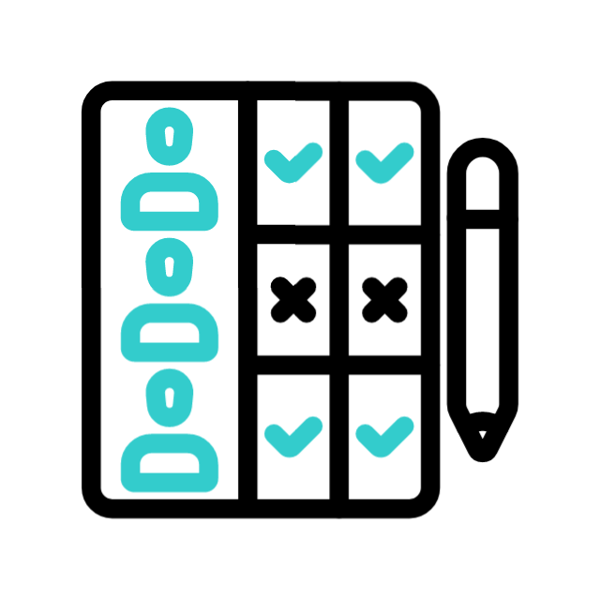




Standard Deal Life Cycle
  Provide a detailed breakdown of costs, including licensing, implementation, training, and ongoing support.
  Work closely with the client to align the quotation with their budget constraints. This may involve offering flexible pricing models or phased implementation options.
  Craft comprehensive responses to Requests for Proposals (RFP) or Information (RFI) to showcase our capabilities.
  Develop a Proof of Concept (POC) to demonstrate the practical application and benefits of our solutions.
Within BizDev, three main teams collaborate to generate new leads and enrich the CRM database:
Marketing team: The initial source can be Outbound Marketing through events, ads etc or Inbound Marketing via the website and campaigns.
  Inside Sales team: Primarily relies on prospections and GTM explorations as an initial source.
  Sales team: Analyzes the target market and initiates comprehensive explorations.
  Lead qualification is conducted through a Lead Scoring system that analyzes metrics and KPIs related to the lead’s profile, source, activities, and engagement.
  This lead scoring system enables us to segment, qualify, and classify our database into three main stages: cold leads, warm leads, and hot leads.
  Showcase key features and functionalities to address the specific needs identified during the qualification stage
  Ensure that the client sees the relevance and applicability of our solutions to their specific context and business segments.
Prospection
Qualification
Demo
Quotation
RFP/ RFI & POC
Notes:
Let's take a closer look at the three key teams that work together to achieve our goals:
The Marketing team initiates the process by generating leads through various channels. This includes events, advertisements, website interactions, and targeted campaigns.
The Inside Sales team focuses on proactive prospecting, identifying potential leads through market exploration.
After identifying leads, the Sales team dig deeper, analyzing the target market and further qualifying these leads.
For qualification, we use an advanced Lead Scoring system. This system looks at key metrics related to the lead’s profile, source, activities, and engagement. It helps us segment leads into cold, warm, and hot categories.
During the demo phase, we showcase our key features and functionalities tailored to the specific needs identified during qualification. Our goal is to show the client how our solutions can meet their unique requirements.
Next is the quotation stage, where we provide a detailed cost breakdown, including licensing, implementation, training, and support. We align the quotation with the client's budget, offering flexible pricing or phased implementation when needed.
We also respond to Requests for Proposals (RFP) or Information (RFI) to highlight our capabilities. Additionally, we develop Proof of Concepts (POC) to demonstrate the practical benefits of our solutions, solidifying our role as a trusted partner.

Slide 3
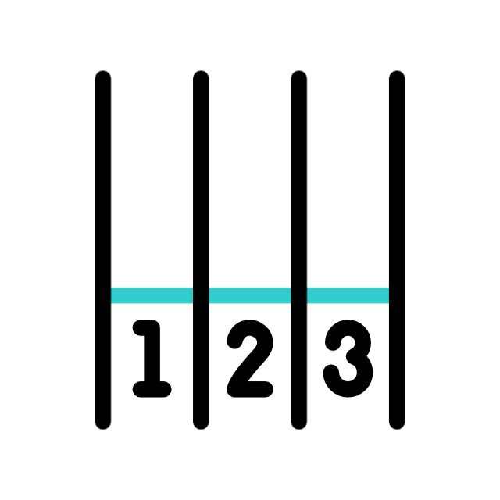



Standard Deal Life Cycle
  Organize a kick-off meeting to introduce key team members, establish communication channels, and clarify project goals.
  Collaborate closely with the client to finalize project specifications.
  Engage in open and transparent negotiations, with a primary emphasis on finding mutually beneficial solutions.
  Consider flexible pricing models or additional services to meet the client's needs without compromising our value.
  Celebrate the successful bid and secure the contract.
  Ensure all terms and conditions are clearly outlined in the contract
Defense
Kick-Off
Negotiation
Award & Contract
  Anticipate and address potential concerns or objections raised by the client.
  Highlight the strengths and unique features of our services.
Notes:
In the defense phase, we proactively address any concerns or objections from the client, emphasizing the strengths and unique features of our services to ensure they see our value.
During negotiations, we aim for open, transparent discussions to find solutions that work for both sides. We might offer flexible pricing or additional services to meet their needs while maintaining our value.
Once we’ve addressed all concerns and reached an agreement, we move to the award and contract phase. Here, we celebrate our successful bid and secure the contract, ensuring all terms are clear to avoid any misunderstandings.
We then organize a kick-off meeting to introduce the key team members, establish communication channels, and clarify project goals. We work closely with the client to finalize project specifications, setting the stage for a successful partnership.
In summary, our prospecting process is efficient and effective, driven by collaboration, innovation, and a deep understanding of our clients’ needs.

Slide 4

Thank You
Notes:
Thank you for your attention, and I’m ready to answer any questions you may have.

