Slide 1


THE INSTITUTE OF CHARTERED ACCOUNTANTS OF INDIA.(ICAI)
PROJECT NAME :- TYPES OF OPERATING
SYSTEMS
PREPAID BY :- NIDHI PITHVA R.
REGISTRATION NUMBER :- WRO0721583.
Submitted to:- SUBMITTED TO ICAI BHAWAN,
RAJKOT.

Slide 2
INTRODUCTION TO OPERATING SYSTEM
An operating system (OS) is system software that manages computer hardware, software resources, and provides common services for computer programs.
An operating system is a program that acts as an interface between the user and the computer hardware and controls the execution of all kinds of programs.

Slide 3
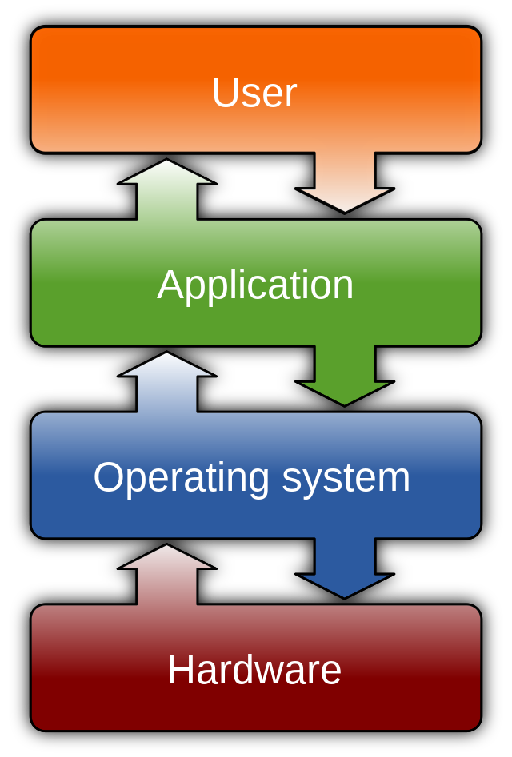
COMPUTER SYSTEM AS USER FRIENDLY:-
Avoids direct dealing with Hardware.
Difficult to write program to deal with hardware.
User feels awkward in direct dealing with hardware.
Provides user commands like read, write ,modify and save.
Easy for user to deal with commands.
Hides complexity of Hardware.
Acts as Virtual machine.

Slide 4
Operating system as resource manager:
The second important objevctive of an os is to manage various resources of computer system .
This involves performing such task as keeping track of ‘who is using which resource’ , granting resource request , accounting for resource usage , mediating conflicting request from different programs and users.
Resource management includes multiplexing or sharing resources in two different ways: in time and in space.
Resources such as CPU time ,memory space , I/O devices , and so on.

Slide 5
Functions of operating system:
Process management.
Memory management.
File management.
Device management.
Security
Command interpretation.

Slide 6
TYPES OF OPERATING SYSTEM:
  REAL TIME OPERATING SYSTEM
  DISTRIBUTED OPERATING SYSTEM (DOS)
  PERSONAL OPERATING SYSTEM
  MULTIPROCESSOR OPERATING SYSTEM
  SERVER OPERATING SYSTEM
  EMBEDED OPERATING SYSTEM
  SMART CARD OPERATING SYSTEM
  MAIN FRAME OPERATING SYSTEM

Slide 7
REAL TIME OPERATING SYSTEM(RTOS)
This operating system is based on time .
That means the process or task should be completed in given time.
There are two types of RTOS :
1) HARD RTOS
2) SOFT RTOS

Slide 8
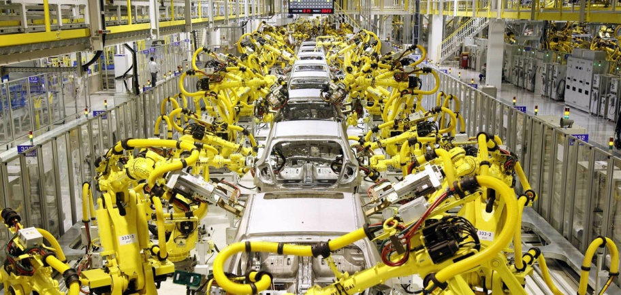
Rtos Continue…
HARD RTOS :
In this operating system there is given time limit in which particular task or process should be done .
Time limit is strictly followed in this type of RTOS.
This type of RTOS is found in many industrial process control , avionics , and military and similar application areas.

Slide 9

RTOS continue…
SOFT RTOS :
There is no time limit given to particular process or task .
Digital audio or multimedia falls in this category.
Example e-Cos

Slide 10
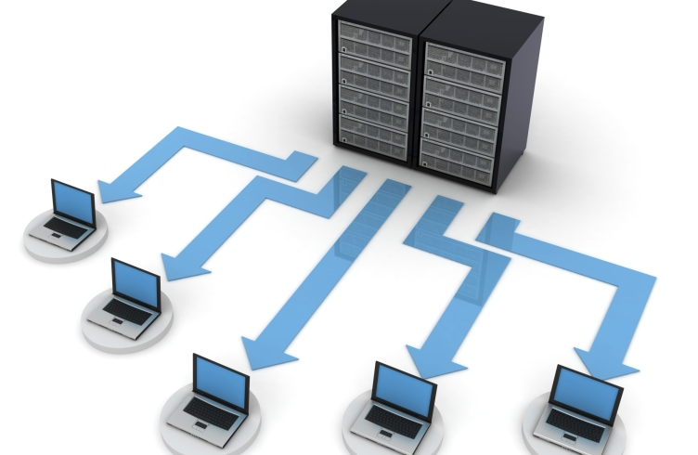
DISTRIBUTED OPERATING SYSTEM(DOS)
A distributed operating system is system software over a collection of independent software, networked, communicating, and physically separate computational nodes. They handle jobs which are serviced by multiple CPUs. Each individual node holds a specific software subset of the global aggregate operating system.

Slide 11
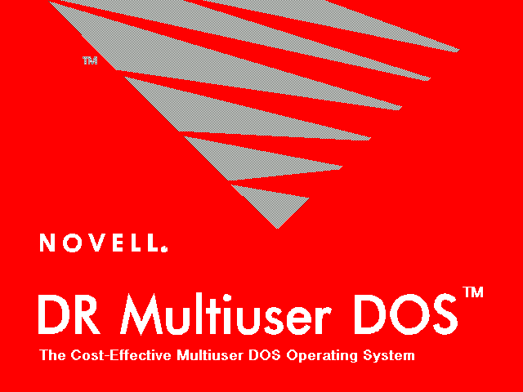
DISTRIBUTED OPERATING SYSTEM CONTINUE….
The main benefit of this system is if one machine crashes , the system as a whole can still survive.
Since it is open system so it is always ready to communicate with other systems.
It has inherent .

Slide 12
Personal computer operating system
They are widely used for personal use .
Their job is to provide good support to single user .
They are widely used for internet access , word processing and spread sheets .

Slide 13
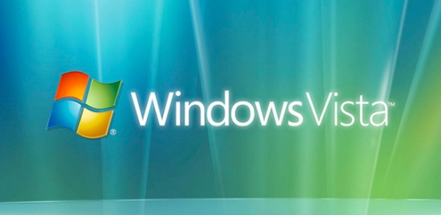
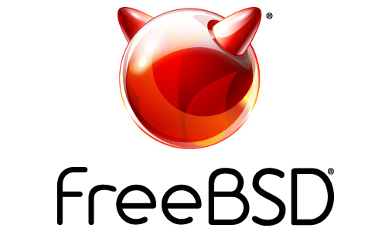
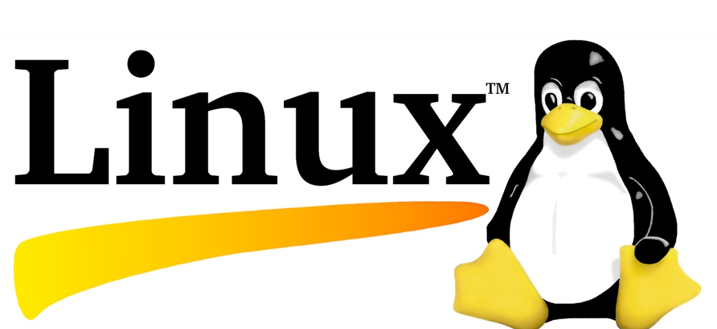
Personal computer operating system continue….
Examples :
LINUX
WINDOWS VISTA
FREE BSD
Etc…

Slide 14
MULTIPROCESSOR OPERATING SYSTEM
Multiprocessor system means, there are more than one processor which work parallel to perform the required operations.
It allows the multiple processors, and they are connected with physical memory, computer buses, clocks, and peripheral devices.
The main objective of using a multiprocessor operating system is to increase the execution speed of the system and consume high computing power.

Slide 15

Types of multiprocessing operating system
There are two types :
1)TIGHTLY COUPLED
2)LOOSLY COUPLED

Slide 16
Tightly Coupled Multiprocessor System:
It is a type of multiprocessing system in which, There is shared memory. In tightly coupled multiprocessor system, data rate is high rather than loosely coupled multiprocessor system. In tightly coupled multiprocessor system, modules are connected through PMIN, IOPIN and ISIN networks.
Loosely Coupled Multiprocessor System:
It is a type of multiprocessing system in which, There is distributed memory instead of shared memory. In loosely coupled multiprocessor system, data rate is low rather than tightly coupled multiprocessor system. In loosely coupled multiprocessor system, modules are connected through MTS (Message transfer system) network.

Slide 17
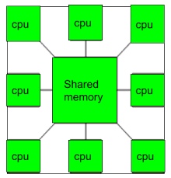
MULTIPROCESSOR OPERATING SYSTEM CONTINUE…
Example :
Windows
Linux

Slide 18
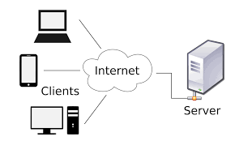
SERVER OPERATING SYSTEM
Multiple clients access the server.
Client sends the request and server fulfills the request.
It is an advanced version of an operating system, having features and capabilities required within a client-server architecture or similar enterprise computing environment.

Slide 19

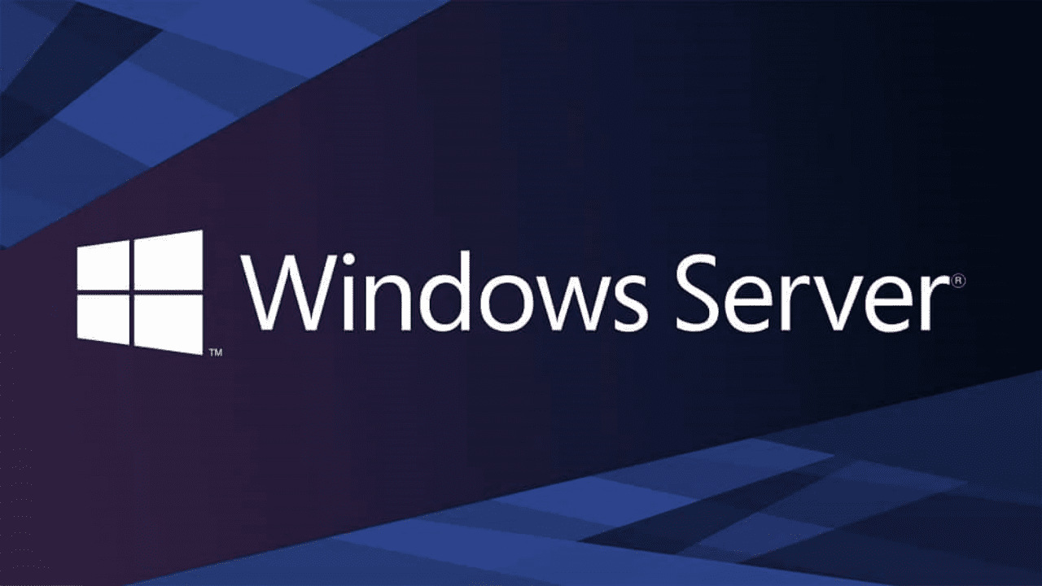
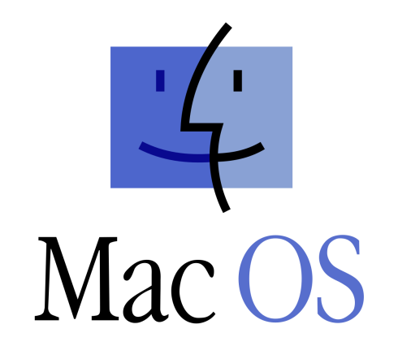

SERVER OPERATING SYSTEM CONTINUE….
Some common examples of server OSs include:
Red Hat Enterprise Linux
Windows Server
Mac OS X Server

Slide 20
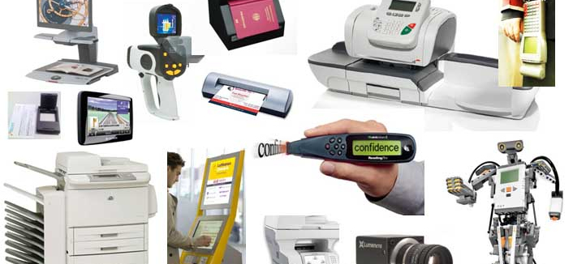
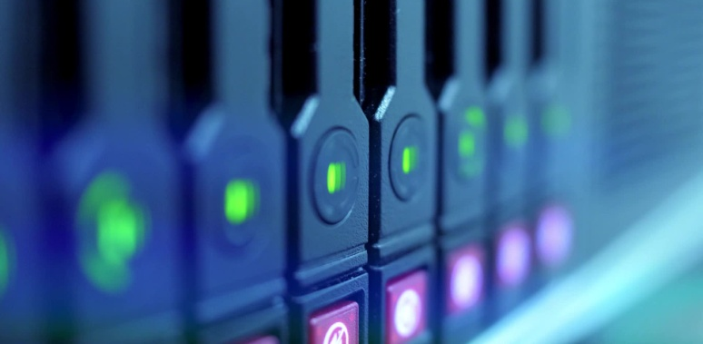
EMBEDED OPERATING SYSTEM
systems can be programmable or have a fixed funcThis type of system installed in various gadgets.
It is used to control gadgets.
An embedded system is a combination of computer hardware and software designed for a specific function. Embedded systems may also function within a larger system. The tionality.
While embedded systems are computing systems, they can range from having no user interface (UI) -- for example, on devices designed to perform a single task -- to complex graphical user interfaces (GUIs), such as in mobile devices.

Slide 21
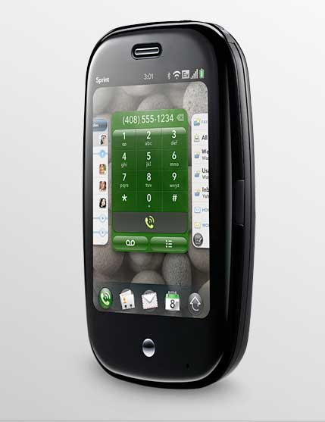
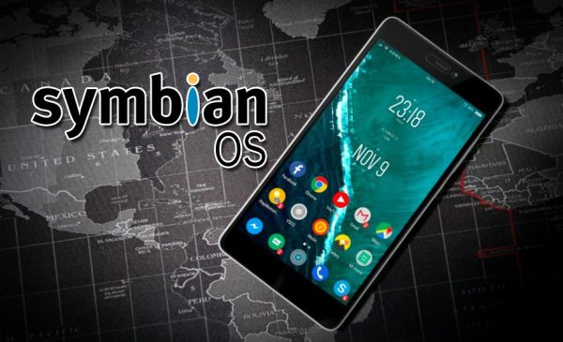
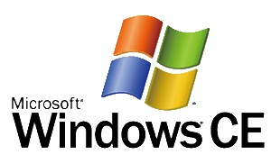
Embedded operating system continue…
Examples:
Windows CE
Palm OS
Symbian OS

Slide 22
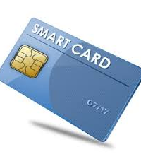
Smart card operating system
Installed into a small chip and used in Credit card and Debit card for electronic payments.
Every smart card has an operating system (OS). The OS is the hardware-specific firmware that provides basic functionality as secure access to on-card storage, authentication and encryption. Only a few cards allow writing programs that are loaded onto the smart card – just like programs on a computer. This is a great way to extend the basic functionality of the smart card OS.

Slide 23

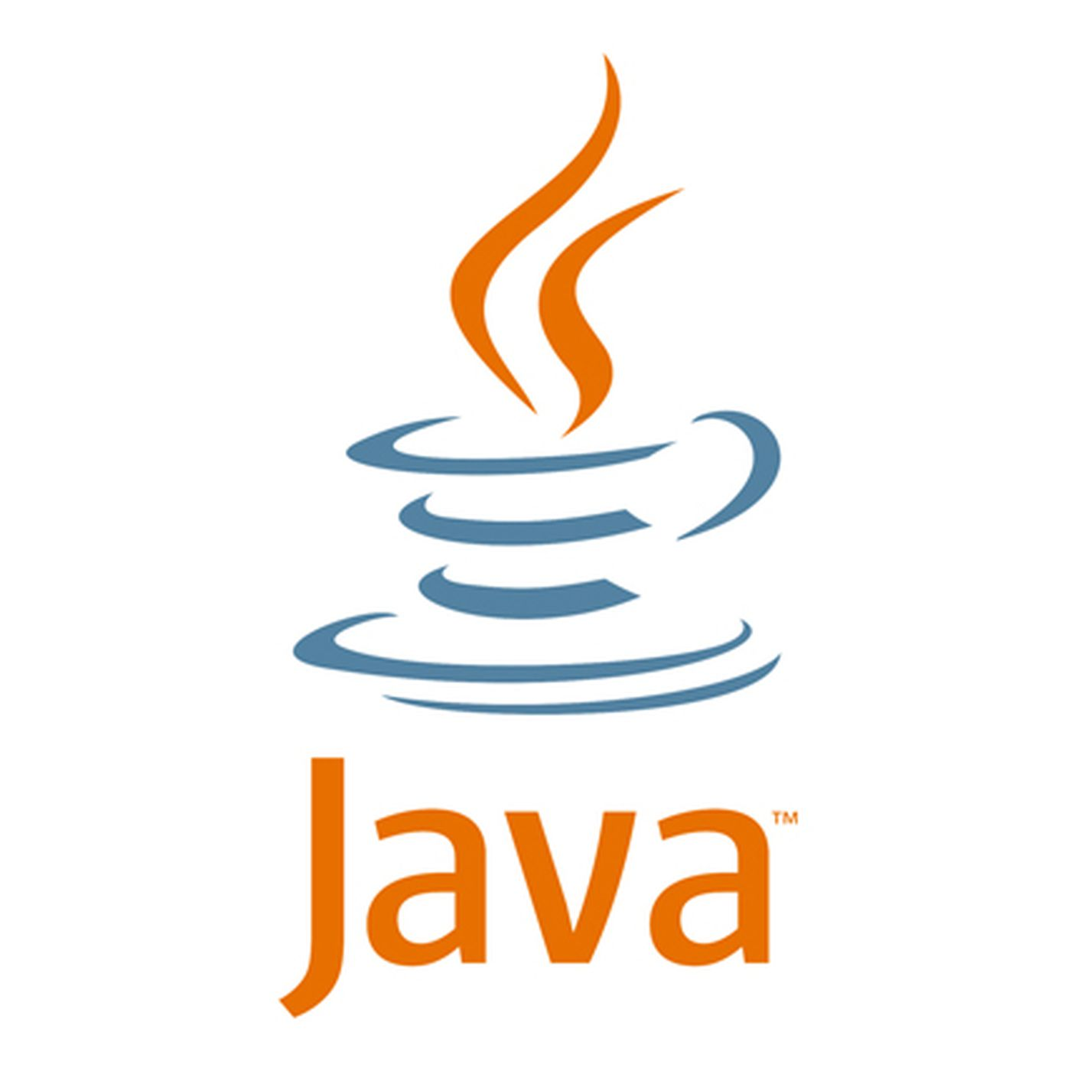
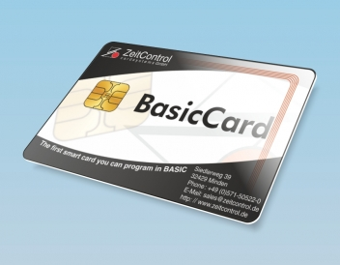
Smart card operating system continue….
Examples:
MULTOS
Java card
Basic Card

Slide 24
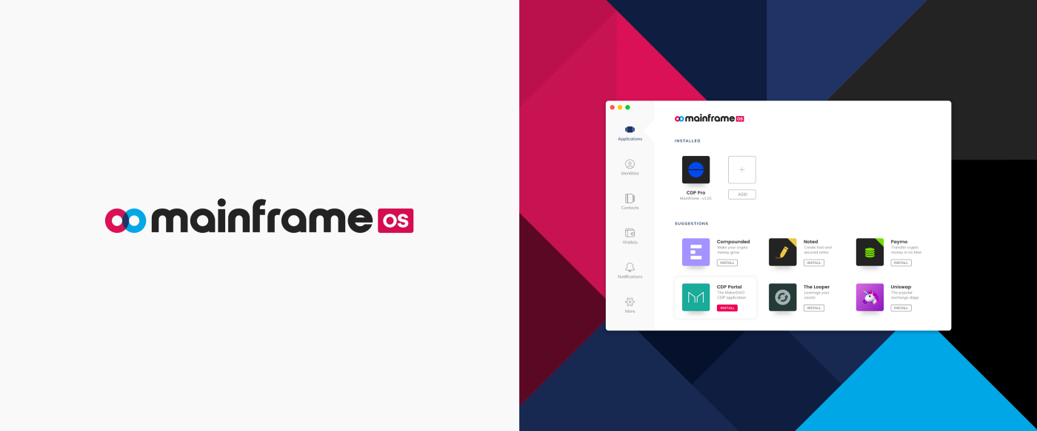
MAIN FRAME OPERATING SYSTEM
It offers three services:-
1. Batch :- Jobs are collected in batch and then processed
2. Transaction processing :- Large number of very small tasks are processed.
3. Timesharing :- Multiple users remotely perform the tasks.

Slide 25
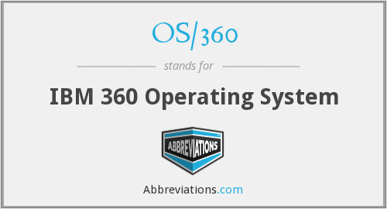
MAIN FRAME OPERATING SYSTEM CONTINUE…
Examples:
OS/390
OS/360

Slide 26


