Slide 1
SMART RETAIL STORE
JIMMY LIM SHEE KHENG TP055737
CHUNG WAI CHUN TP055592
SIOW RUI HONG TP056434

Slide 2
PROBLEM
This scenario takes place in a hypermarket that utilizes the usage of ubiquitous computing to help with problems that frequently occurs in a hypermarket to make the business runs smoother and higher customer satisfaction.

Slide 3
Target Market
Customer
Store Employee
Store Management
The customers visiting the retail store to shop and fulfill their needs.
The staff working at the store including cashiers, stock clerks, customer service representatives.
The managers and executives overseeing the store operations.

Slide 4
SITUATIONS
SECURITY AND THEFT
CUSTOMER ASSISTANCE
Retail stores face major losses due to various types of theft and fraud by customers, employees or organized crime groups. This leads to significant financial losses.
Customers visit the retail store to purchase products and have a good shopping experience. They may need assistance in finding specific products or understanding product information.

Slide 5
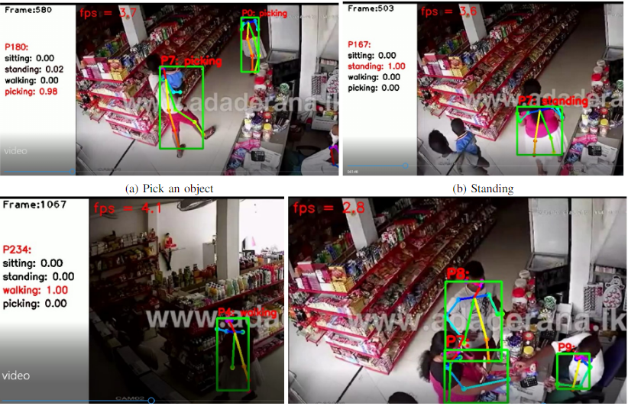
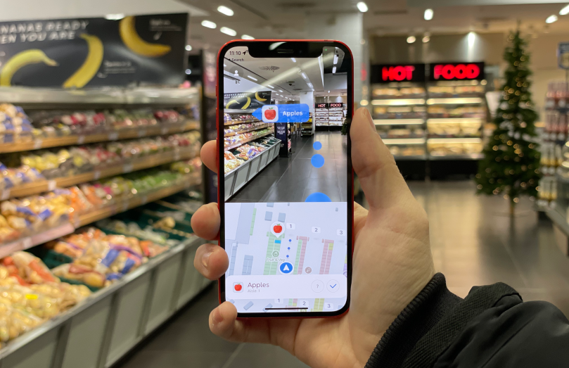
SOLUTION 1
SOLUTION 2
Install high resolution smart surveillance cameras throughout the retail store to monitor activities.
Implement AI-based algorithms that can analyze video feeds in real-time to identify suspicious behavior patterns indicating potential theft.
Develop a mobile app with features like In-store navigation with route optimization
Real-time inventory updates by staff ensure accurate product information.

Slide 6
SITUATIONS
INVENTORY MANAGEMENT
Inaccurate Inventory Tracking leading to Stockouts or Overstocks
Manually Auditing Inventory is time-consuming and error prone
Notes:
For Inventory Management, The Smart Retail Store faces challenges with its inventory tracking system, resulting in frequent stockouts or overstock situations.
Inaccuracies in tracking product quantities often lead to stockouts, where popular items unexpectedly run out of stock.
This can be highly frustrating for customers, resulting in lost sales and potentially damaging the store’s reputation.
Overstocking clogs up valuable shelf space, increasing holding costs and may lead to waste especially for perishable goods.
Besides that, manually auditing inventory is time-consuming and error prone.
Store employees must physically count items on shelves, it is a time-consuming process that does not happen frequently enough to ensure real-time accuracy.
As inventory data becomes outdated quickly, this may lead to inefficient shelf replenishment as products may be restocked too early or too late.

Slide 7
SITUATIONS
SUPPLY CHAIN OPTIMIZATION
Inefficiencies in the supply chain, leading to delays and higher costs
Poor Demand Forecasting

Slide 8
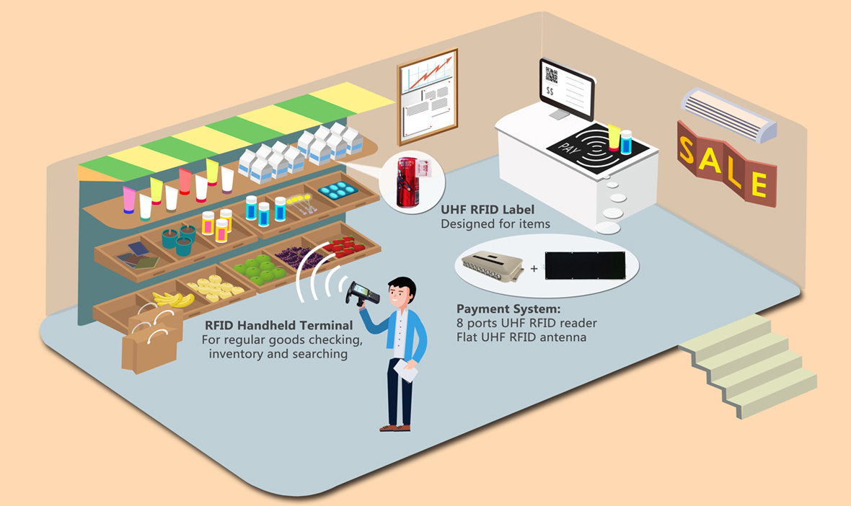
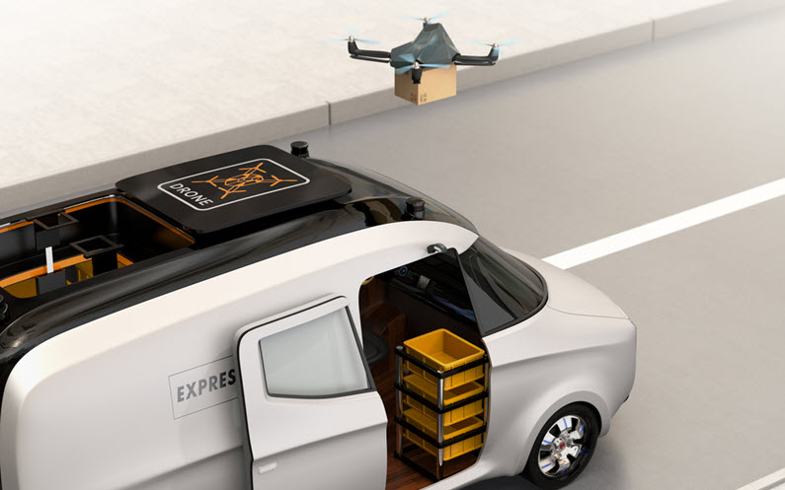
SOLUTION 1
SOLUTION 2
Implement RFID tags to each product and install RFID readers to monitor inventory in real-time
Utilize IoT sensors to monitor temperature, humidity, and other environmental factors for perishable good as it can provide real-time alerts
Implement AI-powered demand forecasting models that analyse historical sales data, market trends, weather patterns, and other factors.
Implement autonomous systems like autonomous vehicles for transportation within supply chain that can optimize routes, reduce delays, and enhance efficiency

Slide 9
SITUATIONS
STORE LAYOUT & PRODUCT PLACEMENT
CHECKOUT AND PAYMENT
Some products might be overlooked by customers due to being displayed poorly.
Poorly placed products might lead to reduced sales.
Badly designed floor plan might lead to bad customer traffic, especially during peak hours.
Long queue at checkout counters, especially during peak hours.
Inefficient payment process where items have to be manually scanned by cashier one by one at checkout counters.
Human errors can occur such as some items left unscanned, which results in losing profit.

Slide 10
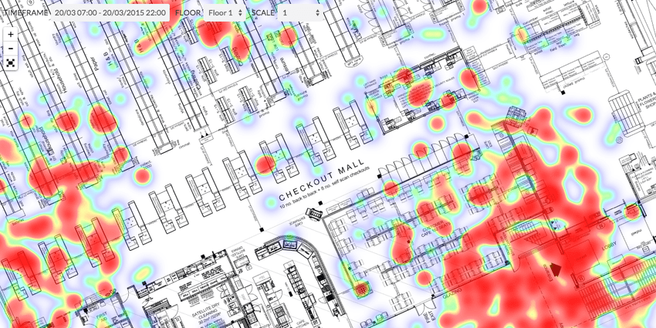
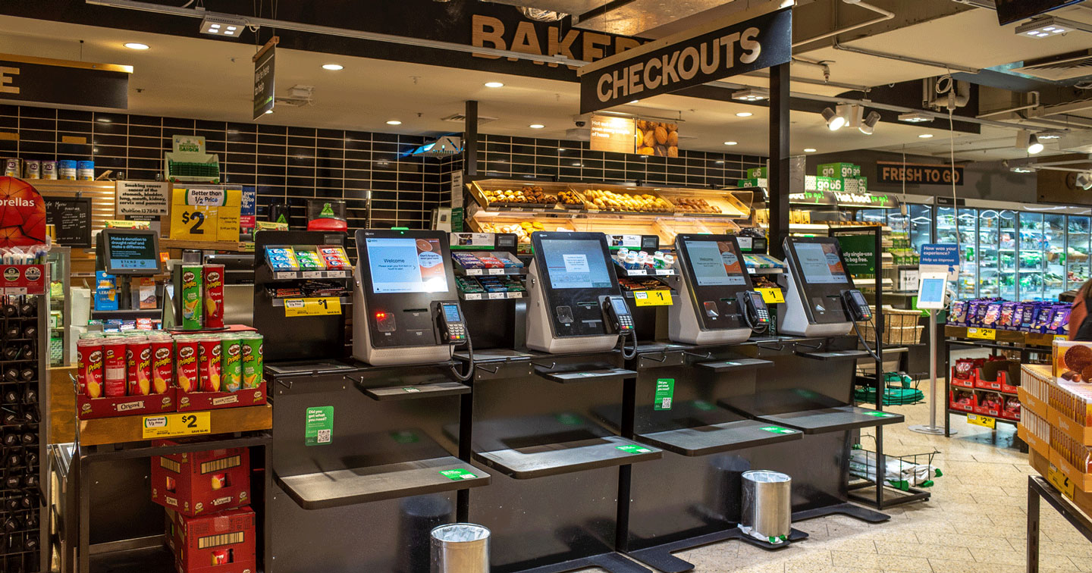
SOLUTION 1
SOLUTION 2
The system will then generate a more suitable store layout and product placement map that can help improve sales by allowing all kinds of product to be easily noticed by customers
This will increase customer satisfaction and also increase the chances of product being displayed to customers, leading to increased sales.
Customers can now use the self-checkout counter to proceed with their payment.
With RFID Scanners and payment processing facilities, every item in the cart can be accurately identified without human error.

Slide 11
THANK YOU FOR LISTENING!

