Slide 1
UNIT-3
HEATING AND WELDING

Slide 2
UNIT3 - HEATING AND WELDING
  Introduction -Advantages of electric heating
  Modes of heat transfer
  Methods of electric heating
  Resistance heating
  Arc furnaces
  Induction heating
  Dielectric heating
  Electric welding – types
  Resistance welding
  Arc welding
  Power supply for arc welding
  Radiation welding.

Slide 3
Electric Heating
Electric heating is a process in which electrical energy is converted directly to heat energy.
Common applications include space heating, cooking, water heating and industrial processes.
An electric heater is an electrical device that converts an electric current into heat.
This process is done by using Joule’s Law of heating.
Electric heating is based on the principle, when an electric current passes through the heating element or the coil then due to the resistance or the properties it induces heat.
Joule’s Law states that when a current flows in a conductor the amount of heat generated is proportional to current, resistance, and time in the current flowing.

Slide 4
Formula of Heat
H α I². (RT) (I, R, and T are variables)
H= (1/ J).I²RT (where J is a Joule’s Constant)
R – Resistance in ohms , T- time in seconds & I – current in amperes
The joule’s constant J is defined as the number of work units that furnishes one unit of heat when converted completely into heat.
The value of J= 4.2 joules/cal.
1 Kcal = 4186 Joules
According to Joule’s law :
I²RT= work done in joules when through a resistor of R ohms, I Ampere of current is maintained for T seconds.

Slide 5
The specific heat capacity of a substance is the quantity of heat needed to raise the temperature of a unit quantity of the substance by one degree.
Calling the amount of heat added Q calories, which will cause a change in temperature ∆T to a weight of substance W, at a specific heat of material Cp, then
Q = W x Cp x ∆T.
If Mass= 200 grams , Cp = 1 cal/ g °C , calculate H required to raise temperature from 20° C to 100 ° C .
Ans: 16000 calories

Slide 6
Advantages of electric heating
Cleanliness: It completely eliminates dust and ash and keeps the surroundings clean.
No pollution: Due to the absence of fur gases, there is no risk and contamination of the atmosphere.
Ease of control: It is possible to control and regulate the temperature accurately either manually or fully automatically. This is not possible with non-electrical heating.
Uniform heating: The charge can be heated uniformly throughout whether the charge is conducting or non-conducting material.
High efficiency: The overall efficiency of electric heating is high since the heat can be produced directly with the charge itself.
Low attention: Electric heating generally does not require continuous attention.
Localized heating: A particular job can be heated up to a particular depth for heat treatment.

Slide 7
Better working conditions: Electric heating produces no irritating noise.
High Temperature: A particular job can be heated up to a particular depth for heat treatment.
High temperature: High temperature can be obtained by electric heating (the only thing is the heating element should withstand the heat).
Less floor area is required: Due to the compactness of the electric furnace, the floor area required is less.
No carrying expense: The heat can be developed at or close to the point of use.

Slide 8
  Modes of heat transfer
What is Heat Transfer?
According to thermodynamic systems, heat transfer is defined as
“The movement of heat across the border of the system due to a difference in temperature between the system and its surroundings.”
Interestingly, the difference in temperature is said to be a ‘potential’ that causes the transfer of heat from one point to another.
Heat can travel from one place to another in several ways. The different modes of heat transfer include:
  Conduction
  Convection
  Radiation
Conduction requires contact.
Convection requires fluid flow.
Radiation does not require any medium

Slide 9
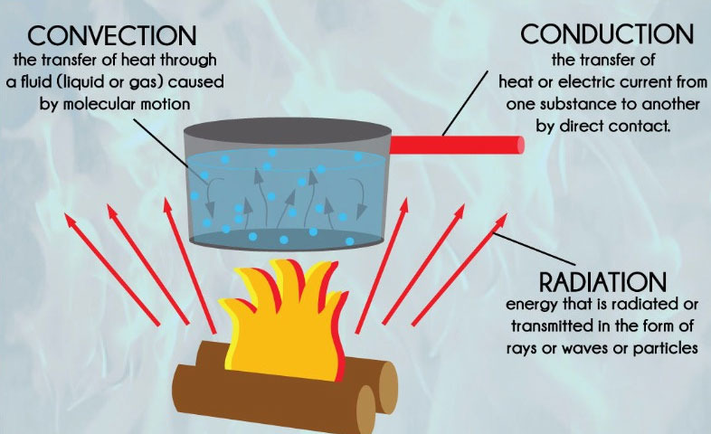

Slide 10
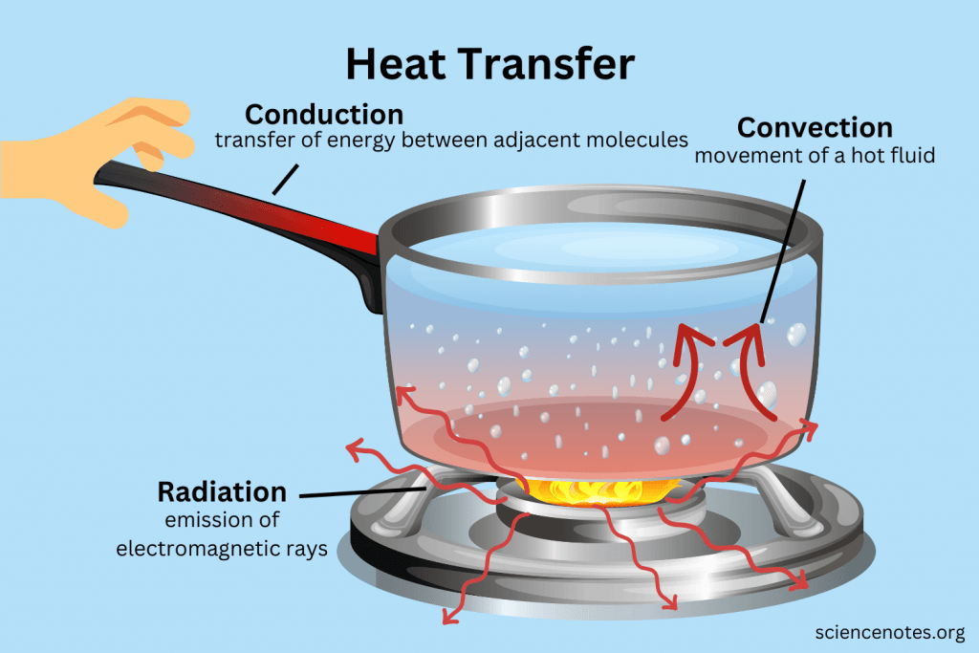

Slide 11
Conduction
It is defined as the heat transfer directly between neighboring atoms or molecules. Usually, it is heat transfer through a solid.
For example, the metal handle of a pan on a stove becomes hot due to convection. Touching the hot pan conducts heat to your hand.
Conduction Equation
Q = [K ∙ A ∙ (T_{hot} – T_{cold})] / d
Where
    Q is heat transfer per unit time
    K is the coefficient of thermal conductivity of the substance
    A is the area of heat transfer
    T_{hot} is the temperature of the hot region
    T_{cold} is the temperature of the cold region
    d is the thickness of the body

Slide 12
Convection
Convection is heat transfer via the movement of a fluid, such as air or water.
Heating water on a stove is a good example. The water at the top of the pot becomes hot because water near the heat source rises.
Another example is the movement of air around a campfire. Hot air rises, transferring heat upward. Meanwhile, the partial vacuum left by this movement draws in cool outside air that feeds the fire with fresh oxygen.
Examples of Convection
Boiling water undergoes convection as less dense hot molecules rise through higher density cooler molecules.
Hot air rises and cooler air sinks and replaces it.
Convection drives global circulation in the oceans between the equators and poles.
A convection oven circulates hot air and cooks more evenly than one that only uses heating elements or a gas flame.

Slide 13
Convection Equation
Q = h_{c} ∙ A ∙ (T_{s} – T_{f})
Where
  Q is the heat transfer per unit time
  h_{c} is the coefficient of convective heat transfer
  A is the area of heat transfer
  T_{s} is the surface temperature
  T_{f} is the fluid temperature

Slide 14
Radiation
It is the emission of electromagnetic radiation.
While it occurs through a medium, it does not require one. For example, it’s warm outside on a sunny day because solar radiation crosses space and heats the atmosphere.
The burner element of a stove also emits radiation. However, some heat from a burner comes from conduction between the hot element and a metal pan. Most real-life processes involve multiple forms of heat transfer.
Examples of Radiation
There are many examples of radiation:
  A microwave oven emits microwave radiation, which increases the thermal energy in food
  The Sun emits light (including ultraviolet radiation) and heat
  Uranium-238 emits alpha radiation as it decays into thorium-234

Slide 15
Radiation Equation
P = e ∙ σ ∙ A· (Tr – Tc)⁴
Where
    P is the net power of radiation
    A is the area of radiation
    Tr is the radiator temperature
    Tc is the surrounding temperature
    e is emissivity
    σ is Stefan’s constant (σ = 5.67 × 10⁻⁸Wm⁻²K⁻⁴)

Slide 16
  Methods of electric heating
In electric heating there are various methods by which heat can be produced, the heat can be produced by passing the current through resistance or by initiating an arc between two current-carrying electrodes or by using the principle of induction or by using dielectric heating, etc.
Bombardment by some high energy particles like α, β, γ, and x-rays or accelerating ions can produce heat on a surface.

Slide 17
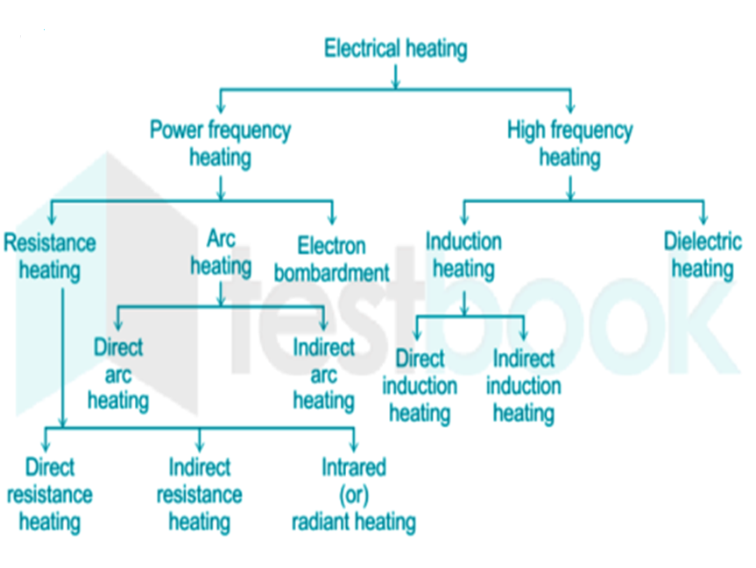

Slide 18
Resistance Heating
We know that there will be always a power loss in a conductor due to its resistance which results in the form of heat energy.
This property of power loss due to resistance can be used for heating a substance, known as resistance heating.
This type of heating has wide applications such as drying, domestic and commercial cooking, annealing and hardening of metals, etc.
When the current passes through a resistance, power loss takes place therein, which appears in the form of heat.
Power loss = I²R watt = VI watt =V²/R watt
where
      R = resistance of the element (ΩΩ)
      V = voltage (volt)
      I = current (ampere)

Slide 19
All the electrical energy given to a resistance heating element will be converted to heat energy.
The loss of energy takes place only in transferring heat from the element to charge or load.
Resistance heating is further classified as
      Direct resistance heating
      Indirect resistance heating
      Infrared or Radiant heating.

Slide 20
Direct Resistance Heating
In the direct resistance heating, the current flows directly through the substance to be heated.
The substance which to be heated in an electric heating system is called charge.
As here the charge itself provides the path for passing current and heat gets produced in the charge itself, the efficiency of the system is quite high.
The resistance offered by the charge to the flow of current results in the production of heat in the charge.
The charge can be in the form of powder, liquid, or pieces.
The popular examples of direct resistance heating are resistance welding and electrode boiler.

Slide 21
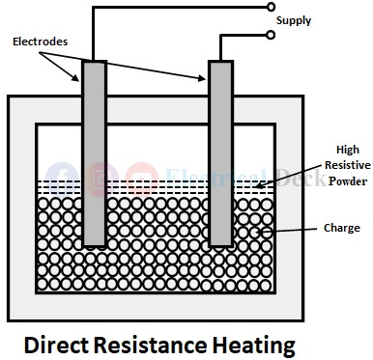

Slide 22
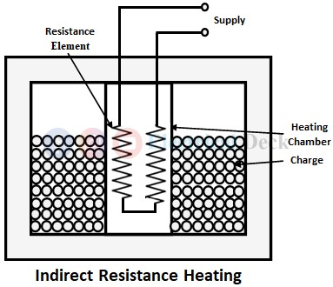
Indirect Resistance Heating :
In indirect resistance heating, the current is made to pass through a high resistance element, known as the heating element.
This heating element is placed above or below or around the charge to be heated.
The heat produced by the heating element due to I²R loss is transferred to the charge by one or more modes of heat transfer i.e., conduction or convection, or radiation.

Slide 23
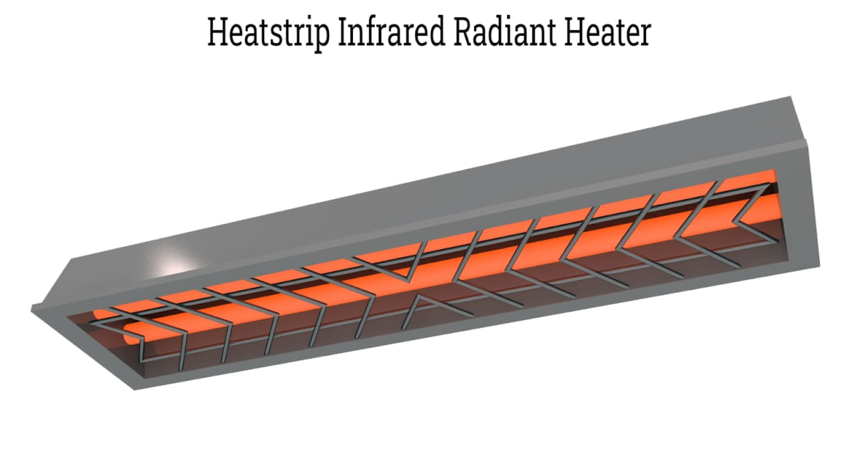
Infrared or Radiant Heating
In radiant heating, the heating element consists of tungsten filament lamps together with reflectors to direct all the heat onto the charge.
The lamp used is rated between 250-1000W with a voltage rating of 120-250V and operated at 2300°c, thereby giving a large amount of infrared radiation.
Radiant heating is mainly used for drying enamel or painted surfaces.
A high concentration of radiant energy enables heat to penetrate the coating of paint or enamel to a depth sufficient to dry it out without wasting energy in the body of the work piece.

Slide 24
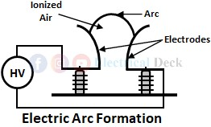
Electric Arc Furnace
An electric arc is a flow of electric current in the form continuous spark in a circuit.
We know that atmosphere is a poor conductor of electric current.
When a high voltage is applied across an air gap, the air gets ionized under electrostatic forces, and it starts acting as a conductor for the flow of current.
Thus the current starts to flow in the air gap in the form of a continuous spark called an arc.
In order to strike an arc, high voltage is required which can be obtained from a step-up transformer.
But once the arc is initiated a normal voltage is sufficient to maintain the arc.

Slide 25
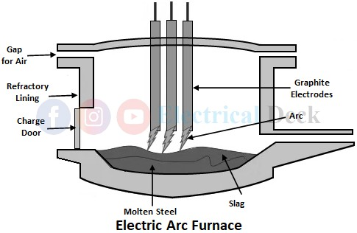
Electric Arc Furnace :

Slide 26
Generally, arc furnaces are made in a cylindrical shape, but conical shape furnaces are employed due to the availability of large surface area per unit volume, less power consumption, less radiation loss, and reduction in melting point.
The arc chamber of the furnace consists of a suitable acid or basic refractory lining supported on a metal frame.

