Slide 1

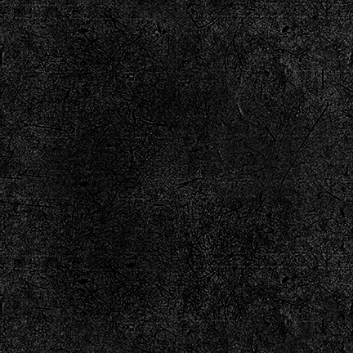
Why does a realistic food picture make you want to buy it?
Notes:
%%TTS_FEMALE% Why does a realistic food picture makes you want to buy it?

Slide 2
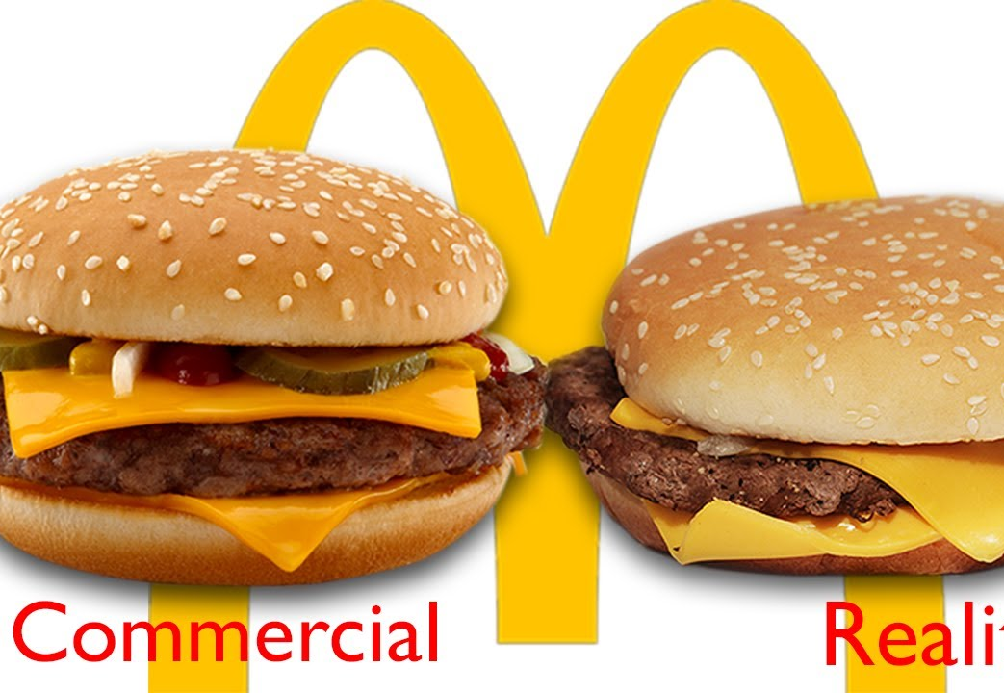
Why do food pictures make someone buy the item?
The picture helps make it look really appetizing making you want to give in and buy it since it looks good, but when it looks too good you also know that that is not how it is going to look, imagine eating a potato that has food coloring so that it looks that it is rotten but it actually not, try seeing which one you are actually going to want to eat. Obviously the one that doesn’t look rotten, but sometimes the one that looks the best is has fake ingredients so you can’t eat it.
This Photo by Unknown Author is licensed under CC BY
Notes:
%%TTS_FEMALE% Normally when you see an add you like what you see so you think you should try it, but it is not always the same taste, as promised or the looks are different.

Slide 3
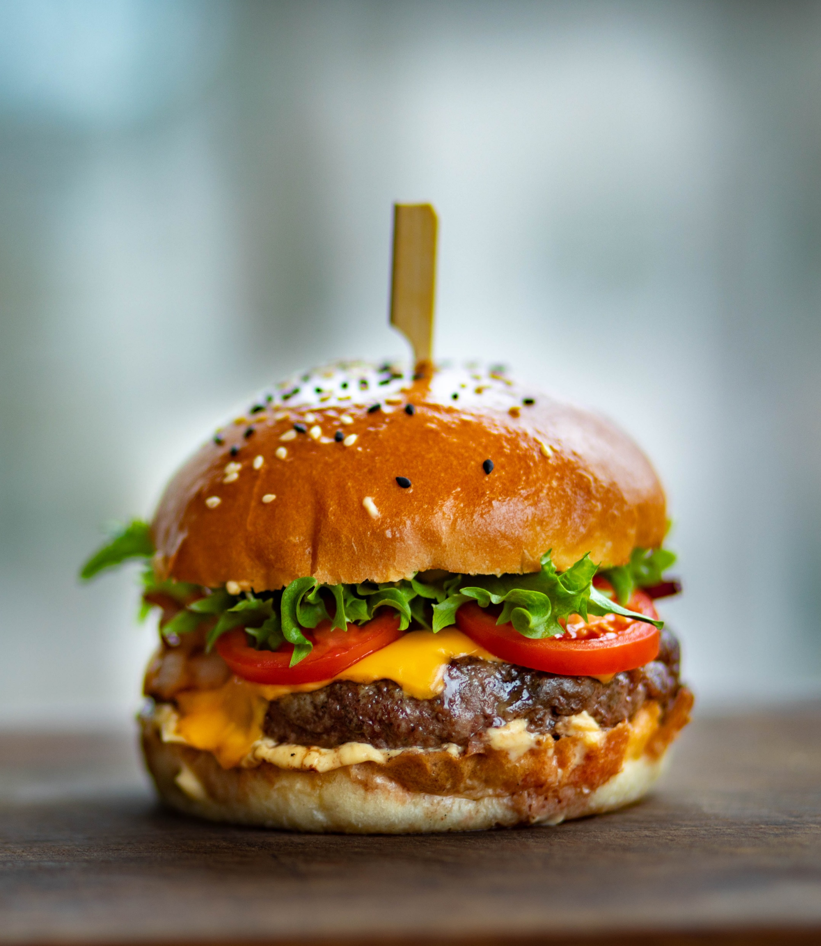
What can we do about this?
For adds people should try to make the food look as good as possible but with ingredients people can actually consume so the next time, they make those in the restaurant it looks the same as the add, so people don’t feel lied too.
Notes:
%%TTS_FEMALE% What we can do is just not expect the same look, the food on the add is made to make people want to buy it so it will look better in general.

