Slide 1
Interdisciplinary Contributions to Criminology:
The Roles of Law and Jurisprudence from Classical Times to the Present
Notes:
The Roles of Law and Jurisprudence from Classical Times to the Present

Slide 2
Criminology
Is not just about studying Crime it’s also about understanding the systems and ideas that deal with it.
The Two most important contributors to criminology are LAW and JURISPRUDENCE
LAW- gives us the official rules and definitions of crime, while JURISPRUDENCE is more about the philosophy and reasoning behind those laws.
Notes:
Criminology
Is not just about studying Crime it’s also about understanding the systems and ideas that deal with it.
The Two most important contributors to criminology are LAW and JURISPRUDENCE
LAW- gives us the official rules and definitions of crime, while JURISPRUDENCE is more about the philosophy and reasoning behind those laws.

Slide 3
If we think of it simply, Law is the WHAT – What counts as a crime ,
What the Punishments are, and What procedures must be followed. And Jurisprudence is the WHY- Why certain acts are illegal, Why punishments are set at certain levels, and Why some laws change over time.
Together, they shape how we view justice and how we handle people who break the rules.
Notes:
If we think of it simply, Law is the WHAT – What counts as a crime ,
What the Punishments are, and What procedures must be followed. And Jurisprudence is the WHY- Why certain acts are illegal, Why punishments are set at certain levels, and Why some laws change over time.
Together, they shape how we view justice and how we handle people who break the rules.

Slide 4
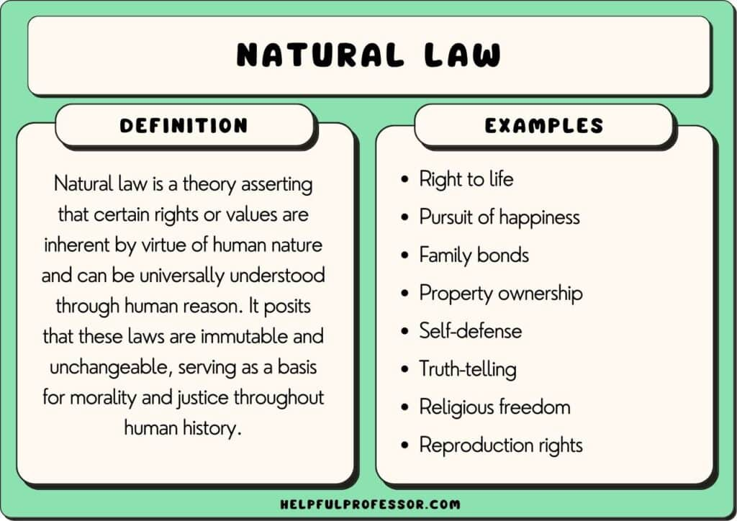
Back in the Classical period of criminology, thinkers like CESARE BECCARIA and JEREMY BENTHAM believed that humans are rational – meaning we think about the consequences before we act. Their ideas pushed for punishments that were fair, proportional, and meant to discourage crime rather than simply inflict pain. At that time, jurisprudence followed the idea of Natural Law – That laws should be based on universal moral principles that apply all people, regardless of culture or status.

Slide 5
As history moved forward, Jurisprudence evolved. From natural law, we shifted to legal positivism, which focused more on man- made laws created by governments. Later, sociological jurisprudence emerged, recognizing that laws need to reflect the needs and conditions of society. This was important because it made laws more adaptable.
Today, the role of law in criminology is still very clear;
It defines what crimes are
It sets punishments
It guides law enforcement, the courts and the corrections system.

Slide 6
Meanwhile, jurisprudence ensures that these laws are interpreted in a way that keeps them relevant, fair and in line with principles of justice. It's what allows the legal system to evolve instead of staying stuck in the past.
The Interdisciplinary part comes in when law and jurisprudence connect with other fields.
For example:
With sociology, they help us see how social conditions – like poverty or inequality –affect crime
With psychology , they help us to understand why individuals commit crimes.
With economics, they let us analyze whether certain laws or punishments are worth the cost.

Slide 7
In short, law and jurisprudence are more than just legal tools. They are the backbone of criminology, shaping how we define crime, how we prevent it, and how we respond when it happens. And just like society, they continue to evolve, making criminology a living, changing field that adapts to new challenges.

