Slide 1

Topic :
Black History Month
Presented By:
Aliyan Shakeel

Slide 2
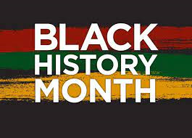

Slide 3
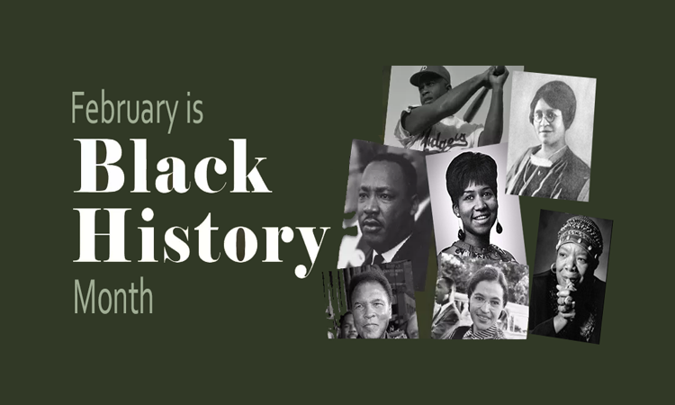

Slide 4
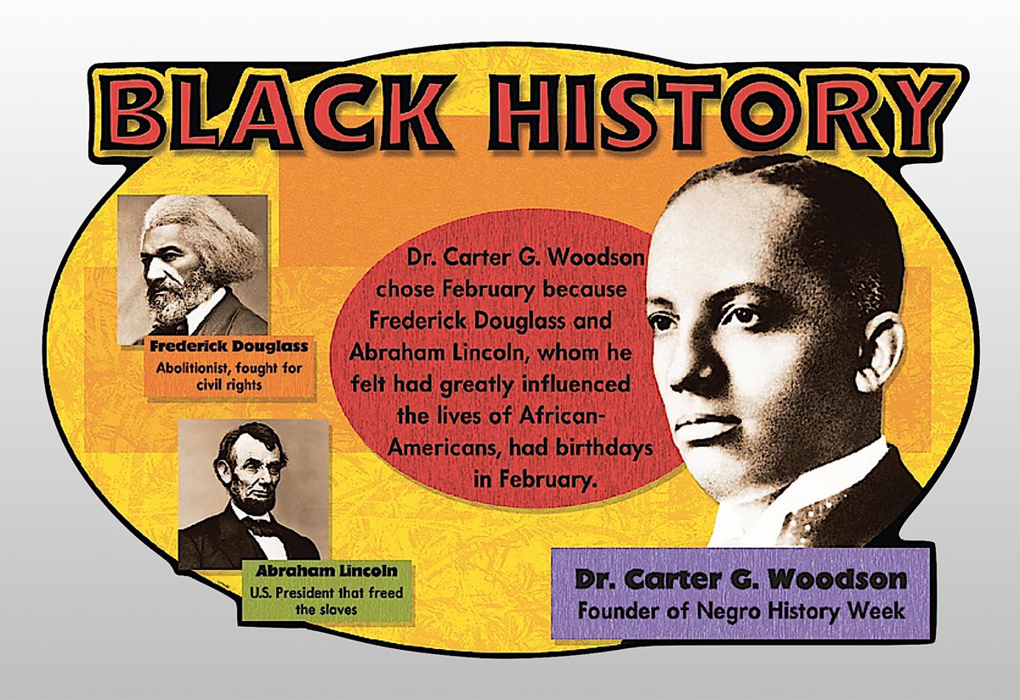
The celebration of Black History Month began as “Negro History Week,” which was created in 1926 by Carter G. Woodson, a noted African American historian, scholar, educator and publisher. It became a month-long celebration in 1976. The month of February was chosen to coincide with the birthdays of Frederick Douglass and Abraham Lincoln.

Slide 5
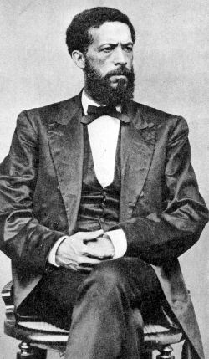
John Mercer Langston was the first Black man to become a lawyer when he passed the bar in Ohio in 1854. When he was elected to the post of Town Clerk for Brownhelm, Ohio, in 1855 Langston became one of the first African Americans ever elected to public office in America. John Mercer Langston was also the great-uncle of Langston Hughes, famed poet of the Harlem Renaissance.

Slide 6
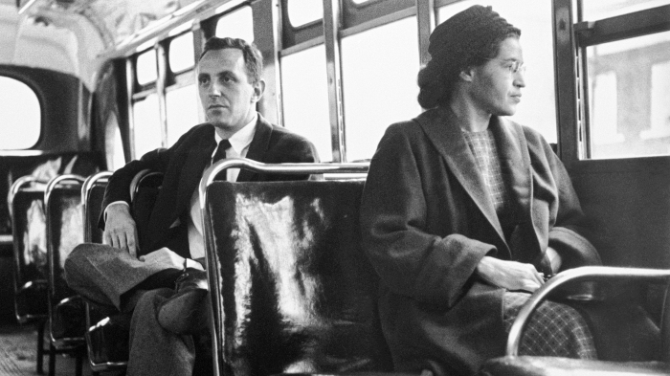
While Rosa Parks is credited with helping to spark the civil rights movement when she refused to give up her public bus seat to a white man in Montgomery, Alabama in 1955—inspiring the Montgomery Bus Boycott—the lesser-known Claudette Colvin was arrested nine months prior for not giving up her bus seat to white passengers

Slide 7
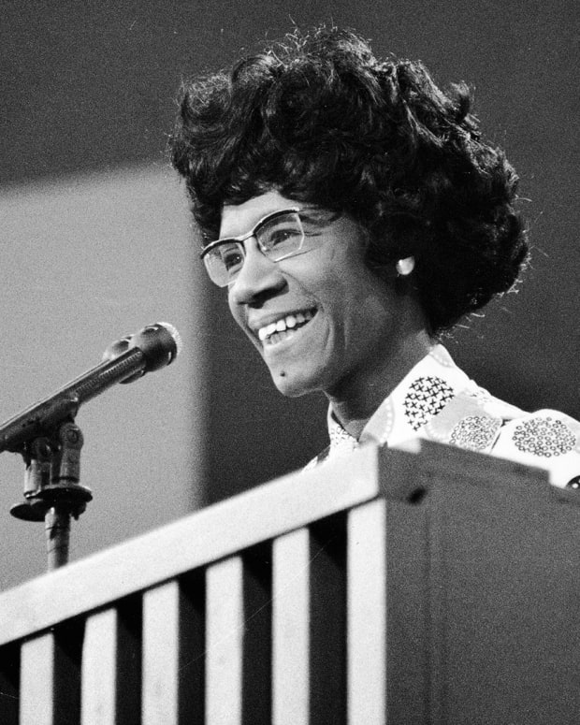
Shirley Chisholm was the first African American woman elected to the House of Representatives. She was elected in 1968 and represented the state of New York. She broke ground again four years later in 1972 when she was the first major party African American candidate and the first female candidate for president of the United States.

Slide 8
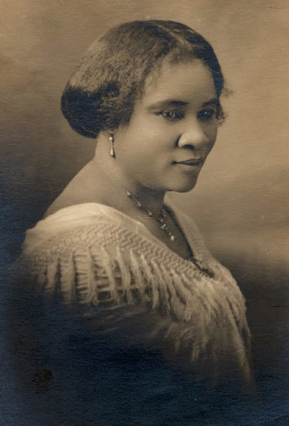
Madam C.J. Walker was born on a cotton plantation in Louisiana and became wealthy after inventing a line of African American hair care products. She established Madame C.J. Walker Laboratories and was also known for her philanthropy.

Slide 9
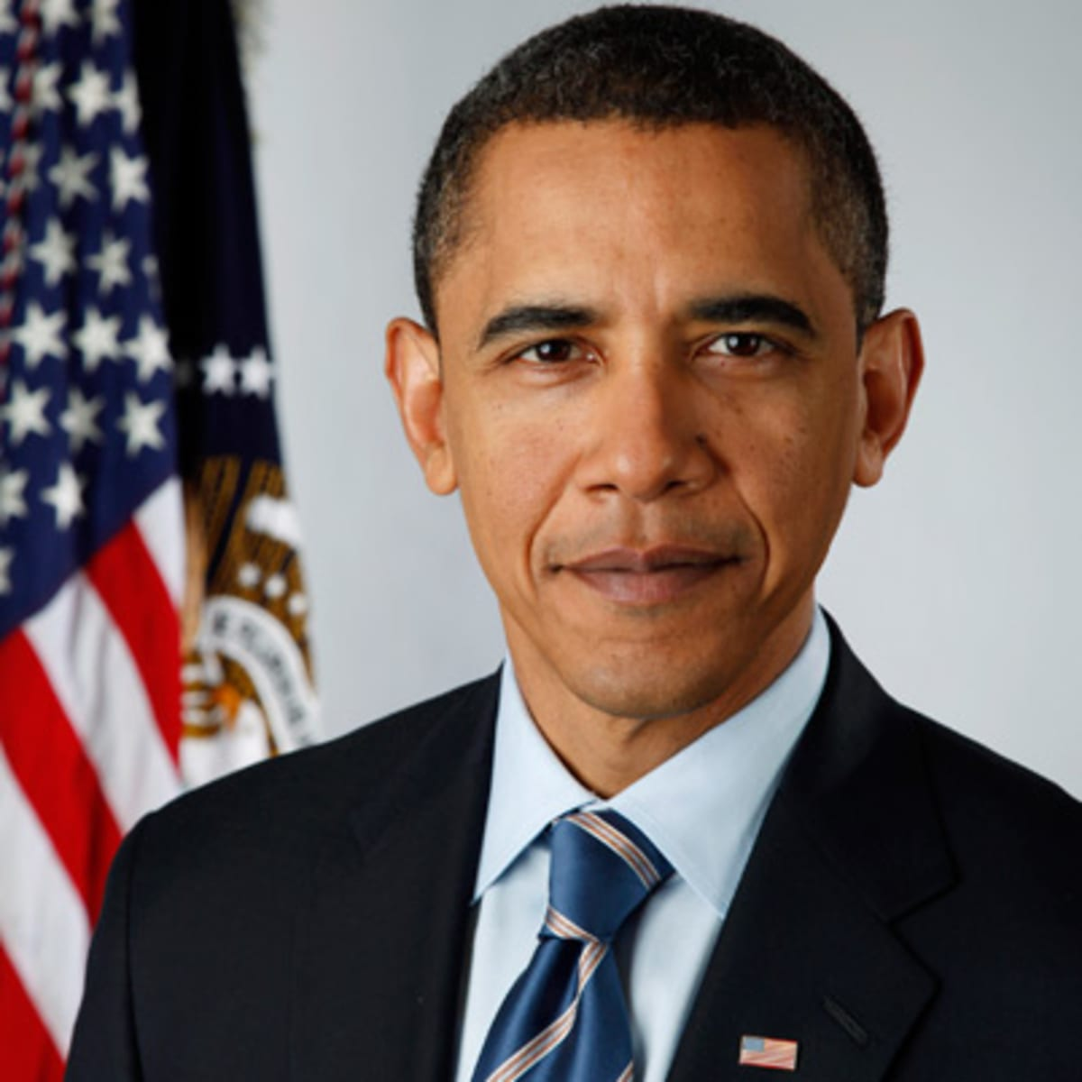
In 2008, Barack Obama became the first Black president of the United States.

Slide 10
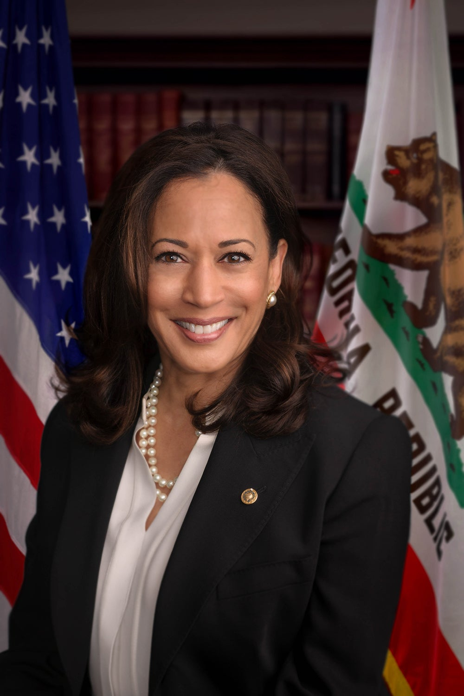
Kamala Harris became the first woman of African or Asian descent to become vice president. Harris's mother immigrated to the United States from India and her father immigrated from Jamaica.

Slide 11
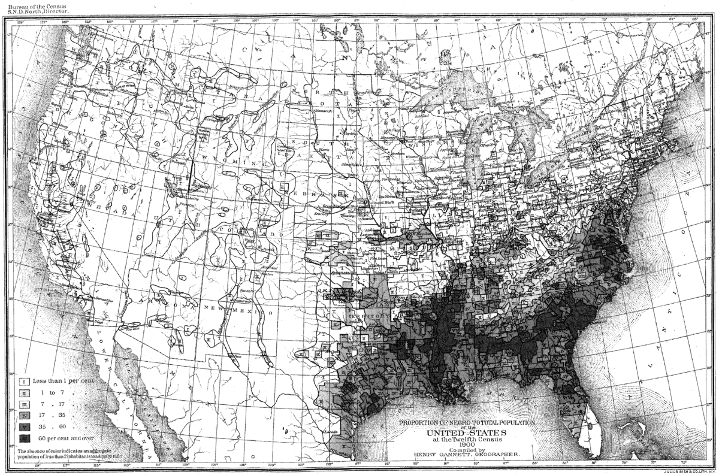
The Black population of the United States in 1870 was 4.8 million; in 2019, the number of Black residents of the United States 46.8 million.

