Slide 1
DANGOTE FERTILISER LIMITED
HSSE DEPARTMENT
SAFETY INDUCTION FOR NEW JOINEES

Slide 2
SAFETY PRINCIPLES
All accidents and injuries are preventable.
No business objective is so important that it will be achieved at the sacrifice of safety.
Any one observing an unsafe act or condition is obliged to intervene to correct the situation (IF YOU SEE IT YOU OWN IT, DO SOMETHING).
Each of us has a responsibility for our safety and those around us on and off the job.
A job is done well only if it’s done safely.
Zero is the target level for incidents.
We are only successful when everybody goes home at the end of the day fit and injury free.

Slide 3


Slide 4
FACILITY DISCRIPTION
The Process Units which consists of the following:
    Ammonia Plant Train 1: 2200 MTPD Ammonia;
    Ammonia Plant Train 2: 2200 MTPD Ammonia;
    Urea Plant Train 1: 3850 MTPD Urea;
    Urea Plant Train 2: 3850 MTPD Urea;Urea
    Granulation Plant Train 1: 3850 MTPD Granulated Urea
    Urea Granulation Plant Train 2: 3850 MTPD Granulated Urea

Slide 5
FACILITY DISCRIPTION
Utility Units made up of the following:
    Water Treatment Plant,
    Steam and Power Generation,
    Cooling Water System,
    Natural Gas System,
    Nitrogen Production System,
    Instrument and Plant Air System,
    Potable Water System,
    Emergency and Power Diesel System,
    Effluent Treatment System
    Fire Fighting System.
    CCR
    Ammonia Plant Flaring System

Slide 6
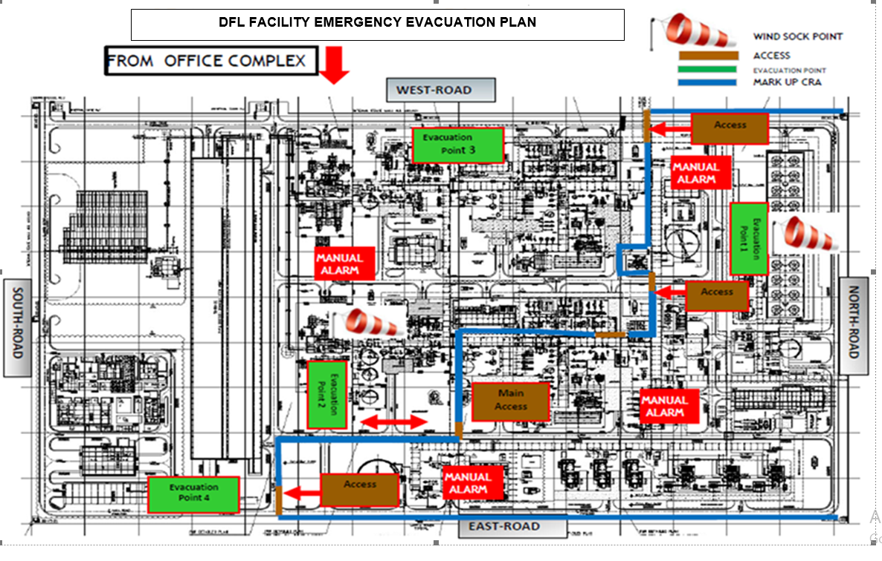

Slide 7
















DANGOTE HSSE GOLDEN RULES – what are they?
Work with a valid work permit when required
Report ALL Incidents
Stop unsafe work
Verify isolation before work begins and use specified ppe
Protect yourself against a fall when working at height
Do not position yourself or walk under a suspended load
1
2
3
4
5
6
7
8
9
10
11
12
Obtain authorisation before entering a confined space
Conduct gas tests when required
Do not smoke outside designated smoking areas
These rules are Mandatory for all
Dangote’s Employees,
Contractors and Visitors.
Obtain authorisation before overriding or disabling safety critical equipment
No alcohol or drugs while working or driving
While driving, do not use your phone and do not exceed speed limits
Use the correct PPEs
Wear your seat belt
Do not discharge/ dispose hazardous materials into unauthorized areas
13
14
15

Slide 8

Notes:
8

Slide 9


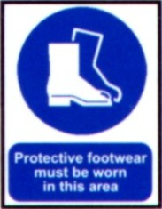

PERSONAL PROTECTIVE EQUIPMENT
All personnel on Dangote Fertiliser Limited will be required to wear as a minimum the following PPE.
Additional PPE will be used as determined by JSA for the associated task for example Welding, Work at Height etc.)

Slide 10
HEALTH, SAFETY & ENVIRONMENT PROGRAMME
DFL activities shall be planned and executed in such a way as to:
    Ensure good community relations and liaison, making life more meaningful and comfortable for the inhabitants of the local community in which they operate.
    Avoid injury and pursue the safety and health of its Client, employees, those of its contractors and any visitors that could be affected.
    Minimize impact on the environment in which DFL operates. Ensure the security of life and property of its Client, employees, those of the contractor and any visitor.
    Activities must be suspended when any employee believes that their work cannot be continued in accordance with this policy.

Slide 11
PERMIT TO WORK SYSTEM
The objective of the Permit-to-Work (PTW) system is to prevent accidents by avoiding misunderstanding when non-routine and potentially hazardous work is done. For example, Work Permit shall always bobtained prior to entering any confined space.
  Ensuring that company approved standards are applied to the work
  Helping persons to identify possible risks associated with the work and the precautions to take.
  Providing a basis for monitoring that the specified precautions are taken.
  Ensuring that the person responsible for an area or operation is aware of and approves the work to be done.
  Ensuring that an authorised Competent Person accepts responsibility for the safety of the worksite.

Slide 12
PERMIT TO WORK SYSTEM
Should a PTW be withdrawn, for any reason, including the following, it must be cancelled and repeated when the situation has been resolved:
  The permit is found to be inadequate or inaccurate
  The system of work described has been changed
  The work is cancelled/postponed (a permit cannot be transferred in location, time or method, equipment used etc.)
  Permit system not being followed
  The work is stopped because of unsafe practices/situation

Slide 13
CONFINED SPACE ENTRY
A “Confined Space” means any place, including any chamber, tank, vat, silo, pit, trench, pipe, sewer, well or similar space in which, by virtue of its enclosed nature, there arises a reasonably foreseeable specified risk such;
Serious injury arising from fire or explosion
Loss of consciousness arising from an increase in body temperature
Loss of consciousness arising from gas fumes, vapors or lack of oxygen.
Drowning arising from an increase in the level of liquid.
Asphyxiation arising from a free flowing solid or because of entrapment by it.

Slide 14
CONFINED SPACE ENTRY
When working in confined space:
Test the air to make sure there is no hazardous substance present
Have a good source of ventilation/air
Use non-sparking tools
Do not use petrol or diesel equipment
Only work there if absolutely necessary.
There must always be an emergency escape route.
Only qualified personnel with a Permit to Work can enter confined space
No person shall be allowed to enter a confined space without a ‘hole watcher’ being on duty.
No person shall be allowed to enter a confined space without having completed the confined space training
Emergency response equipment is at the work site.
Trained emergency response team are on site.

Slide 15
Ammonia in Fertilizer
What is ammonia?
Ammonia, also known as NH3, is a colorless gas with a distinct odor composed of nitrogen and hydrogen atoms.
It is produced naturally in the human body and in nature—in water, soil and air, even in tiny bacteria molecules. In human health, ammonia and the ammonium ion are vital components of metabolic processes.
Ammonia is a basic building block for ammonium nitrate fertilizer, which releases nitrogen, an essential nutrient for growing plants, including farm crops and lawns.
About 90 percent of ammonia produced worldwide is used in fertilizer, to help sustain food production for billions of people around the world.
The production of food crops naturally depletes soil nutrient supplies. In order to maintain healthy crops, farmers rely on fertilizer to keep their soils productive. Fertilizers also can also help increase levels of essential nutrients like zinc, selenium and boron in food crops.

Slide 16
Ammonia Safety
Handling ammonia requires careful attention to safety. Both at storage facilities and during field application, appropriate personal protective equipment must be used.
Since it is water soluble, free ammonia will rapidly react with body moisture in the lungs and eyes, causing severe damage.
Ammonia is considered a high health hazard because it is corrosive to the skin, eyes, and lungs. Exposure to 300 parts per million (ppm) is immediately dangerous to life and health.
Ammonia is also flammable at concentrations of approximately 15% to 28% by volume in air.

Slide 17
Ammonia Safety
So, if ammonia leak happens, do the following safety precautions:
  Report immediately about leak, spill, or safety equipment failure.
  If there is an emergency alarm, push it to notify others about the leak or spill.
  Exit from the room or area immediately.
  Look up and observe the windsock for the wind direction and move away from the wind direction.
  If the incident occurs whilst you are on the roadside of the facility, move quickly away from the leak or spill location.

Slide 18
What to Do in Case of Ammonia Leakage
TWA (Time-Weighted Average) and STEL (Short-Term Exposure Limit) values of ammonia are 25 ppm and 35 ppm.
At the concentration of 500 ppm, ammonia causes you to feel immediate and severe nose and throat irritation.
Difficult breathing will happen if you inhale ammonia at 1500 ppm or more.
So, if ammonia leak happens, do the following safety precautions:
  Report immediately about leak, spill, or safety equipment failure.
  If there is an emergency alarm, push it to notify others about the leak or spill.
  Put on a respirator or self-contained breathing apparatus with a special cartridge that can filter the ammonia.
  Exit from the room or area. If the incident occurs on the road like the above story, run away from the leak or spill location.
  Run away from the wind direction.
  If you fail to do this, you will suffer ammonia gas poisoning.

Slide 19
ELECTRICAL SAFETY
Electrocution is the second biggest killer of employees in general industry.
Always inspect your electrical tools prior to use.
Any electrical equipment showing wear or damage shall not be used and must be taken out of service for inspection and repair.
Unauthorized person shall not attempt any maintenance or repair of any electrical equipment.
Never remove cover plates or safety guards on electrical equipment.
Always disconnect electrical equipment after use.
Cables must be protected against accidental damage.
Socket extensions must be grounded and properly terminated.
Remember that insulated grips on electrical tools protect you only when the insulation is free from cracks, tears/or worn spots.
Sockets on walls / extension leads / equipment should be tagged.

Slide 20

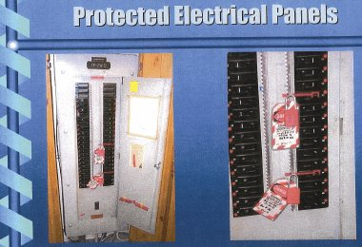
LOCK-OUT/ TAG OUT SYSTEM
This is the system used to isolate energy source (electrical, mechanical) and to disable machines or equipment to prevent unexpected energization, start-up or release of stored energy in order to prevent injury to employee.

Slide 21
SAFETY OBSERVATION
If you observe any unsafe act of condition, rectify it immediately. U-see U-act form is available on site for use by all employees to write up safety observations. Completed forms should be returned to HSE Department for recording and further action when necessary.
Remember, if you do not fill out the forms, management will not be able to rectify the problem.
Help management to help you create a safe work environment so that no nobody gets hurt.

Slide 22
MANUAL HANDLING/SAFE LIFTING TECHNIQUES
Keep your legs apart for good balance.
Bend your knees and hips, not your, waist to help you stay within your natural limits.
Keep your back straight with ears, shoulder and hips lined up so your upper body is well supported.
Take a deep breath, tighten your stomach muscles and hug the load to your waist area to support your back.
Lift, using your leg and arm muscles to lessen the force of the load on your back.
When carrying, know where you are going, make sure you have a clear path and hold the load close to waist area.
NEVER ATTEMPT TO LIFT A LOAD TOO HEAVY FOR YOU, ASK FOR HELP.

Slide 23
WELDING / CUTTING
Permit to Work must be secured before any hot work may be done in any area where there is possibility of presence of flammable liquids or vapours.
All gas cylinders must be properly secured in an upright position against falling at all times and caps be kept on all gas cylinders when regulators are not in place.
Be careful when placing welding equipment and cable so that they do not constitute trip and fall hazard.
Always wear welding goggles and cap, safety shoes, hard hats, fire-resistant clothing and gloves.
Correct eye and face protection must be worn i.e. double eye protection
A properly charged Dry Chemical Powder Fire extinguisher must be made available at all welding or cutting operations.
If you are not welding, stay away from welding activities, if you must be there avoid looking into the welding arc.
Screen should be used to eliminate welding flash from other employees.

Slide 24
GRINDING OPERATIONS
Use the right grinding disc
Always wear hard hat, safety glasses and face shield, ear plugs, safety shoes, gloves and a fire-resistant clothing.
All employees must be at a safe distance from the line of fire.
Never use a grinding machine without the disc guard and handle where designed.
Ensure no flammable materials are close by.
When not in use, disconnect the grinding machine from the source of power and face it down.
If you are the one grinding, warn off other personnel prior to grinding.
Material Store Personnel are the ONLY authorized people to change discs.

Slide 25
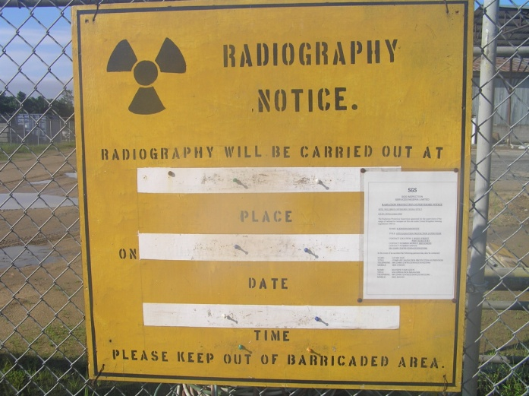
RADIOGRAPHY
Prior to radiography, permit has to be prepared and approved.
All personnel will be notified of the exact time / date and location where the radiographic testing is to be carried out.
Affected areas are to be barricaded and danger signs posted in all possible access of personnel.
Generally, radiography is carried out at lunch break, weekends and evenings when majority of the workforce (unauthorized personnel) are off from the work area.

Slide 26
PRESSURE TESTING
All personnel will be notified on the date / time and location where this test is to be carried out.
Area will be barricaded and danger signs will be posted conspicuously.
Prior to testing, Job Safety Analysis or safe work procedure for the test will be prepared and discussed.
Only qualified team will undertake the test.

Slide 27
BARRICADES AND DANGER SIGNS
All DFL Personnel shall obey all safety signage at all times
All unauthorized personnel are not allowed to go beyond any erected barricade.
The barricade / danger sign must be removed as soon as the hazard in the area ceases to exist.
The barricade / danger sign must be removed by the persons that posted it or their designate.

Slide 28
STORAGE OF MATERIAL
All tools, equipment and materials that are no longer to be used must be returned to store room.
Materials shall be placed properly so as not to obstruct any access way.
In materials lay down area, a minimum of 3ft wide walkway from front to rear shall be maintained unobstructed.
Combustible materials shall be stored separately from paint, thinner or other flammable material. Areas will be designated
When loose materials are no longer required, they must be placed where they will not hinder the passage of any person or constitute a drop hazard.
Materials, tools and other objects must not thrown or dropped from or to a different height.
All materials must be stacked securely and adequately supported.
Area Supervisors are responsible to keep their work locations as stated above.

Slide 29
HOUSEKEEPING
One third of all major reported accidents / incidents at work being a direct result of a slip, trip, fall, or fire.
WHY
    Lack or Poor Supervision.
    Lack of Resources.
    Poor Planning.
    Poor Maintenance on Equipment.
    That’s not my job.
    I’m a Operations / tradesman I don’t need to clean up.

Slide 30
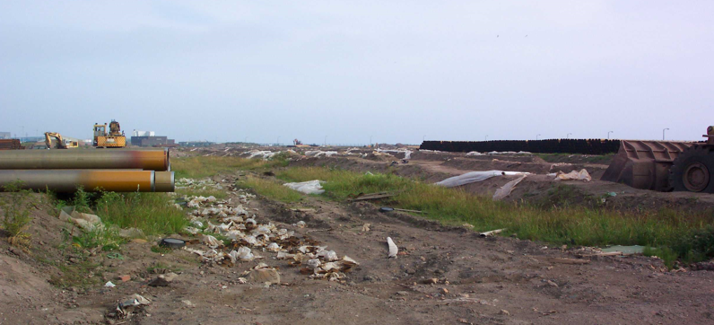
EXAMPLES OF POOR HOUSEKEEPING

Slide 31
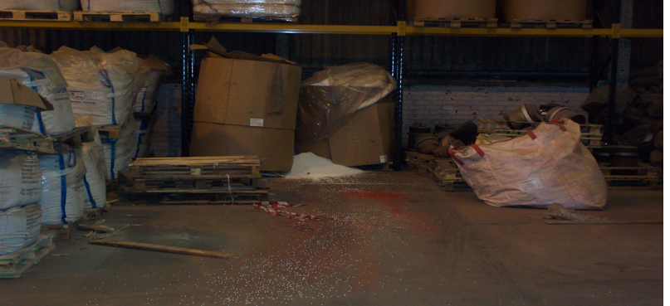
EXAMPLES OF POOR HOUSEKEEPING

Slide 32
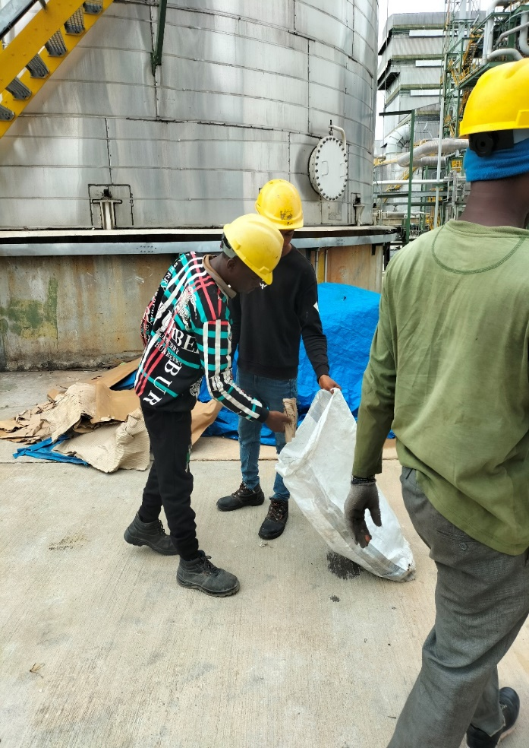
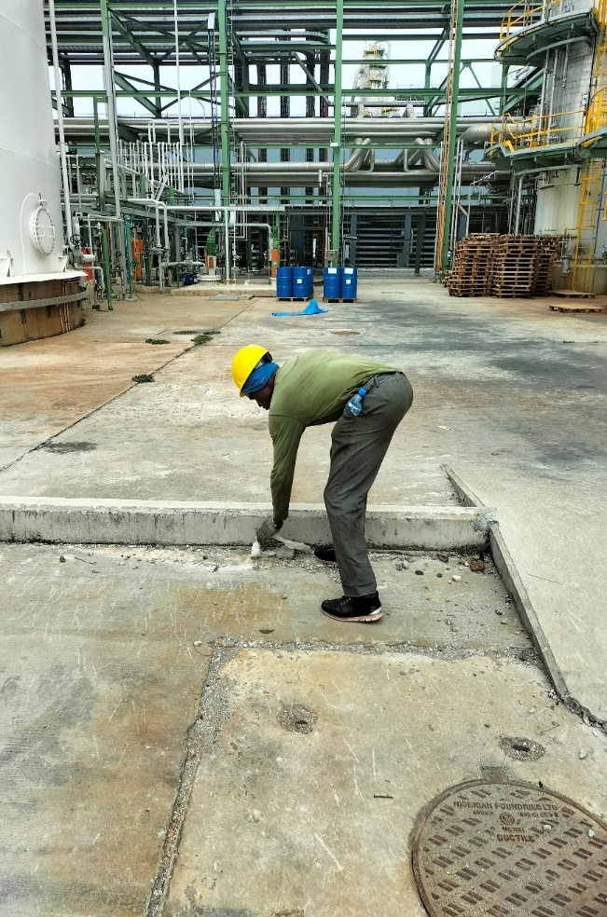
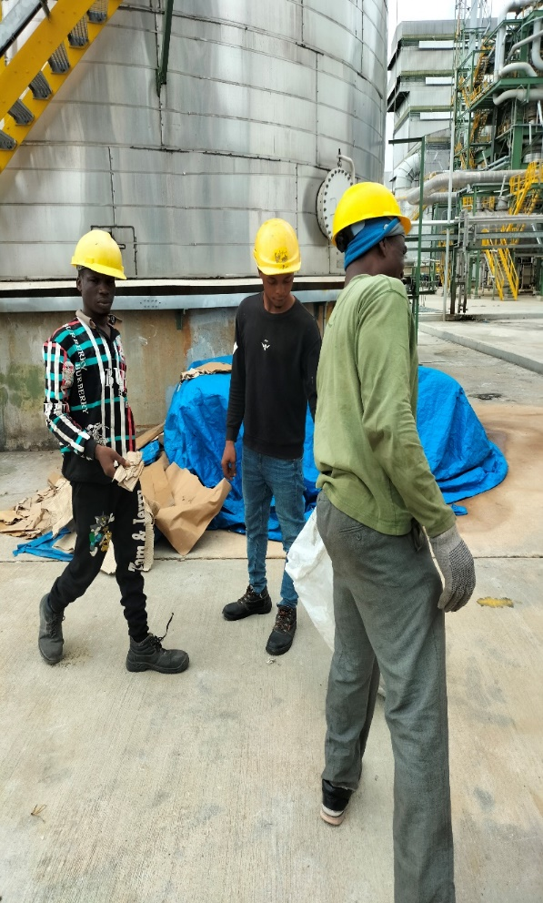
EXAMPLES OF POOR HOUSEKEEPING
BEFORE
DURING
AFTER
OBSERVATION: POOR HOUSE KEEPING , DIRTS LYING AROUND THE AMMONIA AREA TRAIN 1
ACTION TAKEN: THE DIRTS WERE MOVED AWAY FROM THE AMMONIA AREA AND STACKED TOGETHER FOR SUBSEQUENT EVACUATION

Slide 33
REMEMBER!
A CLEAN FACILITY IS A SAFE SITE

Slide 34
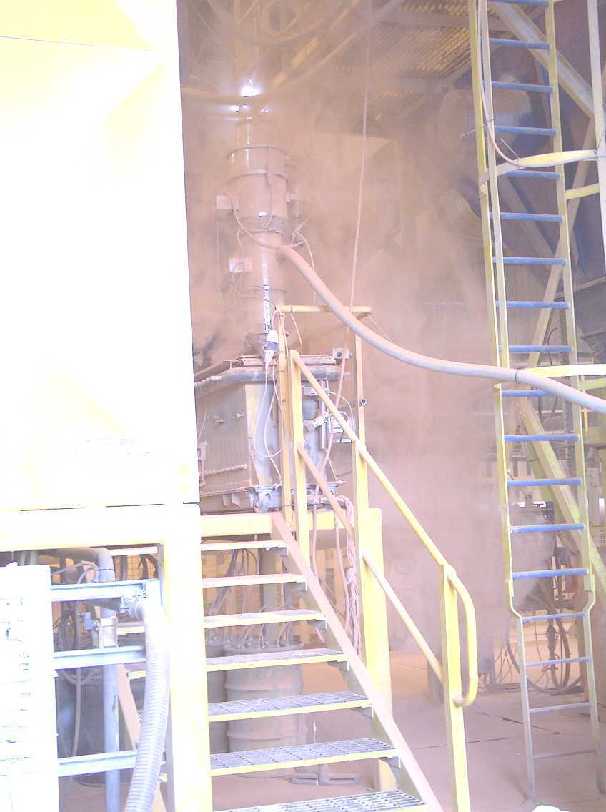
EXAMPLES OF POOR HOUSEKEEPING
(DUST ACCUMULATION)

Slide 35
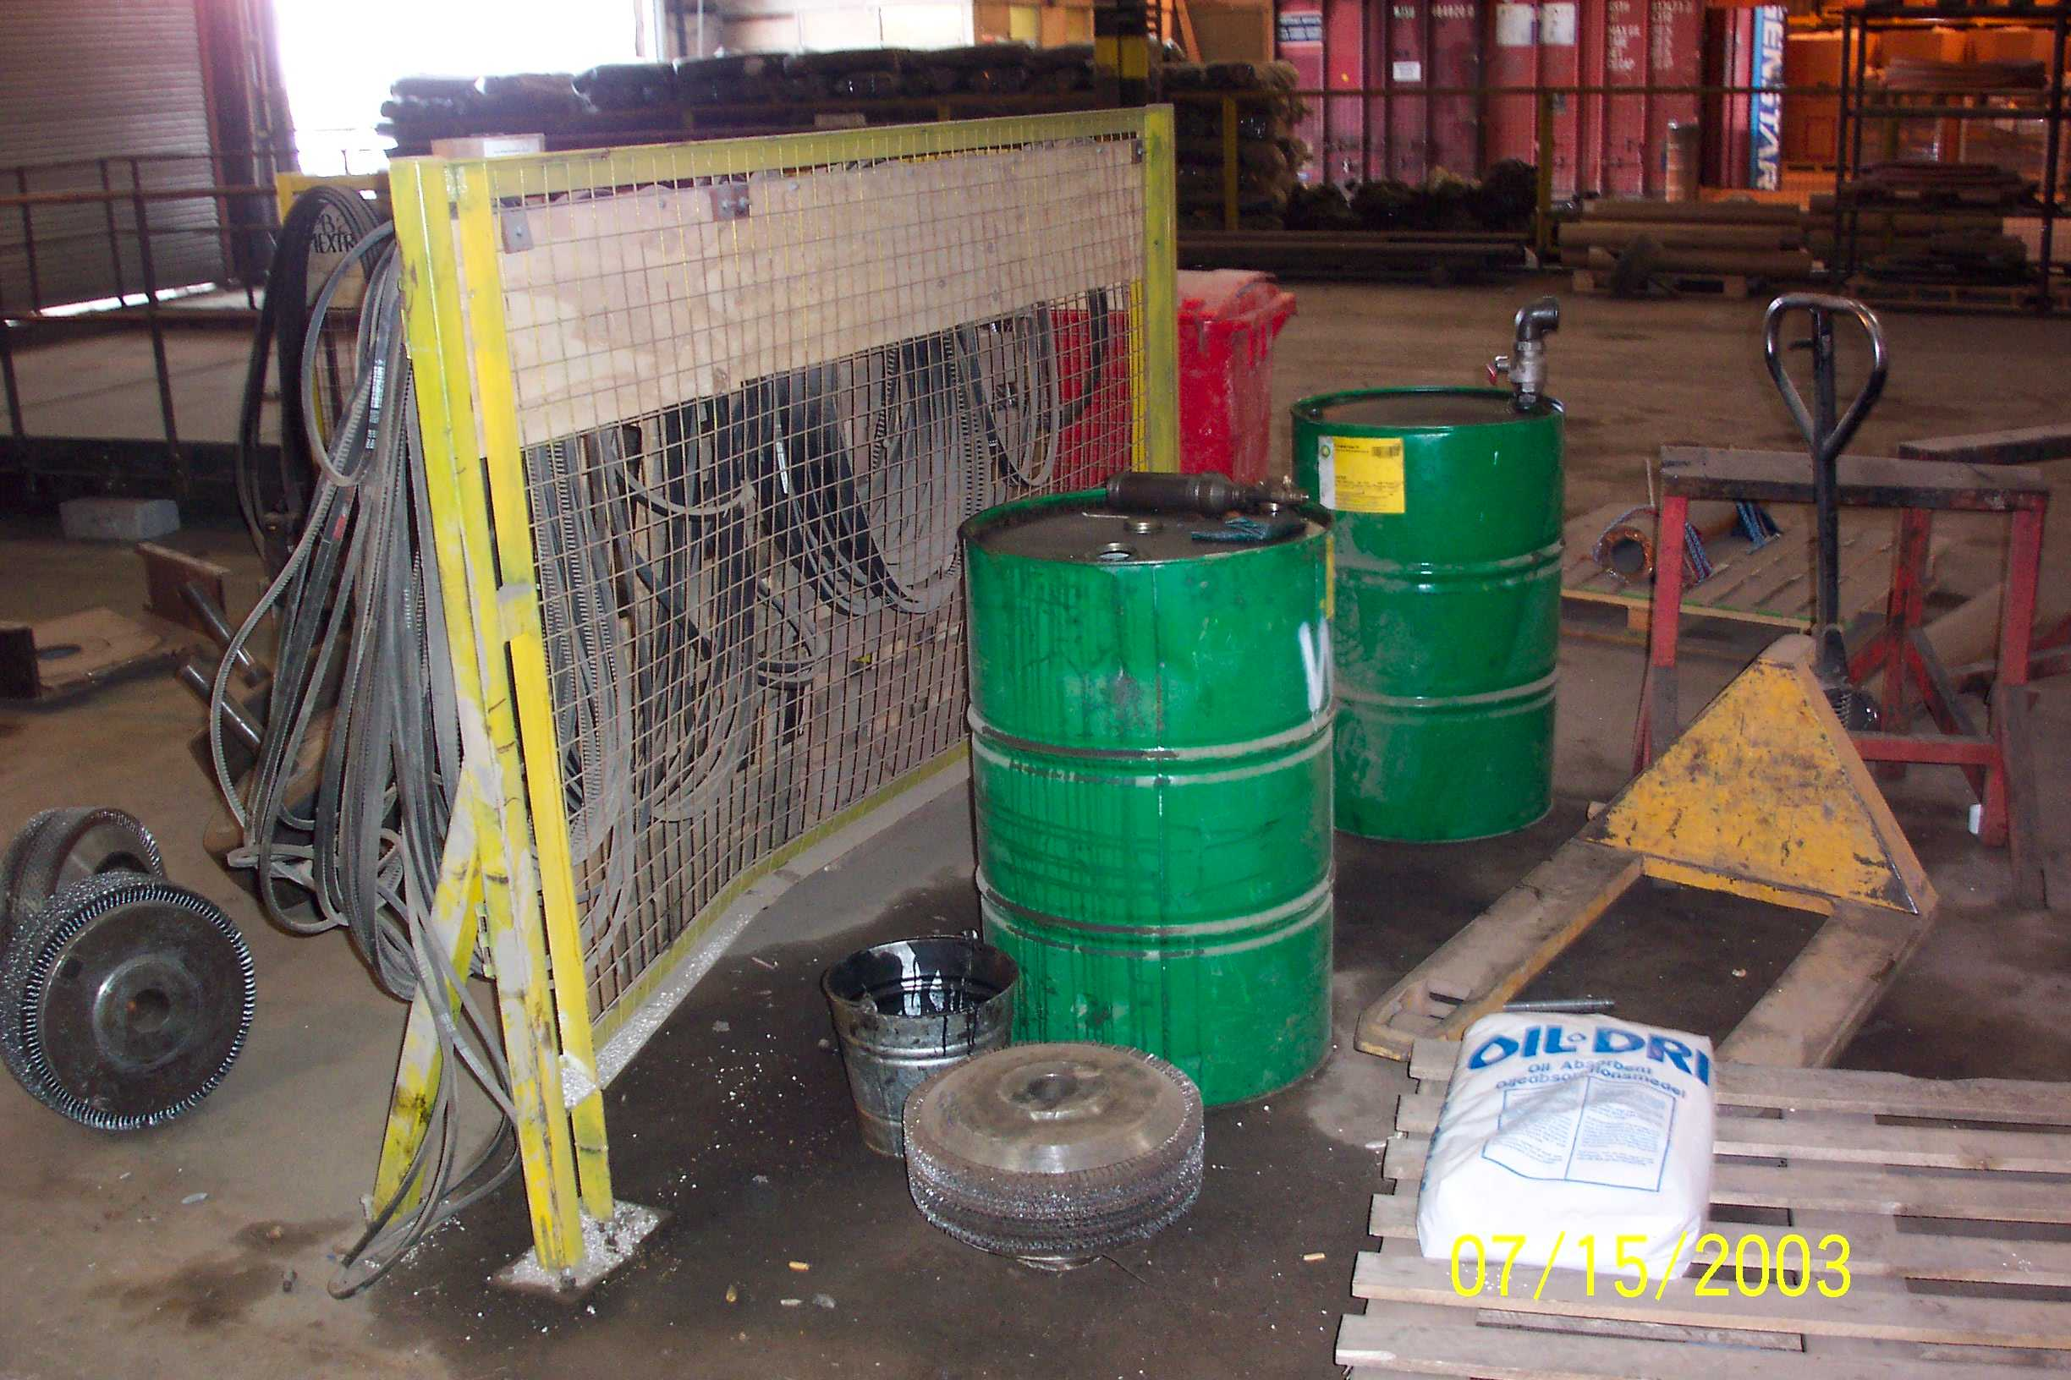
EXAMPLES OF POOR HOUSEKEEPING
(CHEMICAL SPILLAGE)

Slide 36
CHEMICAL SPILLAGE
    Environmental issue e.g. Leaching into water course etc.
    Fire hazard e.g Did you know that contaminated rags & gloves can internally combust.
    Slip hazard.
    HOW CAN WE CONTROL CHEMICAL SPILLAGE
    Store all chemicals in a bund, Bund must be able to hold 110%, To stop overflow.
    Diesel & Petrol generators etc to be fitted with drip trays.
    Contaminated rags, gloves, etc to be disposed of in steel drums fitted with lids.
    Spillage to be cleaned up immediately.
    Spillage kits to be made readily available.

Slide 37
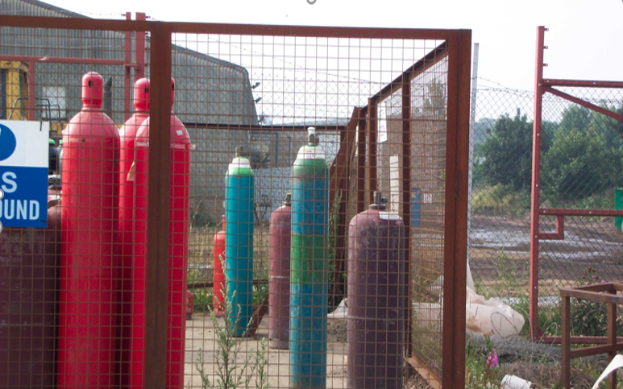
GAS BOTTLE STORAGE AND USE
    Fire & Explosion.
    Free standing bottles.
    Transportation.
    Damaged threads.
    Leakage.
    Damaged or perished hoses.
    Flash back arrestors not used or damaged.

Slide 38
FIRE PREVENTION / PROTECTION
Smoking is strictly prohibited within the facility.
Trained fire watch shall be provided in hot work area.
Regular inspection / audit is to be carried out to ensure fire hazards are eliminated or controlled.
Fire extinguishers are deployed in different locations and employees shall be trained in the use of each type of fire fighting equipment.
Before using an open flame, such as in welding, cutting etc., make sure certain that fire extinguisher are in the immediate area.
Keep work areas free of combustible materials.

Slide 39
HOW TO USE A FIRE EXTINGUISHER (PASS)
P - Pull the pin: Break the plastic seal by pulling or twisting and removing the trigger pin.
A - Aim: Aim the extinguisher at the base of the fire where the chemical reaction is strongest.
S - Squeeze: Squeeze the handle to activate the spray.
S - Sweep: Swipe the spray nozzle from side to side.

Slide 40

THEORY OF FIRE EXTINGUISHMENT
Extinguishment Theory
  Remove Heat
  Remove Fuel
  Reduce Oxygen
  Inhibit Chemical
  Chain Reaction

Slide 41
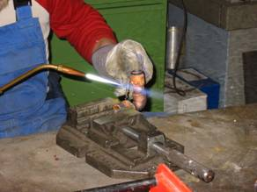
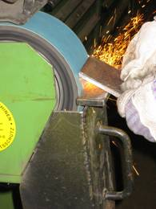
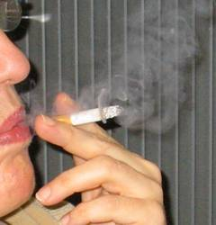


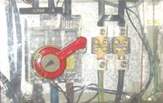

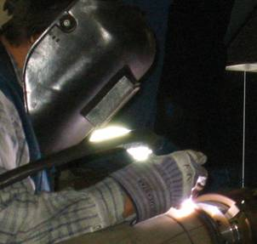
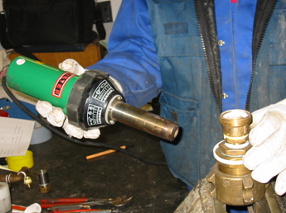
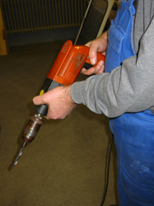
Ignition
sources…

Slide 42




CLASSIFICATION OF FUEL
Class A: Wood, paper, cloth, trash, plastics—solids that are not metals.
Class B: Flammable liquids—gasoline, oil, grease, acetone. Includes flammable gases.
Class C: Electrical—energized electrical equipment. As long as it’s “plugged in.”
Class D: Metals—potassium, sodium, aluminum, magnesium. Requires Metal-X, foam, and other special extinguishing agents.

Slide 43
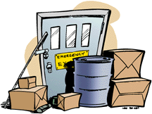
CAUSES OF FIRE
  Electrical
  Improper storage
  Housekeeping
  Heat Sources (i.e. welding)
  Cleaning supplies
  Construction
  Flammable & Combustible Liquids
  Machinery

Slide 44
THANKYOU
ANY QUESTIONS ?

