Slide 1

Focuses on bringing Product Ideas to Reality, Enabling Entrepreneurs, IP (Intellectual Property) creation with vast experience in end-to-end Product Visioning, Architecting, and Solutioning and Digital commerce for B2B.
https://www.bhumaha.com/

Slide 2

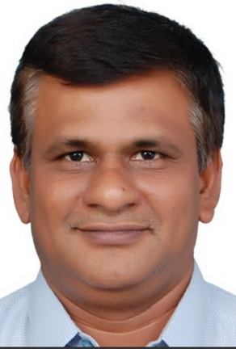











Bhumaha inception
Meet the Founder
of Bhumaha
Entrepreneur
2020 – Founded Bhumaha Solution Private Limited
IP Creation & Oursourced product development
Technology Competency centre consulting
B. Thirumoorthy
Bahwan Cybetek 2010-2020
Founder with 51% majority stake
Senior Vice President
Technology Specialization
Domain experience
Sathyam → 2002-2010
Senior Vice President
Business Process management
Ecommerce
SRA Systems 1997-2002
Enterprise Service Bus
Logistics
Project Manager
SOA / EDA
Banking, Financial services & Insurance
Vetri Software – 1994-97
EDI / IOT
Natural Language processing (NLP)
Developer
BE CSE from CIT - 1994

Slide 3








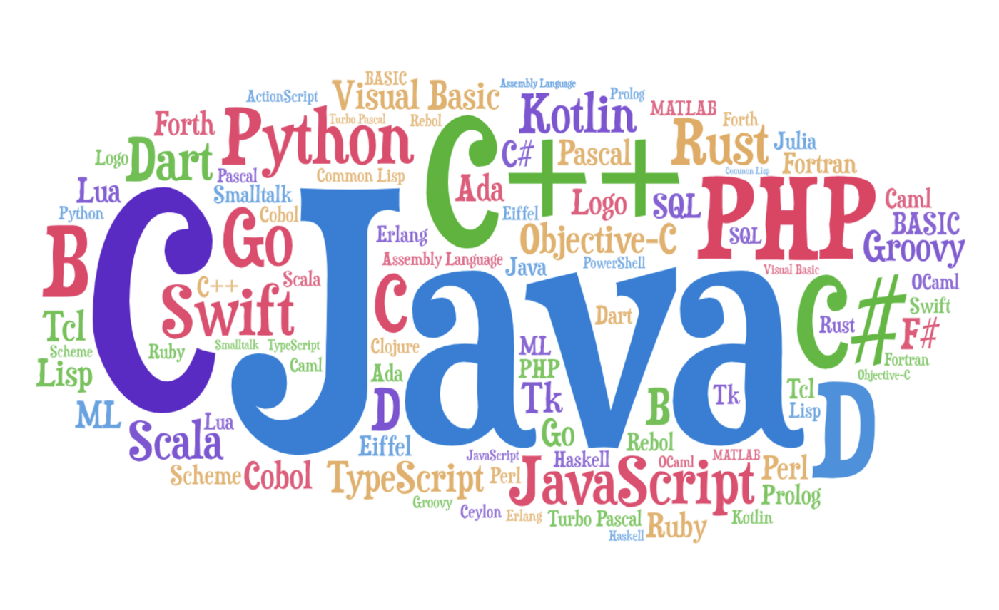



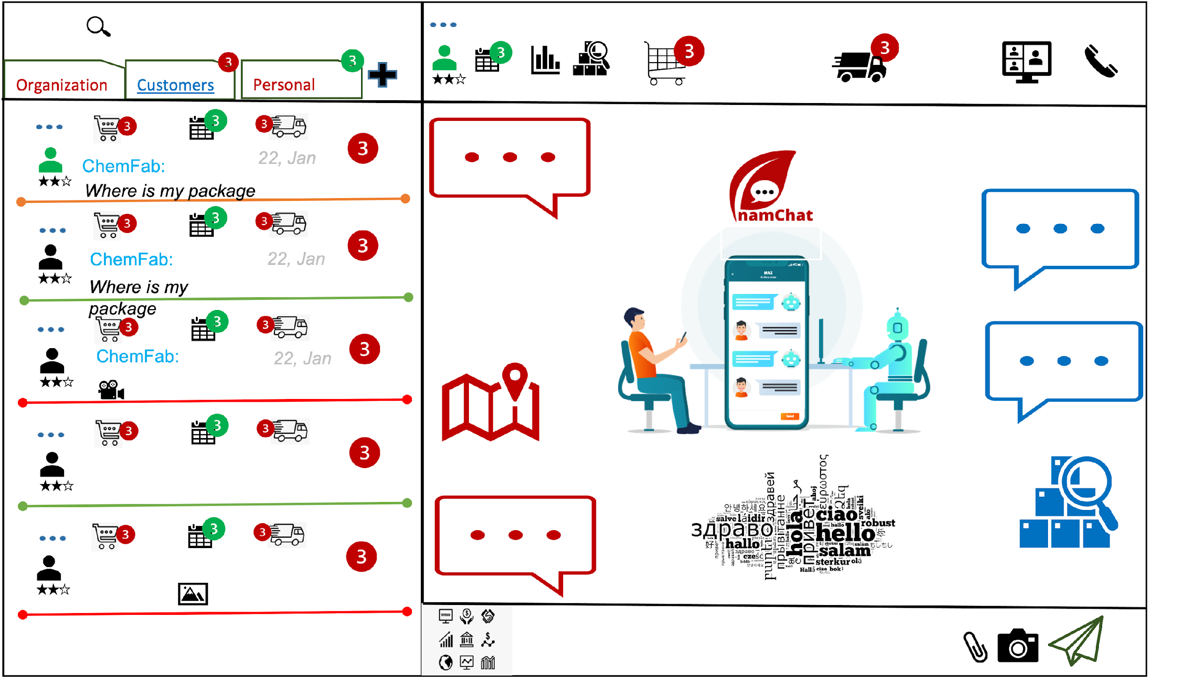

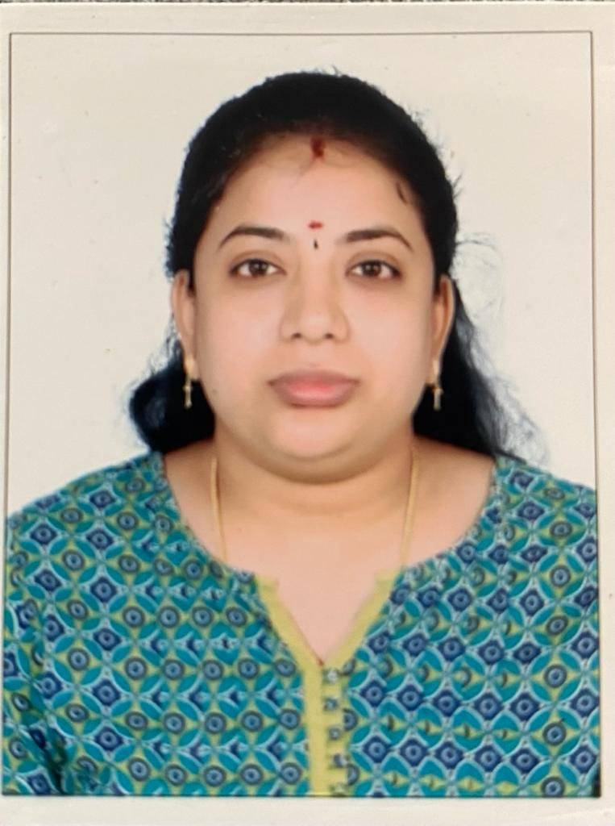
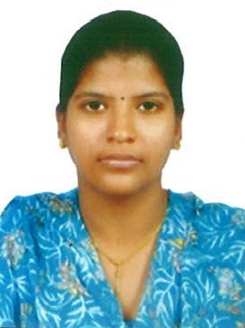



Slide 4


Challenges and Market Validation
Slow Response
Need for Strong Engagement and collaborative Platform
Lesser Engagement
Low Visibility
Not Effective Service fulfilment
Less Supply Chain Visibility
Stakeholder engagement across all points of interactions
Inconsistent information provided to stakeholders
Linked process automation.
Performing Task in-efficiently due to lack of information

Slide 5

Startup INITIATIVE
Product Ideas
Interactive Eco System for B2B
Ease Business Process
Perform Task Efficiently

Slide 6


Automated Business Process
BPM enabled through Text
Visibility on Process
Enable transparency by providing visibility on the stage(s) and Task(s)
Ease on Engagement
Chat based engagement
Configurable Workflow Templates
BUSINESS ENGAGEMENT PLATFORM
Template based workflow to bootstrap business process quickly
Plugin Bots
Plugin Bots to boost the engagement (Multilingual bot, AI Textual / Audio Bot, Cross Chat enablement)

Slide 7





TECHNOLOGY CHOICES
Ease to adopt, Secured, deploy, scale…….. Minimal User Interface
Micro Services
Structured / un structured data sources
Platform agnostic
Leverage Cloud Services
Serverless Architecture

Slide 8
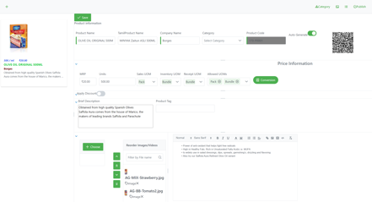
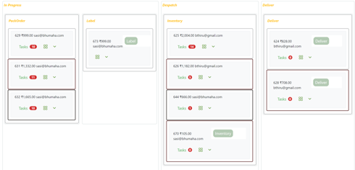
Features Ellaborated
Configure / Boot Strap Business Process
Configure Task Intelligent Templates
Define / Use templated business process / workflow
(BPM) Process on Chat
Realtime visibility
Human to Human
Machine to Human
Machine to Machine
Bot on Top
Customized privileges and Display of relevant information
Plugin / Integrate Services
Trigger Process
AI based Task
Perform Task Intelligently and efficiently

Slide 9
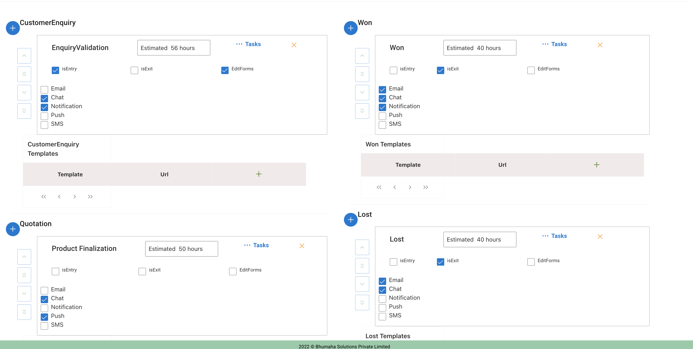



April 2021
July 2021
Oct 2021
Apr 2022
Product Progress
Nuggets
Digital Enablement
Chat Enablement
BPM
Engagement Platform
Ecom B2B

Slide 10
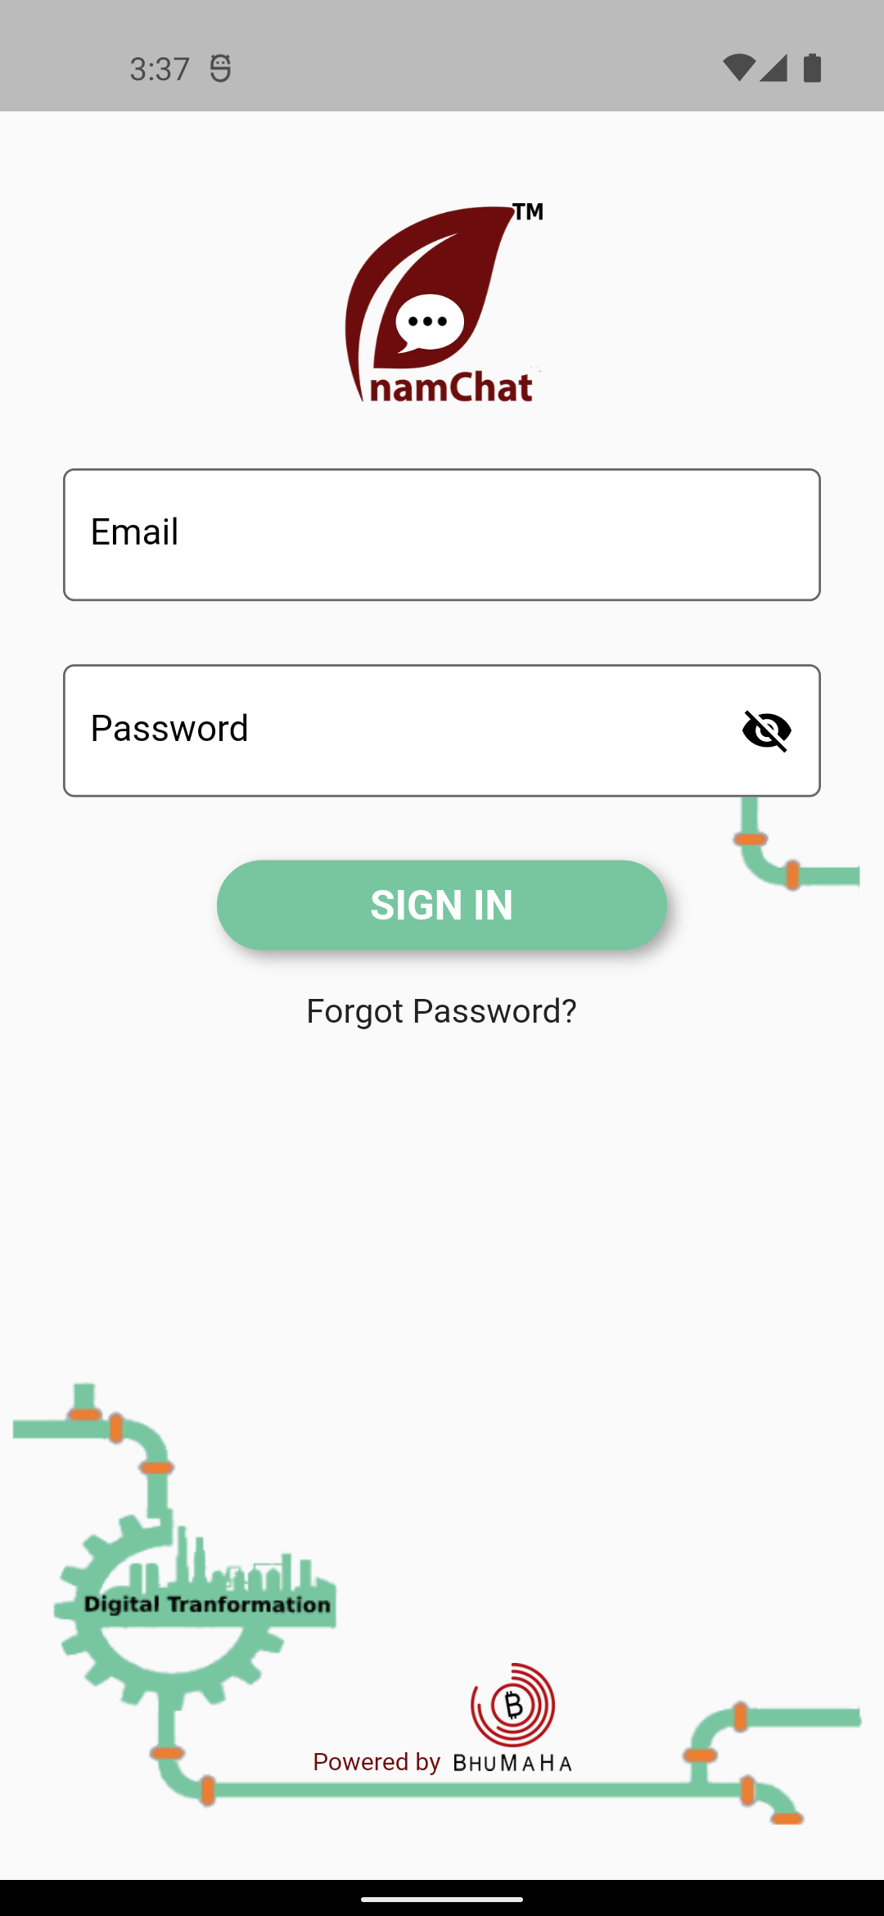
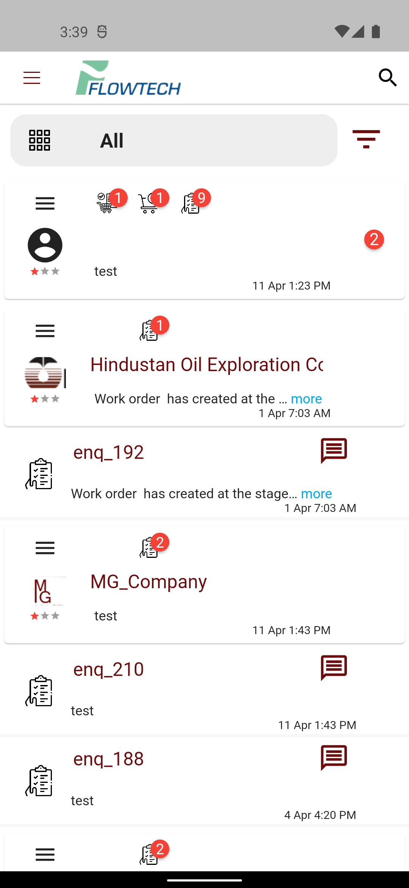
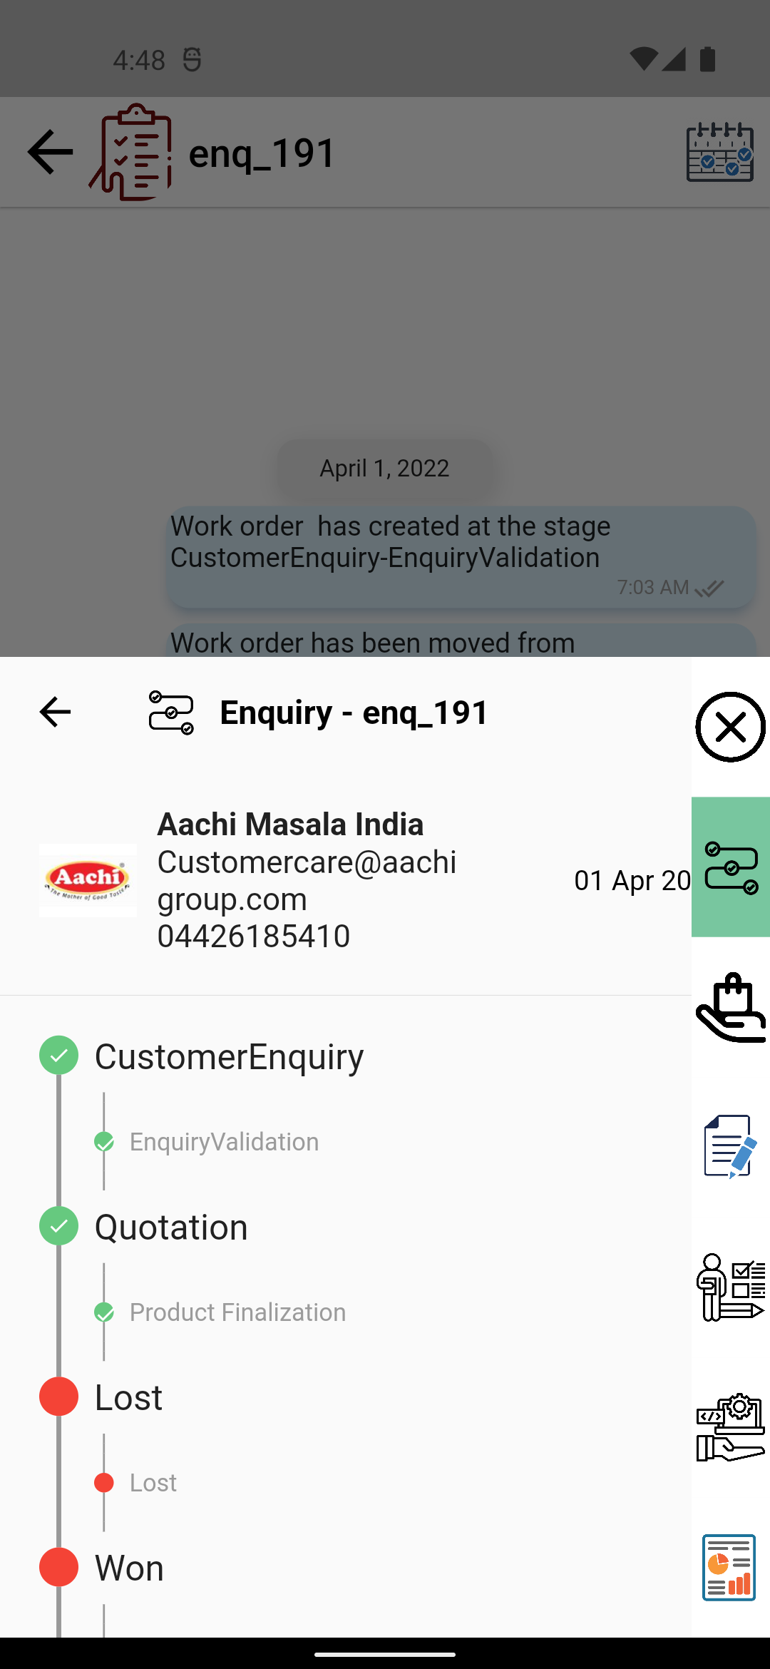
April 2021
July 2021
Oct 2021
Apr 2022
Product Progress
Nuggets
Digital Enablement
Chat Enablement
BPM
Engagement Platform
Ecom B2B

Slide 11
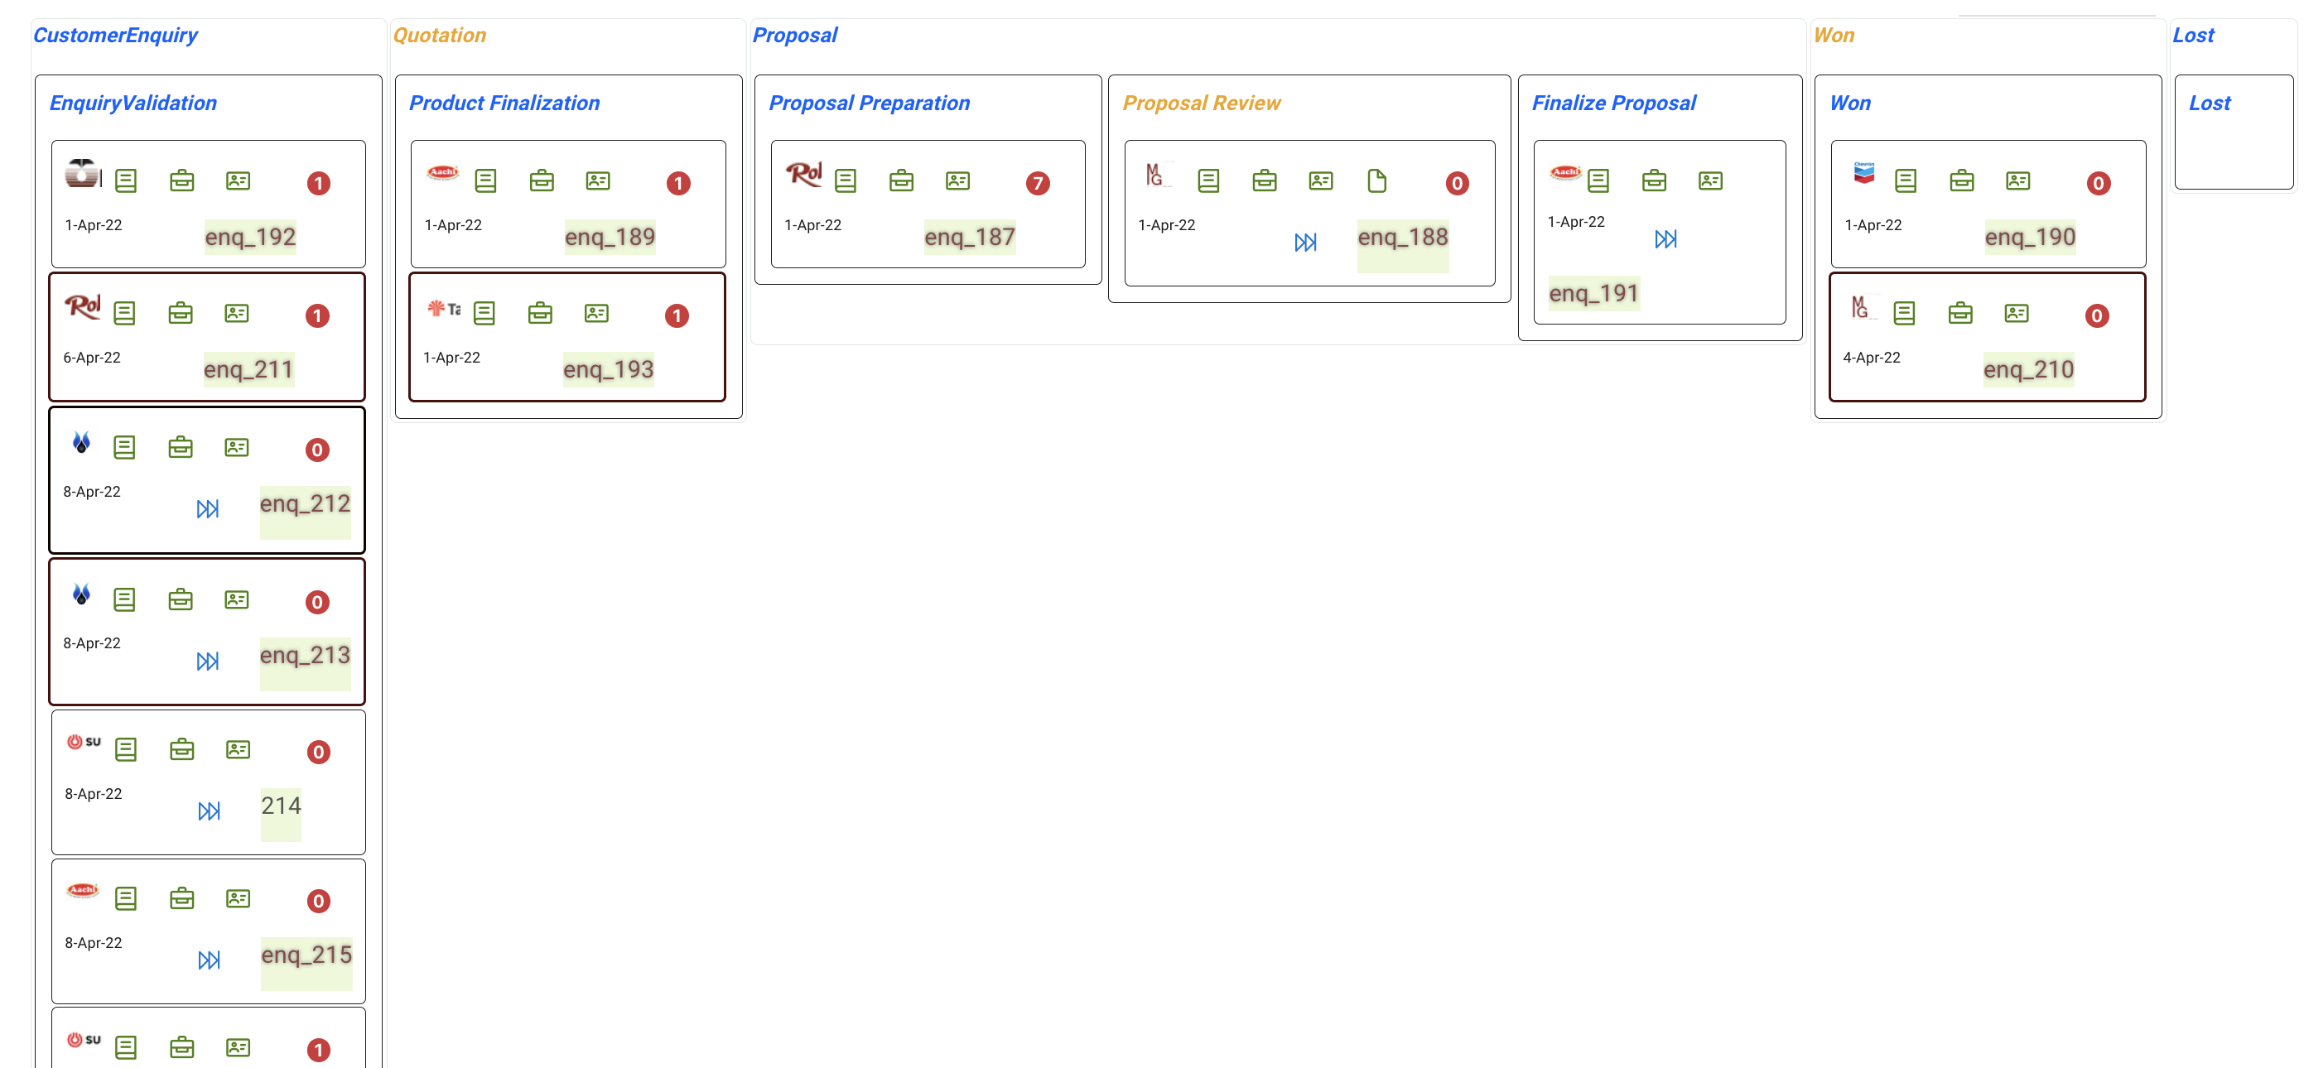
April 2021
July 2021
Oct 2021
Apr 2022
Product Progress
Nuggets
Digital Enablement
Chat Enablement
BPM
Engagement Platform
Ecom B2B

Slide 12
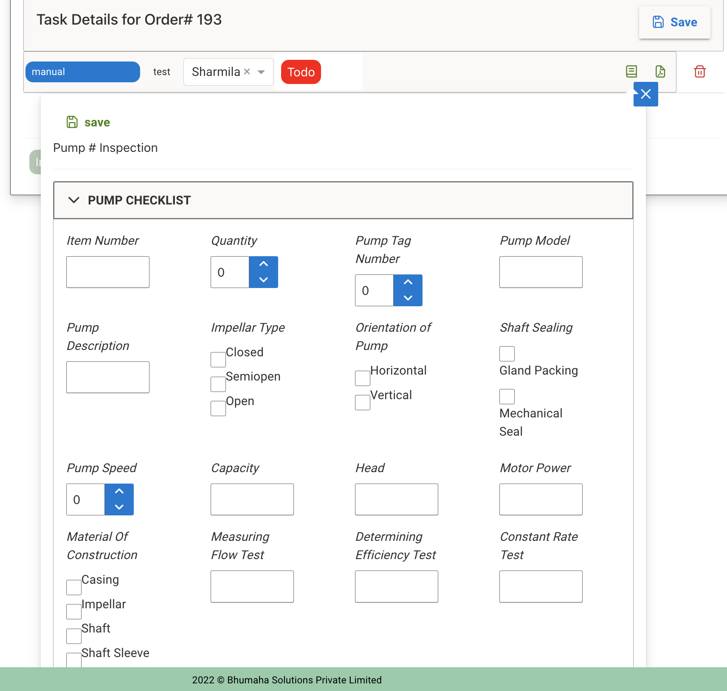
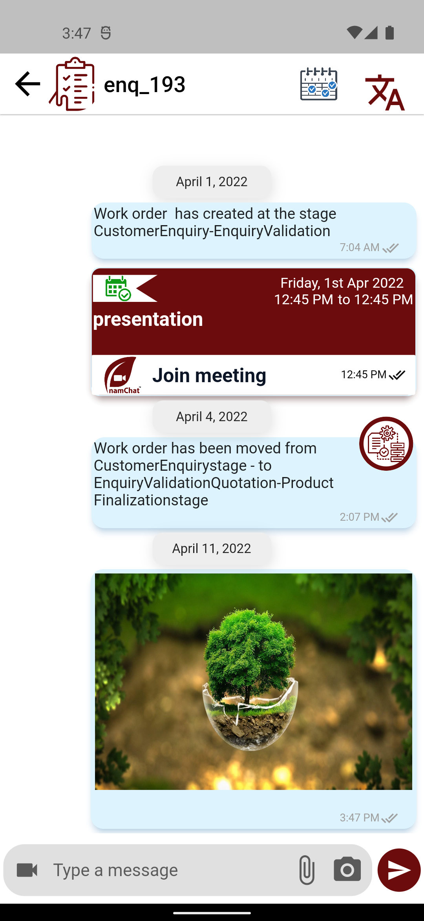
April 2021
July 2021
Oct 2021
Apr 2022
Product Progress
Nuggets
Digital Enablement
Chat Enablement
BPM
Engagement Platform
Ecom B2B

Slide 13

hank you
Bhumaha Solutions
www.bhumaha.com | sales@bhumaha.com | +91-9841565164

