Slide 1

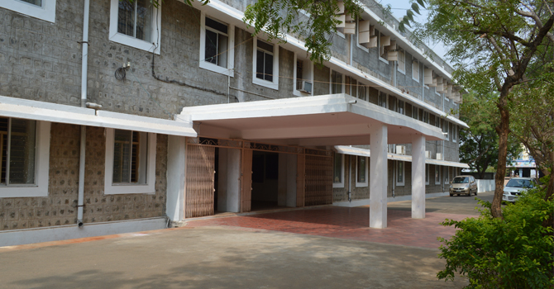
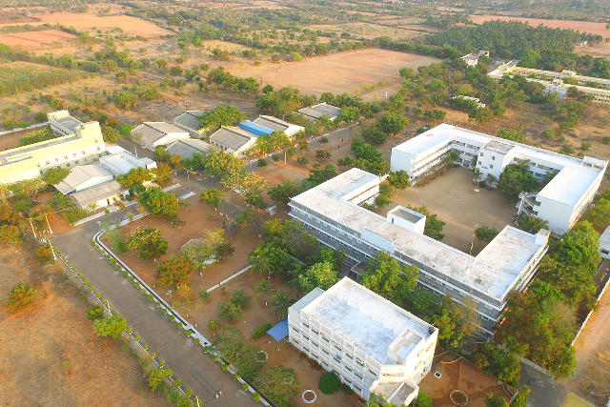


M.P.NACHIMUTHU M.JAGANATHAN ENGINEERING COLLEGE
CHENNIMALAI, ERODE – 638112.
DEPARTMENT OF ELECTRONICS AND COMMUNICATION ENGINEERING
HEARTY WELCOME ALL

Slide 2

VISION:
To produce technically competent students in the field of Electronics and Communication Engineering by imparting quality education with the industrial and societal needs.
DEPARTMENT OF ECE
VISSION
AND
MISSION
OF THE DEPARTMENT
MISSION:
To disseminate technical knowledge in the field of Electronics and Communication Engineering and allied disciplines through innovative teaching – learning process.
To enhance the research skills of graduates and make them employable or choose entrepreneurial ventures.
To infuse ethical and value based principles among students to make them to meet the growing challenges of the industry and society.

Slide 3

Program Educational Objectives (PEOs)
DEPARTMENT OF ECE
Graduates of Electronics and Communication Engineering will:
To enable graduates to pursue research, or have a successful career in academia or industries associated with Electronics and Communication Engineering, or as entrepreneurs.
To provide students with strong foundational concepts and also advanced techniques and tools in order to enable them to build solutions or systems of varying complexity.
To prepare students to critically analyze existing literature in an area of specialization and ethically develop innovative and research oriented methodologies to solve the problems identified.

Slide 4

PROGRAMME OUTCOMES (POs)
DEPARTMENT OF ECE
PO | Graduate Attributes | Description
PO1 | Engineering Knowledge | Apply the knowledge of mathematics, science, engineering fundamentals, and an engineering specialization to the solution of complex engineering problems
PO2 | Problem Analysis | Identify, formulate, review research literature, and analyze complex engineering problems reaching substantiated conclusions using first principles of mathematics, natural sciences, and engineering sciences.
PO3 | Design / Development of Solutions | Design solutions for complex engineering problems and design system components or processes that meet the specified needs with appropriate consideration for the public health and safety, and the cultural, societal, and environmental considerations.
PO4 | Conduct Investigations of Complex Problems | Use research-based knowledge and research methods including design of experiments, analysis and interpretation of data, and synthesis of the information to provide valid conclusions.
PO5 | Modern Tool Usage | Create, select, and apply appropriate techniques, resources, and modern engineering and IT tools including prediction and modeling to complex engineering activities with an understanding of the limitations.
PO6 | The Engineer and Society | Apply reasoning informed by the contextual knowledge to assess societal, health, safety, legal and cultural issues and the consequent responsibilities relevant to the professional engineering practice.

Slide 5

PROGRAMME OUTCOMES (POs) Con….
DEPARTMENT OF ECE
PO | Graduate Attributes | Description
PO7 | Environment and Sustainability | Understand the impact of the professional engineering solutions in societal and environmental contexts, and demonstrate the knowledge of, and need for sustainable development.
PO8 | Ethics | Apply ethical principles and commit to professional ethics and responsibilities and norms of the engineering practice.
PO9 | Individual and Team Work | Function effectively as an individual, and as a member or leader in diverse teams, and in multi disciplinary settings.
PO10 | Communication | Communicate effectively on complex engineering activities with the engineering community and with society at large, such as, being able to comprehend and write effective reports and design documentation, make effective presentations, and give and receive clear instructions.
PO11 | Project Management and Finance | Demonstrate knowledge and understanding of the engineering and management principles and apply these to one’s own work, as a member and leader in a team, to manage projects and in multi disciplinary environments.
PO12 | Life – Long Learning | Recognize the need for, and have the preparation and ability to engage in independent and life-long learning in the broadest context of technological change.

Slide 6

PROGRAM SPECIFIC OUTCOMES (PSOs)
DEPARTMENT OF ECE
To analyze, design and develop solutions by applying foundational concepts of electronics and communication engineering.
To apply design principles and best practices for developing quality products for scientific and business applications.
To adapt to emerging information and communication technologies (ICT) to innovate ideas and solutions to existing / novel problems.

Slide 7

PROGRAMMES OFFERED
DEPARTMENT OF ECE
Under Graduate Programme B.E. – ELECTRONICS AND COMMUNICATION ENGINEERING | Started 2001 - 2002 | Approved Intake 60
Post Graduate Programme M.E. – VLSI DESIGN | Started 2011 - 2012 | Approved Intake 18

Slide 8
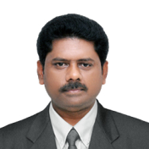

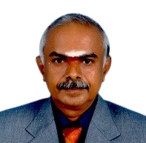
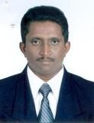
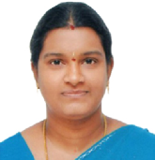
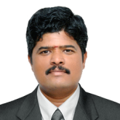
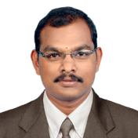
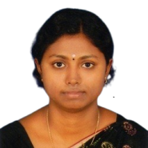
LIST OF FACULTIES
DEPARTMENT OF ECE
SL.NO. | NAME OF THE FACULTY | AREA OF SPECIALIZATIONION | TEACHING EXPERIENCE
1. | Mr.R.MOHAN Associate Professor, HEAD/ECE | APPLIED ELECTRONICS | 20 YEARS
2. | Dr.P.SENGUTTUVAN Professor | APPLIED ELECTRONICS | 35 YEARS
3. | Dr.G.RAVIKUMAR Professor | APPLIED ELECTRONICS | 34 YEARS
4. | Mrs.M.ANITHA Associate Professor | COMMUNICATION SYSTEMS | 18 YEARS
5. | Mr.A.P.GOBENATH Assistant Professor | EMBEDDED SYSTEM | 15 YEARS
6. | Mr.T.MAHESWARAN Assistant Professor | APPLIED ELECTRONICS | 15 YEARS
7. | Mrs. G.BRINDA Assistant Professor | COMMUNICATION SYSTEMS | 14 YEARS

Slide 9
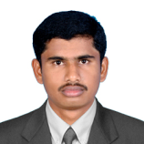
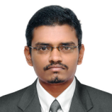
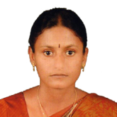
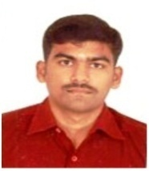
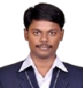
LIST OF FACULTIES Con….
DEPARTMENT OF ECE
SL.NO. | NAME OF THE FACULTY | AREA OF SPECIALIZATIONION | TEACHING EXPERIENCE
8. | Mr. K.NANTHAKUMAR Assistant Professor | VLSI DESIGN | 13 YEARS
9. | Mr. A.KAMESWARAN Assistant Professor | VLSI DESIGN | 12 YEARS
10 | Mrs.R.TAMILSELVI Assistant Professor | VLSI DESIGN | 12 YEARS
11. | Mr. G.MOHAN KUMAR Assistant Professor | VLSI DESIGN | 8 YEARS
12. | Mr. G.M.NIRMAL Assistant Professor | VLSI DESIGN | 4 YEARS
Total No. of Teaching Faculties : 12 Nos.
Supporting Staff : 2 Nos. 1. Mrs.Vasuki and 2. Mrs. K.Gomathi

Slide 10

DEPARTMENT ACHIEVEMENTS
FACULTY MEMBERS PURSUING PH.D. WORK
DEPARTMENT OF ECE
SL.NO. | NAME OF THE FACULTY | AREA OF RESEARCH
1 | Mrs.M.ANITHA | Internet of Things
2. | Mr.A.P.GOBENATH | Artificial Intelligence and IoT
3. | Mrs.G.BRINDA | Wireless Sensor Network
4. | Mr.T.MAHESWARAN | Remote Sensing

Slide 11

DEPARTMENT ACHIEVEMENTS
SPONSORS PROGRAMMES
DEPARTMENT OF ECE
SL. NO. | NAME OF THE FACULTY | NAME OF THE SEMINAR / WORKSHOP / FDP | NAME OF THE FUNDING AGENCY | GRANT AMOUNT Rs.
1 | Mr. T.MAHESWARAN, Assistant Professor | Digital signal processing and its applications | IETE | 5,000
2 | Mr. R.MOHAN, Associate Professor | Emerging Trends in Smart Satellite Technology & Its Applications | ISRO/ DOS | 30,000
3 | Mr. T.MAHESWARAN, Assistant Professor Mr. K.NANTHAKUMAR, Assistant Professor | Recent Trends in Digital Image processing and its Applications | CSIR | 40,000
4 | Mr. R.MOHAN, Associate Professor | Optical Fiber Technician | AICTE- PMKVY | 3,57,000

Slide 12

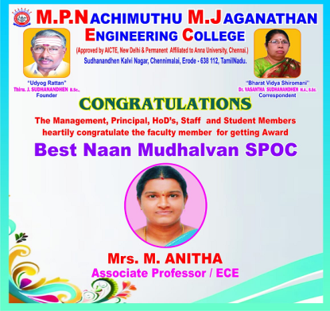
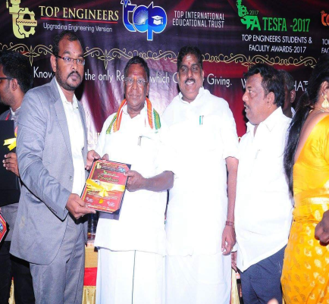
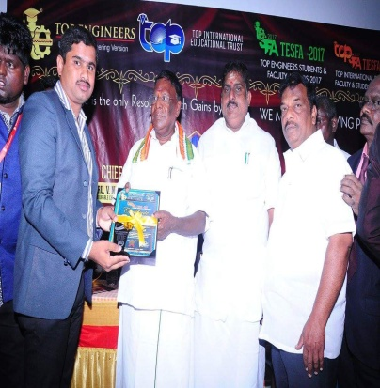
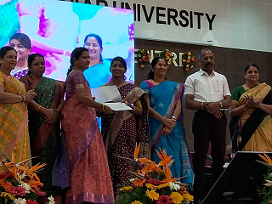
DEPARTMENT ACHIEVEMENTS
FACULTY AWARDS
DEPARTMENT OF ECE
SL. NO. | NAME OF THE FACULTY | NAME OF THE AWARD | YEAR
1 | Mrs.M.ANITHA Associate Professor | Best SPOC Award for Naan Mudhalvan Scheme, TN Govt. | 2024
2 | Mr.T.MAHESWARAN Asst. Professor | Best Outstanding Faculty Award, TOP ENGINEERS | 2017
3 | Mr.K.NANTHA KUMAR Asst. Professor | Best Inspirational Leadership Award, TOP ENGINEERS | 2017

Slide 13


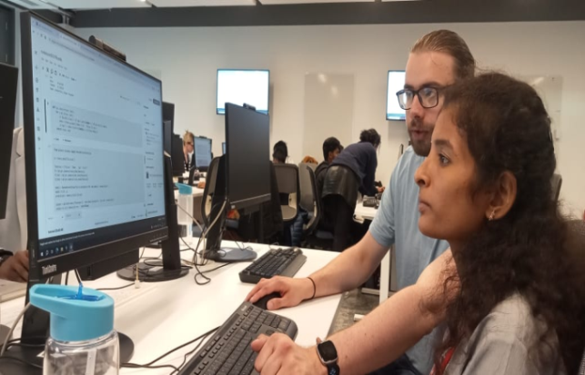
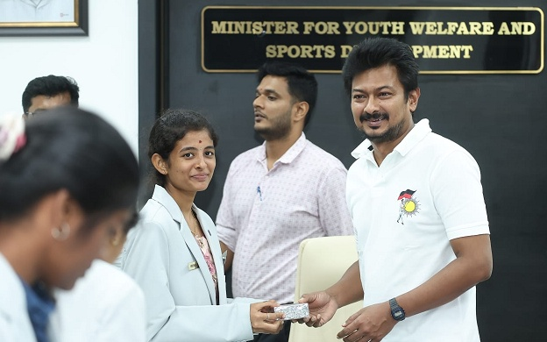
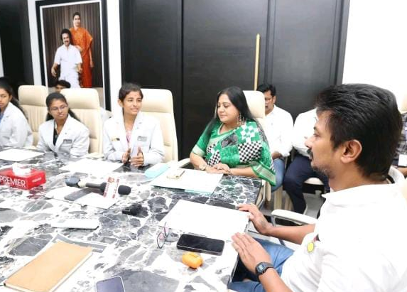
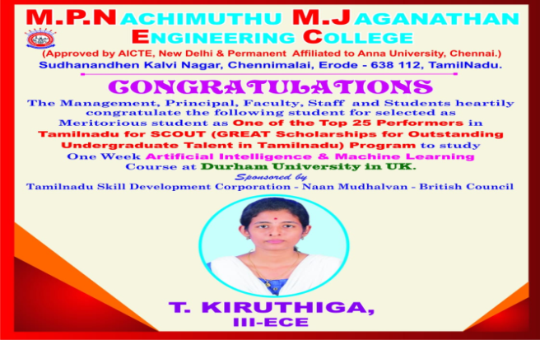
DEPARTMENT ACHIEVEMENTS
DEPARTMENT OF ECE
Selvi. T. KIRUTHIKA, III YEAR – ECE
Meritorious Student as One of the Top 25 Performers in
Tamilnadu for SCOUT ( GREAT Scholarships for Outstanding Undergraduate Talent in Tamilnadu) Program to Study One week ARTIFICIAL INTELLIGENCE & MACHINE LEARNING Course at DURHAM UNIVERSITY in UK
Sponsored By
Tamilnadu Skill Development Corporation - Naan Mudhalvan – British Council

Slide 14
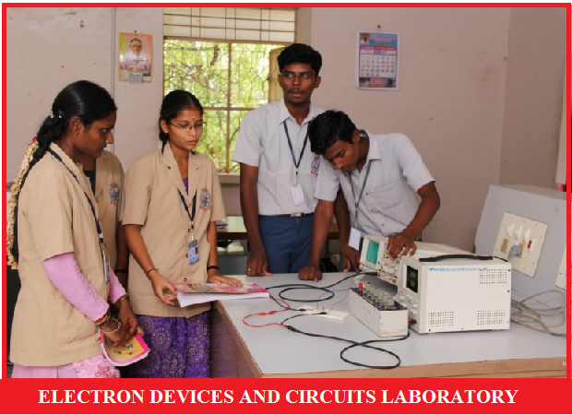
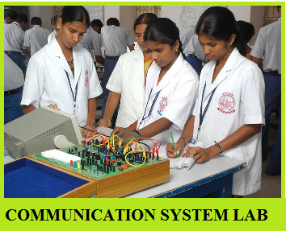
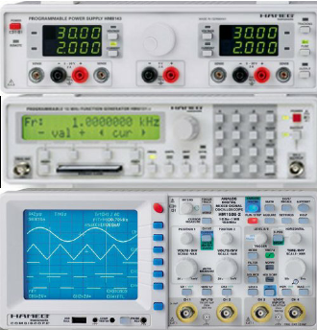
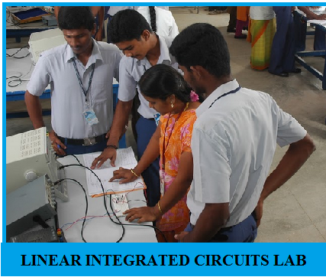
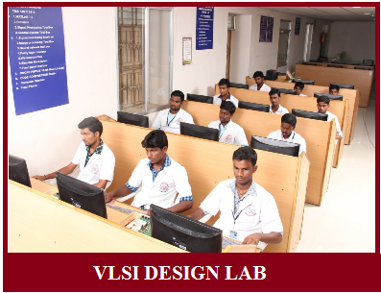
LABORATORY FACILITIES
DEPARTMENT OF ECE

Slide 15
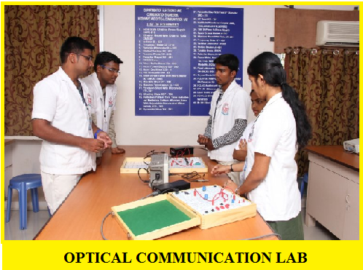
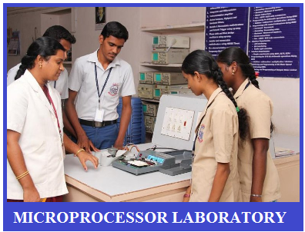
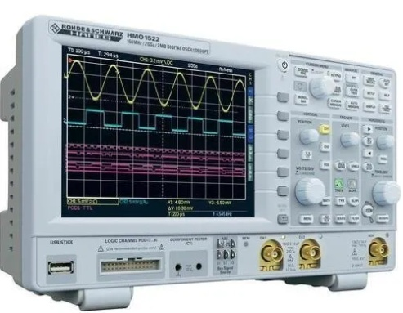
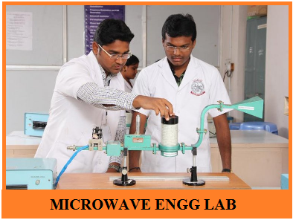
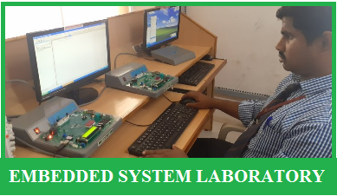
LABORATORY FACILITIES Con…
DEPARTMENT OF ECE

Slide 16
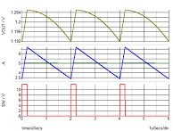
LABORATORY FACILITIES
LIST OF SOFTWARE
DEPARTMENT OF ECE
S.No. | Softwares | No. of Users
1. | Mentor Graphics | 10
2. | MATLAB | 10
3. | Xilinx | N Users
4. | OrCAD P-Spice | 10
5. | N- Sim , L- Sim | 10
6. | Keil | 10
7. | IAR and Flash Magic | N Users
8. | Microwind | N Users

Slide 17

MoUs Signed
DEPARTMENT OF ECE
S. No. | Name of the Company
1. | CODSIA - THE COIMBATORE DISTRICT SMALL INDUSTRIES ASSOCIATION (2014)
2. | MEGATRONICS (2011)
3. | SRI VIJAYA DURGA SYSTEMS AND SOLUTIONS (2017)
4. | ABE TECHNOLOGIES (2010)
5. | SPARK DRIVES AND AUTOMATION (2019)
6. | EEDISSIA (2014)
7. | TECH WORK SOLUTION (2018)

