Slide 1
Bin It Right: A Garbage Segregation Project for a Greener Tomorrow
A Community Project Proposal for
Barangay Outlook Drive, Baguio City
Prepared by:
Nathan Perdon
Angel Atasha Paramio
Analyn Dino
Notes:
%%TTS_MALE% Welcome to the Project Proposal for the Bin It Right: A Garbage Segregation Project for a Greener Tomorrow, A Community Project Proposal for
Barangay Outlook Drive, Baguio City

Slide 2
Rationale of the Project
Solid Waste Management is a common environmental issue that needs a solution. In order to reduce the amount of waste into the landfill, it is best to implement the solid waste management that give priority to the waste reduction through 3R (Reduce, Reuse, Recycle).
Notes:
%%TTS_MALE% Rationale of the Project: Solid Waste Management is a common environmental issue that needs a solution. In order to reduce the amount of waste into the landfill, it is best to implement the solid waste management that give priority to the waste reduction through 3R (Reduce, Reuse, Recycle).

Slide 3
Rationale of the Project
“Bin It Right: A Garbage Segregation Project for a Greener Tomorrow” is a project provides garbage dumpsters and these will be labeled as Biodegradable, Non- Biodegradable, and Recyclable Materials. Each garbage dumpster will have a color code as well. One of the goals of proper waste segregation in barangays is to help reduce the increasing level of improper waste disposal of trash or garbage in the society.
Notes:
%%TTS_MALE% “Bin It Right: A Garbage Segregation Project for a Greener Tomorrow” is a project provides garbage dumpsters and these will be labeled as Biodegradable, Non- Biodegradable, and Recyclable Materials. Each garbage dumpster will have a color code as well. One of the goals of proper waste segregation in barangays is to help reduce the increasing level of improper waste disposal of trash or garbage in the society.

Slide 4
Rationale of the Project
“Bin It Right” aims to provide garbage dumpsters with the labels and color code of , green for biodegradable materials, black for non-biodegradable, red for recyclables, to conspicuous places with a minimum of 100-meter distance from a set of garbage dumpsters to the next set of garbage dumpsters.
Notes:
%%TTS_MALE% “Bin It Right” aims to provide garbage dumpsters with the labels and color code of , green for biodegradable materials, black for non-biodegradable, red for recyclables, to conspicuous places with a minimum of 100-meter distance from a set of garbage dumpsters to the next set of garbage dumpsters.

Slide 5
Objectives of the Project
1. To help maintain the cleanliness in the barangay.
2. To achieve waste reduction
3. To introduce strategies to make the place into a low waste community.
4. To revive the simplest way of gathering and collecting garbages and trash.
Notes:
%%TTS_MALE% Objectives of the Project: 1. To help maintain the cleanliness in the barangay.
2. To achieve waste reduction
3. To introduce strategies to make the place into a low waste community.
4. To revive the simplest way of gathering and collecting garbages and trash.
1. To help maintain the cleanliness in the barangay.
2. To achieve waste reduction
3. To introduce strategies to make the place into a low waste community.
4. To revive the simplest way of gathering and collecting garbages and trash.

Slide 6
Objectives of the Project
5. To minimize garbage nuisance in the environment.
6. To promote 3R’s.
7. To lessen pollutants that cause illness to people.
Notes:
%%TTS_MALE% 5. To minimize garbage nuisance in the environment.
6. To promote 3R’s.
7. To lessen pollutants that cause illness to people.

Slide 7
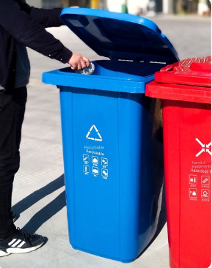
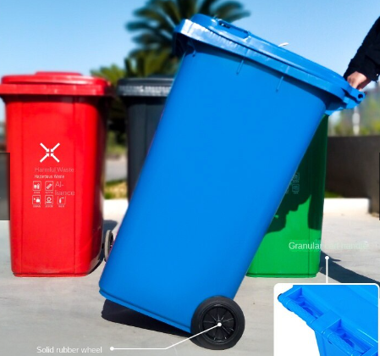
Sample Pictures of the proposed garbage dumpsters
Notes:
%%TTS_MALE% These are the Sample Pictures of the proposed garbage dumpsters.

Slide 8
Plan of Action
a. Preparation
The proponents will gather and prepare the materials that will be used such as the garbage dumpsters. They will also seek the help of barangay kagawads to identify the accessible areas for both the garbage truck and constituents.
Notes:
%%TTS_MALE% Plan of Action: a. Preparation
The proponents will gather and prepare the materials that will be used such as the garbage dumpsters. They will also seek the help of barangay kagawads to identify the areas where the garbage truck and constituents

Slide 9
Plan of Action
b. Discussion
The proponents will conduct a short discussion to the residents of the barangay introducing their project and explaining how it works. They will also discuss about waste management including recycling and other related topics.
Notes:
%%TTS_MALE% b. Discussion
The proponents will conduct a short discussion to the residents of the barangay introducing their project and explaining how it works. They will also discuss about waste management including recycling and other related topics.

Slide 10
Plan of Action
c. Action
They will start putting the trash bins and label them accordingly. It will be placed every 100-meters.
Notes:
%%TTS_MALE% c. Action
They will start putting the trash bins and label them accordingly. It will be placed every 100-meters.

Slide 11
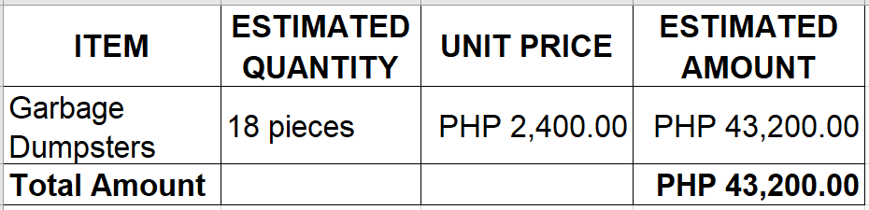
Financial Plan
Notes:
%%TTS_MALE% For the Financial Plan of the Proposed Project. 18 areas were identified where the dumpsters will be situated. A canvassed price of the garbage dumpsters is indicated at 2,400 pesos. The Total Estimated Amount for the Project is 43,200 pesos.

Slide 12
Responsibilities of Agencies Involved
The Barangay or SK officials are responsible in doing the final disposal of the garbages that fall under the category of biodegradable as well as in the final judgement for the garbages that fall under the category of non- biodegradable once the trash cans reached their full capacity. They may sell it to junk shops, or recycle it themselves to form a useful product.
Notes:
%%TTS_MALE% Responsibilities of Agencies Involved. The Barangay or SK officials are responsible in doing the final disposal of the garbages that fall under the category of biodegradable as well as in the final judgement for the garbages that fall under the category of non- biodegradable once the trash cans reached their full capacity. They may sell it to junk shops, or recycle it themselves to form a useful product.

Slide 13
THANK YOU!
Prepared by:
Nathan Perdon
Angel Atasha Paramio
Analyn Dino
Notes:
%%TTS_MALE% This is the end of our presentation. We are hoping that, through this project proposal, the financial assistance we seek through your company would be granted. Thank you!

