Slide 1


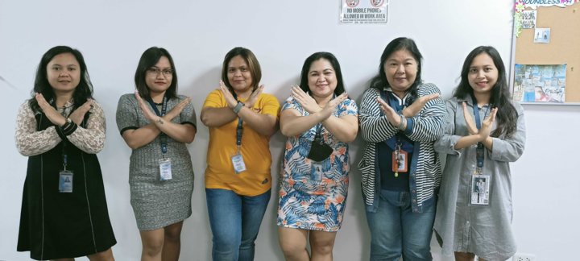




I will try to influence others' beliefs & actions
#BreakTheBias
“Think Like A Queen. A Queen Is Not Afraid To Fail. Failure Is Another Stepping Stone To Greatness.”
- Oprah Winfrey.

Slide 2
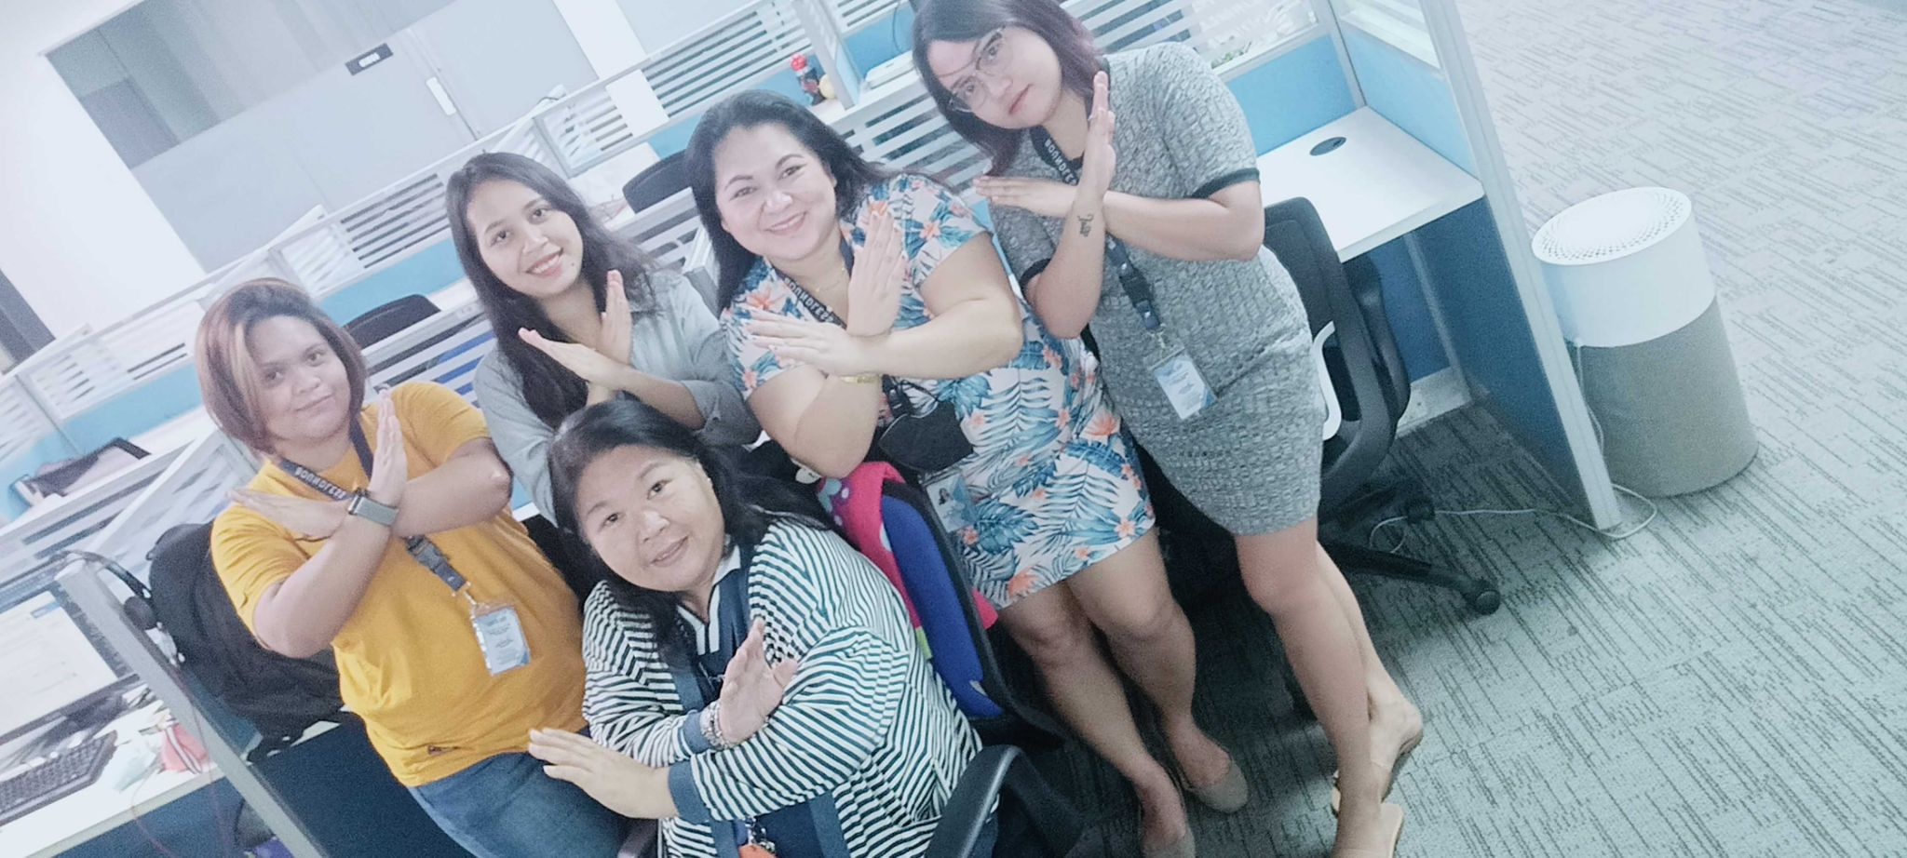
We will Celebrate Women’s Achievements.
#BreakTheBias
“To all the little girls who are watching this, never doubt that you are valuable and powerful, and deserving of every chance and opportunity in the world to pursue and achieve your own dreams.”
- Hillary Clinton.

