Slide 1

www.chaitanyahr.com

Slide 2
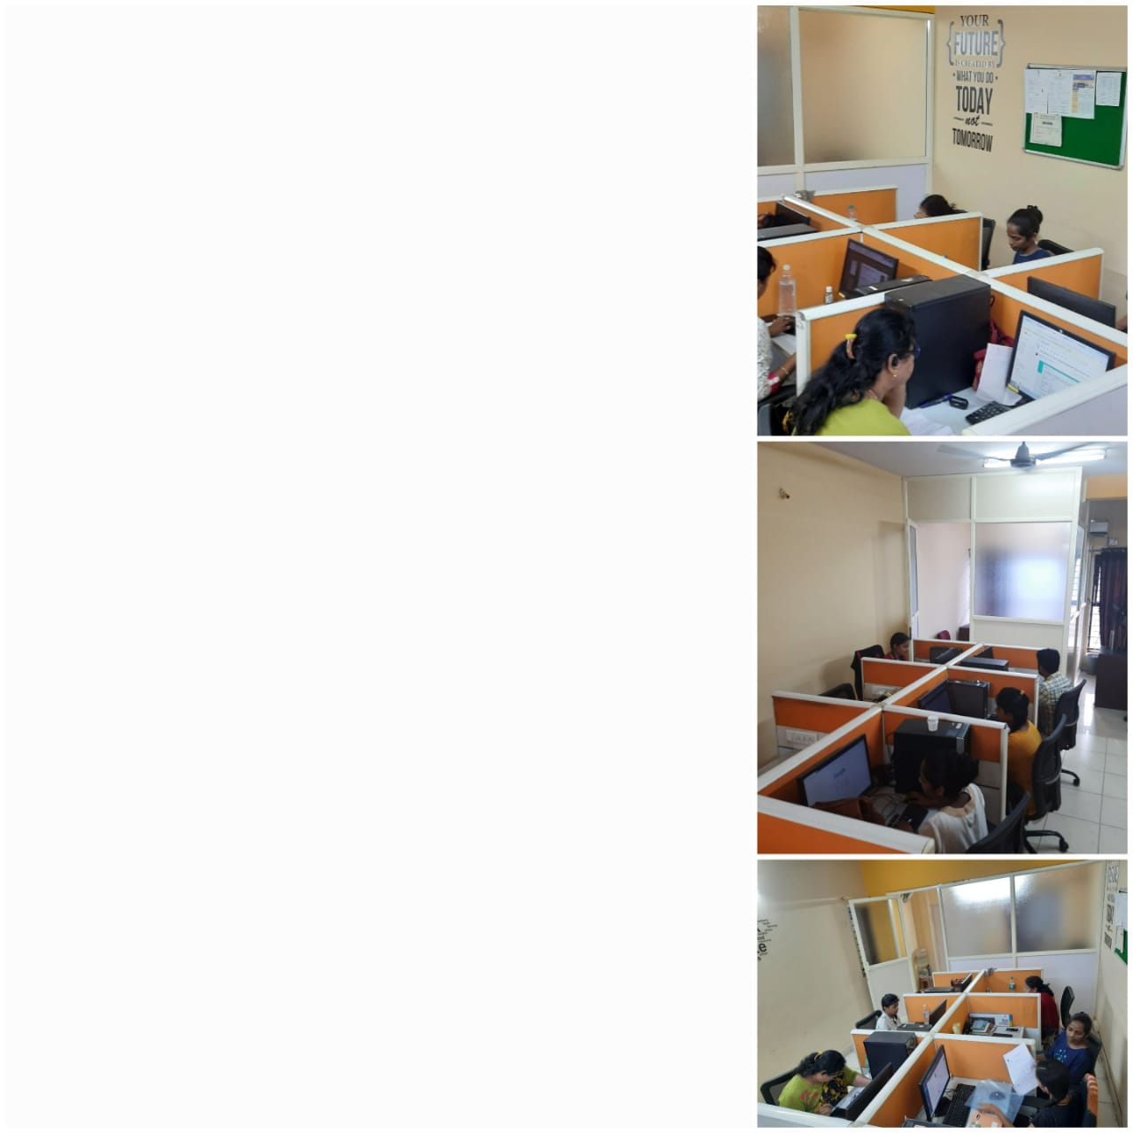
We @ Chaitanya HR Consultancy
Will provide
Qualified ,Potential , professionals
From rural , remote to metropolitan Location
Since 2013
For short and long term staffing needs
About Us
Free Service to Candidates

Slide 3

Specialized
Staffing Solutions

Slide 4

General Physician
Gynecologist
pediatrician

Slide 5

Nephrologists
Urologist
Cardiologists
Radiologist
Anesthetist
General surgeon

Slide 6

Lab Tech
CT Scan
Staff Nurse
Hospital Admin
Accountant

Slide 7








Our Clients

Slide 8
Thank you

