Slide 1
A LESSON PLAN
FOR A
LISTENING LESSON

Slide 2
Preliminary Information
Level of Students: Grade 10
Lesson: Unit 5-The Seven Wonders of the World
Competency Level:
Skills Focused: Listening, Writing
Language areas focused: vocabulary related to seven wonders of the world, Scanning, skimming, listening for gist, Grammar-Simple past tense and present perfect
Duration: 40 minutes
Description: In this lesson, the students are presented with the vocabulary of the Seven Wonders of the World. Revision of the previous lesson’s knowledge of visiting places. They will be able to construct sentences using the vocabulary related to the Seven Wonders of the World in using Simple Present and Present Continuous Tense verbs appropriately in the next session.

Slide 3
Intended Learner Outcomes:
-by the end of the lesson the learners will be able to,
Fill a tabular by listening for the audio.
Fill the missing words by listening for the audio.
Identify the meanings of the vocabulary learnt.
Identify the Simple Past and Present perfect tense sentences.
Main Aim: By the end of the lesson the students will be better able to identify the vocabulary related to the 7 wonders of the world in the given activities.
Subsidiary aims: The students will be able to use the vocabulary related to the seven wonders of the world. The students will learn the pronunciation and how to identify the sentences of the simple past and present perfect tense.
Personal Aims: Encourage the students to learn content related to the seven wonders of the world, encourage to focus on listening for gist (extensive listening , scanning (intensive listening). Encourage learners for group activities and peer activities.

Slide 4
Background: 32 Students All students are secondary level. Gifted learners, average learners and few slow learners who are eagerly participating in collaborative learning.
Timetable fit: The students would improve their scanning, listening for gist and listening for specific information.
Assumptions: have a prior knowledge of the wonders. Curious about the topic.
Anticipated problems: the gifted learners might finish the activities prior to the given duration. Apprehensiveness of slow learners.
Solutions: Design challenging worksheets. Group the students for scaffolding.
Teaching aids: Text with images, worksheets, listening audio, presentation,

Slide 5
Pre-Listening Stage
Aim: The learners will be able to identify the vocabulary of the Seven Wonders of the World.
Time: 5 minutes
Interaction pattern: Whole class
Procedure: The teacher introduces the vocabulary using images and meanings. The learners will listen and follow the instructions while interacting for the lesson.

Slide 6
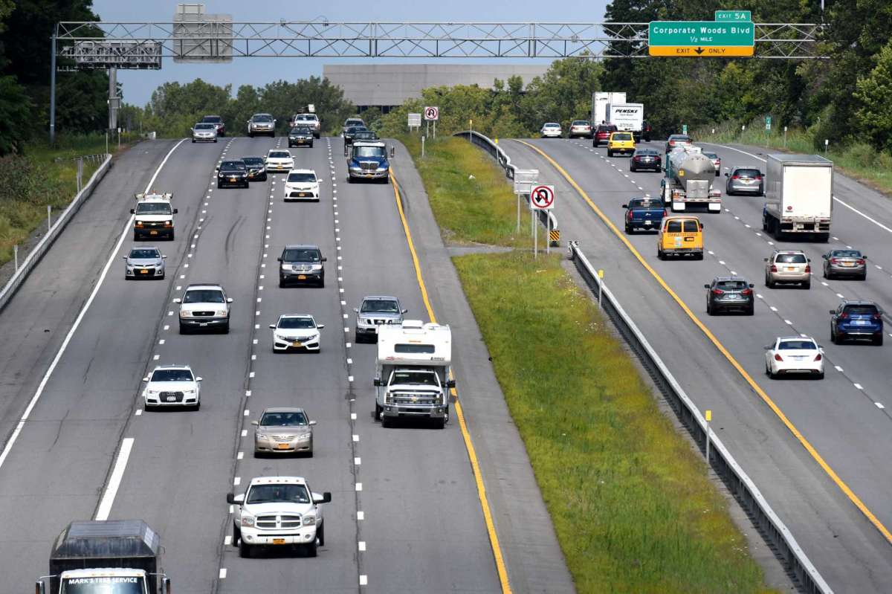
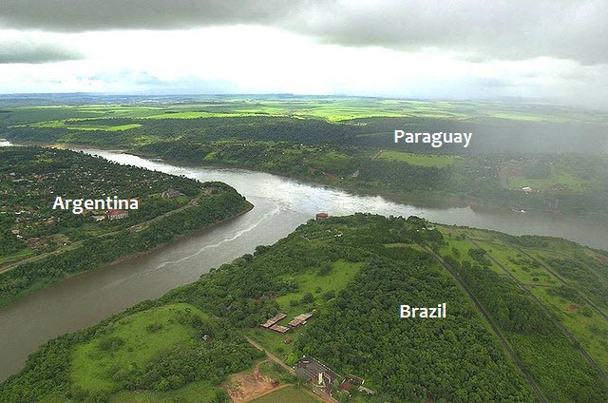
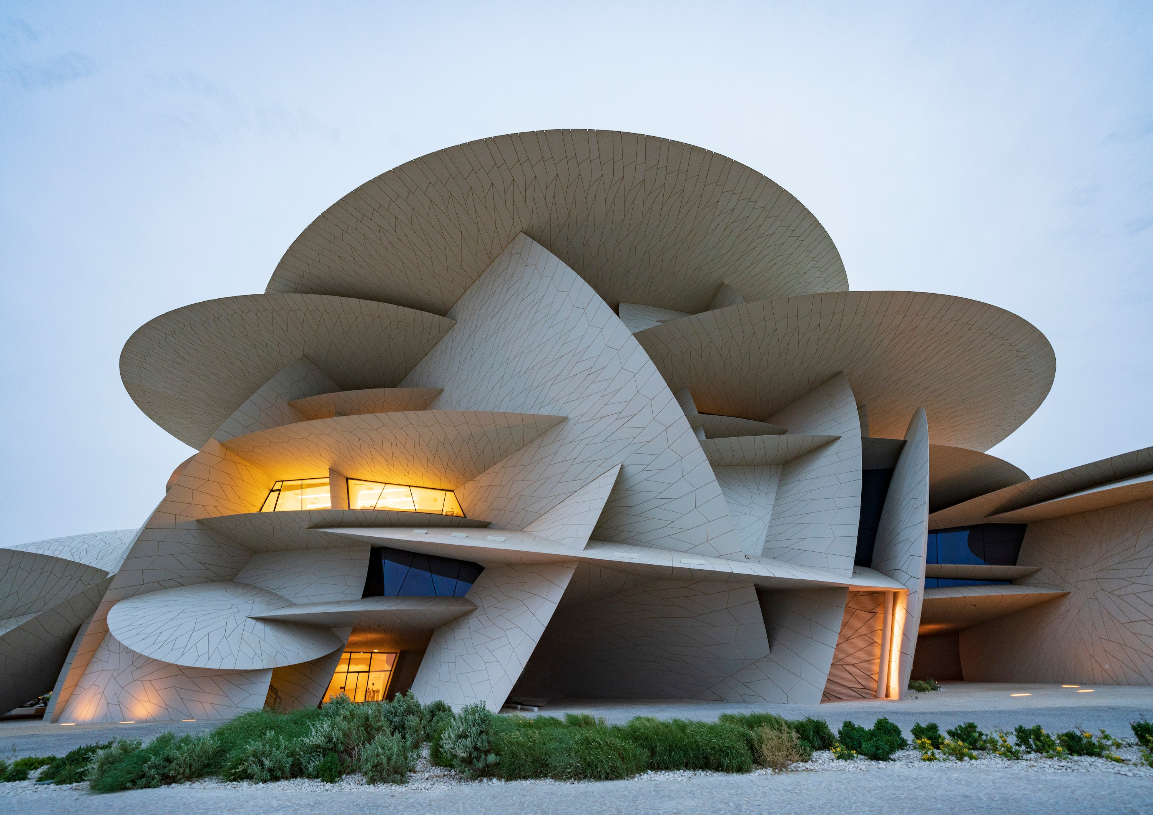
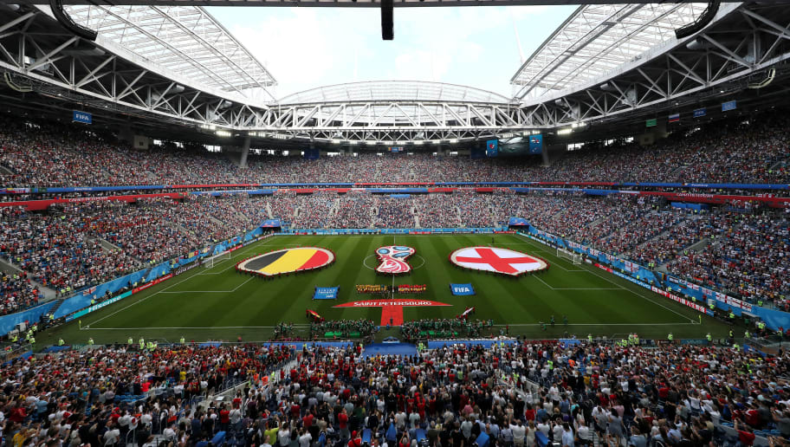
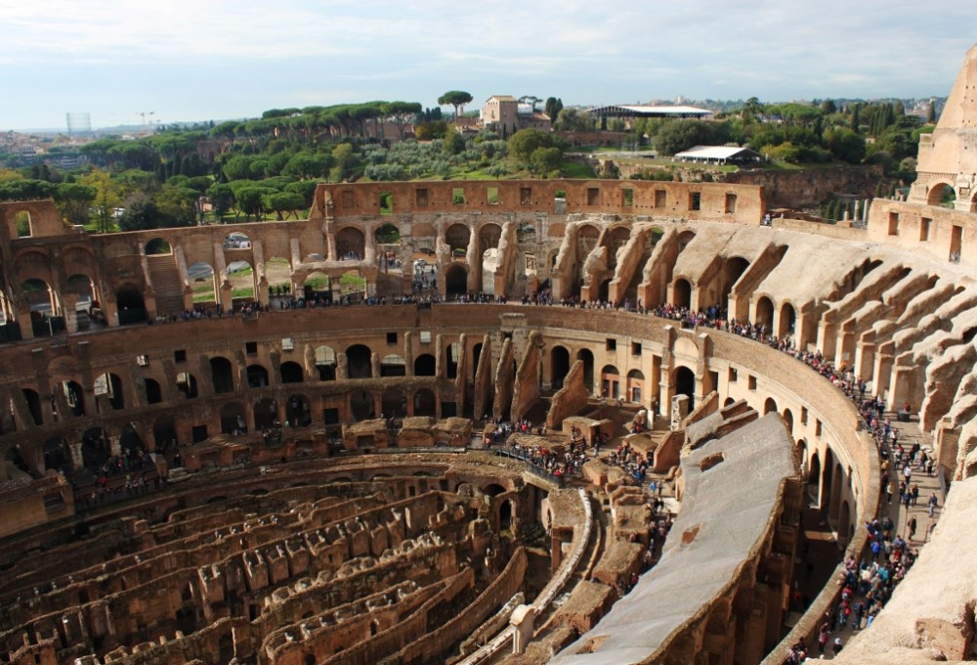
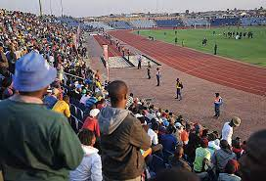
Actual course- an accurate distance from the starting point to the end.
Frontier – a line or a boarder that separate a country.
Architecture- act of designing and constructing.
Spectators- people who watch a show, game or an event.
Amphitheater- an open circular building with a central space, surround with seats for the people to watch a sporting event.
Estimated- the general number of people who can enter a certain place.

Slide 7
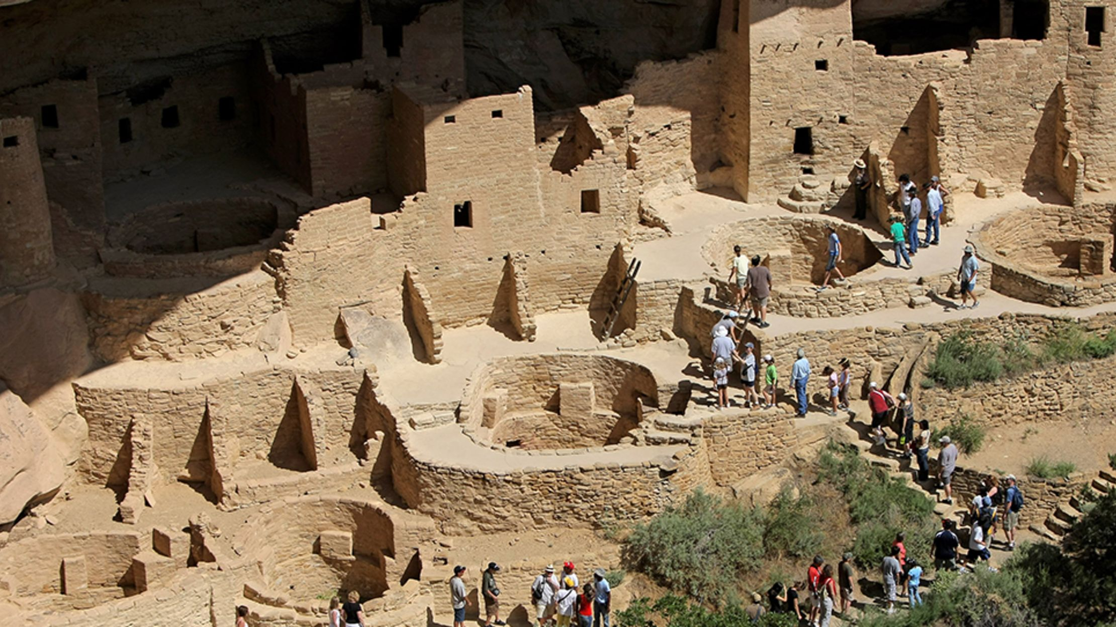
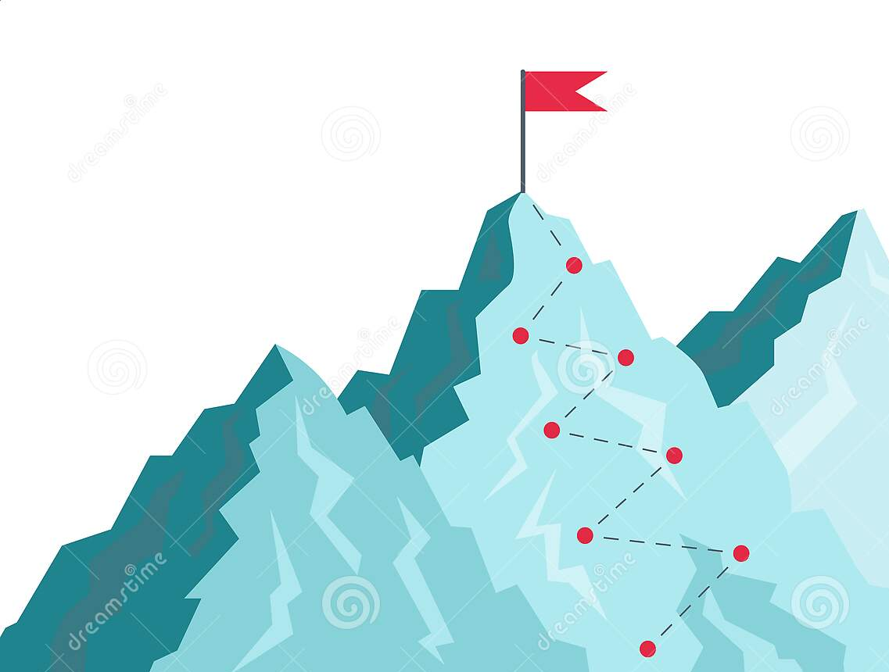
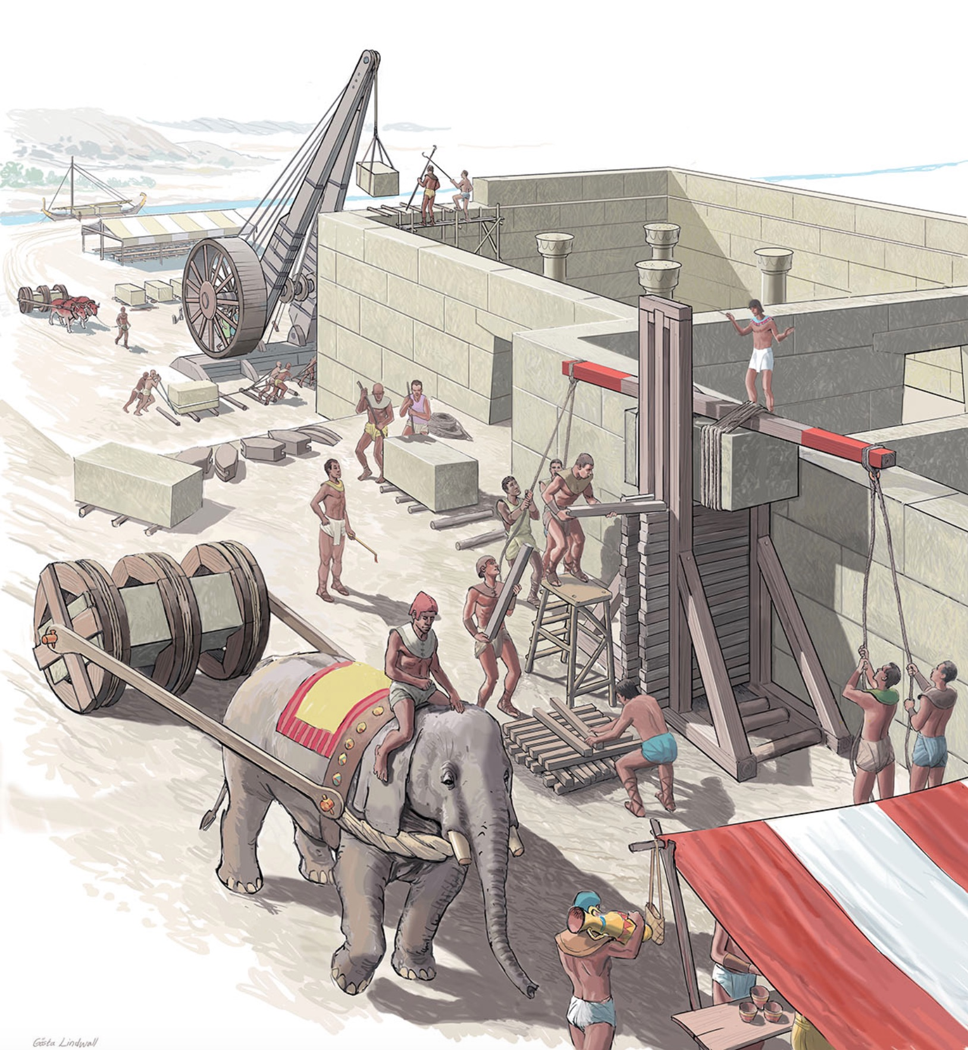
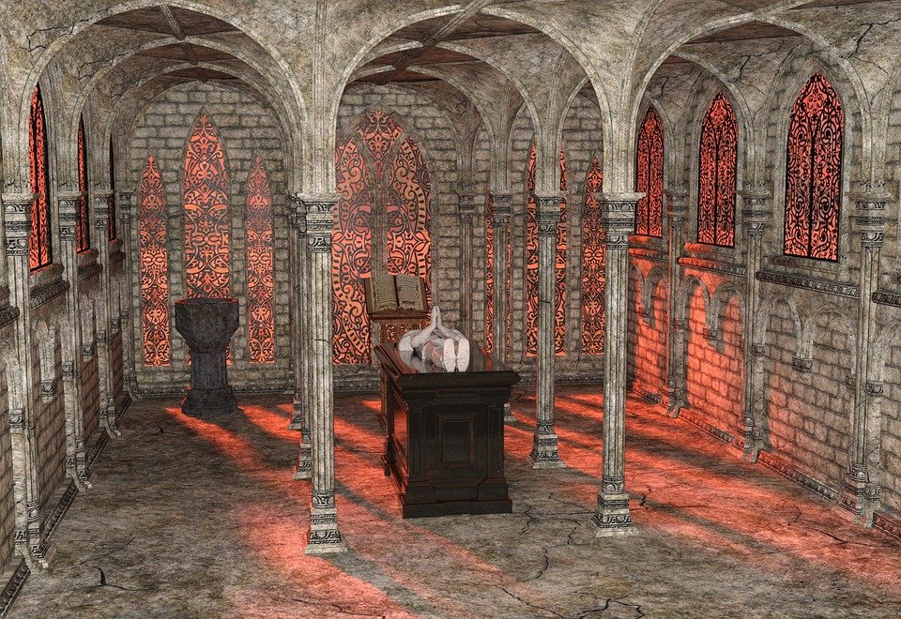
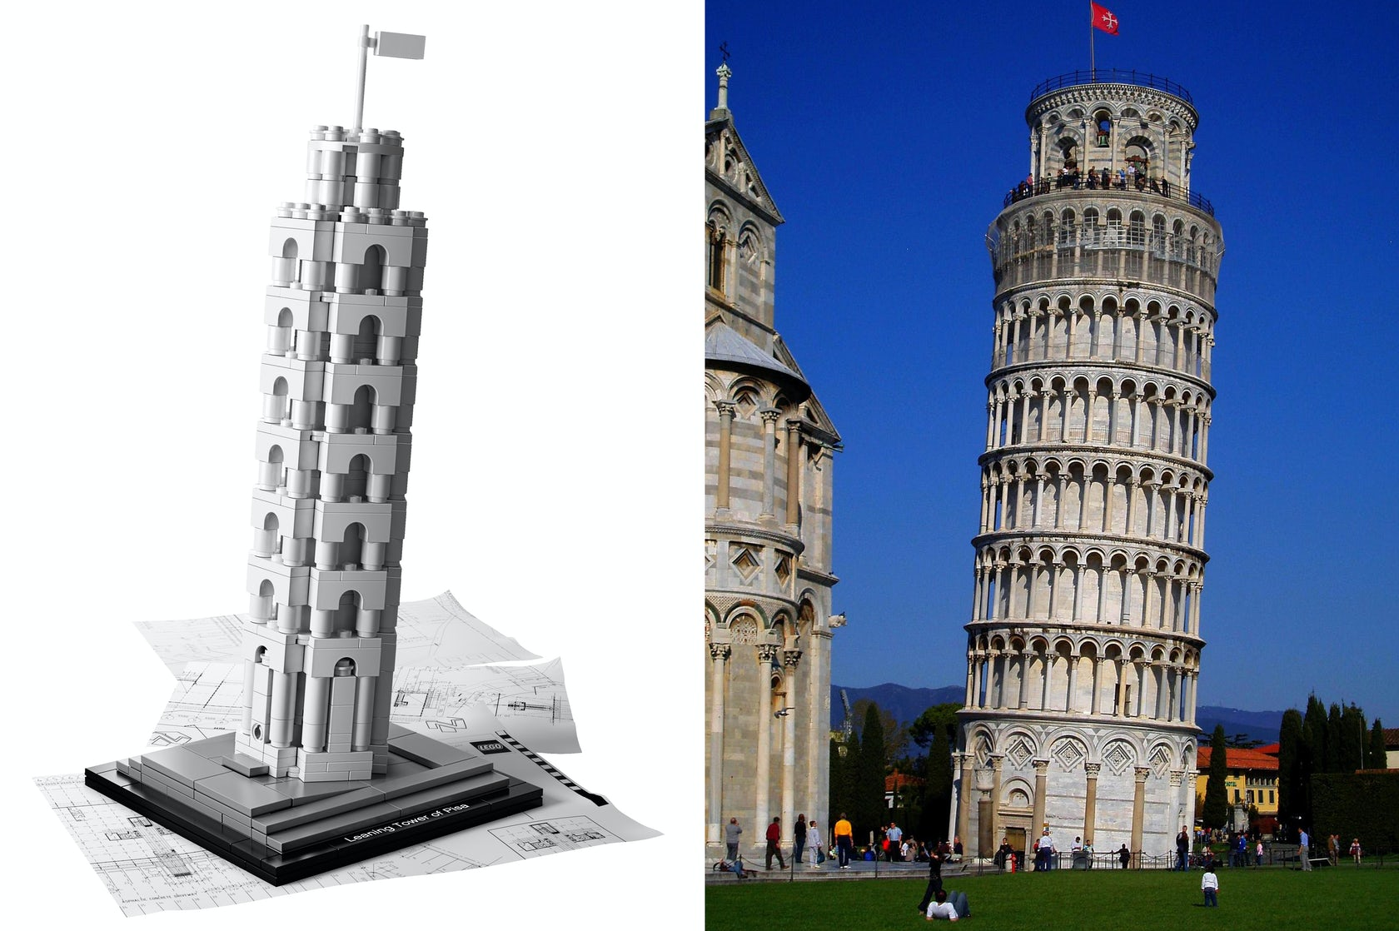
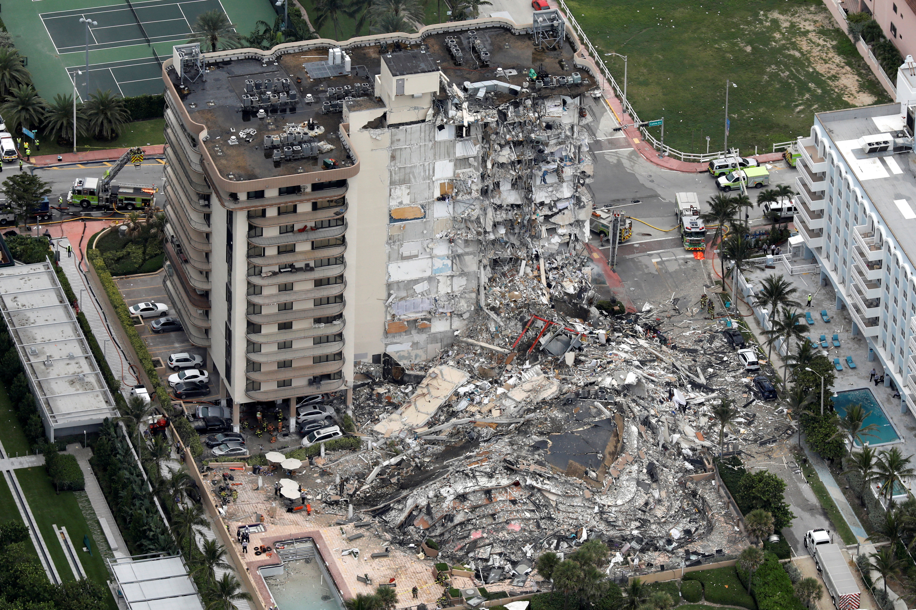
Archeological site- a place where you can find evidence of past activities.
Peak- the pointed top of a mountain.
Construct- to build or to make something as if like a building or a road.
Crypt- an underground room especially designed to place a dead body
Tilted- constructed in a slanted or in a sloping manner
Collapsed- sudden fall of a structure.

Slide 8
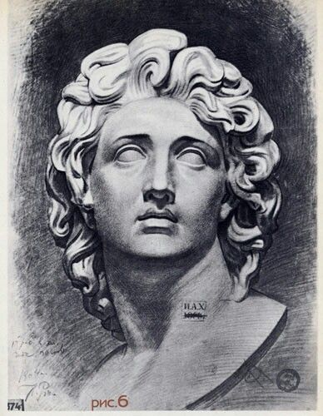
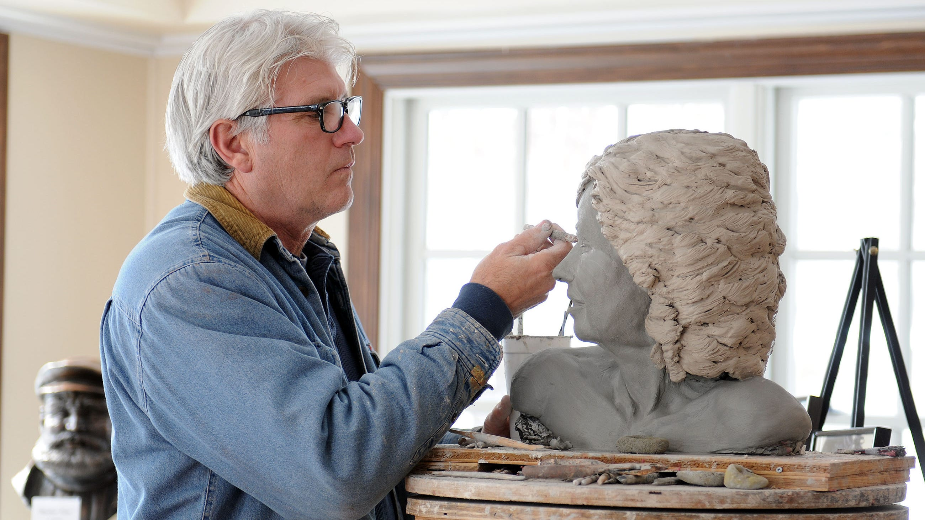
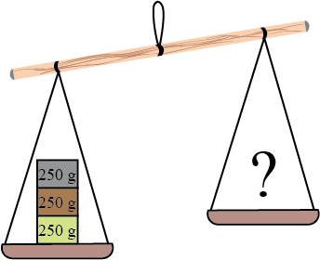
Sketched- a rough drawing
Sculptor- an artist who makes a statue using materials according to a sketch.
Weigh- how heavy an object is.

Slide 9
While-Listening Stage
Aim: The learners will be able to listen for the audio of the seven wonders of the world and write answers accordingly to the given worksheets.
Time: 25 minutes
Interaction pattern: Pair work
Activities: Tabular Question, Fill in the blanks, Writing the simple past and present perfect tense sentences by listening to the audio.
Procedure: Teacher plays the audio while the learners interactively answer the worksheets.

Slide 10
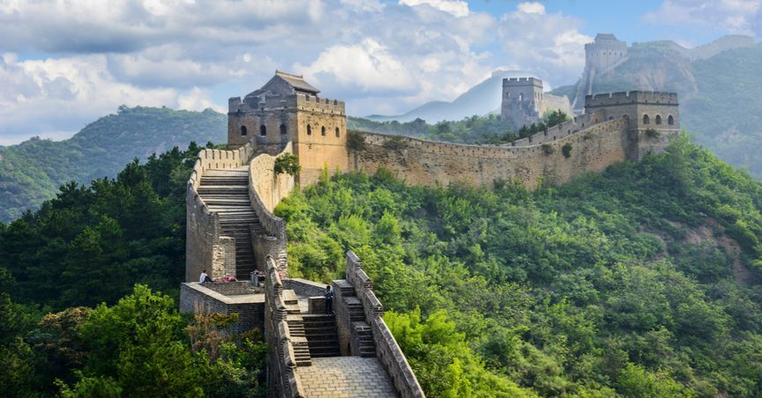
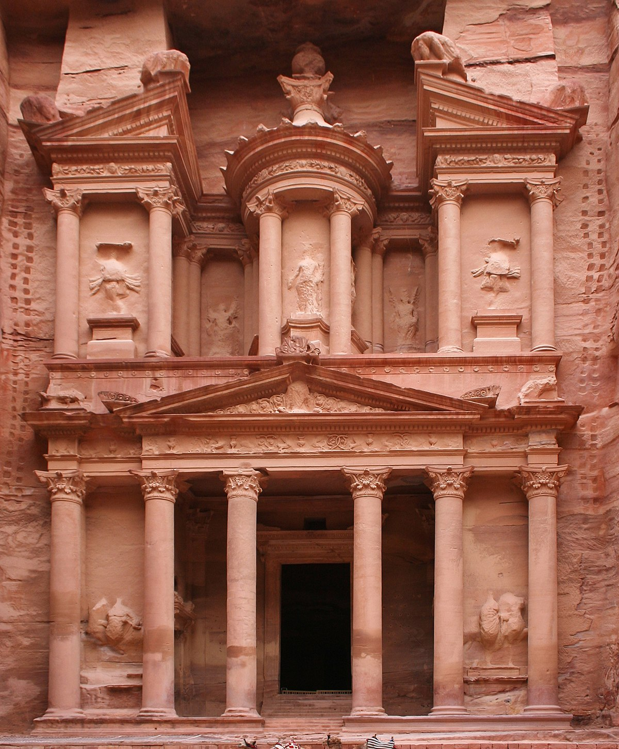
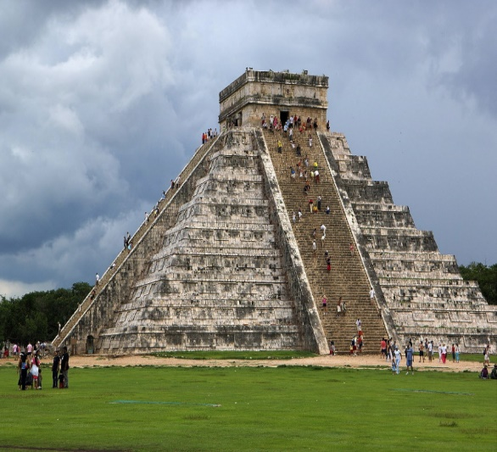
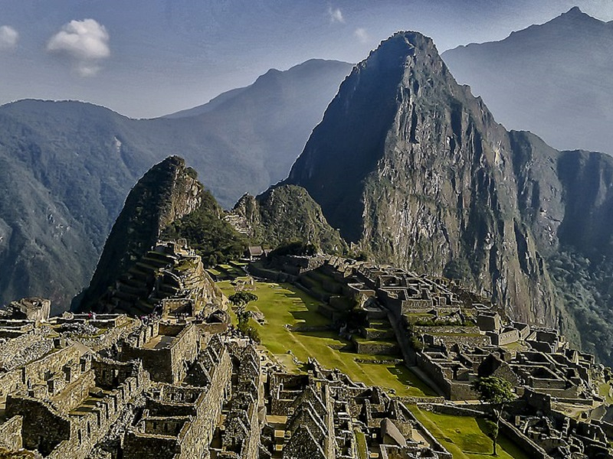
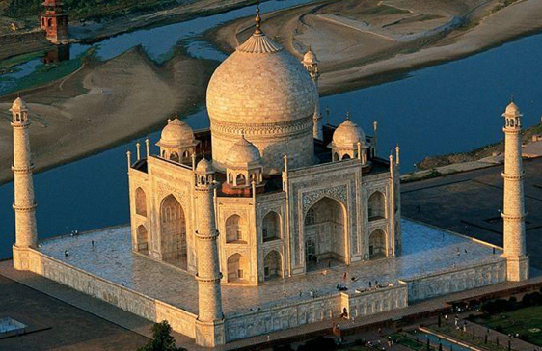
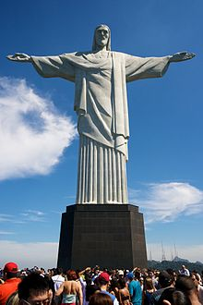
The Seven Wonders of the World
It covers under a distance of 1500 miles, but it’s actual course covers over 2000 miles.
The Great Emperor Shih Huang Ti joined the frontier walls.
It is situated in Southern Jordan. Petra is also known as Rose city.
It is famous for it’s rock cut and architecture.
The colosseum is an oval amphitheater in the centre of the city of Rome. It can hold an estimated spectators between 50,000 to 80,000. In ancient it was used for gladiatorial contests, animal hunts, executions, and for some famous battles.
Chichen Itza is a city built by the Mayan people as well
as it is an archeological site in Yucatan, Mexico.
Machu Picchu means “ old mountain or old peak”. The archeologists have found that the granite rocks which were used to construct Machu Picchu were extremely heavy weighing over 55 tons. It is in Peru.
In order to protect the crypt of the Queen Mumtaz Mahal, the architectures have tilted the towers slightly so that even if the Taj Mahal collapsed the tomb will be prevented from damage. It’s in India.
Christ the Redeemer is an art deco statue of Jesus Christ in Rio the Jeneiro, Brazil. It was sketched by a French sculptor. It was built using solid stones, it weighs around 635 tons.
Notes:
It covers under a distance of 1500 miles, but it’s actual course covers over 2000 miles.
The Great Emperor Shih Huang Ti joined the frontier walls. %%TTS_FEMALE%

Slide 11
While-Listening Worksheets
Worksheet 1: Fill the following Tabular while listening to the audio.
Name of the Wonder | Country Situated | An important fact

Slide 12
Worksheet 3: Identify the missing words and fill the blanks.
In order to protect the Crypt of Mumtaz Mahal the architecture paid special attention on the construction.
2. The colosseum can hold an estimated Spectators between 50,000 to 80,000.
3. The great emperor Shih Huang Ti joined the Frontier Walls and later most of the walls were completed on the Ming times.
4. Even though the Taj Mahal Collapsed the tomb will be protected.
5. In ancient the colosseum could hold an estimated 50,000 to 80,000 spectators.

Slide 13
Worksheet 3: Identify the meanings of the following words given.
Tilt
Collapsed
Spectators
Peak
Frontier
Crypt
Sketch
Amphitheater
Sculptor
A rough drawing.
B. An artist who makes statues using materials
C. line boarder separating two countries.
D. Move or cause to move into a sloping position.
E. A person who watches at a show, game, or other event.
F. An open circular or oval building with a central space surrounded by tiers of seats for spectators, for the presentation of dramatic or sporting events.
G. Having fallen down or given way.
H. An underground room or vault beneath a church, used as a chapel or burial place.
I. A place where you can find evidence of past activities.
Archeological site | J. The pointed top of a mountain

Slide 14
Post-Listening Stage
Aim: The learners will be able to check their answers and evaluate themselves with the marks scored.
Time: 10 minutes
Interaction pattern: Pair Work
Procedure: The teacher asks the students to exchange their answer sheets and play the audio clip for the learners to check their answers. The learners check the answers while listening to the audio.

Slide 15
Questions
&
Answers

