Slide 1
A PRESENTATION
ON
CLOSED CIRCUIT TELEVISION
(CCTV)

Slide 2
Contents
Definition
Uses
Types of CCTV system
Block diagram
Types of CCTV lens
Camera selection
Elements of CCTV system
Monitor Unit
Video Recorders (DVR/NVR)
Cables
Storage device
Applications

Slide 3
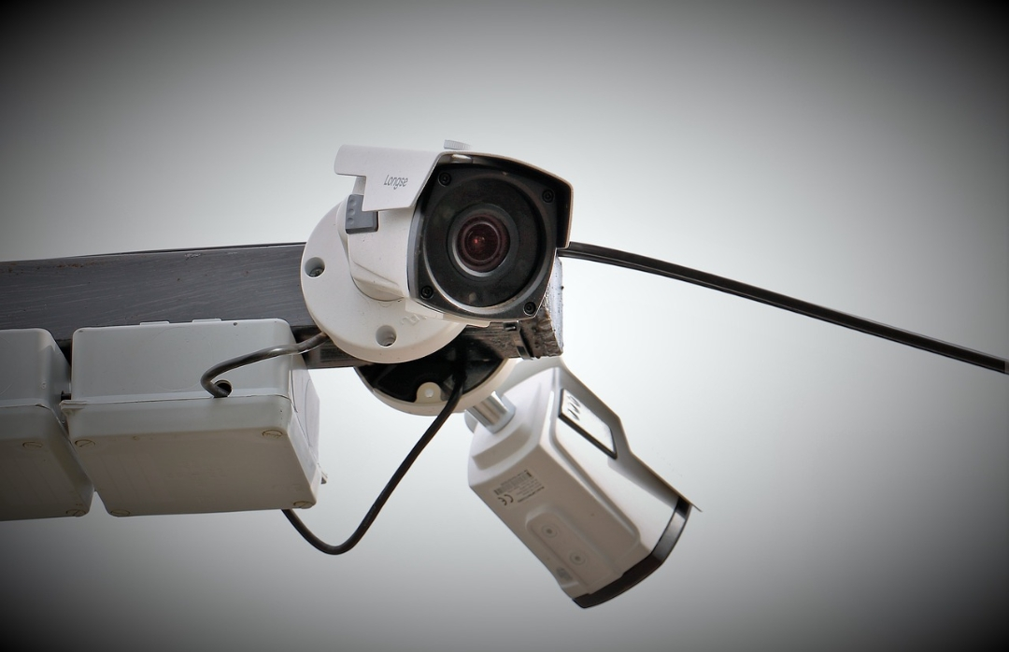
What is CCTV?
Closed-circuit television CCTV is the use of video cameras to transmit a signal to a specific place, on a limited set of monitors.
It differs from broadcast television in that the signal is not openly transmitted, though it may
employ point to point (P2P), point to multipoint, or mesh wireless links.
CCTV systems may operate continuously or only as required to monitor a particular event.

Slide 4
Uses of CCTV
CCTV is commonly used for a variety of purposes, including;
Maintaining perimeter security in medium-to-high secure areas &installations.
Observing behaviour of incarcerated inmates and potentially dangerous patients in medical facilities.
Traffic monitoring
Building & ground security
Overseeing locations that would be hazardous to a human, for example, highly radioactive environment.
Obtaining a visual record of activities where it is necessary to maintain proper security, for example, in banks, casinos or airports.

Slide 5
Types of CCTV system
1. Analog CCTV system
Analog security cameras an analog video signal and transfer that signal over coax cable to Digital Video Recorder (DVR). Each camera may be powered by plugging in the power supply right at the camera or by using RG siamese cable or which bundles the video and the power cable.
Digital/IP CCTV system
IP stand for Internet Protocol, and basically refers to a digital video camera that can send and receive data via a computer network.

Slide 6
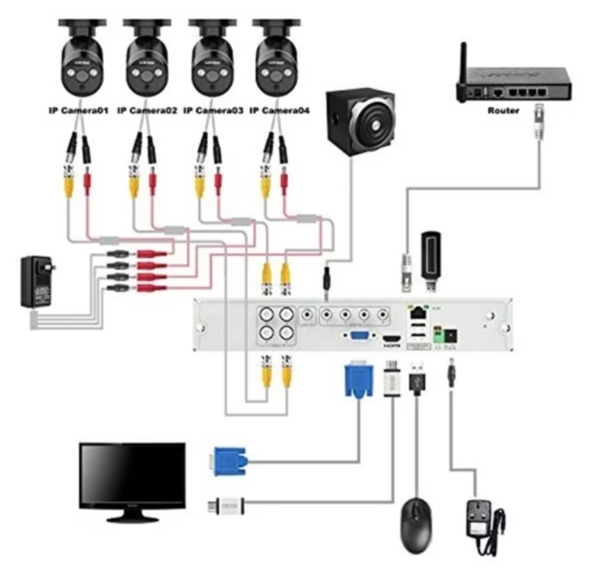
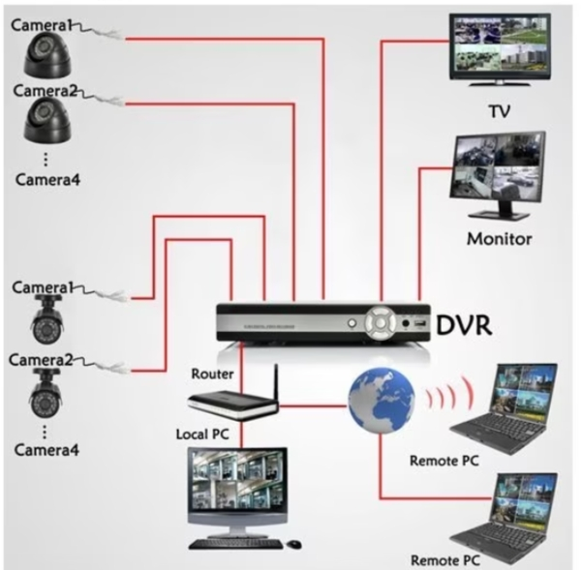
CCTV systems block diagram

Slide 7
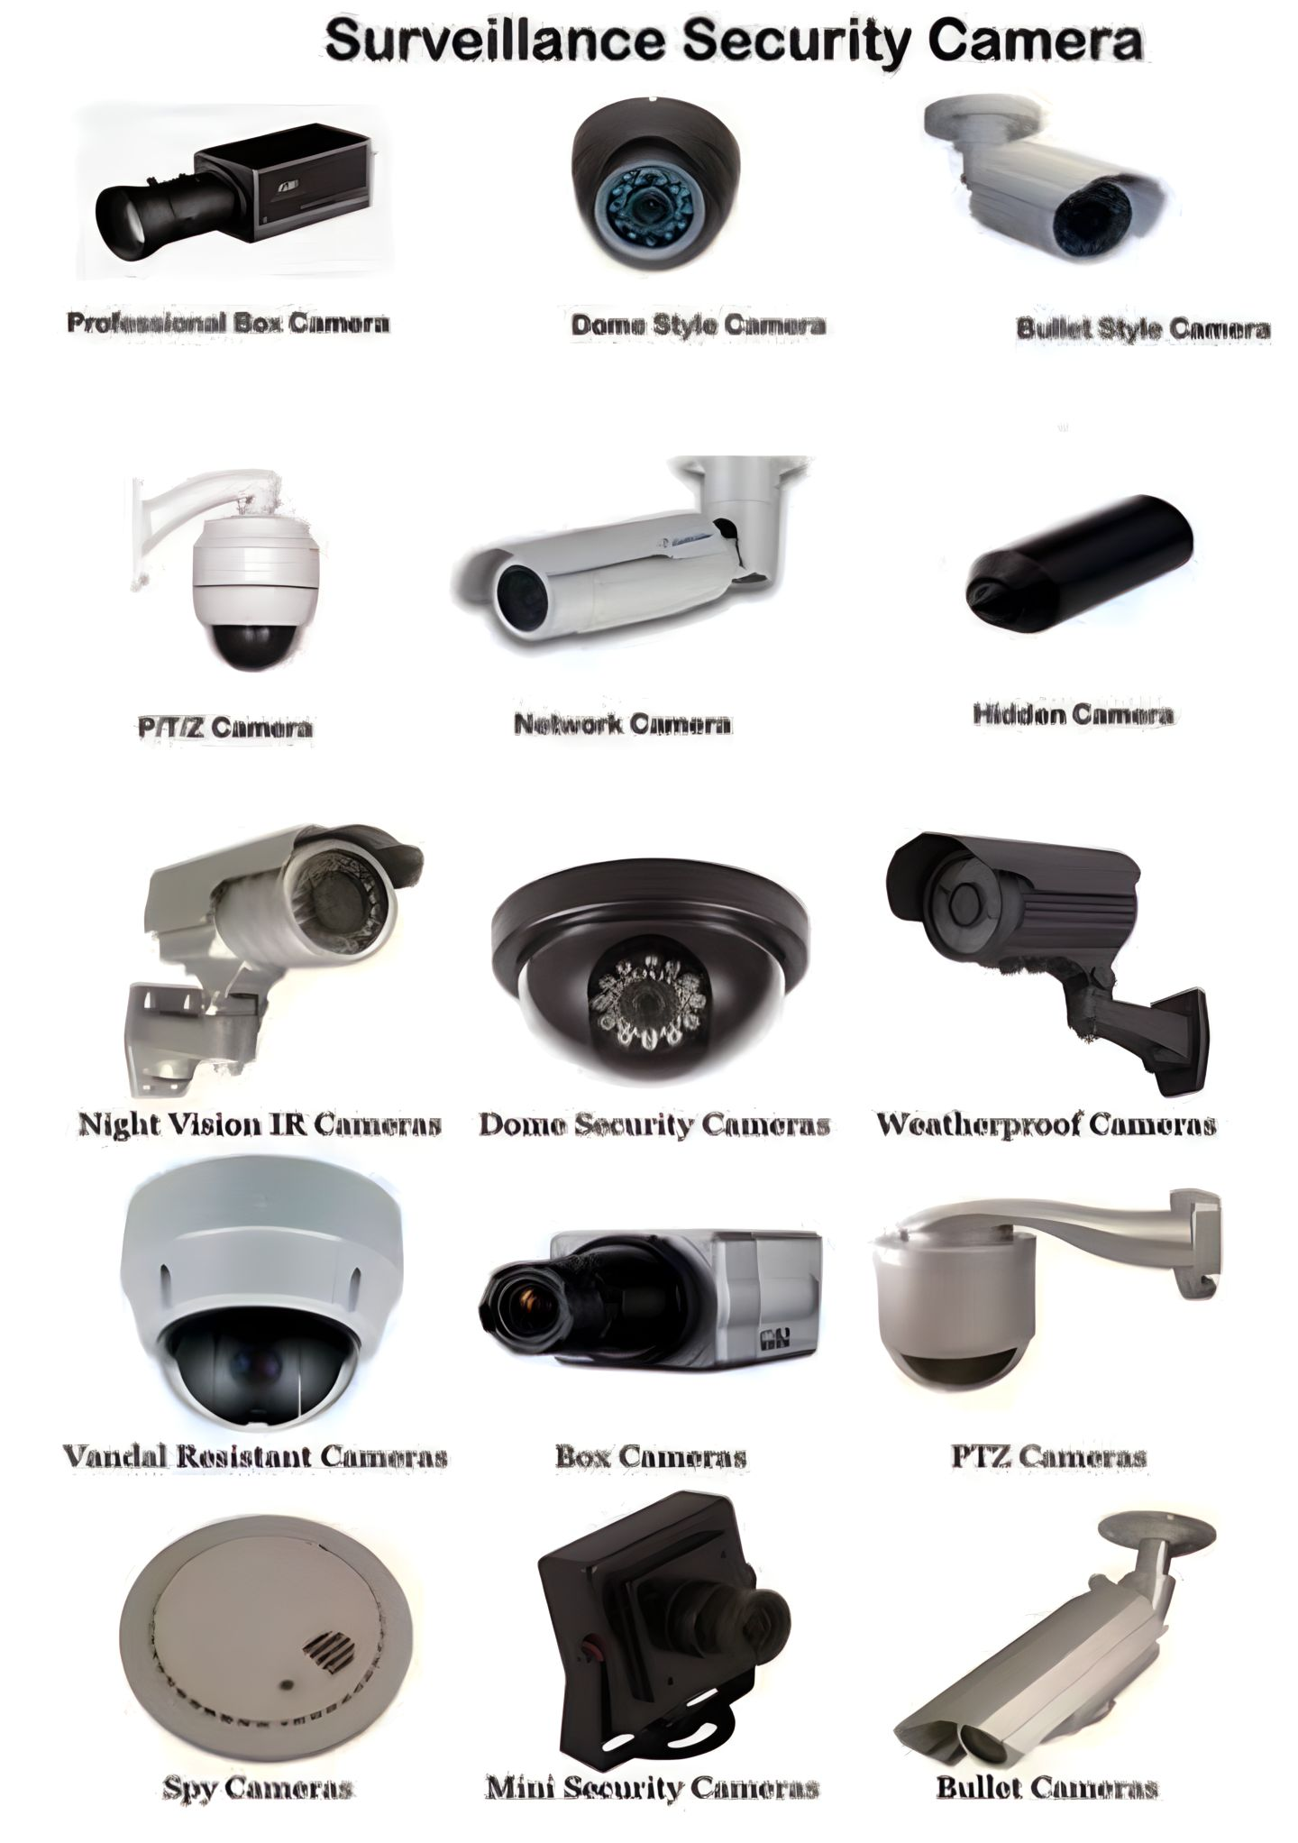
Types of CCTV camera
Indoor camera
Outdoor camera
IR Day/Night camera
Dome camera
Bullet camera
Hidden camera
Pan Tilt zoom camera
Fish eye camera

Slide 8
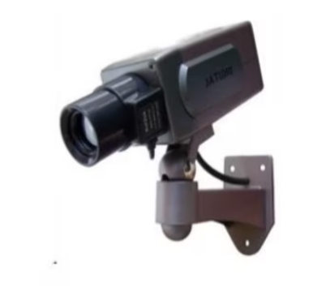
Indoor Camera
Indoor camera as it name suggests used for indoor security mechanism.
These are suitable for security in homes, schools, offices, hotels etc...

Slide 9
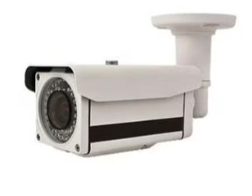
Outdoor Camera
Outdoor camera is used for outdoor places.
They are mostly used for entry and exit points with limited night lighting.
These cameras have hard shell vandal-proof casings.

Slide 10
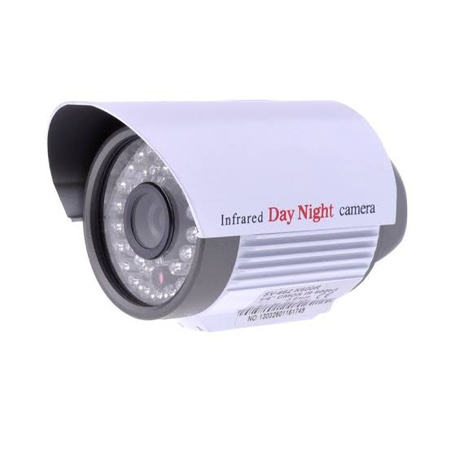
IR day/Night Camera
IR day/night camera are used for high alert security areas were surveillance needs to happed day and night
These cameras are used by military personal, in parking a lots and high security zones.
The cameras are ideal for outdoor surveillance application.

Slide 11
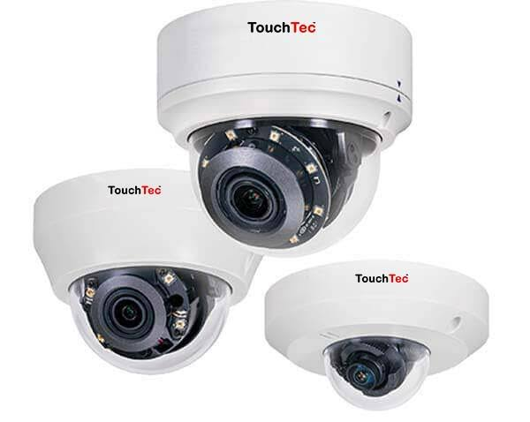
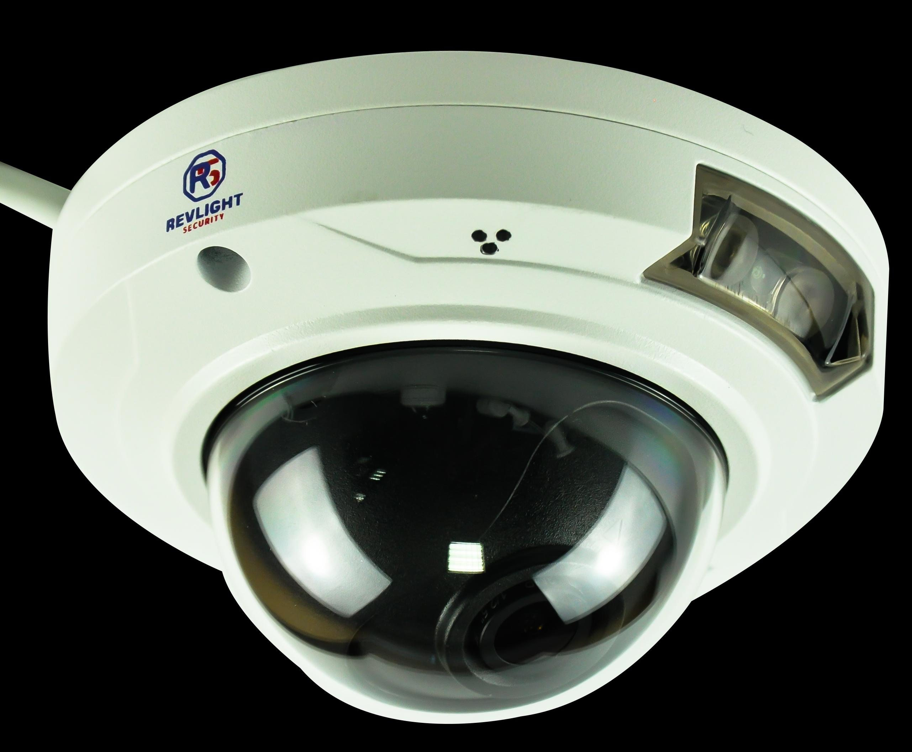
Dome Camera
Dome CCTV Cameras. Dome Security Cameras are named for their dome-like shape.
Cameras are installed inside a dark dome and are design in a way that they go unnoticed by the visitors.
The camera can be rotated and tilted manually.
Dome cameras are commonly used in surveillance systems inside of homes, casinos, retail stores, and restaurants.

Slide 12
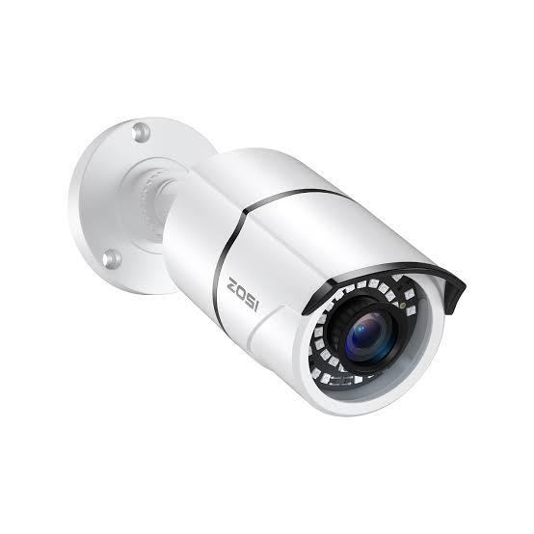
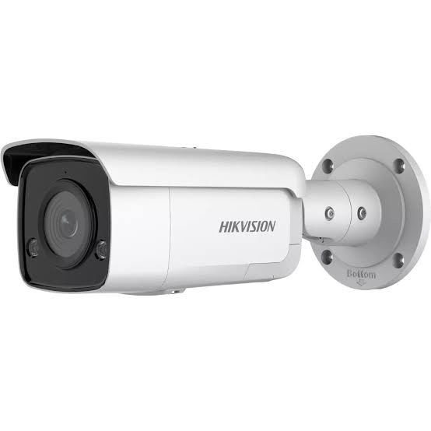
Bullet Camera
Bullet Security Cameras are a type video surveillance camera that is typically small and shaped like a rifle bullet shell.
Cylindrical
Outdoor use
Installed inside protective casings, which protects against dust, dirt, rain and other harmful element.

Slide 13
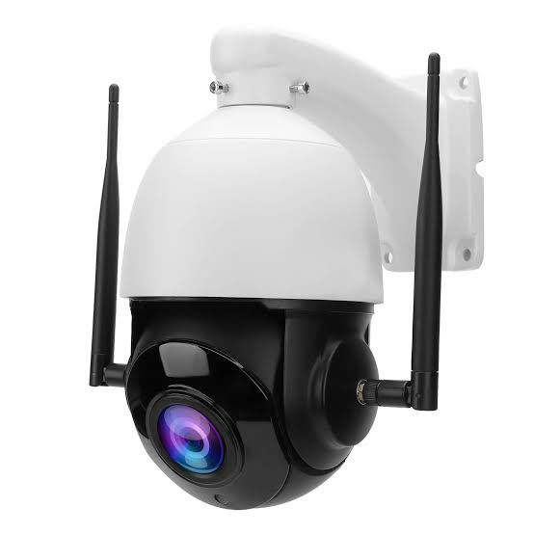
PTZ (Pan-Tilt-Zoom) cameras
PTZ cameras offer pan, tilt, and zoom capabilities, allowing them to rotate horizontally (pan), vertically (tilt), and adjust the focal length (zoom). This flexibility enables users to remotely control the camera’s movements and focus on specific areas or objects of interest.
Remote Control: PTZ cameras can be controlled remotely through various methods, such as using a joystick controller, software interface, or mobile applications.

Slide 14
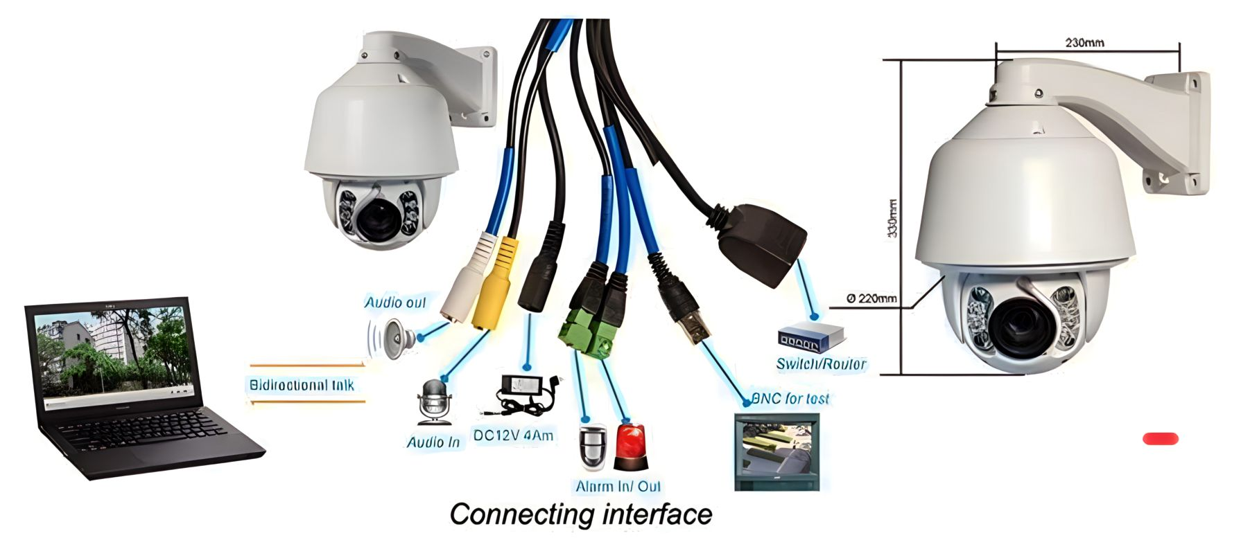
Connecting methods of PTZ camera

Slide 15
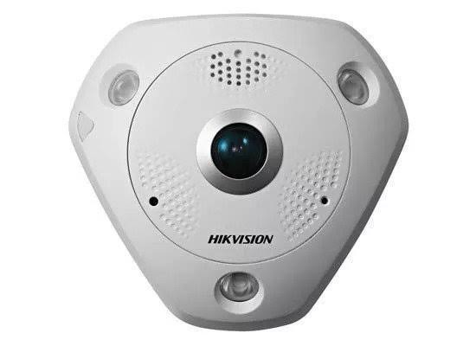
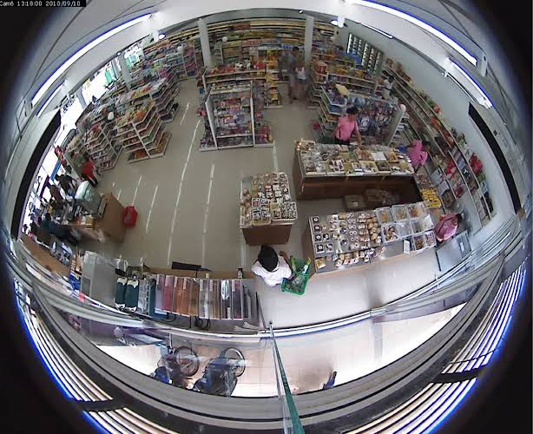
Fish Eye Camera
The fish eye camera is the single camera which allows you to record everything With a 180 or 360 degree panoramic view.
Types of fish-eye lenses: There are primarily two types of fish-eye lenses: circular fish-eye and full-frame fish-eye. Circular fish-eye lenses capture a complete circular image within the frame, while full-frame fish-eye lenses cover the entire rectangular frame.

Slide 16
Types of cctv lens
There are two types of lenses.
1. Fixed
Fixed lens are those lenses where lens size doesn’t make change, all we can do is focus, we can’t join or zoom out
Common sizes are
12mm, 0.8mm, 06mm, 04mm, 3.6mm, 2.8mm
2. Varifocal
In varifocal lens size can be changed during the installation process and Zoom In and zoom out is possible
Common sizes available are
2.5mm~8mm, 3.0mm~12mm, 5.0mm~50mm

Slide 17
Camera Selection
If we select the camera, we will consider about these categories.
Indoor or Outdoor
Day / Night surveillance
Camera form factor
Video codec
Motion detection
Wireless
Viewing

Slide 18
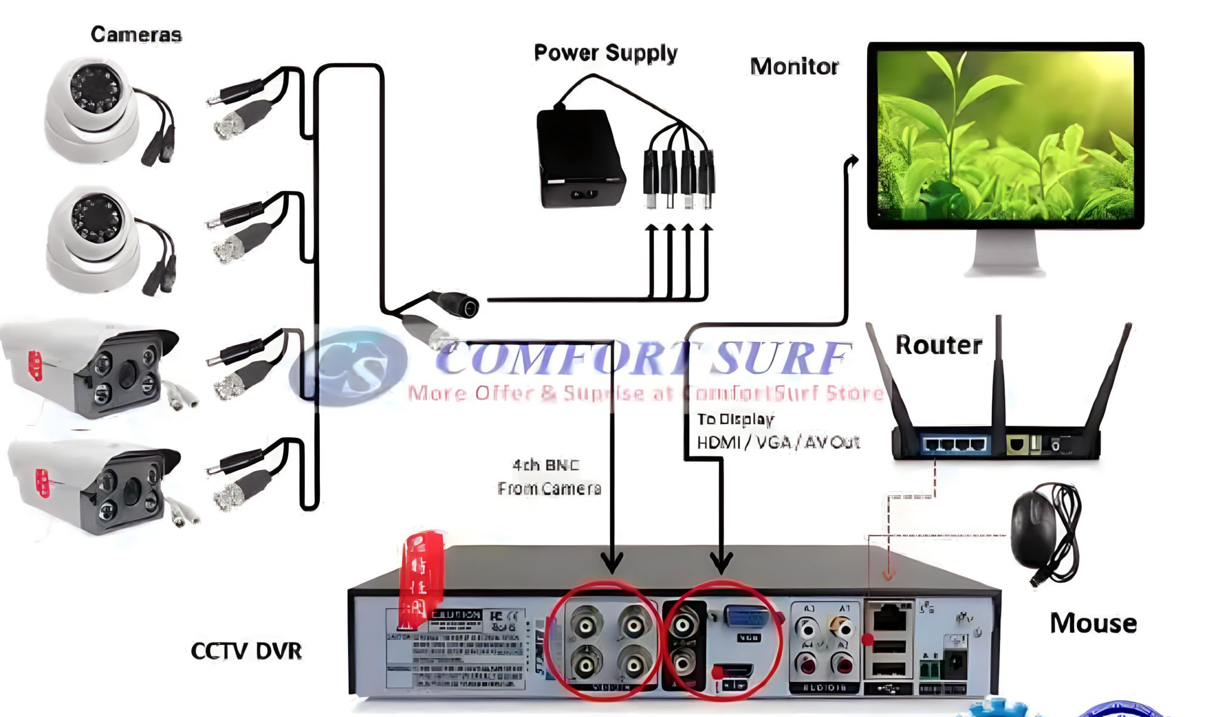
Elements of cctv system
Camera
Lens
Monitor unit
DVR/NVR
Cables
Storage Device
DC Power supply (12volt)

Slide 19
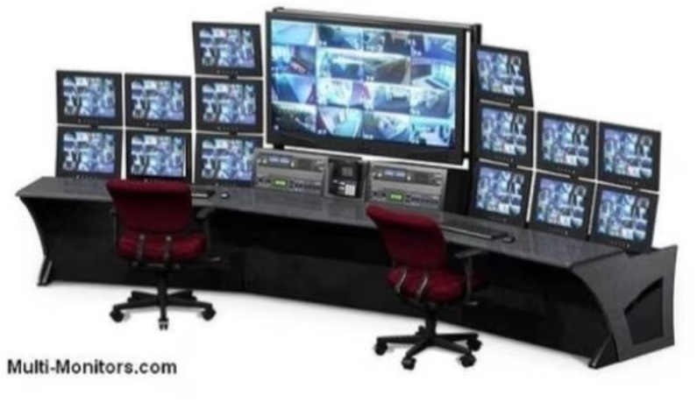
Monitor Unit
The functions of the monitor is to display video images for viewing.
The selection of monitors is as important to the quality of image as the selection of cameras, lenses and other components in the imaging chain.
Liquid crystal displays(LCDs) and LED displays, various sizes, and other features.
Considerations for monitor selection.
Pixels
Size

Slide 20
Video Recorders (DVR/NVR)
Video recorder is at the heart of the CCTV installation. They received, manage, store and record the video captured by the cameras.
Video recorders are two types
DVR- Digital Video Recorder
NVR- Network Video Recorder

Slide 21
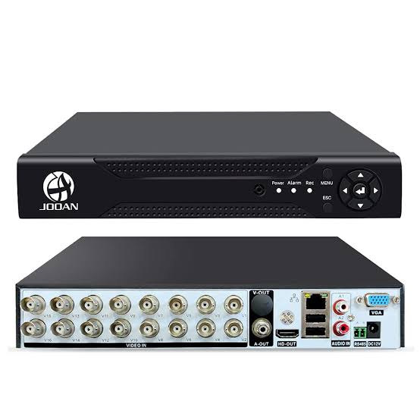
DVR (Digital Video Recorder)
It is a device that records video and audio signals from various sources, typically television broadcasts, security cameras, or other video input devices.
In surveillance systems, DVRs are used to capture and store video footage from security cameras

Slide 22
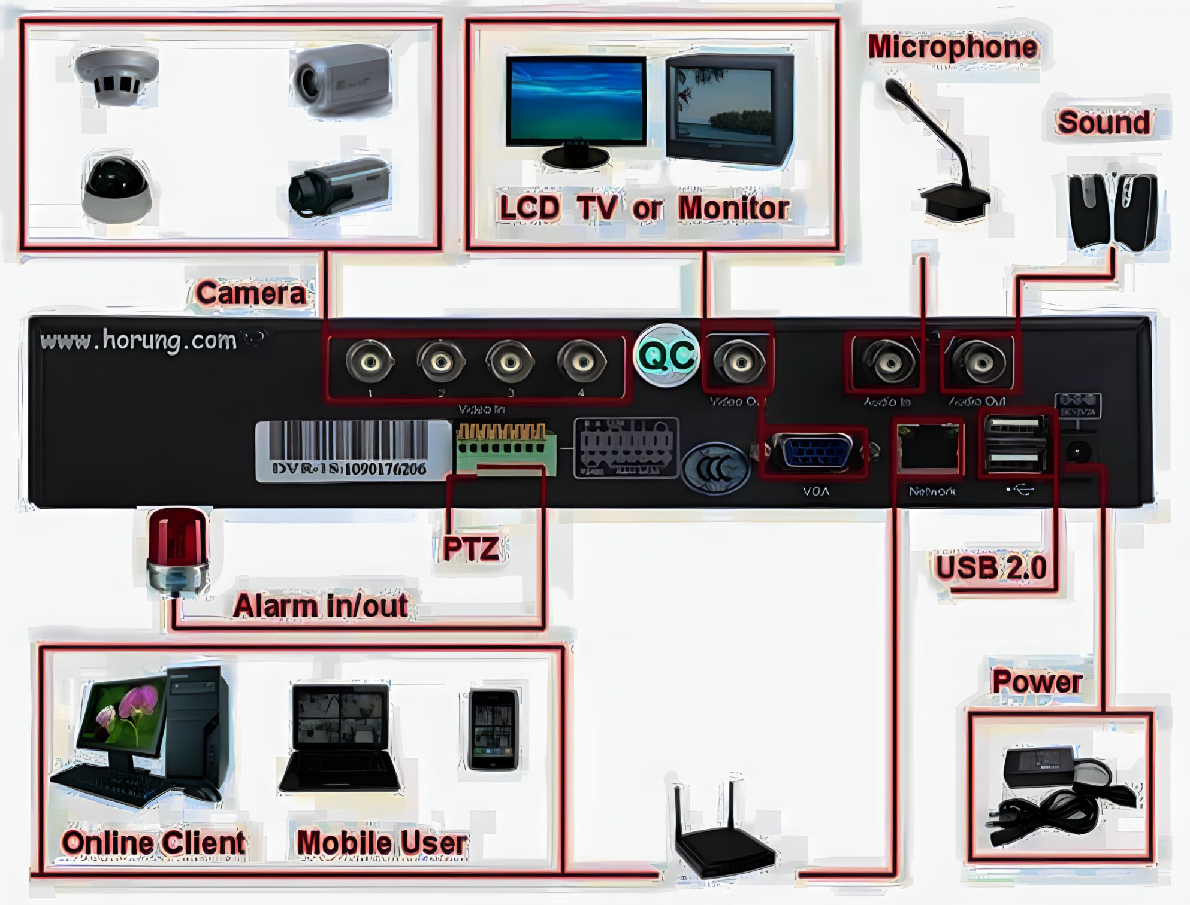
DVR back side ports

Slide 23
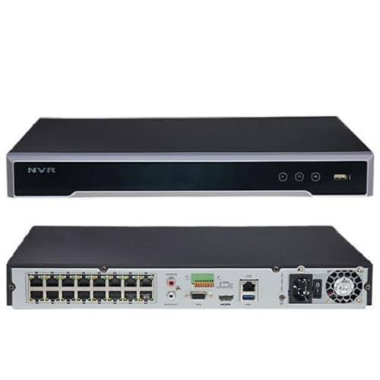
NVR (Network Video Recorder)
It is a device used in video surveillance systems to capture, store, and manage video footage from IP cameras or network-based video sources.
NVRs are designed to work with IP cameras, which are cameras that transmit video over a network or the internet.

Slide 24
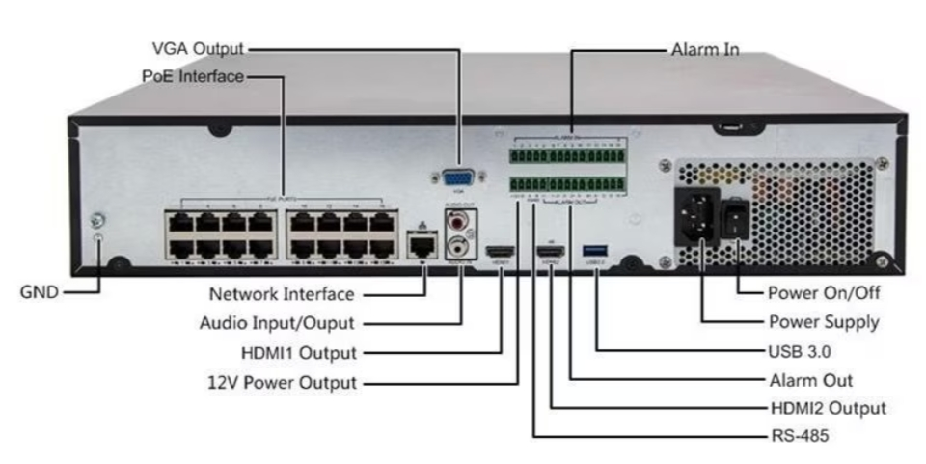
NVR back side ports

Slide 25
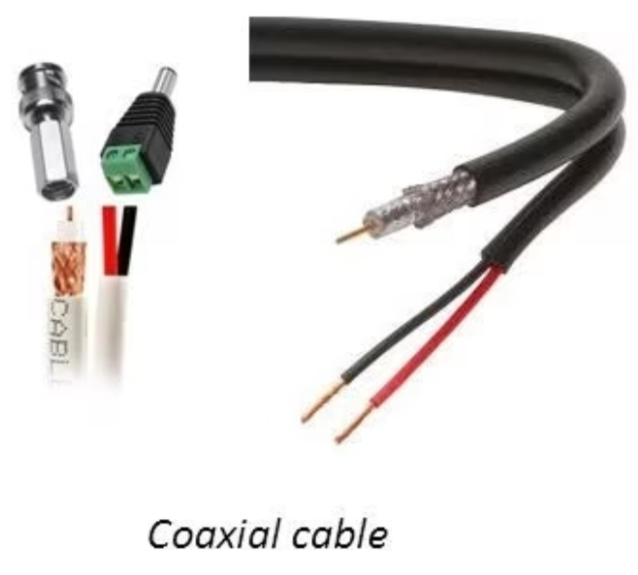
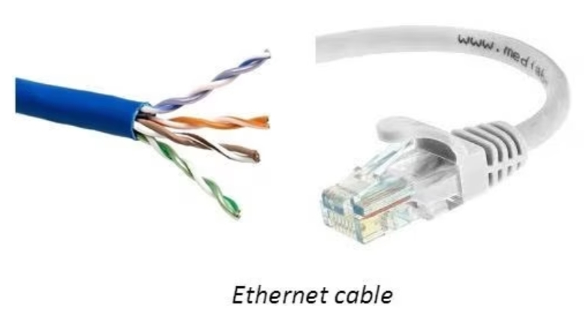
Cable
Coaxial / Ethernet
CCTV can be analogue or IP based. Depending on that the cables can be coaxial cable or CAT5/CAT6(RJ45) cables also known as Ethernet cable.
Cables connect the camera with the DVR / NVR

Slide 26
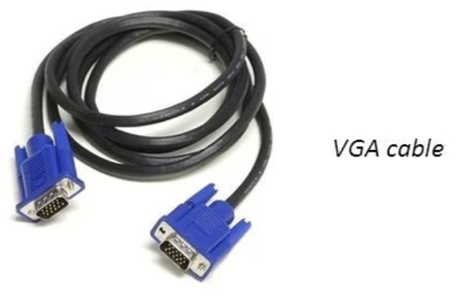
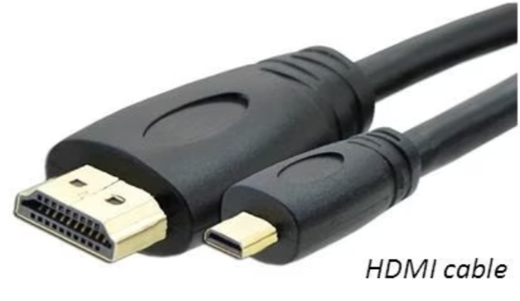
VGA cable
Video Graphics Array is a standard type of connection for video devices such as monitors and projectors.
HDMI cable
HDMI (High Definition Multimedia Interface) provides and interface between any audio / video source for transferring UN compressed video data and compressed or uncompressed Digital audio data from HDMI-compliant source device.

Slide 27
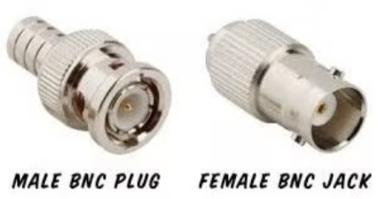
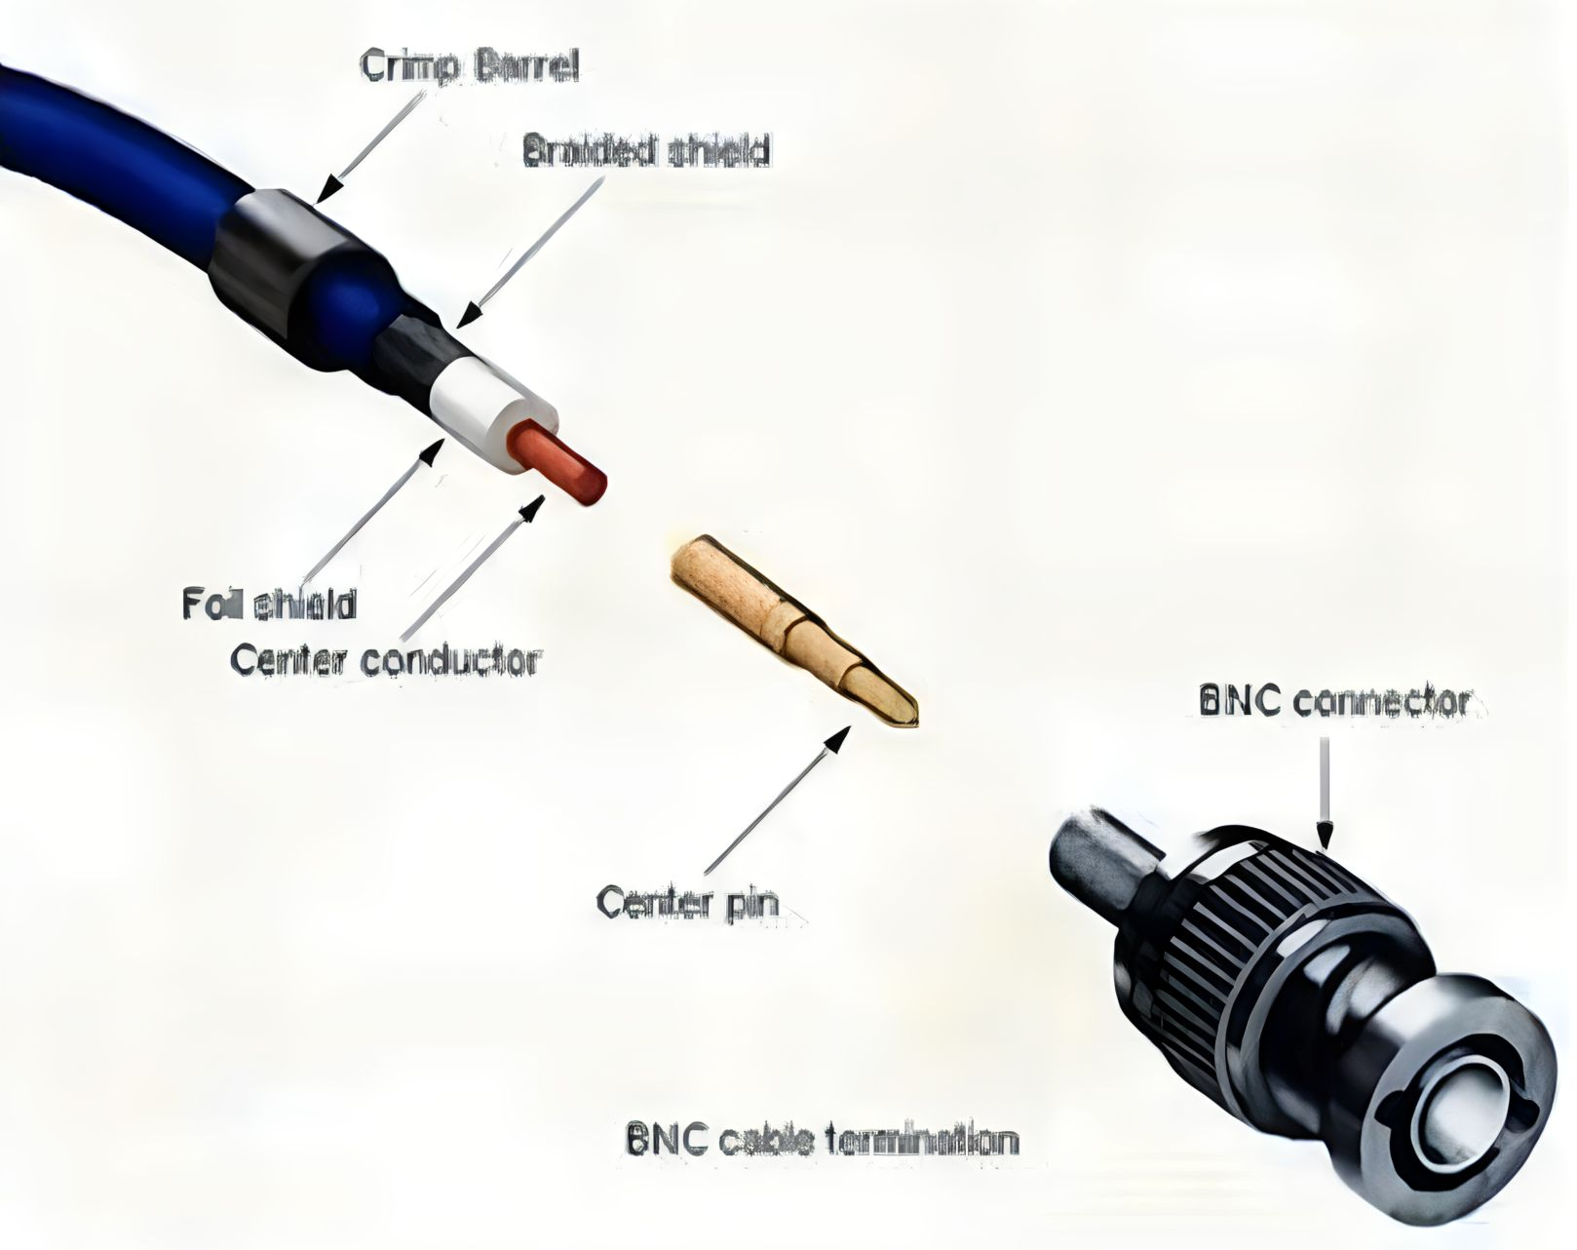
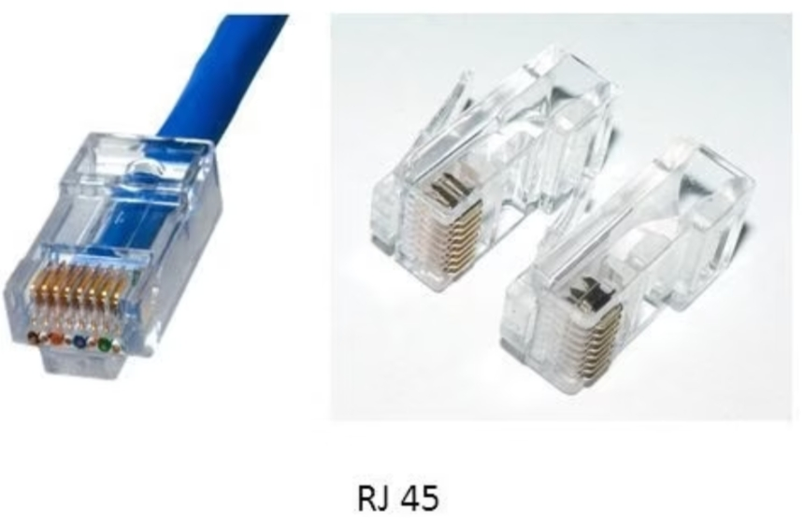
Cable Connectors
BNC Connectors
Type of connector used to connect coaxial cables.
RJ 45
Type of connector used to connect internet cables

Slide 28
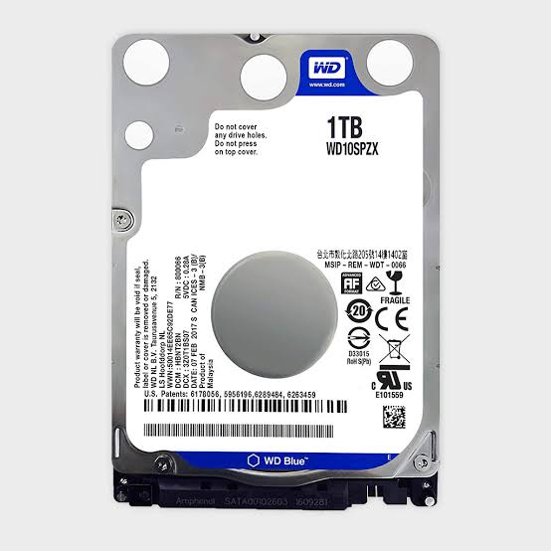
Storage devices
Hard disc drive or HDD need to store the CCTV camera footage. It help to review the system footage

Slide 29
Applications of CCTV camera
Bars
Cash rooms
Gaming machines
Historic sites
Holiday sites
Hospitals
Number plate recording
Public species and other large areas
Reception areas
Retail
Schools
Shops
Football and cricket stadiums
Staff thief and fraud
Swimming pools
Car park
Vending machine
Warehouse CCTV
Other uses

Slide 30
Thank you

