Slide 1


Franchises Opportunity
We are passionate about pure water…

Slide 2
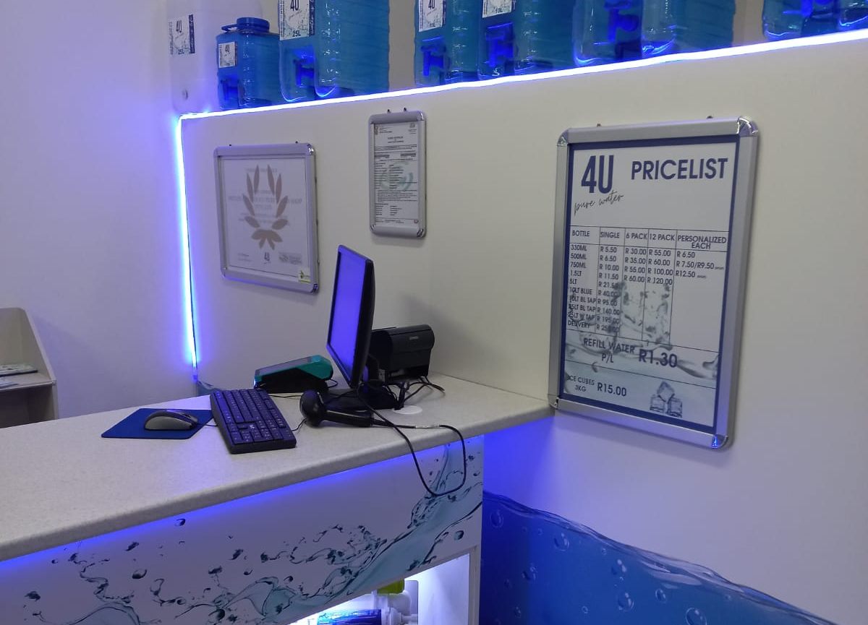
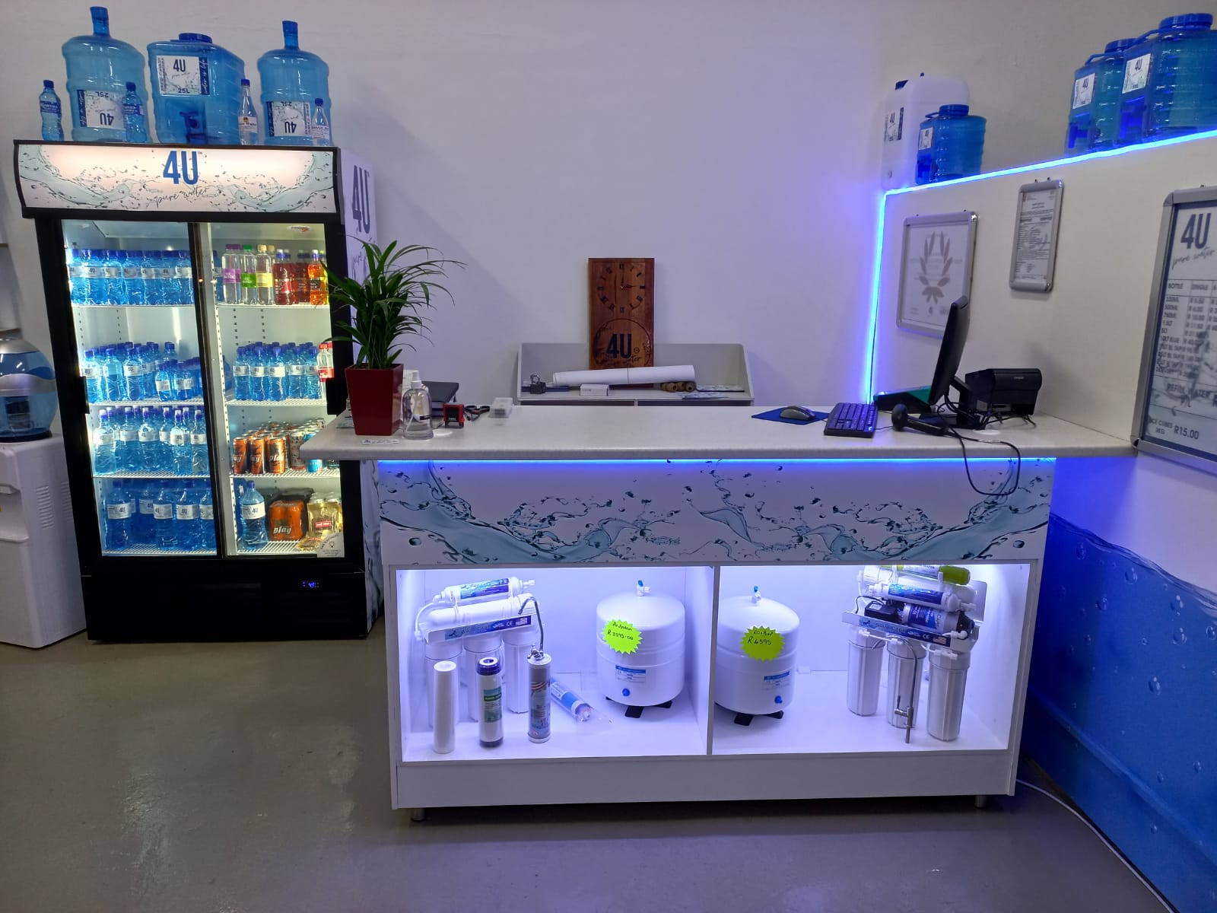
WHAT PRODUCTS WILL BE SOLD at 4 U PURE WATERSHOP?
PURE PURIFIED REFILL WATER
PURE PURIFIED ICE CUBES
COLD DRINKS and JUICES
LARGE VARIETY OF BEVERAGES
WATER CONTAINERS
WATER DISPENSER
HOME USE PURIFING SYSTEMS AND CARTRIDGES
PERSONALIZED LABELED PURIFIED BOTTLED WATER
ALKALINE BOTTLED WATER ON TAP

Slide 3
Water shop standard Investment starts at R 460,000.00
The 4 U Pure Water Standard shop offers a complete package with the standard of excellence.
This is our top of the range, fully fitted water shop that offers the client a beautiful environment to shop and the franchisee the ultimate environment to render quality service.
The Standard Shop also projects our trendy brand in a modern designed shop fit and state of the art purification plant. 4000 GPD RO System
Complete Pre & Post Filtration Bottle Shelve
2 Reservoir Tanks Dispensing Pump
1 Bulk Filling Station Filter Shelves
Full Display Units Sales Counter

Slide 4
Water shop Ultimate CONTINUED
Full Shop Branding
Window Branding
Promotional Material
Image Wear
Advertising
Start up stock
Range of Dispensers
Full Range of Filters
Full Range of Fittings
Loading Trolly
NO TURNOVER ROYALTIES’ FEES ARE PAYABLE

Slide 5
Standard Water shop
Investment starts at 460000
Premium Water shop
Investment starts at 560 000
Superior Water shop
Investment starts at 660000
Ultimate Water shop
Investment starts at 760000

Slide 6
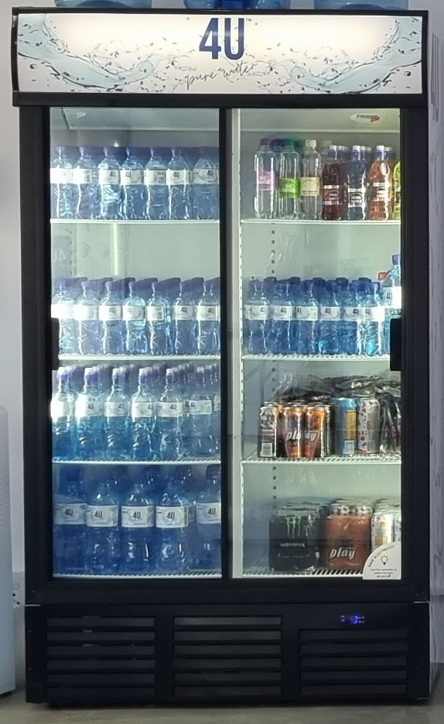
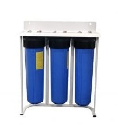
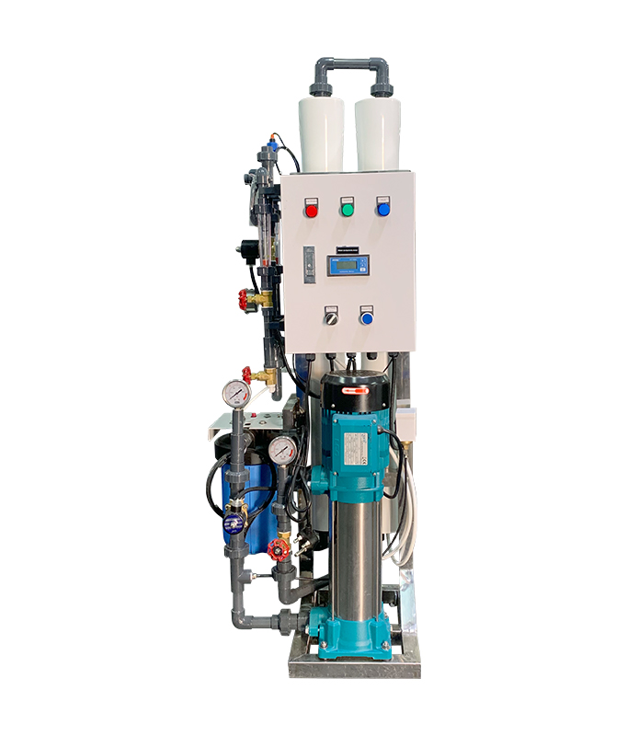
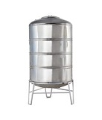
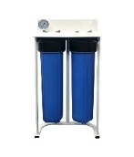

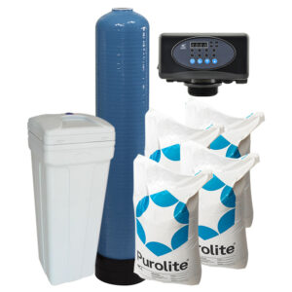
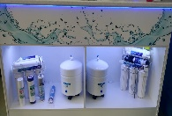
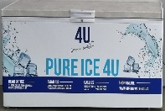
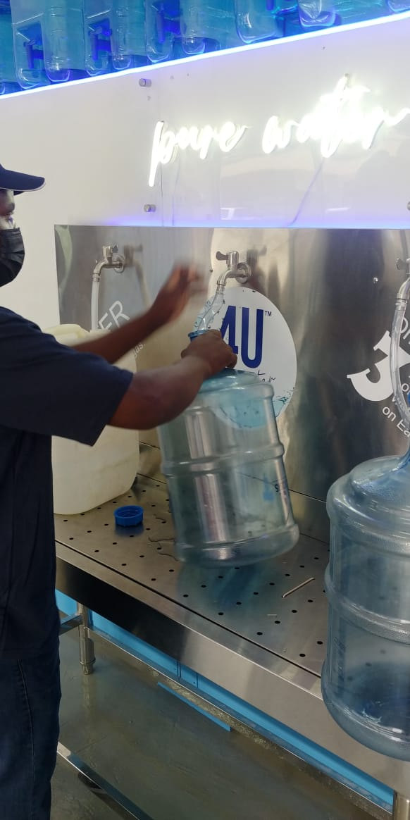
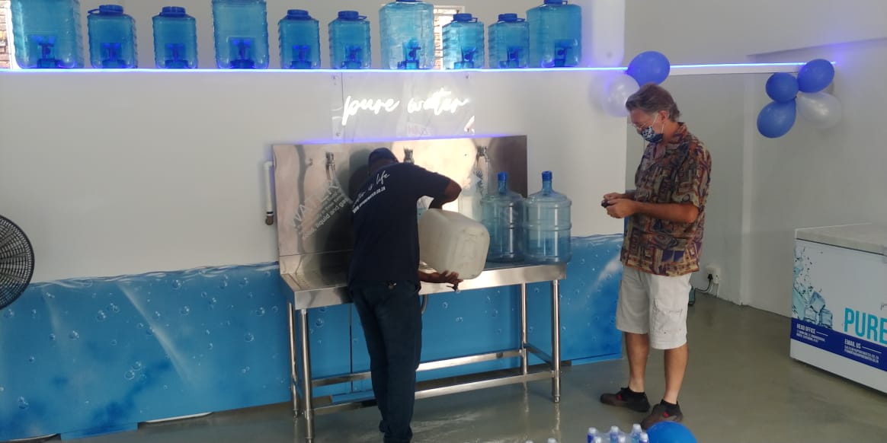
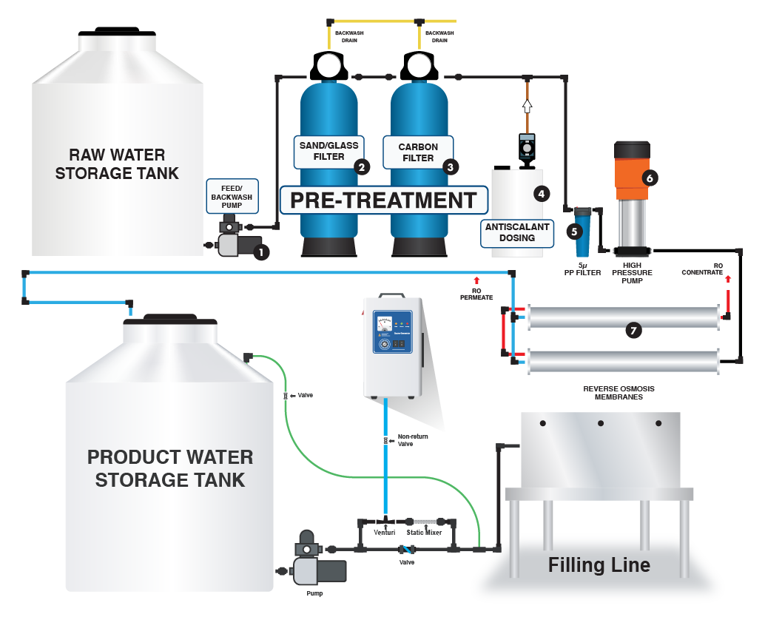
Equipment

Slide 7
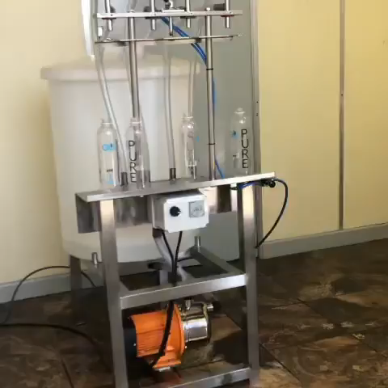
Ultimate Water shop will be fitted with this Filling as well as The standard filling station
Standard Water shop will be fitted with this standard filling station
Wrapping Station
Storage

Slide 8
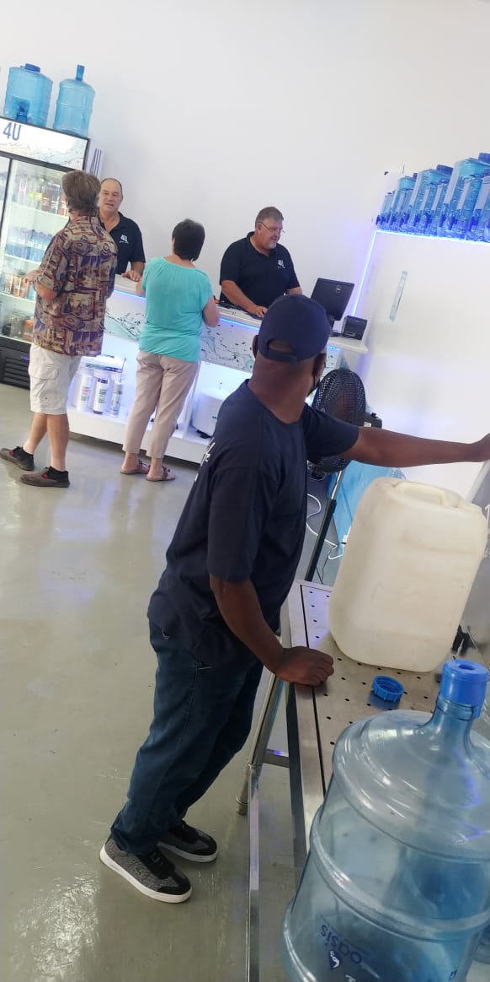
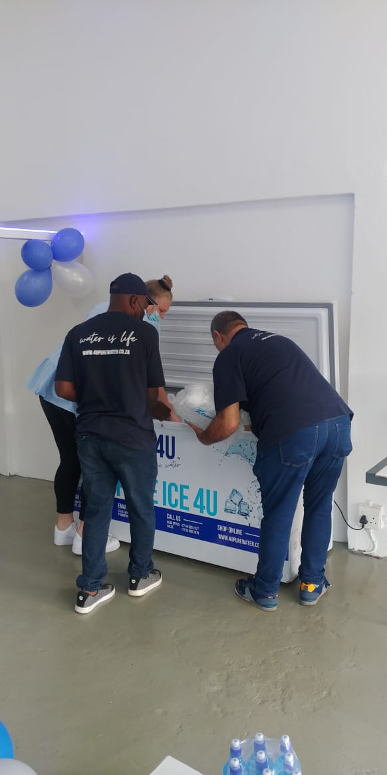
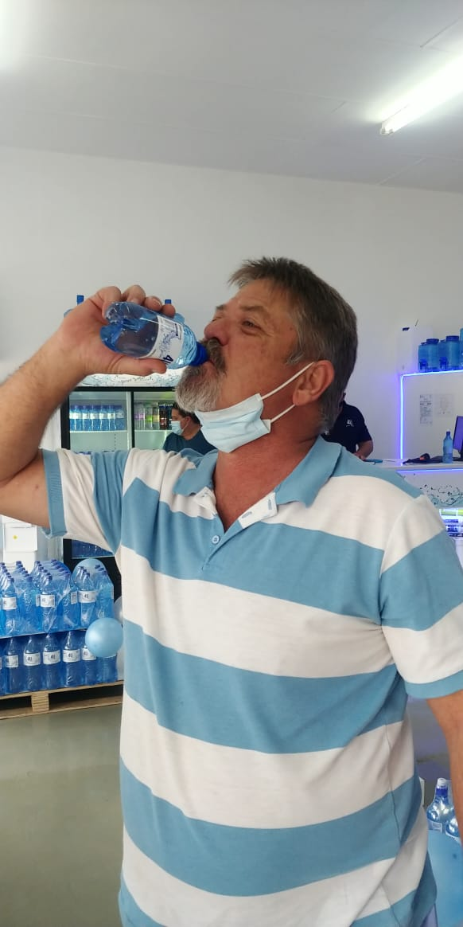
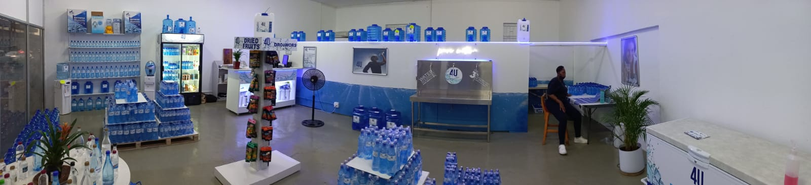
training of staff filling and rapping

Slide 9
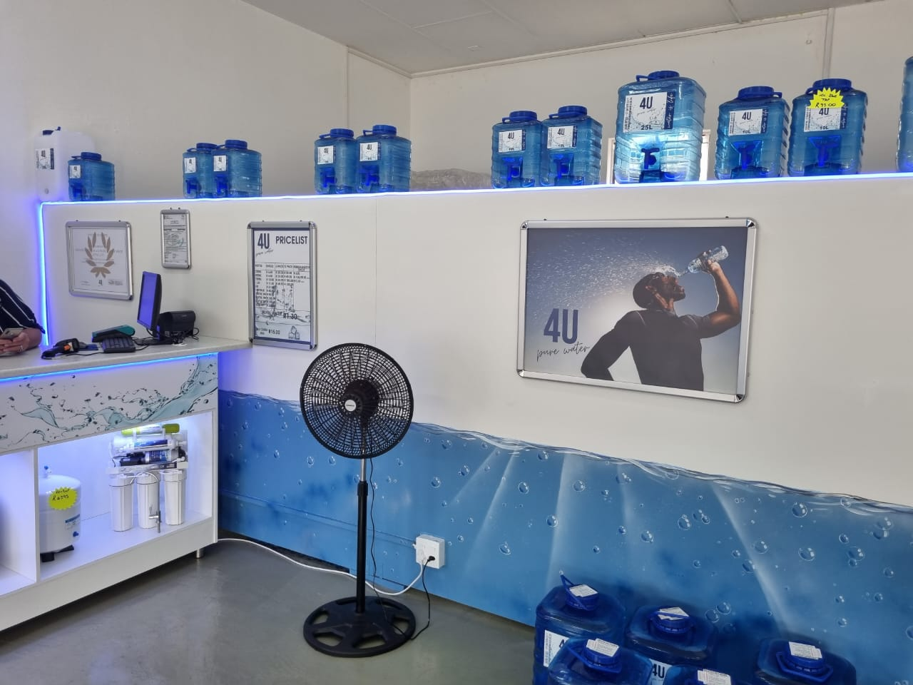

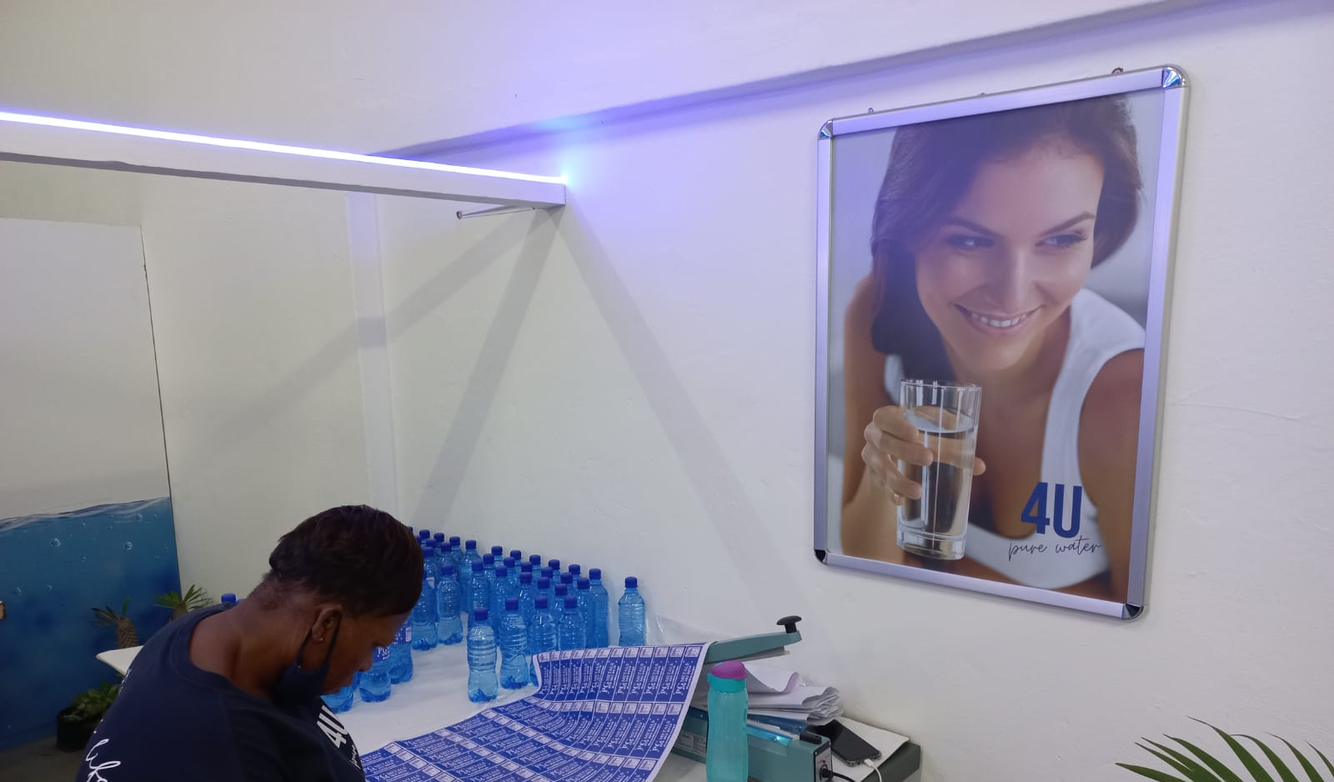
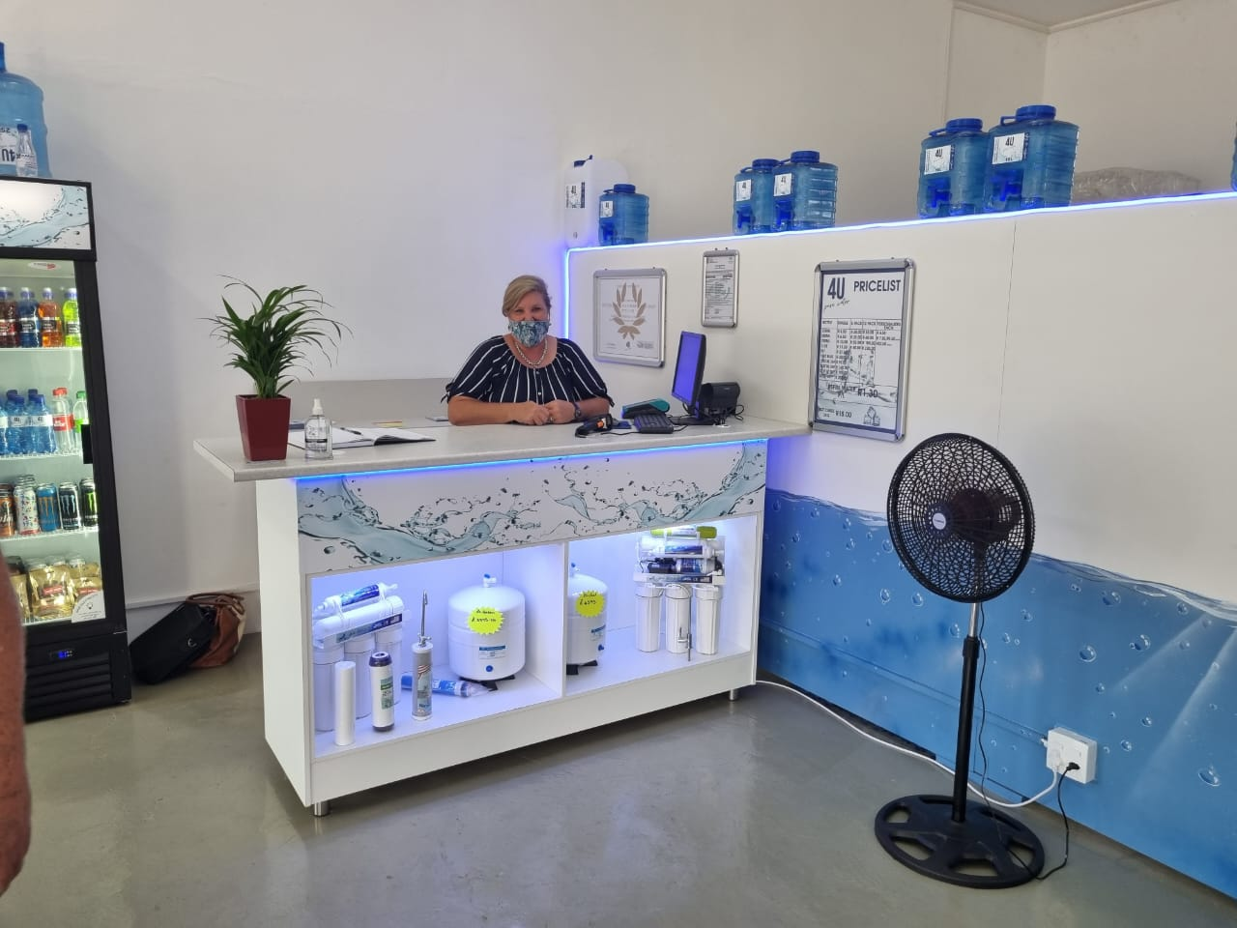

Slide 10
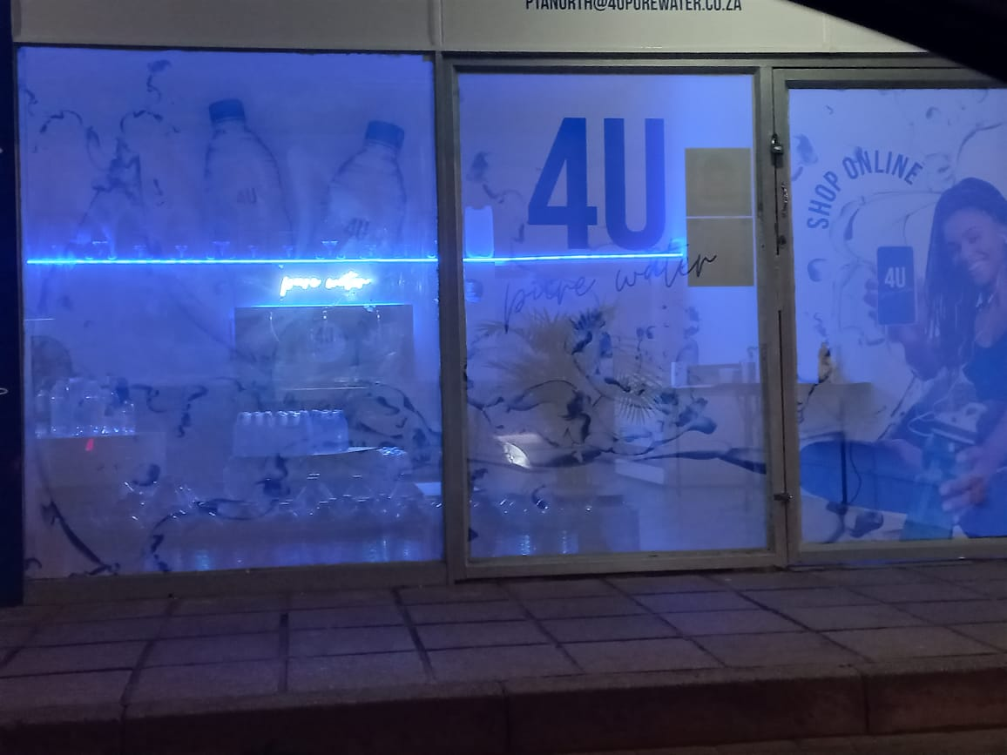
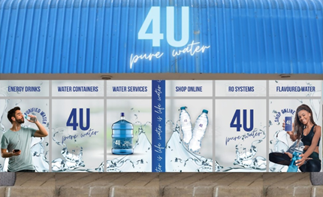
4 u pure water
585 GERRIT MARITZ STREET PRETORIA NORTH
Full window Contra view
Neon led lighting
Clean look

Slide 11
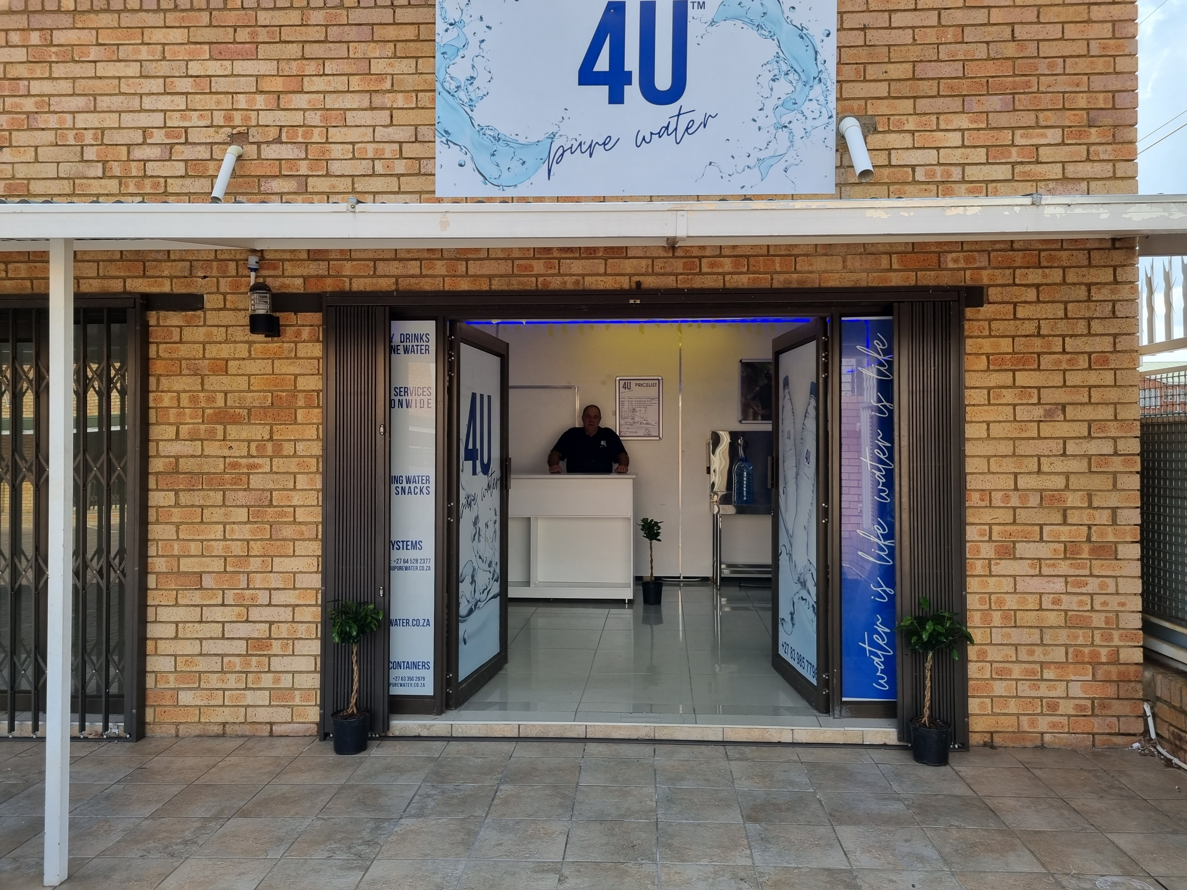
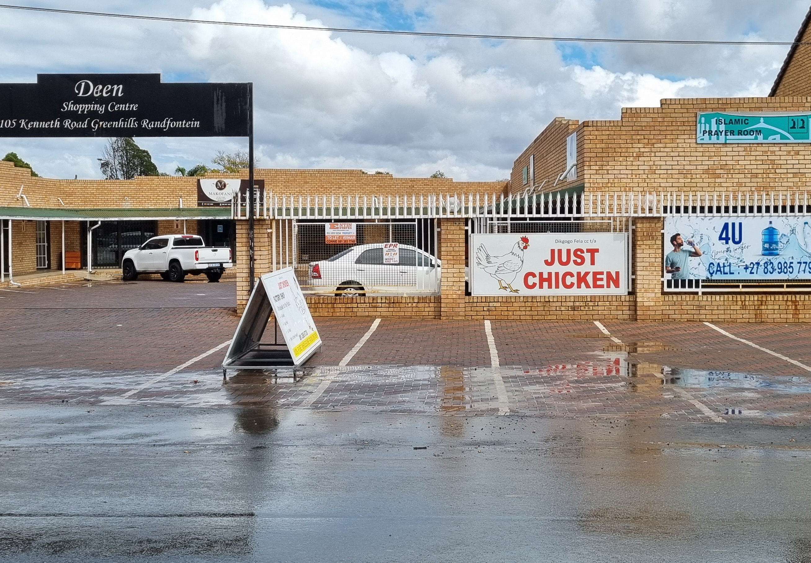
4 u pure water
105 Kenneth road, Greenhill’s, deen center randfontein
Full window Contra view
Neon led lighting
Clean look

Slide 12
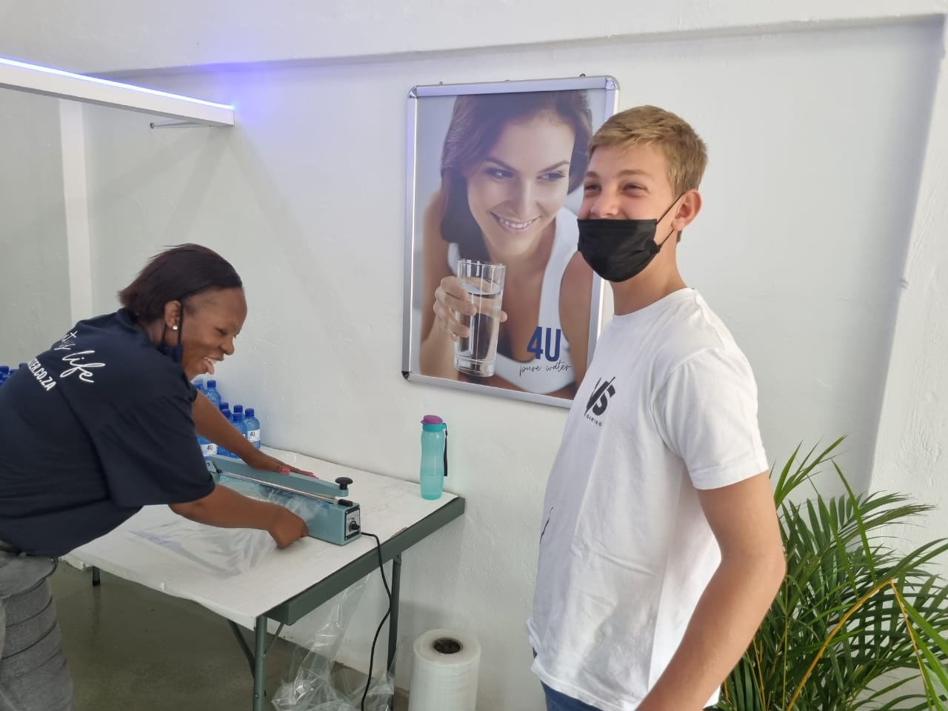
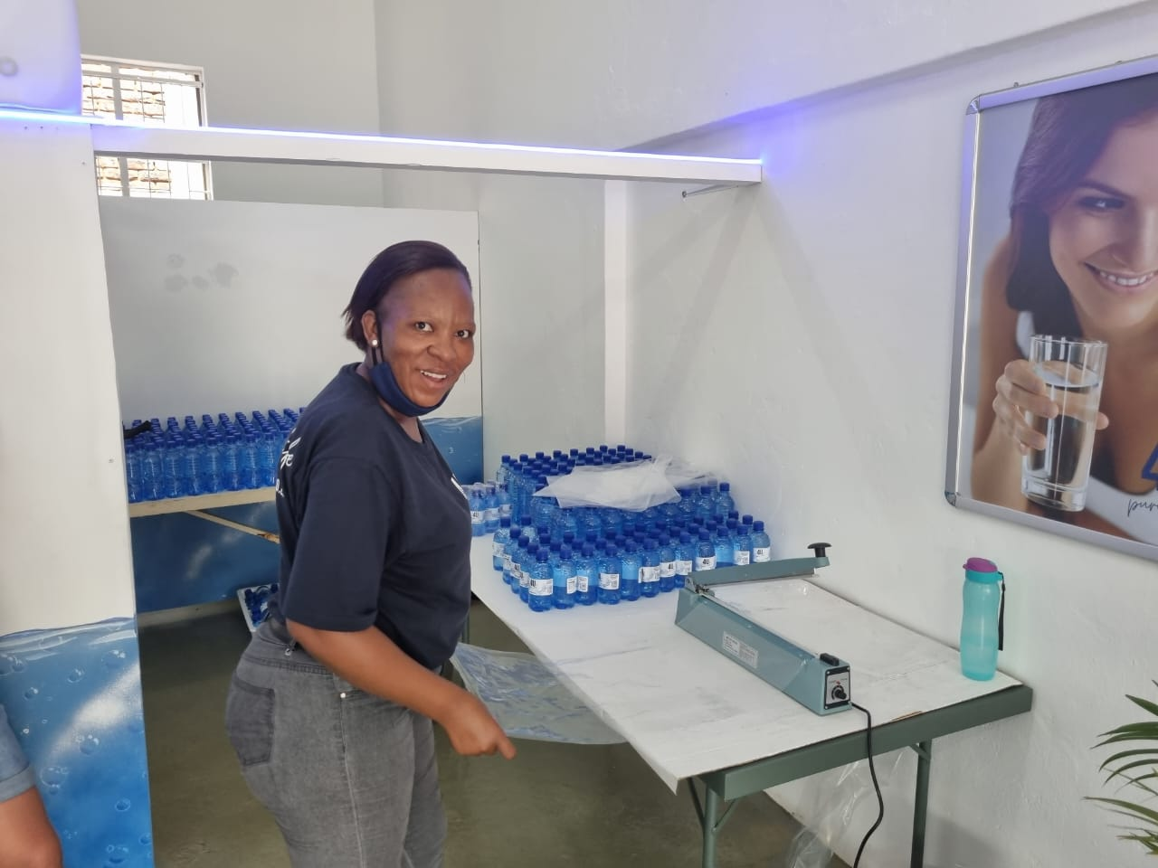
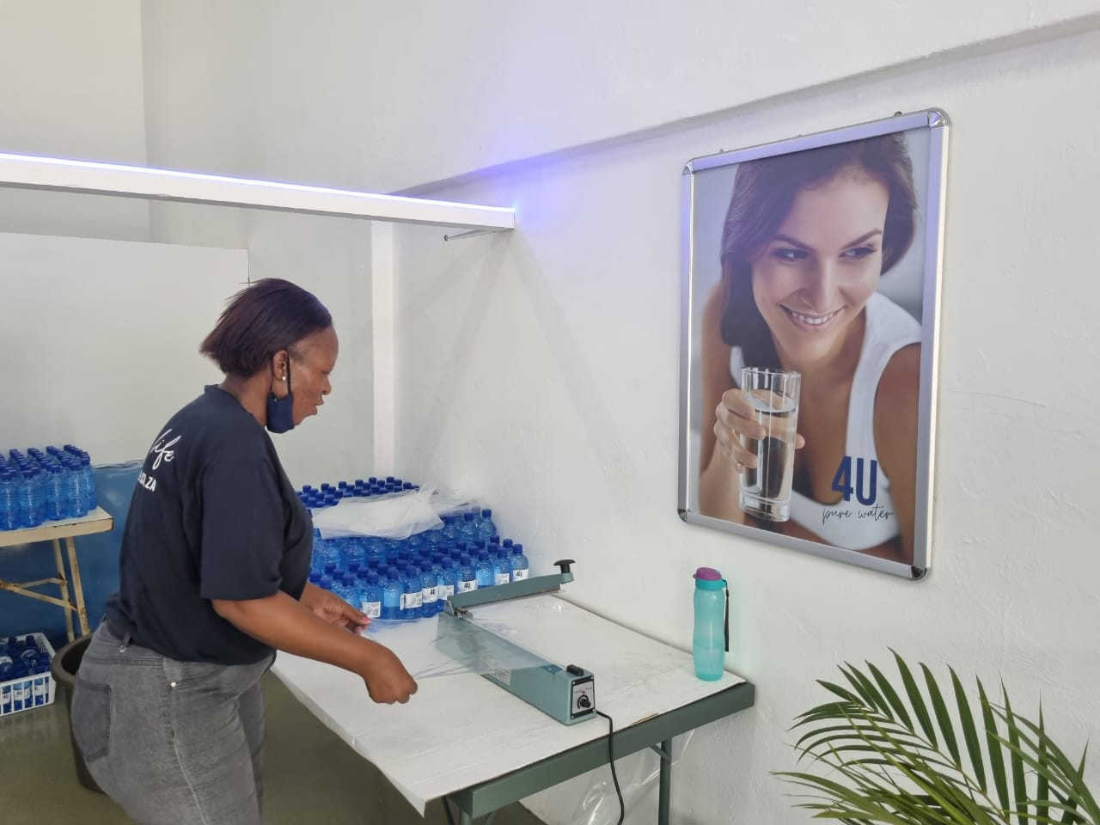
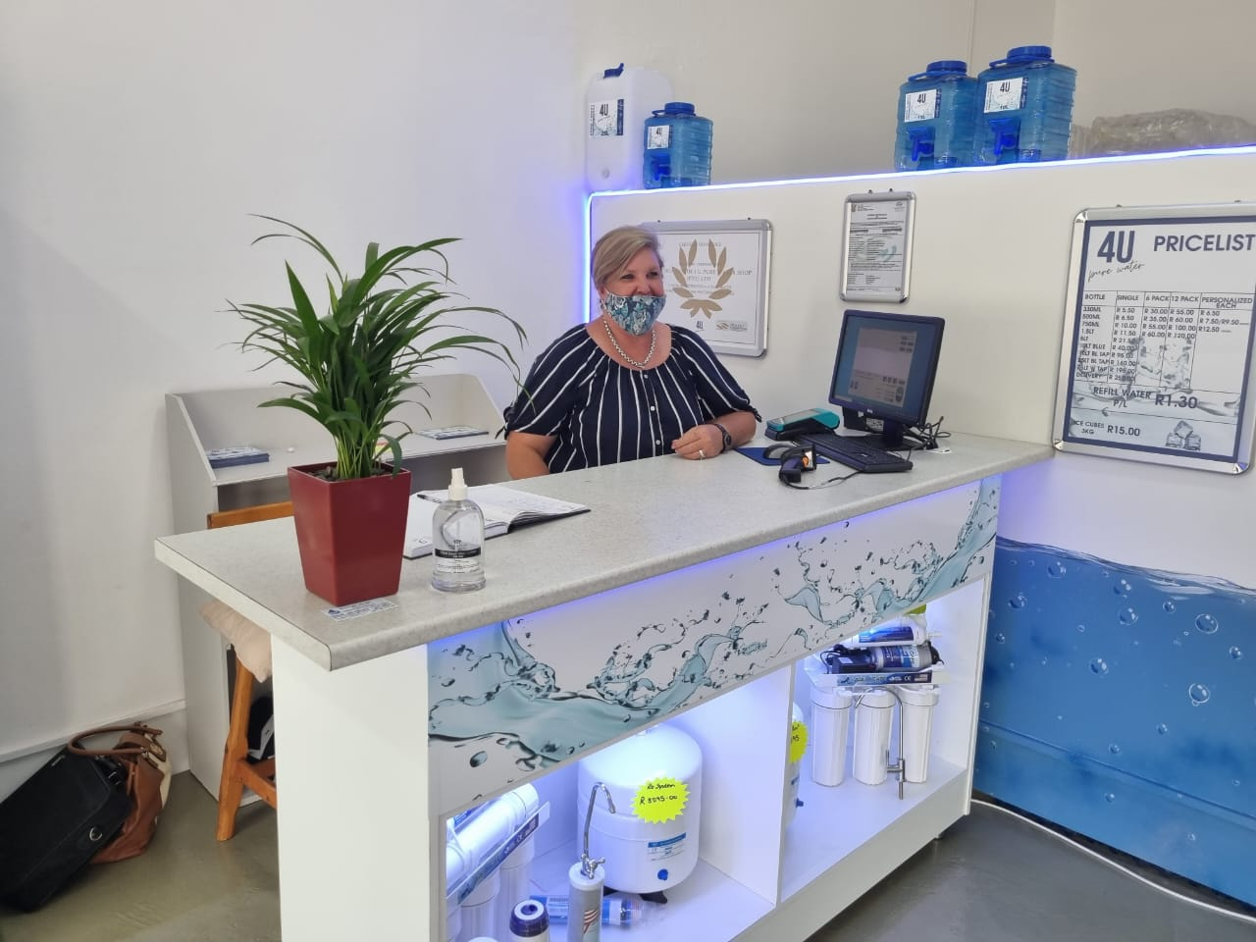
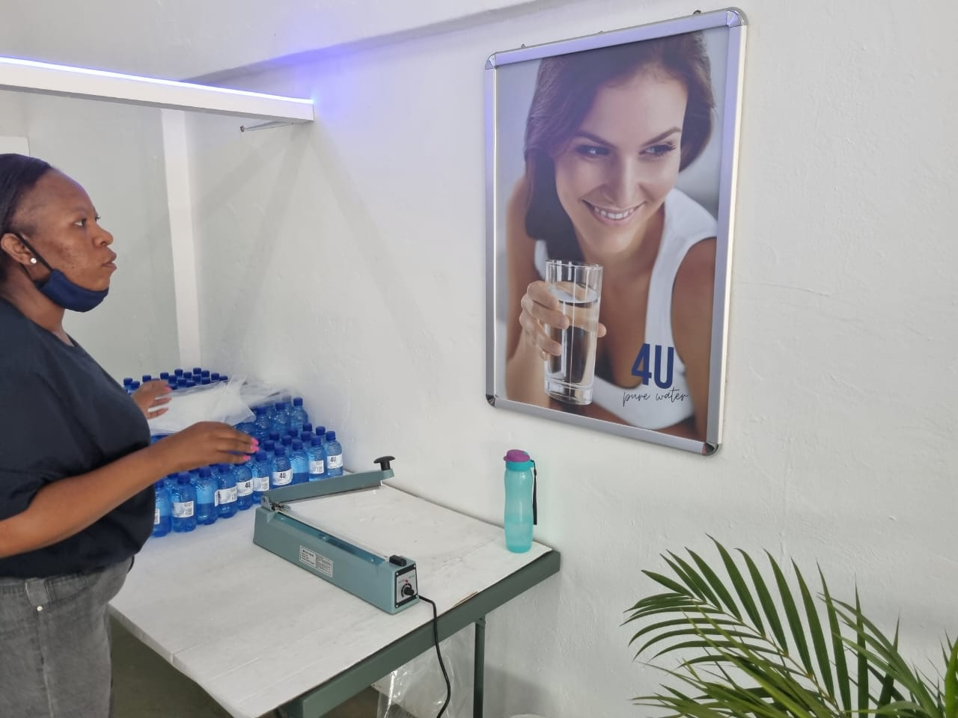

Slide 13
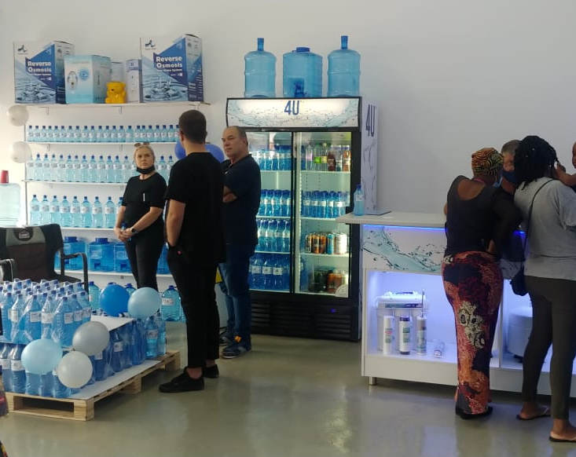
Enjoying the moment

Slide 14

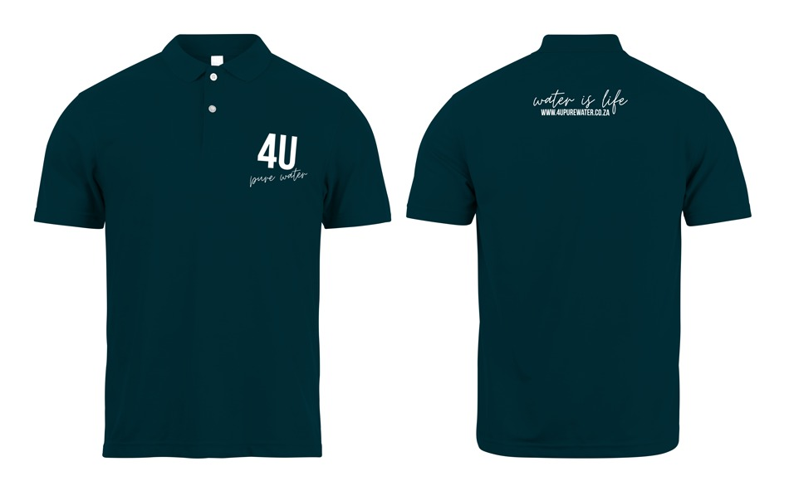

UNIFORMS

Slide 15
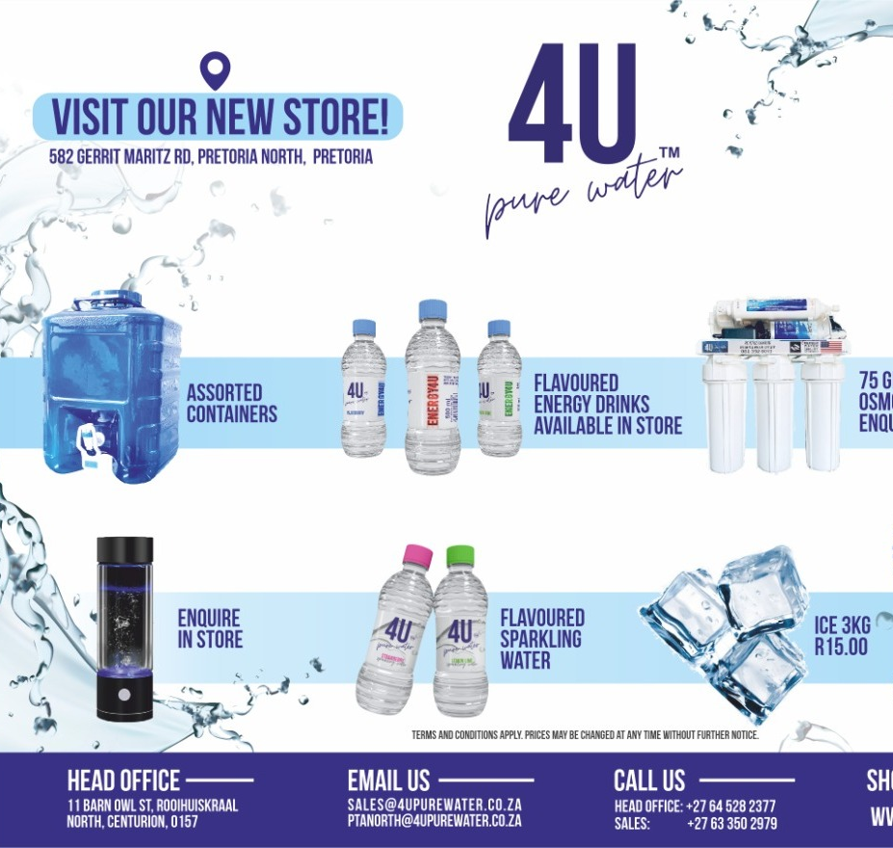
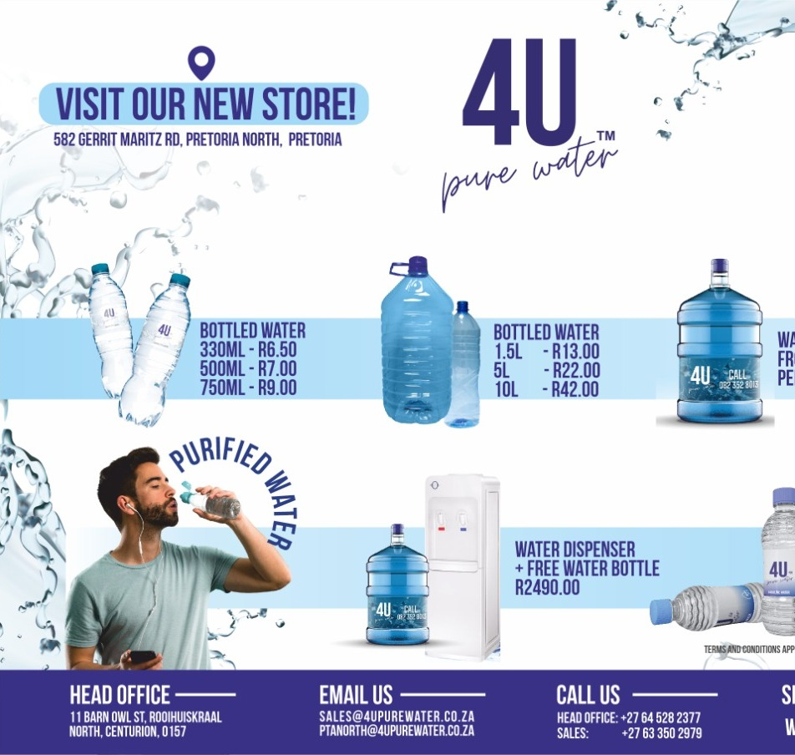

Slide 16

END
THANK YOU

