Slide 1

CSO PORTAL
JULY 2023

Slide 2

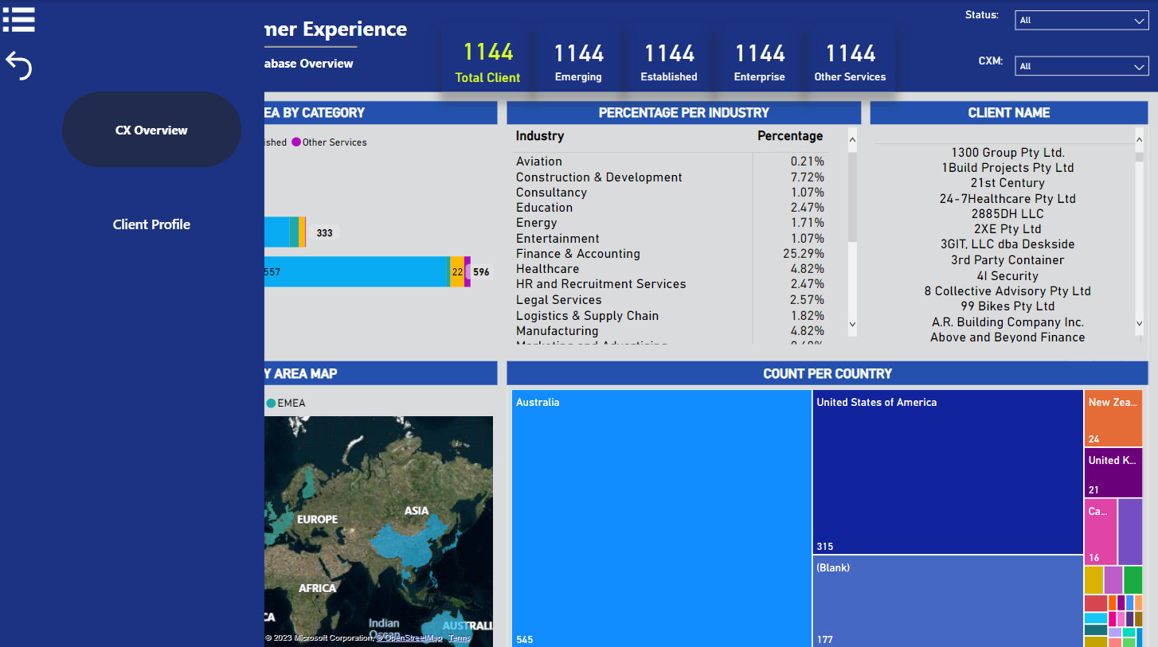
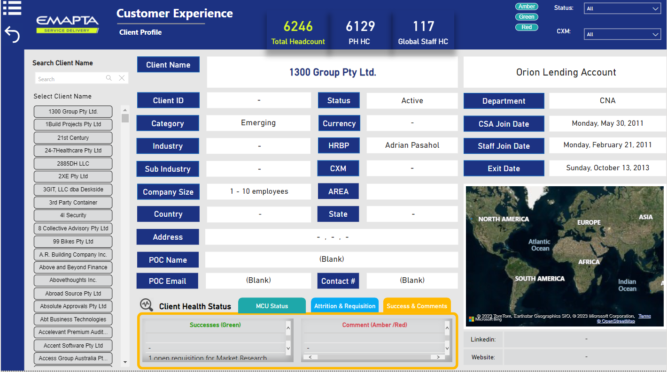
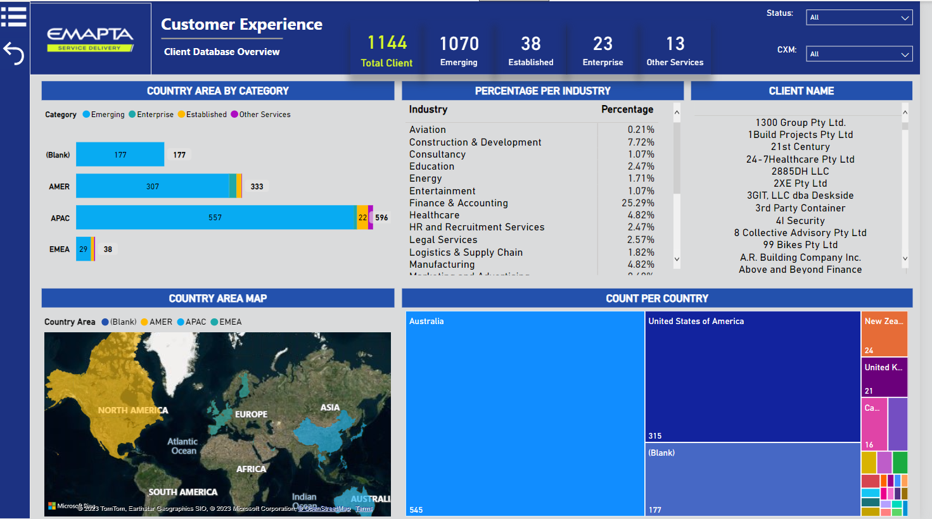
Introduction

Slide 3
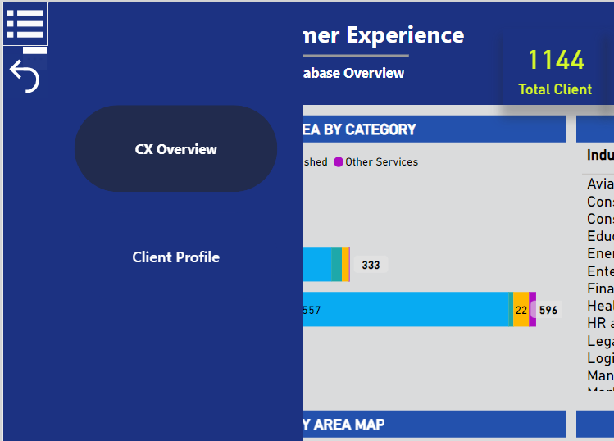
Navigation Pane
Menu Button
Use the navigation pane to go from one tab to another.
To view the pane, click on the Menu button and click on the tabs that you’d like to view.
Click on the Back button to hide the pane.
Back Button
Portal Tabs
Notes:
Use the navigation pane to go from one tab to another.
To view the pane, click on the Menu button and click on the tabs that you’d like to view.
Click on the Back button to hide the pane.

Slide 4
CSO Portal Tabs
CX Overview
  Or Client Database Overview contains the view or total number of clients by:
      Category
      Country
      Country area
      Industry
  With filters per status and CXMs.
Client Profile
Contains per client information which includes:
  Client Profile (such as Client ID, Status, Industry, Currency, Address, Join Date, Exit Date, etc.,)
  Client Health Status (based on the weekly RAG sent by CXMs)

Slide 5


CX Overview

Slide 6
CX Overview

Slide 7

CX Overview
Number Cards, for the Total Clients and breakdown per category (Emerging, Established, Enterprise, & Other Services).

Slide 8

CX Overview
Dropdown Filters, for client Status and the assigned CXMs.

Slide 9

CX Overview
Horizontal Bar Chart, for Country Area (AMER, APAC, EMEA) stacked by Category (Emerging, Established, Enterprise, & Other Services).

Slide 10

CX Overview
Filled Map, for Country Area
Color codes:
AMER – yellow
APAC – blue
EMEA – green

Slide 11

CX Overview
Treemap chart, shows the number of clients per country.

Slide 12

CX Overview
Matrix, shows the percentage distribution of clients per Industry in tabular view.

Slide 13

CX Overview
Matrix, shows the list of client names.

Slide 14
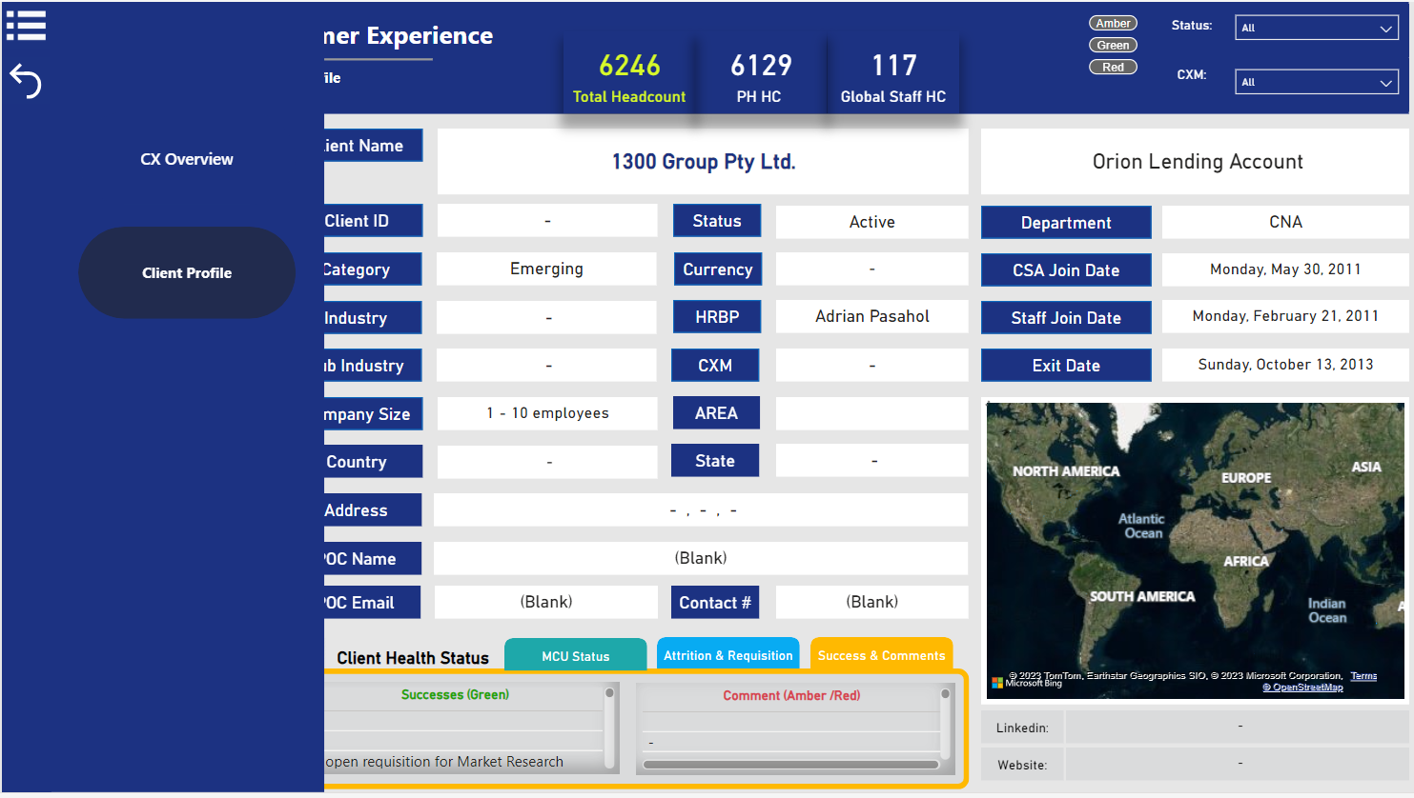
Client Profile

Slide 15
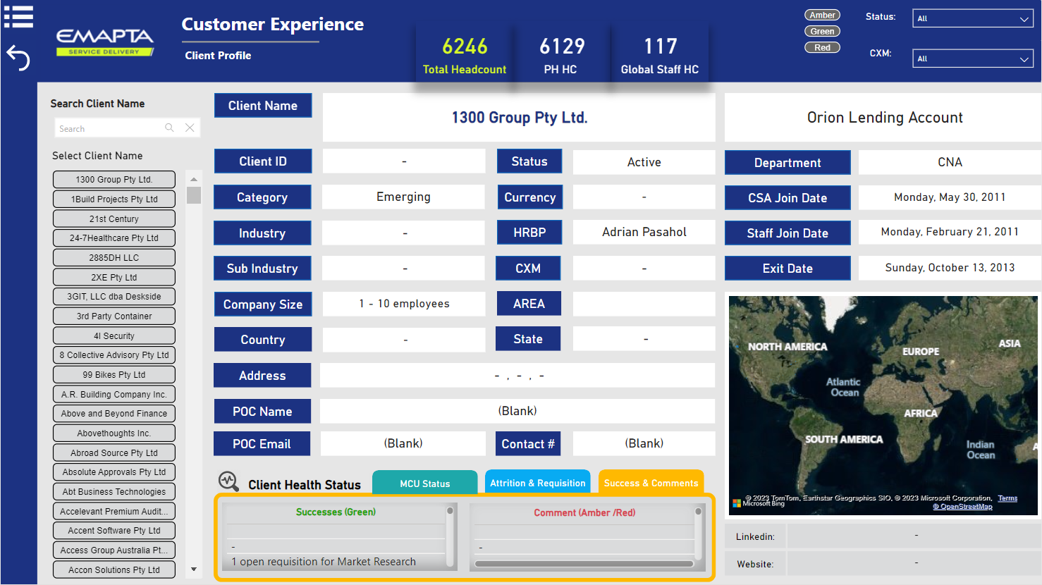
Client Profile

Slide 16

Client Profile
Number Cards, for the Total Headcount and the breakdown per PH HC and Global Staff HC.

Slide 17

Client Profile
RAG Buttons, directly linked to the Weekly RAG updates.

Slide 18

Client Profile
Dropdown Filters, for client Status and the assigned CXMs.

Slide 19

Client Profile
Search Box, use to quickly find the specific client's name by entering a query term to the search box.
(Click the “x” icon on the right
side box to clear the search)

Slide 20

Client Profile
Client Name Slicer, contains the list of all client names shown in button format and is also linked to the Search Box.

Slide 21
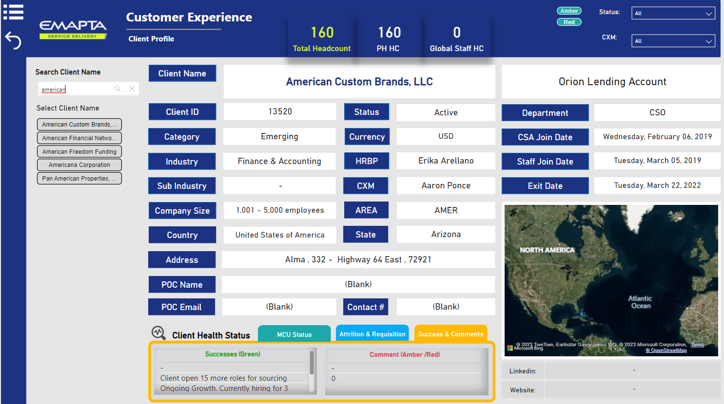

Client Profile

Slide 22

Client Profile

Slide 23

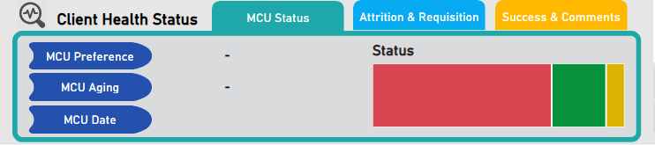
Client Profile
Client Health Status – MCU Status tab, contains the MCU status of the client whether its Red, Amber, or Green. It also contains the MCU Preference, MCU Aging, and MCU Date.

Slide 24

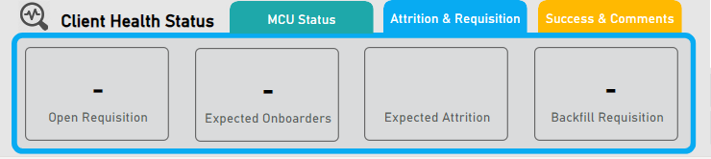
Client Profile
Client Health Status – Attrition and Requisition tab, contains the number of Open Requisition, Expected Onboarders, Expected Attrition, and Backfill Requisition.

Slide 25

Client Profile
Client Health Status – Success and Comments tab, contains other client updates. Successes (Green) are the highlights and Comment (Amber/Red) are the lowlights.

Slide 26
Thank You!

