Slide 1



Third Quarter Recognition Day

Slide 2
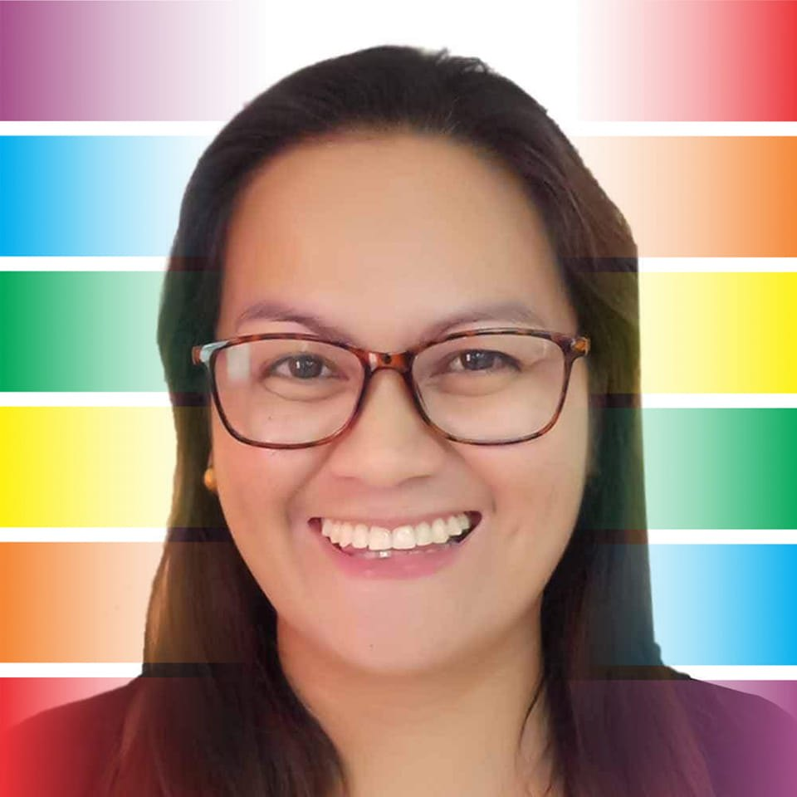
DIOSDADO BANATAO

Slide 3

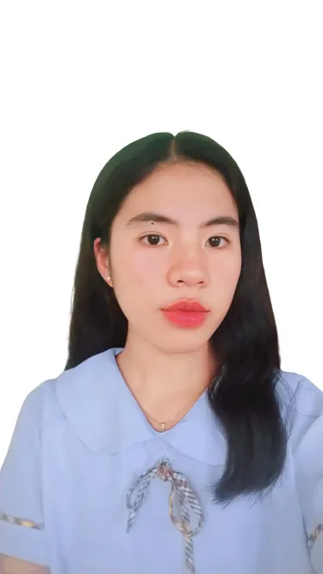
CABBAB, NANIA MAE C.
With High Honors
97%

Slide 4
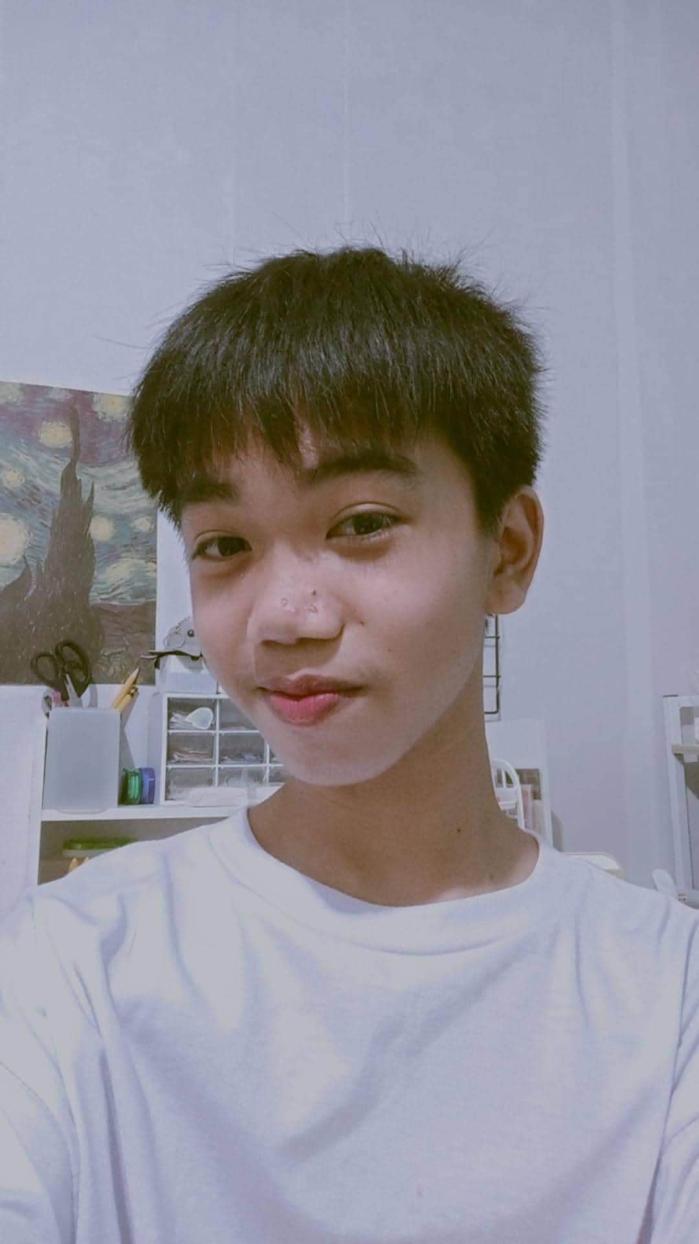
GARDUQUE, KEINZ TRAVISH G.
With High Honors
96%

Slide 5
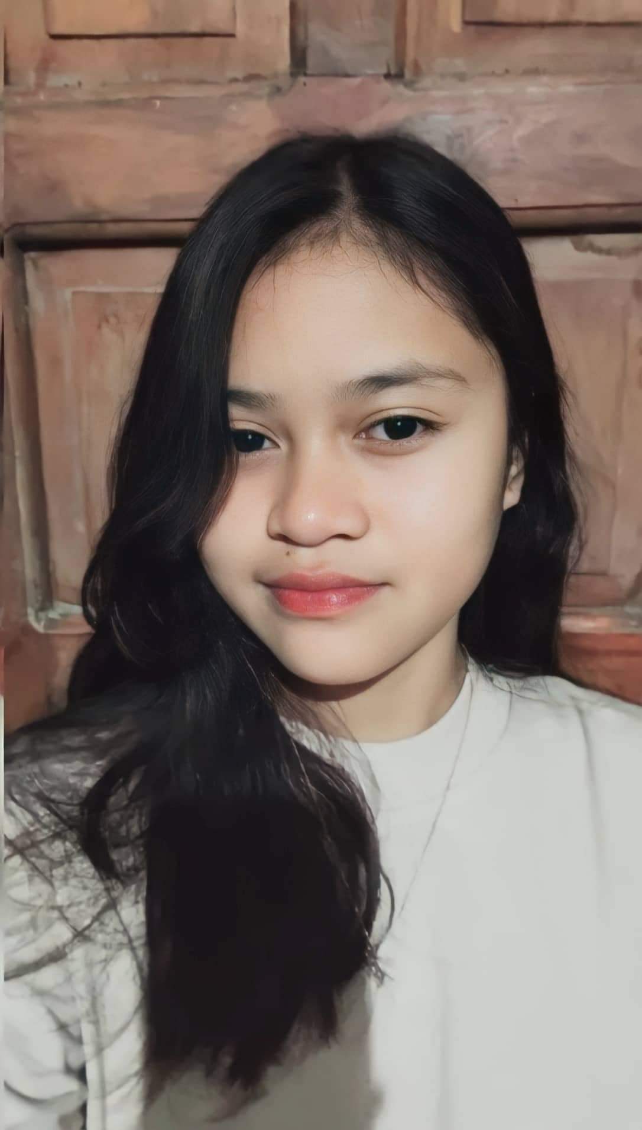
ANACIO, HANNAH GRACE A.
With High Honors
96%

Slide 6
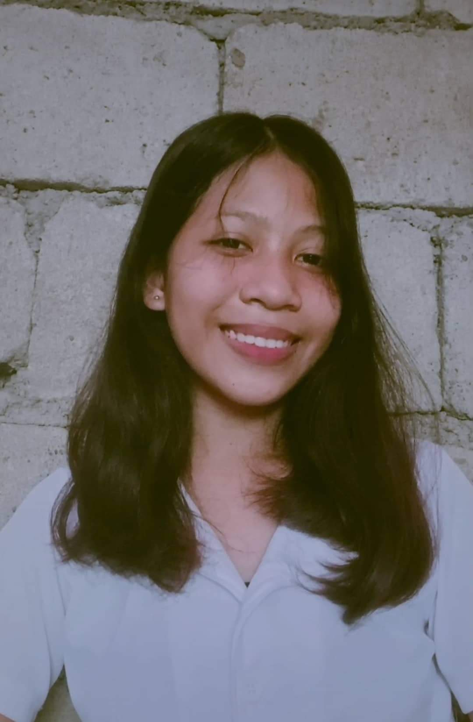
JAVIER, LIAN T.
With High Honors
96%

Slide 7
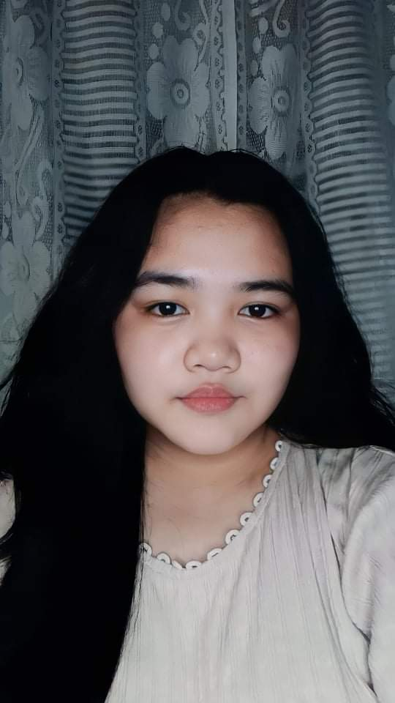
AGUILAR, THERESA JANINE G.
With High Honors
95%

Slide 8
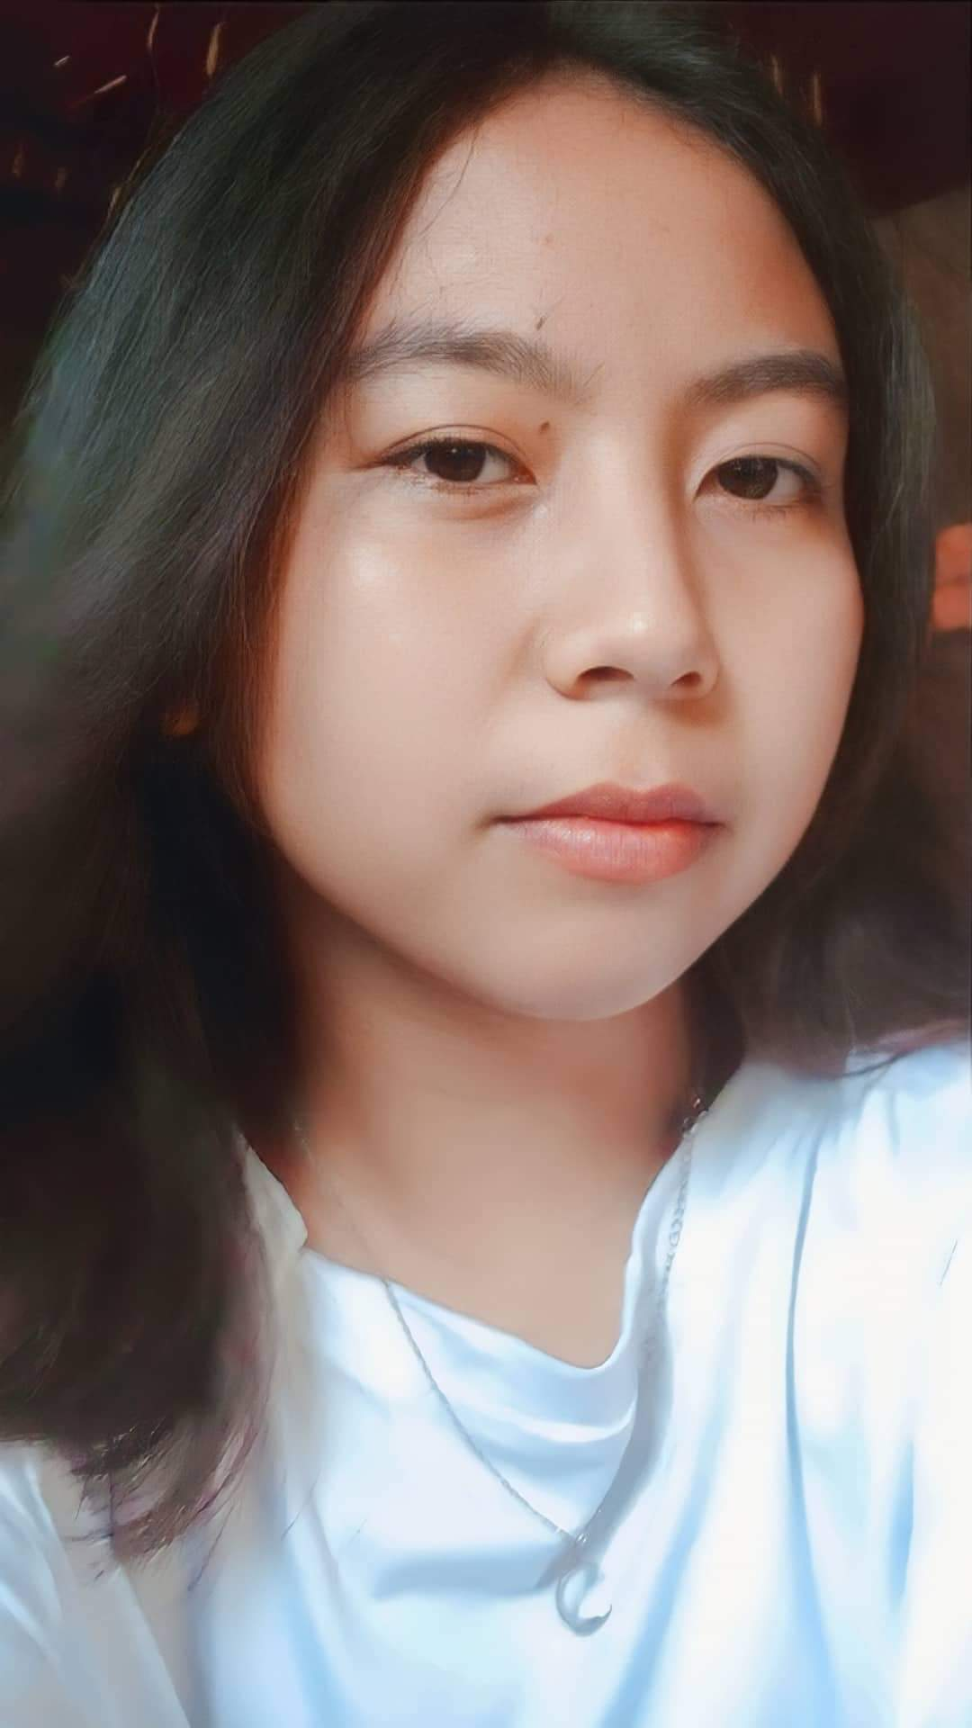
BOSI, PRINCESS CAMILE T.
With High Honors
95%

Slide 9
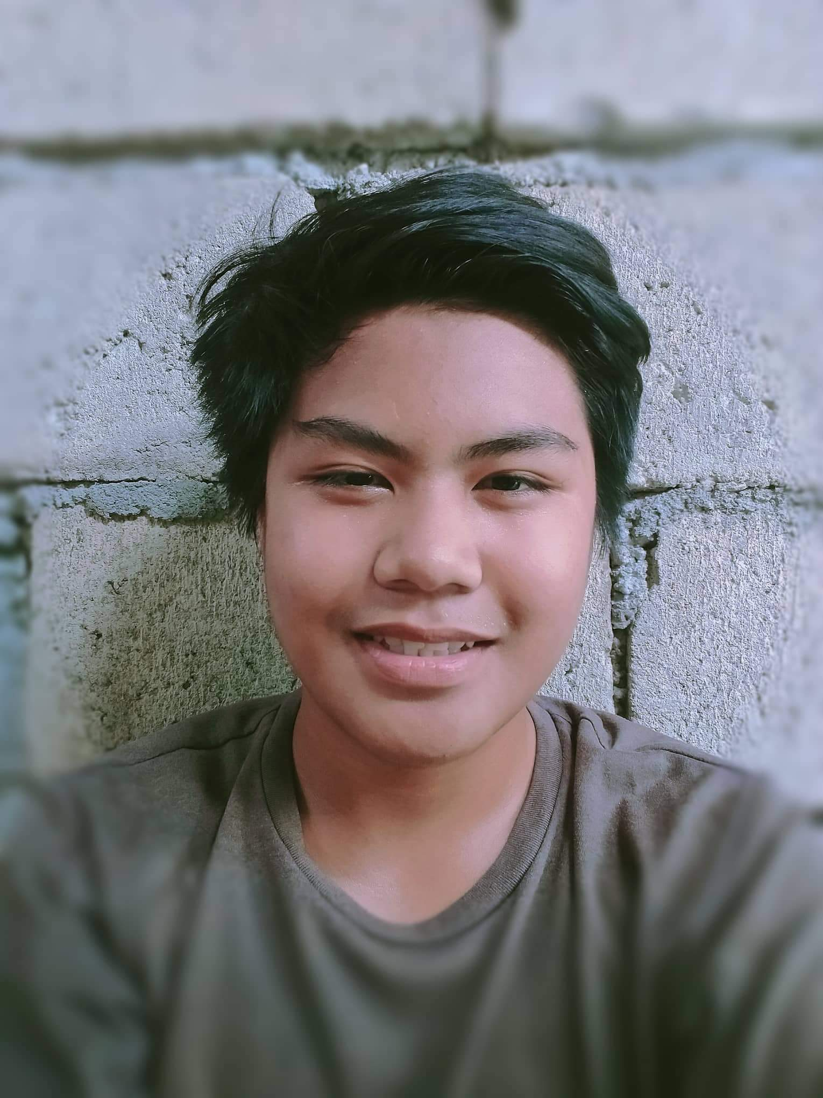
IGNACIO, BEIGE JOEBER D.
With High Honors
95%

Slide 10
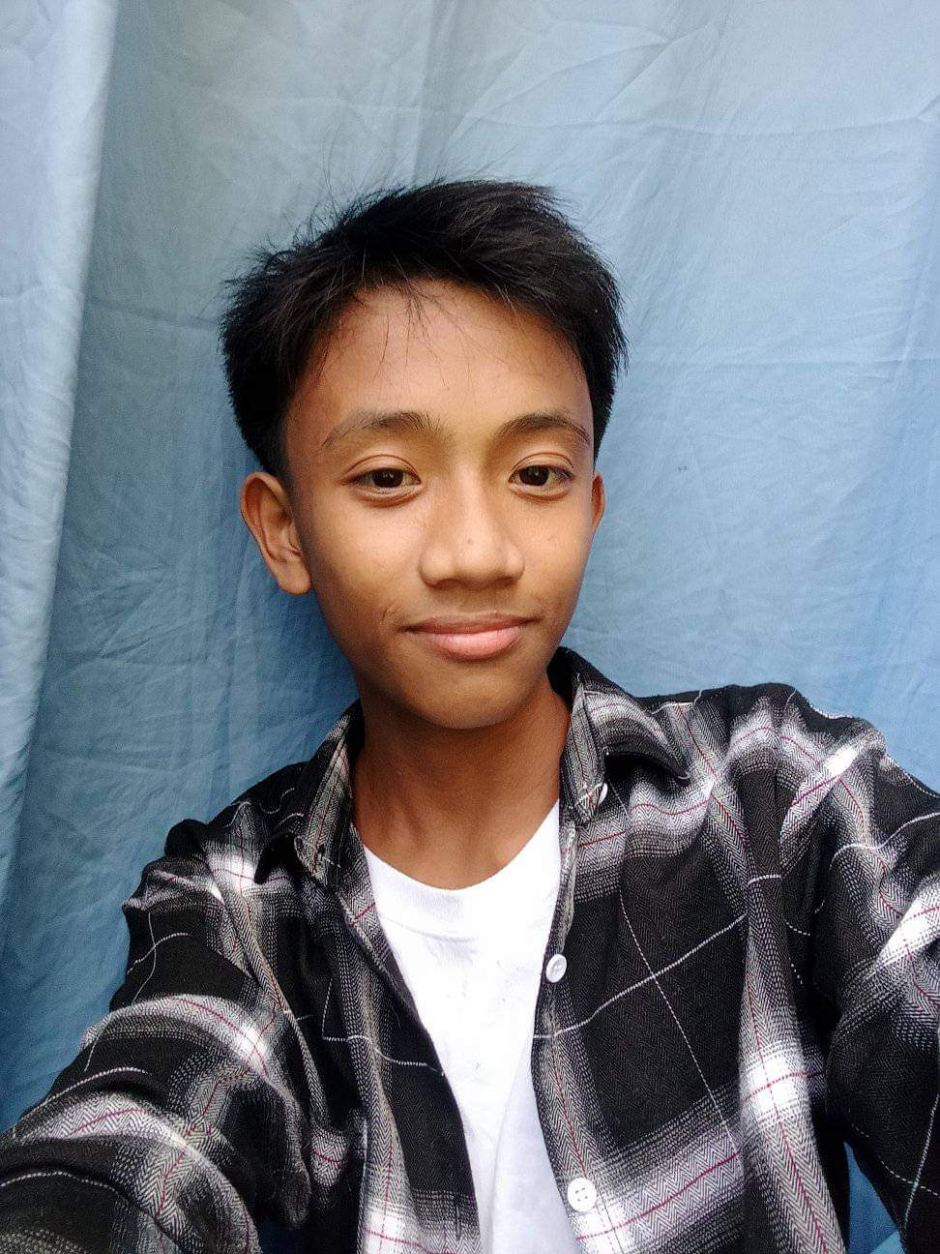
TABOG, MARCELINO JR M.
With High Honors
95%

Slide 11
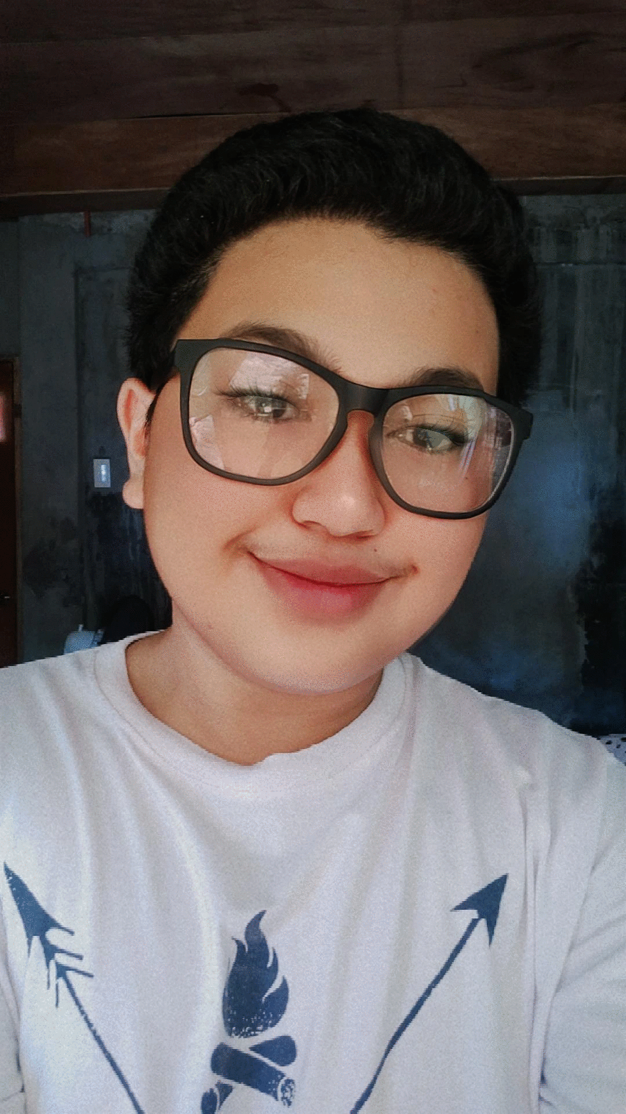
DELA CRUZ MICHAEL ANGELO P.
With High Honors
95%

Slide 12
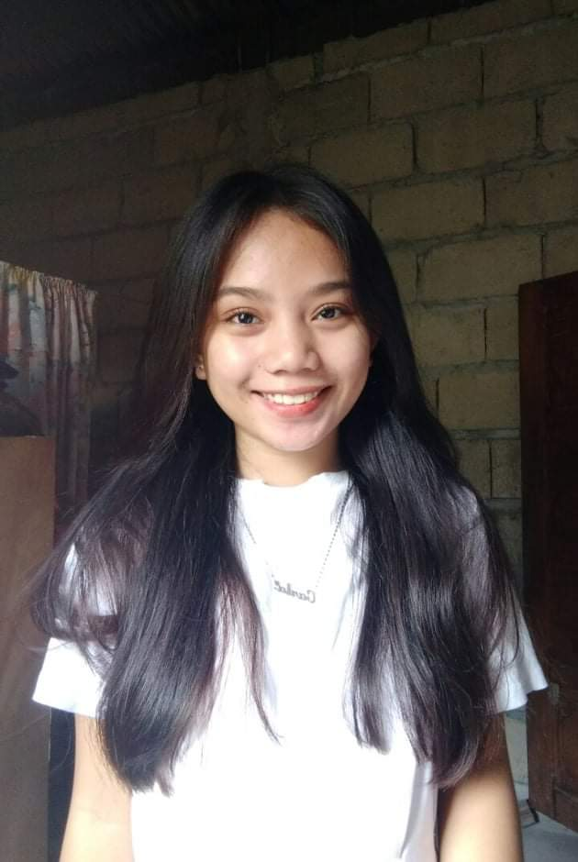
BARIBAD, KARLA CATRINA P.
With High Honors
95%

Slide 13
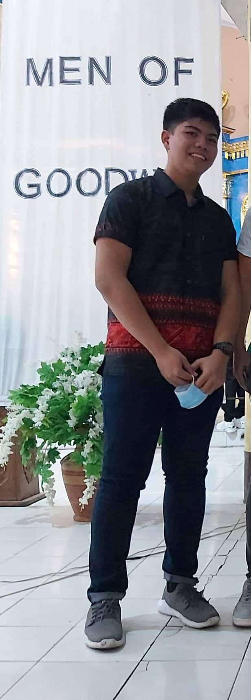
CUMLAT, AARON PHILIP D.
With Honors
94%

Slide 14
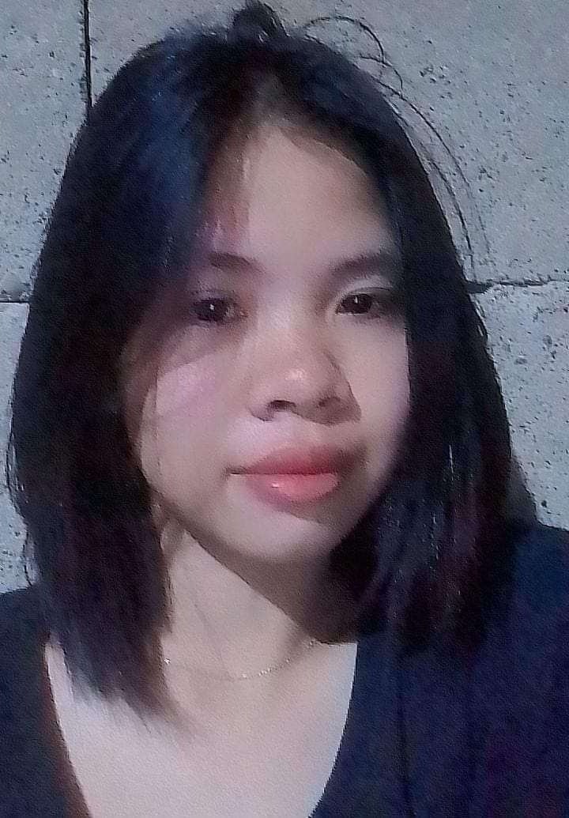
DOMINGO, ANSHANE B.
With Honors
94%

Slide 15
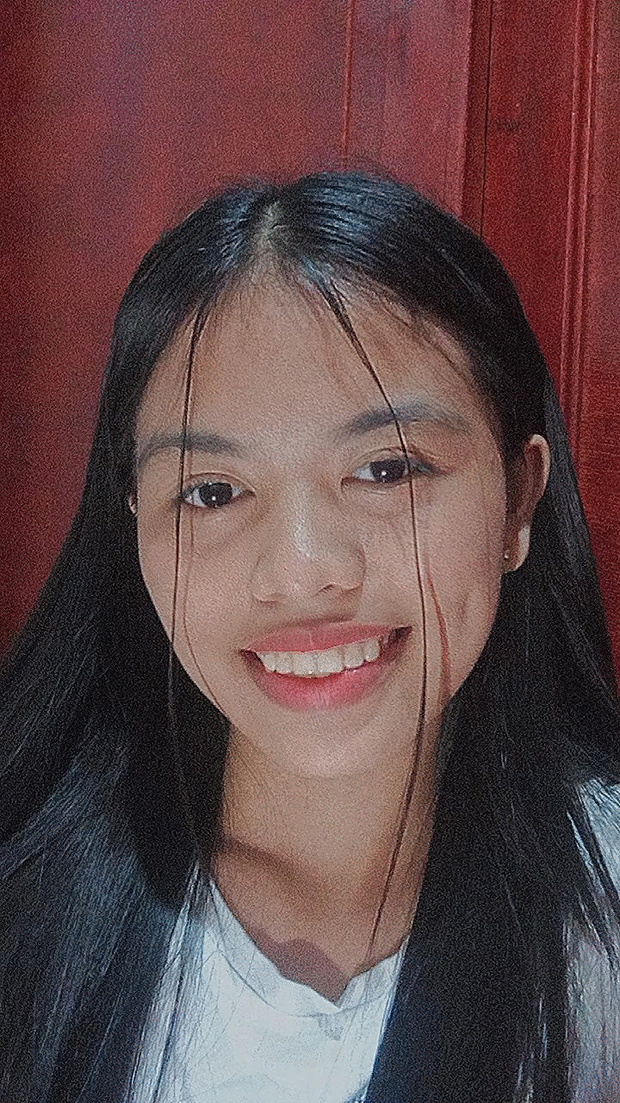
ANTONIO, JASMIN V.
With Honors
94%

Slide 16
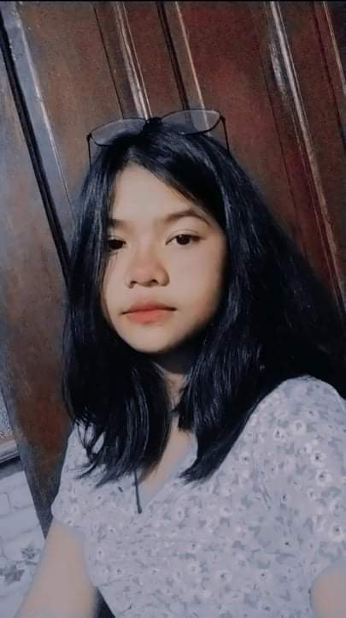
FORONDA, MARIELLE G.
With Honors
94%

Slide 17
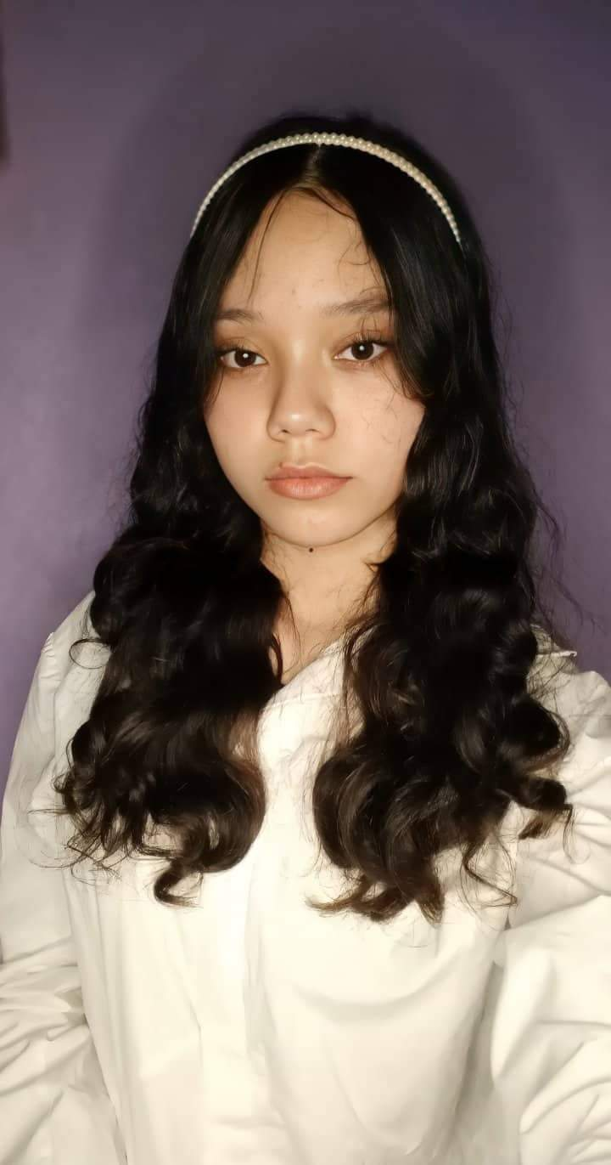
MONTILLA ,HANAH JOY M.
With Honors
94%

Slide 18
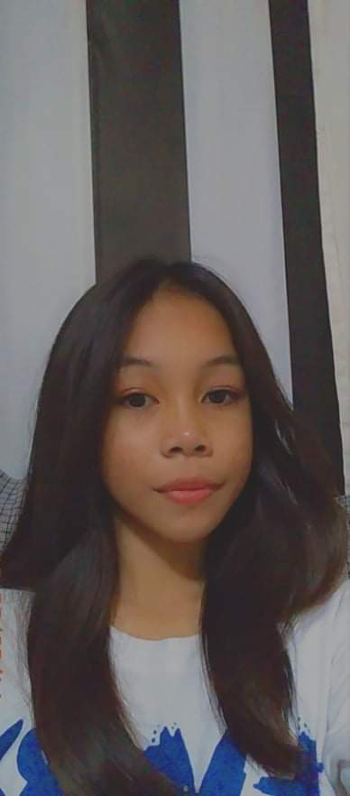
CALDERON, SHAIRA M.
With Honors
93%

Slide 19
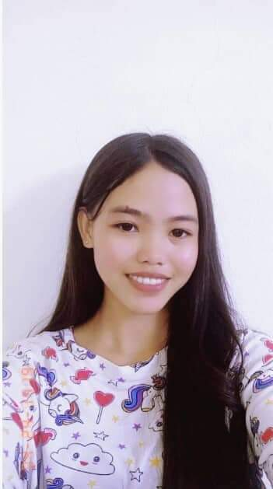
MAKILANG, MARIFE S.
With Honors
93%

Slide 20
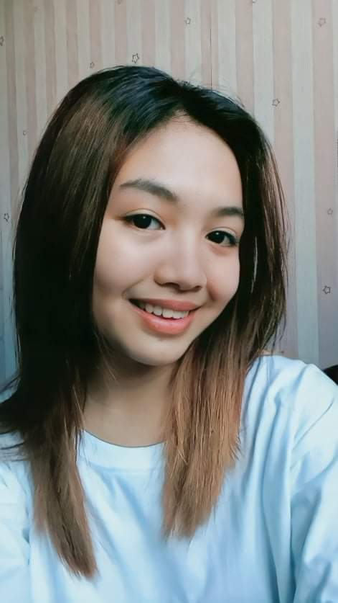
BACULI, KIRSTEN FRIA D.
With Honors
93%

Slide 21
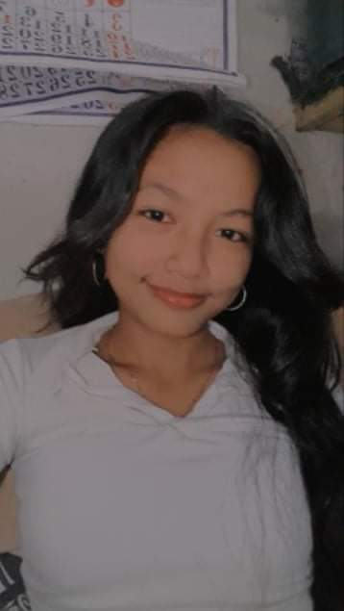
NARAG ALLYSA CLAIRE S.
With Honors
92%

Slide 22
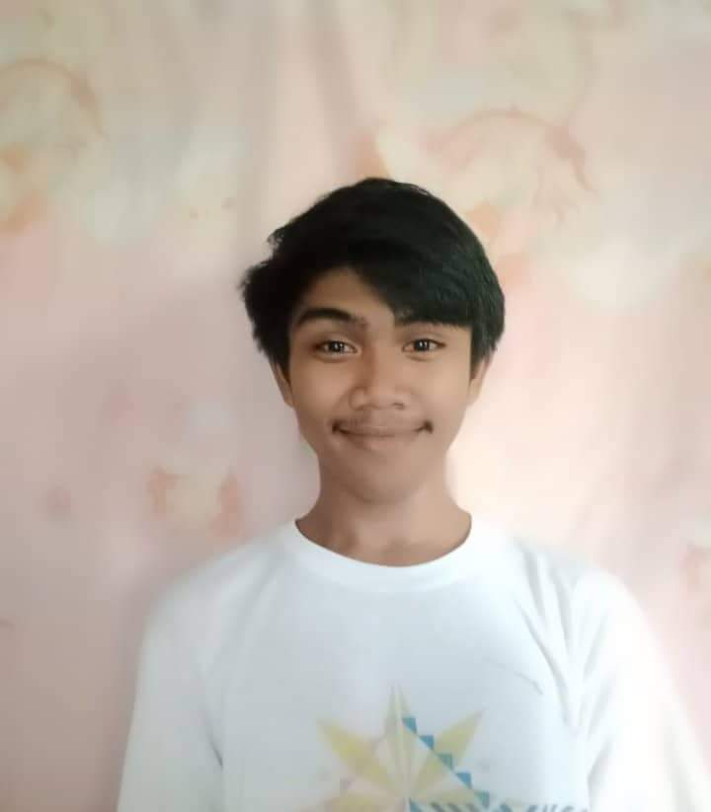
JIMENEZ EMERSON D.
With Honors
92%

Slide 23
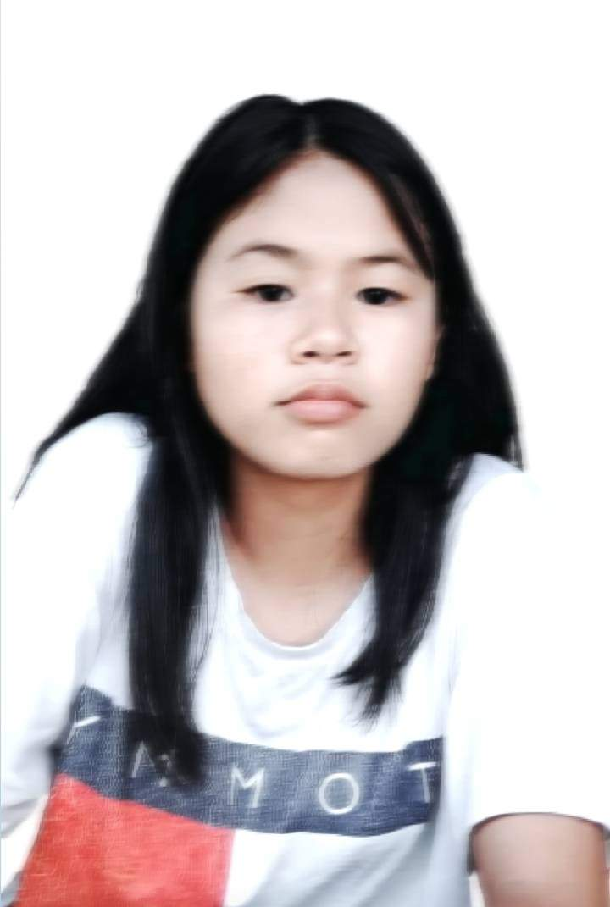
ADRIANO, GLEIZEL M.
With Honors
92%

Slide 24
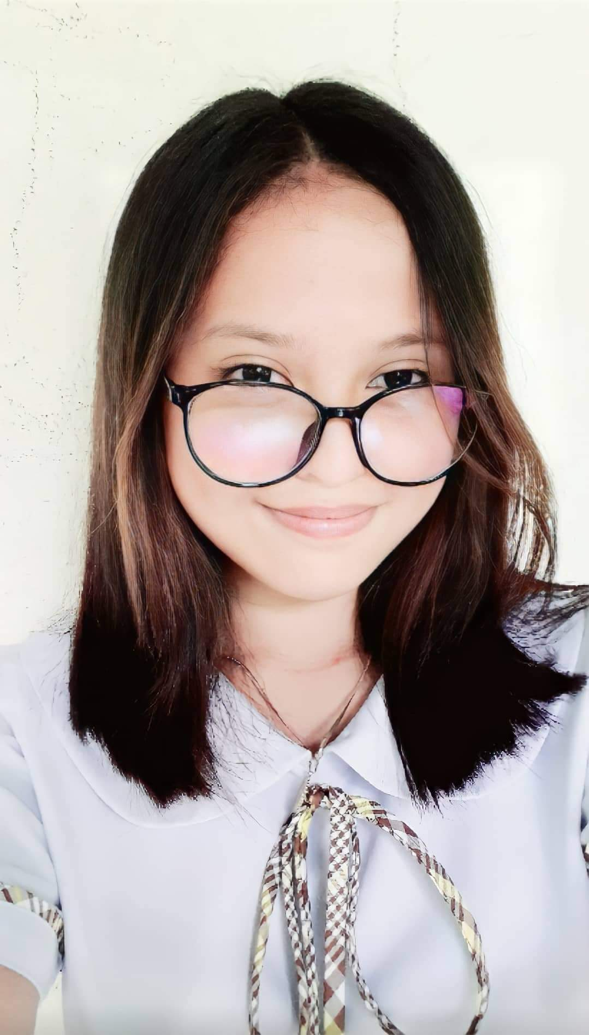
TEANO, JEDIELLE E.
With Honors
92%

Slide 25
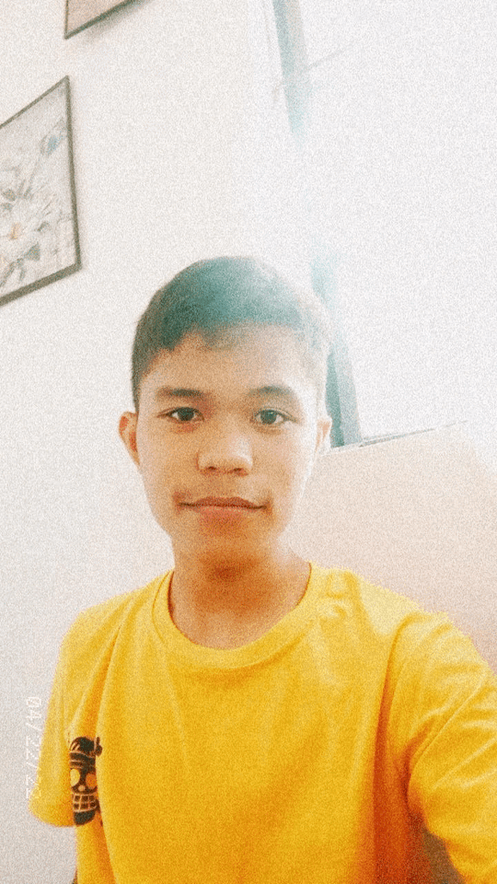
SERA CLARK JOHN O.
With Honors
92%

Slide 26
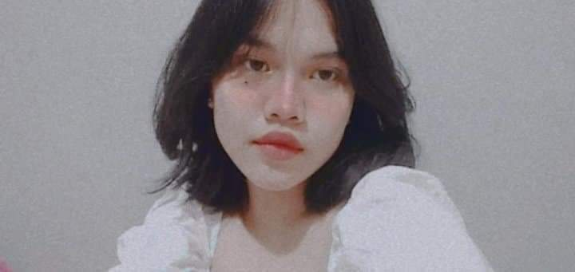
MALAQUENO, MARA JANNICA G.
With Honors
92%

Slide 27
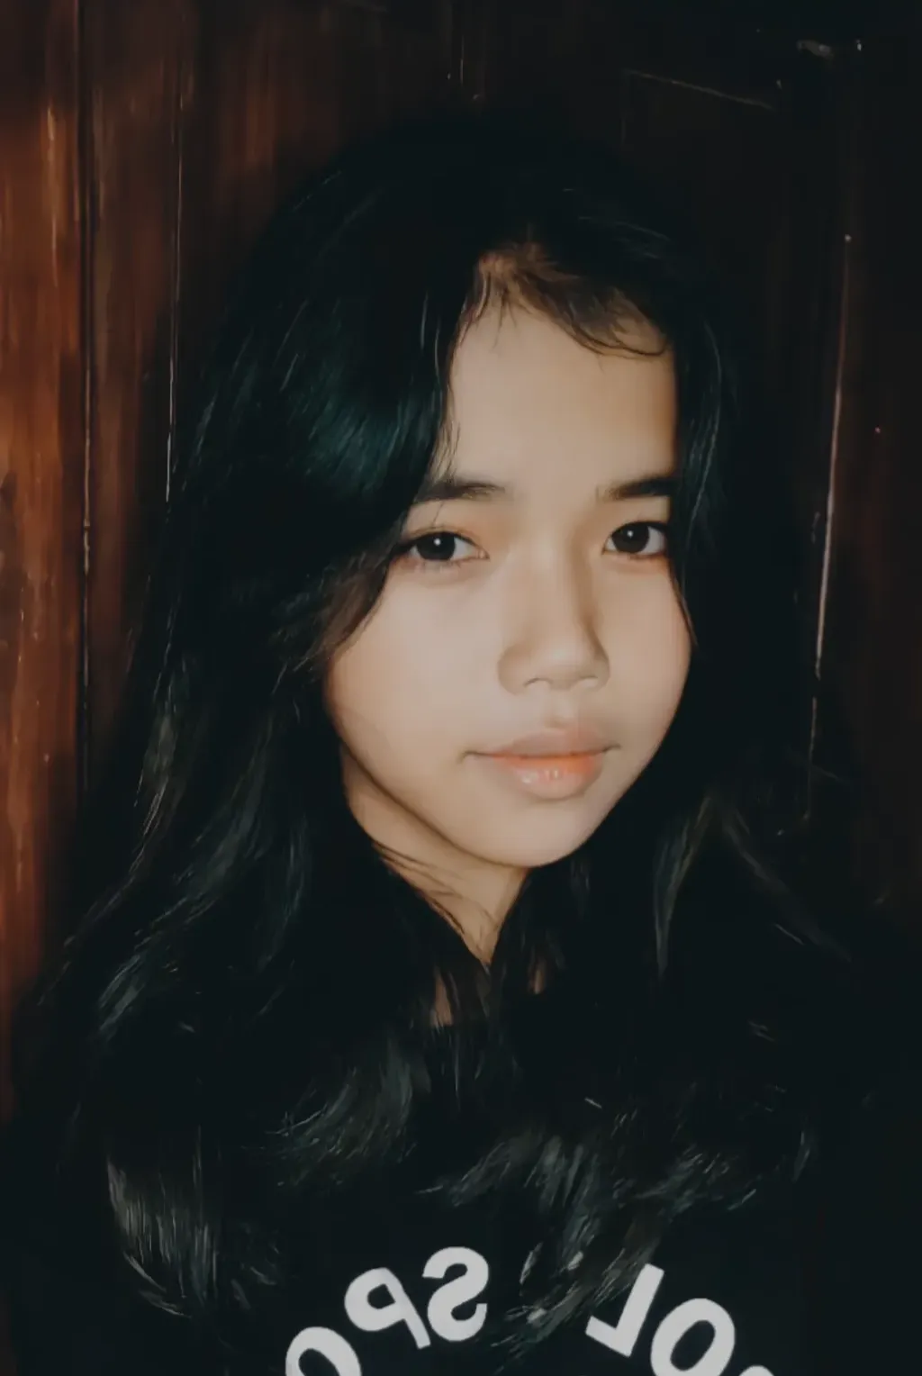
MORA, VALEIRE ANN G.
With Honors
92%

Slide 28
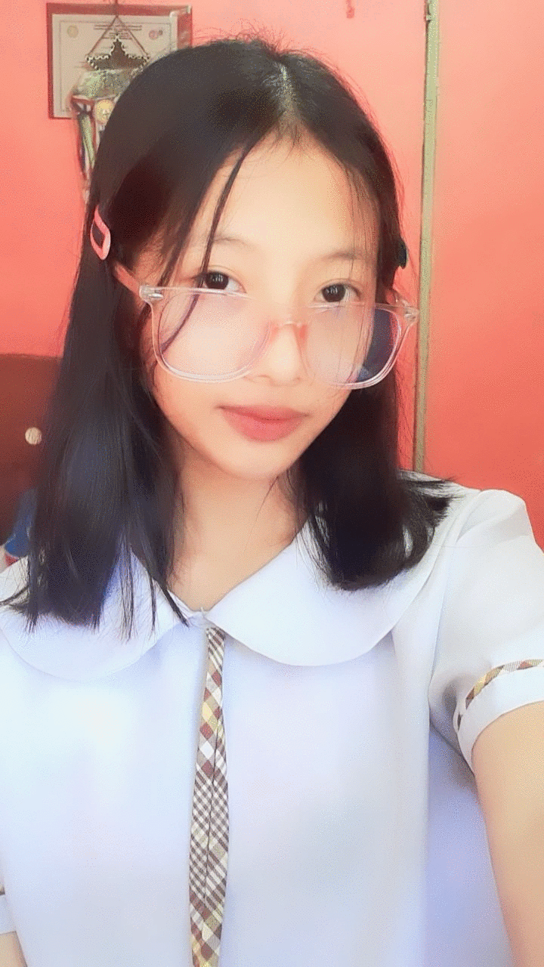
DOMINGO, RUBY ANNE A.
With Honors
92%

Slide 29
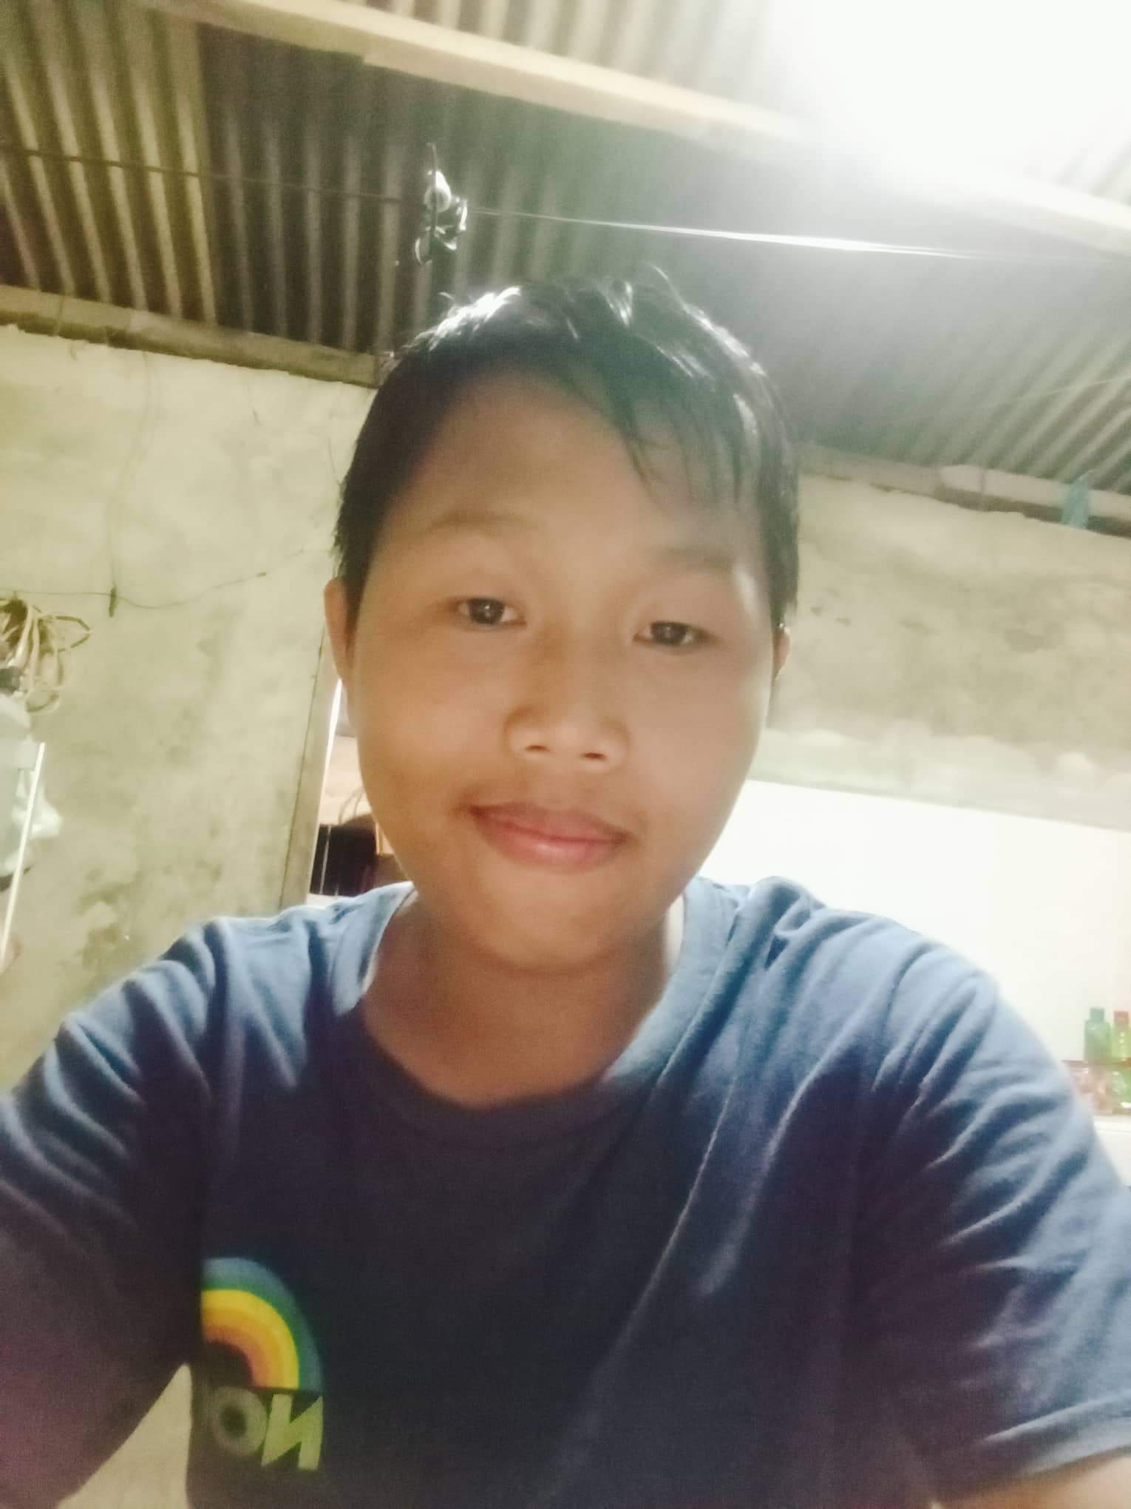
RODRIGUEZ, RALPH PATRICK M.
With Honors
94%

Slide 30
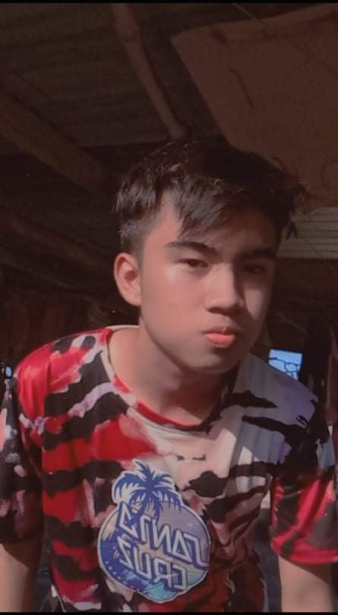
ESPINOSA, ARJAY M.
With Honors
92%

Slide 31
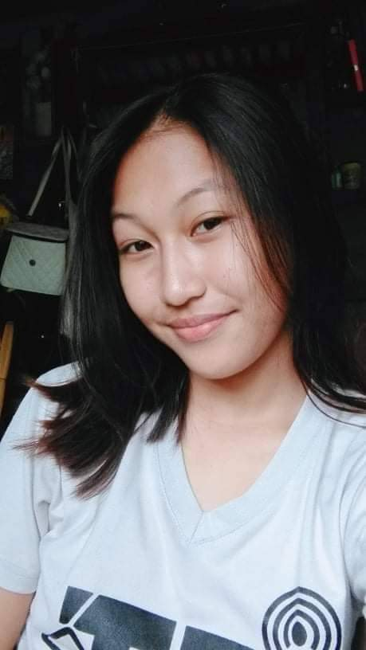
ESPINOSA, MARINEL L.
With Honors
92%

Slide 32
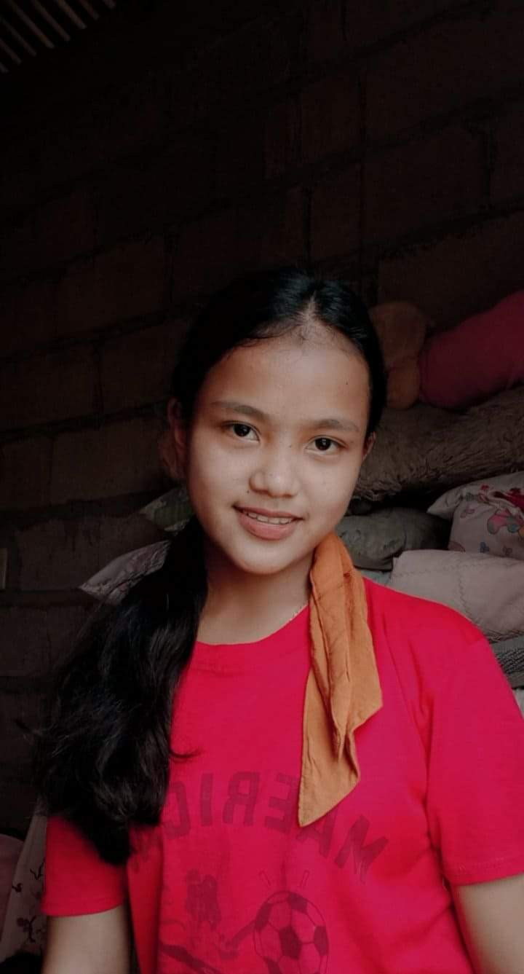
BALMAS, GEORGINA M.
With Honors
92%

Slide 33
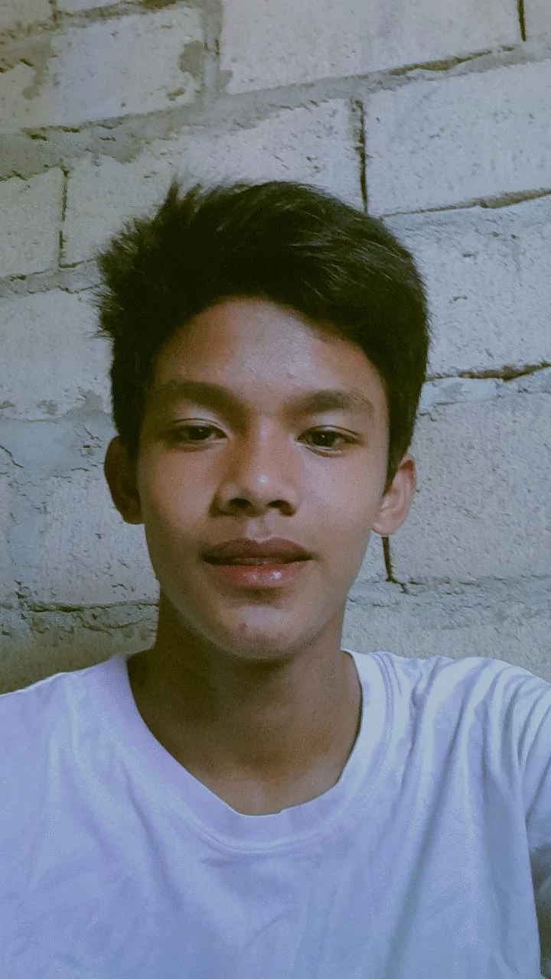
DELA CRUZ, LARRY MARK M.
With Honors
91%

Slide 34
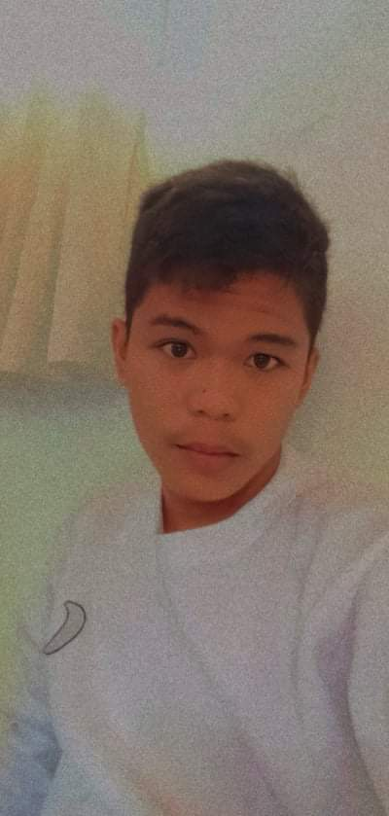
SERA, CALVIN PAUL O.
With Honors
91%

Slide 35

BURAC GERALD H.
With Honors
91%

Slide 36

MATAGAY, JAYMAR R.
With Honors
91%

Slide 37
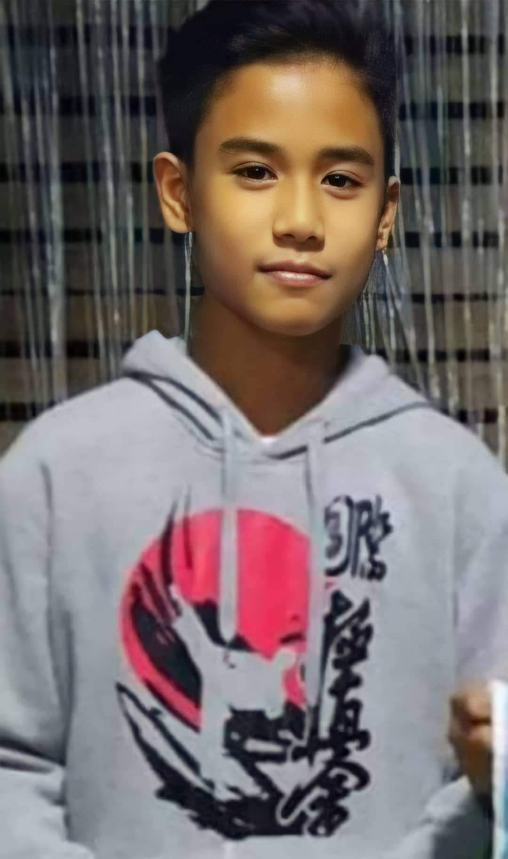
LIGGAYU, EDZEL S.
With Honors
90%

Slide 38
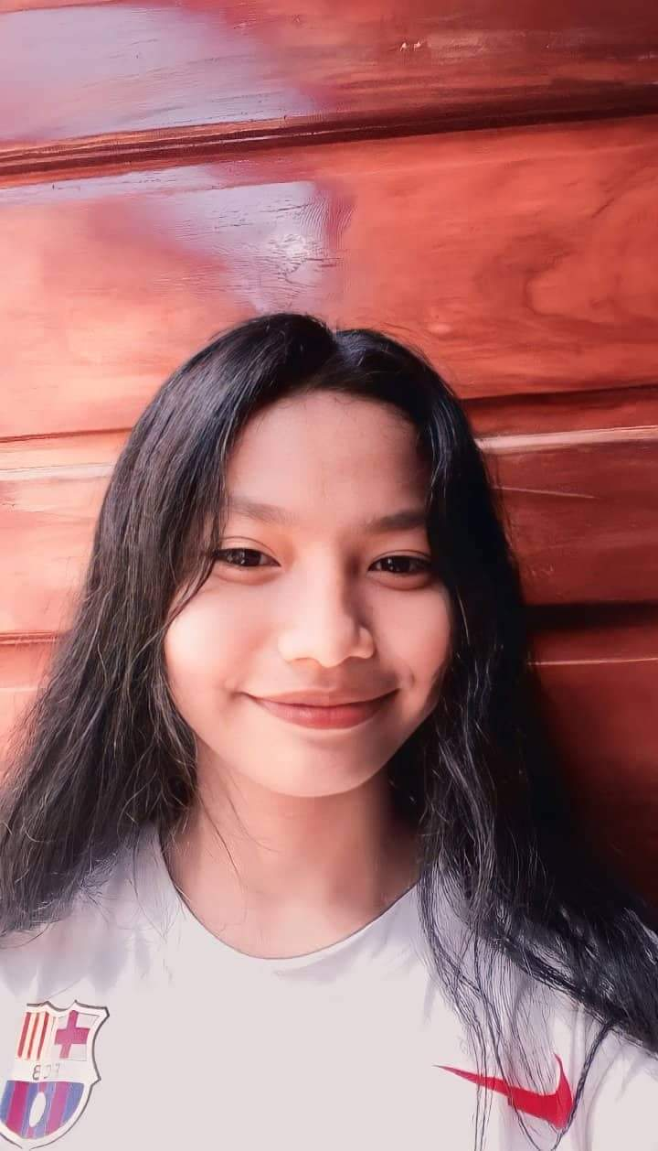
BURAC, DIVINE JOY Q.
With Honors
90%

Slide 39
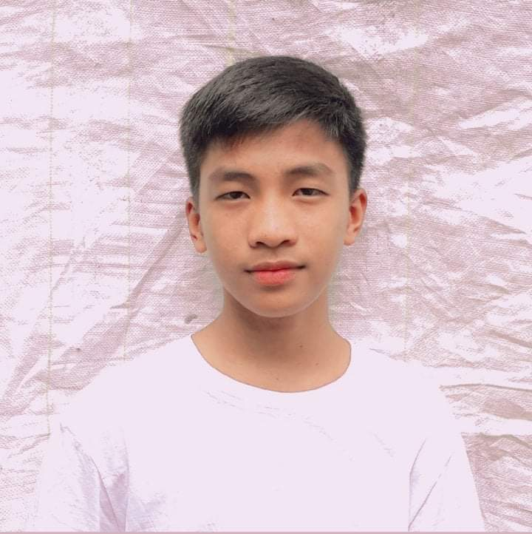
OLEA, B-JAY M.
With Honors
90%

Slide 40
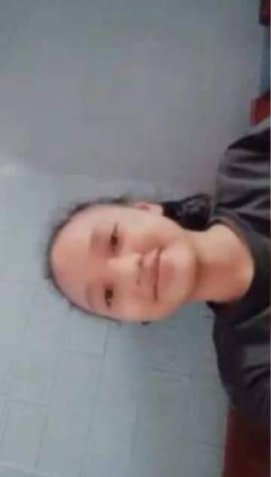
ANDRES, HERSHEY MAE D.
With Honors
90%

Slide 41
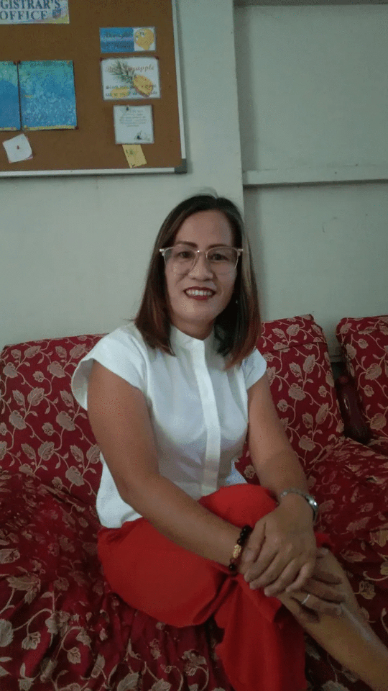
FE DELMUNDO

Slide 42
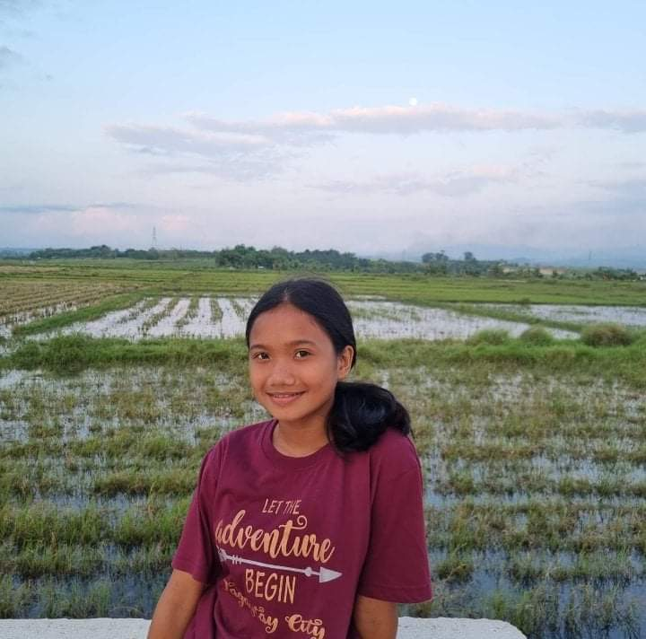
CALANOGA, KRIZZA G.
With Honors
92%

Slide 43
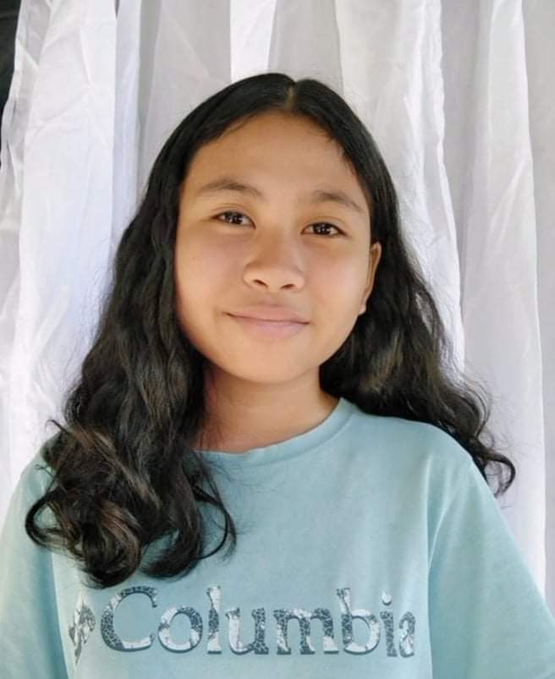
RAFINIAN, FEMIE S.
With Honors
90%

Slide 44
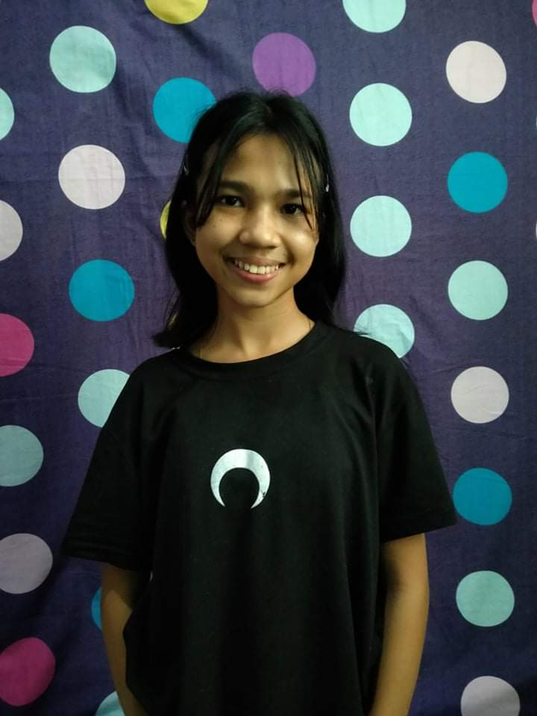
MALUBAG, DIANNE NICOLE D.
With Honors
90%

Slide 45
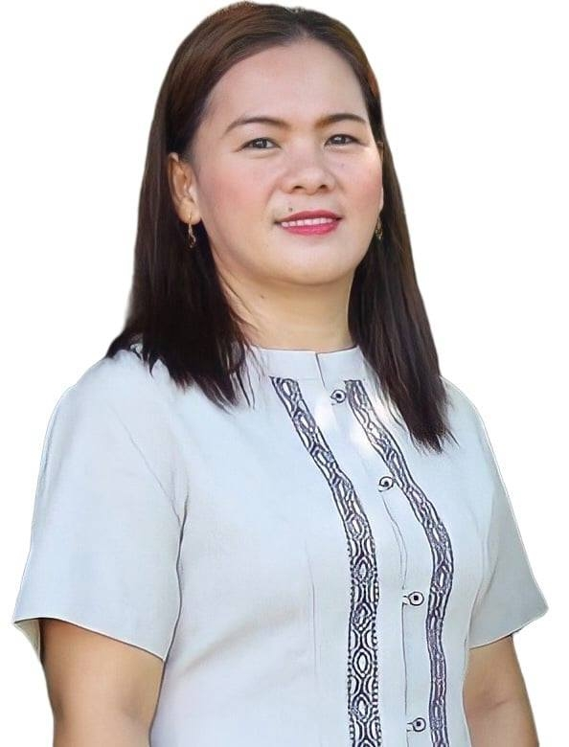
AGAPITO FLORES

Slide 46
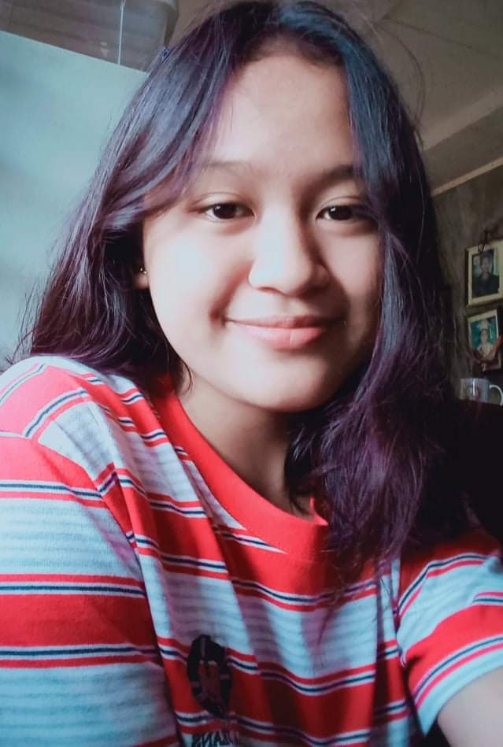
BOSI, PAULENE JOY E.
With Honors
93%

Slide 47
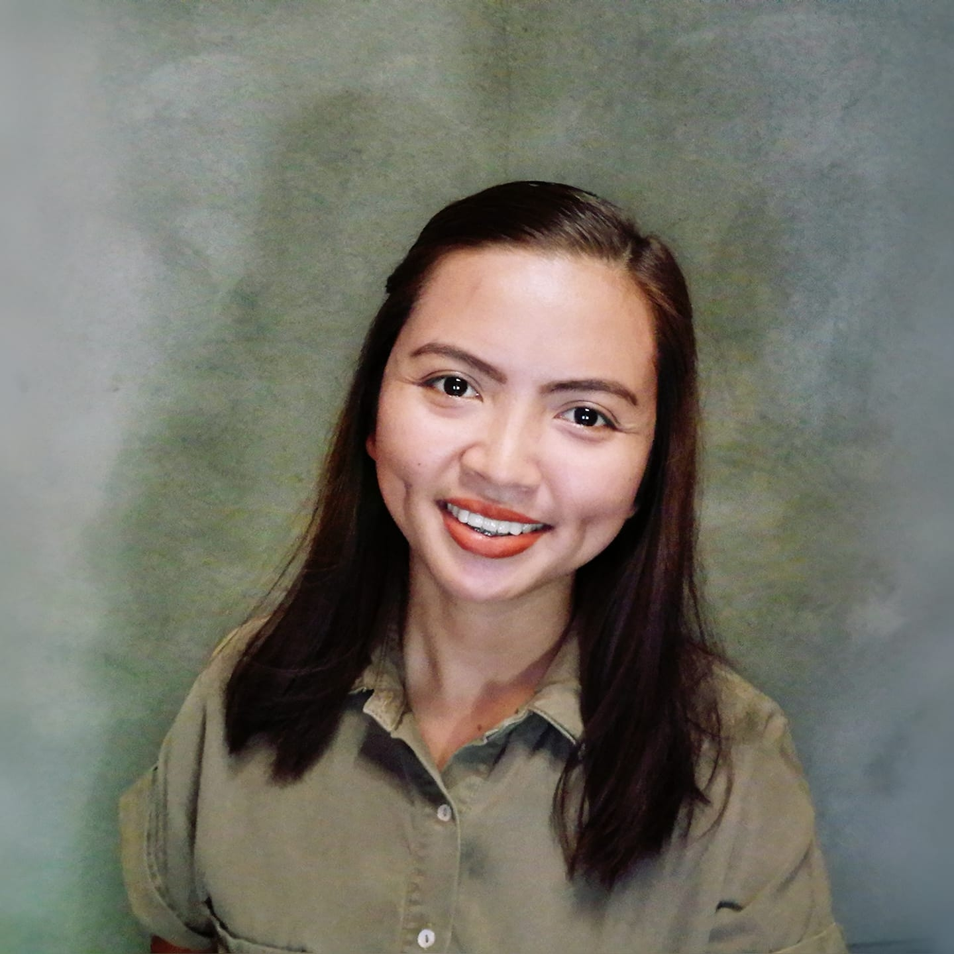
MARC LOINAZ

Slide 48
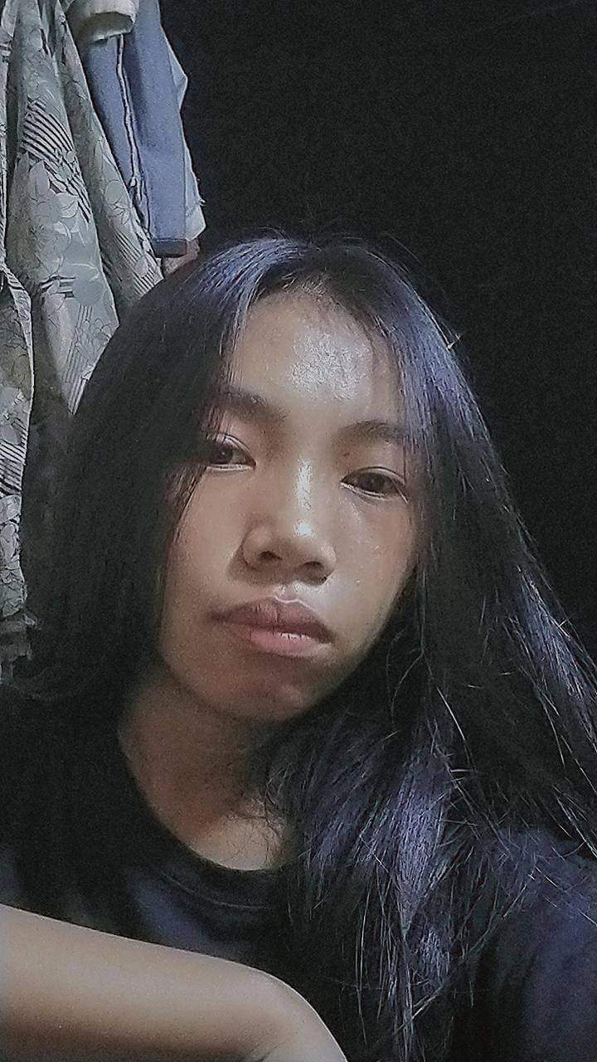
PENASCOSAS, ANGELICA CLARIZ B.
With Honors
90%

Slide 49
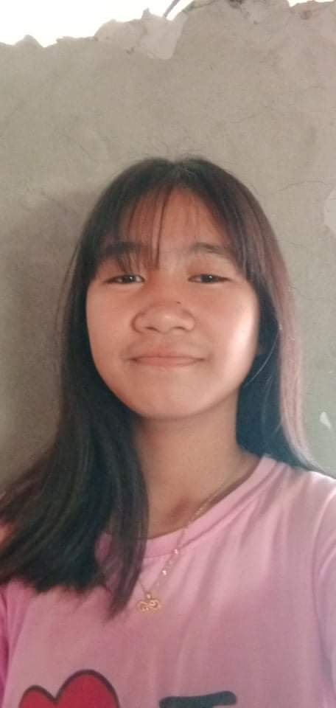
CAIS, KRISHA MAY G.
With Honors
90%

Slide 50
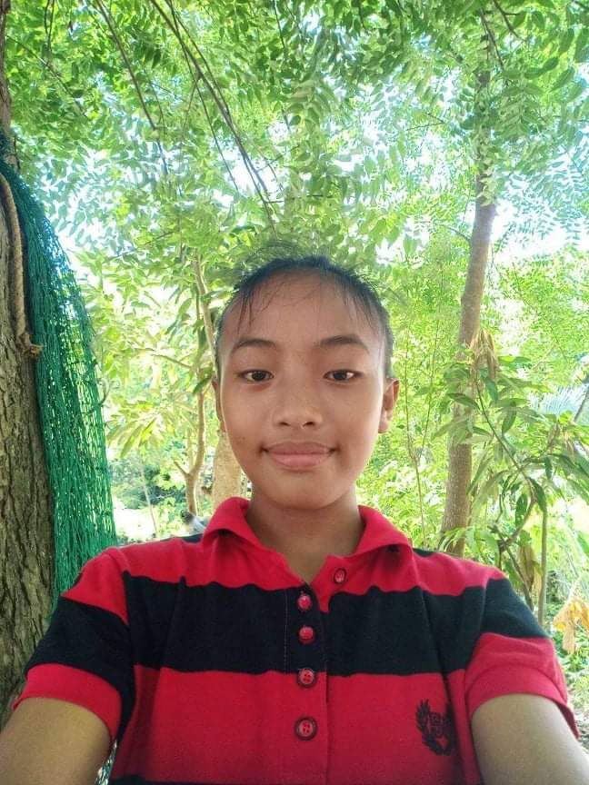
BURAC, ELOISA MAE C.
With Honors
90%

Slide 51
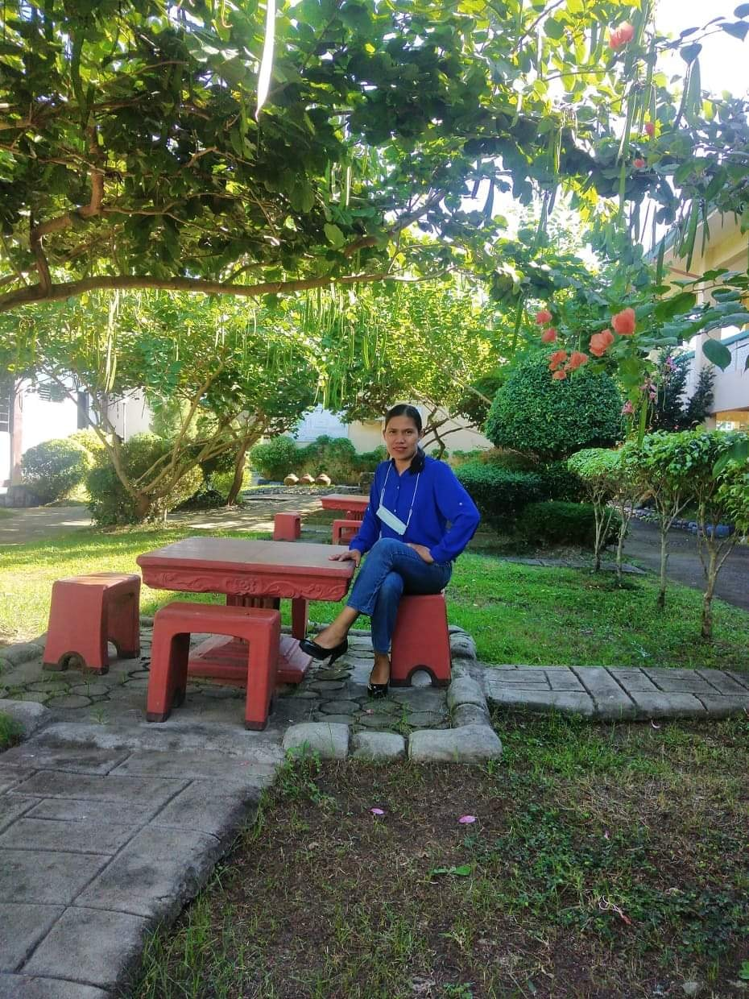
EDUARDO SAN JUAN

Slide 52
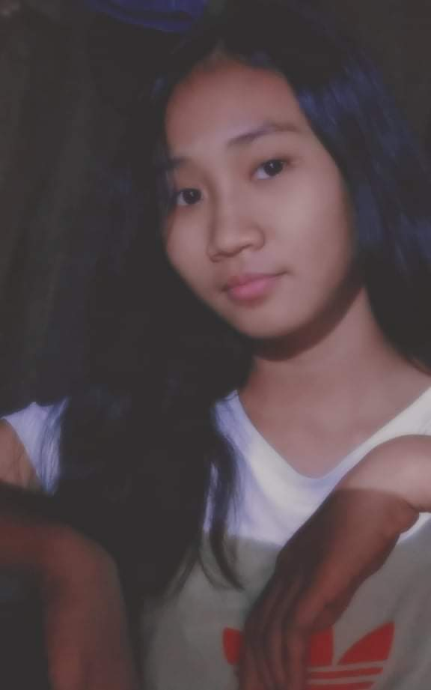
ROJADO JESSA B.
With Honors
90. 38%

Slide 53
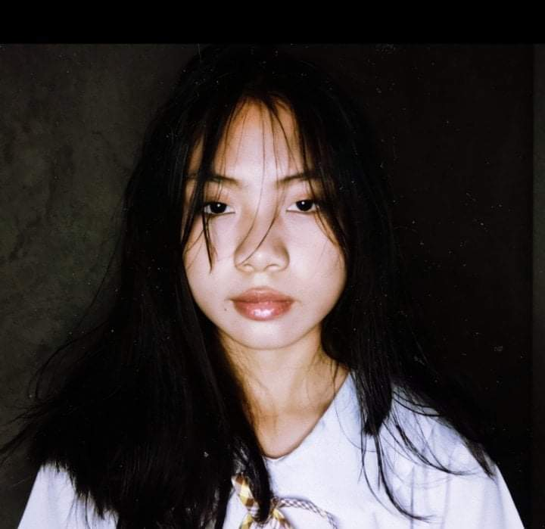
CORPUZ KARISA M.
With Honors
90. 25%

Slide 54

ANCHETA DIENEZE ALLIANA R.
With Honors
90. %

Slide 55


