Slide 1
Data Preparation and Analysis
PREV 758: Week 12
Very special thanks to Dr. Brown and the many talented TAs who have edited these slides over the years
Notes:
Good morning today we're going to discuss data preparation and analysis and I wanted to make a special note of thinking doctor brown and many TA's who have helped edit these slides over the years

Slide 2
Outline
Issues to consider before analysis
Data preparation
Data analysis

Slide 3
Issues to consider before analysis
“Statistics are no substitute for judgment.”
-Henry Clay

Slide 4
Issues to Consider Before Analysis
What are the main objectives of your study
  What was your research question(s) and/or hypothesis(es)?
The type of design used
  Cross-sectional, longitudinal
What is your unit of analysis?
  Individual, group, community, etc.

Slide 5
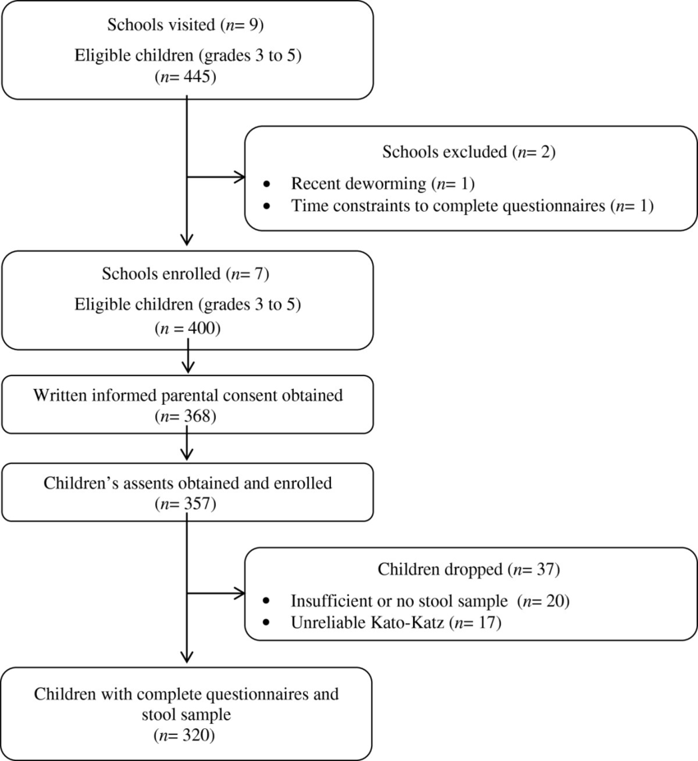
Issues to Consider Before Analysis
Eligibility criteria
Sample design
Sample size and response rate
  Do you have adequate power to detect a difference?
Gabrie et al. Parasites & Vectors. 2014.

Slide 6
Prior to Analysis: Ask
What is my research question?
What are my hypotheses?
How do I test my hypotheses?
How can I test the effect of interest?
Your conceptual framework is invaluable!!!

Slide 7
Psychometric Properties
Validity
  Content: comprehensive & representative
  Criterion: correlation with gold standard
    Sensitivity, specificity, positive predictive value, negative predictive value
  Construct: theoretical grounding
    Principal Component Analysis
    Factor Analysis

Slide 8
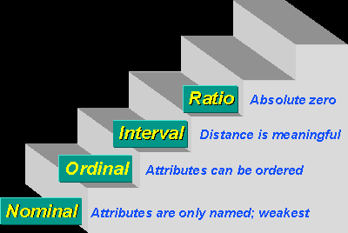
Measured Variables and Levels of Measurement
What are the independent/predictor variables?
What are the dependent/outcome variables?
What are the levels of measurement for these key variables?
  Nominal
  Ordinal
  Interval
  Ratio
http://www.socialresearchmethods.net/kb/

Slide 9
Level of Measurement
Nominal
  They “name” the attribute; no ordering is implied
Ordinal
  Rank-ordered; distances do not have meaning
Interval
  Distance has meaning but ratios are not interpretable
Ratio
  A scale in which both differences and ratios are interpretable
http://www.socialresearchmethods.net/kb/

Slide 10
Develop a Measurement Matrix
Survey Question # | Concept | Level of Measurement | Research question/ objective
Q1 | Satisfaction with patient-provider communication | Ordinal | #1
Q2 | Health status | Ordinal | #2
Q3 | Body Mass Index (kg/m²) | Interval | #2
. . .
Q55 | Demographics: sex of participant | Nominal | #1,#2, #4

Slide 11
Data Preparation
Activity that ensures the accuracy of the data
Conversion from raw form to a form more appropriate for analysis
This includes
  Preparation for data entry
  Data entry
  Preliminary analysis
  Data cleaning
  Evaluating missing data

Slide 12
Preparing for Data Entry: Data Dictionaries
Define all variables—create a data dictionary and codebook mapping out variables
  Variable names and labels
  Data type
    Numeric (integer and/or with decimal places)
    Character (open text to be coded)
  Valid values, valid range, missing value codes

Slide 13
Preparing for Data Entry: Coding
Coding involves usually assigning numbers to responses so that they can be easily grouped into categories (this will make analysis a lot easier)
  Use existing coding schemes
    Examples: Physical Disease (ICD)
  Specific codes for responses for each variable
  Examples:
      Gender: Male = 0 and Female = 1
      Health status: Poor = 1, Fair = 2, Good = 3, and Excellent = 4

Slide 14
Preparing for Data Entry: Scoring
You may need to score your questionnaire and/or do some calculations
Assign values/scores to responses
Combine response scores measuring same construct to have composite measures
  Indices
  Scales

Slide 15
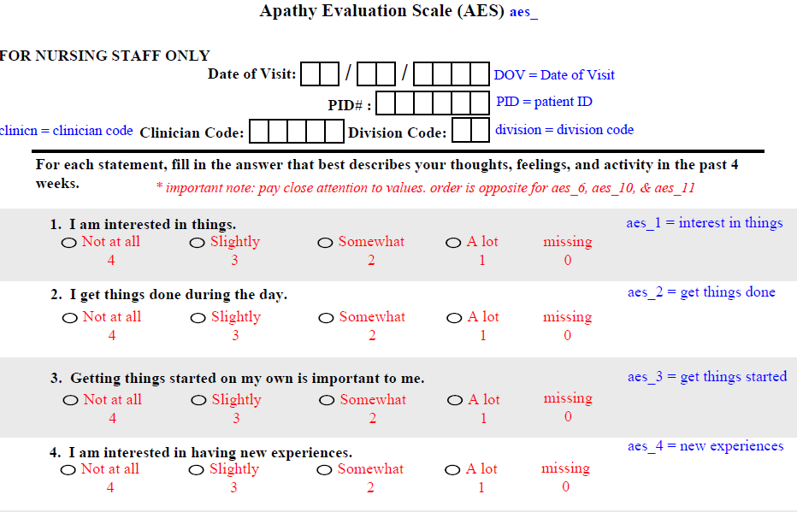
Covariate | Questionnaire | Level of Measurement | Scoring Range | How Administered | Years Available | n
Age | N/A | Continuous | N/A | Medical Record | 2003-Present | 1,686
Apathy | AES (30) | Ordinal | 18-72 (high=bad) | Self-Reported | 2007-2014 | 821
BMI | N/A | Continuous | N/A | Medical Record | 2003-Present | 1,565
Cognition | MMSE & MOCA (31, 32) | Ordinal or Binary (Impairment) | MMSE: 0-30; MOCA: 0-30 (high=good) | Nurse Admin | MMSE: 2003-2009; MOCA: 2010-Present | 1,591

Slide 16
Data Entry
Options
  Manual
  Optical character recognition (e.g., Teleform®)
  Computer-assisted data collection methods (e.g.,REDCap)
Transfer to statistical software (e.g., SPSS, SAS, STATA, etc.) for analysis

Slide 17
Data Cleaning
Main purpose is to guarantee that the data are:
  Accurate
  Consistent with the intent of the question and related information in the survey
  Uniformly entered
  Complete
  Arranged to simplify coding and tabulation

Slide 18
Data Cleaning
Range edits: data should be between specified range
  Age 1 to 120, no subject is 300 years old
Ratio edits: are they logical?
  Number of gallons of milk produced and number of cows should fall between expected values (are 2 cows producing 100,000 gallons of milk?)
Comparison to historical data: consistency across study visits
  Have demographics changed? Treatments? Retention?

Slide 19
Data Cleaning
Balance edits: percentage of time spent in activities should equal 100%
Outliers: check highest and lowest values
  In general, values 3 or more standard deviations from the mean
  Depends on your sample size
Consistency checks: cross tabulations
  A 10 year old should not report having a college degree

Slide 20
Example
In the following question asked of adults aged 18 and older, one respondent checked two categories—indicating that he was a retired officer and currently serving on active duty
PLEASE INDICATE YOUR CURRENT MILITARY STATUS:
  ACTIVE DUTY
  RESERVE
  RETIRED
  NATIONAL GUARD
  SEPARATED
  NEVER SERVED IN THE MILITARY

Slide 21
Data Cleaning
If multiple responses given when only one is expected, confirm which of the responses is:
  Consistent with the intent of the question or other information in the questionnaire, and
  Most accurate for this individual participant
May require call-backs or further investigation
Field or central editing

Slide 22

Choosing the Appropriate Statistical Test
Nature of the data
Sample characteristics
Inferences to be made

Slide 23
Nature of the Data
Number of variables
  Not for the entire study, but for the specific question at hand
Type of variables
  Numerical, continuous
  Dichotomous, categorical information
  Rank-order or ordinal

Slide 24
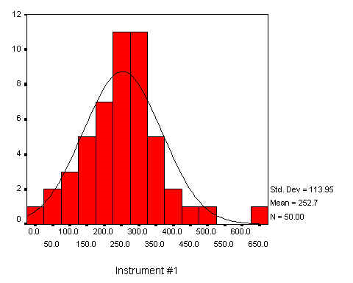
Sample Characteristics
Number of groups
Sample type
  Normal distribution (parametric) or non-normal distribution (non-parametric)
  Independent or dependent observations

Slide 25
Inferences to be Made
Data are meant to represent the population
  Do group means differ?
  Is there an association between variables?
    Strength?
    Direction?

Slide 26
Preliminary Analysis
A descriptive statistical summary is important in understanding the collected data
  Total number of participants
  Examine outliers and values outside of valid range
  Statistics on shape of distribution: skewness (asymmetry of distribution) and kurtosis (peakness of distribution)
  Using measures of central tendency to explore characteristics of the sample (e.g., demographics)
  Data entry errors may be identified

Slide 27
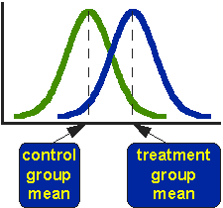
Descriptive vs. Inferential Statistics
Descriptive statistics
  Summary of characteristics of study participants (proportions, means, medians, range, SD)
Inferential statistics
  Hypothesis testing
  Drawing inferences about the population based on sample data
  Generate measures of association
  Describe likelihood that random chance alone would have given you similar results

Slide 28
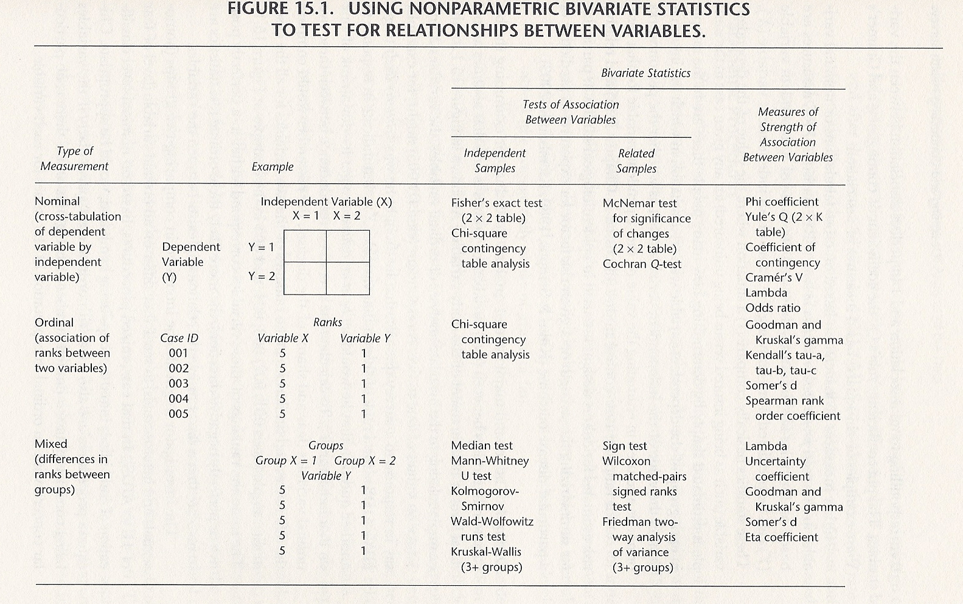
Aday, L.A., & Cornelius, L. J. (2006). Designing and Conducting Health Surveys (3rd ed.). Jossey-Bass, San Francisco, CA. (p. 375)

Slide 29
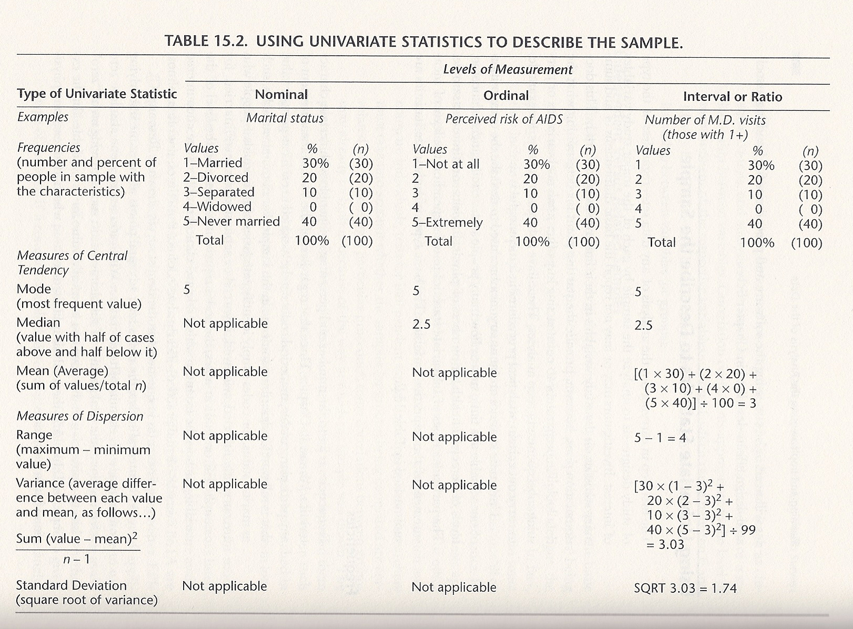
Aday, L.A., & Cornelius, L. J. (2006). Designing and Conducting Health Surveys (3rd ed.). Jossey-Bass, San Francisco, CA. (p. 370)

Slide 30
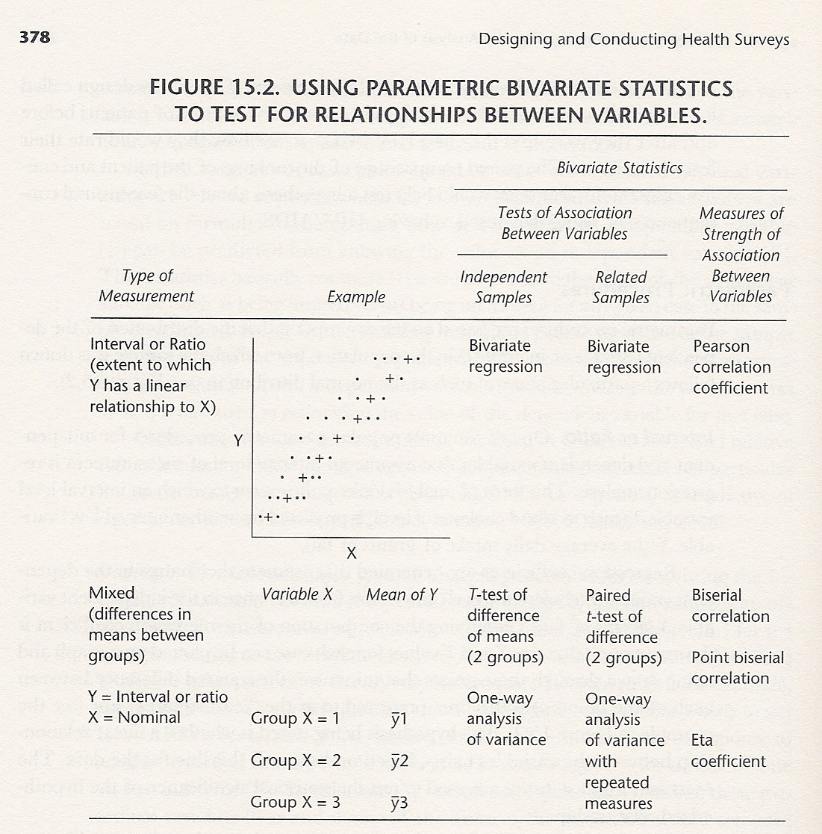
Aday, L.A., & Cornelius, L. J. (2006). Designing and Conducting Health Surveys (3rd ed.). Jossey-Bass, San Francisco, CA. (p. 378)

Slide 31
Analysis Plan
Univariate analysis
  Explore all variables of interest
  Categorize
  Assess normality
  Transform if necessary
Bivariate analysis
  Association of exposure(s) and outcome
  Associations of covariates with outcome
  Associations of covariates with exposure(s)
  Can help identify potential confounders

Slide 32
Analysis Plan Continued
Stratified analysis
  Can help identify effect modifiers
Regression analysis, survival analysis, etc.

Slide 33
Common Inferential Statistics
Z-test: compare means or proportions
Chi-square: association between categorical variables
Relative Risk/Prevalence Ratio/Odds Ratio: strength of association between two categorical variables
T-test: compare means between two groups or compare whether mean is different from a fixed value for one group
Mann Whitney-U test: like t-test but compares medians when distribution is non-normal
ANOVA: compares means for more than two groups
Kruskal-Wallis test: like ANOVA but used for non-normally distributed data
Correlation: association between two continuous variables

Slide 34
Regression
Linear regression: continuous dependent variable
Logistic regression: dichotomous (binary) dependent variable
Poisson regression: count/rate outcome
Survival analysis: time to event
  Kaplan Meier analysis
  Cox proportional hazards models

Slide 35
Independent or Dependent Samples
Independent
  Z test
  Unpaired/Independent samples t-test
  Wilcoxon rank sum test
  Chi-square test
  Fisher’s exact test
  Linear/Logistic/Poisson regression
  Survival analysis

Slide 36
Independent or Dependent Samples
Dependent → important for pre-post designs or designs where you collect data on individuals >1 time
  Paired t-test
  Wilcoxon signed rank test
  McNemar’s test
  Repeated measures ANOVA
  Repeated measures regression

Slide 37
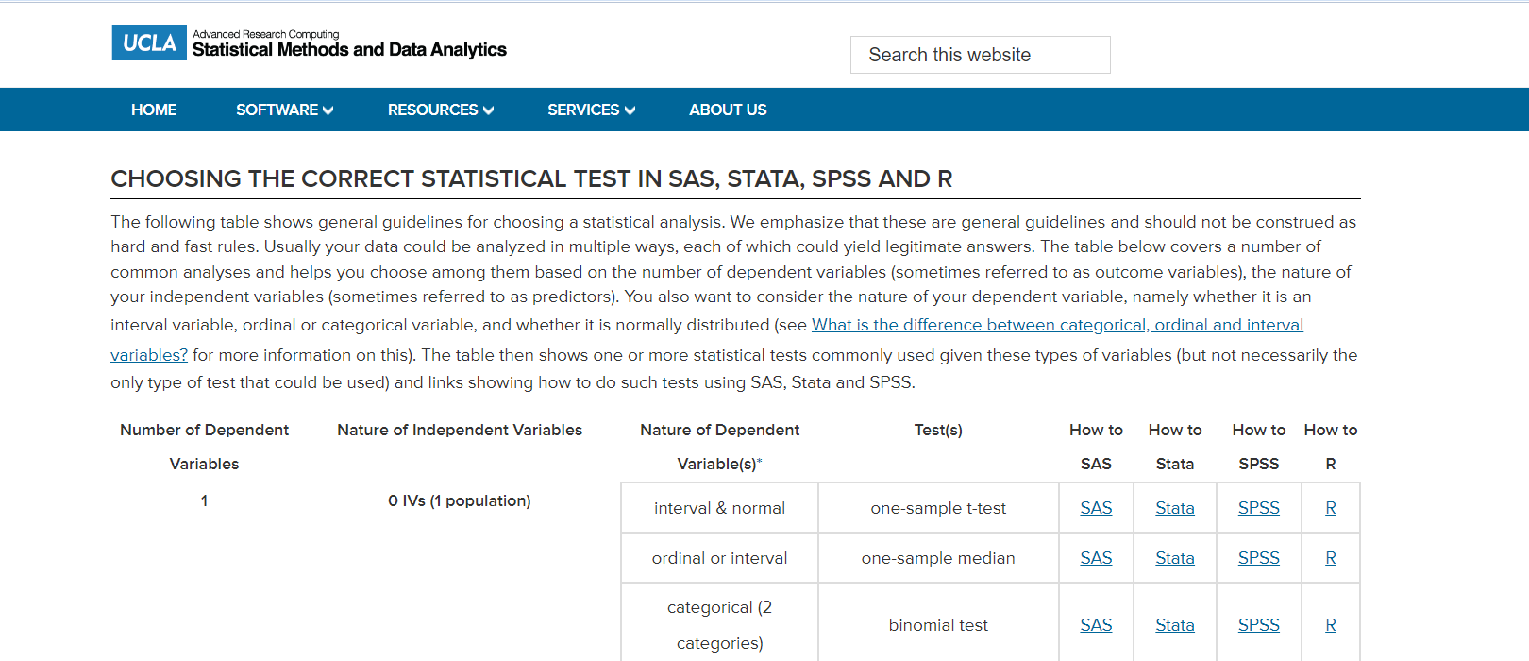
Notes:
https://stats.oarc.ucla.edu/other/mult-pkg/whatstat/

Slide 38
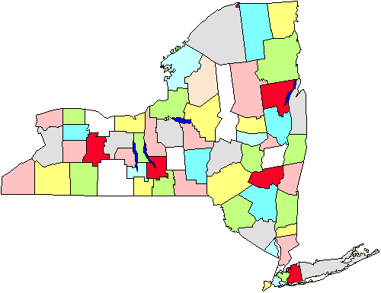
Weights and Survey Sample Design
Probability sample
  Simple random sample
  Systematic sampling
  Complex sample designs
    Stratified
    Cluster
    Mixed
Non-probability sample

Slide 39
Sample Weights
Used to adjust for differing probabilities of selection
Types of sample weights
  Post-stratification weights—bring sample proportions of demographic subgroups into agreement with population proportions
  Non-response weights—inflate weights of respondents to compensate for non-respondents with similar characteristics

Slide 40
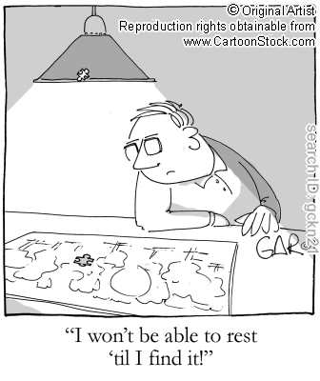
Missing Data
Why are there missing data?
  Refusals
  Not applicable
  Unintelligible responses
  “Don’t Know” responses
  Attrition: loss to follow-up
  Data processing errors
  Questionnaire programming errors
  Design factors (e.g., skip patterns, change in instrument)

Slide 41
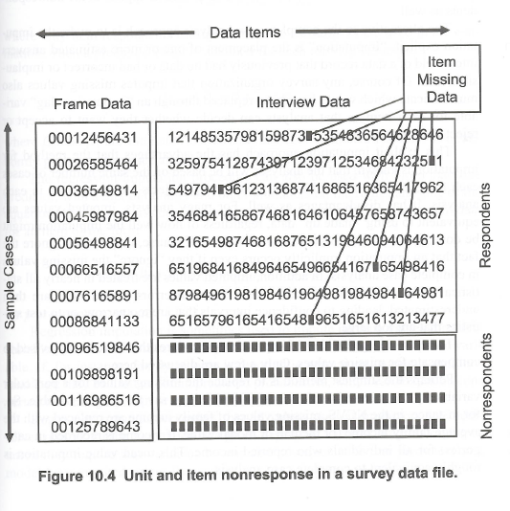
Missing Data
Descriptive analysis
  Unit nonresponse: the respondent does not answer at all
  Item nonresponse: the respondent participates but does not respond to certain individual items
Schafer, J. L., & Graham, J. W. (2002). Missing data: our view of the state of the art.
Psychological Methods, 7, 147-177

Slide 42
Why should I worry about this?
Ignoring or inappropriately handling the problem of missing data can lead to:
  Biased estimates of descriptors and associations
  Incorrect standard errors
  Incorrect inference!

Slide 43
Missing Data
The strategy for handling missing data consists of a two-step process:
  Explore the pattern of missing data
    Ignorable missing data
      Missing completely at random (MCAR)
      Missing at random (MAR)
    Non-ignorable missing data
      Missing not at random (MNAR)
  Select a missing data technique

Slide 44
Missing Data: MCAR
Missingness is independent of any variable
  Cases with complete data are not significantly different from cases with missing data
  Missing cases reflect a random subset of the original sample
  Example Random refusals: Suppose smoking information is missing on a questionnaire truly at random, then the missing data mechanism is considered random.
  Nothing determines which values will be missing except chance.

Slide 45
Missing Data: MAR
Example: Suppose women are less likely to report smoking than men.
Missingness is independent of the true value of that variable controlling for one or more other variables
  E.g., probability of missing a data point is unrelated to the value of that data point but is related to the value of another variable
    Grades and year in program
    Weight lost and weeks following diet

Slide 46
Missing Data: MNAR
Pattern of data missing is neither MCAR nor MAR
The fact that data are missing is related to what the value would have been
Suppose smokers are less likely to report their smoking status. Then the missing data mechanism is based on the (sometimes missing) values of smoking itself.
The probability of missing values is not random, but dependent on the true value of smoking.

Slide 47
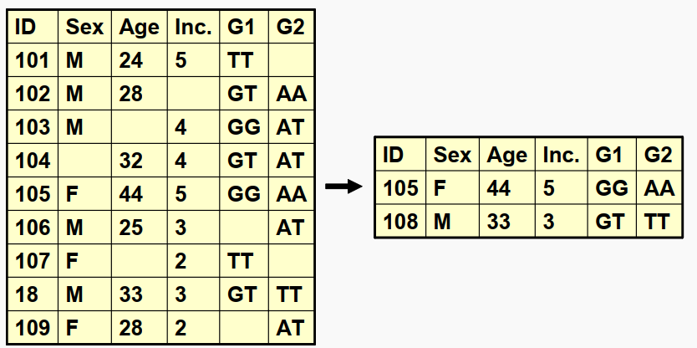
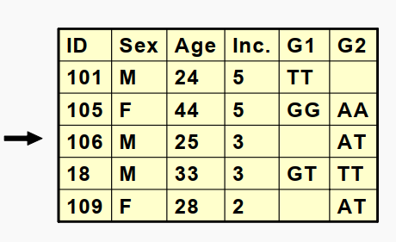
Missing Data: Strategies to Handle
List-wise deletion—uses only cases with complete data for all variables
Pair-wise deletion—uses all available data for a given variable
Dummy variable adjustment—use an indicator variable to adjust for missing

Slide 48
Missing Data: Strategies to Handle
Cold deck imputation—uses group estimates
  Group estimates, like the mean, are computed from available cases to substitute for a missing value
Hot deck imputation—uses actual data
  Random imputation within classes—randomly selects a case that matches missing case on certain characteristics (e.g., age, sex, etc.) and uses that case’s value to substitute for the missing piece of data
  Simple hot deck imputation—randomly selects a case and uses that case’s value to substitute for all cases missing that piece of data

Slide 49
Missing Data: Strategies to Handle
Regression methods
  Predict value based on regression equation with other variables as predictors
Maximum likelihood methods
  Use all available data to generate maximum likelihood-based statistics
Multiple imputation
  Combines the methods of ML to produce multiple data sets with imputed values for missing cases (e.g., multiple estimates of missing values)

Slide 50
Missing Data: Our Advice
Do not have missing data ☺
If you do, consult a biostatistician
For final assignment:
  Decide on exclusion or imputation
  State your chosen method and rationale

