Slide 1

Machine Tools
REALIZING YOUR IDEAS INTO MACHINE

Slide 2

INVITES YOU TO

Slide 3


Bengaluru International Exhibition
Centre
Stall A133
HALL 4 : Sukrit Machine Tools

Slide 4
MACHINES FOR
SHEET BENDING

Slide 5
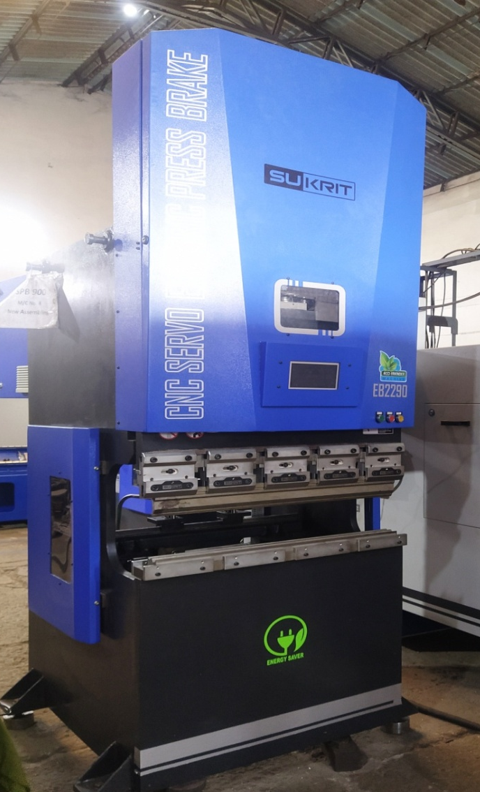
SERVO
ELECTRIC
PRESS
BRAKE

Slide 6
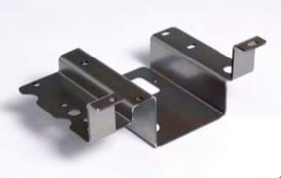
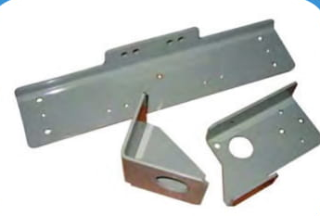

Slide 7
EB ECO – BEND MODELS
• 22 TON X 900 MM
• 22 TON X 1250 MM
• 40 TON X 1600 MM

Slide 8
Machine Tools
INVITE YOU TO
IMTEX FORMING 2022
16 -21 JUNE 2022
Bengaluru International Exhibition Centre
Stall A133
HALL 4 : Sukrit Machine Tools

