Slide 1


Media and Communication Skills
(Course Code: BEGG-171)
BLOCK -1: INTRODUCTION TO MASS COMMUNICATION
UNIT-1: The Concept of Communication
by IGNOU Guidance

Slide 2
BLOCK -1: INTRODUCTION TO MASS COMMUNICATION
UNIT-1: The Concept of Communication
In this class we aim to introduce you to the fundamentals of communication and its processes. The study of the different aspects of communication. It will help you to understand the dynamics of the communication process and the importance of communication in our daily life.
by IGNOU Guidance

Slide 3
BLOCK -1: INTRODUCTION TO MASS COMMUNICATION
UNIT-1: The Concept of Communication
After studying this unit you should be able to:
• Define communication and its meaning
• Explain its importance
• Define the communication process
• Identify essential elements of communication and the role that each of these elements plays in the communication process
• Discuss the seven C’s of communication.
by IGNOU Guidance

Slide 4
Communication: The Foundation of Human Interaction
Communication is the lifeblood of human civilization. It's how we share ideas, build relationships, and make sense of the world around us. From simple gestures to complex arguments, communication permeates every aspect of our lives. Whether it's a conversation with a friend, a presentation at work, or a text message to a loved one, the ability to communicate effectively is crucial for navigating the complexities of human interaction.
by IGNOU Guidance

Slide 5


Types of Communication
1
Verbal Communication
Verbal communication encompasses spoken language. It's the most common form of communication and involves the use of words to express thoughts, feelings, and ideas. This includes both formal and informal speech, ranging from presentations to casual conversations.
2
Nonverbal Communication
Nonverbal communication involves all forms of communication that do not rely on spoken language. This includes body language, facial expressions, gestures, and even silence. It's often subtle but powerful, adding nuance and depth to our interactions.
3
Written Communication
Written communication involves the use of written symbols to convey messages. This includes letters, emails, reports, and even social media posts. While it lacks the immediate feedback of verbal communication, it offers the advantage of permanence and allows for careful consideration of the message.
4
Visual Communication
Visual communication encompasses the use of images, symbols, and other visual elements to convey information. This includes everything from signs and diagrams to charts and graphs. It's particularly effective for conveying complex information in a concise and engaging manner.
by IGNOU Guidance

Slide 6
Understanding the Communication Process
1
Sender
The communication process begins with a sender who has a message to convey. This could be an individual, a group, or even an organization. The sender must first formulate the message, considering their purpose and the intended audience.
2
Encoding
The sender then encodes the message, transforming it into a form that can be transmitted. This involves choosing the appropriate language, tone, and medium, depending on the context and the intended receiver.
3
Channel
The message is then sent through a channel, which can be anything from face-to-face interaction to a phone call or email. The choice of channel depends on the nature of the message, the distance between the sender and receiver, and other factors.
4
Receiver
The receiver receives the message and begins the process of decoding it. This involves interpreting the message based on their own background, experiences, and understanding of the sender's intent.
by IGNOU Guidance
5
Decoding
The receiver decodes the message, attempting to understand its meaning based on their knowledge, experiences, and cultural background. This stage involves interpreting the words, gestures, and other signals sent by the sender.
6
Feedback
Feedback is the final stage of the communication process. It involves the receiver responding to the sender, confirming their understanding of the message. Feedback can be verbal, nonverbal, or written and is essential for ensuring that the communication is successful.

Slide 7
The Importance of Effective Communication
Building Relationships
Solving Problems
Achieving Goals
Effective communication is essential for building and maintaining strong relationships. It allows us to connect with others on a deeper level, share our thoughts and feelings, and build trust and understanding. This is true in both our personal and professional lives.
Communication is vital for resolving conflicts and finding solutions to problems. When we communicate effectively, we can clarify misunderstandings, identify common ground, and work together to find mutually agreeable solutions.
Effective communication is crucial for achieving individual and collective goals. It allows us to share ideas, motivate others, and work collaboratively to achieve common objectives. It's the foundation of successful teams and organizations.
by IGNOU Guidance

Slide 8

Barriers to Effective Communication
Physical Barriers
Psychological Barriers
Physical barriers can include noise, distractions, and distance. A crowded room, a noisy environment, or a poor phone connection can all make it difficult to communicate effectively.
Psychological barriers arise from our own thoughts, feelings, and perceptions. These can include stress, anxiety, biases, and preconceived notions. These can make it difficult to listen attentively, interpret messages accurately, or respond appropriately.
Cultural Barriers
Semantic Barriers
Cultural barriers can include differences in language, customs, values, and beliefs. These can lead to misunderstandings and misinterpretations. It's important to be mindful of cultural differences and adapt our communication style accordingly.
Semantic barriers arise from differences in the meaning of words or phrases. These can be caused by slang, jargon, or technical terms. It's important to choose language that is clear, concise, and understandable to the intended audience.
by IGNOU Guidance

Slide 9
Improving Your Communication Skills
Active Listening
Active listening is a crucial skill for effective communication. It involves paying close attention to what the speaker is saying, both verbally and nonverbally. It includes asking clarifying questions, summarizing key points, and showing empathy and understanding.
Clear and Concise Language
Using clear and concise language helps ensure that your message is understood. Avoid jargon, technical terms, and complex sentence structures. Choose words that are appropriate for your audience and the context of the communication.
Nonverbal Communication
Being aware of your own nonverbal communication is essential. Maintain eye contact, use appropriate gestures, and pay attention to your posture and tone of voice. These subtle cues can have a significant impact on the effectiveness of your communication.
Empathy and Understanding
Putting yourself in the other person's shoes can help you understand their perspective and communicate more effectively. Try to see the situation from their point of view and consider their feelings and needs.
by IGNOU Guidance

Slide 10

The Impact of Communication on Society
Political Discourse
Communication plays a crucial role in shaping political opinion, facilitating debates, and influencing elections.
Social Change
Communication has been a driving force behind social movements, enabling people to organize, raise awareness, and advocate for change.
Economic Growth
Effective communication is essential for businesses to succeed. It allows for clear communication of ideas, negotiation of deals, and building relationships with customers and partners.
Global Understanding
Communication bridges cultural divides, fostering understanding and cooperation between people from different backgrounds.
by IGNOU Guidance

Slide 11






The Future of Communication
Advancements in Technology
Advancements in technology, such as artificial intelligence, virtual reality, and augmented reality, are transforming the ways we communicate. These technologies are creating new opportunities for interaction, collaboration, and information sharing.
Global Connectivity
The internet and social media have made it easier than ever to connect with people across the globe. This increased connectivity is breaking down geographical barriers and fostering intercultural communication.
Digital Literacy
As technology continues to evolve, it's becoming increasingly important to develop digital literacy skills. This includes being able to navigate online platforms, evaluate information, and communicate effectively in digital environments.
by IGNOU Guidance
Ethical Considerations
As communication technology advances, ethical considerations are becoming increasingly important. This includes issues such as privacy, data security, and the potential for misinformation and manipulation.

Slide 12


The Functions of Communication
Communication is a fundamental aspect of human interaction, serving a multitude of purposes in our daily lives. From sharing information to influencing others, communication plays a vital role in shaping our understanding of the world and our relationships with others.
by IGNOU Guidance

Slide 13


Information
Information is a core function of communication. It encompasses a wide range of meanings, from everyday usage to technical settings. The concept of information is closely tied to imparting instruction, knowledge, meaning, mental stimulus, pattern, perception, and representation.
by IGNOU Guidance

Slide 14


Persuasion
Persuasion is a form of social influence that guides people towards adopting an idea, attitude, or action. It relies on rational and symbolic means, often employing appeals rather than force. Aristotle (philosopher) recognised persuasion as a crucial function of communication, as it facilitates decision-making and consensus on public policy, enabling control and governance.
Reaching Decisions
Ulterior Motives
Persuasion helps in reaching decisions or consensus on public policy so that it is possible to control and govern.
It is possible that one may resort to persuasion with an ulterior motive. The receiver must be careful about the source of such persuasion.
by IGNOU Guidance

Slide 15

Debate and Discussion
Debate is a formal method of interactive argument, encompassing persuasion and appealing to the emotional responses of an audience. It allows people to discuss and decide on differences within a defined framework. Deliberative bodies like parliaments, legislative assemblies, and meetings engage in debates, with outcomes determined by audience vote, judges, or a combination of both.
1
Clarifying Viewpoints
2
Critical Appraisal
It is through debate and discussion in media that the public can clarify different viewpoints on issues of public interest and arrive at a general agreement on matters that concern all.
It is important for them to find out the reasons for such debates and discussions. Critical appraisal of debates and discussions benefit the users.
by IGNOU Guidance

Slide 16


Instruction
Instruction is a form of communicated information that serves as both a command and an explanation for how an action, behavior, method, or task is to be begun, completed, conducted, or executed. One of the major functions of communication is to instruct, educate, and socialize members of society.
Early Life: These functions start early in life, at home or in
school and continue till one completes the full cycle of life.
Knowledge and Skills: Communication provides a fund of
knowledge, expertise and skills that enable people to
operate as effective members of society.
Public Life: It also creates awareness, gives direction and
opportunity to people so that they actively participate in
public life.
by IGNOU Guidance

Slide 17
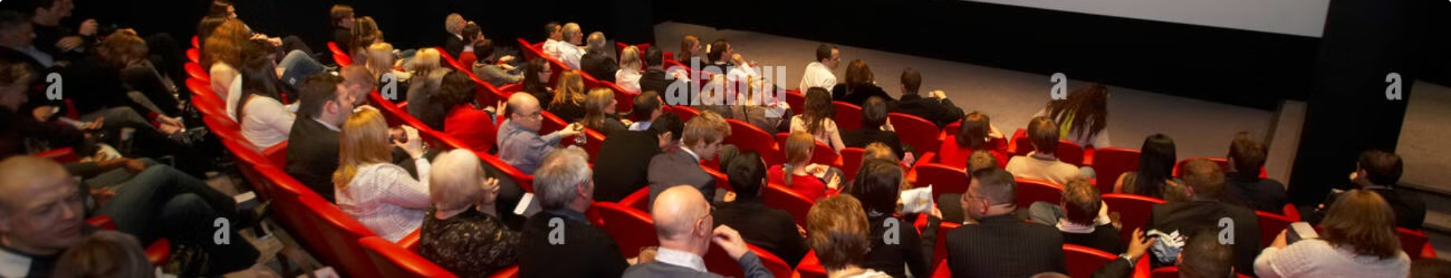


Entertainment
Entertainment is an activity designed to give pleasure or relaxation to an audience. The audience may participate in the entertainment passively, as in watching film, TV show or actively, as in playing a game.
Passive Entertainment
Active Entertainment
The audience may participate in the entertainment passively, as in watching opera.
The audience may participate in the entertainment actively, as in playing a game.
by IGNOU Guidance

Slide 18
Social Interaction
Communication is essential for social interaction. It allows us to build relationships, share experiences, and connect with others. Through communication, we can express our thoughts and feelings, understand others' perspectives, and resolve conflicts.
Building Relationships
Expressing Ourselves
Communication allows us to build relationships, share experiences, and connect with others.
Through communication, we can express our thoughts and feelings, understand others' perspectives, and resolve conflicts.
by IGNOU Guidance

Slide 19




Cultural Transmission
Communication plays a vital role in transmitting culture from one generation to the next. It allows us to share traditions, values, beliefs, and knowledge, ensuring the continuity of our cultural heritage.
Traditions
Communication allows us to share traditions, values, beliefs, and knowledge.
Cultural Heritage
It ensures the continuity of our cultural heritage.
by IGNOU Guidance

Slide 20
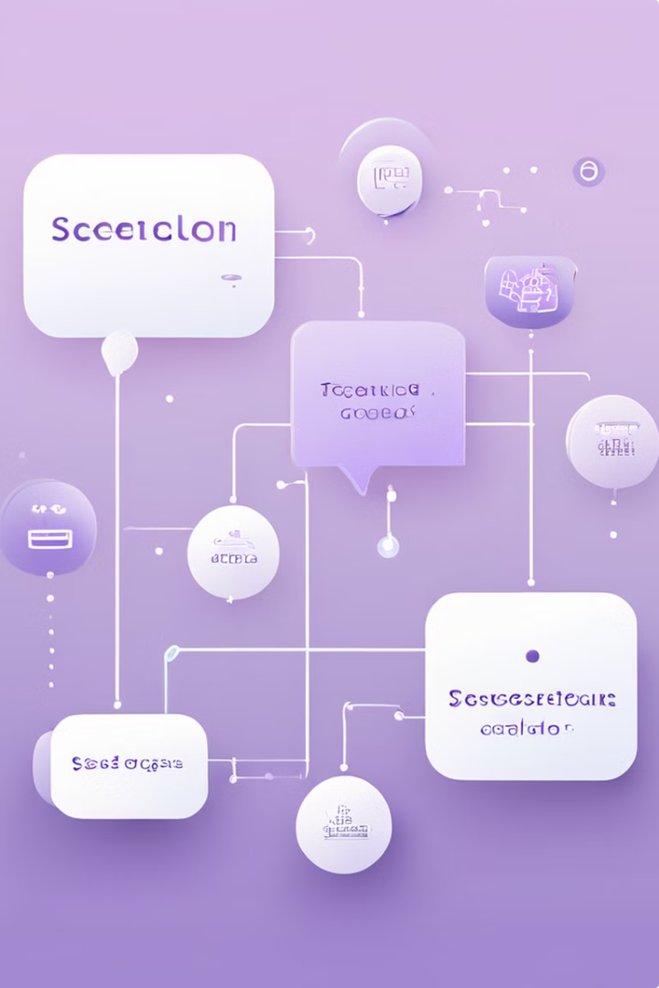
Elements of Communication
Communication is a complex process involving various elements that work together to facilitate the exchange of information, ideas, and messages. These fundamental components are essential for effective communication.This process is ongoing and ever changing, which involves five major elements. The five elements are:
the message,
the sender,
the transmission medium,
the receiver and
the feedback.
by IGNOU Guidance

Slide 21



The Message
Definition
Mediums
Emotion and Meaning
A message is the fundamental object of communication, containing information that conveys meaning in a given context.
Messages can be conveyed through various spoken and written mediums, such as radio programs, films, paintings, and photographs.
Messages involve not just information, but also the emotions that give words their full meaning. Non-verbal cues can further shape the interpretation of verbal messages.
by IGNOU Guidance

Slide 22
The Communicator (sender)
Formulate the Message
Overcome Psychological Barriers
The communicator starts by putting their thoughts into words, encoding the message to be transmitted.
The message must be filtered through the communicator's existing knowledge, beliefs, biases and feelings before encoding.
Transmit and Receive Feedback
Know Your Audience
After encoding and transmitting the message, the communicator immediately becomes the receiver to accept feedback and verify delivery.
Failure to understand the audience can lead to misunderstood messages. The communicator must tailor the message accordingly.
by IGNOU Guidance

Slide 23
The Transmission Medium (Channel)
Verbal Communication
Written Communication
Choosing the Right Channel
Verbal communication channels include face-to-face meetings, telephone conversations, and video conferencing. These allow for real-time interaction and immediate feedback, but can be limited by distance and lack of visual cues.
Written communication channels like letters, emails, and reports provide a permanent record and can convey complex information. However, the lack of immediate feedback can lead to misunderstandings.
The choice of communication channel should consider the message's complexity, the need for feedback, and the intended audience. Each channel has strengths and weaknesses that must be weighed to ensure effective delivery.
by IGNOU Guidance

Slide 24



The Receiver
Successful Decoding
Avoiding Misunderstandings
Overcoming Barriers
Interpreting a message effectively requires skills like active listening and careful reading. The receiver must have enough context and knowledge to properly understand the meaning.
Environmental factors like noise, poor lighting, and physical distractions can interfere with the receiver's ability to properly perceive and interpret a message. Reducing these barriers is key for effective communication.
Decoding errors can lead to confusion, especially if the receiver lacks the necessary background to make sense of the message. Shared language and definitions are crucial for successful communication.
by IGNOU Guidance

Slide 25
Feedback: The Key to Effective Communication
Confirm Understanding
1
Feedback is crucial to verify that the message has been received and comprehended as intended. It completes the communication process.
2
Solicit Questions
In face-to-face conversations, encouraging the receiver to ask questions is an effective way to gauge their understanding.
Vary Feedback Types
3
Feedback can range from a simple verbal acknowledgment to a specific action, depending on the communication channel and context.
by IGNOU Guidance

Slide 26

Kinds of Communication
Explore the different types of communication, from internal self-talk to mass media broadcasts, and understand how each serves unique purposes and contexts.
by IGNOU Guidance

Slide 27

Intrapersonal Communication
Intrapersonal communication is the internal dialogue we have with ourselves. It involves the symbolic processing of messages within the individual, where they become both the sender and receiver of their own thoughts and ideas.
This internal communication is crucial for self-awareness, decision-making, and personal growth. It allows us to reflect on our experiences, process information, and formulate responses before expressing them externally. So, Every time an individual does something or speaks, he or she hears it first within himself or herself.
by IGNOU Guidance

Slide 28
Interpersonal Communication
Defined by Relationship
Comparing Communication Forms
Contextual Factors
Communication Channels
Interpersonal communication is defined by the interdependence and shared history between the participants. It involves direct, face-to-face interactions where multiple sensory channels are used.
Interpersonal communication differs from other forms in the number of people involved, physical proximity, sensory channels used, and immediacy of feedback.
Beyond just the participants and channels, the relationship between interactants also plays a key role in defining interpersonal communication.
Interpersonal communication can occur through direct (e.g. face-to-face) or indirect (e.g. phone, email) channels, each with their own advantages and constraints.
by IGNOU Guidance

Slide 29

Group Communication
Group communication examines the most effective ways of interacting within social and work groups. It provides an opportunity for direct interaction among members, helping to bring about changes in attitudes and beliefs, and offering a clearer understanding.
The degree of interaction and intimacy in group communication depends on the size of the group - the larger the group, the lesser the personal intimacy and exchange.
Three general categories have been identified as critical to successful group communication:
Commitment - Members’ integrity and leadership qualities
Communication- discussion, listening and facilitation
Organisation- setting ground rules for communication, decision-making
by IGNOU Guidance

Slide 30

Mass Communication
Mass communication refers to the methods by which individuals and organizations distribute information to large audiences simultaneously through media like newspapers, radio, television, and the internet.
Advancements in media technology have enabled more interactive and engaging forms of mass communication, allowing people to actively participate and shape the content they consume.
by IGNOU Guidance

Slide 31
The Changing Landscape of Mass Communication
The traditional notion of 'mass' communication has evolved. Rather than a passive, homogeneous audience, people now actively engage with media through computers, smartphones, and the internet. This two-way interaction challenges the assumption of a bland and undifferentiated mass culture, as individuals question and shape the content they consume.
Advancements in media technology have empowered people to be more than just recipients of information. They now participate in the creation and curation of content, making mass communication a more dynamic and collaborative process.
by IGNOU Guidance

Slide 32
What is Mass Communication?
Mass communication refers to the methods by which organizations or individuals distribute information to large audiences simultaneously through various media channels such as newspapers, radio, television, and the internet. It enables the rapid and widespread dissemination of information, ideas, and entertainment to a diverse population.
Unlike interpersonal or group communication, mass communication is characterized by one-to-many transmission, where a single source communicates to a large, often anonymous and heterogeneous audience. This dynamic has evolved with the rise of digital media, allowing for more interactive and participatory forms of mass communication.
by IGNOU Guidance

Slide 33
The Seven C's of Communication
Content - The substance and meaning of the message being communicated.
Context - The setting, situation, and circumstances that frame the communication.
Channels - The method of transmission, such as verbal, written, or digital.
Clarity - Ensuring the message is understandable and free of ambiguity.
Composition - The structure and organization of the communication.
Contrast - Using visual elements to highlight important information.
Consistency - Maintaining a coherent and recognizable style across communications.
by IGNOU Guidance

Slide 34
The Importance of Content in Communication
Defining Your Message
Tailoring to the Audience
Providing Necessary Information
Achieving Your Communication Goal
The content of your communication is the most crucial element. Start by identifying your key message - what do you want your audience to understand and remember?
Knowing your audience is essential. Craft the content to match their needs, values, and level of understanding to ensure your message resonates.
Ensure your content covers all the relevant details and facts required for your audience to comprehend the full meaning and significance of your message.
Whether your aim is to inform, persuade, or entertain, the content must be aligned to successfully accomplish your intended purpose.
by IGNOU Guidance

Slide 35
The content of a message is the most crucial factor in determining the effectiveness of communication. What you want your audience to remember and take away is the foundation of your communication. Before crafting your message, you must clearly define your primary objective and ensure the content is tailored to address it. Gather the necessary information, structure it logically, and present it in a way that resonates with your audience's values and needs.
by IGNOU Guidance

Slide 36
The Importance of Context in Communication
The context in which communication takes place is crucial for its effectiveness. It provides the necessary background, setting, and circumstances that frame the message. A clear understanding of the context allows the communicator to tailor the content, tone, and approach to best resonate with the target audience.
Identify the Situation: Before crafting your communication, ask yourself - do you fully grasp the existing context? Are there any underlying issues or unspoken factors that could impact the reception of your message?
Adapt to the Environment: Consider the physical environment, social dynamics, and cultural norms that will shape how your message is perceived. Adjust your communication style and content accordingly to create the most favorable conditions for engagement and understanding.
by IGNOU Guidance

Slide 37
Communication Channels
Effective communication relies on utilizing established channels that the receiver already uses and respects. Different channels have unique effects and serve different stages of the communication process. Introducing new channels can be challenging, so it's crucial to select the right medium for your message.
Leverage Existing Channels: Identify the communication channels your audience already uses and prefers, such as email, social media, or face-to-face interactions.
Match the Channel to the Message: Choose the communication channel that best suits the content, tone, and purpose of your message for maximum impact.
Consider the Diffusion Process: Utilize different channels at various stages of the communication process, from initial awareness to deeper engagement and action.
by IGNOU Guidance

Slide 38
The Importance of Clarity in Communication
1
Concise and Focused
2
Common Understanding
3
Simplicity Wins
Effective communication requires distilling complex ideas into simple, straightforward messages. Avoid unnecessary jargon or tangents that could cause your audience's attention to drift.
Ensure that the words and concepts you use have the same meaning for the receiver as they do for you. Bridge any gaps in background knowledge or cultural references.
As communication travels further, it should become increasingly simple and direct. Condensing your message into clear, memorable slogans or talking points can help it resonate and be easily shared.
by IGNOU Guidance

Slide 39



Crafting Effective Composition
Modular Approach
Identifying Patterns
Crafting the Narrative
Break down your content into easily digestible modules using index cards or other tools. This allows you to rearrange and refine your messaging in a flexible way.
Analyze how your information can be grouped and connected. Identify key themes and relationships to structure your communication in a logical, engaging flow.
Develop a clear narrative arc for your communication, complete with characters, goals, conflicts, and a resolution. This will captivate your audience and make your message more memorable.
by IGNOU Guidance

Slide 40
Contrast: The Power of Comparison
When making any point, ask, “in comparison with what?” It is a trigger to the brain that says “pay attention"
Big vs. Small
Rough vs. Smooth
Black vs. White
Before vs. After
Highlighting the stark differences between large and small can instantly capture attention and emphasise key points. This visual contrast triggers the brain to focus on the underlying message.
Contrasting rough and smooth textures, surfaces, or finishes can add depth and dimension to your communication. This sensory contrast evokes emotions and helps your audience better understand the concepts you're presenting.
Using the extremes of the colour spectrum - black and white - creates a high-contrast visual that immediately draws the eye. This striking comparison makes your key points stand out and be more memorable.
Showing the transformation from one state to another through a "before and after" contrast can powerfully demonstrate the impact or effectiveness of your message. This comparative approach helps your audience grasp the significance of the change.
by IGNOU Guidance

Slide 41

Consistency in Communication
Consistency is key in effective communication. Maintain consistent styles, spacing, and formatting to avoid distracting your audience. Repetition is essential to reinforce your message and ensure it resonates. A consistent narrative and storytelling approach will make your communication more impactful and memorable.
by IGNOU Guidance

Slide 42
Summing Up Communication Concepts
The Communication Process
1
Communication is a dynamic, ever-changing process involving the message, sender, transmission medium, receiver, and feedback.
2
Effective Communication
Effective communication requires the message to be clear, accurate, and understood by the receiver. It is a complex process of designing and constructing the right presentation or experience.
Key Elements of Communication
3
At minimum, communication requires a source, a message, and a destination. The source could be an individual or an organization, and the destination could be a person or a group.
by IGNOU Guidance

