Slide 1
Architecture Document for
EMPLOYEE
ONBOARDING
RPA
Presented by
Best of the Best

Slide 2
1 Introduction – PART-A
1.1 Purpose
This document provides a comprehensive architectural overview of the EMPLOYEE ONBOARDING RPA system , When a new employee is going to be offered a job, the offer letter is automatically generated and sent out by the RPA system. This onboarding workflow allows access to company data systems that are needed for the new employees to do their work.
Onboarding helps new hires adjust to the social and performance aspects of their jobs so they can quickly become productive, contributing members of the organization.
The software or robot can be taught a workflow with multiple steps and applications, such as taking received forms, sending a receipt message, checking the form for completeness, filing the form in a folder, and updating a spreadsheet with the name of the form, the date filed, and so on. RPA software is designed to reduce the burden for employees of completing repetitive, simple tasks.

Slide 3

1.2 SCOPE OF EMPLOYEE ONBOARDING
Employee onboarding, also known as organizational socialization, is a process that enables a new employee to familiarize themselves with the company.
It provides them with all the necessary tools, skills & support that will help them get started with their role & contribute effectively to the company in as little time as possible.
New employee onboarding is the process of integrating a new employee with a company.
Its culture, as well as getting a new hire the tools and information needed to become a productive member of the team.

Slide 4

SCOPE OF RPA
RPA has provided an excellent solution for organizations to replace repetitive, mundane, rule-based processes with software bots.
It is now helping organizations who were looking to increase their workflow accuracy and efficiency. First, RPA was widely adopted in the IT sector.

Slide 5
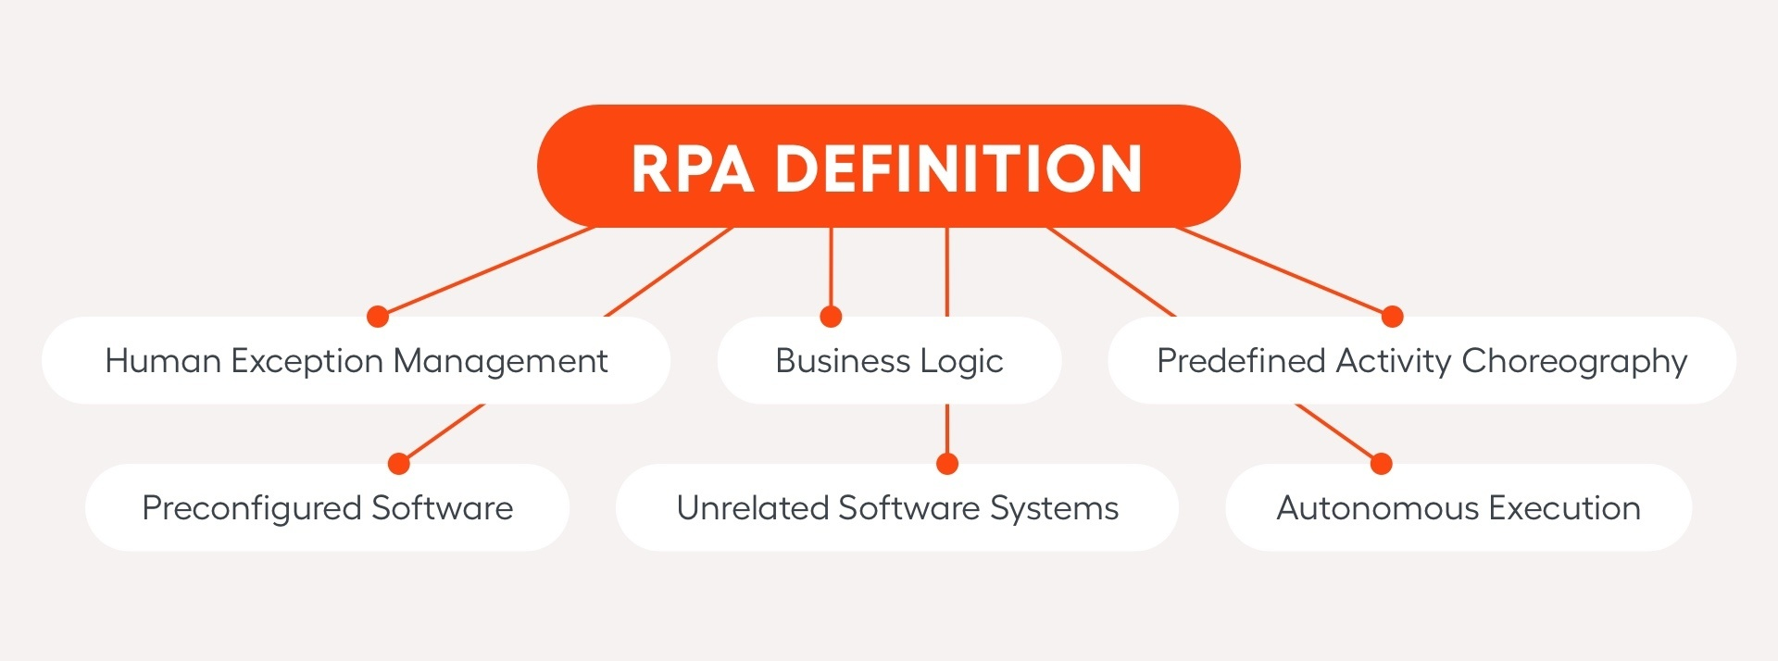
1.3 DEFINITIONS,ACRONYMS AND ABBREVATIONS
Definition: Employee Onboarding
Employee onboarding is broadly defined as the process of familiarizing a (new) employee with the organizations policies, the employees role in the organization, and the organizations culture. It also involves creating an environment in which the employee is made comfortable enough to interact freely with their colleagues and establish social relationships in the workplace.
Definition: RPA
RPA occurs when basic tasks are automated through software or hardware systems that function across a variety of applications, just as human workers do. This can greatly reduce labor costs and increase efficiency by speeding things up and greatly minimizing human error.

Slide 6
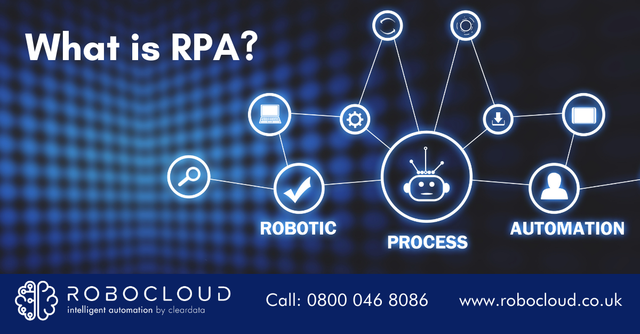
ABBRIVATIONS
NEO : New Employee Onboarding
RPA : Robotic Process Automation

Slide 7
1.4 References
https://www.nummite.com
https://www.techfunnel.com>information-technology
https://www.automationanywhere.com>rpa>
https://elearningindustry.com

Slide 8

2.Architectural Goals and Constraints
2.1 Reusability
Reusable RPA plugins can be added to your RPA bot to take care of specific tasks like checking and sending emails, manipulating spreadsheets, translating text etc. Therefore, they reduce development efforts, error rates and implementation time. Reusable RPA plugins have numerous names.

Slide 9
2.2 Scalability
1.Build an engaging yet scalable employee onboarding process
The first step toward onboarding multiple new hires at once is to build an engaging, scalable employee onboarding process.
Sync with your hiring managers and new employees to learn what’s working, what’s not, and where you can improve.
2. Onboard new employees in groups
If you’re onboarding multiple employees at once, using a group format for certain activities is more efficient for you and more engaging for your new hires.
A group format may be appropriate for things like:
Office tours
Benefits explanations
Company leadership meet-and-greets
Product demos
Company history, mission, vision, and values review
Internal tools overview
Onboarding groups encourage early relationship-building among new hires, and can help cut back on the time your People Ops team spends onboarding employees.

Slide 10
3. Enable your managers
Your managers play an important role in onboarding, and should be enabled to provide an outstanding early employee experience.
Make sure they’re up-to-date on your employee onboarding process, and that they understand their roles and responsibilities.
Your managers are more equipped to give new employees the one-on-one time they may need to fully ramp.
Enabling them to execute on a strategic employee onboarding plan can help you fully onboard more hires at once.
4. Invest in the right technology
Spreadsheets or your project management tool may have worked when you were hiring a few people each month, but they get messy once you scale.
Tasks can be overlooked, you may forget to provide updates for completed tasks, or you may mark the wrong column.
The right technology can help you build a more efficient and consistent employee onboarding experience.
Take full advantage of HR integrations, so that new hire data can flow from your applicant tracking system to your People Operations Platform, then to your other systems.

Slide 11
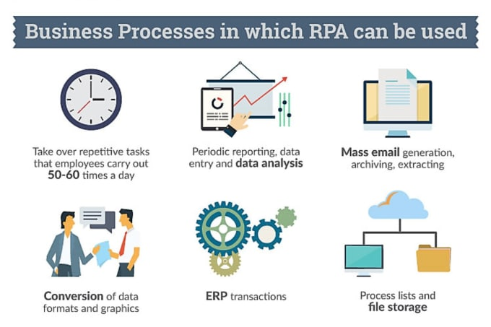
2.5 Use of Existing Business Logic

Slide 12
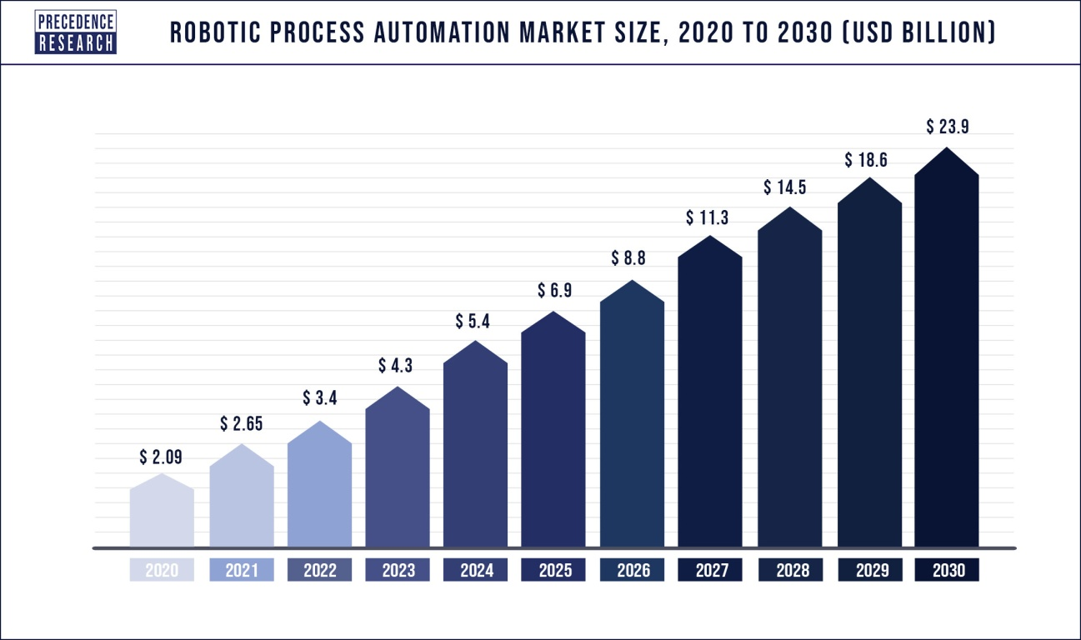
Crucial factors accountable for market growth are:
Penetration of RPA to manage complicated unstructured data and automate any business operation.
Increasing Adoption of Artificial Intelligence and Cloud-Based Solutions.
High demand for RPA services from BFSI sector.
The innovation and technological advancement.
The increasing focus on reducing the burden of medical professionals.

Slide 13
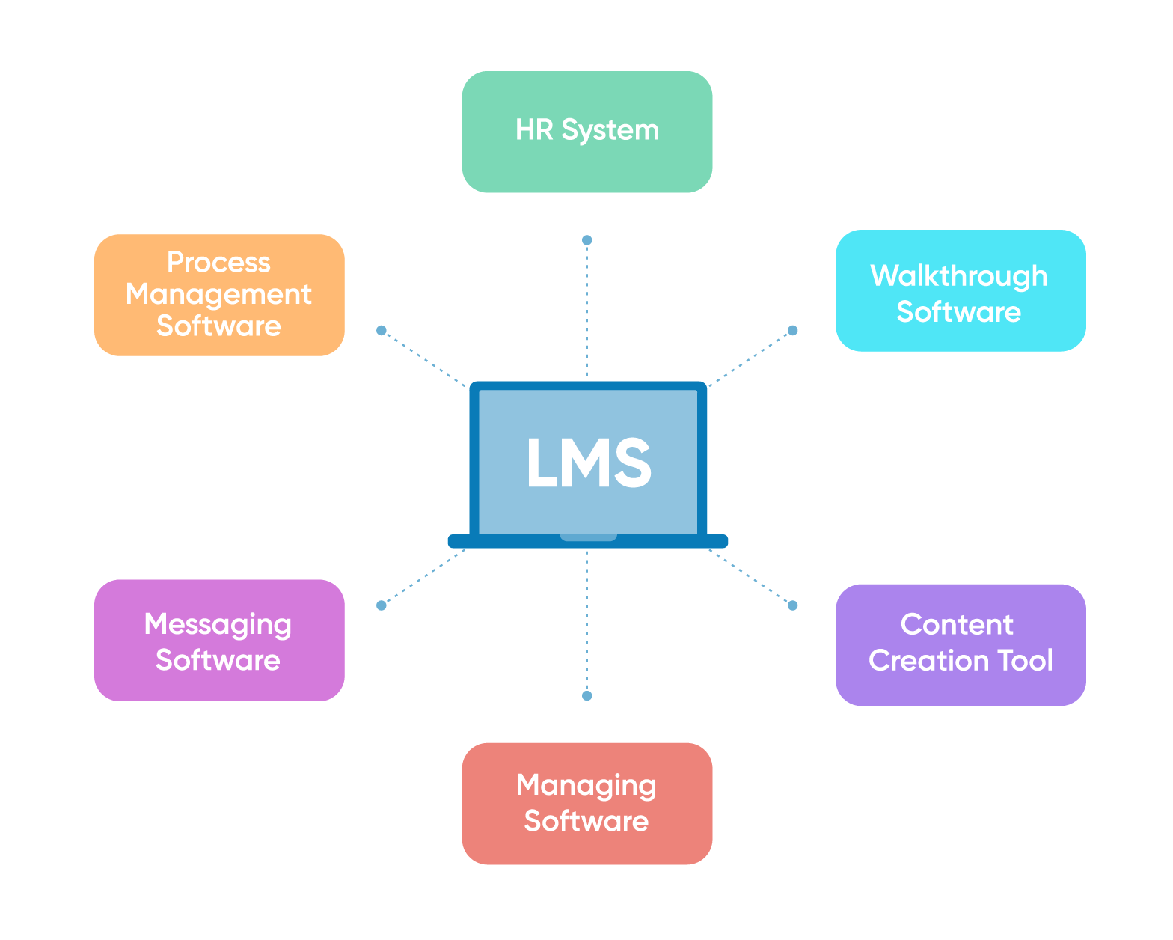
2.7 Portability
Portability in this context refers to the ability to open, read, and action automation files in any RPA platform.
The major RPA vendors have their own proprietary way to detail process automations, limited to those platforms.
A good analogy for this is that there is no equivalent .docx that can be opened in any word processing tool
.xlsx that can be opened and modified in any of the most common spreadsheet tools, whether it be Microsoft Excel, Google Sheets, or Apple Numbers.

Slide 14
2.8 Availability
The data analysis helped to code and classify the information contained in this research paper to achieve the research objective.
The categories related to HRMS data for use in RPA application were defined. The data are from the organization and focus on the employee’s data records.
The data were analyzed at the organizational level and collected at the employee level, following which the data were aggregated and saved to the HRMS database.
Data were formatted in-text, directly retrieved from excel and saved to the database in a proper format and there was no need to transcribe or reformat the data.
The information is updated in the HRMS employee record profile by the RPA software using the AA tool.
The information in the employee records profile is listed below.
Employee name
Email
Mobile number
Address
Designation
Department
Staff number

Slide 15
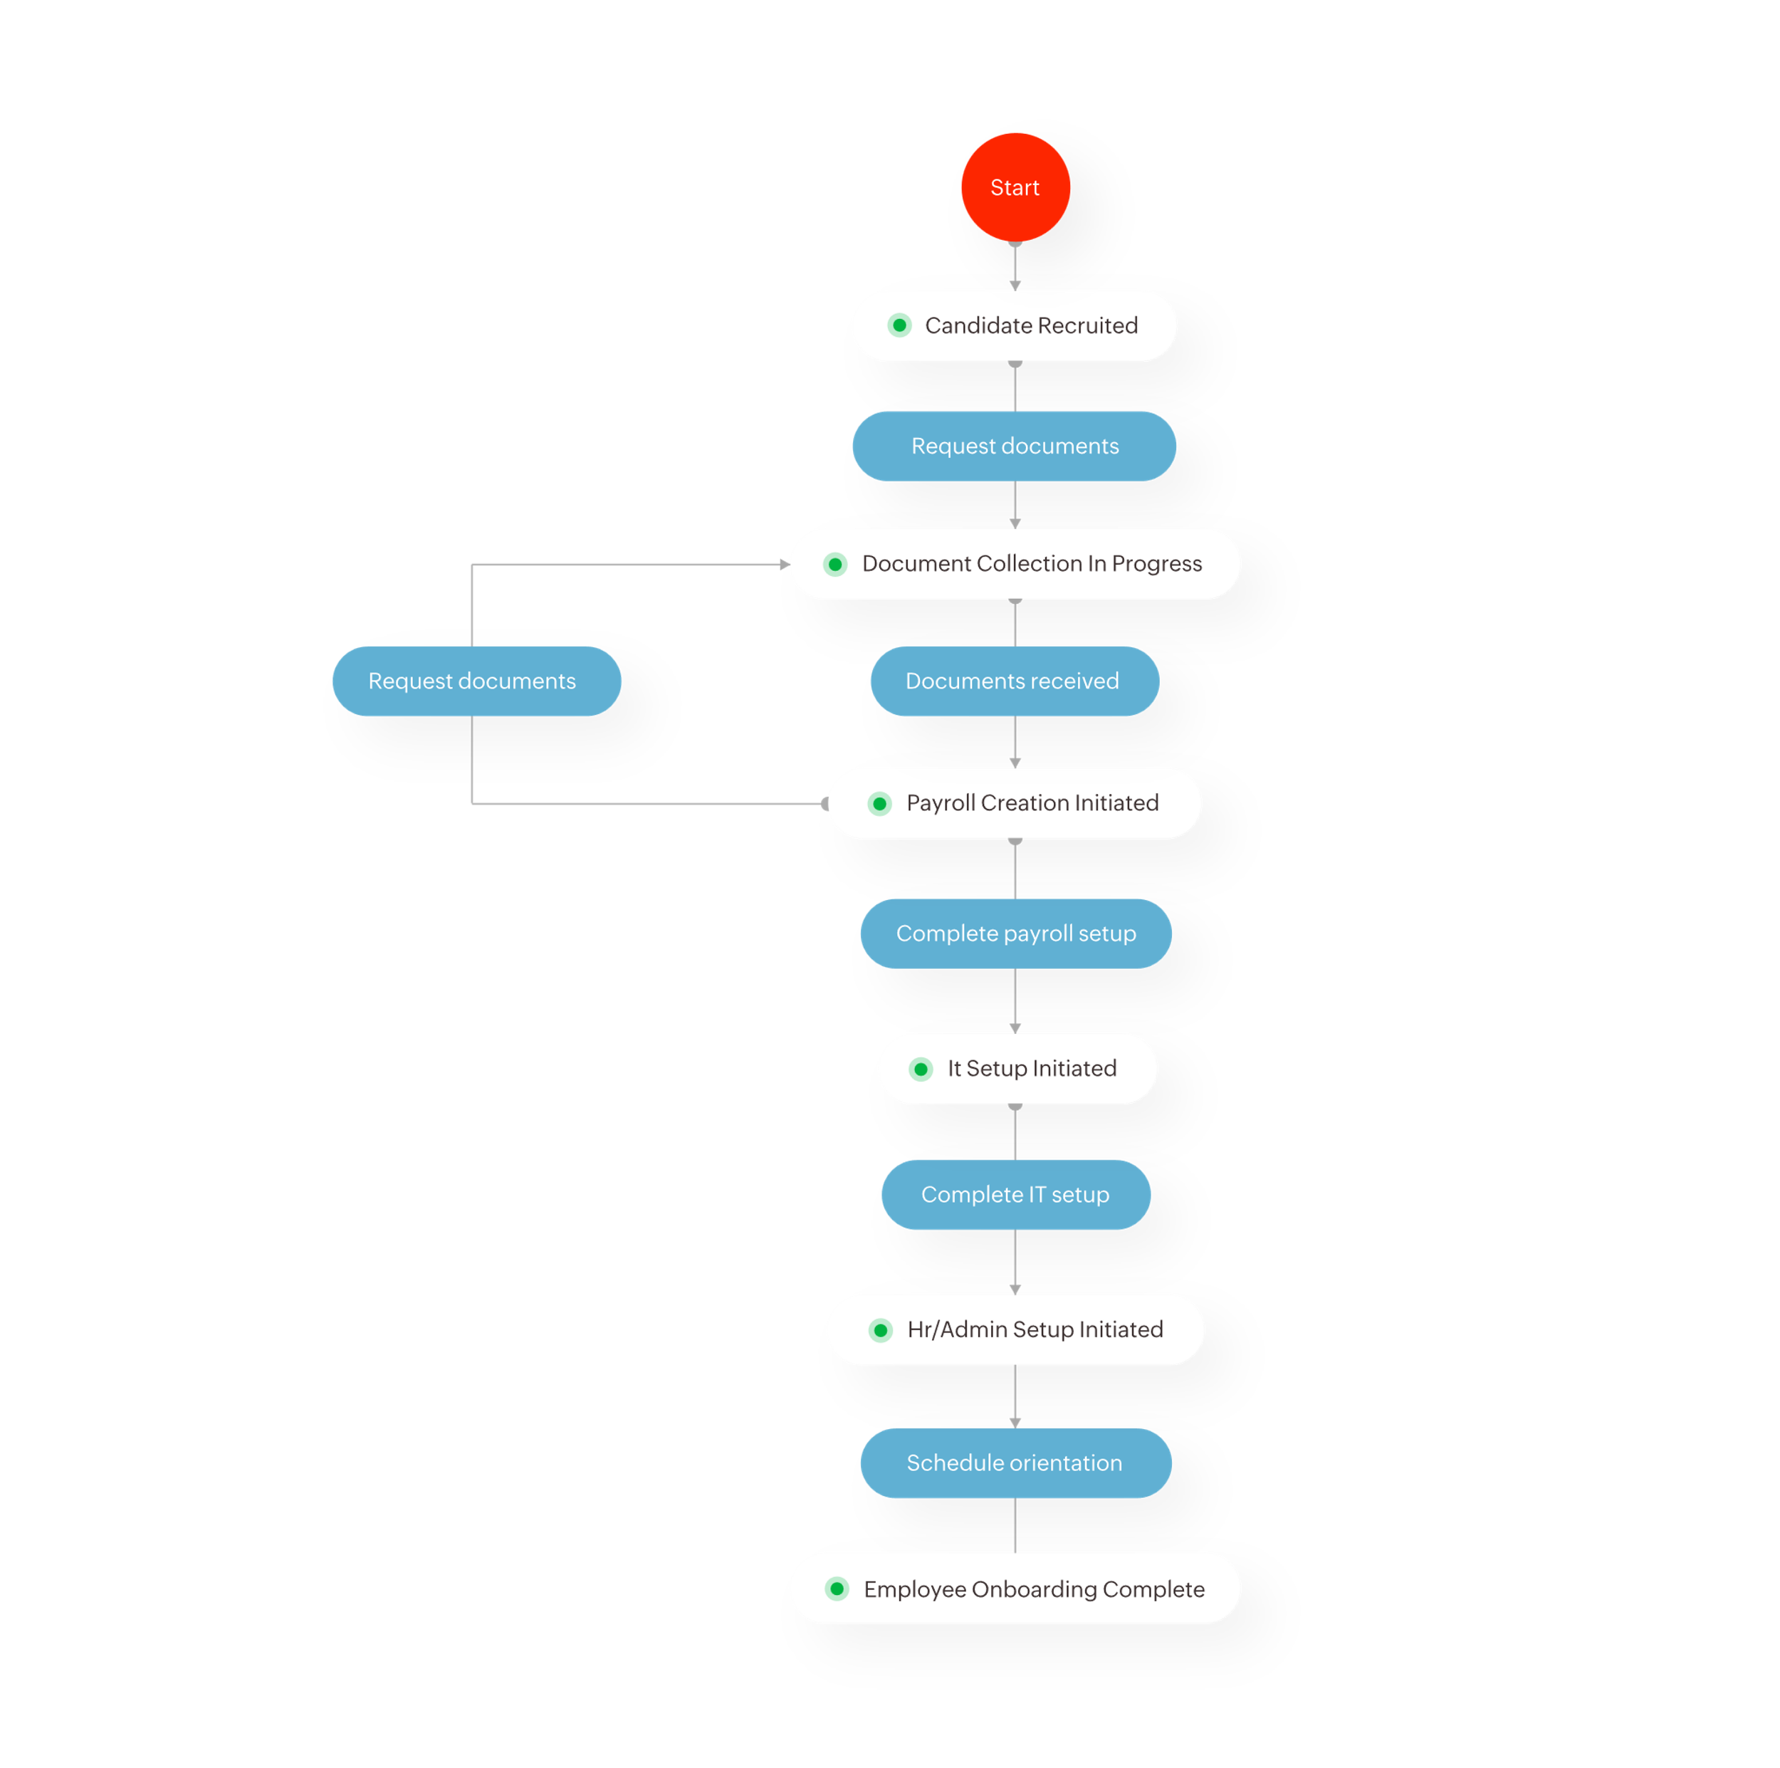

Slide 16
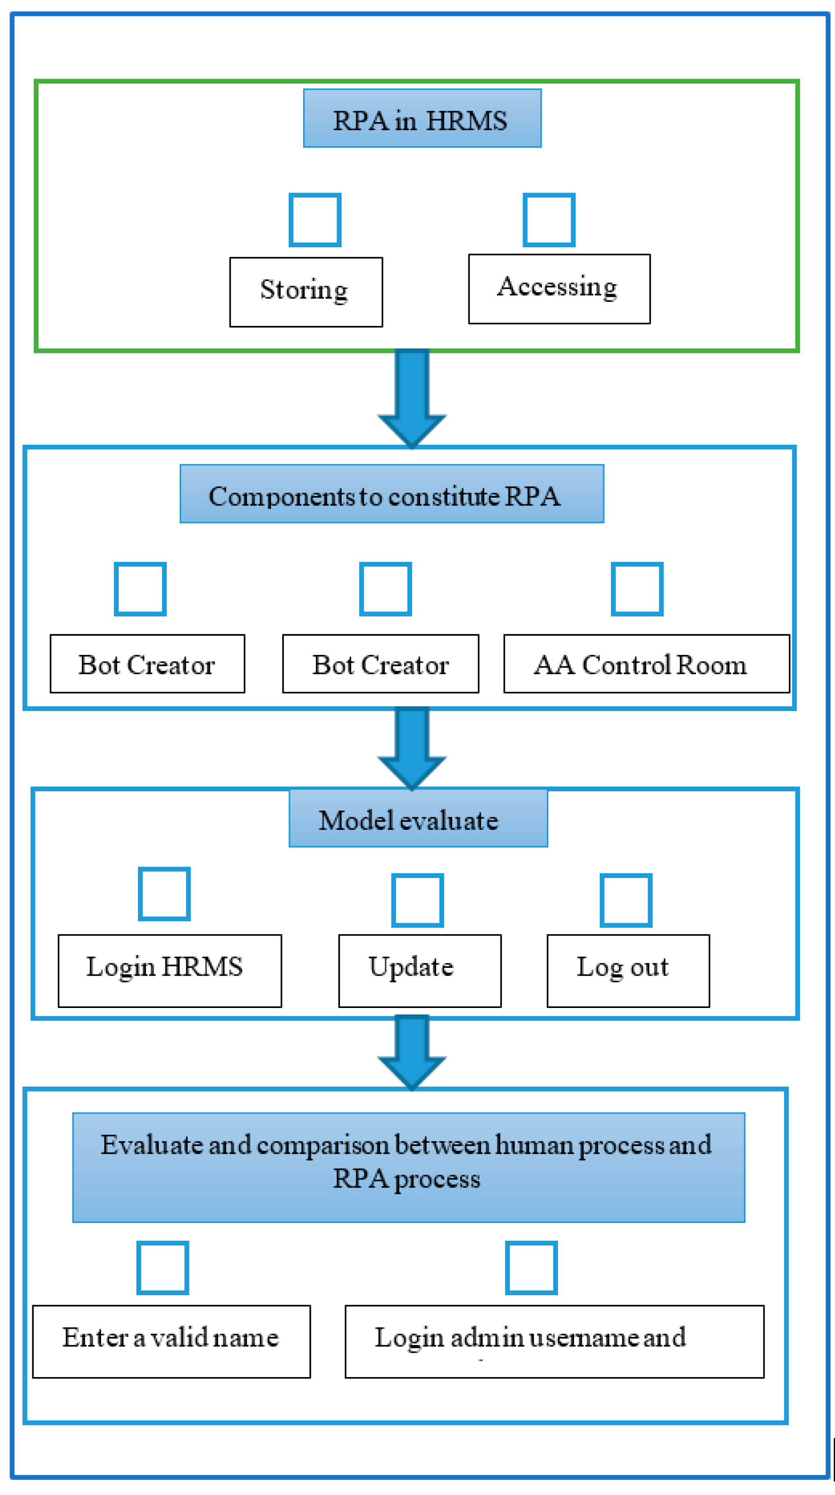
Summary of Management system process
In the development phase, the code created automates the tasks from the AA development studio.
This coding scripts at a presentation layer of the system and is created based on the design of the process model.
The script provides instructions to perform tasks for each software bot with regard to what to do at each step.
To provide tasks to bots runners, the developer needs to configure bots by creating process libraries based on the process flow recorded previously.
After this workflow has been programmed into the RPA.
The software can automatically run the program repetitively and complete the specified task multiple times as per the requirements.

Slide 17
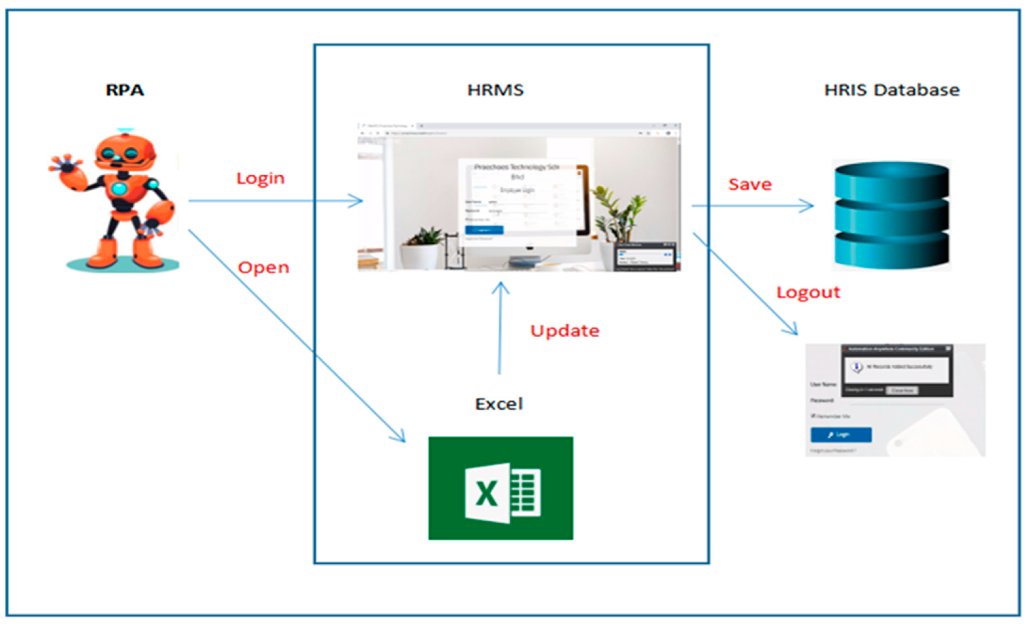
RPA in HRMS gathering , storing & accessing employees information process model development

Slide 18
3. Productization Assessment
3.1 Reusable Components
Reusability in RPA can be difficult for several different reasons including, but not limited to:
Element selectors being too specific or generic
Hard coding variables which should be passed in / out as dynamic arguments
Differences in application speed
Performing data manipulation, parsing, and / or process flow logic in an inappropriate location
Throwing process specific business exceptions
Differences in development style
Reusable code is an important concept for engagement teams to be mindful .
If the backlog of processes is thoroughly analyzed for reusable components during planning.
Benefits such as lower time-to-market, development consistency, less time-consuming change requests, and easier debugging can be realized.

Slide 19
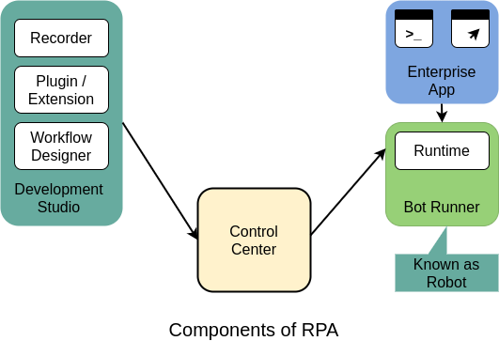

Slide 20
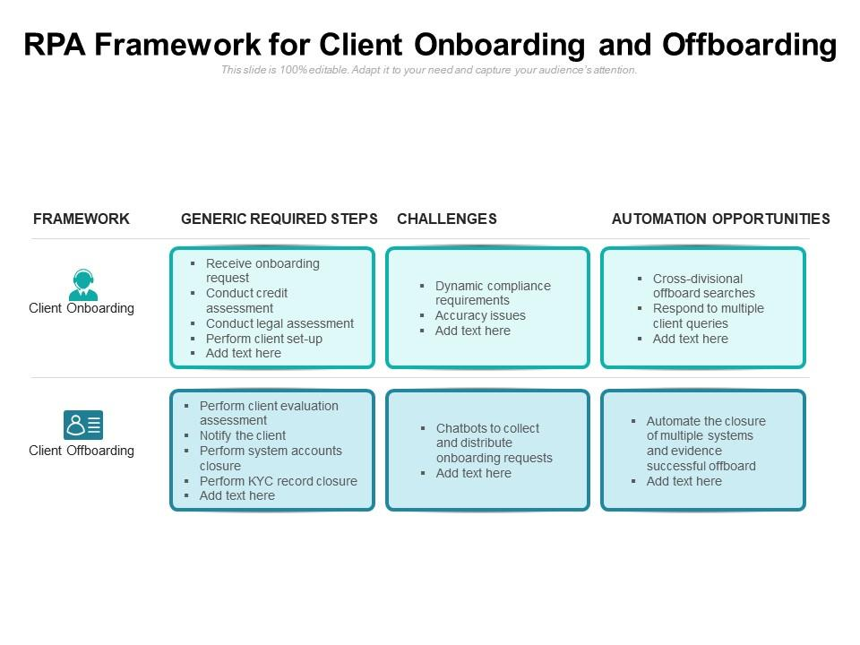
3.2 Analyze Architectural Frameworks in Repository
RPA Framework for client Onboarding & Offboarding

Slide 21
Advantages of RPA
Efficiency gains:
RPA can complete tasks more quickly than humans, and it's able to do so at a lower cost.
Organizations can expect productivity boosts without seeing a commensurate increase in costs that would have occurred had they hired new workers to do the same volume of work within the same allotment of time.
2. Reduction in errors:
Computers do what they're told.
They don't make a lot of errors as humans can sometimes do, adding that RPA software also provides a comprehensive audit trail so organizations can see what was done when.
3. Increased employee engagement:
Because RPA bots handle the repetitive, and sometimes mundane ,tasks within the enterprise, employees can shift more of their time to more valuable work, which, in turn, often makes for more engaged employees.
4. Improved customer satisfaction:
customers can also benefit from organizations automating processes, as the automation can create a faster and better experience.
Can access and retrieve information to answer a customer's request in real time so that there's no need to ask the customer to hold.
5. Standardization of processes:
Even when organizations optimize their processes, they can rarely ensure that the human employees follow the prescribed steps every time in every single office location.

Slide 22
6. Business continuity support:
Organizations can use RPA to help support their business continuity (BC) plans by building bots that can take on tasks typically handled by outsourced services in the event those services are knocked offline.
Disadvantages of RPA
Attrition:
Although RPA bot’s don’t always display workers, it is a possibility.
Moreover, because organizations can add bots to handle increasing workloads, they won't need to hire the additional workers who would have otherwise handled that growing volume of work.
2. Sprawling technology:
As organizations add more bots to perform more tasks, they risk creating an unwieldy collection that becomes more difficult and more costly to manage and maintain.
3. Added complexity:
Similarly, RPA can create layers upon layers of software when it's not effectively documented, managed and governed, Weilerstein said. It creates complexity that could make business improvements harder to achieve.
4. Magnification of problematic processes:
According to experts, organizations that don't first review and, if necessary, reengineer and optimize processes before automating them risk automating problematic processes.
This means amplifying inefficiencies, errors and anything else that was wrong with the process in the first place. It also adds costs, which could negate any expected ROI, and introduce new risks.

Slide 23
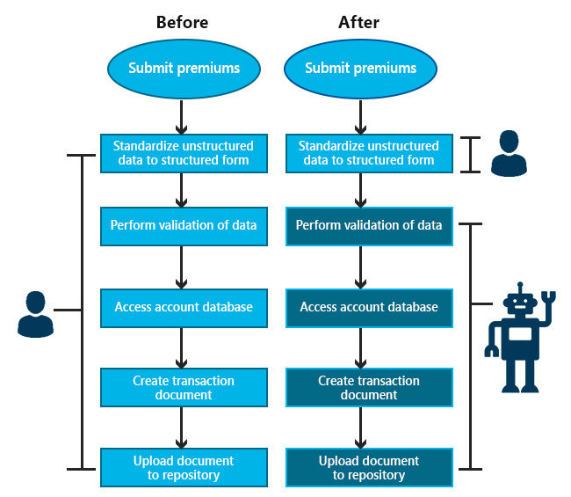
Before RPA & After RPA

Slide 24
3.3 IDENTIFY AND ANALYZE OPEN SOURCE AND COTS PRODUCTS
Introduction to RPA Open Source Tools:
Humans are again coming into the new world of Automation. RPA is one transformation that is automating our daily repetitive tasks.
RPA enables a higher efficiency in human actions, just like AI and chatbots. With RPA, we get a virtual employee who can perform repetitive activity faster and more cost-effectively than humans.
Robotic Process Automation has truly changed the game with some of the best RPA Open Source Tools available in the market.
Top 6 RPA Open Source Tools are:
Automation Anywhere
UiPath
Blue Prism
Pega
Contextor
Kofax

Slide 25
Automation Anywhere
Automation Anywhere is a developer tool that changes the way an enterprise operates.
This tool combines the RPA with elements like Natural language understanding and reading any unstructured data.
Automation Anywhere has three components :
1.Control Room
2.Bot Creator
3.Bot Runner
Applications of Automation Anywhere
Travel Business
Finance sector
Social platforms
Energy sector
UiPath
UiPath is a Robotics Process Automation software.
It is a windows desktop tool.
This tool contains multiple activities that help to reduce repetitive tasks, reduce human power, and scalability. It works on the flowcharts, sequence, and Framework .
UiPath Architecture consists of three product suites :
1.Studio
2.Robot
3.Orchestrator

Slide 26
Applications of UiPath
Finance and Banking
Healthcare
Insurance
Manufacturing
Telecom
Retail and CPG
Public Sector
Blue Prism
Blue Prism is a UK-based software development company in RPA. They supply software that automates clerical back-office processes that work the same as a human.
The Blue Prism invented the Robotic Process Automation.
The operations done by Blue Prism enables them to be cost-effective by automating manual, repetitive office processes or back-end work, and improve their accuracy by developing an automated flow.
A Step by step automation of processes is done by just drag and drop activities.
Blue Prism has two components:
1.Process Studio: Process studio is the same as that of the flowchart. It is the area the main process is created. It allows control loops, variables, object calls, and business logic. As human users act in a way, a process acts the same. It uses the robot's logic.
2.Object Studio: It is the place where we create a visual business object. They are created to interact with other applications.

Slide 27
Pega
Pega is an open-source RPA tool.
It can be used to automate the tasks using the user interface itself of existing applications.
Two types of automation in PEGA are :
Process Automation
Desktop Automation
Applications of Pega:
Communications and Service Providers
Government
Automotive
Retail
Media and Entertainment
Contextor
Contextor has guided many customers of different sectors, including telecom, energy, retail, and banking, for their first RPA projects.
Applications of Contextor
Baking
Professional Services
Telecommunications
Sports and Entertainment
HR and Business Management

Slide 28
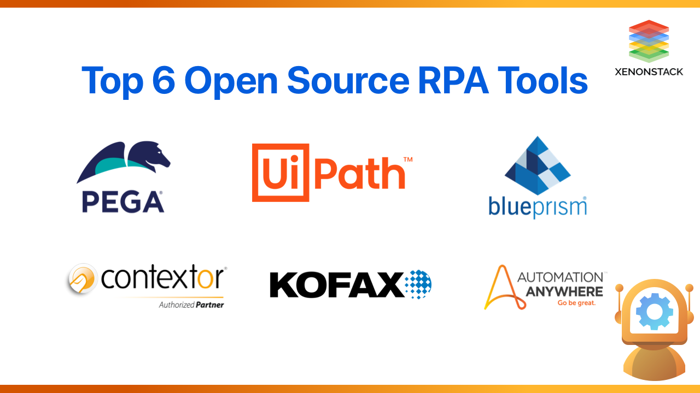
Kofax
Kofax is an automation tool of RPA. It helps to automate high-value, information-intensive processes that require intelligence and process orchestration.
It incorporates a site, desktop applications, portals with no information on coding.
Applications of Kofax
Banking
Government
Insurance
Transportation and Logistics
Cross-Industry

Slide 29
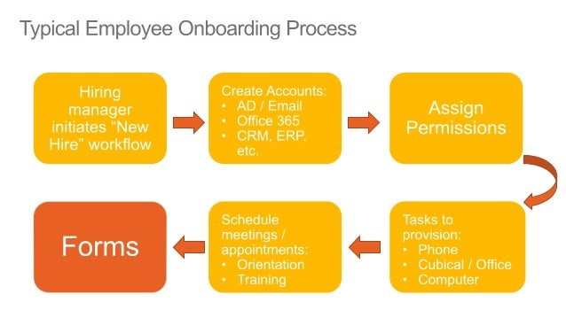
4. System Architecture
4.1 OVERVIEW
The onboarding process involves lot of paperwork, which is inefficient and prone to human error:
It one of the most important processes for new employees, as they learn about their new role& acquire the right knowledge for performing their daily tasks.
Onboarding is one of the most complex processes, taking into account the amount of new data that should be provided by the company, creating new accounts to offering access rights and passwords for different systems.
Using RPA, the whole process can be simplified, a specific template for the onboarding workflow can be automatically activated by the user.
software robots can be used for assigning new credentials to the new employee and so on.

Slide 30
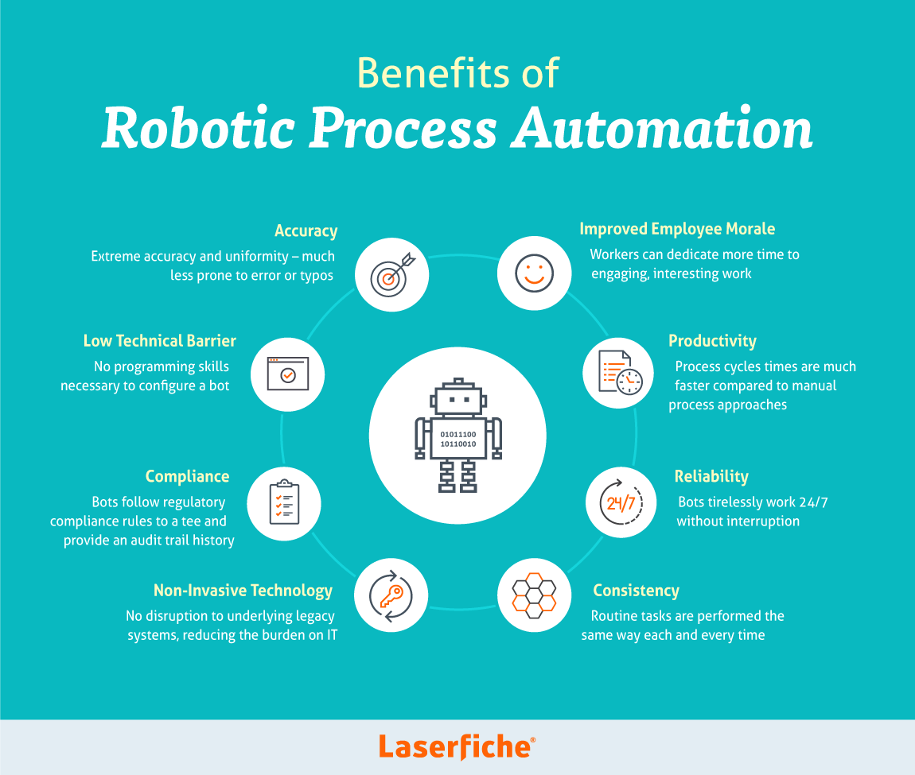

Slide 31
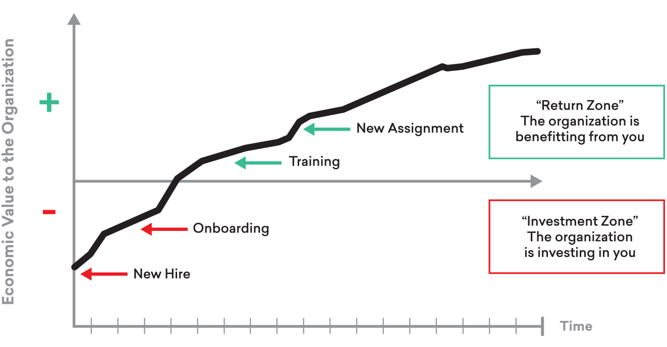
4.2 LOGICAL VIEW some of the ways to use automation in your onboarding process:
1.Connect recruiting and onboarding software.
2.Start processing documents sooner.
3.Automatically enter employee data.
4.Engage better with new employees.
5.Send swag.
6.Provision systems.
7.Plan an engaging first day.
8.Automate benefits enrollment.
9.Introduce continuous feedback.

Slide 32
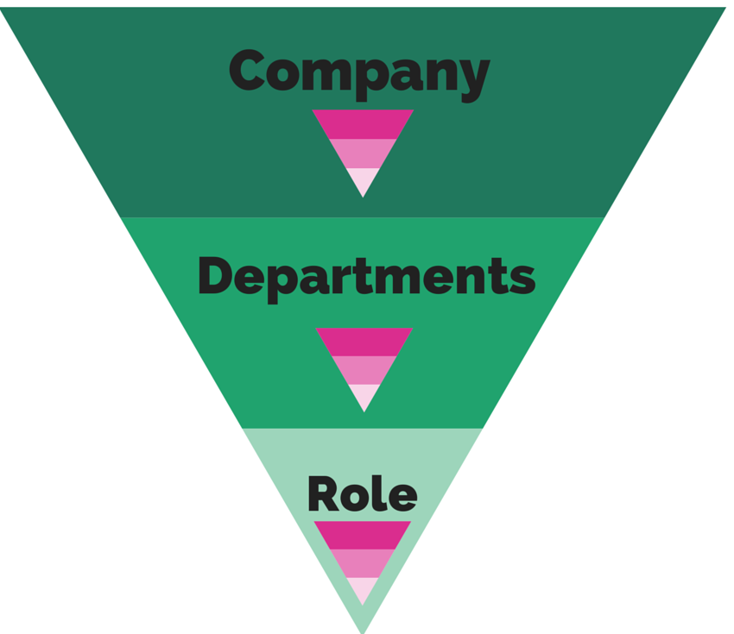
FUNCTIONAL VIEW
1.We define functional onboarding as the learning and knowledge that new hires need, specific to their department and role (function).
2. Functional onboarding is an in-depth, guided journey into the employee's new job beyond their duties and expectations.
3. Functional onboarding makes sense from a business perspective, saving those resources and creating returns on your investment.
Ifiiofthesndicators sound familiar, it’s a sign the company is in dire need of a Rapid hiring, especially if the company is young.
High rates of absenteeism.
Newly-hired employees leaving after six to 18 months.

Slide 33
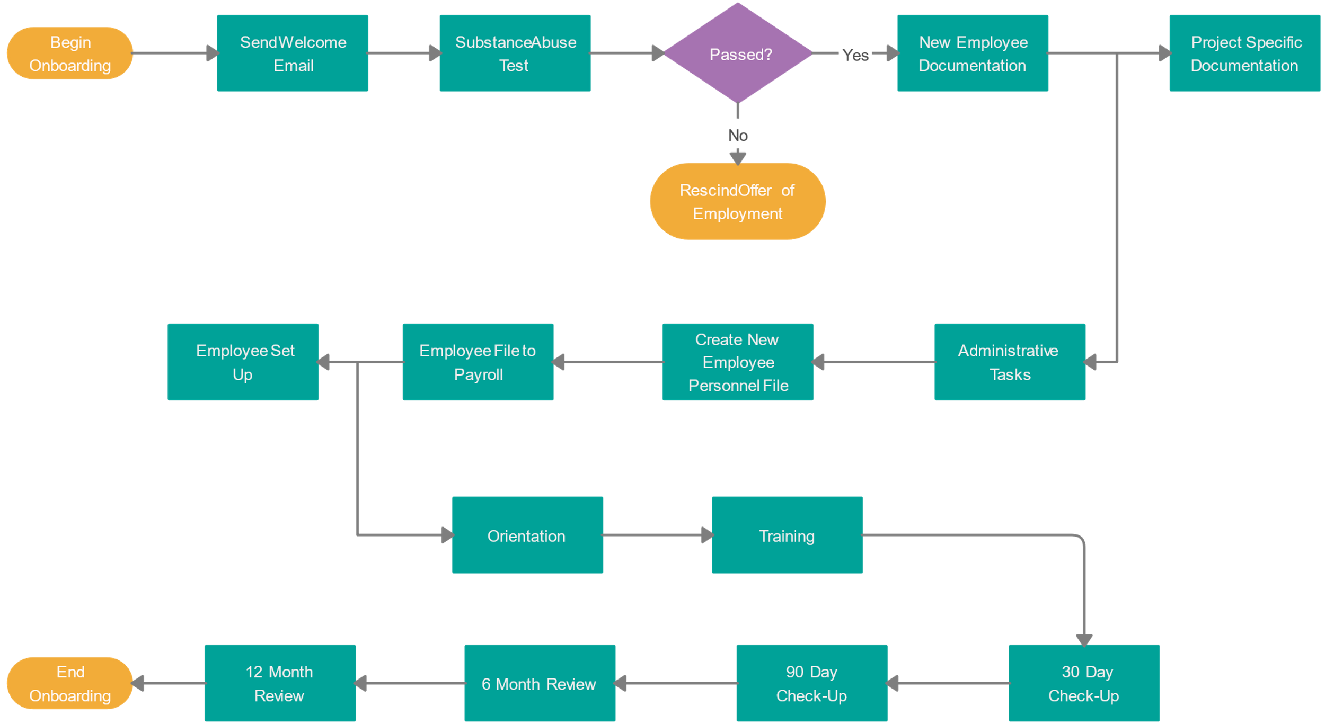

Slide 34
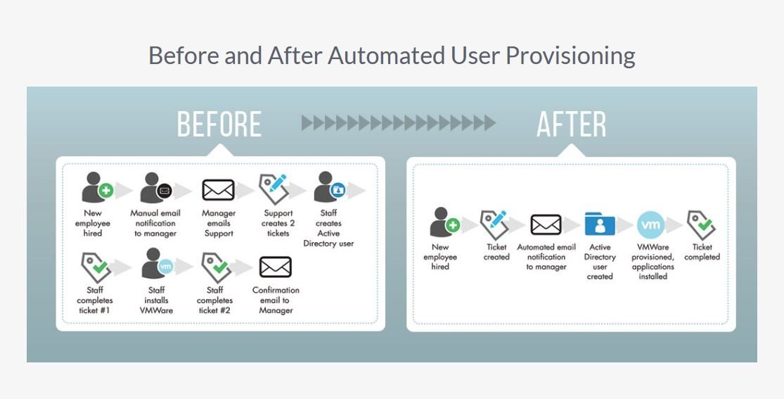
4.3 USE CASE VIEW

Slide 35
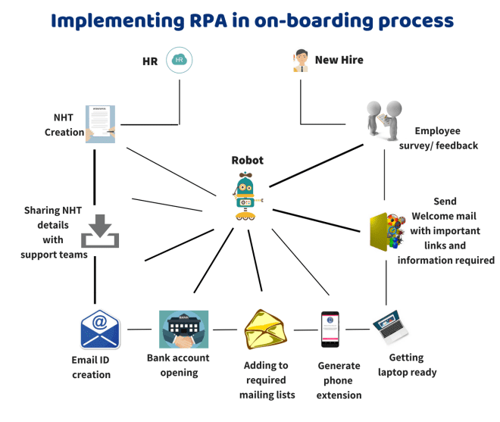

Slide 36

Improving onboarding with RPA
A streamlined onboarding with RPA includes various steps and workflows. The most common process includes:
Making the Offer
Offer Acceptance
Waiting Period and Joining
Inter-departments coordinating
Training and orientation
1. Making the offer
The employee onboarding process begins soon after the interview and selection process is over.
Once the candidate is decided, an email is triggered by the bot to send a warm welcome note, along with the offer letter.

Slide 37
2. Offer Acceptance
After the employee accepts the offer, the bot notifies the department, allowing them to either have a quick call to review.
The forms and set expectations or program the bot to send personalized communication, review the forms and revert in case of missing information.
This is a step towards creating an emotional connection between the employee and the company.
3. Waiting Period and Joining
Accepting the offer letter is just a formality and does not confirm if the employee will join.
During the waiting period, the bot can build a good rapport with the future employee by checking on them regularly.
During the day of joining, these bots can assist the HR managers to create a welcoming and comfortable environment by gathering all the information in the employee onboarding checklist.

Slide 38
4. Inter-department Coordinating
The bots can send notifications to various departments, including the IT and finance, about the start date of the new hire and required actions to be taken.
It can also schedule an orientation session of the new hire with various teams and peers.
5. Training and orientation
The bot can block calendars of the required employees for a smoother orientation process.
It allows the manager to set role-based goals and assign relevant training for the new employees.
It can also send a list of training that the employee needs to finish to complete their orientation and keep sending regular reminders until they are complete.

Slide 39
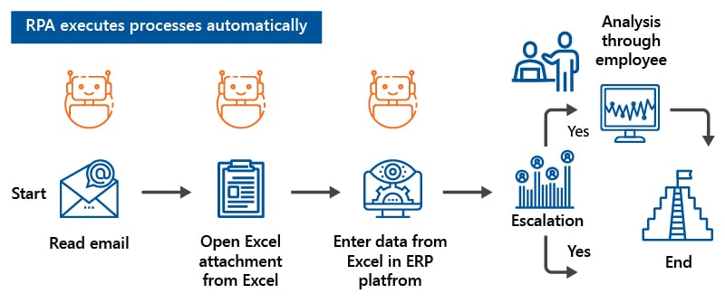

Slide 40
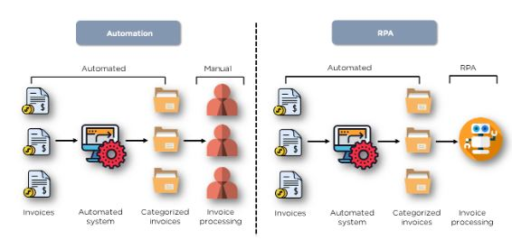

Slide 41
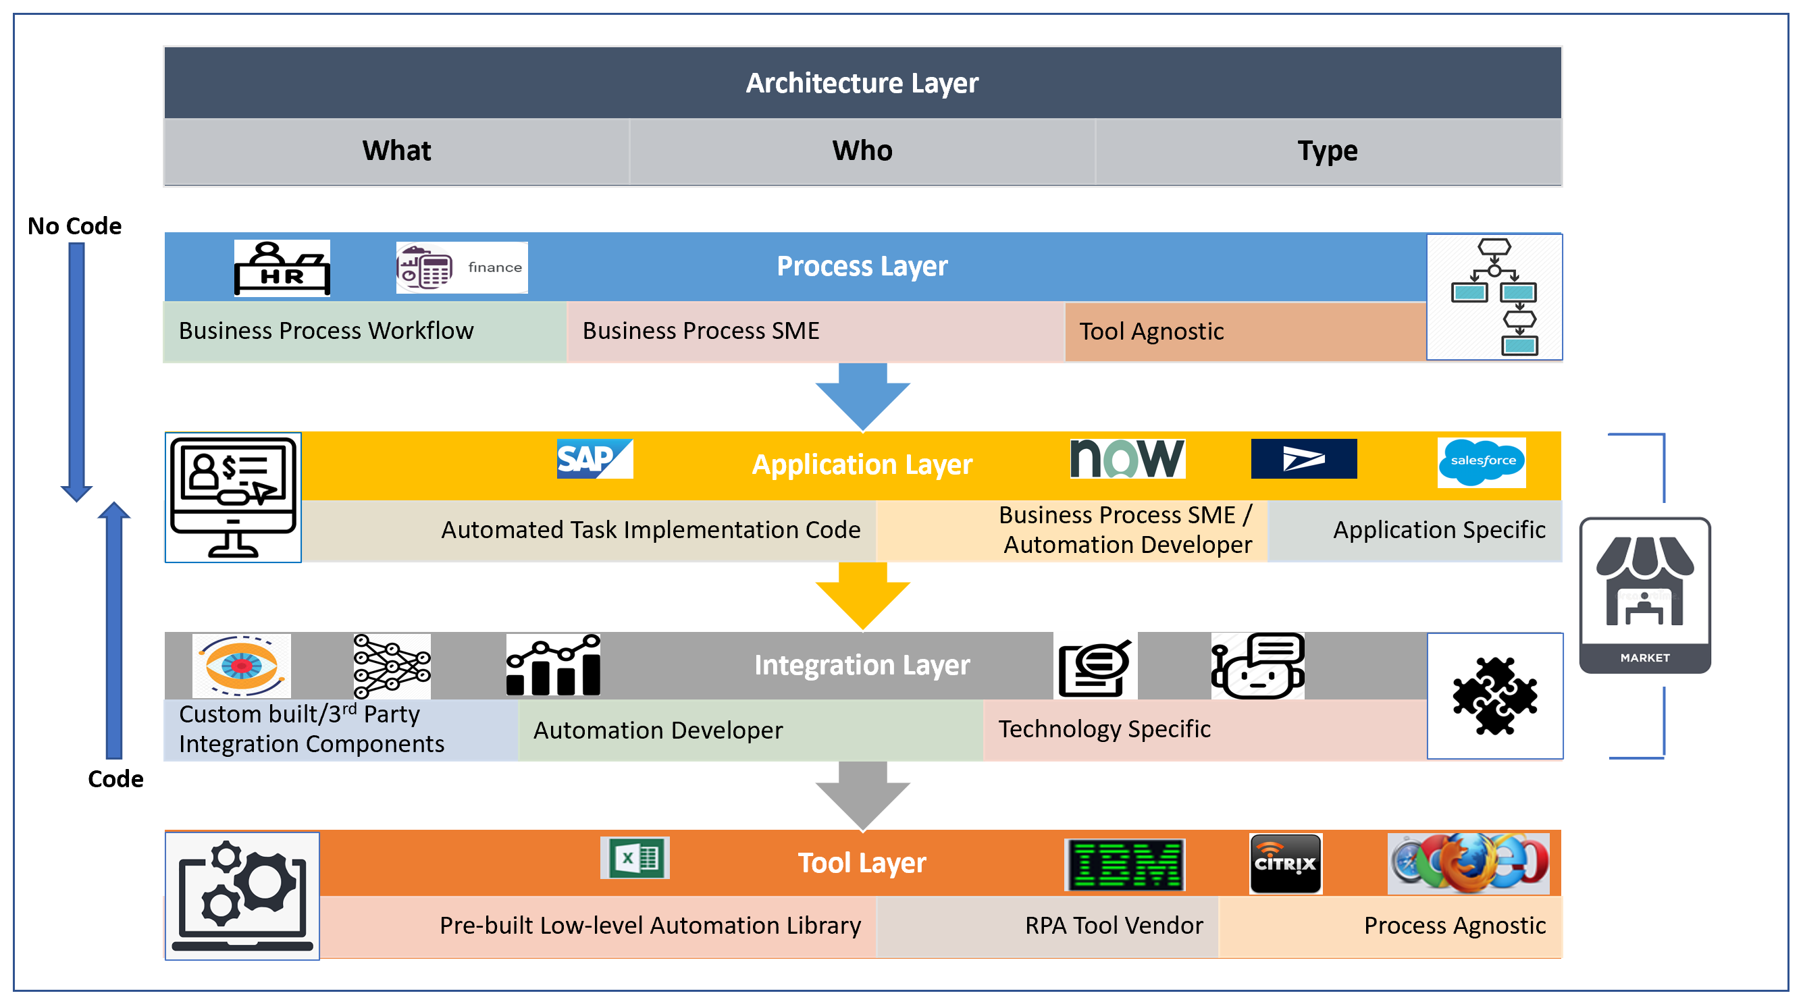
4.4 Deployment view
RPA Design Phase & Architecture
Process Layer–
This is the business domain-specific layer containing workflow models designed by the Process SMEs for the business process and sub-processes to be automated.
Process models can be developed within an RPA tool, or developed outside and imported into an RPA tool.
They can be developed with the help of other techniques such as Process mining
Application Layer-
This is the automation implementation layer grouped by application-level tasks .
Can be developed by business users or automation developers as low-code to medium code solution, and depending upon the complexity of the automation via UI or API interfaces.

Slide 42
Integration Layer-
This is the automation implementation layer which integrates with other technologies needed to solve specific automation problems.
Other technologies such as Machine Learning Models are available pre-trained from external vendors or custom-built internally, integrating RPA with physical devices such as IoT, a mobile device, or a Chatbot.
Integrations can be built by automation developers extending the RPA tool with custom libraries or consuming third party solutions.
Tool Layer-
This is the foundational layer provided by the RPA tool vendor as part of the tool offering.
This comes in the form of a low-level pre-built library, to be able to automate on different application surface technologies such as Web, Desktop, Citrix, Java, and SAP.
It also comes in the form of API technologies such as REST or SOAP and be able to automate simple tasks on desktop applications such as MS Office apps, PDFs, Notepad, Files and Database.

Slide 43
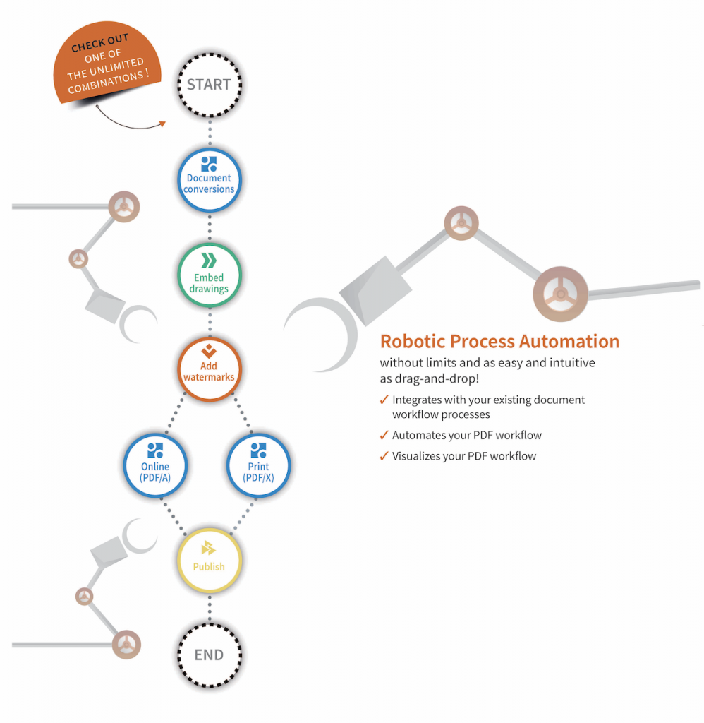
5.Alternative Solutions considered
Depending on the diversity and quality of the files, this can place high demands on the PDF software.
Print shops receive their raw material (PDF files) from numerous companies and agencies in varying degrees of quality.
Manual corrections should avoided in RPA, so the first step in most RPA processes will be the standardization of input material.
Standards, such as PDF/X, are used to streamline the definition of normalization requirements: if the raw material is converted to PDF/X, subsequent steps can rely on that.

Slide 44
Normalization should be the first step – at least if the source of the data (PDF) is not always the same. That might even include the creation of PDF from other source formats:
Document conversion, office conversion.
If the source is an image, OCR (Optical Character Recognition) should be applied:
Apply OCR for scanned PDFs.
Since PDF is so flexible, you would then normalize to a PDF with a certain quality. This could be based on internally developed standards, but in most cases an official standard like PDF/A leave out the development of internal standards. If needed, requirements can be adjusted to internal needs.
Normalization to PDF/A-2u:
Font embedding.
Make sure Unicode representation is present.
And then, the actual processing can take place:
Extract text
Embed files
Merge files
Split PDF pages at certain keywords
Normalize page sizes
Add page numbers if missing

Slide 45
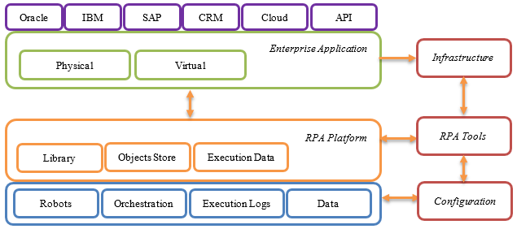
RPA solution architecture

Slide 46
Application under Robotic Process Execution
RPA is best suited for enterprise applications such as ERP for e.g. SAP, Siebel.
massive data/records processing applications such as mainframes, or other similar front office CRM applications or back office administrative platforms.
RPA Tool
Ability to automate on a variety of application environments such as web, desktop, citrix.
Ability to develop software robots by recording, configuring, and enhancing them with programming logic such as loops, conditions, etc.
Ability to handle exceptions, and synchronization issues.
Building reusable components that can be applied to multiple software robots allowing for modularity, faster development and easier maintenance.
RPA Platform
RPA platform, preferably in the cloud, acts as a shared central repository to store all of your software robots and RPA resources created using a RPA tool.
RPA assets can be shared across software robots such as reusable robotic components (repeatable sub-processes) library; Application object stores, input/output Data files.

Slide 47
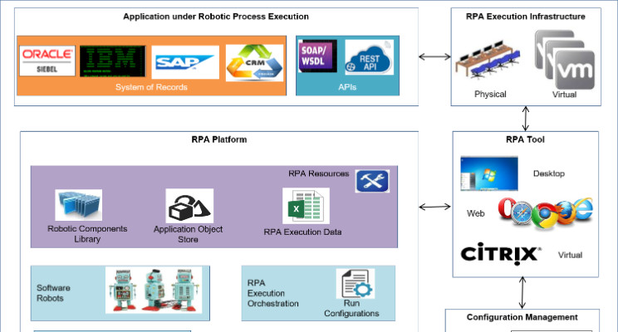
RPA Execution Infrastructure
RPA execution infrastructure in form of a bank of machines that are either physical, in case a front line.
BPM user is using a software robot interactively to assist in executing segments of a business process, or a set of virtual lab machines, that can be scaled up or down based upon usage patterns.
which software robots are executed as unattended for longer business processes not needing human intervention.
Configuration Management
Configuration management is needed for versioning of RPA assets.
The underlying application on which software robots are developed may constantly be updated to introduce newer versions, and so would the RPA assets and software robots.

Slide 48


