Slide 1

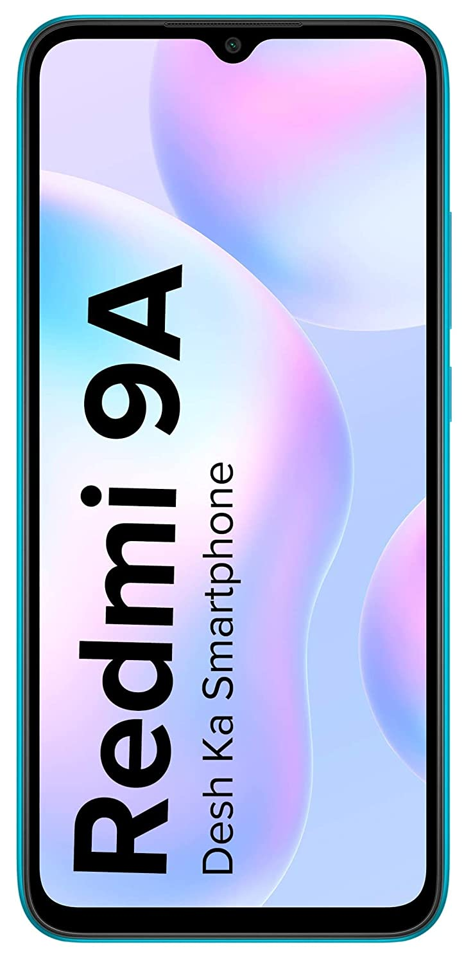
Xiaomi Redmi 9
Xiaomi Redmi 9A
VS

Slide 2
BODY

Slide 3

Height
77.07 MM
77.07 MM
Xiaomi Redmi 9
Xiaomi Redmi 9A

Slide 4
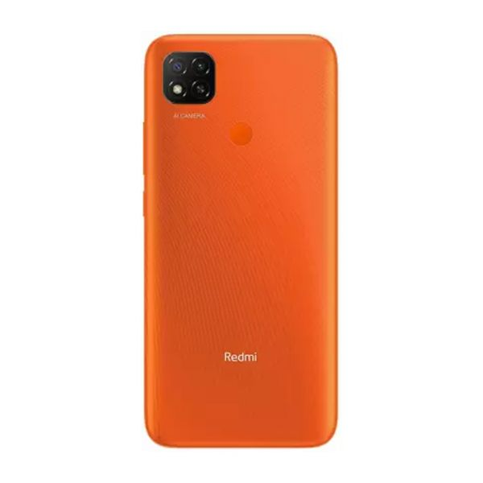

Width
77.07 MM
77.07 MM
Xiaomi Redmi 9
Xiaomi Redmi 9A

Slide 5
Thickness
9.0 MM
9.0 MM
Xiaomi Redmi 9
Xiaomi Redmi 9A

Slide 6

Weight
135 gm
135 gm
Xiaomi Redmi 9
Xiaomi Redmi 9A

Slide 7
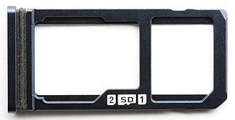
Sim Tray
9.0 MM
9.0 MM
Xiaomi Redmi 9
Xiaomi Redmi 9A

Slide 8
Display

Slide 9
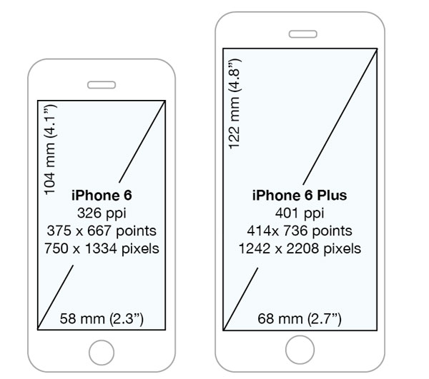
Size & Resolution
Size
6.99
Resolution
720 x 1650 pixels (~268
ppi density)
Size
6.99
Resolution
720 x 1650 pixels (~268 ppi density)
Xiaomi Redmi 9
Xiaomi Redmi 9A

Slide 10
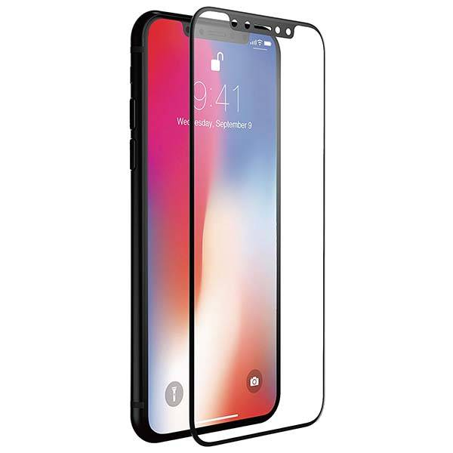
Refresh Rate & Type
Type
IPS
90HZ
Protection
Gorilla Glass 5
Type
IPS
90HZ
Protection
Gorilla Glass 5
Xiaomi Redmi 9
Xiaomi Redmi 9A

Slide 11
Camera

Slide 12

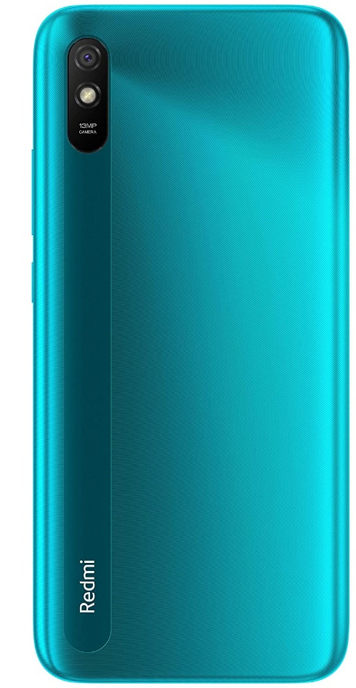
Camera
Rear camera
13MP
f/2.2 aperture
2MP depth sensor
Rear camera
13MP With Flash Light
Xiaomi Redmi 9
Xiaomi Redmi 9A

Slide 13
Camera
Front camera
5MP With Selfie Timer
Front camera
5 MP With Selfie Timer
Xiaomi Redmi 9
Xiaomi Redmi 9A

Slide 14
Storage and RAM

Slide 15
Storage and RAM
4GB+64GB
4GB+128GB
2GB+32GB
3GB+32GB
Xiaomi Redmi 9
Xiaomi Redmi 9A

Slide 16
Battery

Slide 17
Battery
5000 mAh
Built-in rechargeable battery
10W Fast Charger In-box
5000 mAh
Supports 10W charge
Built-in rechargeable battery
Xiaomi Redmi 9
Xiaomi Redmi 9A

Slide 18
Processor

Slide 19
Processor
MediaTek Helio G35
2.3GHz, 8x A53, Octa-core CPU
GPU: PowerVR8320, up to 680MHz
MediaTek Helio G25
CPU: MediaTek Helio G25, octa-core processor
8X Cortex-A53 cores 2.0GHz
Xiaomi Redmi 9
Xiaomi Redmi 9A

Slide 20
OS & UI

Slide 21

OS & UI
  ANDROID 11
  IN BOX
  MIUI 12.8
  ANDROID 11
  IN BOX
  MIUI 12.8
Xiaomi Redmi 9
Xiaomi Redmi 9A

Slide 22
Price

Slide 23

Price
8,999RS/-
6,799 RS/-
Xiaomi Redmi 9
Xiaomi Redmi 9A

