Slide 1


TOPIC 1
GROUP 2
Kinds of Secondary Sources
NEXT

Slide 2

TOPIC 2
BOOKS
  Historical books, written by scholars or experts, provide interpretations and analyses of specific historical periods, events, or themes, often synthesizing information from primary sources.
NEXT

Slide 3

TOPIC 3
JOURNAL ARTICLES
Academic articles, published in academic journals, present research, analysis, and arguments on historical topics, reviewing existing scholarship or providing new insights based on primary sources.
NEXT

Slide 4
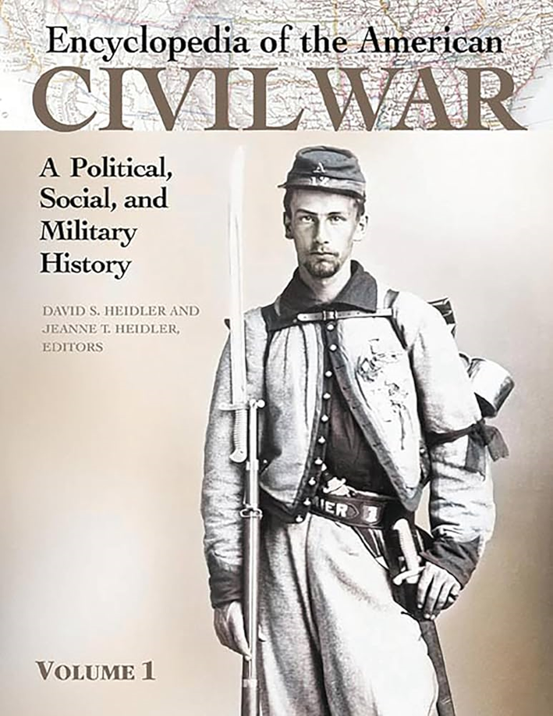
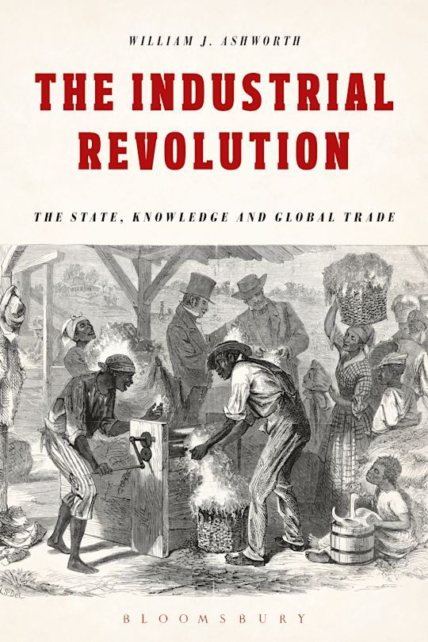
TOPIC 4
ENCYCLOPEDIAS AND DATABASES
Reference works, encyclopedias, and databases are essential sources for showcasing and synthesizing existing knowledge on historical events, figures, or periods.
NEXT
NEXT

Slide 5

TOPIC 5
BIOGRAPHIES AND AUTOBIOGRAPHIES
Biographies, written by historians or biographers, analyze the lives, actions, and impact of historical figures, often serving as secondary sources reflecting the author's perspective on past events.
NEXT

Slide 6

TOPIC 6
DOCUMENTARIES AND FILMS
Historical documentaries or films are visual representations of historical events, figures, or themes, often incorporating primary sources.
NEXT

Slide 7

TOPIC 7
HISTORICAL REVIEWS AND CRITIQUES
Critical reviews and theses provide in-depth analysis and original research on historical topics, often contributing new insights or interpretations to the field.
NEXT

Slide 8

TOPIC 8
CONFERENCE PAPERS AND PRESENTATIONS
Scholarly presentations or papers are presentations or papers given at conferences or symposiums, sharing research findings, analyses, and interpretations of historical subjects.
NEXT

Slide 9
quiz
1. What is the main purpose of secondary sources?
A) To give firsthand accounts
B) To analyze and interpret primary sources
C) To provide fictional stories
2. Which secondary source type includes books that interpret historical events?
A) Journal Articles
B) Historical Books
C) Documentaries
NEXT

Slide 10
quiz
3. Why are journal articles important as secondary sources?
A) They provide new ideas and detailed analysis
B) They are mainly opinion-based
C) They focus on fictional events
4. What do encyclopedias and databases help with in historical studies?
A) They give overviews and summaries of events
B) They provide fictional stories
C) They are only used in primary research
NEXT

Slide 11
quiz
5. Biographies are secondary sources because they:
A) Tell the author’s life story
B) Analyze a historical person’s life using primary sources
C) Are always factual without any opinion
6. What is a key purpose of historical documentaries?
A) To bring history to life and interpret events
B) To focus only on entertainment
C) To avoid any primary sources
NEXT

Slide 12
quiz
7. Historical reviews and critiques are valuable because they:
A) Offer new research or detailed analysis on historical topics
B) Focus on retelling known facts without opinion
C) Are simple overviews
8. Where are conference papers usually presented?
A) In public libraries
B) At academic conferences or symposiums
C) In private collections
NEXT

Slide 13



Slide 14
Answer key
B) To analyze and interpret primary sources
B) Historical Books
A) They provide new ideas and detailed analysis
A) They give overviews and summaries of events
B) Analyze a historical person’s life using primary sources
A) To bring history to life and interpret events
A) Offer new research or detailed analysis on historical topics
B) At academic conferences or symposiums

