Slide 1


ASSIGNMENT
Faras Panca Wangi
Communication Science – 2J

Slide 2


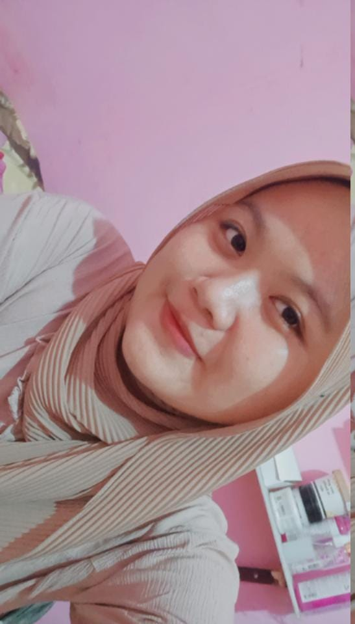

ABOUT MY SELF
It's me again Faras Panca Wangi, just call me Faras for short, I'm a communication science student of Uhamka, in 2] class anyway. In this video I'm going to share my survey report how well I have known my classmates. Shall we start?

Slide 3

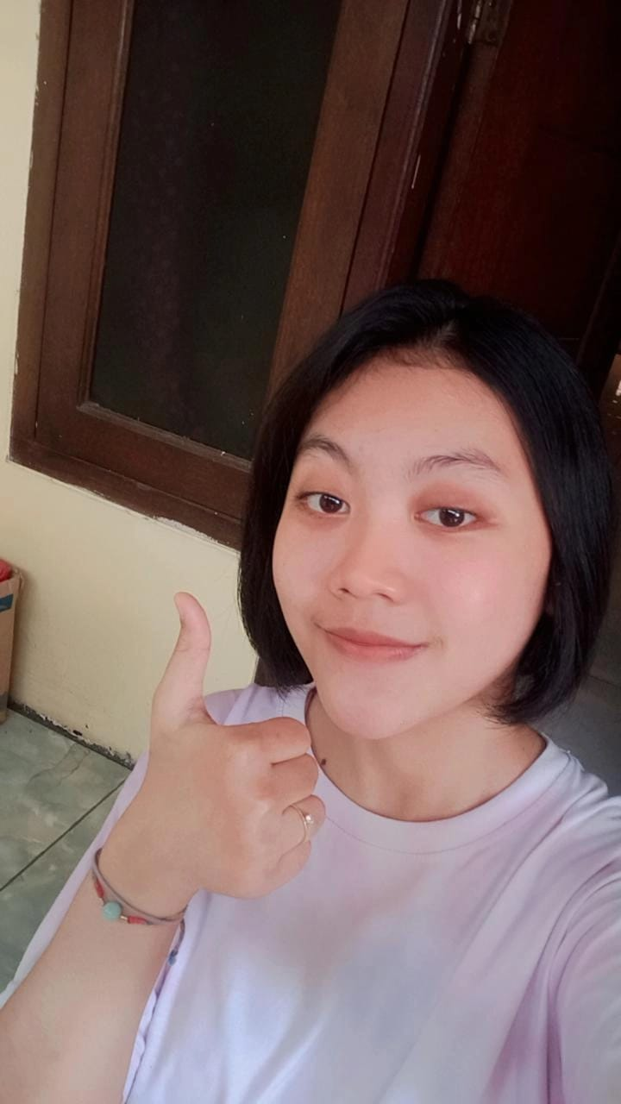
It’s Dallilah Fauzia, call her Dilla
She plays games too much, when the lecturer teaches, she looks unfocused, I think she should reduce she’s habit of playing games too much.

Slide 4

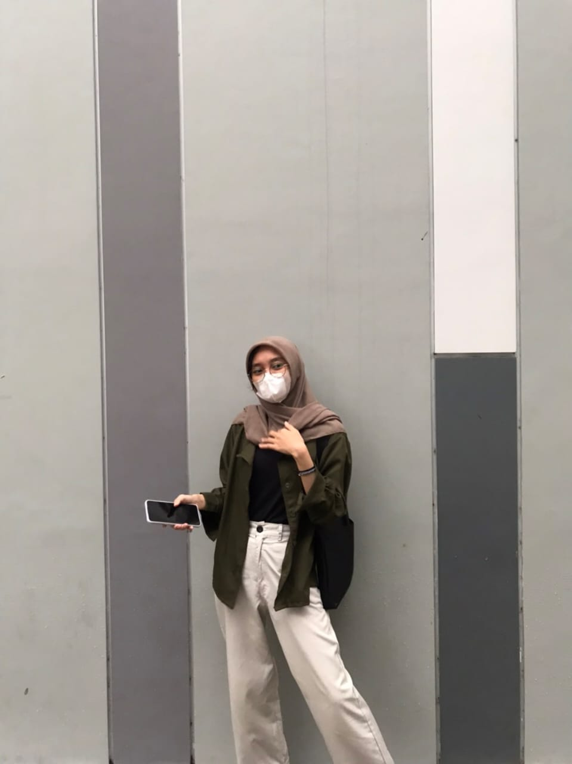
It’s Dea Merilanisti, call her Dela
She's a Netflix lover, every day she always watches dramas or movies until midnight, that's not cool, I think, she should reduce that slightly bad habit

Slide 5
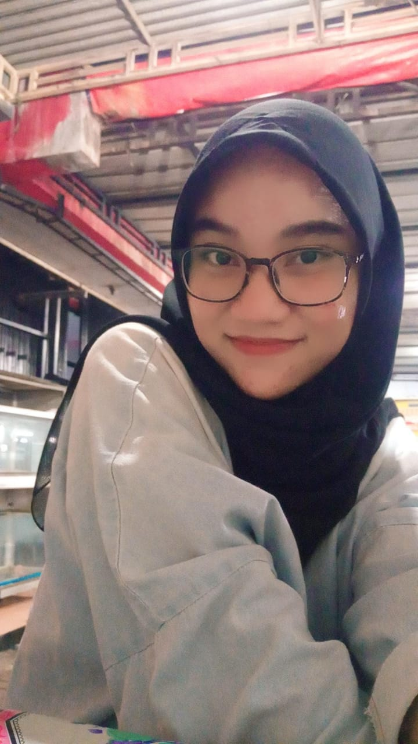
It’s Annisa Putri Fauziah, call her Putri
She studies too much, she always refuses when I take her on a trip, I think she should take a vacation so she doesn't focus too much on studying

Slide 6
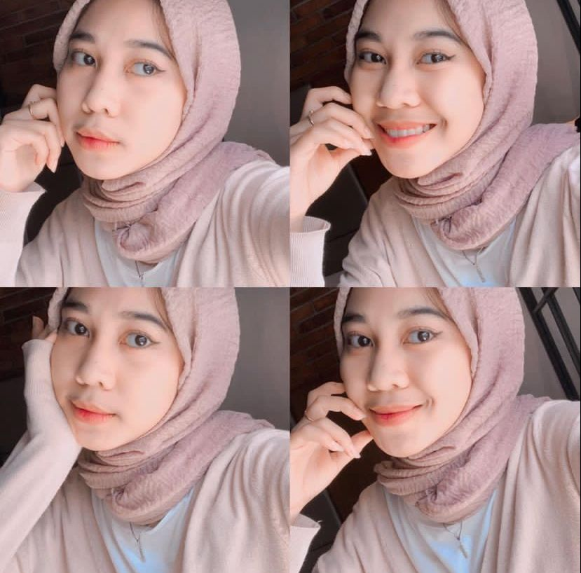
It’s Intan Karomah, call her intan
She spend a lot of money too much, sometimes she always buys what she doesn't need, she should only need to use money as necessary, and must be diligent in saving and thrifty

Slide 7
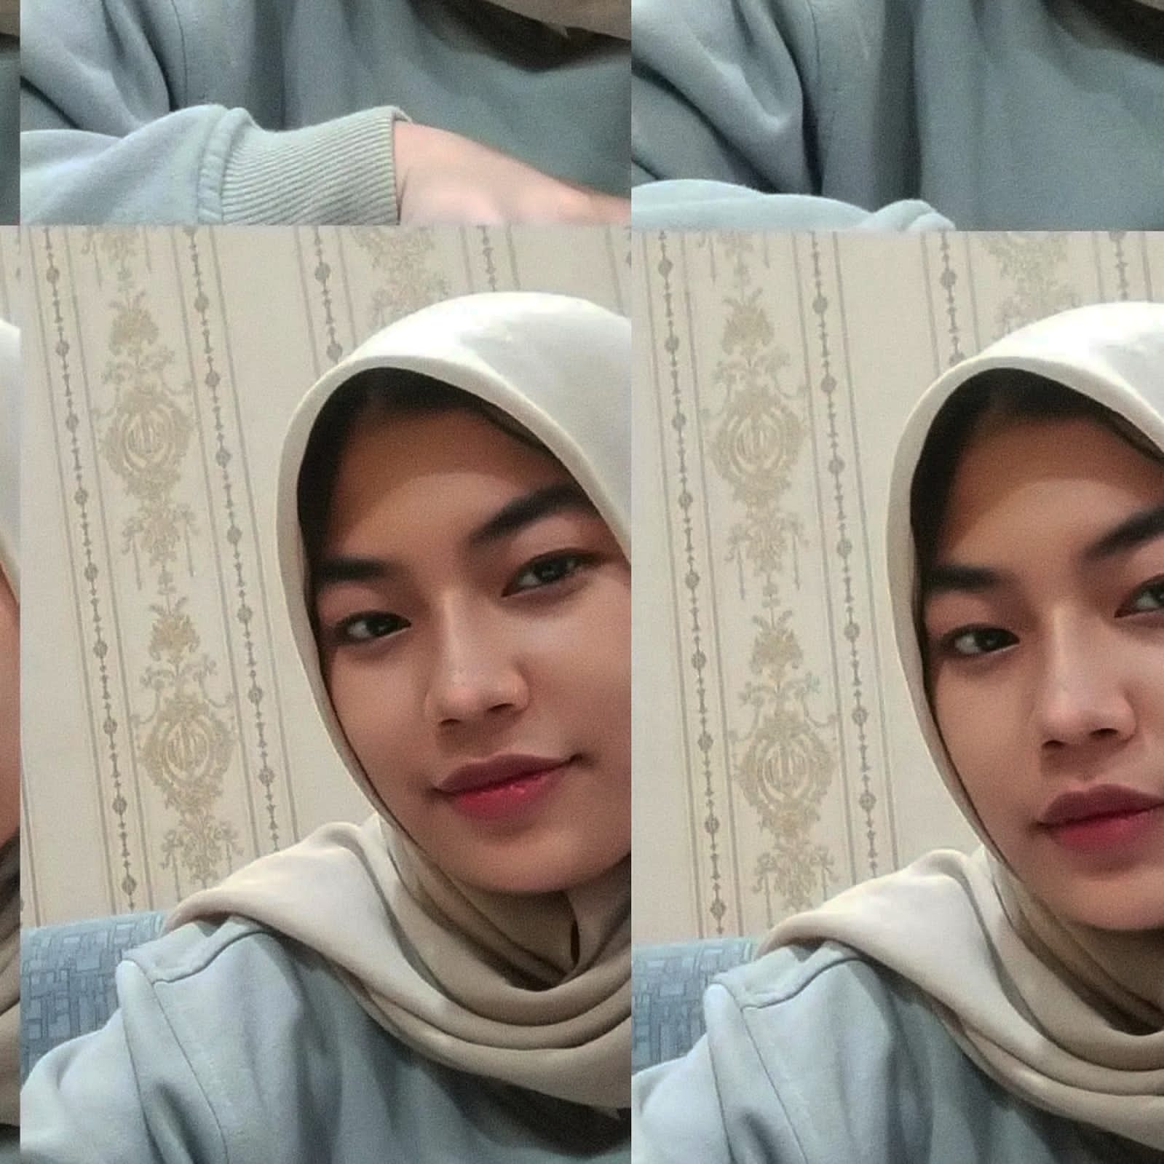

It’s Divanty Zahra, call her dipa
She always complaining about everything, I think she should have a boyfriend to look happier and be able to express his emotions all the time

Slide 8
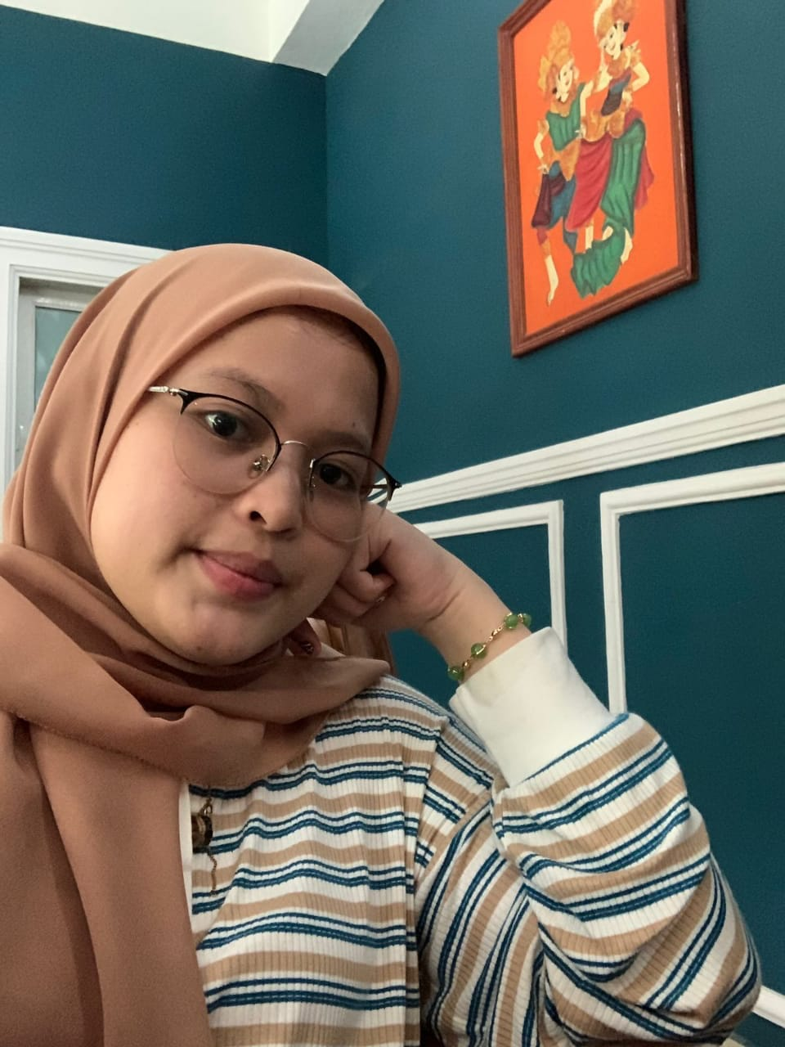
It’s reihani fadilla lbs, call her lala
She always eats spicy food, she really like seblak, i think she should reduce spicy food and switch to healthier food

Slide 9

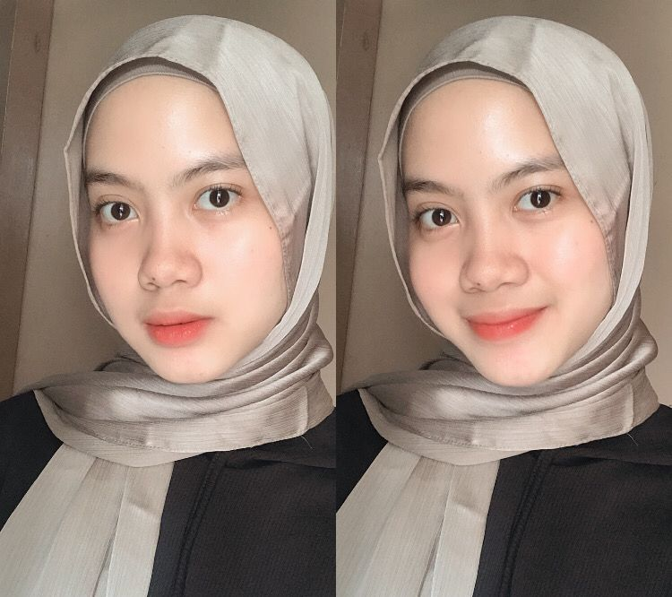
IT’S AZZAHRA NAZHIFAH NIZAR, CALL HER ZAHRA
She doesn't take a shower when there is class, I think she should take a shower before class to be more enthusiastic and more focused

Slide 10



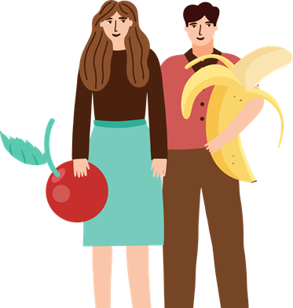
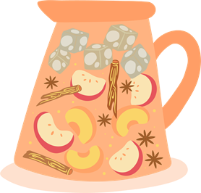
THANKS FOR WATCHING

