Slide 1
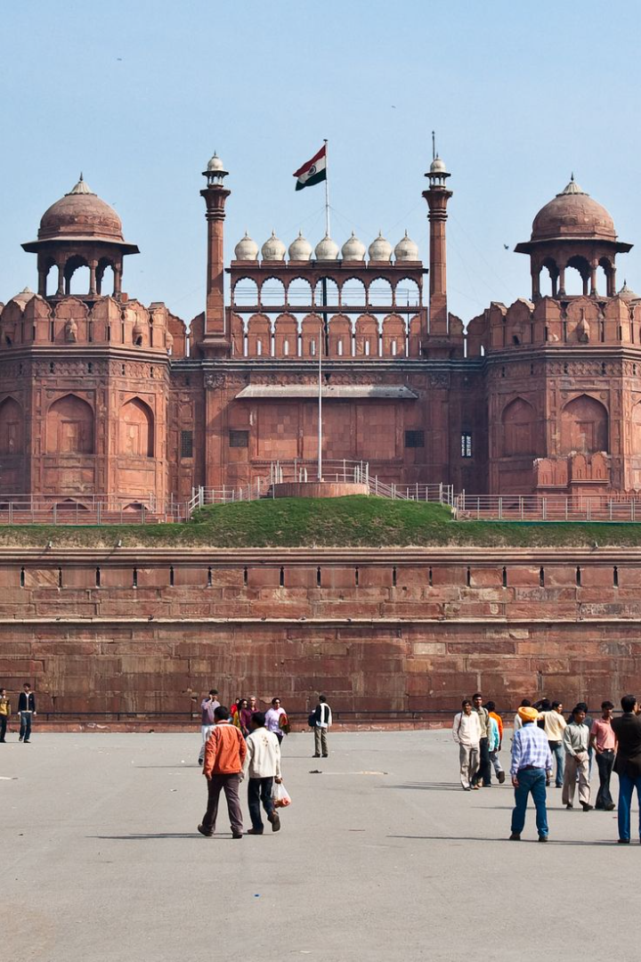
Tourism in India
India is one of the most diverse and culturally rich countries in the world. Its tourism industry attracts millions of visitors every year. In this presentation, we will explore the different types of tourism, benefits of tourism, and popular destinations in India.

Slide 2

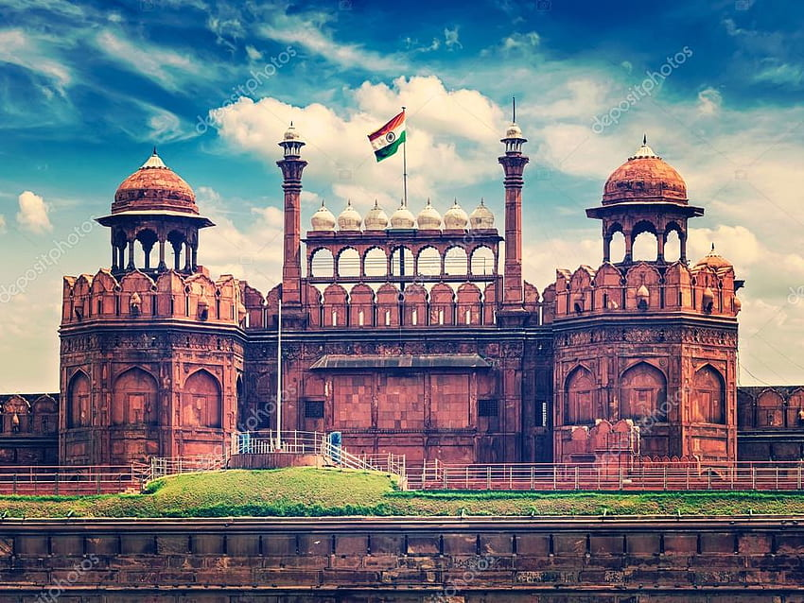
Introduction
The World Economic Forum's Travel and Tourism Development Index 2021, which replaced its previous Travel and Tourism Competitiveness Report, ranks India 54th out of 117 countries overall. The last edition of the Travel and Tourism Competitiveness Report, published in 2019, had ranked India 34th out of 140 countries overall. The report ranked the price competitiveness of India's tourism sector 13th out of 140 countries. It mentioned that India has quite good air transport infrastructure (ranked 33rd), particularly given the country's stage of development, and reasonable ground and port infrastructure (ranked 28th). The country also scored high on natural resources (ranked 14th), and cultural resources and business travel (ranked 8th). The World Tourism Organization reported that India's receipts from tourism during 2012 ranked 16th in the world, and 7th among Asian and Pacific countries.

Slide 3
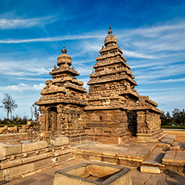
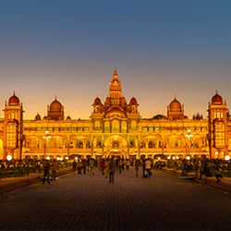
Cultural Tourism
Madurai's Meenakshi Amman Temple
Amba Vilas Palace
From Madurai's Meenakshi Amman Temple to the monolithic structures and blissful rock carvings at Mahabalipuram, Tamil Nadu is a land of exquisite cultural heritage.
Mysore has been considered to be the cultural capital of Karnataka and for all the right reasons. With palaces galore and myriad of museums and galleries, you would be amazed by the rich culture of the city.

Slide 4

Nature Tourism
Munner
Covered with an extensive layer of forests, grasslands and tea orchards and dotted with several species of exotic flora including the rare Neelakurinji flower, Munnar at an elevation of 1,700 meters is a snug hideout for eco travellers.
Majuli Island
Majuli island is the world's largest river island and home to a variety of flora, fauna, and endangered species of birds.
Jim Corbett National Park
If you're a wildlife enthusiast, then Jim Corbett National Park is a must-visit destination. It's home to several species of animals, including tigers, leopards, and elephants.

Slide 5
Government Benefits from Tourism
Growth in Economy
Employment Opportunities
Preservation of Heritage
Tourism industry is an important source of revenue for the government which contributes to the growth of the economy.
Tourism provides employment opportunities for local people which reduces unemployment rates in the country.
Tourism helps to preserve the country's heritage, culture and historic monuments by generating funds for their maintenance and restoration.

Slide 6
Foreigners' Attraction to Indian Tourism Sites
Rich Cultural Heritage
Breathtaking Landscapes
Hospitality & Warmth
Experience India's ancient traditions, vibrant festivals, and profound spirituality that captivates visitors from around the globe.
From snow-capped mountains to pristine beaches, India offers a diverse range of natural wonders that mesmerize foreigners.
Immerse yourself in India's legendary hospitality as locals welcome you with open hearts and share their vibrant culture.

Slide 7
West India Tourism
Goa
Mumbai
Udaipur
Known for its beautiful beaches, nightlife and Portuguese architecture, Goa is a perfect destination for a relaxing holiday.
The financial capital of India, Mumbai is a city that never sleeps. From Bollywood to street food, Mumbai has something for everyone.
A city of lakes, Udaipur is known for its magnificent palaces, museums, and historic landmarks.

Slide 8

East India Tourism
1
Konark Sun Temple
Located in Orissa, the Sun Temple is an architectural marvel and a UNESCO World Heritage Site.
2
Darjeeling Tea Gardens
Darjeeling is famous for its tea gardens, scenic views of the Himalayas and the famous Toy Train.
3
Cherrapunjee, Meghalaya
Known as the wettest place on Earth, Cherrapunjee is a popular destination for nature lovers and adventurous activities such as trekking and caving.

Slide 9
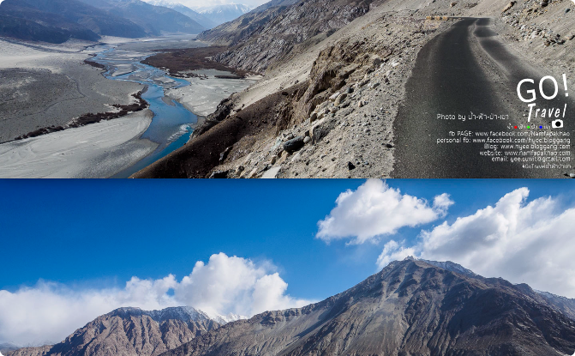
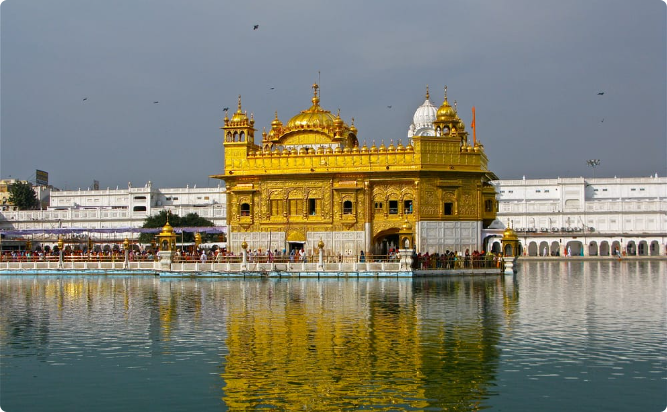
North India Tourism
Leh Ladakh
Golden Temple Amritsar
In the northernmost part of India, Leh Ladakh is surrounded by the Himalayan and Karakoram mountain ranges. It's a paradise for adventure lovers.
This beautiful temple in Amritsar is known for its golden dome and is a place of worship for the Sikh community.

Slide 10

South India Tourism
1
Kerala Backwaters
Kerala is known for its beautiful waterways and lush landscapes. A boat ride through the backwaters will leave you mesmerized.
2
Hampi
Hampi is a UNESCO World Heritage Site known for its ancient ruins, temples and stunning landscapes.
3
Mysore Palace
Mysore Palace is a magnificent palace that is also one of the most famous landmarks of Mysore city

Slide 11

Benefits of Tourism for the Indian Government
1
Economic Growth
Tourism boosts the revenue of the economy, creates thousands of jobs, develops the infrastructures of a country, and plants a sense of cultural exchange between foreigners and citizens.
2
Cultural Exchange
It helps you develop enhanced cultural sensitivity that aids in interpersonal relationships. It also provides a more enlightened perspective on global issues. Additionally, cultural tourism offers insights into traditions and customs different from your own. It even provides opportunities for language learning.
3
Preservation of Heritage
Heritage tourism has become a significant area of the worldwide tourism industry. It helps make ancient preservation economically viable by using heritage attractions and culture to draw in and assist tourists. Heritage tourism can bring cultural prosperity at the places of heritage attractions.

Slide 12
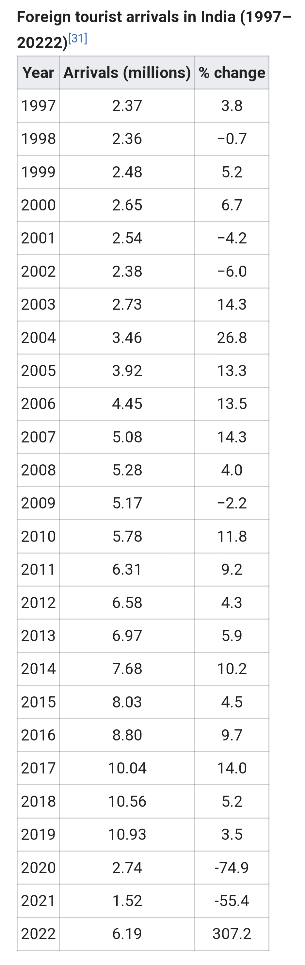
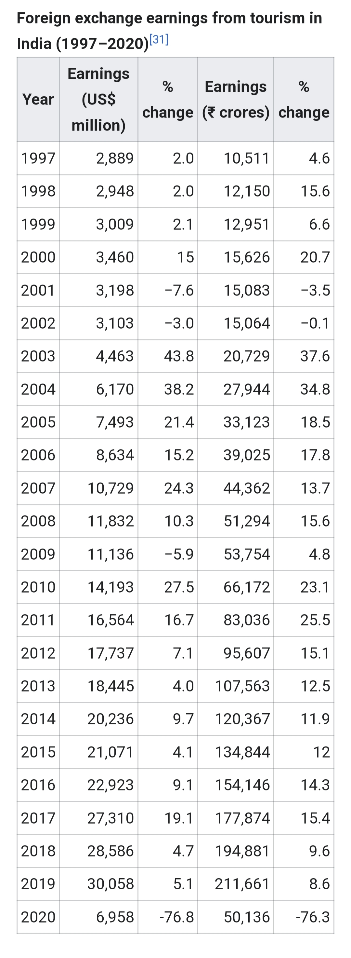
Tourist arrivals in india-2019

Slide 13

STD-11th
Detroja jenish
Zala mohitrajsinh
Tank smit

