Slide 1
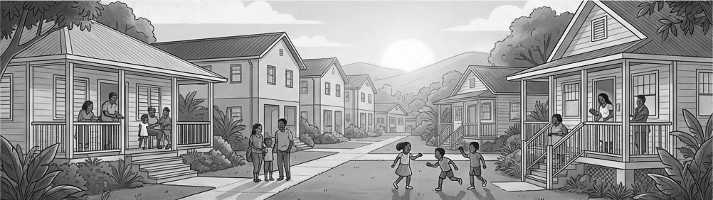
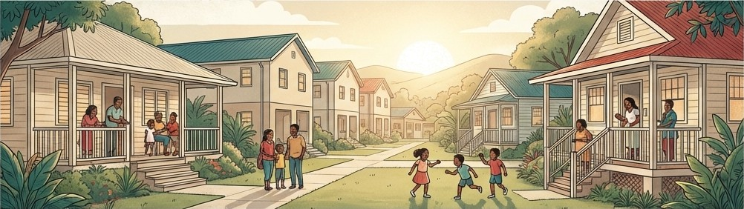



A Reimagined Housing Repair Ecosystem for Trinidad & Tobago
!
Strengthening Communities
Driving Sustained Employment
Preserving National Housing Assets
Notes:
This presentation sets out a new national approach to housing maintenance—one that we have framed as the Homes • Jobs • Growth ecosystem.
From the perspective of the Ministry of Housing and Urban Development, the proposal is simple but transformative: we take the existing public housing stock and use its maintenance as a deliberate engine for employment, community stability, and economic activity.
Rather than treating home repairs as sporadic, emergency works, we propose a planned, cyclical Home Repair Programme that creates predictable work for small and medium contractors and reliable recurrent income opportunities for vulnerable citizens, while preserving the State’s investment in housing assets.
Today, we will show how this ecosystem works, who benefits, what it will cost, and why this is a compelling opportunity for Cabinet consideration at this time.

Slide 2
Table of Contents
Direct Beneficiaries
8
The Silent Opportunity in Housing Maintenance
3
A Reimagined Housing Repair Ecosystem
4
Executing Agencies
9
Annual Cycle of Repair & Renewal
5
A Clear Leader in Among Alternatives
10
Why it Matters ?
6
Structure of (Pilot) Program
11
The Benefits
7
Financial Model
12
Closing
13
Notes:
The presentation is organised into five parts.
First, we outline the current situation in housing maintenance—the “silent copportunity” that is emerging as the public housing stock ages and repairs remain largely reactive.
Second, we introduce the proposed solution: an annual construction cycle with two dedicated Home Repair seasons anchored around the existing School Repair Programme.
Third, we describe the ecosystem of beneficiaries and the nationwide value chain that this programme will mobilise—homeowners, SME contractors, hardware's and transport providers, and vulnerable workers.
Fourth, we compare delivery options and show why an initial dedicated Home Repair Programme Unit under the Ministry provides better value for money and social impact than existing mechanisms such as traditional maintenance departments.
Fifth, we outline the proposed structure of the Pilot.
Finally, we walk through the financial model, budget options, and the opportunity assessment that demonstrates why this is an attractive, scalable initiative for Trinidad and Tobago.

Slide 3

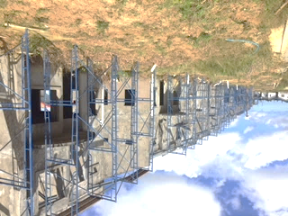




The Silent Opportunity in Housing Maintenance
Ageing Public Housing Stock
A large and growing portfolio of national housing assets requires regular, large-scale maintenance to prevent decay.
Inefficient Current Repairs
The current approach is reactive, irregular, and costly, leading to higher long-term expenses and asset degradation.
Precarious Employment
The reliance on temporary work programs for repairs creates a cycle of unpredictable employment for vulnerable workers.
Stifled Economic Activity
The current system misses significant opportunities for widespread economic stimulation through local SME’s and suppliers.
3
Notes:
The challenge we face is a silent one because it builds up gradually over time. The public housing stock is ageing; without regular, planned maintenance, minor defects become major structural and social problems.
Today, repairs are often reactive, irregular, and triggered only when conditions have deteriorated significantly. Emergency works are more expensive, place pressure on the budget, and disrupt residents’ lives. In parallel, much of the employment attached to maintenance is ad hoc—short-notice, unpredictable engagements that offer little stability to workers.
We also see stifled economic activity. When repairs are handled through large, centralised structures with high overheads, less of each dollar reaches the people who actually perform the work or supply materials and services.
Left unchecked, this pattern shortens the life of housing assets, erodes public confidence in state housing, and represents a missed opportunity for broad-based economic participation.

Slide 4
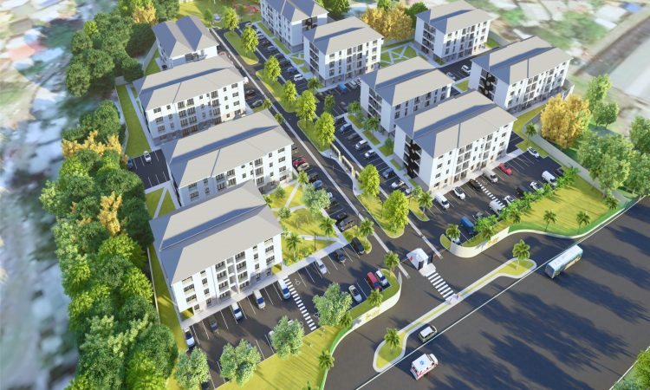




A Reimagined Housing Repair Ecosystem for Trinidad & Tobago
Driving sustained Employment
Strengthening Communities
Preserving National Housing Assets.
4
Notes:
Herein lies the core idea: we are reimagining the housing repair ecosystem, not just launching another repair programme.
Historically, housing policy has been dominated by the provision of new units. Maintenance of existing stock has often been treated as a secondary priority, addressed on an emergency or ad hoc basis.
Our proposal shifts the focus to a proactive, planned system of maintenance. We organise housing repairs into structured programmes, delivered primarily by small and medium contractors under competitive, market-based arrangements. This keeps prices realistic, improves quality, and ensures that the economic benefits are spread widely rather than concentrated in a small group of large firms.
Critically, we frame the ecosystem around three simple outcomes that matter to citizens and to Government: secure homes, dignified jobs, and sustainable growth in local communities.

Slide 5





Annual Cycle of Repair & Renewal
Christmas & Carnival
(Dec. – Mar.)
Nov - Dec
Jan - Feb
Home Repair Program
(Oct.– Nov.)
Sept - Oct
Mar - Apr
Jul - Aug
May - Jun
School Repair Program
(July – August)
Home Repair Program
(April – May)
5
Notes:
This slide illustrates the annual construction cycle that anchors the programme.
We propose two dedicated Home Repair seasons—one in the April–May period, aligned with the Easter vacation, and a second in October–November, leading into the Christmas season. Between these, the established School Repair Programme operates during the July–August vacation, developing a routine known repair cycle that allows national stability and learning .
The December to January period then becomes the primary economic boost window, when the wages earned in the October–November Home Repair season are circulated through Christmas. The Carnival spending period then begins, providing another injection to the economy. Similarly, income earned in the April–May season supports back-to-school expenses and August activities for families.
By structuring the year in this way, we transform what is currently an irregular pattern of works into a predictable national cycle of repair and renewal that citizens, contractors, and communities can anticipate and plan around.

Slide 6






Why this Matters ?
Extends housing asset life,
Reliable income for vulnerable workers
This initiative is important because it delivers widespread social and economic benefits, such as….
Extends housing asset life:
Preserving billions in national infrastructure investment
Provides reliable income for vulnerable workers:
Creating stability for families and communities
Boosts Post-Easter Back to School, Pre-Christmas Spending
Supports SME Contractors
Boosts seasonal economies:
Injecting spending during critical periods like Back to School, Christmas, and Carnival
Supports a network of SME Contractors:
Fueling entrepreneurship and local business growth
6
Notes:
Solving this problem is about much more than fixing leaking roofs or cracked staircases. It is about protecting national assets, supporting families, and giving vulnerable citizens a predictable, dignified way to earn.
By extending the life of the housing stock, we preserve billions of dollars in past investment and avoid the much higher costs of replacement in the future.
By providing reliable, recurrent income opportunities for temporary and vulnerable workers, we replace uncertainty with a measure of stability. People can plan their lives, anticipate two defined “Home Repair seasons,” and organise their financial commitments—especially around back-to-school, August Holidays and Christmas, the periods of greatest stress for households and the children therein.
And by structuring the programme around small and medium contractors, hardwares, and transport providers, we stimulate entrepreneurship and local business growth instead of expanding permanent state payrolls. The end result is a programme that touches homes, jobs, and growth simultaneously.

Slide 7
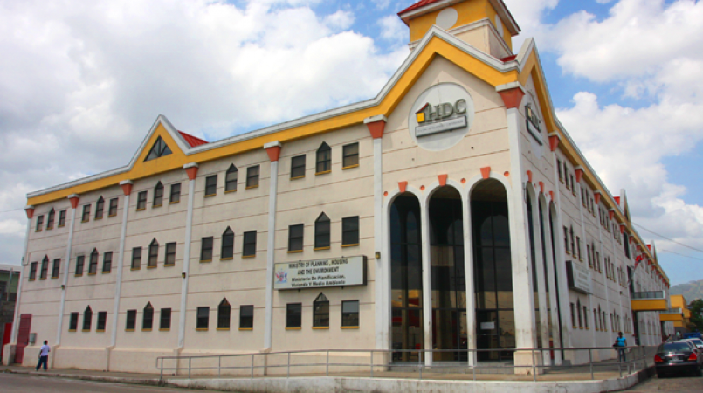

The Benefits
BENEFITS TO THE STATE, INDIVIDUALS AND BUSINESSES,
Stability
A reimagined construction annual cycle with two Home Repair seasons
Social
Reliable, recurrent employment for vulnerable citizens
Business
Small-Medium Businesses throughout the country are utilised
Economy
Disbursement and spending in the Pre-Easter back to School and the Pre-Christmas season
Value for
Money
Private sector efficiency in the maintenance & improvement of housing stock
7
Notes:
We can now summarise the multi-faceted impact of the proposed system.
First, social stability: the programme guarantees reliable, recurrent employment opportunities for vulnerable citizens without locking the State into permanent, long-term staffing obligations. This is scheduled, not sporadic, and creates a social rhythm that citizens can depend on.
Second, business growth: by deliberately targeting small and medium contractors—those with two to three permanent staff and the capacity to engage crews of around eight to nine workers each season—we build out a decentralised network of service providers across Trinidad and Tobago.
Third, economic velocity: spending is timed just ahead of peak household expense periods, particularly the August back-to-school period and the October to November Pre-Christmas season, thereby increasing the circulation of money through local communities when it is needed most.
Fourth, value for the State: by using market-based procurement and private sector efficiency, a higher proportion of each dollar reaches materials and labour, stretching the Ministry’s budget while visibly improving housing conditions.

Slide 8



Direct Beneficiaries
SMALL-MEDIUM CONTRACTORS
&
VULNERABLE LABOUR FORCE
INDEPENDENT HARDWARES
&
EQUIPMENT SUPPLIERS
SMALL TRANSPORT PROVIDERS
VULNERABLE HOME OWNERS
8
Notes:
At the community level, vulnerable homeowners and occupants receive timely, quality repairs that improve safety, comfort, and the overall value of their homes. This reinforces pride in state housing developments and reduces the drift towards informal modifications and decay.
Small and medium contractors gain access to a predictable pipeline of projects. Under the proposed $30 million pilot per Home Repair season, we anticipate approximately 120 projects, each valued at around $250,000. Each project would typically engage a crew of about eight workers, resulting in roughly 960 temporary workers being gainfully employed over a six-week period.
Independent hardwares and small transport providers also benefit as key suppliers of materials and logistics, ensuring that a substantial portion of the budget flows directly into local businesses.
At a macro level, the Ministry itself benefits by being seen as the architect of an innovative programme that simultaneously improves housing, stimulates employment, and drives local economic activity, all while refraining from ballooning the permanent payroll and overheads.

Slide 9












Executing Agencies Options
MHUD Project Unit
Home Repair Program
HDC’s facilities & Maintenance Division (As currently Exists)
Home Repair Program Unit
(Temporary initial Establishment)
Regional Corporations – Local Government Model
Rural Development Company of T&T
MONITORING & OVERSIGHT
SME CONTRACTORS
EXTERNAL PROGRAMME
CONSULTANT
Civilian Conservation Corps -Youth Empowerment Model
MTS, UDECOTT or Other State Agencies not directly tied to Housing or Social Impact for the Vulnerable
SMALL TRANSPORT PROVIDERS & EQUIPMENT SUPPLIERS
LABOUR
INDEPENDENT HARDWARES
9
Notes:
We have considered several alternative executing Agency options including leveraging HDC’s existing Facilities and Maintenance Division, utilising the various Regional Corporations as it will be a nationwide program, using the Civilian Conservation Corp in order to involve the youth, or routing works via other state agencies such as the Rural Development Company, MTS or UDeCOTT.
Each of these options offers some advantages, but they also present constraints—ranging from limited technical focus on housing, to higher overheads, slower mobilisation, and less direct linkage to vulnerable communities. In some instances, established cultures and processes are not aligned with the agile, SME-driven model we are proposing.
Accordingly, the preferred option is the establishment of a dedicated Home Repair Programme Unit under the Ministry of Housing and Urban Development, possibly with staff seconded from HDC. Programme management would be supported by an experienced external consulting team to handle assessment, design, tender evaluation support and monitoring, while execution remains in the hands of competitively selected SMEs, contracted directly with the State Executing Agency.

Slide 10





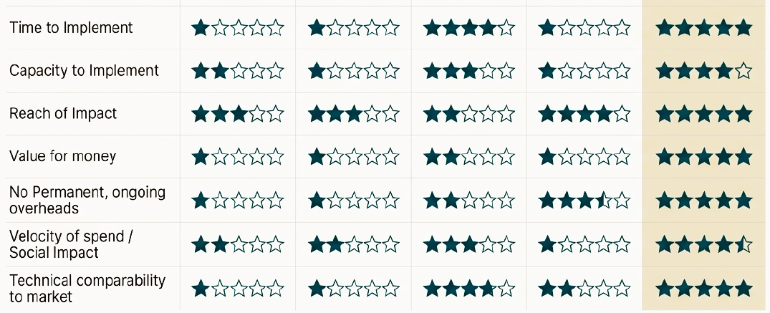
A Clear Leader in Among Alternatives
Housing Repair Programme
Reg. Corp
RDC
HDC M'tce Dept
CCC
MHUD
10
Notes:
The criteria assessment on this slide compares the proposed Housing Repair Programme with other mechanisms—Regional Corporations, the RDC or similar State Executing Agencies, the HDC Maintenance Department, and Youth Empowerment model using the Civilian Conservation Corps.—across several criteria: time to implement, capacity to deliver, reach of impact, value for money, ongoing overheads, social impact, and technical comparability to market.
While the existing agencies score well on certain social objectives, they generally perform less favourably on speed of mobilisation, value for money, and alignment with private-sector standards of quality and productivity.
The Housing Repair Programme, by contrast, is designed to deliver quickly—because it leverages existing housing infrastructure knowledge and familiarity, established repair programming capacity via external consultants and does not require lengthy statutory approvals—and channels a higher proportion of funds into actual works and wages rather than permanent overheads.
In short, when we place all options side by side, the proposed executing structure emerges as a clear leader: it achieves greater social impact while simultaneously improving technical outcomes and financial efficiency.

Slide 11

Structure of (Pilot) Program
TTD$30M
Spend
Home Repair Program
Home Repair Program Unit
(Temporary initial Establishment)
$250k per Contract
120
Contractors
MONITORING & OVERSIGHT
1 External Consultant
SME CONTRACTORS
EXTERNAL PROGRAMME
CONSULTANT
Nationwide
Transport
960
Employed
Nationwide
Hardwares
SMALL TRANSPORT PROVIDERS & EQUIPMENT SUPPLIERS
LABOUR
INDEPENDENT HARDWARES
11
Notes:
The initial proposed pilot is for a $30 million allocation per Home Repair season. Based on a proposed contract value of $250,000 per contract. With each contractor receiving 1 contract only, this is sufficient to fund approximately 120 projects, or 120 contractors. Based on each small contractor employing up to 8 persons, the total labour employed would be 960 workers for six weeks.
The design of the programme is inherently scalable. Once piloted and refined, each Home Repair season could be easily increased or reduced based on available funding. An increase to a $60 million spend, effectively doubles the number of projects, contractors, and workers. At that level, more than 1,900 workers could be engaged per season, while still maintaining manageable project sizes and tight control over quality and value for money.
Importantly, because the works are largely within existing footprints and do not trigger planning approvals, ramp-up can be achieved with relatively short lead times. This provides Cabinet with flexibility: the programme can start modestly, demonstrate results, and then be expanded as fiscal space permits.

Slide 12





Financial Model
60 contracts
120 contracts
240 contracts
 | TTD$15M Spend | TTD$30M Spend | TTD$60M Spend
LABOUR (6 weeks of employment) | TTD$6.84M | TTD$13.68M 960 persons Eff. Monthly Salary - $9,500.00 | TTD$27.36M
MATERIALS & TRANSPORT | TTD$4.56M | TTD$9.12M | TTD$18.24M
CONTRACTOR’S PROFIT | TTD$1.43M | TTD$2.85M 120 Contractors | TTD$5.7M
CONTRACTORS OVERHEADS | TTD$1.43M | TTD$2.85M | TTD$5.7M
CONSULTANTS FEES (External Programme Managers) | TTD$0.6M | TTD$1.2M | TTD$2.4M
MHUD OVERHEADS | TTD$0.14M | TTD$0.3M | TTD$0.6M
≈46%
≈30%
≈9.5%
≈9.5%
≈4.0%
≈1.0%
12
Notes:
Let’s focus specifically on value for money.
Under the proposed $30 million pilot for each Home Repair season, less than 4 percent of the budget is earmarked for programme management and a nominal 1 percent for the executing agency’s overheads, leaving a net $24 million that is directly applied to works.
Of this net amount, we anticipate that roughly 30 percent will be spent on materials—purchased from local hardwares and supported by small transport providers—and the remaining 46 percent, or about $13.68 million, will go directly to labour. With 960 temporary workers engaged, this structure allows each worker to earn in the order of $9,500 per month, depending on skill level and hours worked.
By using competitive procurement with contract values in the $250,000 to $500,000 range, we keep project sizes attractive to SMEs while avoiding the heavy overheads associated with very large contractors. The result is a programme where the majority of each dollar is visible to citizens in tangible repairs and local pay packets.

Slide 13


Building a More Resilient Trinidad & Tobago, Together
This is more than a program; it is a foundational investment in our nation's most valuable assets: our people, our communities, and our homes.
Sustained Employment becomes family stability.
Strengthened Communities become engines of local growth.
Preserved Housing Assets become a legacy for future generations.
13
Notes:
In closing, this programme is about building a more resilient Trinidad and Tobago—one home, one contractor, and one community at a time.
It converts routine maintenance into a strategic tool for social stability, economic inclusion, and asset preservation. It offers vulnerable citizens reliable, recurrent opportunities to earn, without requiring the State to expand permanent payrolls. It strengthens small and medium businesses across the country and ensures that more of every housing dollar is felt in communities.
For the Ministry of Housing and Urban Development, this is an opportunity to lead an innovative, nationally visible programme that can be piloted quickly, scaled responsibly, and communicated clearly to citizens as Homes • Jobs • Growth.

Slide 14
The End
………………….
………………………….

